Slide 1
Wednesday 03/11 – The Plan
Finish electron-cloud program:
Scrubbing with trains of 24 bunches
Comparison vacuum with 12 + 36 bunches
Physics fill with bunch trains of 24 bunches: 1 + 12 +4 * 24 = 109

Slide 2
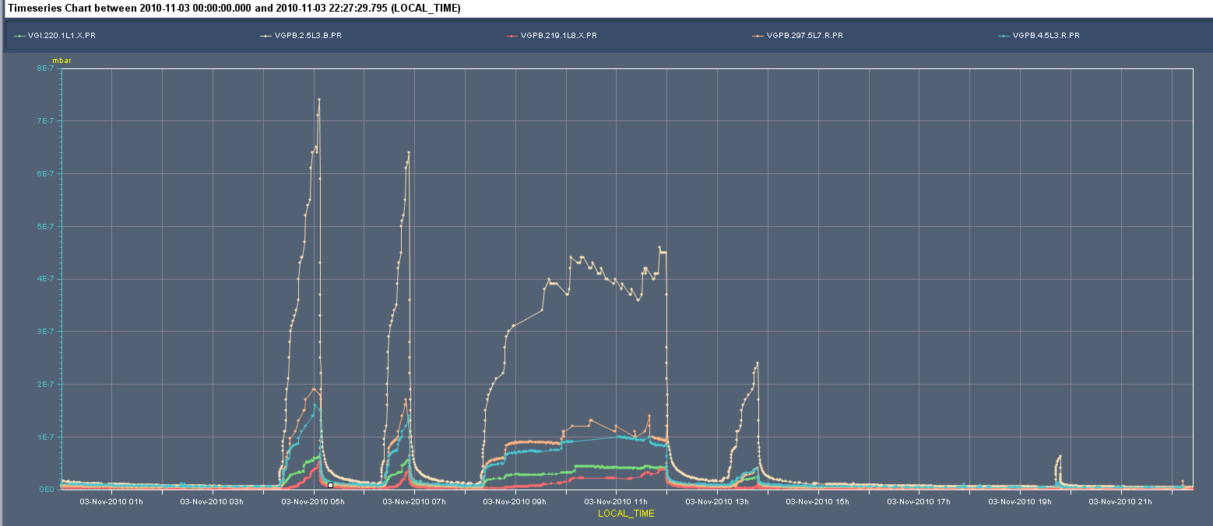
Finish the scrubbing 24 bunches: 23 hours 03/11
Larger εv
228 bunches unstable
RCBXV2.R8 tripped: access
12+36 bunches
8e-7 mbar
Take it easier
1e-7 mbar
Cold to warm transition: worst case

Slide 3
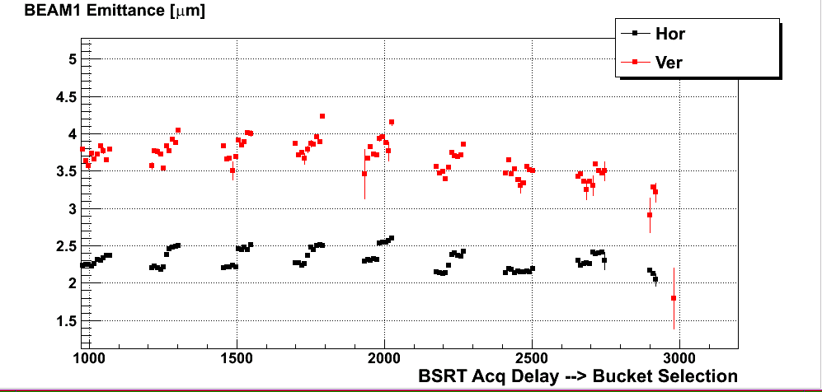
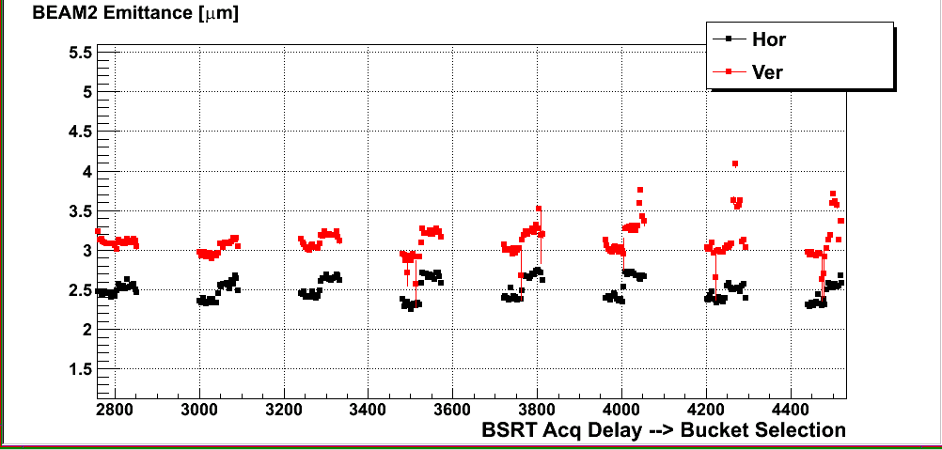
Fill from 06:00: beam unstable – increased chroma
B1
BLM TCTH.4L8B1 triggered
B2
F.Roncarolo

Slide 4
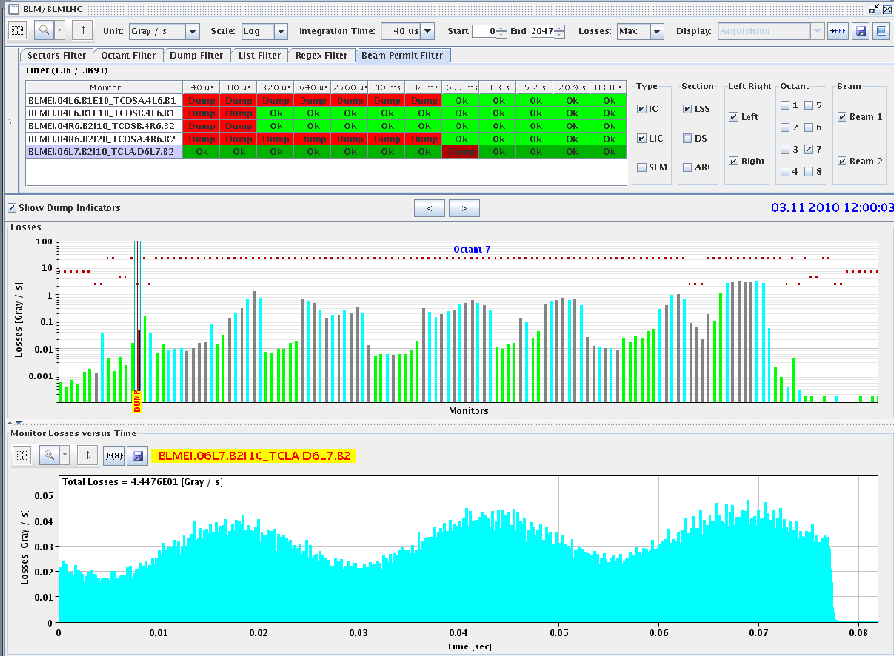
Longer fill until noon
beams dumped shortly after having injected last batch of 24 bunches on B2.
The BLM BLMEI.06L7.B2I10_TCLA.D6L7.B2 triggered on the 655 ms RS.

Slide 5
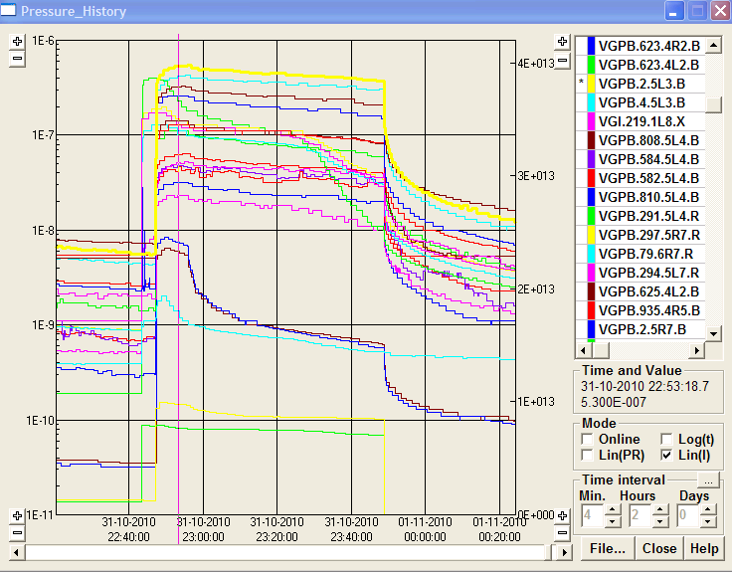
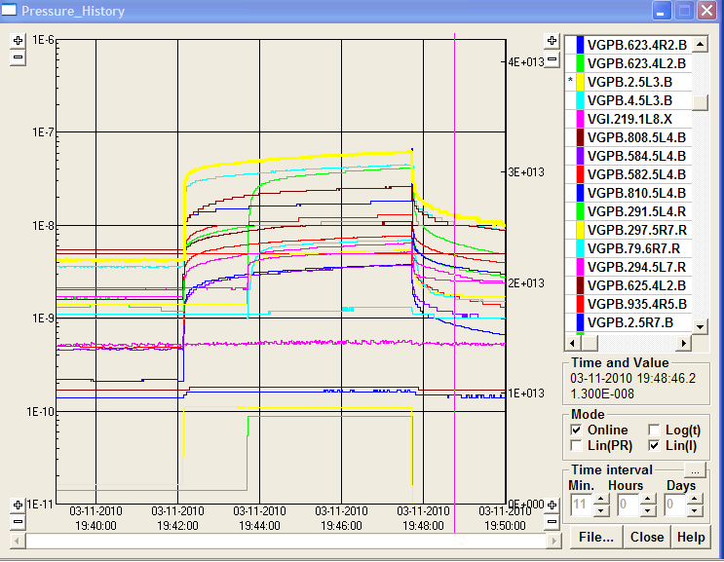
Comparison 12 + 36 bunches
31/10: max p @ LSS3 VGPB.5L3.B = 5.5E-7 mbar
Gained factor 10
03/11: max p @ LSS3 VGPB.2.5L3.B=6E-8 mbar
Beams dumped ... losses on TCTH at Pt8

Slide 6
Loosing beams and filling for physics
Losses on TCTH point 8 also with only 12 bunches
Bring chromaticity down to 4
Switch off Alice solenoid for physics fill and correct orbit
Fill for physics 1 + 12 + 4 * 24 = 109 bunches
Again losses on TCTH.4L8 for B2 dumping the beam
Suspicious damper signals beam 2: put in a bump of -0.5 mm at damper pickup Q9 V – TCTH losses solved
Alice solenoid off -> Large vacuum activity when injecting 4th train of 24 bunches: Vacuum Interlock on Sector Valve VVGSF.221.1R2.X when injecting 108b on B1 !
Switching Alice solenoid back on again
Vacuum improving at 20 kA
Perform interlock test BPMSB.A4L6.B2 to prepare for physics
Ramp Alice solenoid fully up (30 kA)
Fill for physics

Slide 7
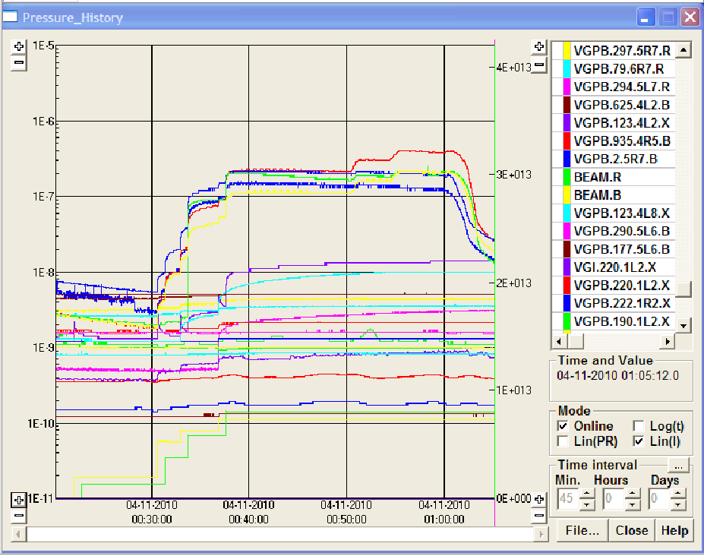
Pressure variation during injection and when ramping solenoid in ALICE up again

Slide 8
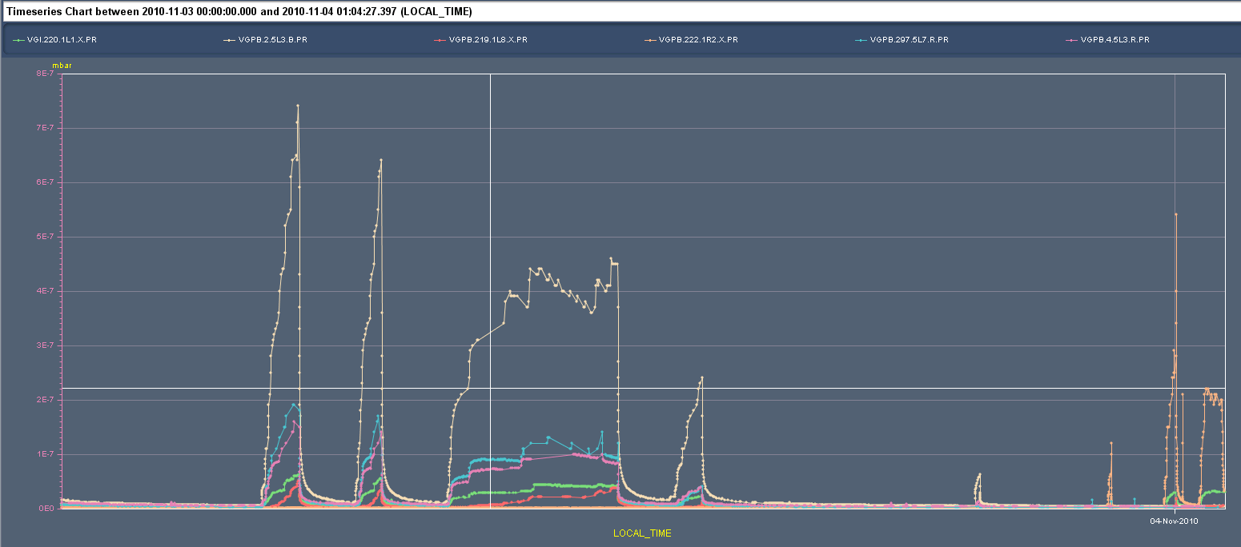
Vacuum in Alice over 25 hours
8e-7 mbar
1e-7 mbar

Slide 9
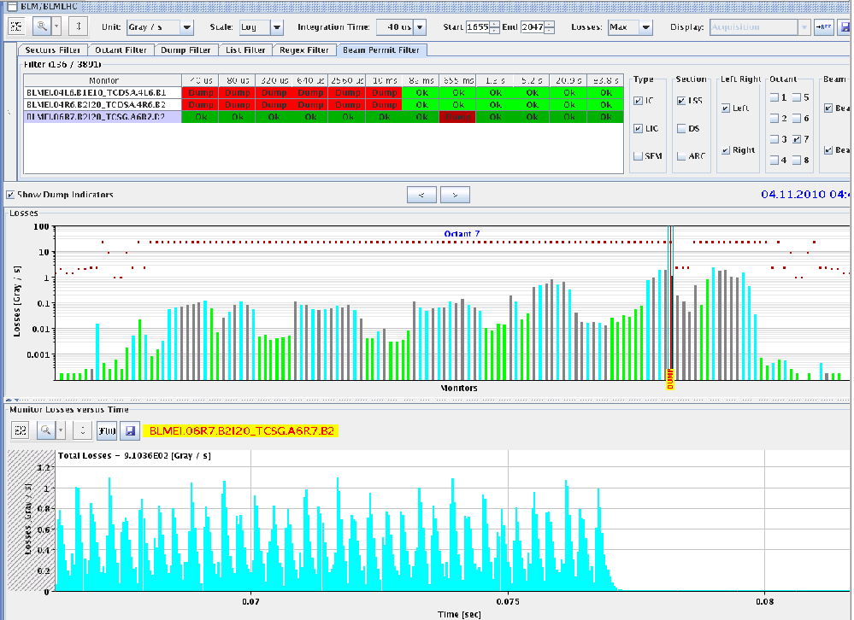
Ramp 12 + 4 x 24 bunches
First ramp lost due to collimator position
TCSG.4R3B1 - LVDT on the right jaw interlocked
Second ramp – arrived at the top
Prepare for squeeze: Switched off damper, beam was lost within seconds
Oscillating in the H plane for both beams

Slide 10
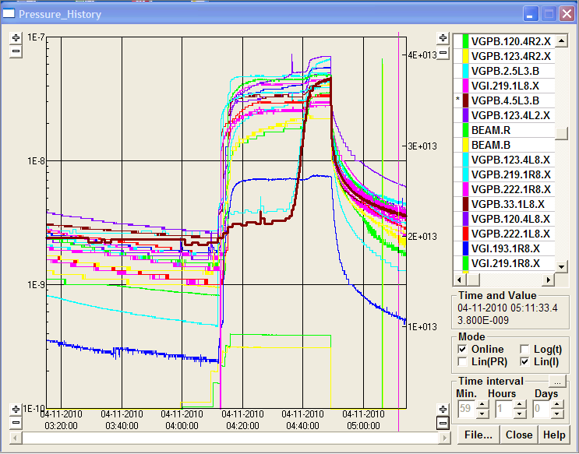
Vacuum during ramp
Ramp above ≈ 2 TeV
Vacuum ok, but beam not stable enough to switch off damper

Slide 11
Plans
Thursday 4/11 – 08:00 | Access | 2 hours
Thursday 4/11 – 10:00 | Check machine after access with protons – BCT calibration
Thursday 4/11 – 12:00 | Start lead ion beam commissioning
Friday and weekend | Lead ion beam commissioning

