Slide 1
Fill 1430
Peak luminosity | 1.48e32
Beam current | 3.59/3.6 e13
Average bunch current | 1.15e11
Emittance (reconstructed from lumi) | 2.5 micron
Approx beam size at IP | 48 micron
Approx beam-beam tune shift | 0.017
Stored beam energy | 20 MJ

Slide 2
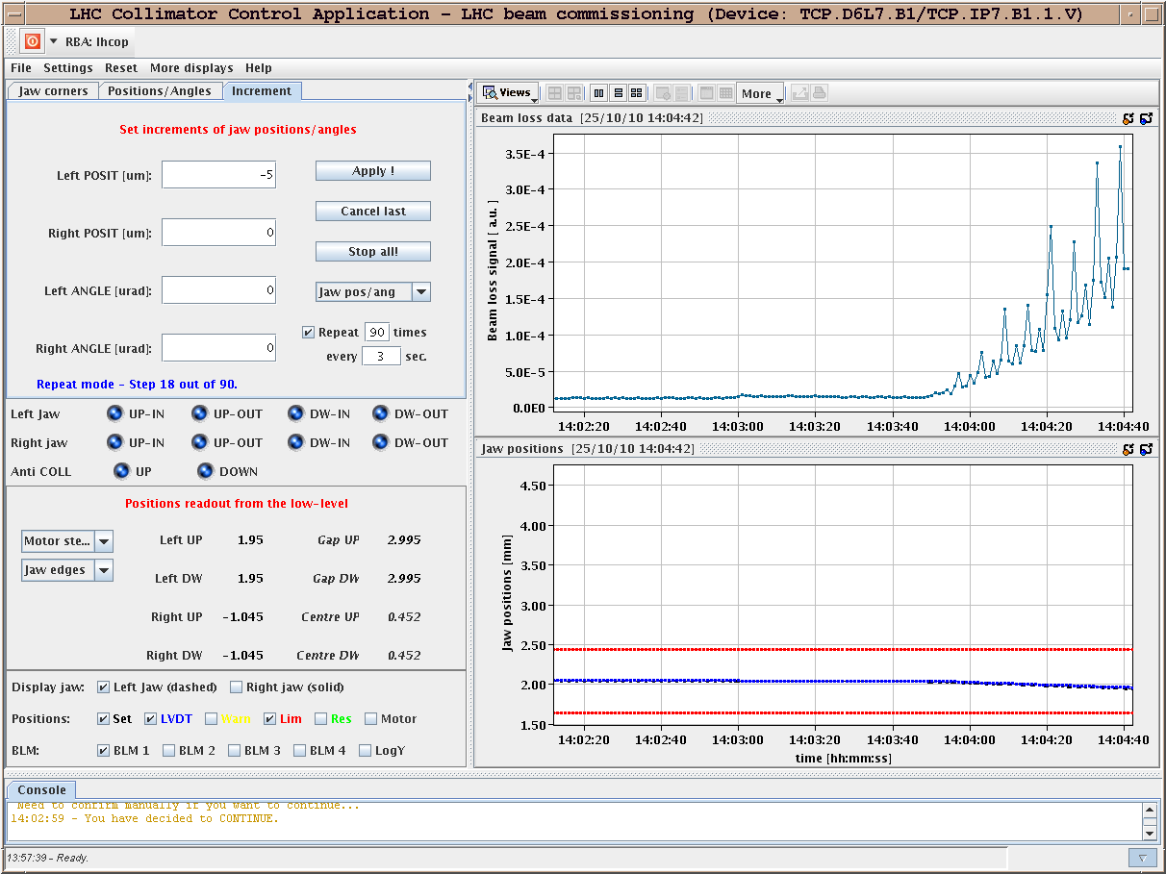
Monday 25-10-10
Fill 1440
13:55 Changed to adjust
primary coll movement for beam tail studies:
TCP.D6L7.B1 -> beam 1 vertical
Beams dumped when TCP beam1 V (TCP.D6L7.B1) reached its position limit.
Interlock worked as specified. We had decided not to change the TCP position thresholds for maximum safety.
Got tail data for beam1 vertical from 2.045mm to 1.642mm (explored 1 sigma of tail).

Slide 3
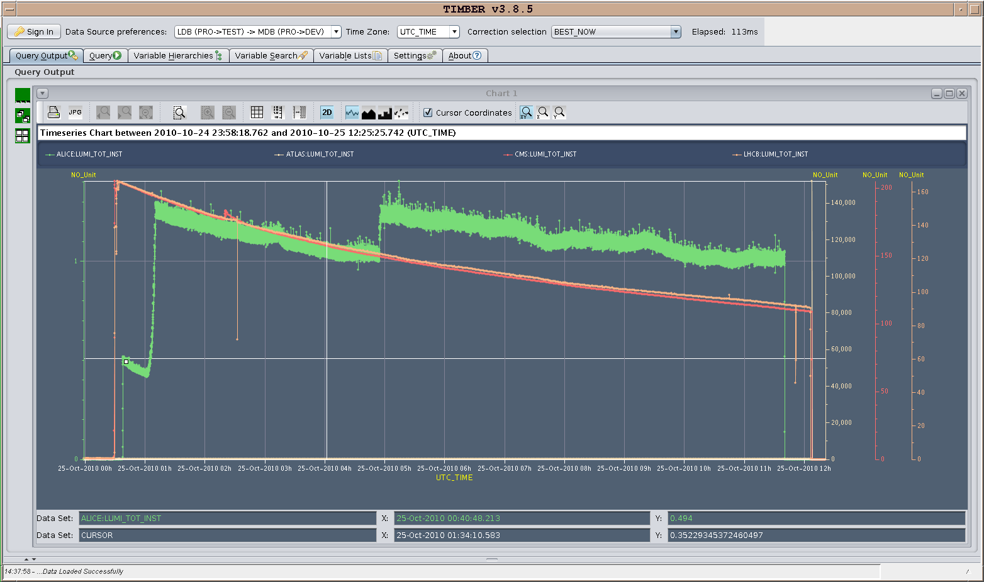
1440
Around 6 pb-1 in Atlas & CMS

Slide 4
1441
16:47 beam back
Minor issues with bunch length
19:00 Problem with orbit references/orbit feedback at flat top – beam dumped by EIC
19:03 Lost of cryo maintain in S34
worldFIP problem
Back by 9:30

Slide 5
1442
Beam quality at injection – dump and re-start
gave back the mastership to SPS to reduce the intensity per bunch as we are too high : we will go for 4.7e13 if going on with this filling.
It was a big one too - high intensity per beam 1.3-1.4e11 on average
01:15:35 BLM over threshold UFO Alarm on: BLMQI.17L4.B2E10_MQ, integration time: 2560 us, losses = 8.997538E-02, threshold = 8.056338E-02, ratio = 112%
UFO after 5 min at flat top (during the 6 min plateau)

Slide 6
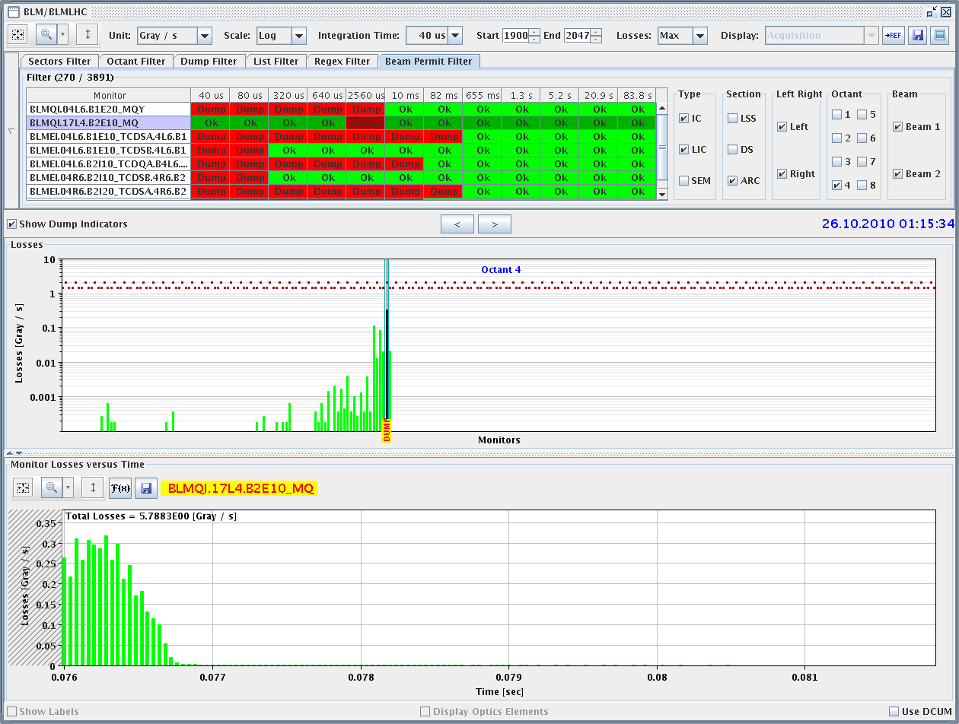
1442 - UFO

Slide 7
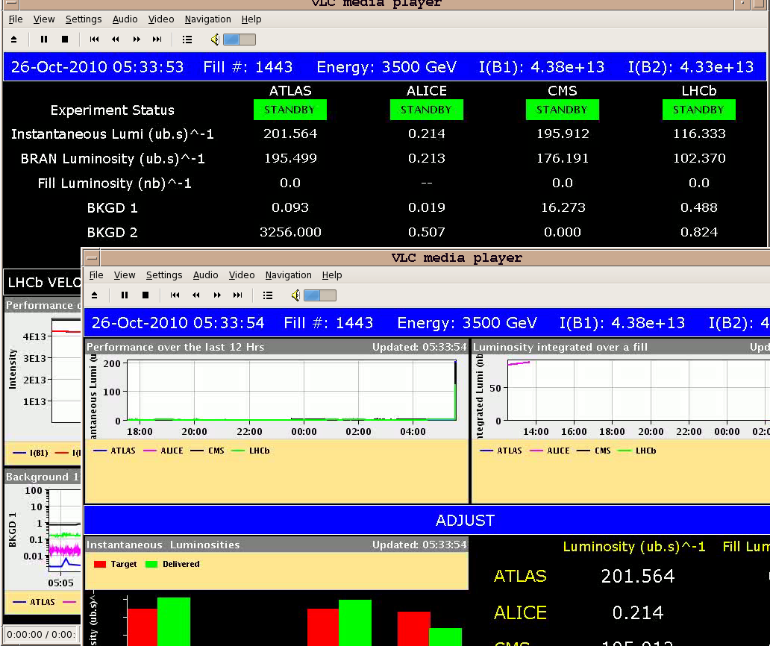
1443
02:35 beams back in
04:40 we lost several time the tune feedback on beam 2 without voice warning on coupling too high (at 500GeV and 600GeV), whereas we got several time the voice warning without stops.
05:34 Stable beams

Slide 8
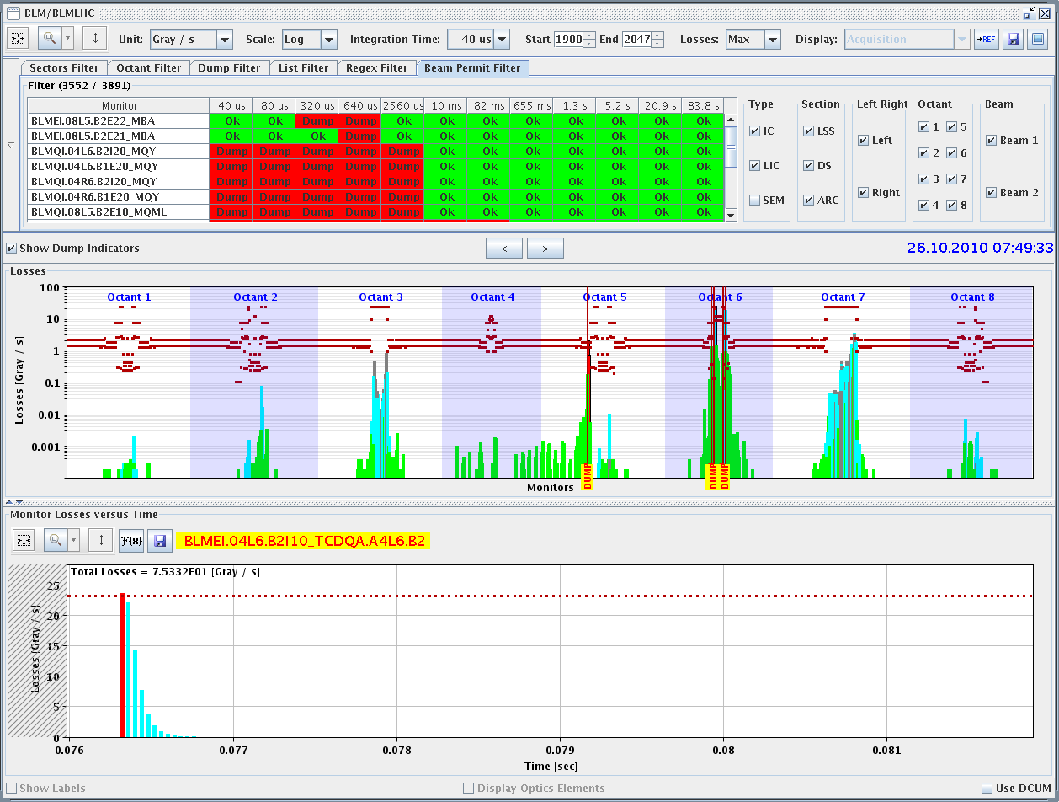
End 1443 – 07:50 - UFO

Slide 9
Planning
368b_348 continued
The battle of 400+ bunches
400+ if we can hold on to 368 for long enough

