Slide 1
Thursday 28.10.
00h37: Stable beams. Fill #1450.
15h17: Beam dump by operations. Integrated: 6.4/6.2/5.2 pb-1 (ATLAS/CMA/LHCb). Length of fill: 14h40.
15h25: Ramp down. Cycle. Change of monitor factor for 4 BLM’s not done before (0.3 -> 0.5).
16h45: Injection.
19h46: Start ramp. 368b.
20h12: Beam dump just at flat top. ALICE removed beam permit. ALICE BCM triggered. ➔ UFINO
22h51: Injection.

Slide 2
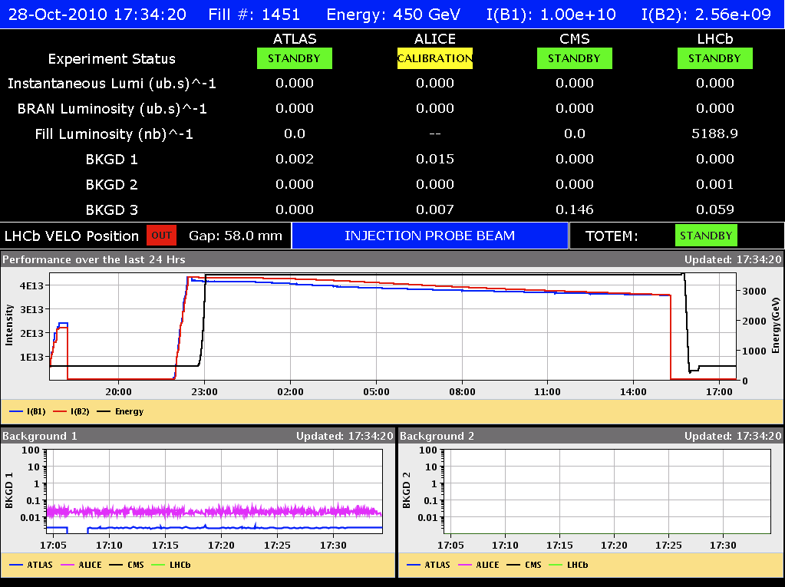
Fill 1450: Up to 6.4 pb⁻¹ Delivered

Slide 3
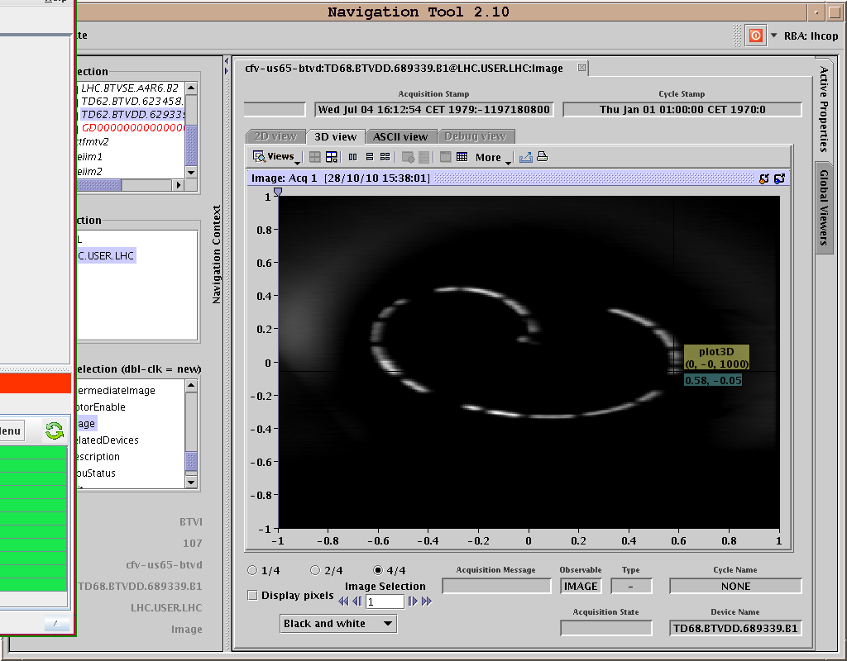
Dump B1

Slide 4
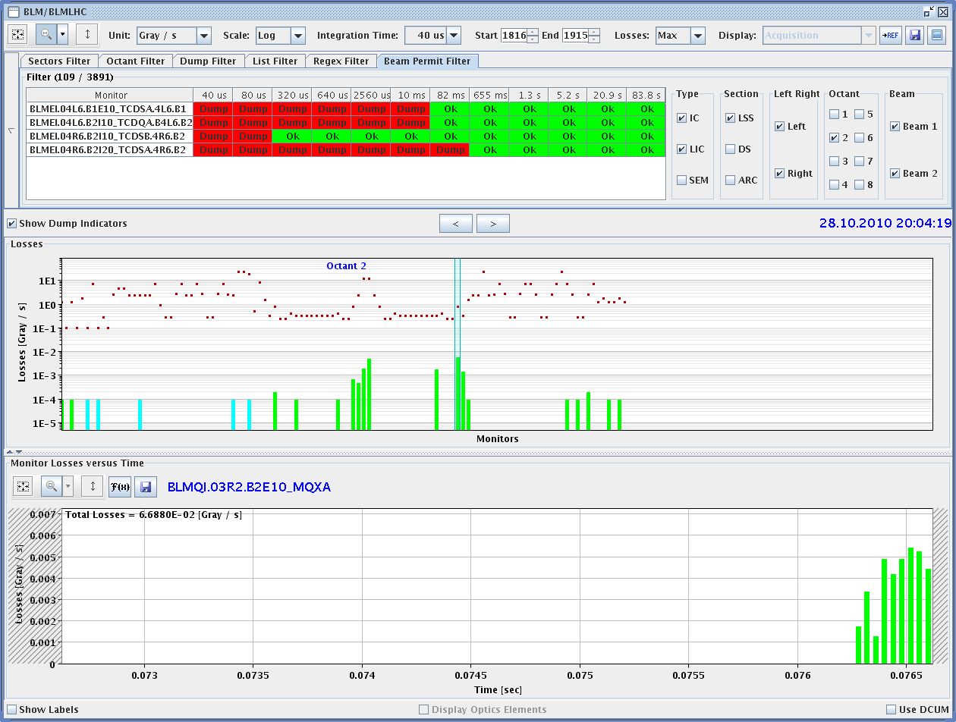
Fill 1451: UFINO IR2
ALICE BCM triggered
See losses on BLM’s:
Symmetric left and right of IR2
Developing over 5ms
Factor 100 below dump threshold!

Slide 5
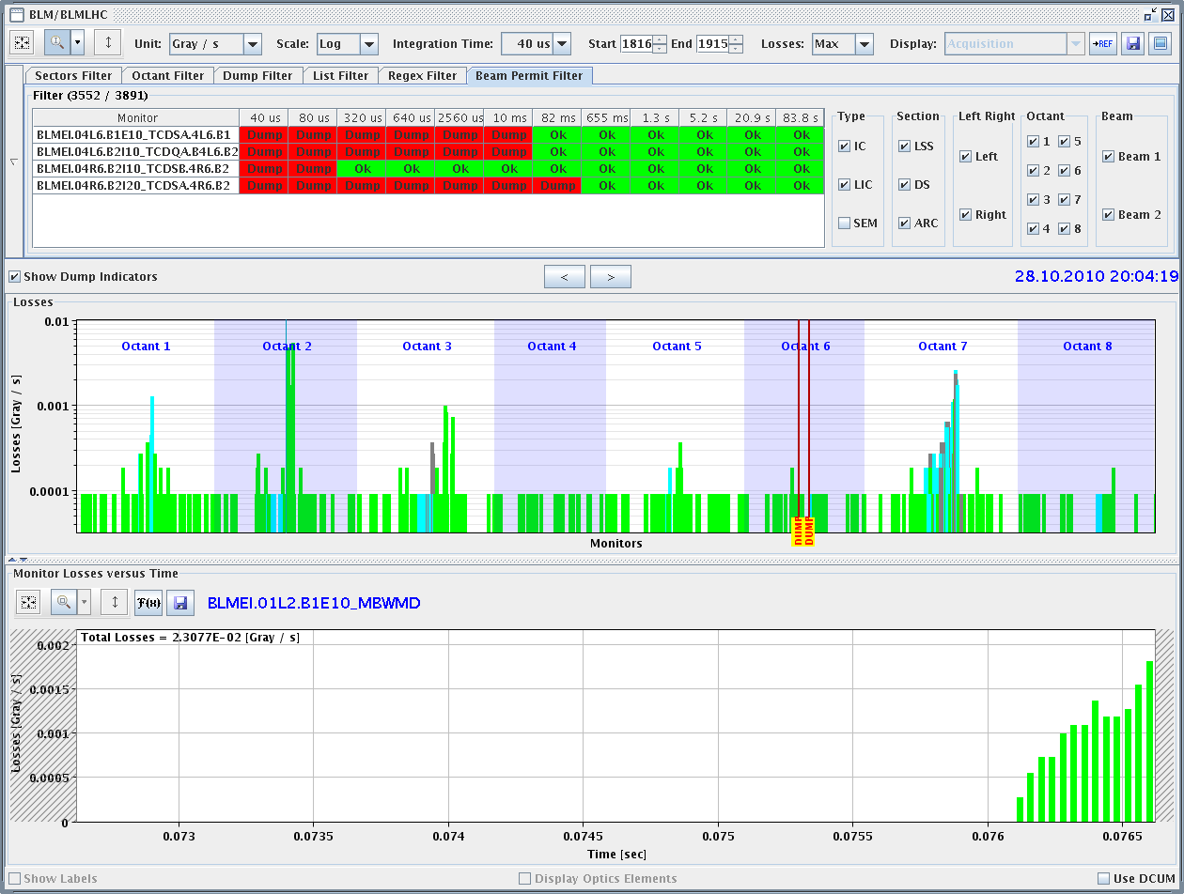
Fill 1451: UFINO IR2

Slide 6
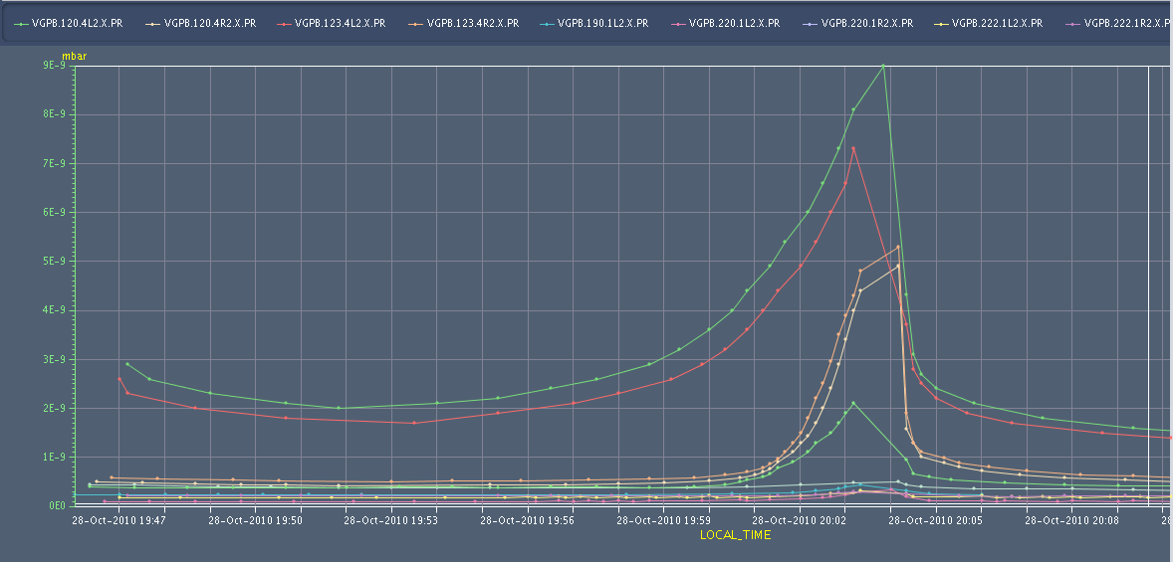
Fill 1451: UFINO IR2 - Pressure

Slide 7
Friday 29.10.
00h36: Start ramp. 368b.
01h27: Beam dump at 3.5 TeV. BLM trigger in Q4.L2 (UFO?). Losses start in injection kicker.
02h35: Injection.
03h15: Start ramp. 368b.
04h16: Stable beams. Fill #1453. Turn-around: 2h40.

Slide 8
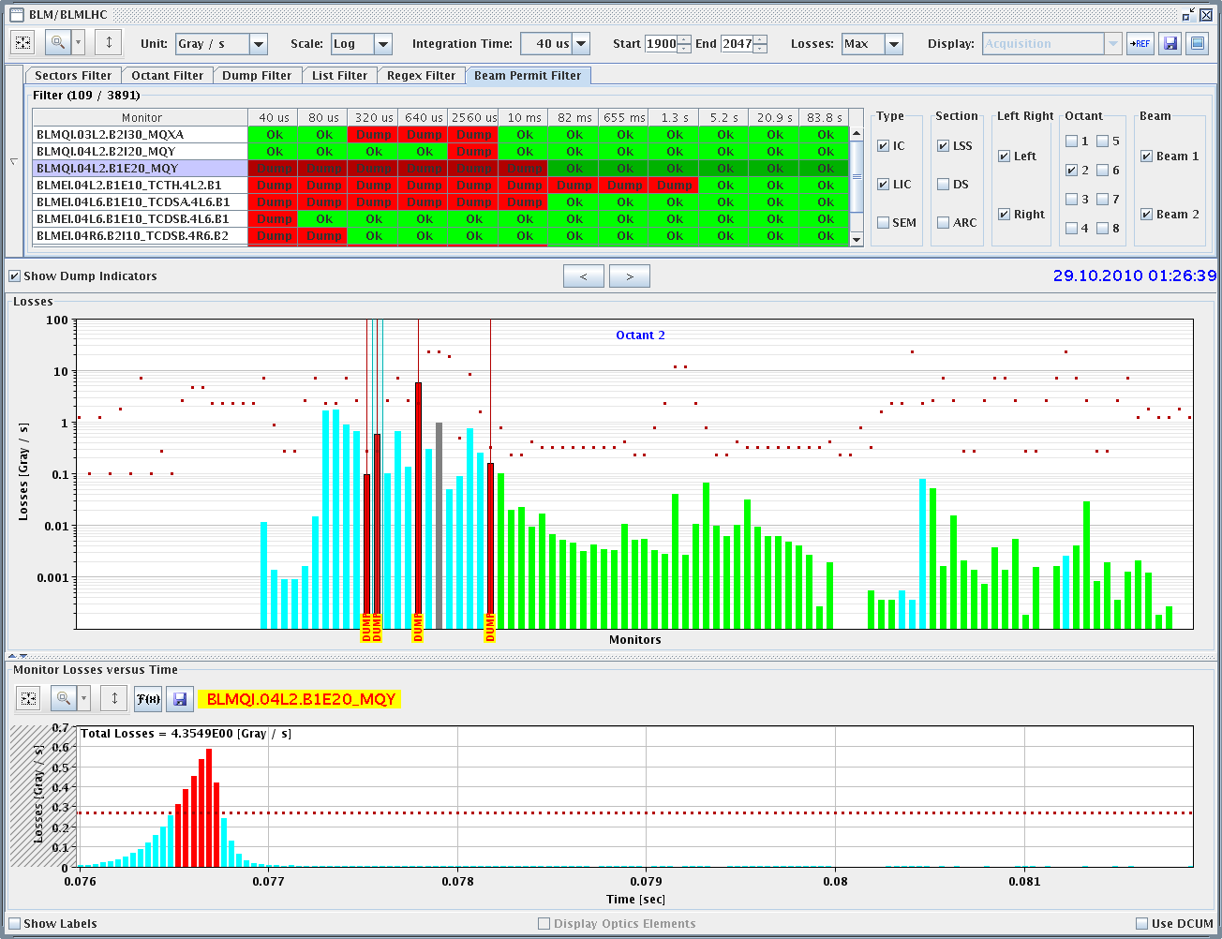
Fill 1452: Beam Dump IR2

Slide 9
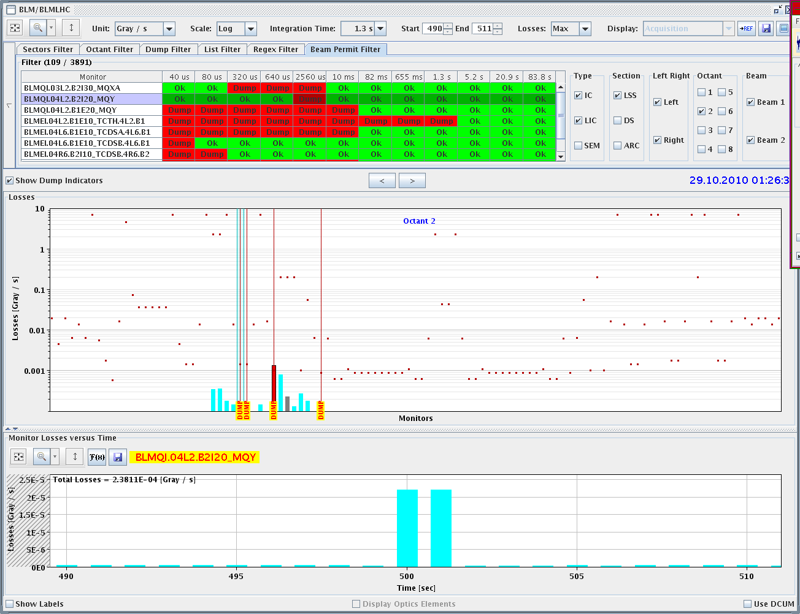
Fill 1452: Beam Dump IR2

Slide 10
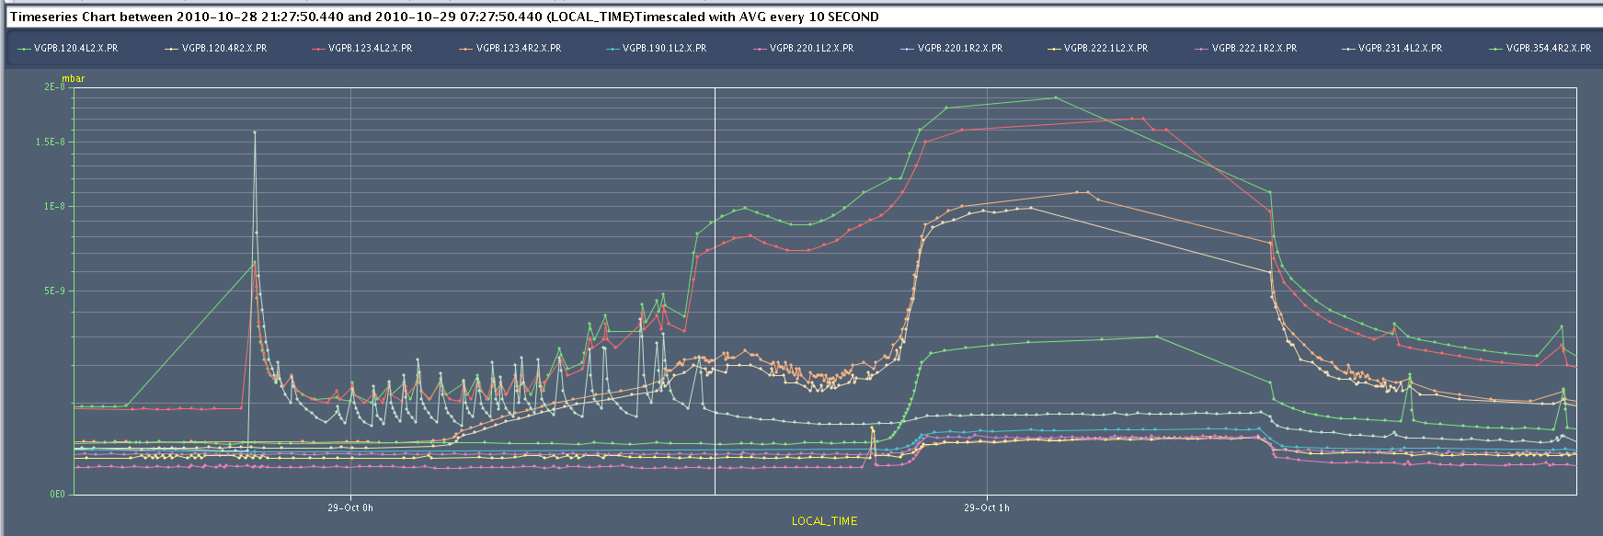
Fill 1452: Beam Dump IR2

Slide 11
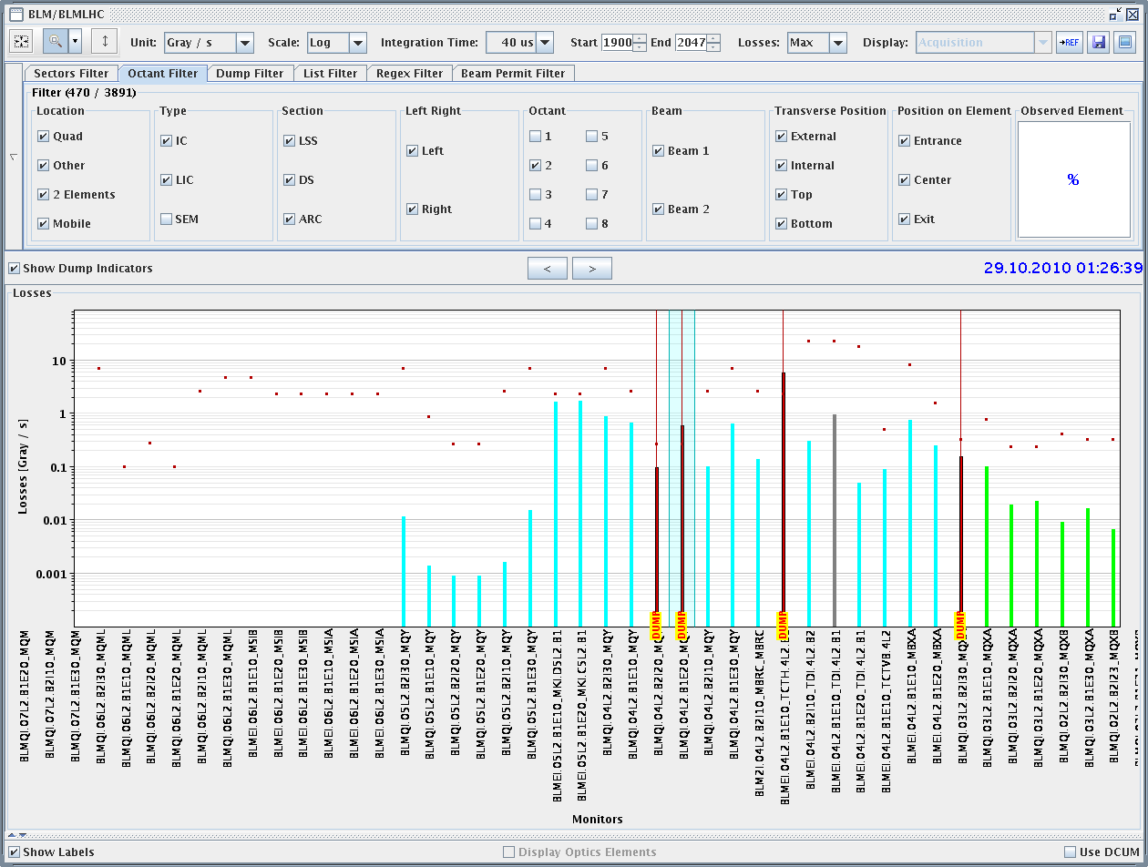
Fill 1452: Probably from MKI’s
➔

Slide 12
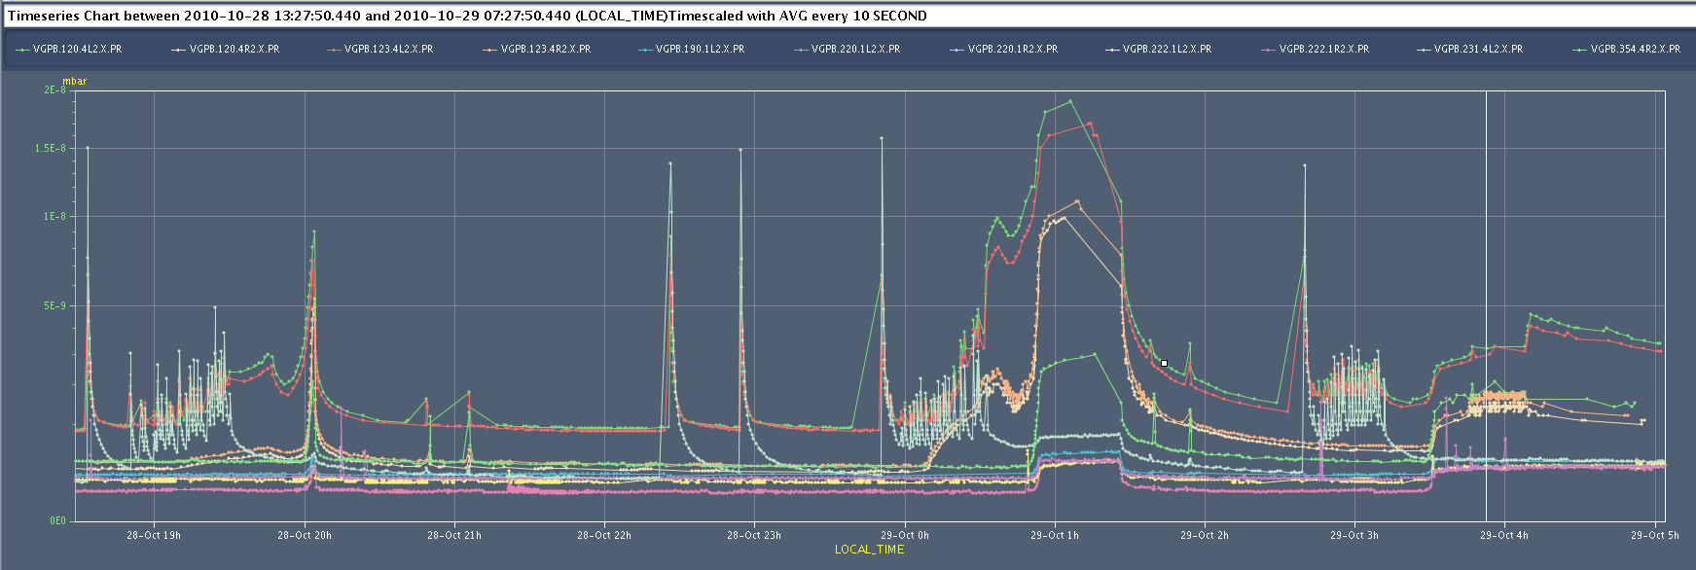
Pressure: Better with Low Intensity

Slide 13
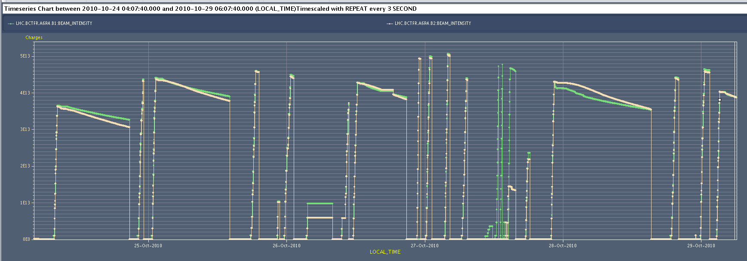
Intensity Limit 150 ns
4.35e13 p (?) → To be followed…
424 b
364b
364b
364b
364b
312b

Slide 14
Ahead
Got up to 47 pb⁻¹ in ATLAS.
Length scale calibration ALICE. Then dump around 9h30.
Afterwards: Switch to 50 ns
Tentative plan: See next slide.
To be finalized after the meeting.

Slide 15
Draft Planning
Fri | 08h00 | 4h | Transv. Damper | W. Hoefle, D. Valuch
 | 12h00 | 4h | Inj up to 72b if possible in time constraints/ RF | B. Goddard et al, P. Baudrenghien, W. Hoefle, D. Valuch
 | 16h00 | 2h | reserve
 | 18h00 | 8h | TOTEM/RF/ALICE | OP, TOTEM, E. Chapochnikova
Sat | 02h00 | 6h | MD
 | 08h00 | 6h | Inj up to 72b per shot if possible in time constraints, RF, transv. damper, inject 100b with 50ns for ramp | B. Goddard et al, P. Baudrenghien, D. Valuch
 | 14h00 | 5h | Ramp 100b, stable beam | OP, R. Steinhagen, M. Gasior, R. Jones,
 | 19h00 | 14h | Inject 200b with 50ns, ramp 200b, stable beam | B. Goddard et al, OP, W. Herr, E. Metral, T. Pieloni, R. Steinhagen, M. Gasior, R. Jones
Sun | 09h00 | 4h | Fill 300b, Beam-Beam MD 450 GeV | OP, W. Herr, E. Metral, T. Pieloni, R. Steinhagen, M. Gasior, R. Jones, F. Roncarolo
 | 13h00 | 6h | Ramp 300b, stable beams | OP
 | 19h00 | 13h | Fill 400b, ramp, stable beams | OP
Mon | 08h00 |  | MD block starting, Injection setup for high intensity at 450 GeV, 72b injection, …

