Slide 1
Saturday
1.3 e32
Overnight
Struggle with beam 1 injection – inter-septa obstruction has worsened
Morning
re-steer around obstruction

Slide 2
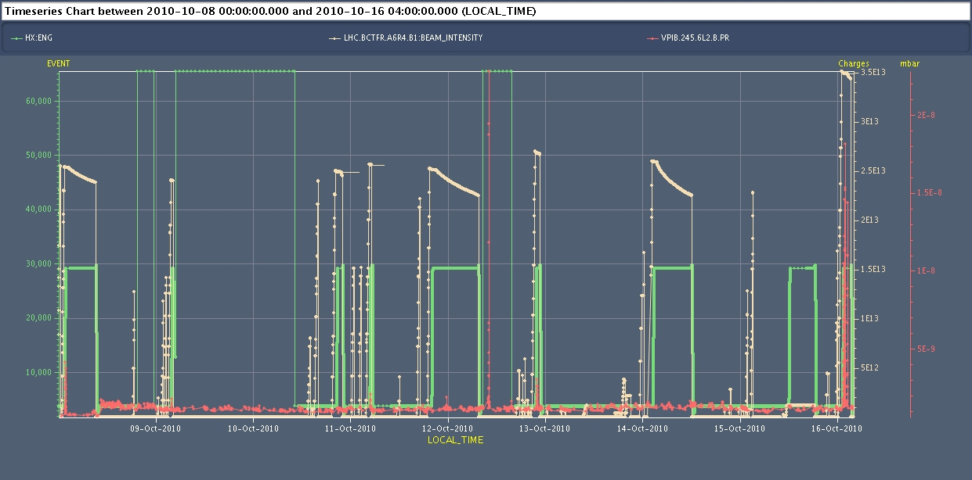
Vacuum
.

Slide 3
Vacuum
Vacuum activity at the transition MSIB-MSIA during the last fill. It seems not related to losses in that area - Arcing? A first spike in vacuum (this is a ion pump) can be observed on Friday 08/10 morning. The level of the vacuum remains then high starting from ~10:30 in the morning. A spike can also be seen at the moment of the intervention in the tunnel (12/10 at ~10 AM) and finally some more activity on 16/10 night
V. Baglin: Regarding the pressure, it is hard to say that what you observed for VPIB.245.6L2.B is due to arcing. I remark that this pressure increase appears during the ramp and at the flat top (this night, the 12th, the 11th, the 8th). There is also a signal the 12th at 10h, but this is when we were in the tunnel as said in the logbook.
The equivalent ion pump (VPI.245.6R8.R) in MSI8R is under-range (less than 1e-9 mbar).

Slide 4
Injection adjustments
Checked losses with 4b injected and different steerings in TI2
Resteered TI2 again to reduce losses in MSI-situation now is -5 mm in V and + 2 mm in H.
reduction in losses by factor 10, with 4b
Additional 1 mm H and -1 mm V bump
Adjusted matching bump in H in LHC to reduce inj oscillations - now near acceptable limit. Need 1 unit of V bump and 1.5 units of H.
Adjusted all TI2 TCDIs around new trajectory
Opened auxiliary inj prot collimator TCLIB.6R2 by 2 sigma
New references and thresholds trimmed in everywhere for collimators and correctors
Test fill with 24b OK for transvserse losses (dumped on uncaptured beam)
Should (just) be able to fill like this but MSI needs repairing asap as we cannot realistically keep chasing after this degrading situation
Brennan Goddard & Malika Meddahi
(young Goddards doing homework in CCC)

Slide 5
Injection issues - summary
Un-captured beam from SPS
Thursday-Friday night
Swept across TDI by injection kick – dumped by LHCb
Tracked down to 800 MHz in SPS
Obstruction in MSI at IP2
Last week & Saturday morning
Capture losses in LHC
Saturday afternoon
Beam swept by injection kickers grazing TDI, proving BLM beam dump down stream
Very dependent on longitudinal beam quality from the injection
Very low tolerances in LHC – general issue with fast losses at 450 GeV – dumping beam after the event

Slide 6
Saturday afternoon continued
14:00
re-filling for physics
Looking OK re transverse losses - only the Q.L2 slightly above the IQC threshold, and not at BLM warning for 24b.
1st attempt lost to un-captured beam
Next at over-injection
SPS adjusted – shorter bunches
16:32
MKI is faulty. Spark on BEAM2 MKI magnet D at the end of the kick. --> vacuum interlock, IQC interlock, no fast interlock. Acknowledged vacuum interlock. Restart system with normal SoftStart. Some vacuum activity visible on magnet D during the KISS.

Slide 7
Saturday afternoon continued
17:07
2 beam 1 dumped because of error on LBDS : generator fault on LBDS.UA63,
E. Carlier - access in UA63
ASI-Monitoring module corrupted. Hard restart of the module solved the problem. Source of the corruption not identified. Strong suspicion of a glitch on the safety power supply. No hardware modification performed.
Access in ALICE in the shadow of the access in point 6
19:39 end access
Pre-cycle
#1427
312b – slightly lower bunch currents – defensive move at injection

Slide 8
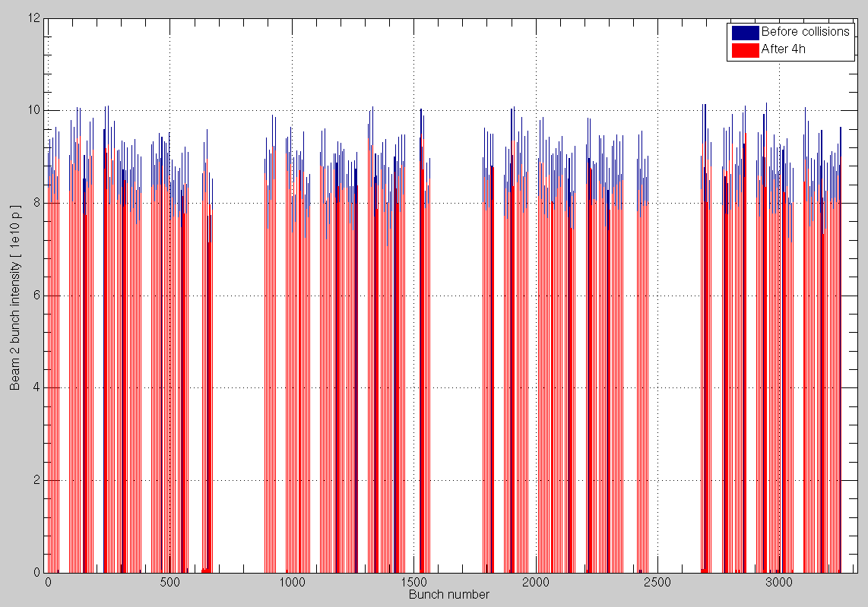
Bunch intensities

Slide 9
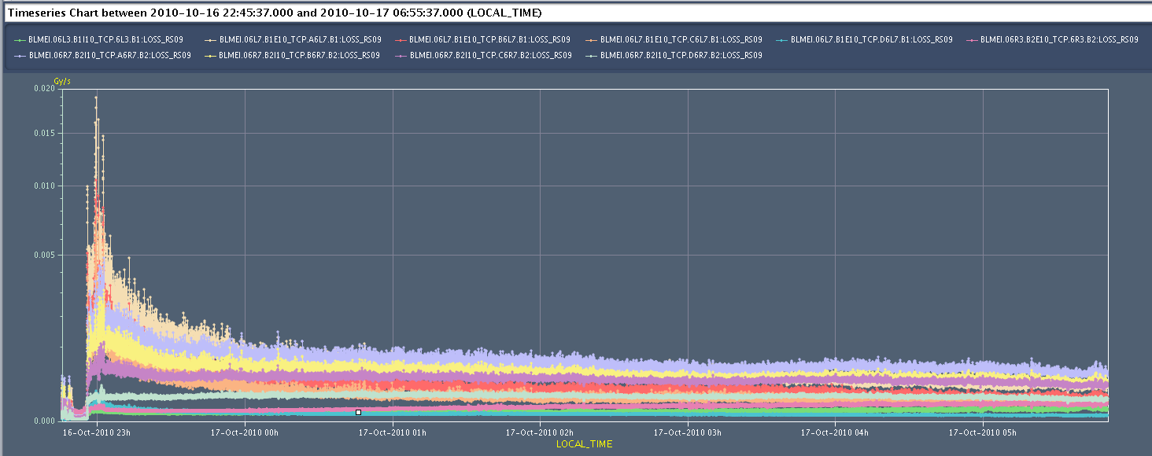
Beam losses at all primaries versus time

Slide 10
BLM
Christos Zamantzas
BLM
1/2 optical links from card 29.R5
measured on surface, comes from tunnel
no MP issue, only availability
to fixed next week – 2 in tunnel, 1 in tunnel
if problem over night – could disable all 6 monitors on the quad concern – in arc so should be enough coverage. (Mariusz or Anitka)
Checking historically, the operational link has been a stable one and has not given single errors in weeks (didn’t check further back) and might be able to sustain the link for days.

Slide 11
Weekend planning
Friday 07:00 – 19:00 | vdM
Friday evening | Check injection
Friday overnight | Physics 312b | 12 hour fill
Saturday | Remedial injection
Saturday overnight | Physics 312b | 12 hour fill
Sunday 10:00 | TL BL calibration | 4 hours
Sunday 14:00 | Quench test | 6 hours
Sunday overnight | Physics 312b | 12 hour fill
Might need an access for QPS before going back to 3.5 TeV

Slide 12
MSI
MSI aperture restriction was again found to be worse early this morning, and despite very carefully adjusting the transfer lines, we have had to increase the beam position offset through the septum again, with all the attendant adjustments.
There seemed to be some vacuum activity (ion pump currents) on the MSI which seems correlated with the times we see reduction in aperture, and with higher beam current.
Little to no margin left

Slide 13
Options
MSI solution is not stable
Weekend is covered
Monday can be covered – the list is long…
Do we open up the MSI next week?
Install mobile pumping unit, inject Neon
open and fix
pump, bake, pump
around 3 -4 days
“we are ready to intervene in MSI2L and remove the RF fingers if required. We will put them back during Xmas break
And move technical stop to Tues-Wed-Thurs next week
no show stoppers when first proposed last week
Vincent Baglin
Katy Foraz, Simon Baird

Slide 14
To-do list

Slide 15
OP
Periodic loss maps
Betatron loss map done week 40.
Orbit shift versus TCT check:
collide 1 bunch and check the TCT center change as compared to predicted orbit change.
All in one ramp, squeeze, collide - 1 shift
Plus test of 'dynamic' references for the OFB (varying Xing.separation bump): injection, then test of ramp + first part of squeeze
IR aperture at 3.5 TeV
50 ns – pilot runs
After 3-4 fills with ~400 bunches
Push beam-beam tune shift with 150 ns
one test already performed with #1410

Slide 16
ABT
Abort gap cleaning tests B1/B2 at 450 GeV and 3.5 TeV [2 shifts]
Injection gap cleaning deployment tests, 450 GeV, B1/B2 [1 shift]
Loss calibration on TCDIs downstream TI2 and TI8 [4 h]
High intensity 32b injection for B2 - filling and P6 interlock checks for 350 and 400b schemes [4h]
MKI8.B2 fine timing adjustment (1st bunch in train always gets too large a kick), and also synchronisation checks [2 h]
50 ns bunch train injection for B2 [1 shift?]
Studies SPS-LHC emittance preservation at injection, and growth on flat bottom [1 shift]
Asynch dump tests 3.5 TeV for B1/B2, to check stablity [1 ramp]
Brennan Goddard

Slide 17
BI studies – list to be updated
Check the linearity of the fast BCT’s in the new configuration for nominal bunches
Tune the High BW/Low Gain fast BCT calibration for the coming ion run
Measure the High BW/Low Gain fast BCT sensitivity limit and linearity for low intensity bunches (ion run)
Re-check BPM sensitivity limit
Calibrate the abort gap over the whole ramp
Check the abort gap acquisition gate timing resolution and stability
Commission BGI in preparation to ions – started…
Check BSRT/BGI/BWS cross-calibration including corresponding emittance logging
Test and compare bunch/bunch profile measurement via BWS and/or BSRT
PLL studies during ramp continued
JJG: for all this, we would need the 2 rings for a few hours at 450 GeV then a ramp and again a few hours at 3.5 TeV. One shift
Quench test at 3.5 TeV – pilot beam
Bernd & co

Slide 18
Experiments
50 pb⁻¹ total (22 delivered so far)
10 fills@3 pb-1 ~ 10 good days
Alice – fill without dipole
Totem – dedicated fill
Totem – 90 m optics
LHCb – switch polarity – plus test ramp (combine with BI plus map)

