Slide 1
Monday
152 bunch operation summary
4 fills with stable beams (~ 16h in total, = ~ 20₈ hours)
Enough for next step
Injection tests and interlocked BPM qualification for 200b
Scheme 150ns_200b_186_8_186_8+8bpi17inj
OK for next step
Parasitic tune measurement studies
Test ramp
Stepped through the squeeze to correct coupling
Loss maps made on the end
Physics with 200 bunches per beam
Target bunch intensity 10¹¹ and emittance between 2 and 3 µm

Slide 2
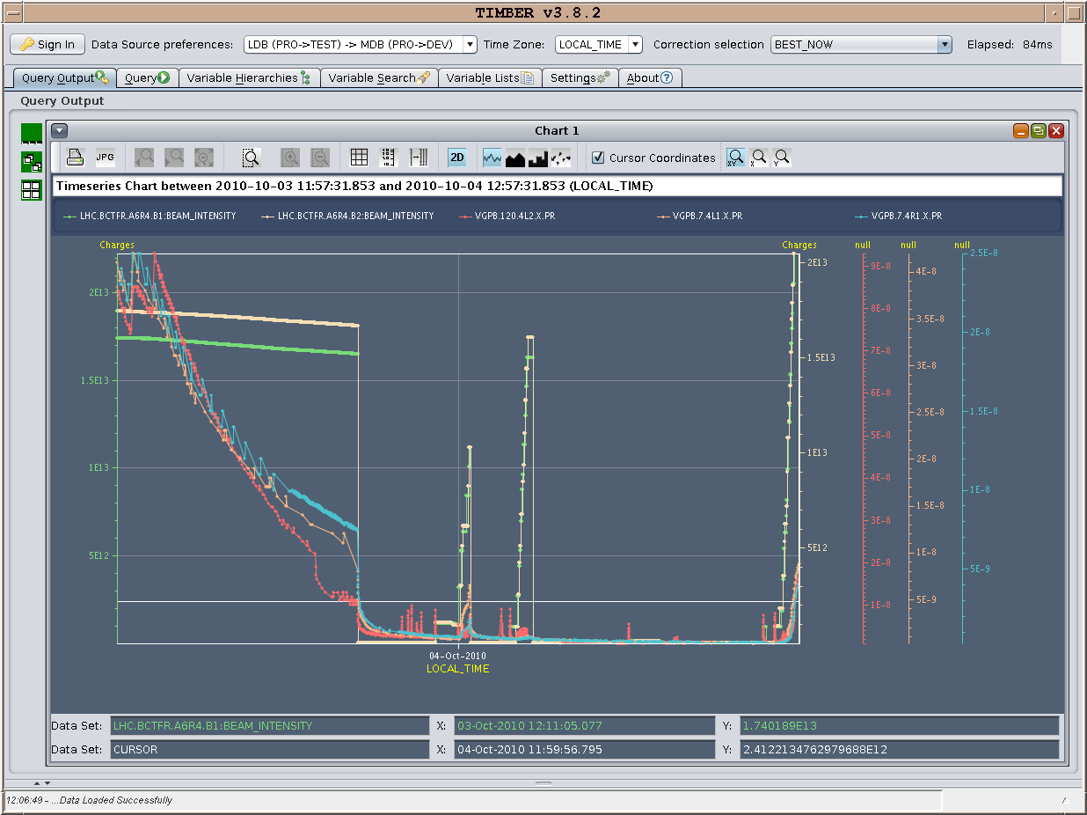
Filling 200 bunches per beam

Slide 3
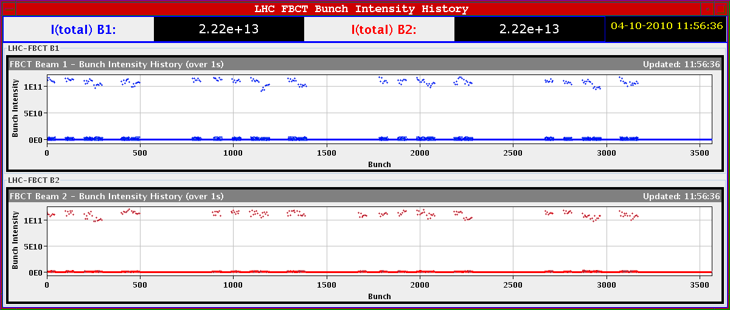
200 bunches, < N > 1.1e13

Slide 4
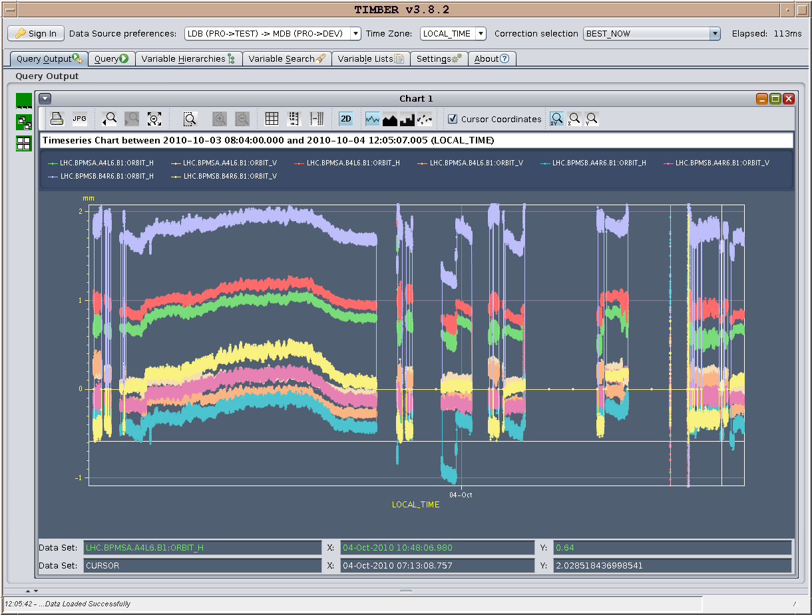
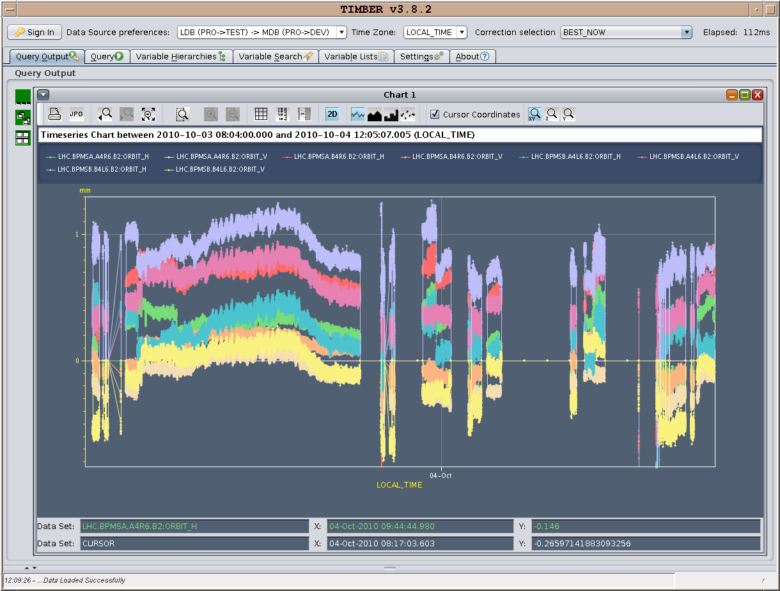
200 bunches per beam
Positions at P6 interlock BPMs - no signs of big changes
Beam 1 Beam 2

Slide 5
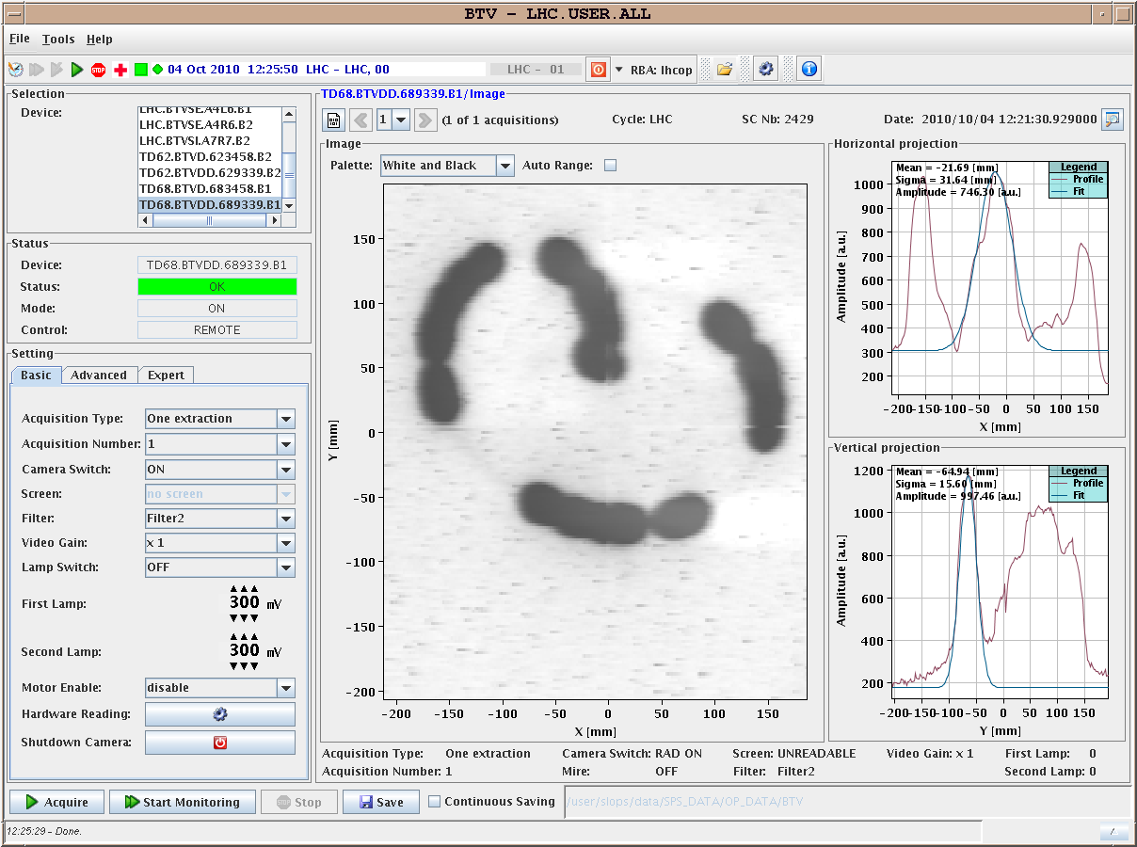
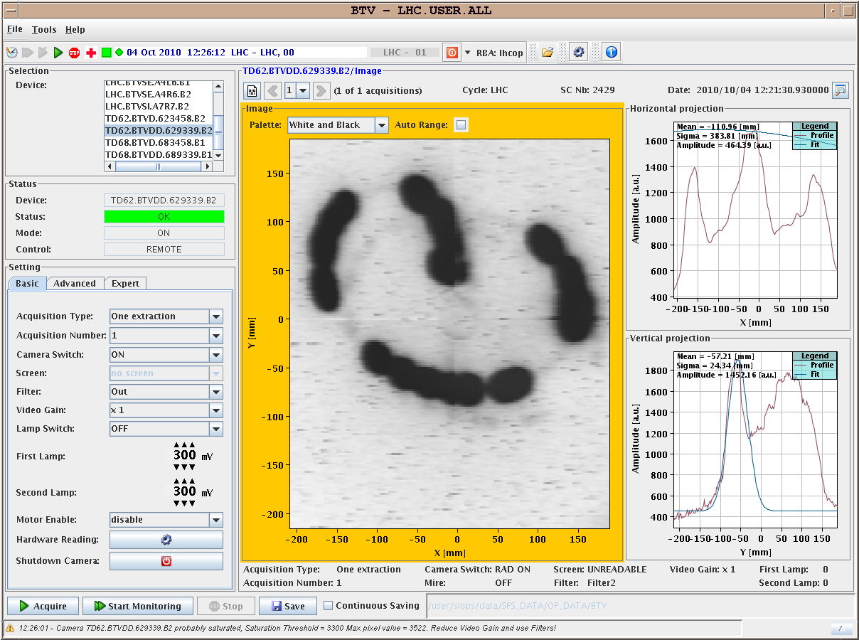
200 bunches per beam
Dumped 200b in B1 when reached 1.32 mm on the BPMSB.B4R6.B1 (about 0.5 mm away from the measured position, on the safe side). Test passed. B2 lost as well due to BLMs in P6
Beam 1 Beam 2

Slide 6
Physics fill 1393
Intensities injected
Around 2 10¹³ per beam
0.85 to 1.05 10¹¹ per bunch
2nd 8 of an 8 + 8 injection systematically lower
Emittances before ramp
B2H 2.2 B2V 2.3
could not do B1 due to intensity interlock (B1 BCT > 2 10¹³)
Very little vacuum activity (on the usual gauges)
Ramp
B1-H drops out for some minutes despite the reduced intensity
B2 is fine all along the ramp though while having slightly higher bunch intensities (1.1e11 p/b) ... strange... to be further investigated

Slide 7
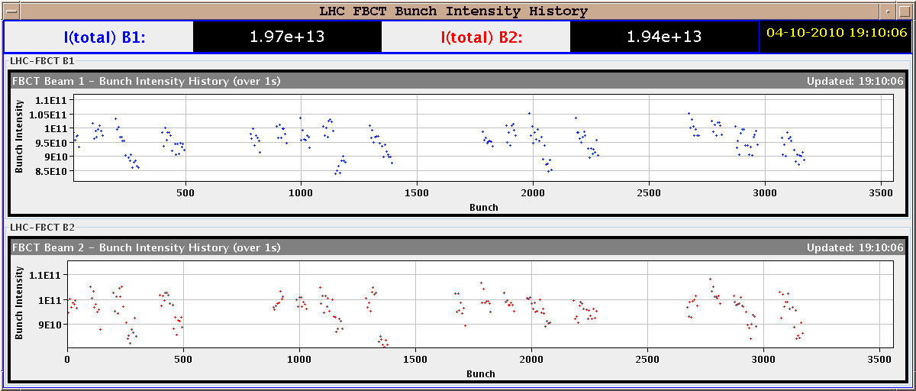
Fill 1393 – bunch intensities

Slide 8
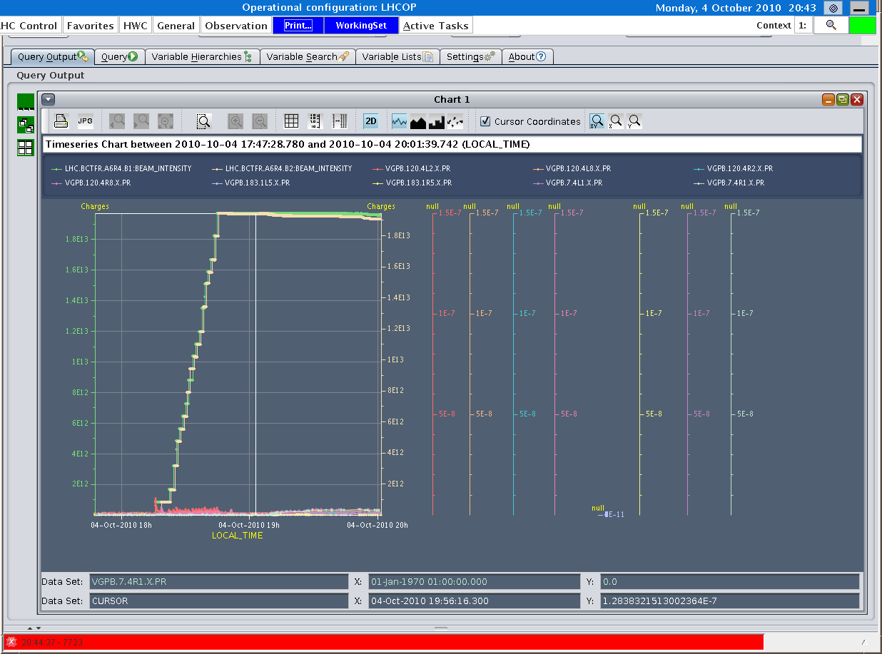
Fill 1393 – vacuum

Slide 9
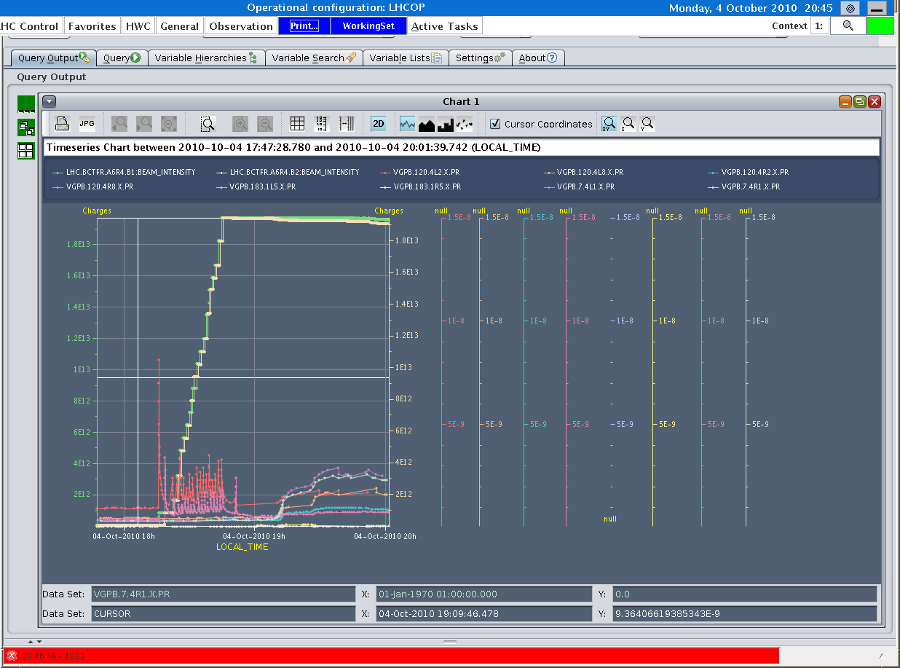
Fill 1393 – vacuum scale zoomed

Slide 10
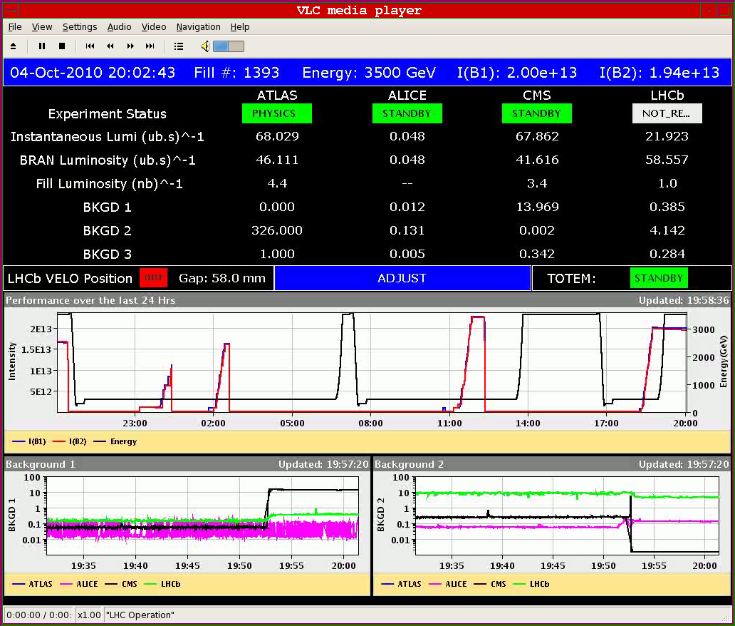
Start of fill 1393
Corresponding emittance around 2.6 µm

Slide 11
Fill 1393
From 20.00 Stable beams
2 10¹³ per beam
11.2 MJ per beam
Initial luminosities 0.68 10³²
Integrated luminosities after 12 hours > 2 pb⁻¹
From 22.00 Length scale calibration IP1
From 06.00 TOTEM pots in
End of fill 09.00

Slide 12
Outstanding requests
Dedicated fill to complete VdM scans
Around 1 shift needed
CMS need access ?
Intensity effects & vacuum - SVC
Quench test (Wedn. – TBC) – Coord.: Joerg Wenninger
Transverse damper – 2 h without beam – no access W. Hofle
MKQA & AC-dipole – will need another access – E. Carlier
Voltage rampdown@injection
Test of new beam presence flag system – M. Gasior
CO security intervention to be scheduled - A.Bland
RCBH15.L6B1 to be exchanged
Mods to Q meter electronics (RS et al, from Thursday)
BI – Coord. J. J. Gras (see next)

Slide 13
BI MD - c/o JJG – One Shift
PLL studies
Measure the sensitivity of Marek’s new beam presence detection system
Check the linearity of the fast BCT’s in the new configuration for nominal bunches
Tune the High BW/Low Gain fast BCT calibration for the coming ion run
Measure the High BW/Low Gain fast BCT sensitivity limit and linearity for low intensity bunches (ion run)
Re-check BPM sensitivity limit
Calibrate the abort gap over the whole ramp
Check the abort gap acquisition gate timing resolution and stability
Commission BGI in preparation to ions
Check BSRT/BGI/BWS cross-calibration including corresponding emittance logging
Test and compare bunch/bunch profile measurement via BWS and/or BSRT
For all this, we would need the 2 rings for a few hours at 450 GeV then a ramp and again a few hours at 3.5 TeV.
This would be really difficult to fit in a 4 hour slot. 8 would be perfect but we could try with 6.

Slide 14
Scheduled lift maintenance
Some preventive maintenance has been requested on the LHC lifts, and agreed according to the following planning:
Tuesday 5 October: PM15 from 8h to 12h00; PM25 from 13h30 to 17h30
Wednesday 6 October: PX24 from 8h to 12h00; PZ33 from 13h30 to 17h30
Thursday 7 October: PM85 from 8h to 12h00; PZ85 from 13h30 to 17h30
Tuesday 12 October : PM56 from 8h to 12h00; PM65 from 13h30 to 17h30
Wednesday 13 October: PZ65 from 8h to 12h00; PM76 from 13h30 to 17h30
Thursday 14 October: PM45 from 8h to 12h00; PZ45 from 13h30 to 17h30

Slide 15
Tuesday
BI shift (part 1)
Limited access early afternoon
CMS
RCBH15.L6B1 to be exchanged
Physics with 200 bunches per beam

