Slide 1
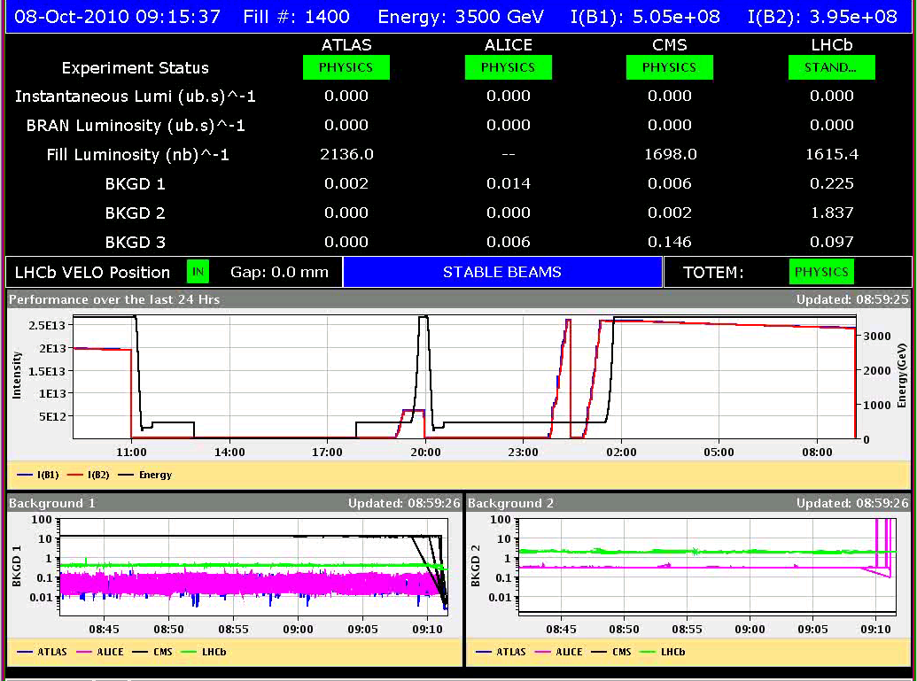
Friday 8/10/10 - Morning
Planned to keep fill until the afternoon
9:15 Beams dumped due to SIS orbit interlock at Totem
interlocking around TOTEM (+- 0.8 mm) was a bit harsh on data dropout; corrected and deployed
6.5 hours of physics with 2 x 248 bunches

Slide 2
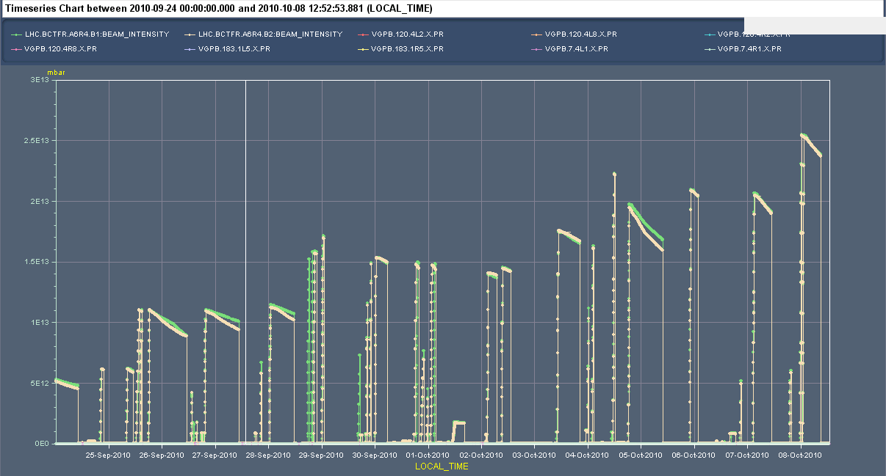
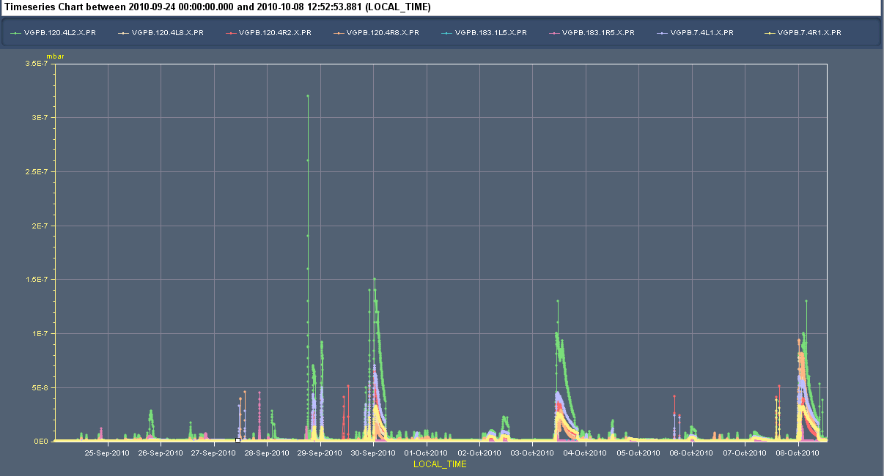
Vacuum over the last two weeks
3.e13 p+
Fri AM
3.5·10⁻⁷ mbar
Bad at first fill of record beam intensity ! After that very rapid conditioning

Slide 3
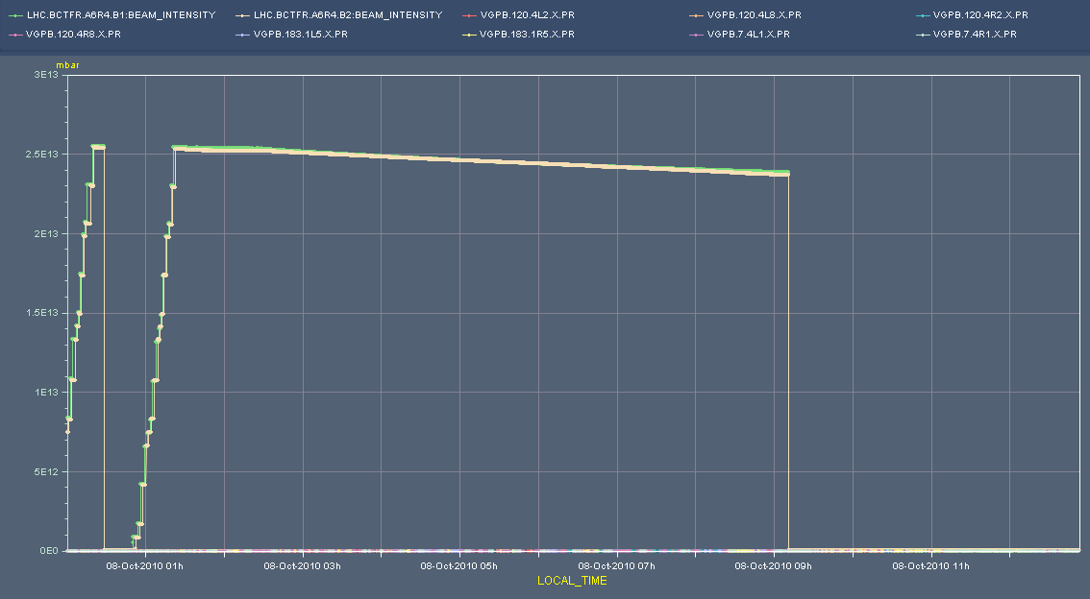
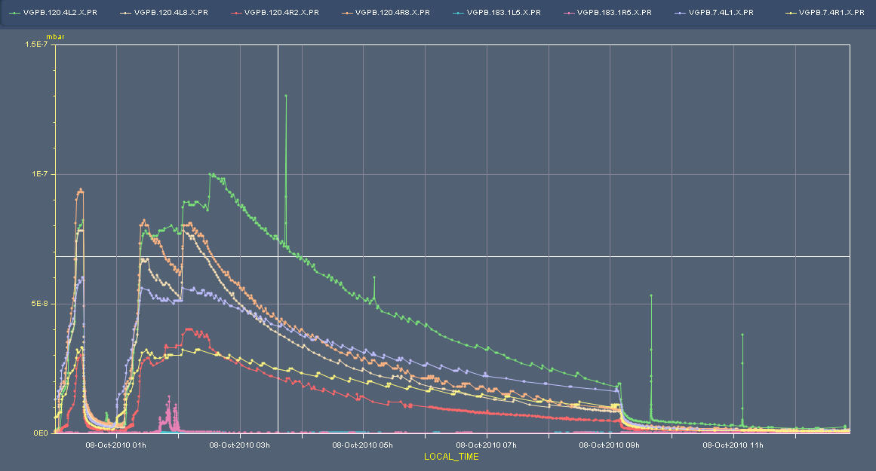
Vacuum Friday morning fill
1:30 – Ramp
2:00 – Squeeze
2:30 - Collide

Slide 4
Access and problems
Access for QPS in pt 2, as announced
Followed by a series of problems:
RF LL major trip, not understood by the piquet;
RB in 78 has one switch which is open since about two weeks. The experts decided not to intervene in the end, they'll wait until the next long access - but it took one extra precycle anyway;
DC-BCT quick calibration returns error - will be fixed when expert back from holidays;
used some time to set up new patterns in BQMSPS, pattern verification is ok now;
additional delays from PSB ring 4, SPS TDV01 and SPS mains.

Slide 5
Waiting and access again
13:30 LHC ready to take beam
15:40 Pilots in
Work on beam to inject
Adjust SPS to get equal bunch intensities, last bunch below 6e10
SBF interlock on the Extraction BICs, due to the BCT3 in SPS that is slight mis-calibrated. Forced SBF to false as temporary solution.
18:20 Start injection with 8 x 1.1e11 bunches, e_{n} = 2.2 – 2.4
B1 looks fine in TL, but losses in LHC giving IQC latches
B2 not IQC latches
18:47 both beams dumped. Losses at injection B1 in the LHC
BLMs at 05L2 and 06L2
20:00 Preparing for refill but RB.A56 fault
Access needed for the FGC in RB.A56 PO and CV to intervene
Also and access needed for demineralised water interlock (on CV) in UA83 ... this is to be done in the shadow of the Pt 6 access

Slide 6
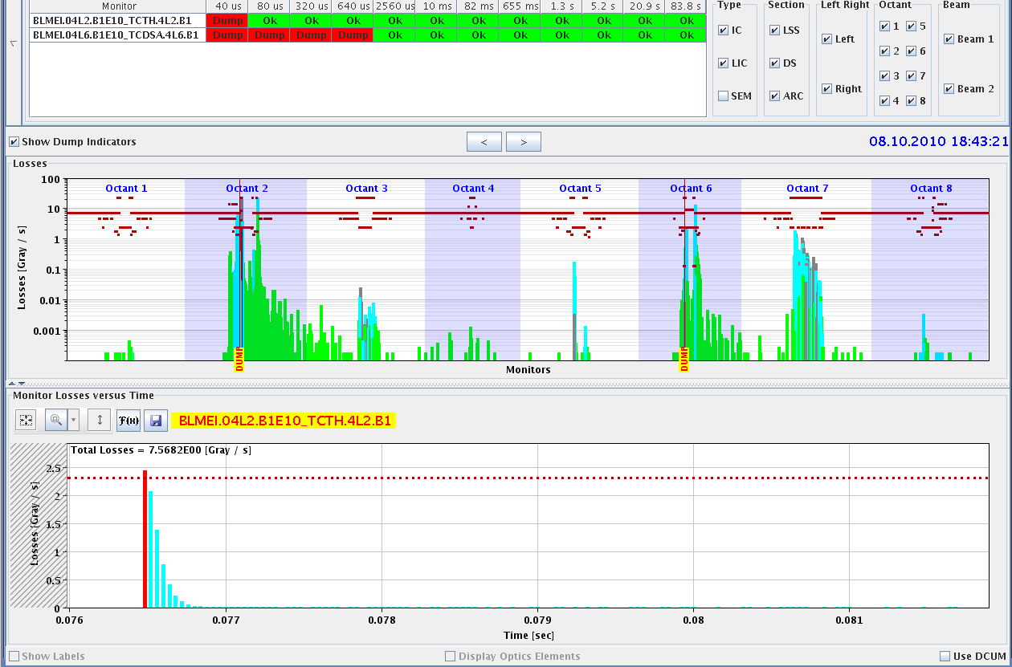
Losses during injection Friday evening

Slide 7
Next attempt for physics
23:50 pilots in
00:38 beams dumped again during injection for physics
Reduced intensity to 1e11 and small emittances of 1.5 – 1.7 um
Corrected trajectory in TI2
Orbit and trajectories look good.
As before: little losses in tl
level of losses at Q5.L2 increased suddenly a lot today. Aperture should be checked!
BLM between 60 and 80 % of dump level around cell 5L2
03:40 Manage to get all 2 x 248 bunches in
Vacuum peaks below 1e-8: conditioned on previous fill
04:15 Ready to squeeze, but Cryo informs of cryo stop in Point 6
06:40 Trip RB.A81

Slide 8
Planning for the weekend
Communication with Cryo point 6 is back but will need to at least Sunday morning before conditions are ok again
In the mean time:
Check RB.A81
Check extraction kicker SPS (MKE6) and check trajectory in TI2
Sunday
Check aperture around Q5.L2
Physics 2 x 248 bunches (2 fills and 13.5 h to go)
V/d Meer Scans next Tuesday
Change LHCb polarity after scan

Slide 9
Outstanding Studies
Periodic loss maps (not really MD)
Orbit shift versus TCT check: collide 1 bunch and check the TCT center change as compared to predicted orbit change.
BI
PLL studies during ramp
Commission BGI in preparation to ions – switch on at injection
Other BI studies – list to be updated
Test of 'dynamic' references for the OFB (varying Xing.separation bump): injection, then test of ramp + first part of squeeze.
BT
Abort Gap Cleaning – on at injection for physics
Injection Studies 32 Bunches when required (344 bunches)

Slide 10
Access Requests
Cryo : access to cavern in Pt8 (PM85) to exchange a 24 V power supply
not urgent ~ 30 minutes
TI : demineralized water alarm UA83: fixed Friday eve?
QPS : 1 resistor switch on RB.78, needs longer access
COD: RCBH15.L6B1
Magnetic measurements Pt3 : ~3 hours (hump hunt) L. Walkiers et al
Electron cloud coil installation

Slide 11
Scheduled lift maintenance
Some preventive maintenance has been requested on the LHC lifts, and agreed according to the following planning:
Tuesday 5 October: PM15 from 8h to 12h00; PM25 from 13h30 to 17h30
Wednesday 6 October: PX24 from 8h to 12h00; PZ33 from 13h30 to 17h30
Thursday 7 October: PM85 from 8h to 12h00; PZ85 from 13h30 to 17h30
Tuesday 12 October : PM56 from 8h to 12h00; PM65 from 13h30 to 17h30
Wednesday 13 October: PZ65 from 8h to 12h00; PM76 from 13h30 to 17h30
Thursday 14 October: PM45 from 8h to 12h00; PZ45 from 13h30 to 17h30
PM56
PZ85
La maintenance du PM56 aura lieu le jeudi 7 de 13h30 à 17h30, celle du PZ 85 le mardi 12 de 8h à 12h.

