Slide 1
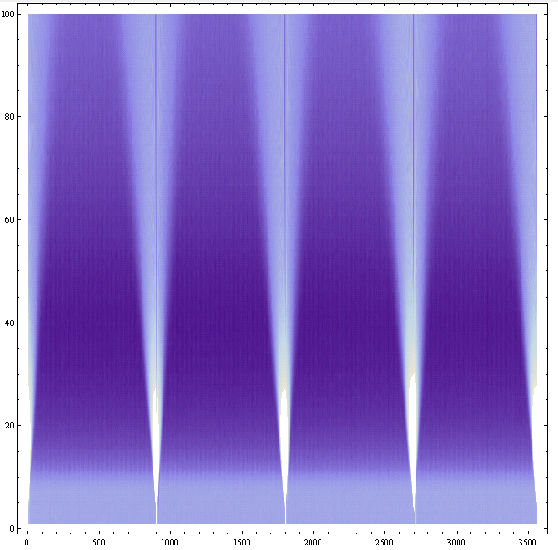
Thursday 30th September
De-bunching test
Intensities before switching off RF 2.6e10 B1 and 3.0e10 for B2
Leave the beam to debunch for an hour
Preliminary conclusions: with present BLM thresholds we can tolerate maximum 1e11p+ uncaptured beam, if equally spread around the ring. The local density should not exceed 3e6 p+/m, which is about 2.4e7 p+/25ns, or 0.02% of injected intensity (!). At present, injecting 150 bunches, the uncaptured beam level is maybe 0.3%.

Slide 3
Abort gap tests 11:00 – 16:30
1) kick delay between abort gap cleaning pulse and bunch 1 adjusted for all dampers of beam 1 and beam 2 ok, except one module of vertical beam 2, needs offline check, one slot error observed (25 ns) 2) injected two nominal bunches in each beam bucket 1 and 1201 [due to abort gap keeper cannot place bunches at edges of true abort gap]; then concentrated on beam 1 3) switched on cleaning pulses modulated exactly at tunes and placed left of bunch 1, i.e. in true abort gap. using 10/10 x25ns (250 ns) as rise and fall time and 50x25ns = 1250 ns as flat top for the cleaning pulse; saw detrimental effect on beam (emittance increase, lifetime drop at large amplitude excitation) 4) reduced pulse length to 20x25ns flat top; placed cleaning pulse between the two bunches, adjusted position to minimize effect on bunches; better preservation of emittance for hor. than for ver. cleaning

Slide 4
Abort Gap 2/2
5) with fresh beam: switched on cleaning program 20 steps, 0.001 in tune, horizontal beam 1 covering 0.27 to 0.29 in tune reduced amplitude, 0.3 in application
4x2.5 kV on damper emittances of bunches seemed to not increase more than usual
6) created losses from bucket by reducing RF voltage in steps, going down in steps (with cleaning on or off) from "7 MV" programmed (is 3.5 MV) to "3.5 MV" (is 1.75 MV) nicely saw unbunched beam passing abort gap and being cleaned If emittance increases are confirmed to be acceptable, could go with these settings for a test during a real fill.

Slide 5
ATLAS’S BACKGROUND
Main subject of the day

Slide 6
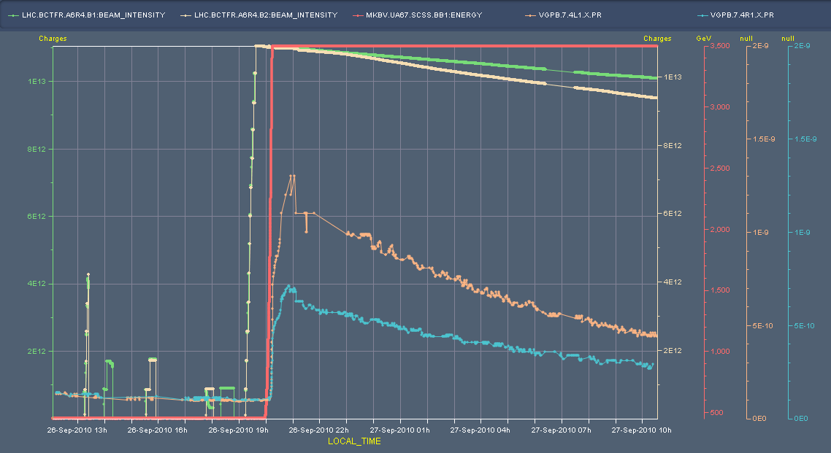
104 - 8 bunch injection
Pressure at Pt 1 from fill 1373 Relatively low increase in ramp Gauges in question between DFBX & D1 around 58.8 m from IP

Slide 7
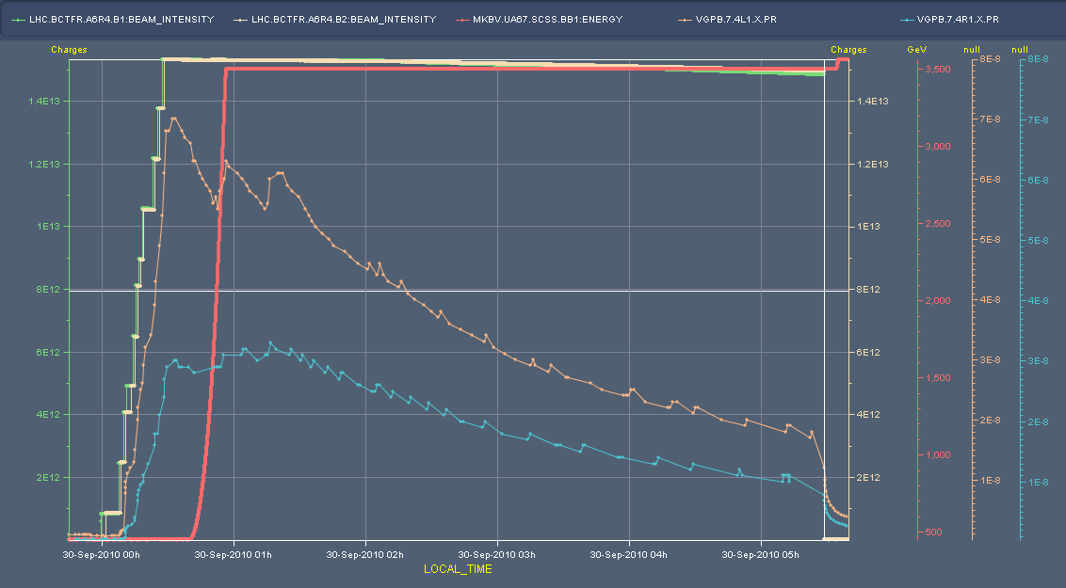
Night before last – 152 bunch (8+8) injection
fill 1381
Strong increase at injection

Slide 8
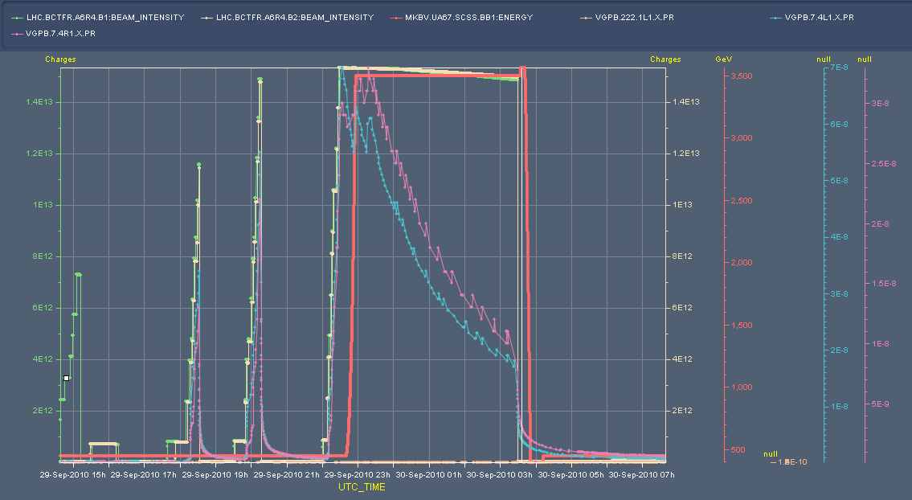
Last night in a wider context
Note spikes during injection tests

Slide 9
Date | Fill # | Bunches | Peak L | Int. L | Dump
Weds. 22/9/10 | 1364 | 24x24 | 4.6e30 | 0.17
Thurs 23/9/10 | 1366 | 56x56 | 2.1e31 | 0.69 | 4*150 ns
Fri 24/9/10 | Alice polarity change
Sat 25/9/10 | 1369 | 56x56 | 1.9e31 | 0.09 | 4
Sat 25/9/10 | 1372 | 104x104 | 3.5e31 | 1.1 | 8
Sun 26/9/10 | 1373 | 104x104 | 3.2e31 | 1.1 | 8
Mon 27/9/10 | Access
Tues 28/9/10 | 1375 | 104x104 | 3.5e31 | 0.96 | 8
Thurs 29/9/10 |  | 152x152 | 4.9e31 |  | (8 + 8)
Parasitic encounters at 11.25, 22.5, 33, 44, 55 …

Slide 10
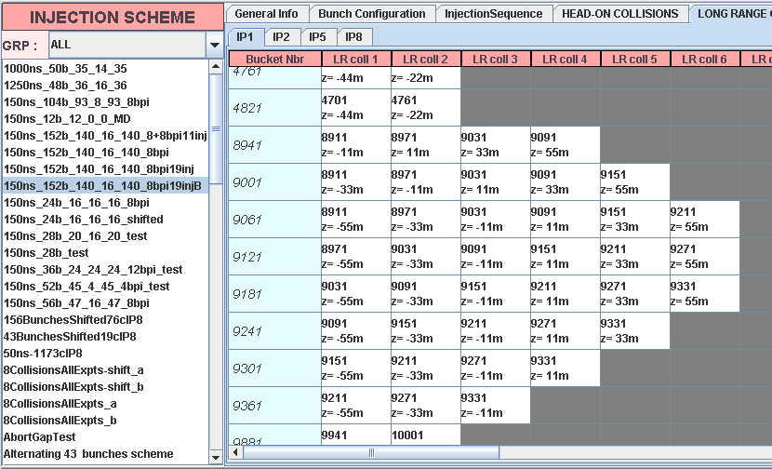
E.g.

Slide 11
And wider context still
104
104
104
152 attempt
#1381
CMS

Slide 12
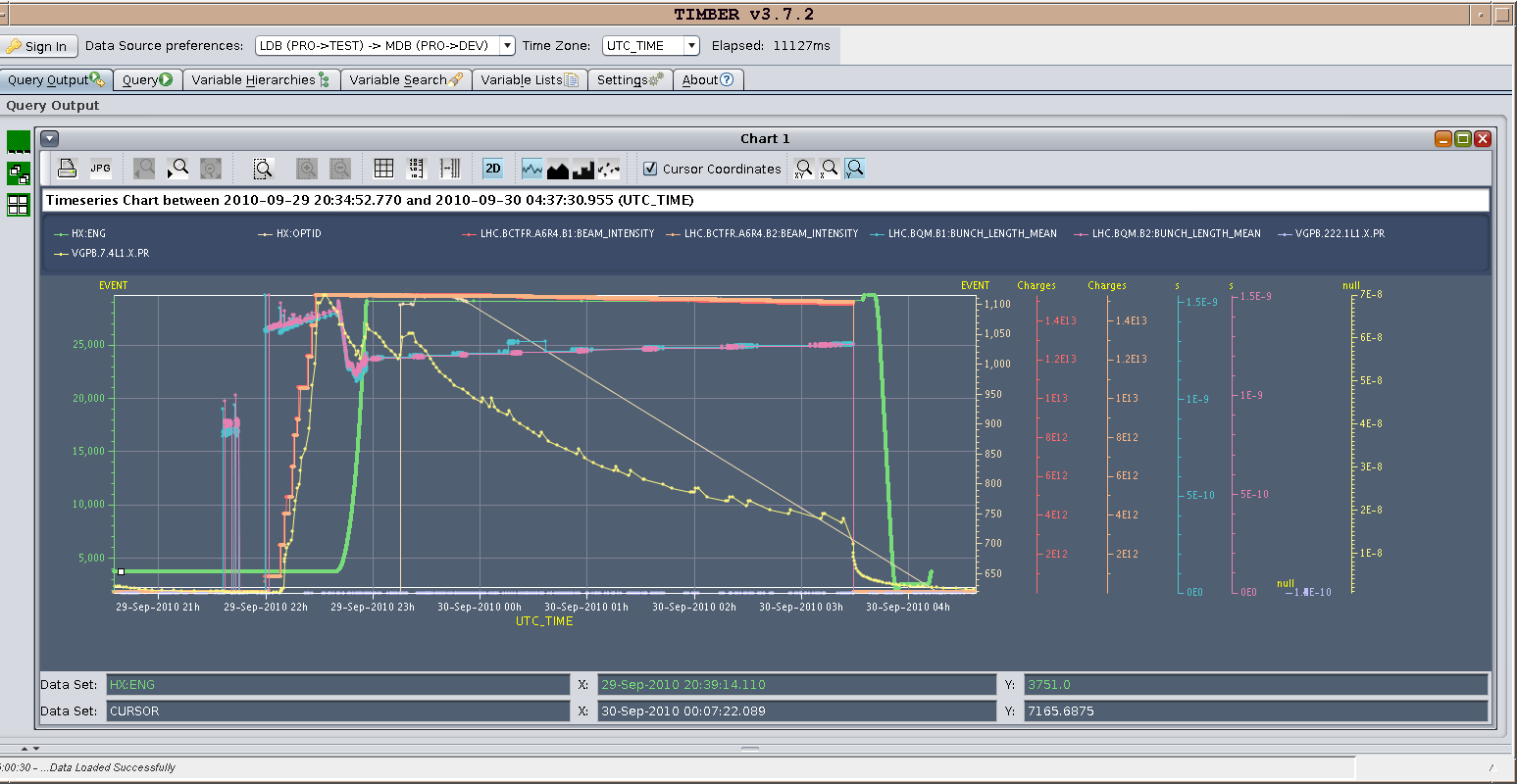
Bunch length

Slide 13
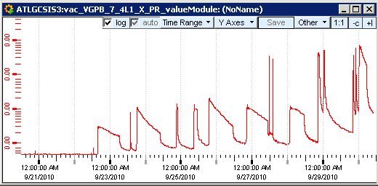
Atlas - history
Ramp
Injections

Slide 14
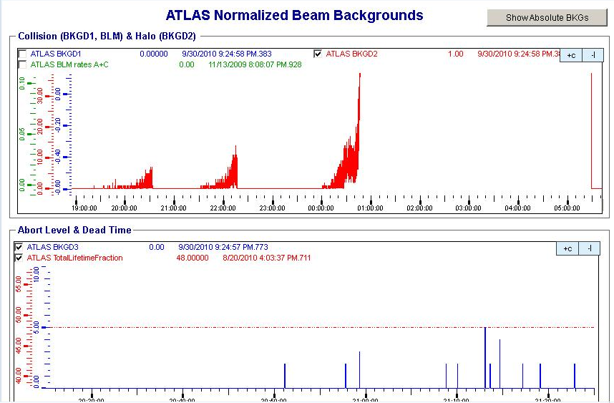
Atlas
Increase in ramp – presumably multiplicity

Slide 15
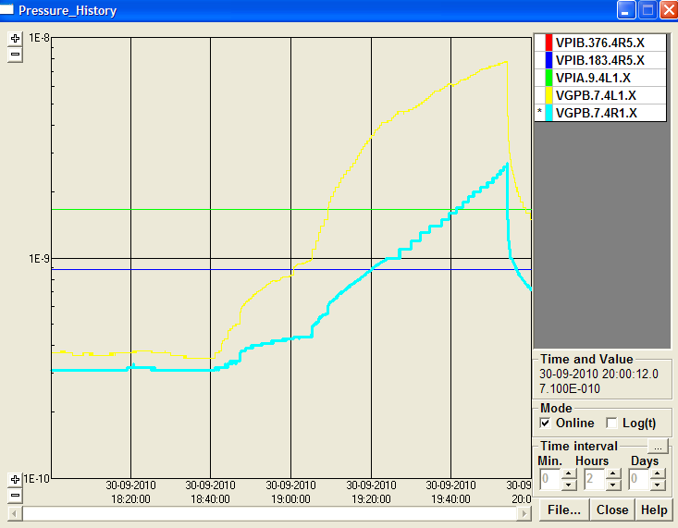
Yester evening
After some delays, 18:00 Vacuum activity injection test
Beam 2 – 151 bunches – no activity
Beam 1
Pressure starts rising at 48 bunches

Slide 16
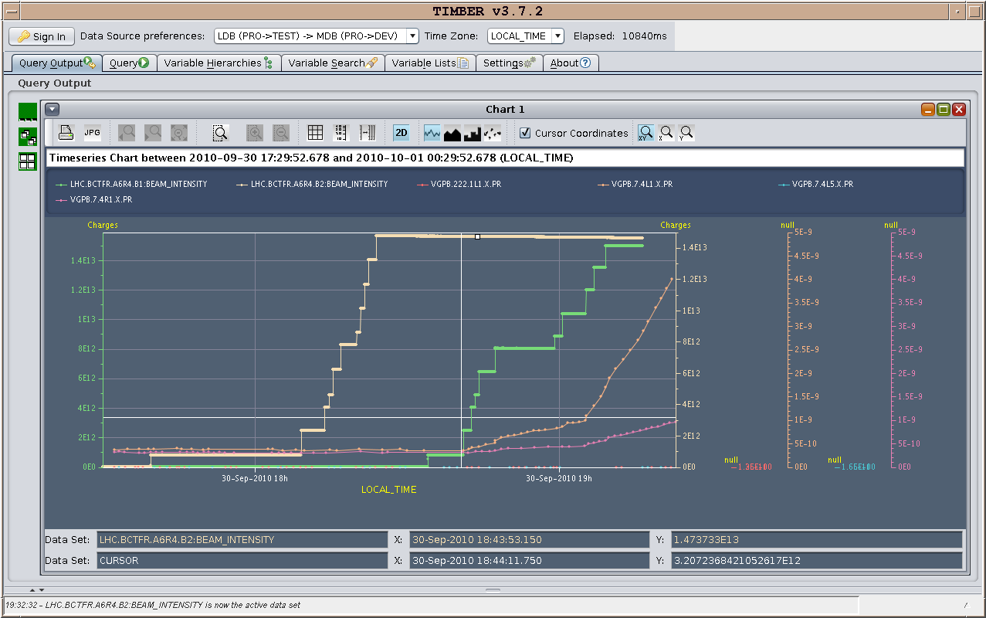
B2 and then B1
pressure was 10 times smaller than those observed on fill 1381
- cleaning?

Slide 17
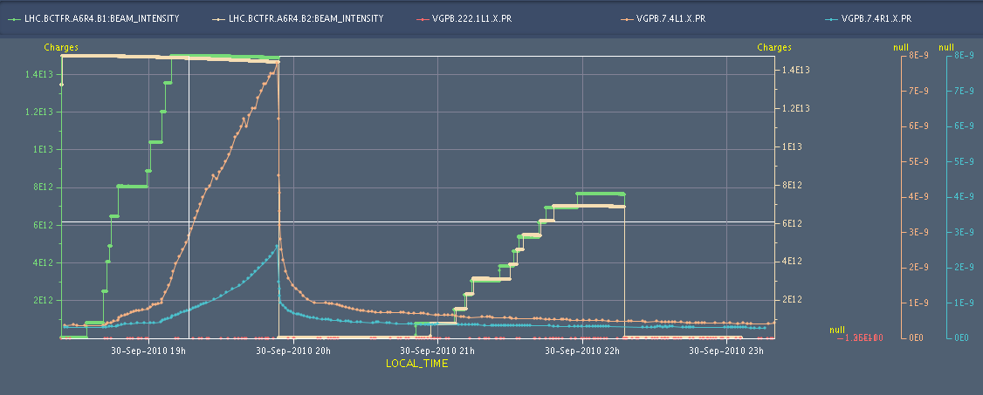
152 and then 104…
104 nothing

Slide 18
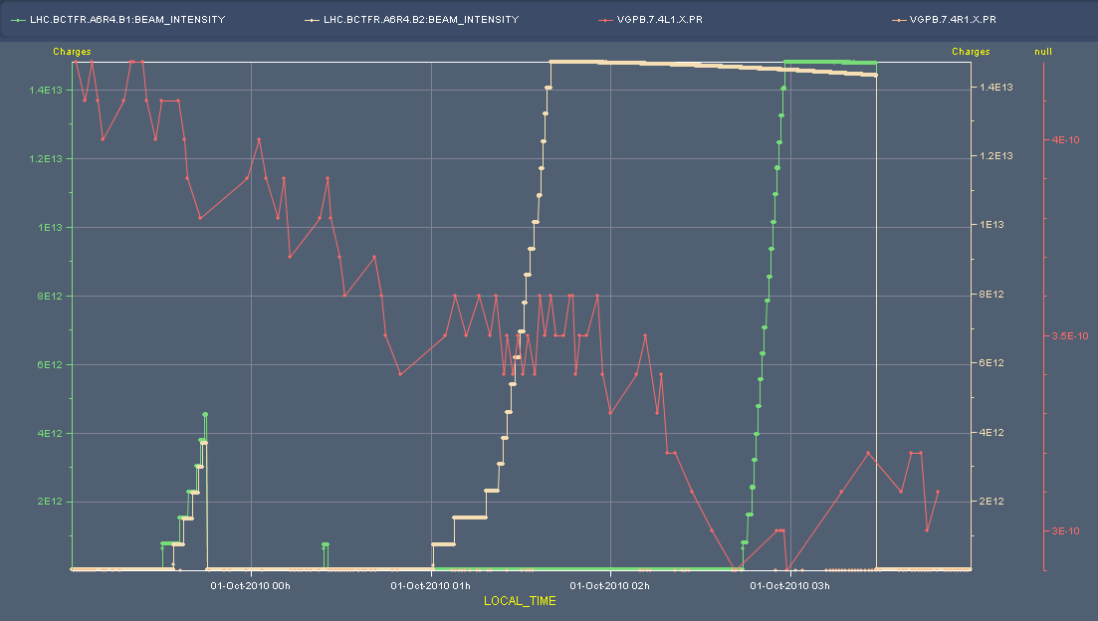
Yesterday night
Shorter bunch length

Slide 19
Overnight Thurs - Friday
Had problems injecting b2 due to LHCb BCM triggers (up to 400% of the dump threshold). According to LHCb the problem had already started at 18:00, while the injections the night before were clean.
We proceeded cautiously, in close contact with LHCb.
In the meanwhile lost a PC in TT60, which obliged us to fill b2 completely first, and then keep it at the flat bottom for over an hour.
By the time we had injected also b1, for b2 the abort gap was completely filled.
When preparing for the ramp, we had the unpleasant surprise that we had no tune measurement for b1h.
Given the fact that the problem is known, but not yet solved, we did not dare start a ramp in these conditions.
Given that the beams would have been dumped at 7:00 anyway, we agreed with the coordinator to do simply a test ramp for chromaticity measurements instead.
Concerning this one, we corrected the coupling and a bit the tunes in the squeeze, but did not feed forward nor backwards any of the trims.
Left the machine ready to inject for vdM scans

