Slide 1
Saturday 18.9
Morning:
Squeeze and collide.
Smooth, orbit rather well under control (max. excursion ~ 0.2 mm at TCT, roughly 0.5 -1sigma). Orbit evolution at the TCTs recorded – to be analysed in details.
All IRs were optimized, then offset for ALICE.
Beam-based alignment of all TCTs for collisions.
TCSG in IR6 was rechecked. TCSG B1 center shifted by 0.4 mm (~0.5 sigma).
15:30 Loss maps in collisions
Loss maps for betatron losses were made for both beams (i.e. B1v, B1h, B2v, B2h) – no surprises, hierarchy looks ok. To be checked in detail offline.
Beams were dumped (the left over of) B2, when trying to perform momentum losses.

Slide 2
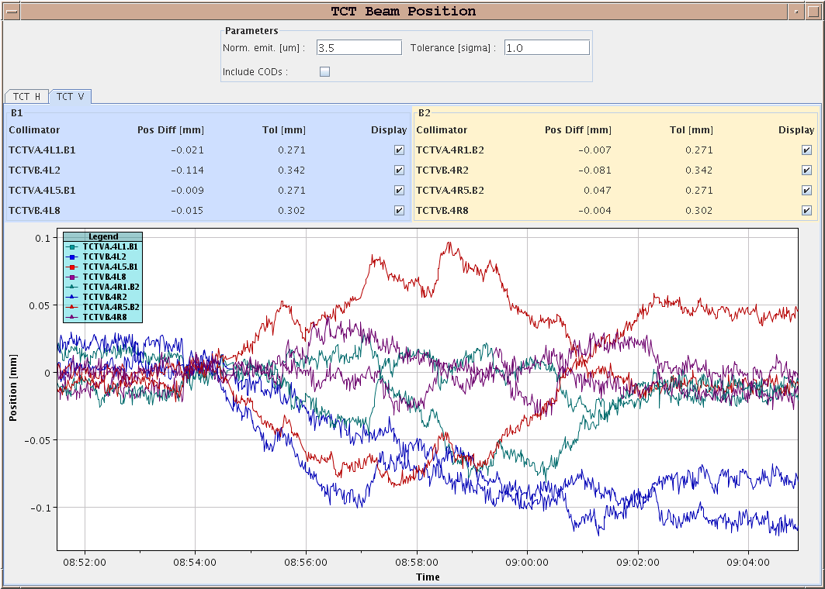
Beam positions at TCTV 7 m → 3.5 m

Slide 3
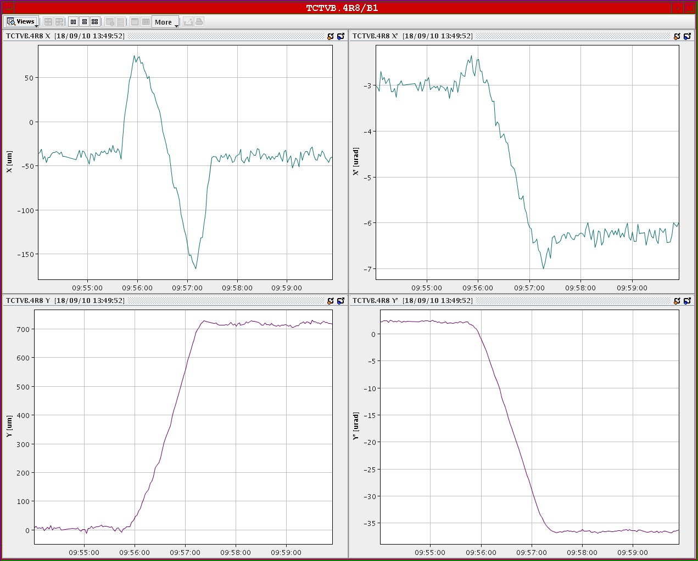
Beam position at TCTVB.4L8 during separation bump (V) collapse

Slide 4
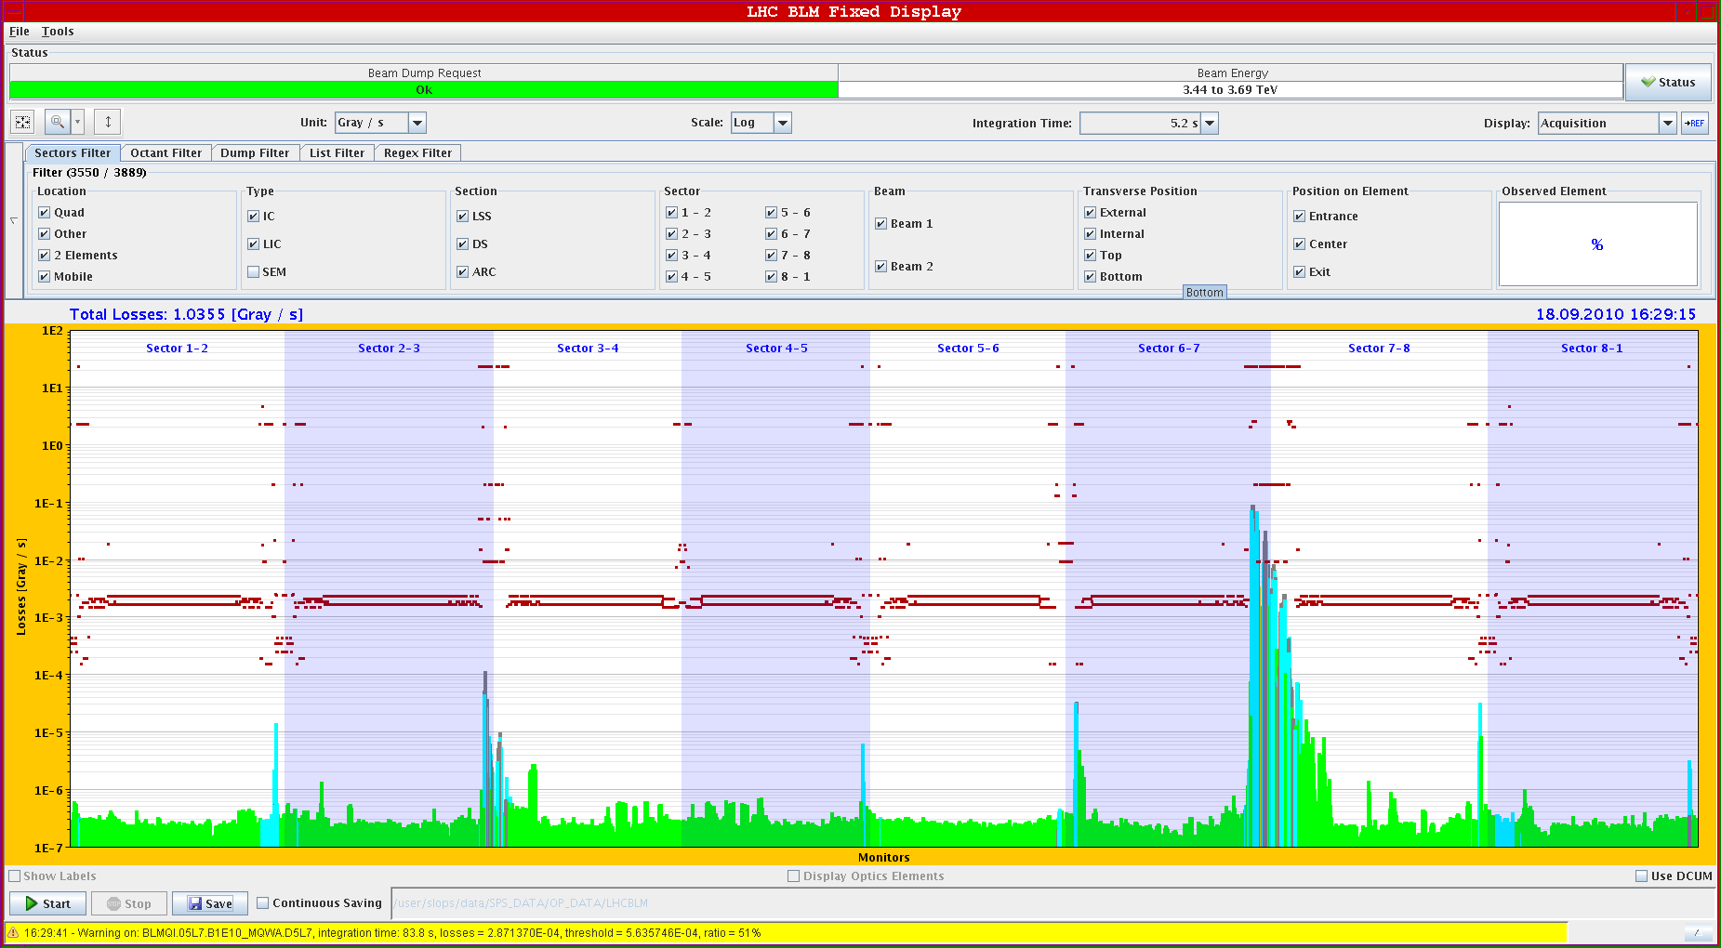
B1 V loss map in collision

Slide 5
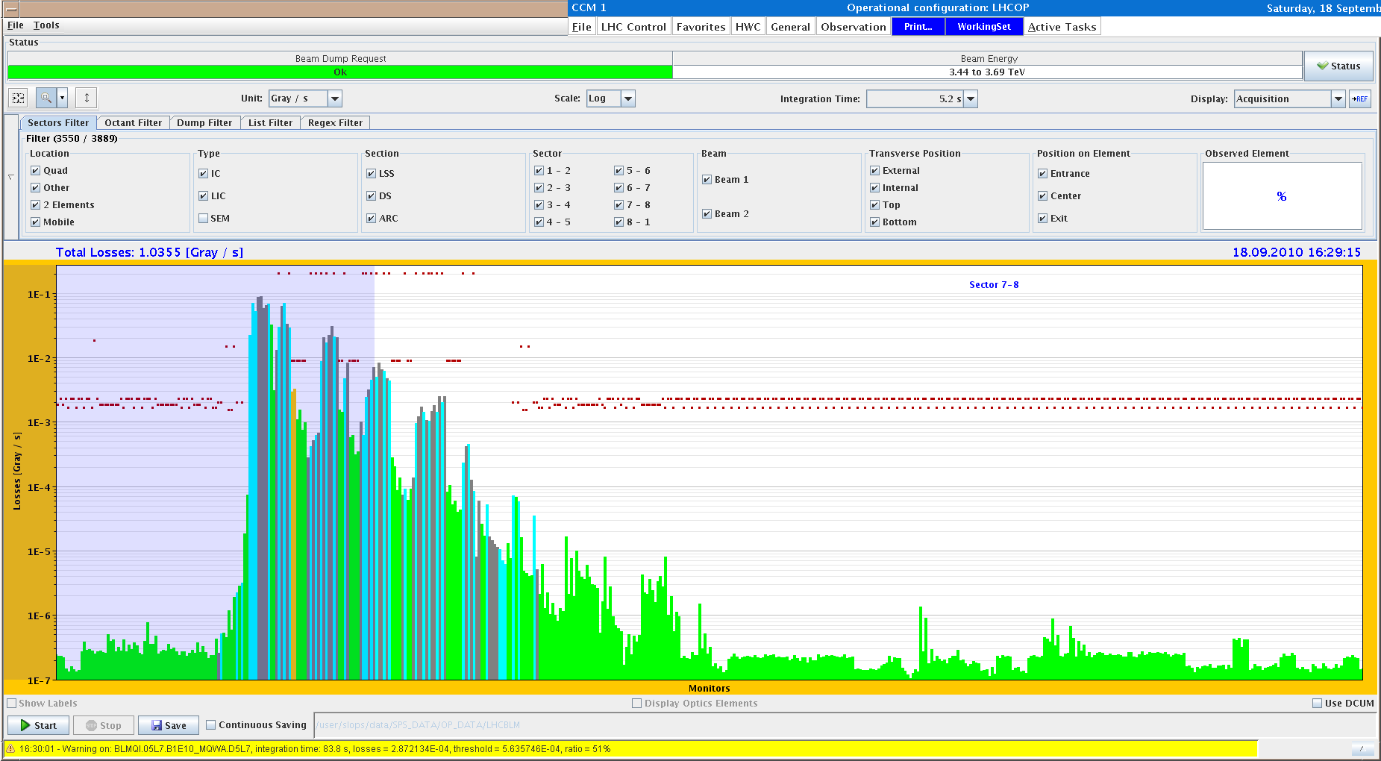
B1 V loss map – zoom into IR7

Slide 6
Saturday 18.9
17:00 Injection protection qualification
TCDI acceptance remeasured for TI 2 V - results look good, and the coverage for both lines is in tolerance. Problem in the week was a bad knob.
Scanned injected beam at TDI and TCLIs - some offset seen of the order of 1 sigma - maybe due to the differences in the LHCFAST1 and LHC3 trajectories in the lines - data to analyse in detail but no big surprises are apparent.
Tripped both ALICE and LHCb BCMs when beam hitting TDI - coincided in all cases with LHC BLMs above dump thresholds.

Slide 7
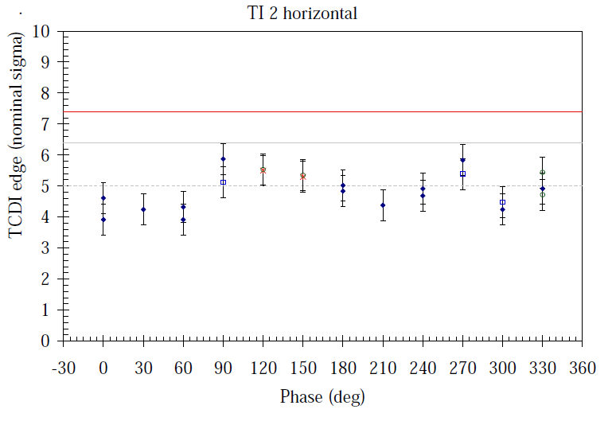
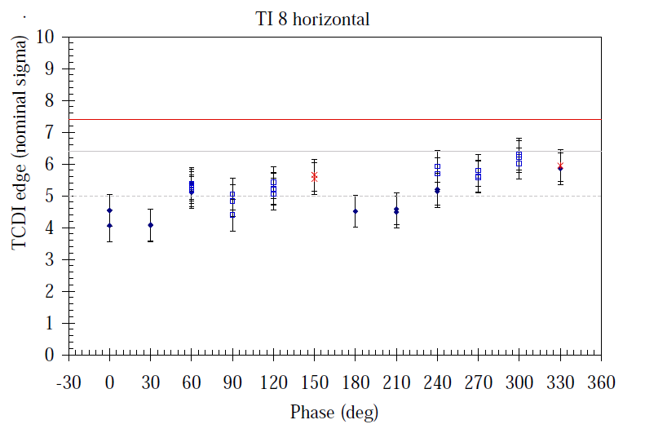
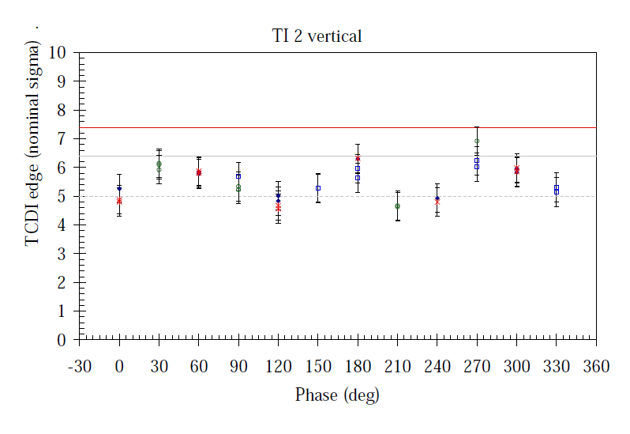
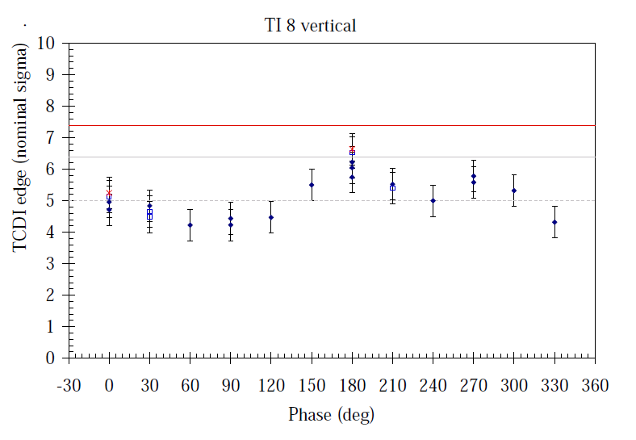
Injection protection

Slide 8
Saturday 18.9
21:00 Quench level measurement at injection
Bump (inwards as B1 on inside) at 14R2.B1.
Beam in inject and dump mode.
No quench was produced, even with ~8E9 p/bunch and bump amplitudes of around 24 mm, but QPS problem on old QPS !
Need access to reset controller. Probably controller reacted to the radiation.
02:00 Access to Pt2.
Lost communication between LASS and LACS.
Finally access at 03:00.
05:00 Injection
Asynch. dump test at injection.

Slide 9
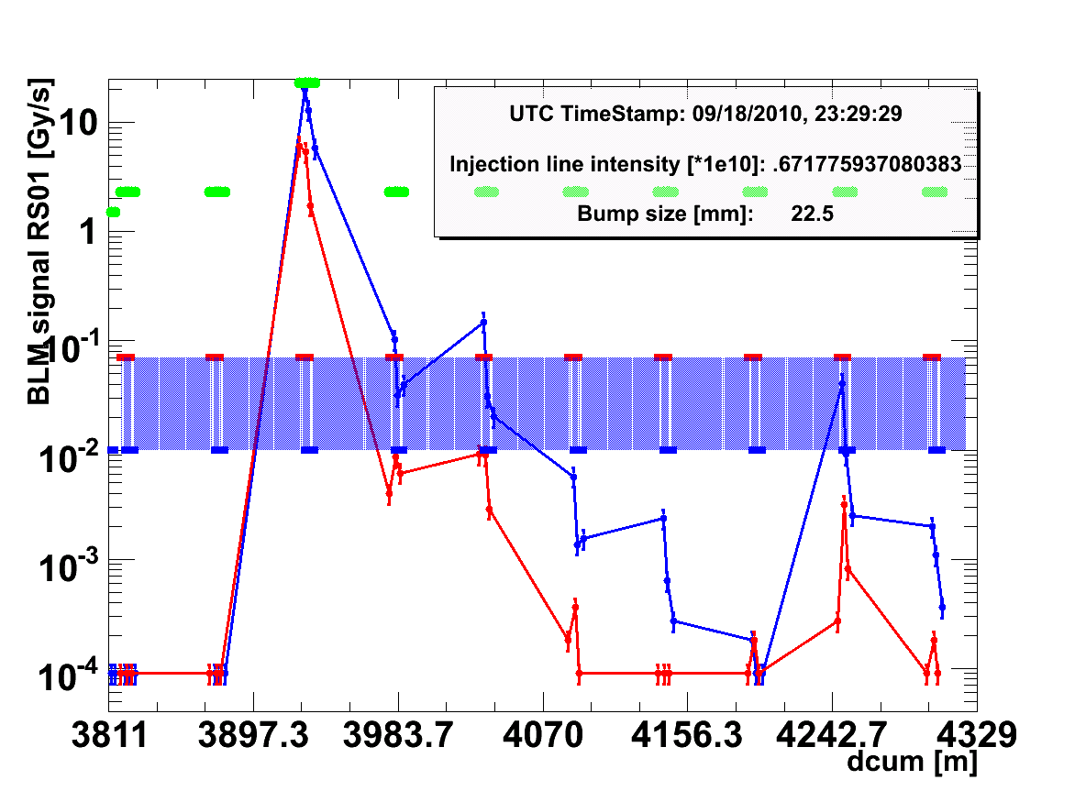
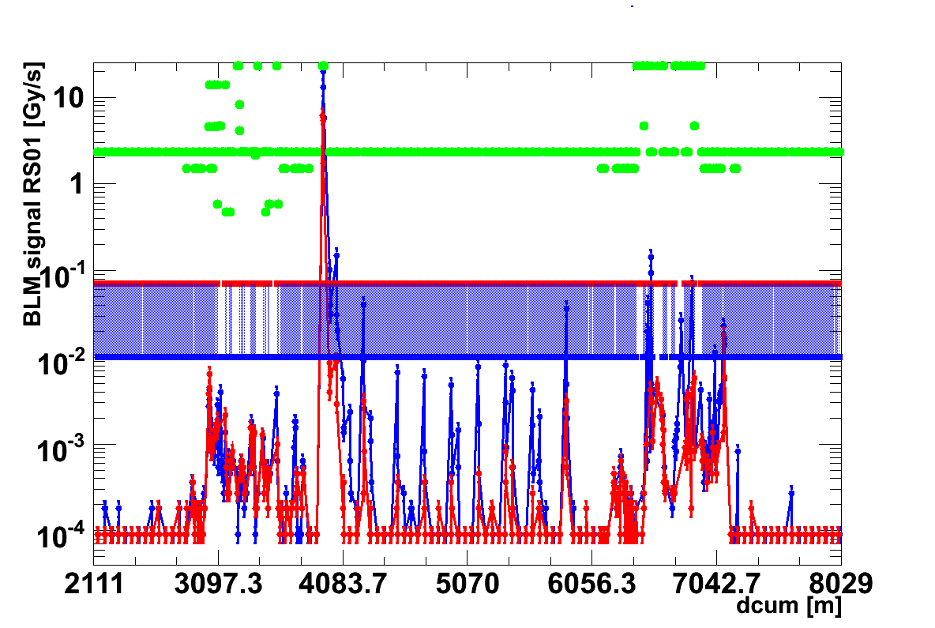
The plots show one of the highest registered losses (transient losses). The values on the first and the second monitor on MQ is up to factor 3 above calculated quench level. A global view shows structure of losses following the lattice in a particular way. No loss is registered after cleaning insertion in IR3 (plot starts left of IP2 and ends right of IP3).
20 uSv/h on contact at MB.C14.R2.

Slide 10
Loss maps and asynch dump tests
Missing loss maps:
Collision settings:
Positive off-momentum B1+B2
Negative off-momentum B1+B2
Further still to be qualified:
Re-check negative off-momentum for 100urad settings for B2 (hierarchy problem seen before) .
Full set of loss maps for end of squeeze, separated beams (B1v, B1h, B2v, B2h, positive off-momentum B1+B2, negative off-momentum B1+B2).
Plus the asynchronous dump tests…

Slide 11
Today
Ramp, squeeze, collide cycles
Loss maps, asynchronous dump tests.
Prepare and test all collimator functions
SPS scrapper to be fixed…

