Slide 1
Monday 6.9.
04h00: Ramp 10 A/s (chromaticity, crossing angle non-closure, beta-beating):
At 7m and 3.5m, put in one by one crossing angles, calculated corrections and removed it in order to prepare the knob correction. The one for IP8 is not good and needs to be redone.
Another iteration on beta beat measurement.
10h23: dump because of losses on un-maskable channel MBW.B6L7
11h47: Injection/Injection protection
19h52: Transverse damper
Gains were changed for beam 2 and beam 1 dampers and emittances recorded. Emittance increase again does not depend on damper gain. Could run at higher gain than our standard gains.
23h05: PLL commissioning
04h08: k-modulation
08h30: Collimation setup 450 GeV

Slide 2
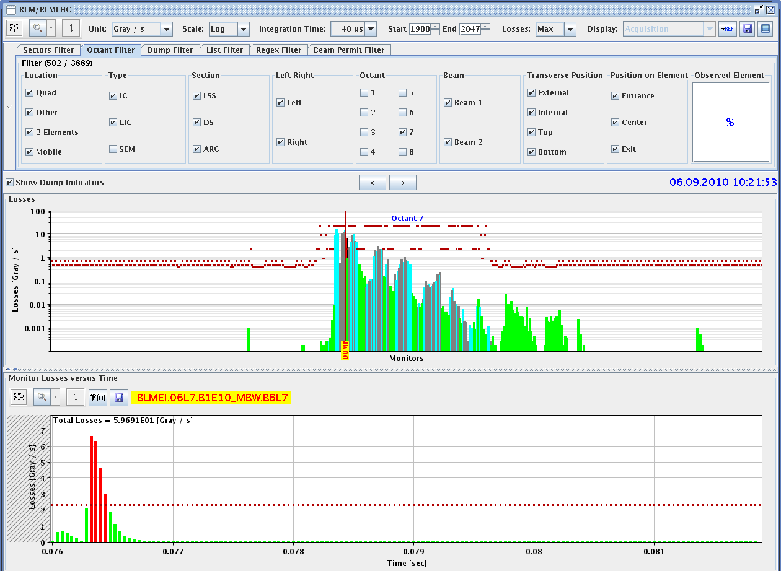
Dump Event 10h23

Slide 3
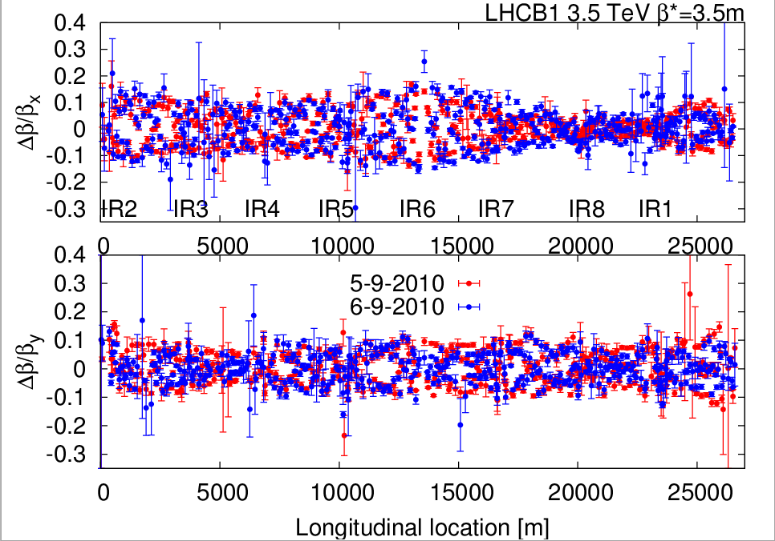
Beta Beat 3.5 TeV B1
R. Tomas et al

Slide 4
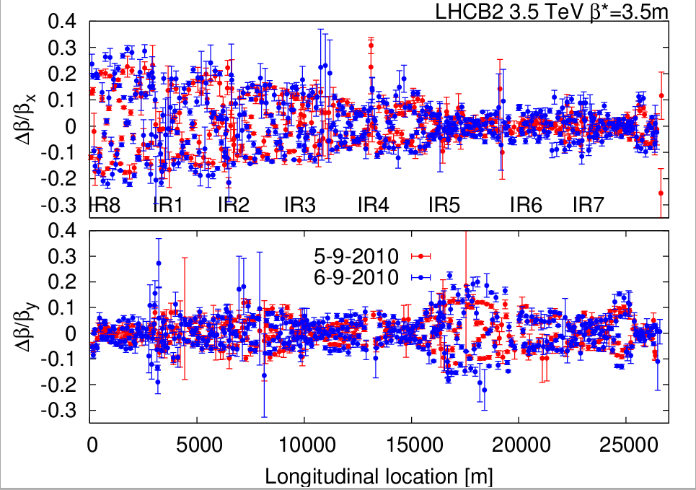
Beta Beat 3.5 TeV B2
R. Tomas et al

Slide 5
Summary of TL and Injection setup with trains I (B. Goddard et al)
TDI setup again checked for B1 with angle scan:
confirmed the 900 urad misalignment of the lower jaw
New TDI thresholds trimmed into the beam process
Single trains of 4 nominal bunches on LHC3 cycle extracted to TT40/60 and TI2/8 TEDs
TI2 and TI8 steered back to July 2010 references.
New working references taken (not yet defined as official references)
Settings copied LHC3 -> LHCFAST1- kicker synchronisation checked B1 with beam trajectories and B2 with just OASIS
keep present settings of 69 us for B1 and 54 us for B2

Slide 6
Summary of TL and Injection setup with trains II (B. Goddard et al)
Injection into LHC then looked good for both beams with single 4b train
Both beams injected cleanly
B1 & B2 losses only from over-injection above IQC thresholds
B1 2nd batch injected very cleanly with no loss warnings and IQC all green
B2 could not inject 2nd batch as BPF FALSE - BCT fix needed
Injection oscillations looked fine - injecton NOT steered
Transfer line losses OK - some TCDIs to re-center
Next steps to do detailed TCDI adjustments - need to be able to fill with 48 bunches for this.

Slide 7
Batch Injection
Long Injection Fill
Injection of 4b per batch
(0.9e11 per bunch)

Slide 8
Injection/Injection Protection Plan (preliminary)
Monday : 12-19, 7 h - finish off TDI setups, steering of TLs with 1 train of 4b [BG, WB, CB]
Tuesday: 12-20, 8 h - steering of TLs with 1 train of 4b, injection steering, setup of TCDIs in TLs, [BG, WB, CB]
Wednesday: 12-23, 11h - finish setup of TCDIs, start injection protection validation checks, [BG, WB, JU]
Thursday: 9-17, 8h - injection protection validation checks, [VK, WB, JU]
Friday: 8-16, 8h - injection of 2 and 3 trains of 4b, [BG, VK, WB]

Slide 9
Summary PLL (R. Steinhagen et al)
re-validated beam-transfer-functions (BTFs) with various damper settings - zero crossings at
BTF phase-responses were within 10deg the same as during last measurements (and initial setup done last December)
locked the PLL on tune and applied dp/p modulations to test the tracking bandwidth and tune measurement stability for various ADT gains and dQ'+-5 trims
initial observations (more details in log):
The PLL gave nice tune tracking signals, provided the excitation and set-bandwidth was large enough.
With the tested excitation amplitudes no obvious beam size growth has been seen in addition to the already constant increase which seem to occur regardless of whether the damper was on/off (observation of the previous ADT expert tests) or whether the PLL excited the beam or not (this test)

Slide 10
Summary k-modulation
Completed the intended measurement programme nearly as planned for the vertical plane in IR1 for crossing angles of -170, -100 and -50 urad
We lost half of B2 due to a beam instability (seen on the tune) while modulating Q2L1 with a crossing angle of +100 urad (Q1 scans were OK). We aborted the missing Q2 and Q3 modulations in favour for some scans in H since this would have been the fourth measurement point in the vertical plane.
For the horizontal plane only the modulation of Q1 at 2 and 1 mm separation has been performed. The feed-down effects were generally small (kicks much below 1urad) but the global r.m.s. generally at least four times larger than the residual BPM noise floor.

Slide 11
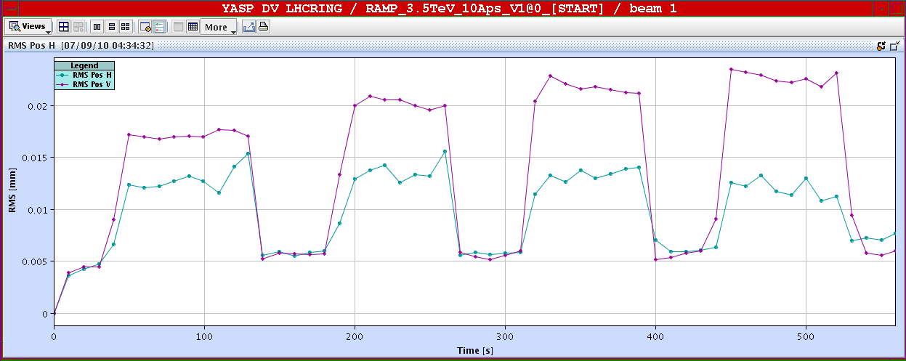
Example Result (more in logbook)
Q1.L1 changed: +k, -k
Q1.R1 changed: +k, -k
Delta k = 2e-5 Tm
Offset: BPMSW.1L1.B1 (V) wrt to quad center: ~ 0.8 mm

Slide 12
Ahead
Add to weekly plan: IR aperture measurements
Interlock tightening at 450 GeV
RF setup, once we have train commissioned
Access requests: QPS (3h), CMS, ALICE in shadow

