Slide 1
Technical Stop #6 30th – 31st August, 1st – 2nd September 2010 DAY2: TUESDAY 31st
Julie Coupard
Schedule and Coordination

Slide 2
Day 1
Stop the beam at 5:30 was too late
Access not before 6:30 instead of 6:00 in point 6
Start works on ion pumps not before 11:00 instead of 9:00
It would be better for the next technical stops to foresee to stop the beam at the latest 1 hour before the first access, 30mn is not enough (already remarked by LHC-EIC)
RP survey
All areas are classified as Supervised Radiation Area for the Technical Stop, except:
- TI2: no survey performed in most part, except specific work sites
- TI8: no survey performed
- LSS3: Simple Controlled Radiation Area, no RP Veto but local posting on
most radioactive elements
- LSS7: Simple Controlled Radiation Area, access remains closed by RP Veto
in UJ76, please contact RP if access is needed
- UD62, UD82 and access galleries: Simple Controlled Radiation Area

Slide 3
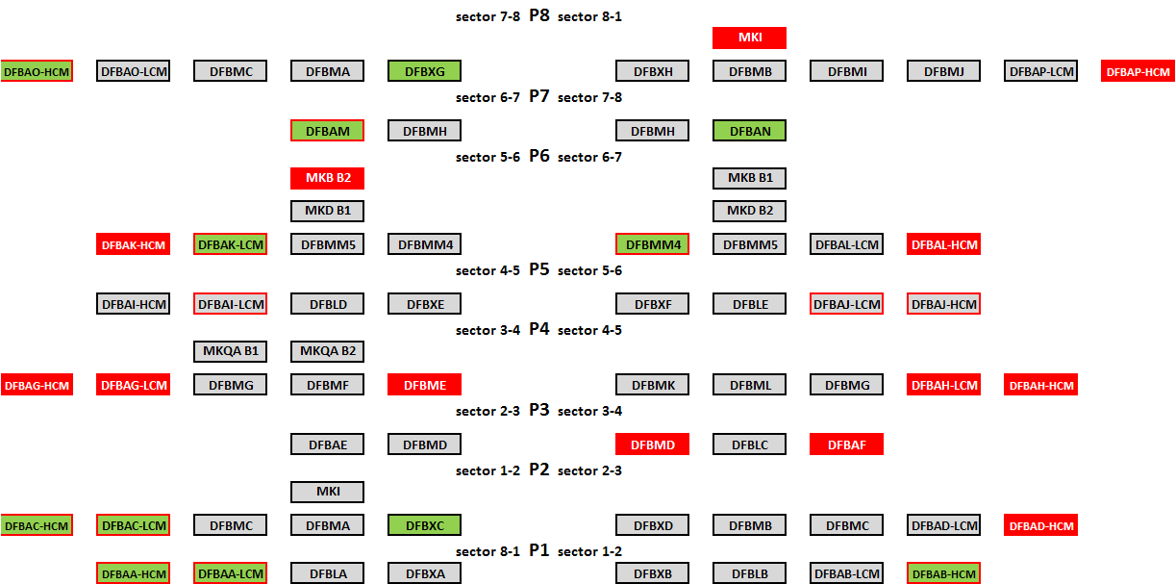
Day 1
Electrical locking-out/Unlocking

Slide 4
Day 1
Change of the ion pumps in Point 6
TE-VSC forecast: change 4 ion pumps day1
Follow-up: they have changed the 4 ion pumps and made a first leak detection
Day2:
Pumping
Final leak detection
Other intervention
Good advancement…
No critical activities

Slide 5
Day 2
Access constraint
Lift maintenance
PM56, PM65 6:00-8:00
PZ45, PZ65 8:00-10:00
PAD maintenance
UX451: access in RF zone can be done through UJ43 and UJ47
Patrols
Point 4, Point 5 17:00 (or earlier if possible)
Thanks to volunteers (~21; TE/VSC, BE/BI, TE/MSC, EN/MEF)

