Slide 1
03/09/2010
06:30 - 09:00 Access required for interlock problem on TI2 collimators and pre-cycle
09:00-10:30 No beam from SPS
10:30 Injection: important corrections required because of the ALICE solenoid/spectrometer polarity change (non-closure of the compensator bump)
11:30 Lost cryo conditions in Sector 67 during orbit investigations ➔ Bad manipulation on temperature sensor
11:30 – 13:00 Pre-cycle

Slide 2
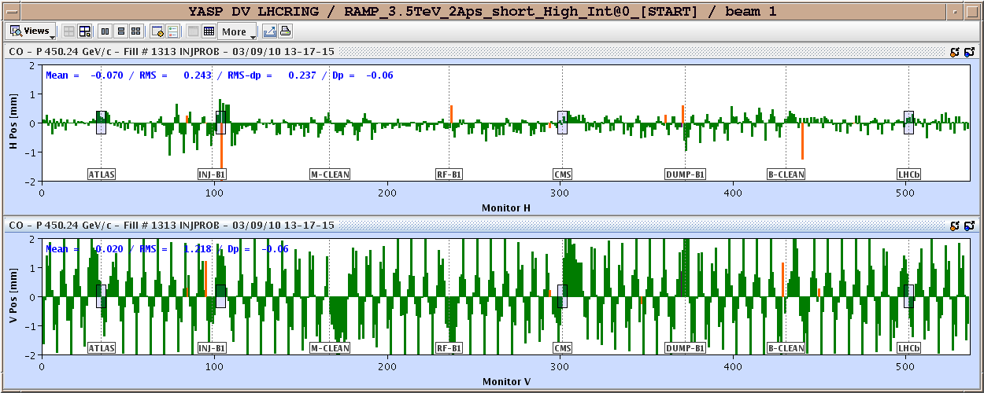
03/09/2010
Can be corrected using compensator magnets and MCBX ➔ need time to verify corrections to be implemented for each polarity.

Slide 3
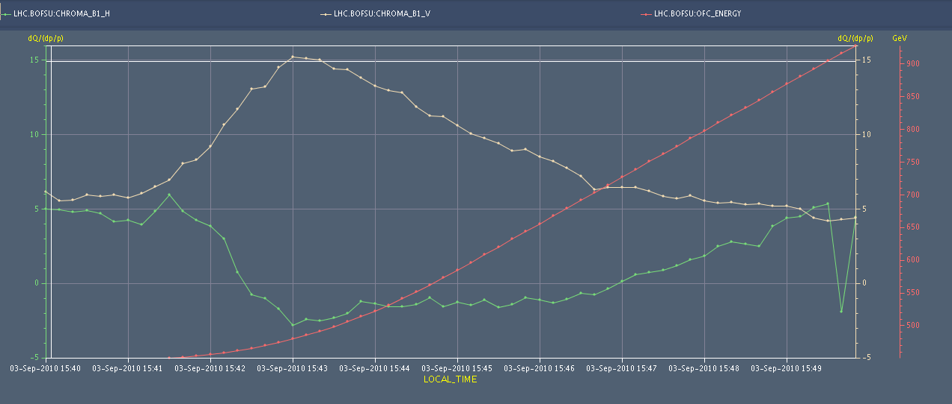
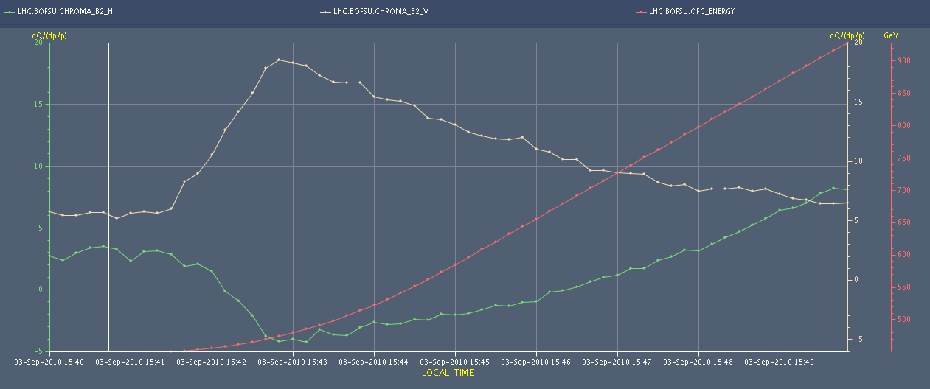
03/09/2010
15:30 Ready to ramp after first iteration orbit clean-up at injection. ATLAS Toroid trip.
Chromaticity measurement at the beginning of the ramp (logged). Negative H-chromaticity particularly for beam 2

Slide 4
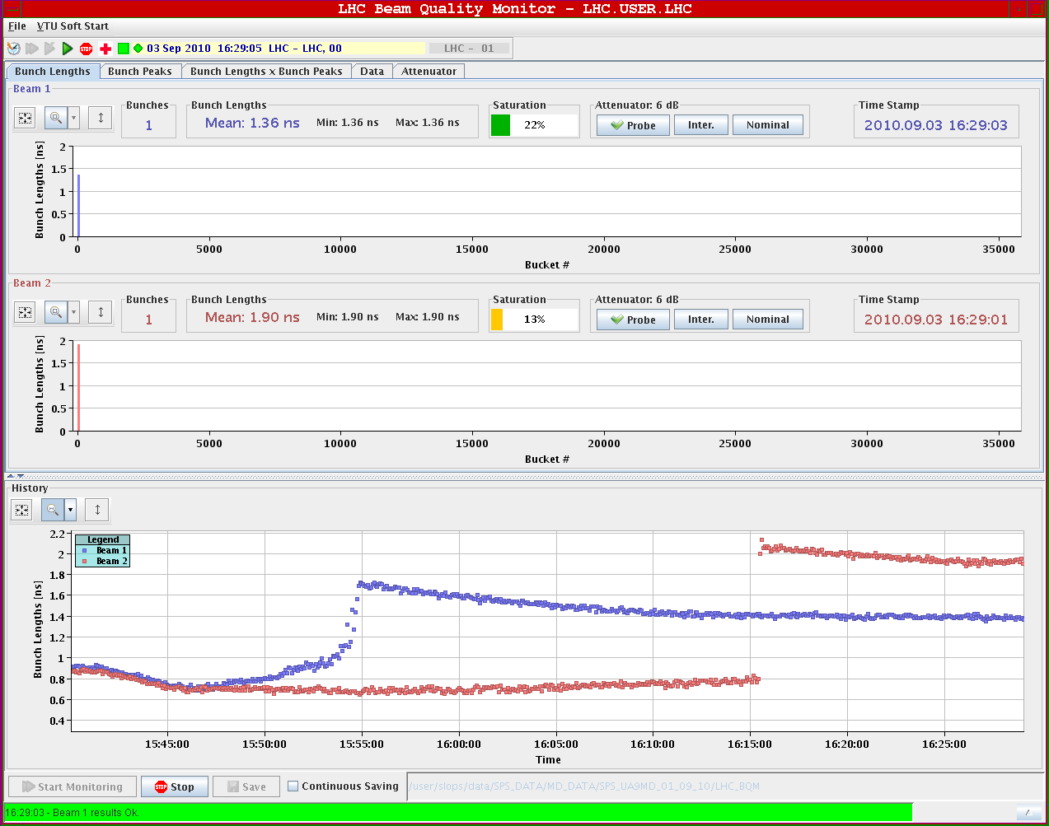
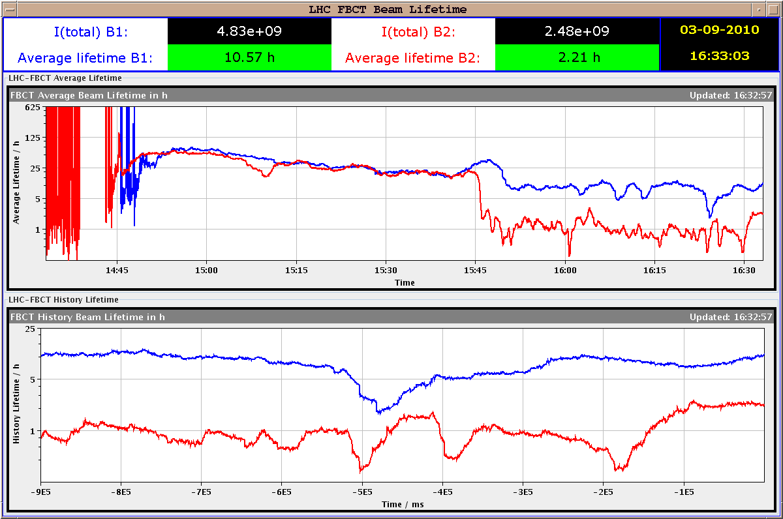
03/09/2010
Low lifetime for beam 2: low chromaticity. Likely phase loop not locking correctly due to low intensity
Finally beams dumped at the end of the squeeze for validation of the dump after technical stop

Slide 5
03/09/2010
17:30 Dump validation at 3.5 TeV squeezed: OK
Move to 10 A/s hypercycle
Setting-up of capture with all RF cavities ON
21:40 Transverse damper team swing into action
22:23 BLM with fast losses on RS #5 ... looks like a UFO candidate

Slide 6
Summary damper
re-adjustments for beam 1 done to improve signal/noise. rms noise varies now between 1.4 um and 1.95 um depending on pick-up; before improvement it varied between 1.8 um and 2.8 um. For three of the pick-ups there is a factor ~2 improvement, for one there is no improvement (it was relatively good already and will be looked at again). One feature with Q9H must be looked at: close to zero there is a small glitch observed; for the time being one should run with a small negative offset on Q9H. See RF logbook for details. The same adjustment should now be carried out for beam 2. The saturation level should then be +/- 2mm @ 1 ns bunch length and 1.3x10**11. Damper gain did not change a lot by the modifications; the calibration factors for the fixed display will be updated after completion of the campaign.

Slide 7
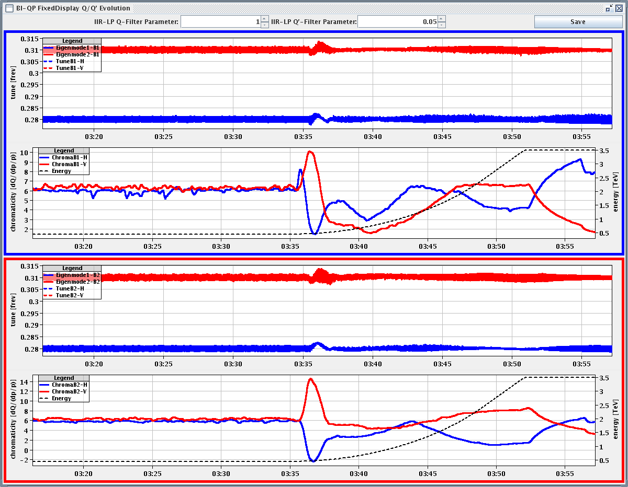
10A/s ramp & squeeze
03:35 ramp started
Tune & chromaticity in ramp

Slide 8
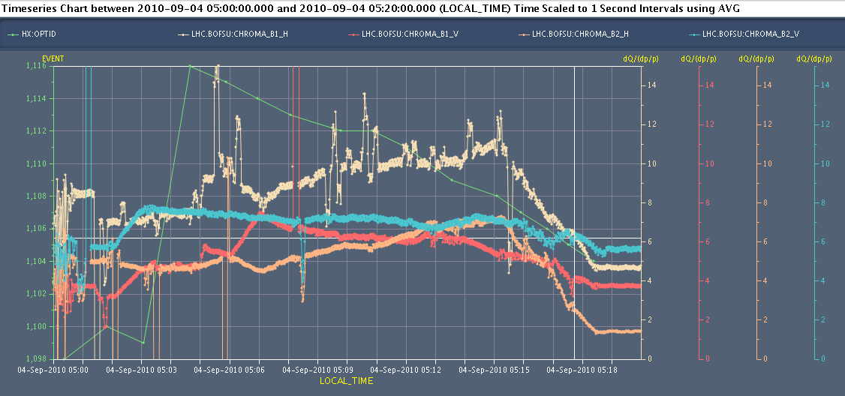
10 A/s ramp & squeeze
flat-top: Q' arrives at about 4/7 (B1) and 2/8 (B2), 4-5 units of Q'-decay visible
Chromaticity in squeeze

Slide 9
05:36 Cryo just came over. Cold compressor 34 just tripped. We were asked to dump the beams. Arghhhh!!!
05:52 S34 tripped due to loss of cryo maintain.

Slide 10
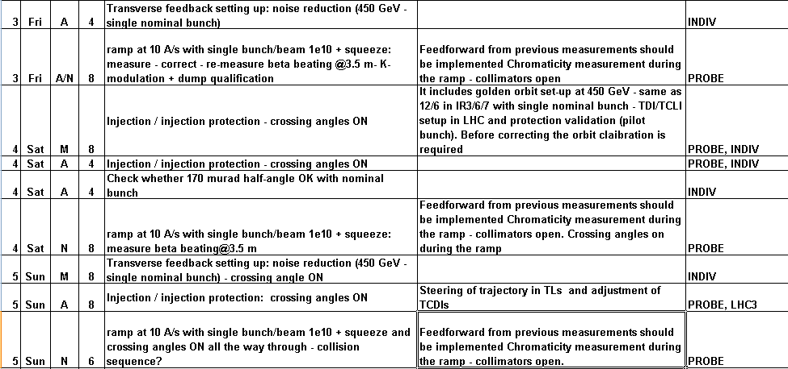
Plan that was…

Slide 11
Plan that is
~18:00 recovery, pre-cycle
Evening: 450 GeV crossing angle set-up
Overnight: ramp, squeeze, beating measurement and correction, K-modulation

Slide 12
Crossing angles
Polarities for ALICE solenoid/spectrometer: + +
Polarity for LHCb spectrometer: -
External crossing angles:
IR1: -170 μrad at inj./ramp and -100 μrad in squeeze/collision
IR2: ±170 μrad at inj./ramp and ±110 μrad squeeze+collision
IR5: +170 μrad at inj./ramp and +100 μrad in squeeze/collision
IR8: -170 μrad at inj./ramp and -100 μrad in squeeze/collision
IP2 with parallel separation (3 to 4 sigmas).

Slide 13
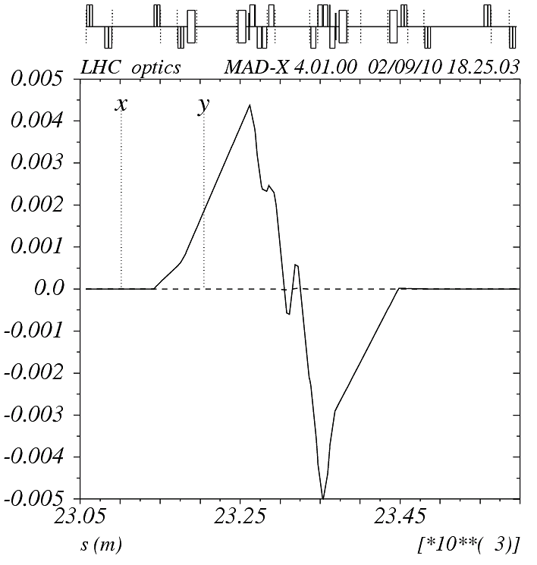
Positive internal angle
Negative external angle
Positive net
on_sep8 := 0;
on_x8 := 100/170;
on_lhcb := 2;
px = 0.0001699757

