Slide 1
Summary Thursday 26.8.
04h21: Stable beams fill #1303.
Lumi > 1e31 in ATLAS and CMS.
Only 47 bunches instead of 50. Last injection per beam not executed due to OP error. Missing buckets: 25081, 26081, 27081 (B1), 22281, 23281, 24281 (B2)
1 RF trip
17h35: Beams dumped with fast beam loss event.
Delivered ~380 nb-1 per experiment.
17h40: Ramp down and precycle. Access in Pt 4 ( for QPS problem on worldFIP problem).

Slide 2
New Record Lumi

Slide 3
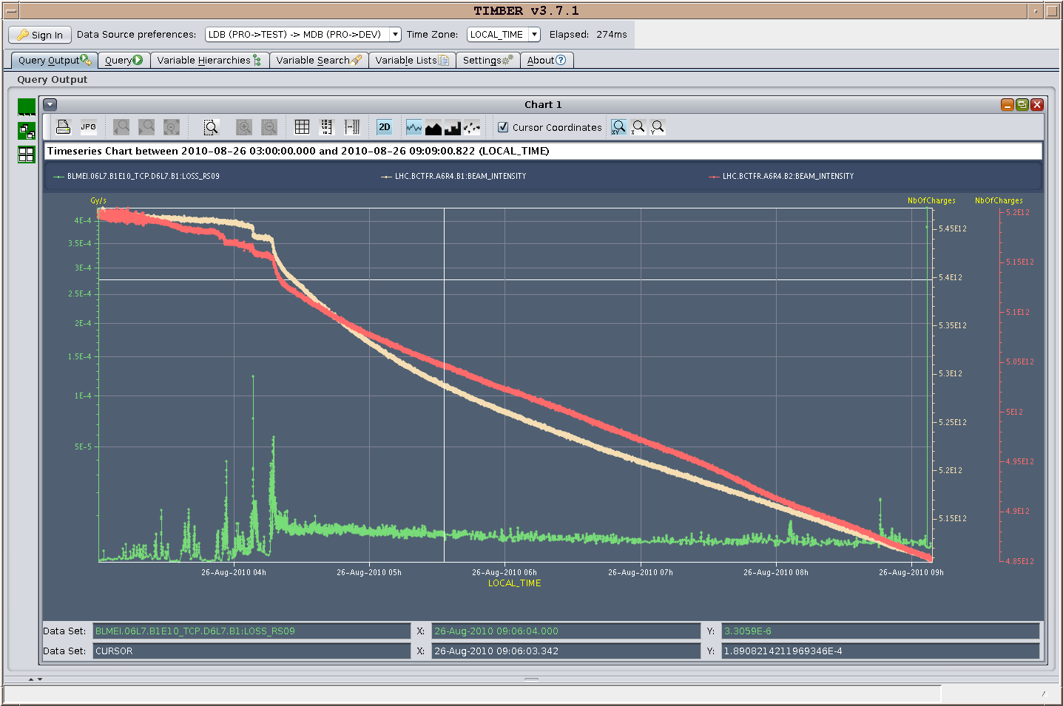
Loss Spikes in Stable Beams
Intensities
Loss at primary collimators B1

Slide 4
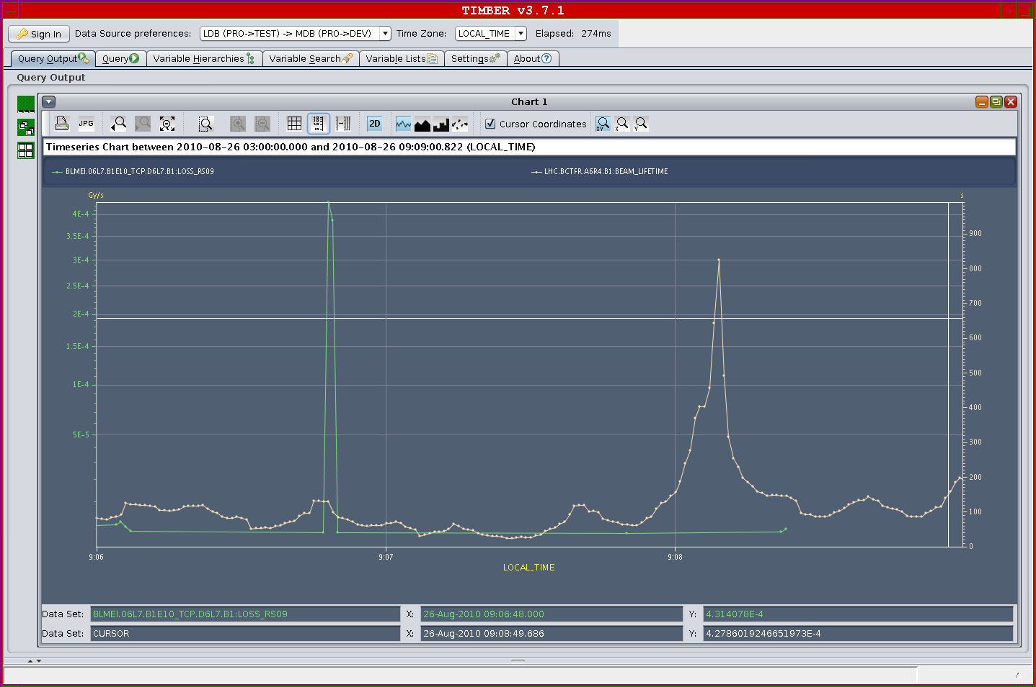
Loss Spikes in Stable Beams
factor ~30 in BLM at TCP
not visible in lifetime
~50 h

Slide 5
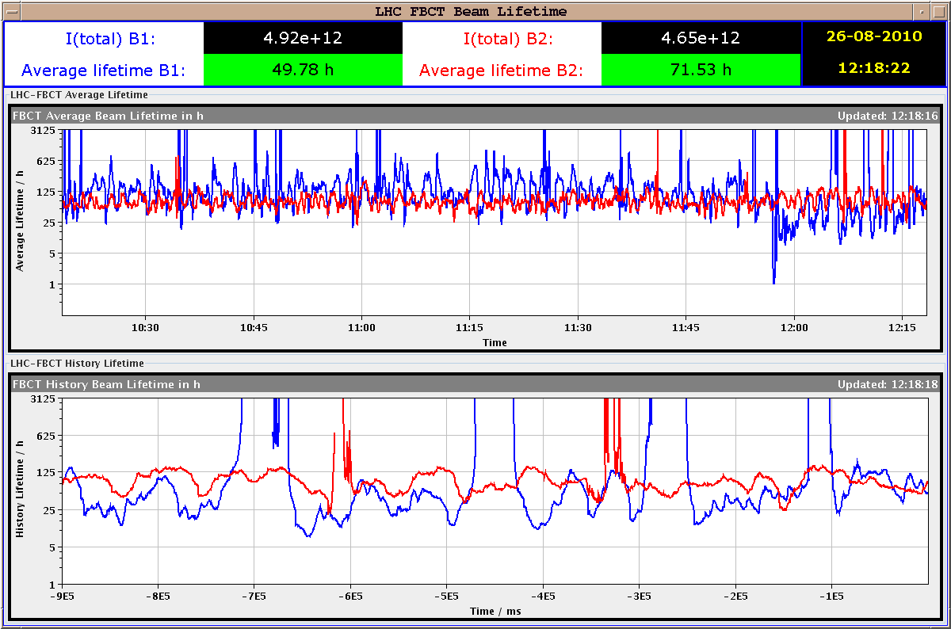
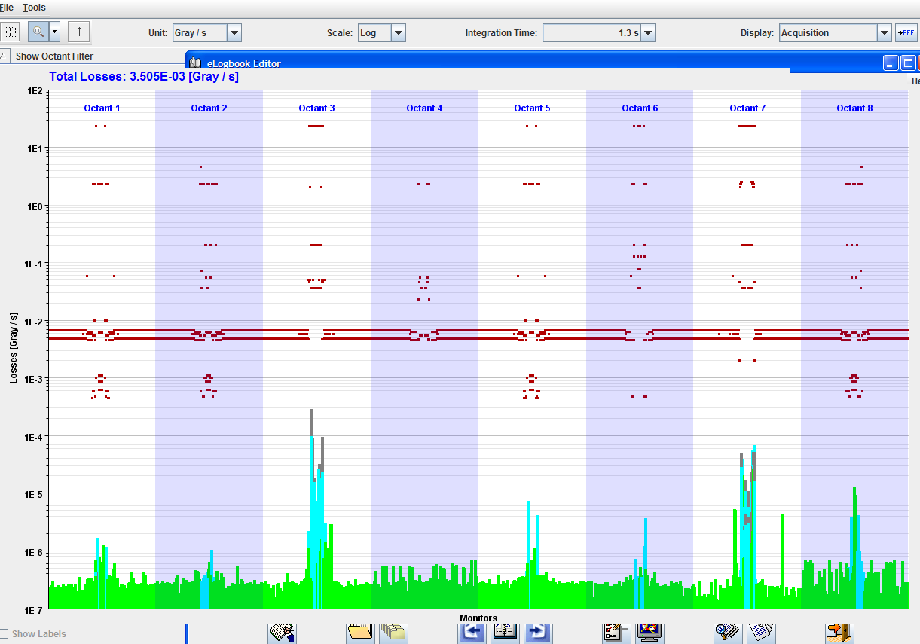
RF Trip: cavity 2B1

Slide 6
Instantaneous Luminosity

Slide 7
Integrated Luminosity
370 nb-1 over 13 hours.

Slide 8
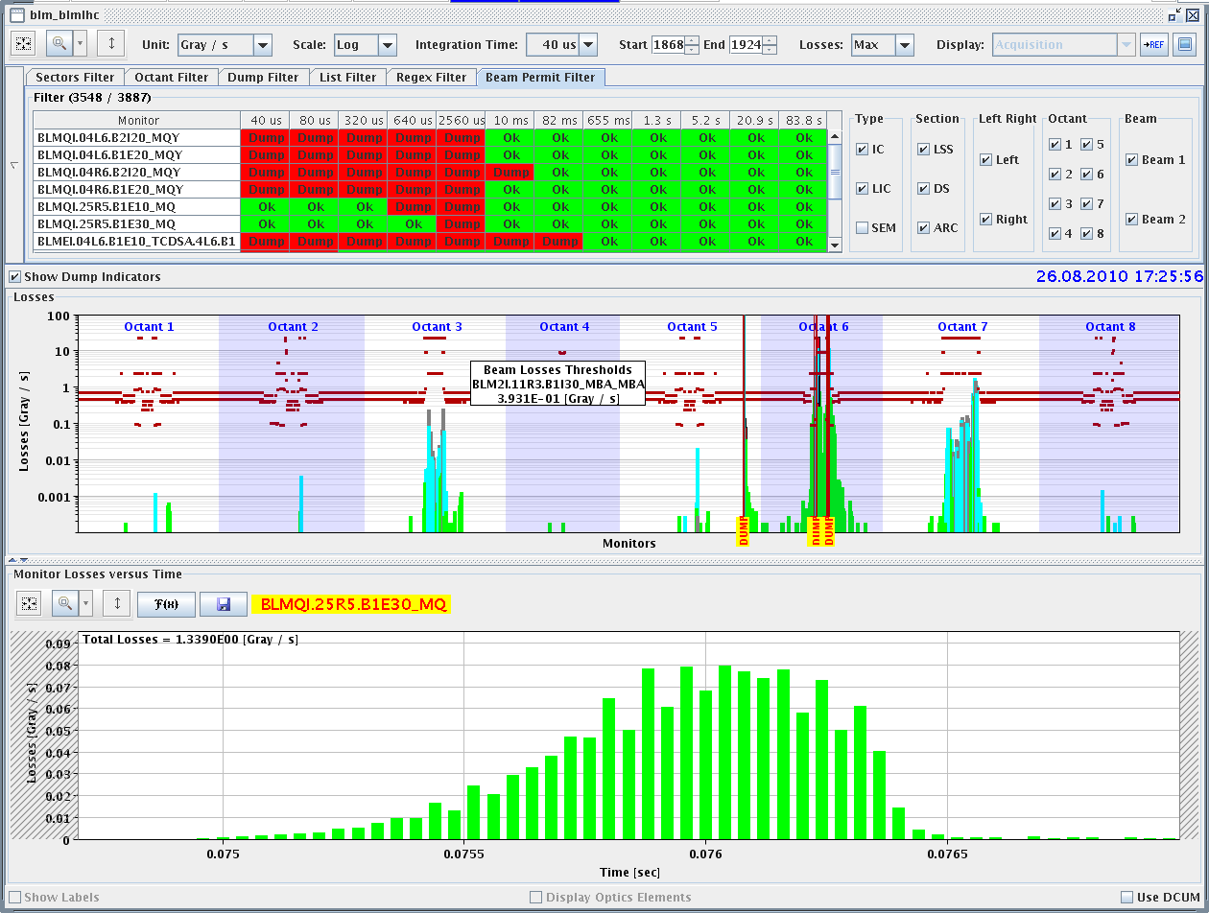
Cause of Beam Dump: Fast Loss in Arc
Q25.R5

Slide 9
Summary Thursday 26.8. to Friday
21h42: Injection of 1 nominal bunch per beam.
23h08: Ramp, squeeze, collide. Loss maps for collimation monitoring.
01h38: Rampdown and precycle.
03h04: Injection for physics.
04h14: Start ramp.
06h11: Stable beams fill #1305.
Initial lumi again above 1e31. What about CMS: 0?
DIP still not working for transmitting collimator info!?

Slide 10
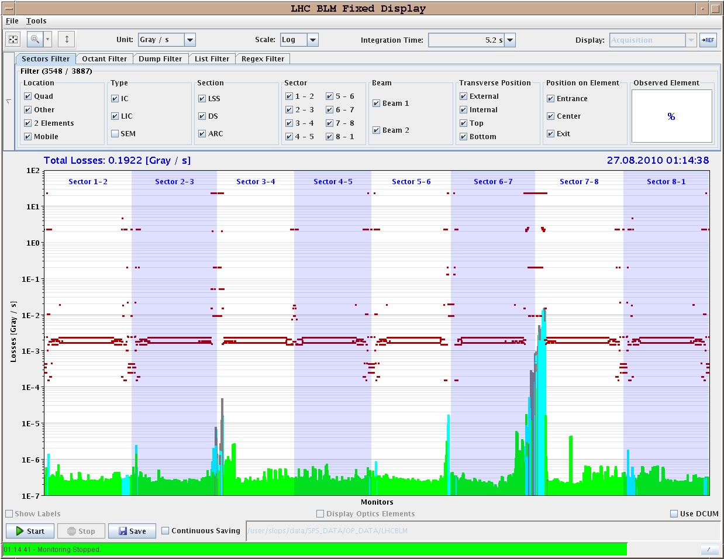
Loss Map: Example B2 V

Slide 11
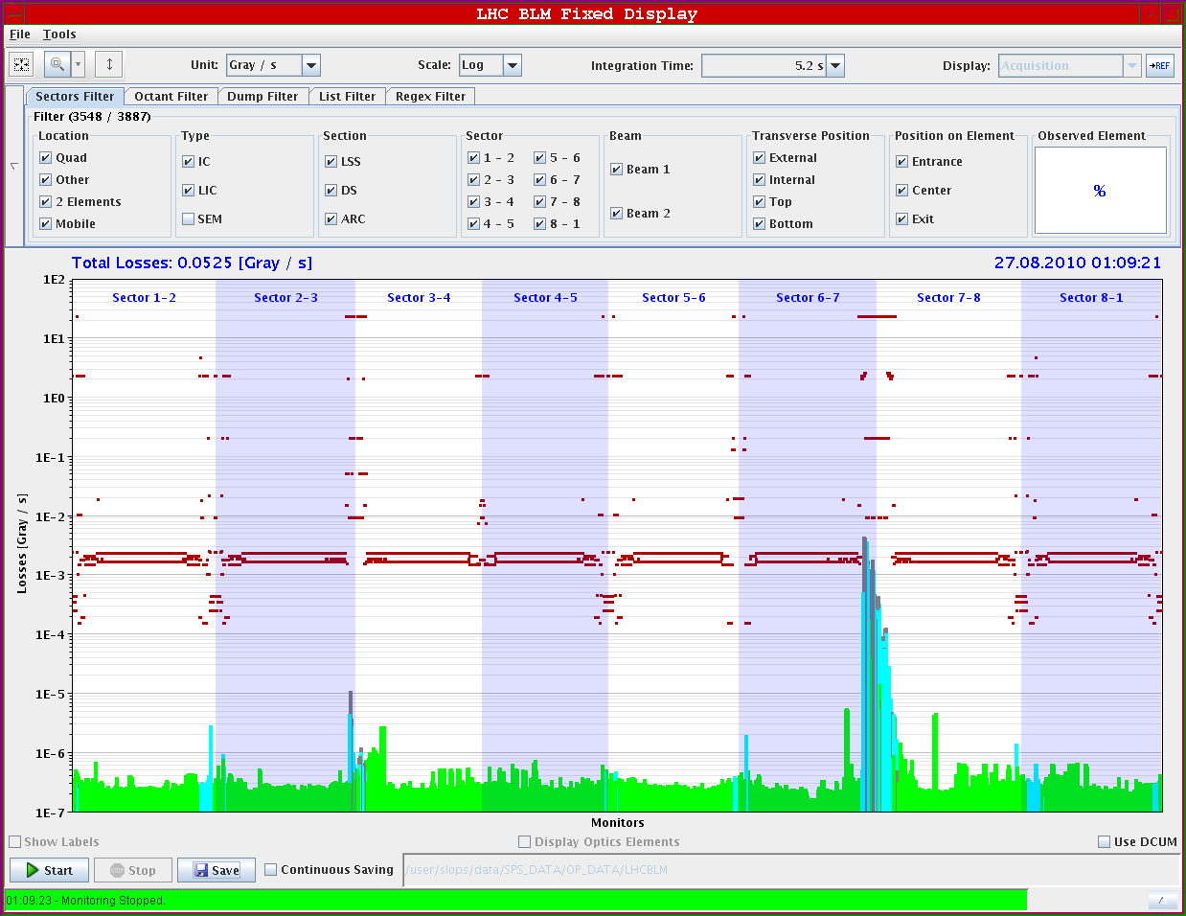
Loss Map: Example B1 V

Slide 12
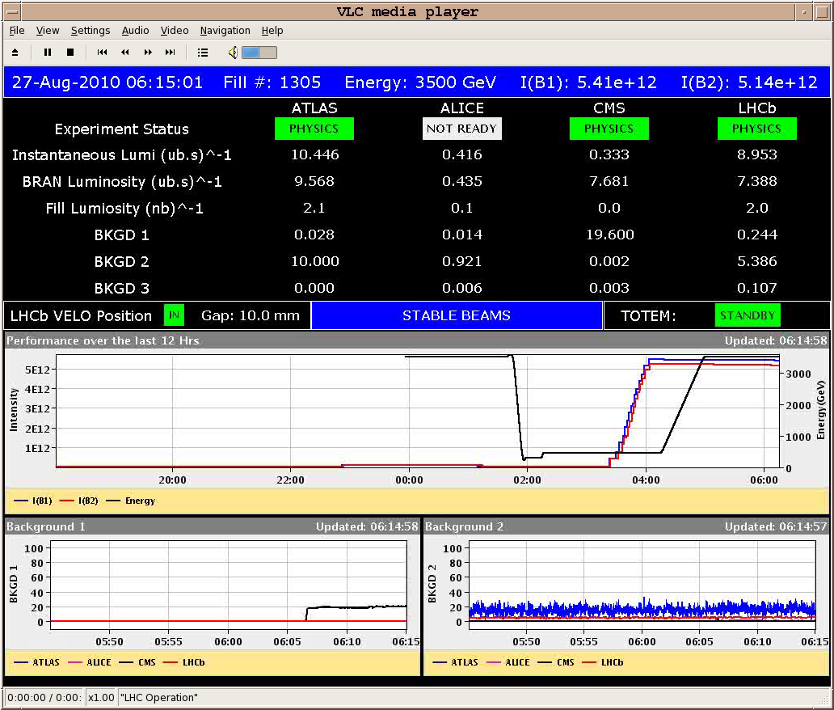
Stable Beams Fill #1305

Slide 13
Program ahead
Cannot update coordination vistar → connection problem?
Fri 09h30: Adjust mode. End-of-fill study.
Fri 11h00: Bunch train: Injection, ADT, PLL (450 GeV, 4x1e11)
Fri 19h00: Physics 50b x 50b
Sat 09h00: Physics continued or bunch train commissioning.
Sat 20h00: k-modulation measurement for triplets
Sun 04h00: recover for physics. Change LHC-b polarity
Mon 06h00: end of beam before technical stop

Slide 14
Backup

Slide 15
List of Ongoing/Pending Work I
Commissioning work for higher intensities:
Multi-bunch injection: N bunches per injection, completed for beam1, to be completed for beam2.
Transverse damper: Train test with 4 bunches at 150 ns. 1 shift. Adjustments for train. 1 shift. Total: 2 shifts.
Multi-bunch studies for RF and BPM's, instrumentation, dump, ...
Crossing-angle setup at 450 GeV. Address losses with 100 micro-rad in IP2, goal is 150 micro-rad (full, see w33 Tuesday summary).
Check of orbit feedback improvement (minimize energy changing COD trims). Can be parastitic. 2 ramps.
PLL commissioning work (better tune feedback with high intensities and damper on): at 450 GeV and later during ramp. 6 times 0.5 shifts.
Injection preparation for 12b bunch train injection (injection protection setup). 2 shifts.
Injection test for 12b bunch train. 0.5 shifts.
Increase of intensity:
Increase bunch intensity to 1.1e11.
More bunches after 1 week with 48b? → NO.
Define plan
Agree target crossing angles

Slide 16
List of Ongoing/Pending Work II
Maintenance of LHC performance & protection:
Monitor collimation validity and efficiency (loss maps). 1b of 1e11 per beam. 1.5 shifts.
Correct the momentum cleaning for beam 2 (collimator setup IR3). 1b of 1e11 per beam. 1 shift.
Test less heavy method for loss maps (blow up selected bunches with transverse damper at end of shift). 1b of 1e11p. 1 hour.
BCT response check for different bunch intensities. Parasitic to collimation loss maps.
BCT response check for different bunch lengths. 450 GeV. 2 hours.
Study and measurements of important LHC parameters:
Independent measurement of beta* and beam offsets in triplets: k-modulation. 1b of 1e11 per beam. Not colliding. Change RQTX1/2/3 by +- 0.5 A. Measure after squeeze to 3.5m. 1 shift.
Measurement of transverse beam distribution at 3.5 TeV.

