Slide 1
Summary Wednesday 25.8.
08h00: Adjust mode for end-of-fill study. Scraping test for determining transverse beam profile (beam 2, vertical). As expected, beam dumped with BLM trigger when approaching beam core.
08h10: Ramp-down and pre-cycle.
09h02: Water leak error on cavity 7B1. Access. No real water leak, instrumentation problem.
09h51: Recovery. Cycle.
10h29: Lost QPS-OK on RB.A45: heater discharging. Access.
12h37: Recovery. Cycle.

Slide 2
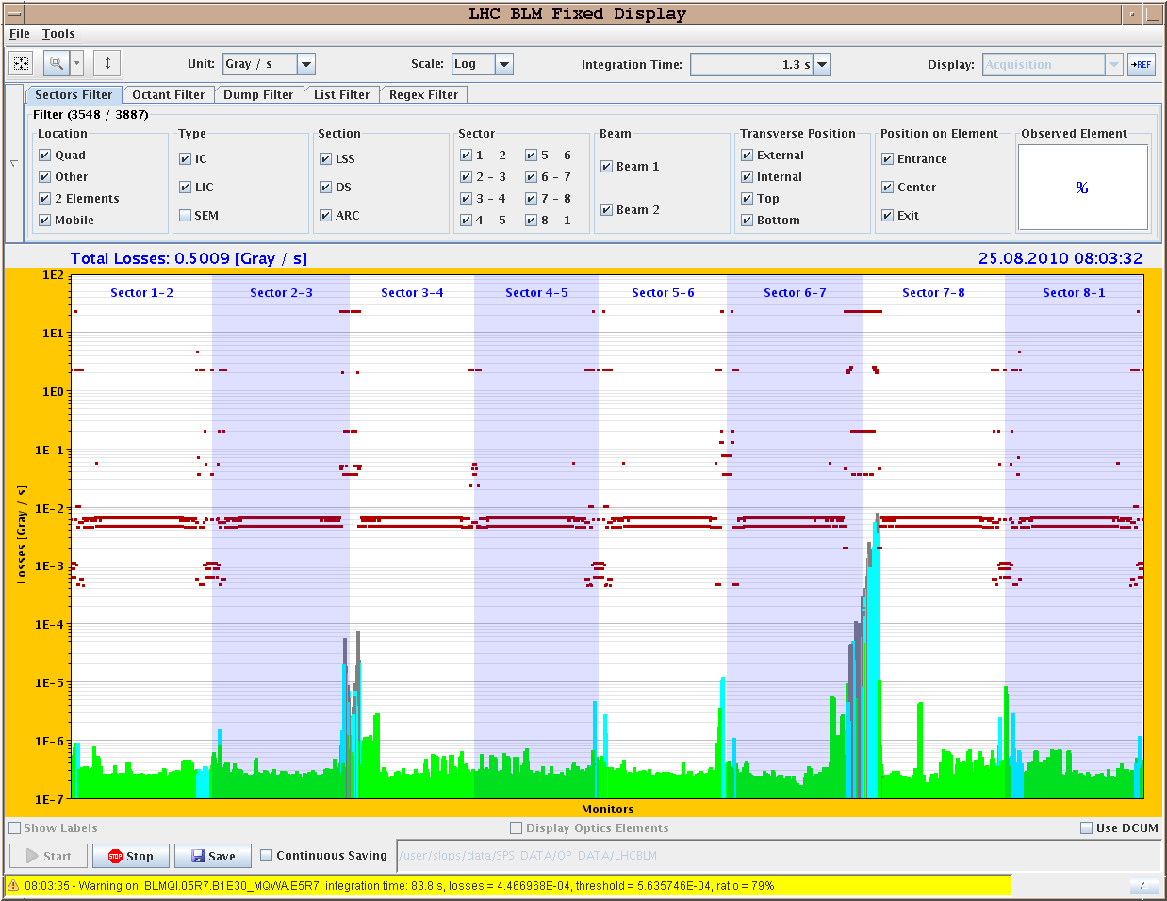
End-of-Fill Scraping Beam2, Vertical

Slide 3
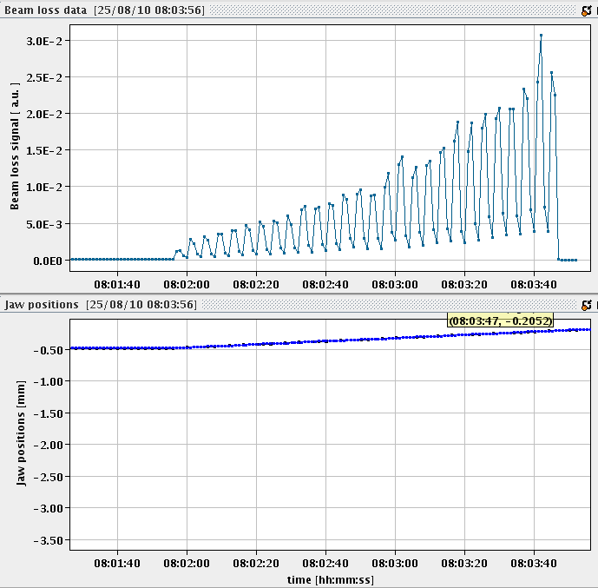
Losses when moving the jaw in
Beam Loss
Jaw towards beam
Jaw position
TCP.D6R7.B2

Slide 4
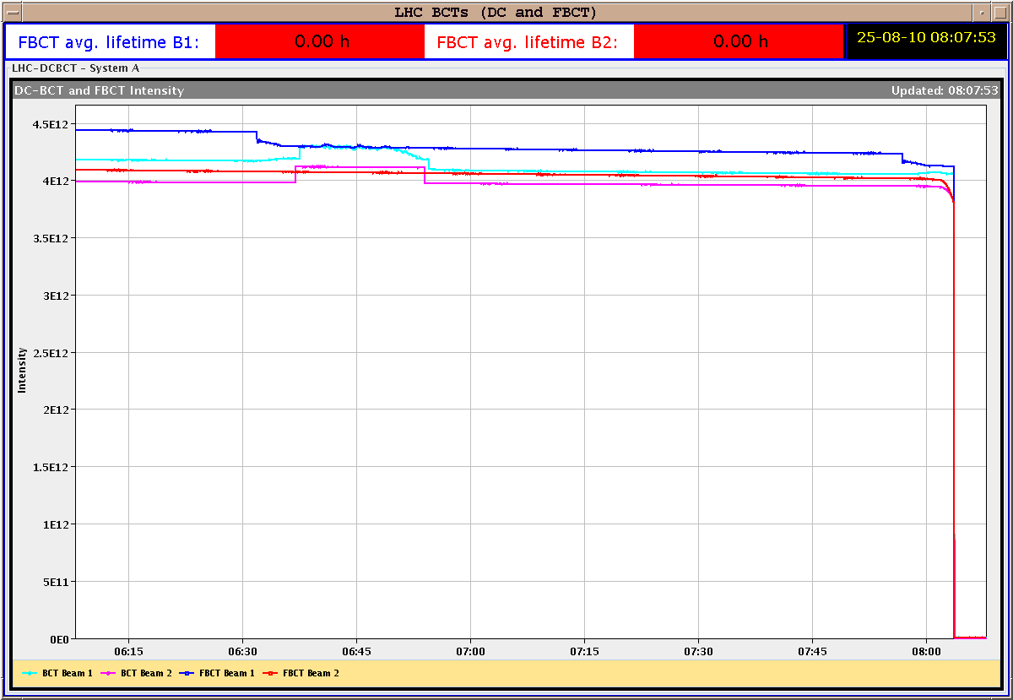
Beam Intensity
- 1.5e11 p
- 3.5 %
Beam dumped from beam loss on Q5 in IR7 (warm) with 84 s integration time!

Slide 5
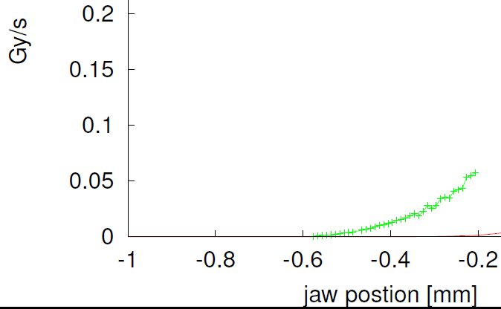
Beam Distribution: Beam 2 Tail
~ 5.7 σ
~ 4.7 σ
~ 3.7 σ
3.5%
of beam within 1.5 σ
σy = 0.27 mm

Slide 6
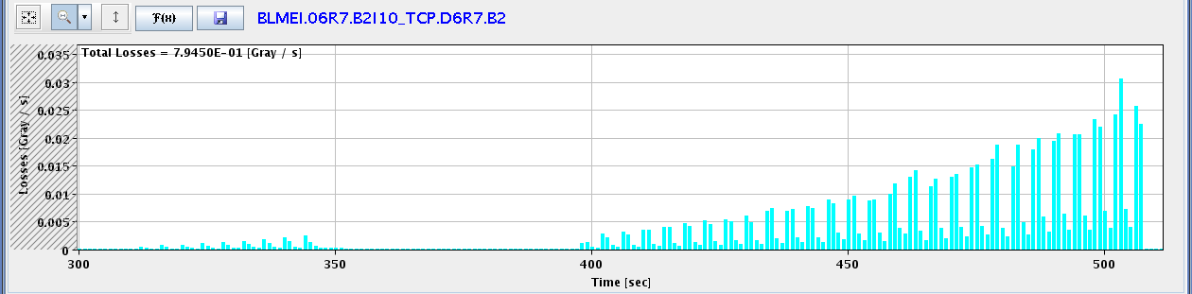
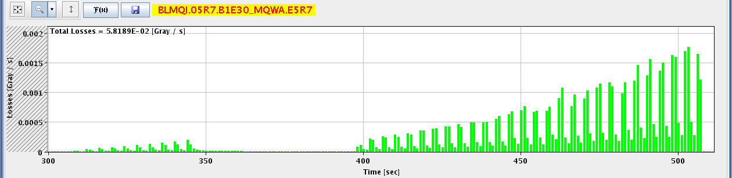
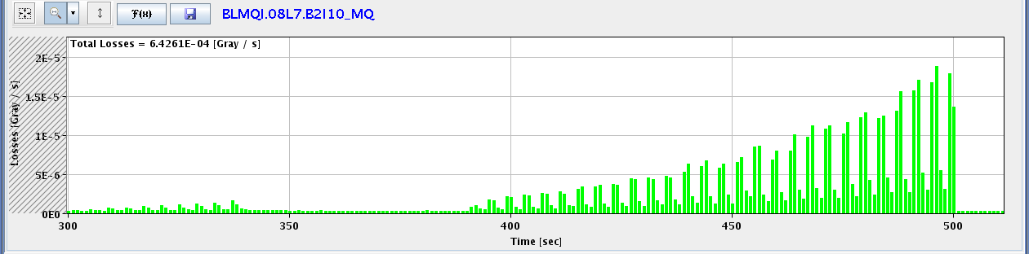
Loss Locations Around Ring
IR7 TCP: 30,000 μG/s
IR7 Q5 (warm): 1,700 μG/s
8 s
IR7 Q8 (SC): 18 μG/s

Slide 7
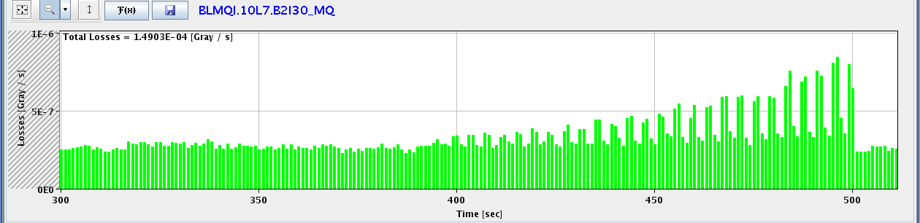
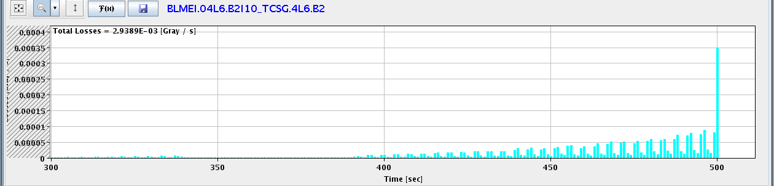
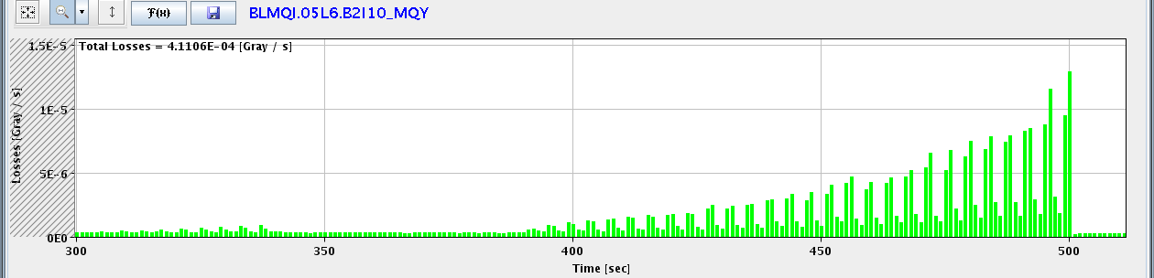
IR7 Q10 (SC): 0.8 μG/s
IR6 TCSG: 900 μG/s
IR6 Q5 (SC): 12 μG/s

Slide 8
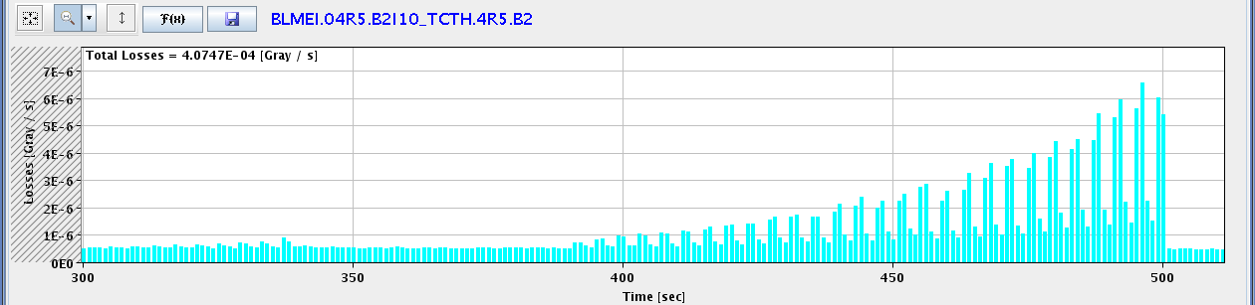
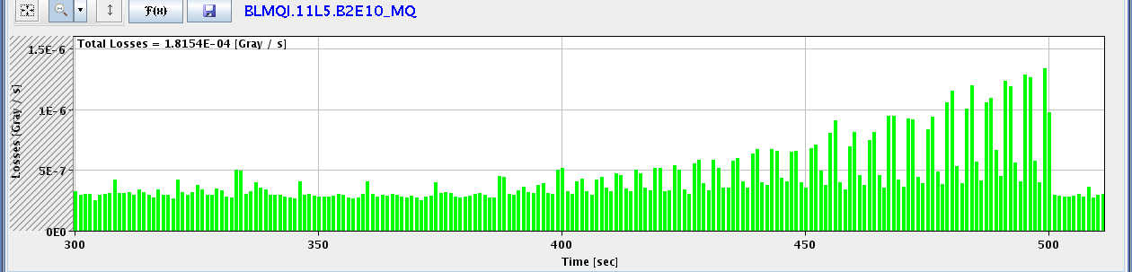
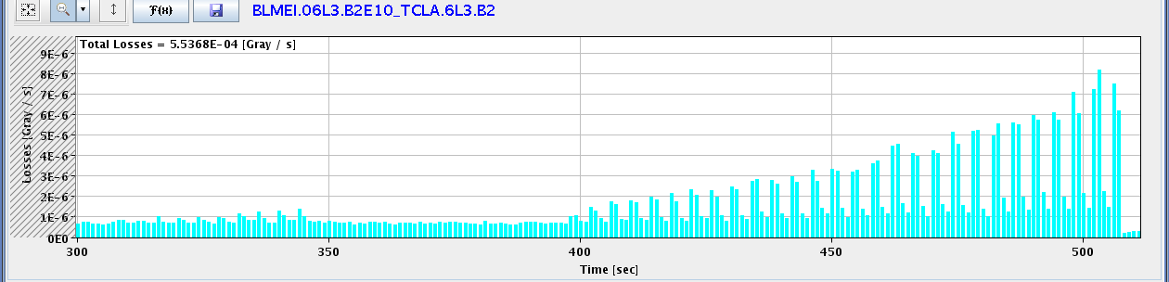
IR5 TCTH: 6.5 μG/s
IR5 Q11 (SC): 1.3 μG/s
IR3 TCLA: 8 μG/s

Slide 9
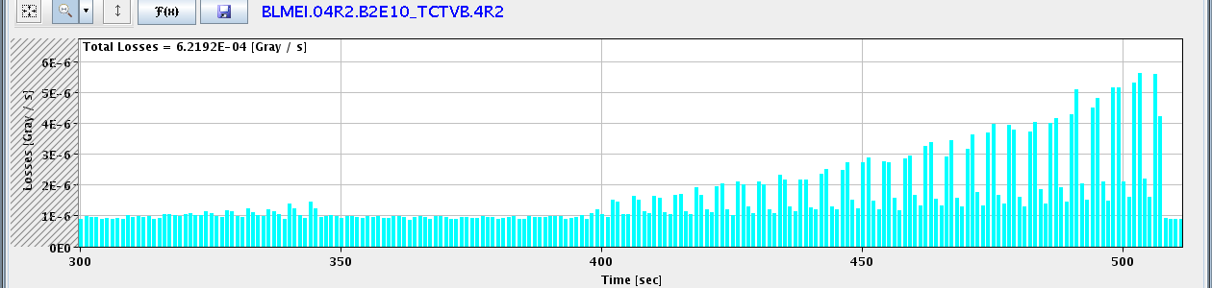
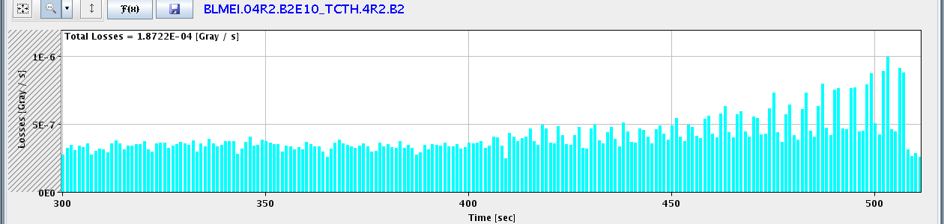
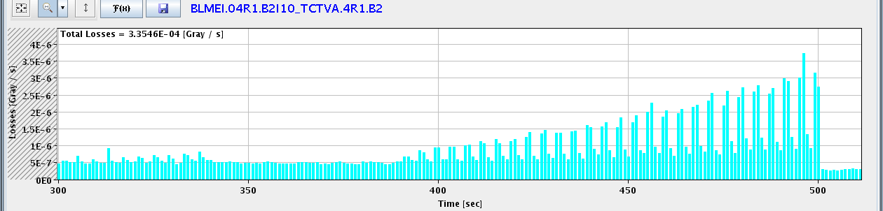
IR2 TCTVB: 5.5 μG/s
IR2 TCTH: 1 μG/s
IR1 TCTVA: 3.7 μG/s

Slide 10
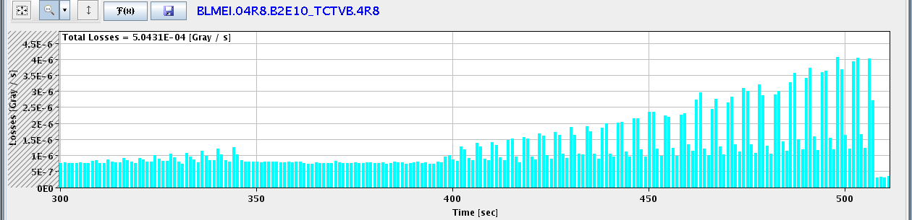
IR8 TCTVB: 4 μG/s
Easily identify all collimation-related losses around the ring.
Notice temporal shift between measurements around ring (8s). Could explain puzzling previous observations: cold losses before losses at collimators!
See loss distribution and efficiency for vertical losses.

Slide 11
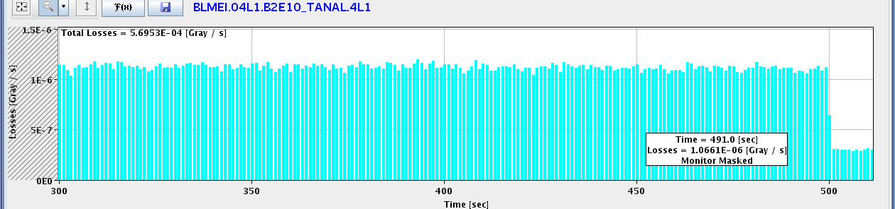

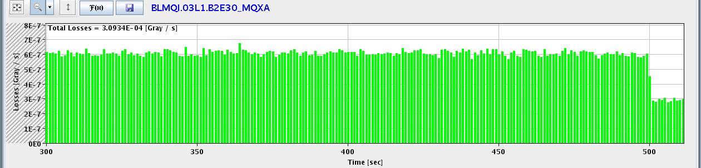
Luminosity-Induced Losses IR1: Selection
Beam dump
IR1 TAN L
IR1 TAN R
IR1 Q3L (SC)

Slide 12
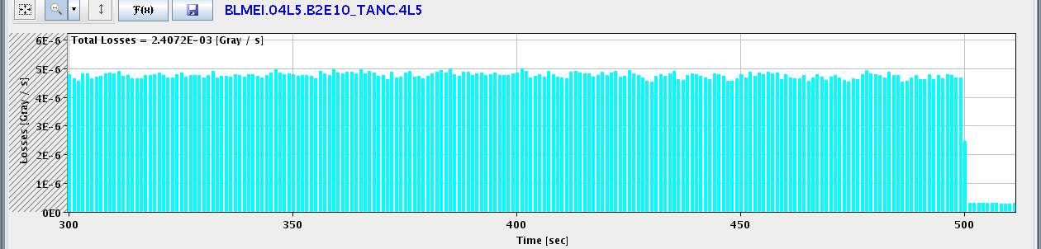

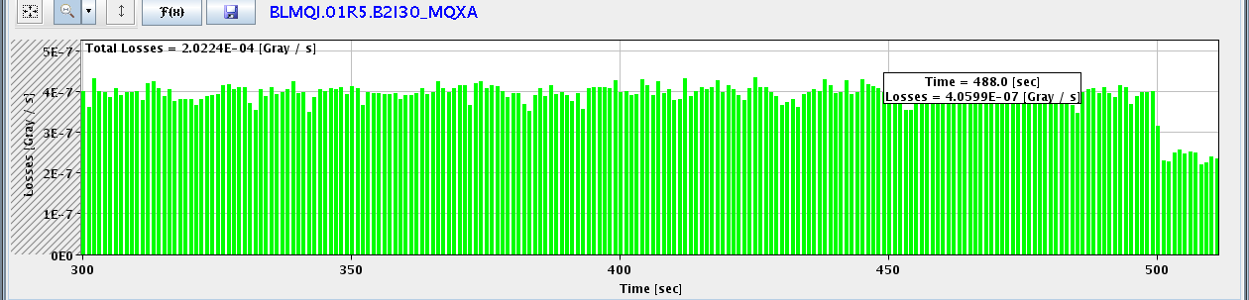
Luminosity-Induced Losses IR5: Selection
Beam dump
IR5 TAN L
IR1 TAN R
IR1 Q1R (SC)

Slide 13
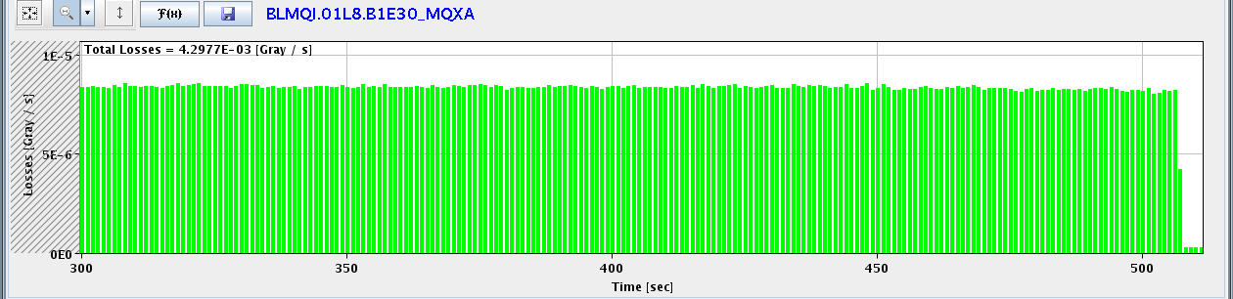
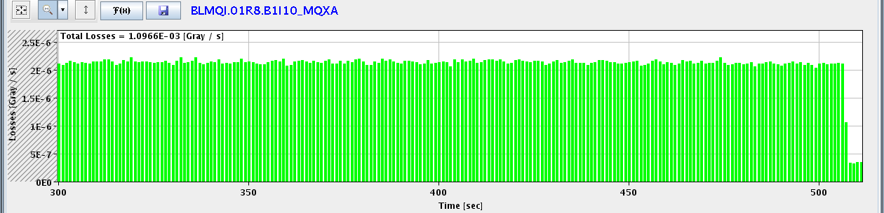
Luminosity-Induced Losses IR8: Selection
Beam dump
IR8 Q1L (SC)
IR8 Q1R (SC)

Slide 14
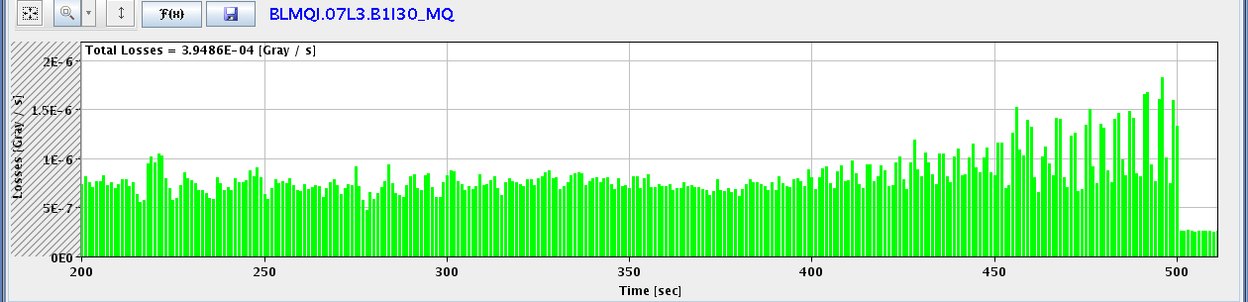
Luminosity-Induced Losses IR3
Beam dump
IR3 Q7 L (SC)
Luminosity: ~ 5e30 cm-2 s-1
Induced losses Q7.L3: 5e-7 Gy/s
Quench limit Q7 at 3.5 TeV: 4.7e-3 Gy/s
factor 10,000 margin at 3.5 TeV for factor 2,000 in lumi → might become critical for luminosity at 7 TeV with lower quench limit (predicted bottleneck – high dispersion)

Slide 15
Summary Wednesday 25.8.
14h14: Injection pilot. Starting transverse damper and PLL work. Some issues with hypercycle for bunch trains:
  hypercycle for train injection, got several problems: 1) injection settings for TL collimators not correct. 2) MCS signature problem during the clone of BP prevents to play the tasks to load collimator thresholds. 3) Q cavity value for injection are 60000. 4) no settings for IP spectrometers.
14h39: PS booster problems. RF rephrasing problems. XPOC server update.
17h57: Bunch trains injected successfully. Transverse damper work with trains. PLL work not possible in parallel.
19h30: SPS problems. Timing problem with sequencer: only pilot bunches available.
22h03: SPS timing problem fixed. Now collimator controls problem.

Slide 16
ADT Summary
all beam position modules flashed with new firmware using phase insensitive algorithm to calculate the bunch position. It will allow us to better adjust signal amplitudes to further improve the noise performance of the ADT
the unit Horizontal Beam 1 is already operated with this new algorithm
bunch hold time constants were shortened for both beams and both planes from 25 buckets (~625ns) to 6 buckets (150ns). The 1-turn delay was readjusted to start kick at 75ns before the bunch comes (was ~300ns)
reduced time between bunches gives less kick strength at high frequencies than we had till now, but damping times between 50-100 turns were still achieved (performs as designed). Needs to be fine-adjusted and damping times precisely measured again later.
150 ns settings left in, should work without problems for any beam/bunch spacing.
Still need to set-up the remaining units (V-B1, H-B2, V-B2) for new algorithm.
Daniel Valuch, Maarten Schokker, Gerd Kotzian

Slide 17
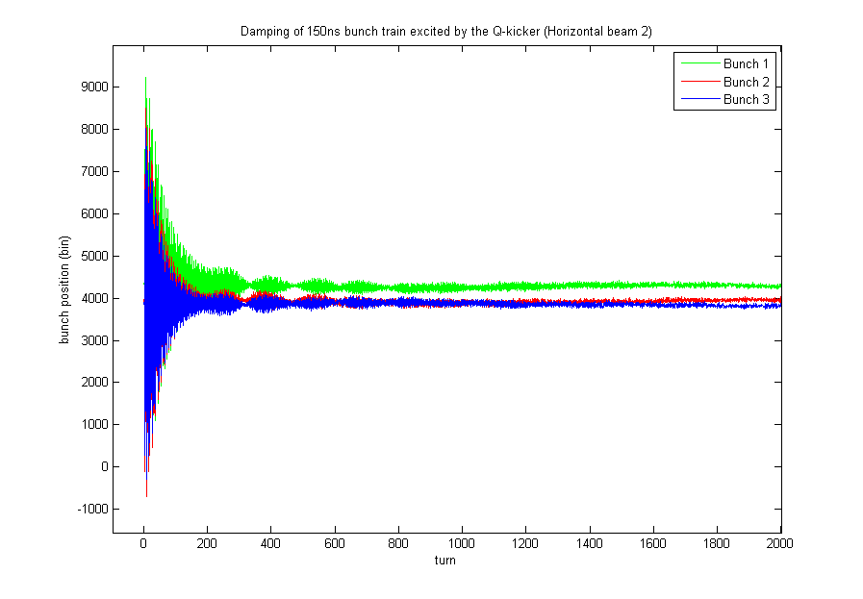
Beam 2, horizontal plane, kicking a batch of 4 bunches/150ns by Q kicker. Graph shows how oscillation of each individual bunch is damped. Beam was gone before measurement of bunch 4
Daniel Valuch, Maarten Schokker, Gerd Kotzian

Slide 18
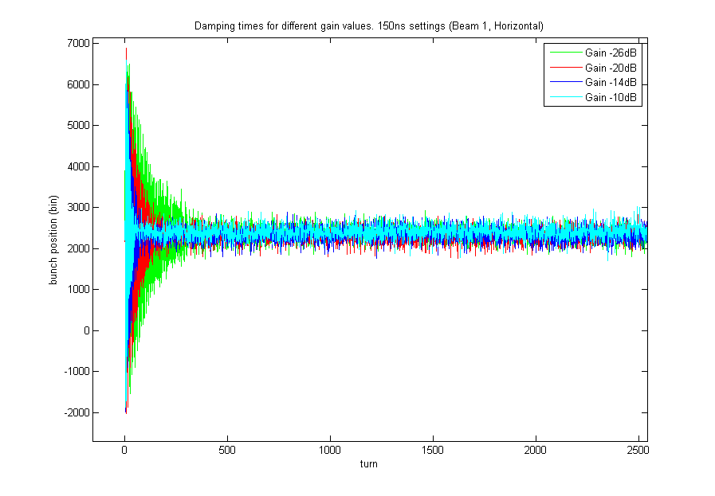
Verification of damping times for different electronic gain values. 150ns settings, beam 1, horizontal plane. Note that currently used gain at injection is set to -20dB.
Daniel Valuch, Maarten Schokker, Gerd Kotzian

Slide 19
Summary Wednesday 25.8.
00h28: DIP analyzed to stall collimator control. Decision to disable DIP. Pilot bunch injection.
02h35: Ramp started.
04h21: Stable beams fill #1303.
  Lumi > 1e31 in ATLAS and CMS.
  Only 47 bunches instead of 50. Last injection per beam not executed due to OP error. Missing buckets: 25081, 26081, 27081 (B1), 22281, 23281, 24281 (B2)
  Still excellent lumi and could even be better…
Continuing collision…

Slide 20
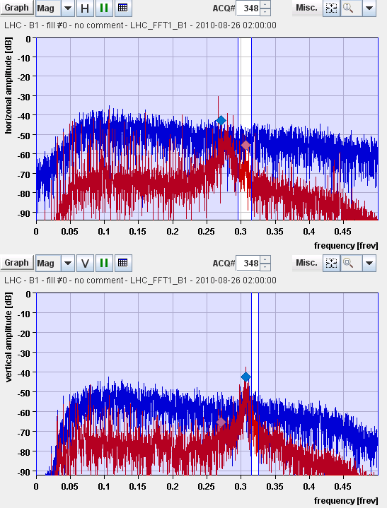
Tune Detection Improvement
Tune detection affected by noise ion the beam.
Reducing the time-constant responsible for the DC suppression of the peak voltage variations of the longitudinal carrier to help reliable detection.
N.B. gains stayed the same.
See curves: Blue before, red after change.
R. Steinhagen

Slide 21
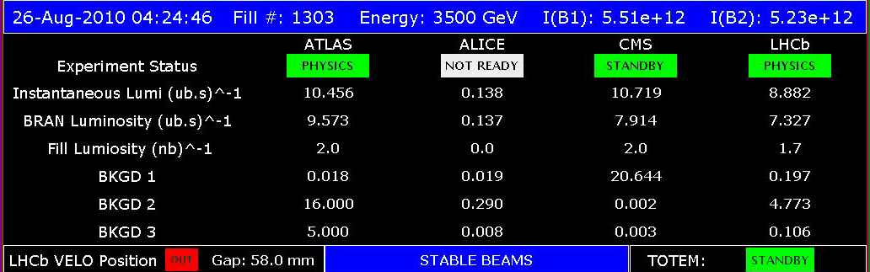
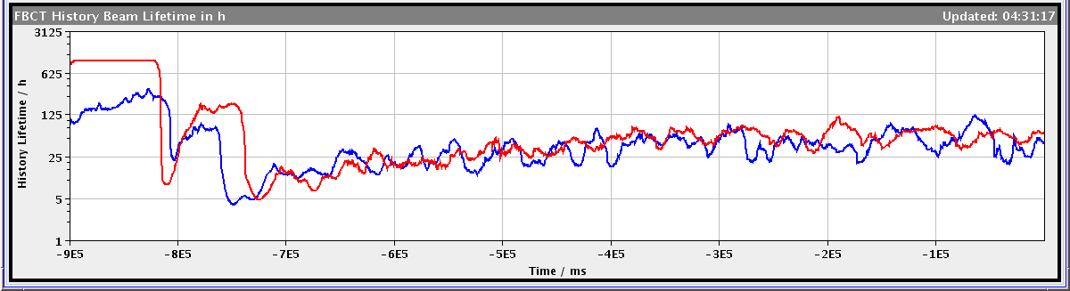
New Record Lumi

Slide 22
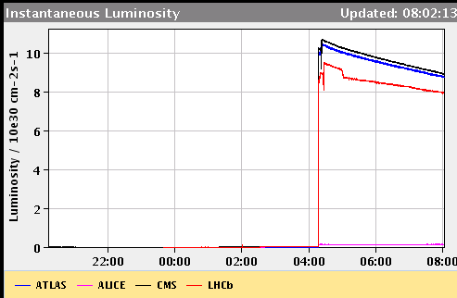
Instantaneous Lumi in First 3.5 hours

Slide 23
Intensity Loss: summary across fills
48 bunches
50 bunches

Slide 24
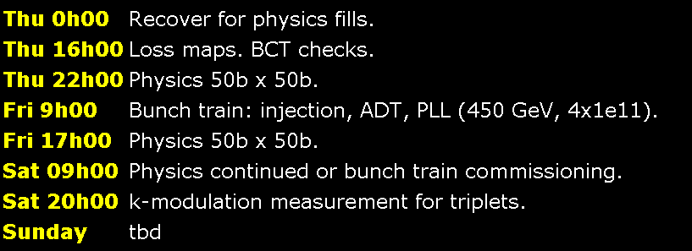
Program ahead

Slide 25
Backup

Slide 26
List of Ongoing/Pending Work I
Commissioning work for higher intensities:
  Multi-bunch injection: N bunches per injection, completed for beam1, to be completed for beam2.
  Transverse damper: Train test with 4 bunches at 150 ns. 1 shift. Adjustments for train. 1 shift. Total: 2 shifts.
  Multi-bunch studies for RF and BPM's, instrumentation, dump, ...
  Crossing-angle setup at 450 GeV. Address losses with 100 micro-rad in IP2, goal is 150 micro-rad (full, see w33 Tuesday summary).
  Check of orbit feedback improvement (minimize energy changing COD trims). Can be parastitic. 2 ramps.
  PLL commissioning work (better tune feedback with high intensities and damper on): at 450 GeV and later during ramp. 6 times 0.5 shifts.
  Injection preparation for 12b bunch train injection (injection protection setup). 2 shifts.
  Injection test for 12b bunch train. 0.5 shifts.
Increase of intensity:
  Increase bunch intensity to 1.1e11.
  More bunches after 1 week with 48b? → NO.
Define plan
Agree target crossing angles

Slide 27
List of Ongoing/Pending Work II
Maintenance of LHC performance & protection:
  Monitor collimation validity and efficiency (loss maps). 1b of 1e11 per beam. 1.5 shifts.
  Correct the momentum cleaning for beam 2 (collimator setup IR3). 1b of 1e11 per beam. 1 shift.
  Test less heavy method for loss maps (blow up selected bunches with transverse damper at end of shift). 1b of 1e11p. 1 hour.
  BCT response check for different bunch intensities. Parasitic to collimation loss maps.
  BCT response check for different bunch lengths. 450 GeV. 2 hours.
Study and measurements of important LHC parameters:
  Independent measurement of beta* and beam offsets in triplets: k-modulation. 1b of 1e11 per beam. Not colliding. Change RQTX1/2/3 by +- 0.5 A. Measure after squeeze to 3.5m. 1 shift.
  Measurement of transverse beam distribution at 3.5 TeV.

