Slide 1
Summary Monday 23.8.
Monday morning: Continuing record fill 1298.
In the shadow analysis of injection quality. PSB problem: LTB.DHZ40 (element in the injection line of the PSB) is pulsing with the wrong polarity from time to time, no obvious pattern. Results in a wrong injection trajectory, increased losses and decreased intensity in the PSB. Experts from PO and CO are worked on the problem.
13h48: Beam dump due to fast beam losses in MQ22.R3. BLM running sum #5. Another fast beam loss event.
Fill 1298: 290 nb-1 delivered in fill to CMS and ATLAS, 270 nb-1 to LHCb.
14h58: Accesses to point 4 (QPS to reset worldFIP on RB.A45) and point 2 (MKI check).
BPM’s in IR6 recalibrated by BI.
17h43: Injection.

Slide 2
Fill 1298
13 hours of stable beams
IPs: 1 5 2 8 - 1 5 8 - 1 5 2
- 1 5 - 2 8 - 8

Slide 3
Fill 1298
1 LR in 2 (33m)
1 LR in 2 (33m)
1 LR in 8 (33m)
1 LR in 8 (33m)
1 LR in 2 (22m)
1 LR in 2 (22m)
no Long Range interactions
with Long Range
IPs: 1 5 2 8 - 1 5 8 - 1 5 2 - 1 5 - 2 8 - 8

Slide 4
Fill 1295
1 LR in 2 (33m)
1 LR in 2 (33m)
1 LR in 8 (33m)
1 LR in 8 (33m)
1 LR in 2 (22m)
1 LR in 2 (22m)
no Long Range interactions
with Long Range
IPs: 1 5 2 8 - 1 5 8 - 1 5 2 - 1 5 - 2 8 - 8

Slide 5
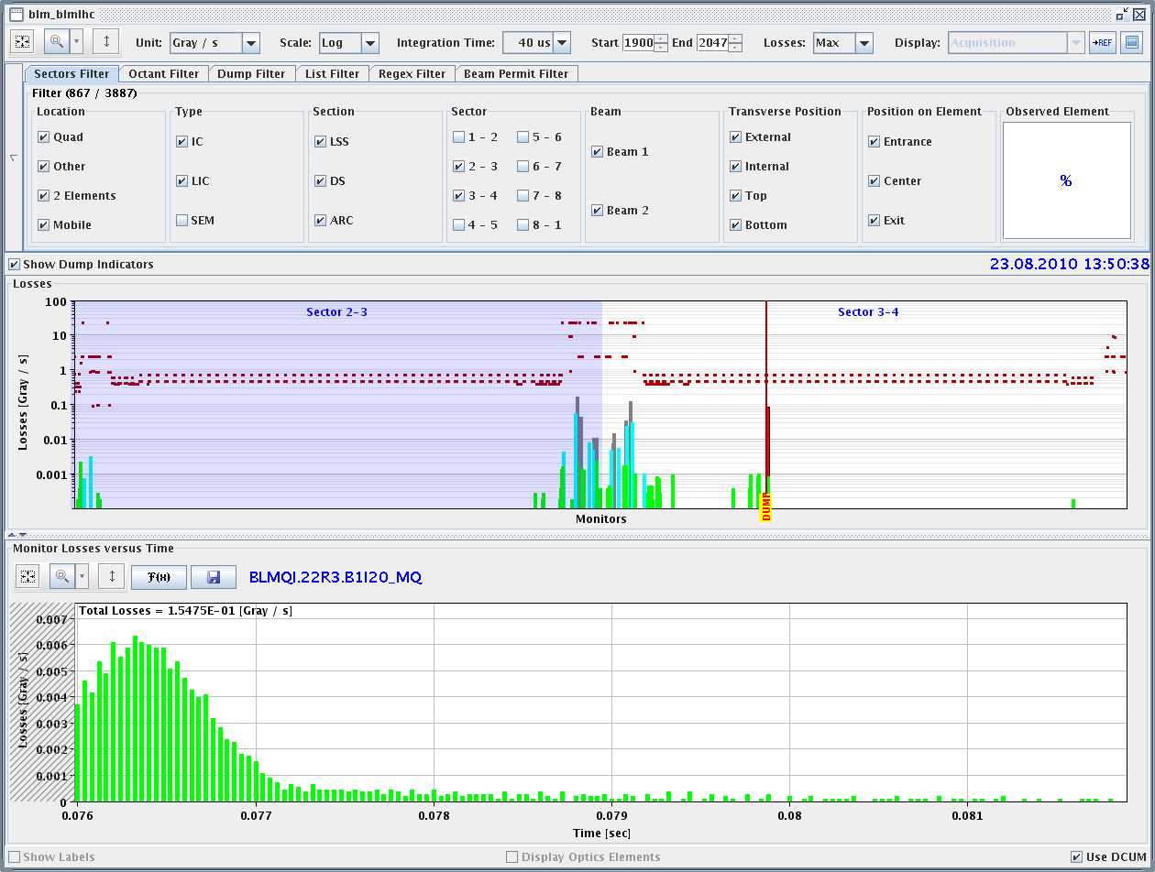
Beam Dump with Fast Loss

Slide 6
Summary Monday 23.8.
18h46: Trip of RD1.R2 (water) during injection process. Reset by piquet.
19h38: Injection. Problems with weak bunches, larger than normal emittances. The SPS-LHC rephasing sometimes fails even in the middle of the high intensity injections, when we do not change RF frequency or measure chromaticity (it happened at least twice in out last 20 injections or so, when training is not needed). IQC latched continuously on heavy losses, the TDI was continuously sprayed.
22h21: Start of ramp.
00h11: Stable beams fill #1299.
03h27: Beams dumped due to RD1.R2 trip. Access by piquet.
06h23: Machine closed. Precycle started.
Now: access for the QPS OK on the RQD/RQF/RB in 67 (died at 04h11).

Slide 7
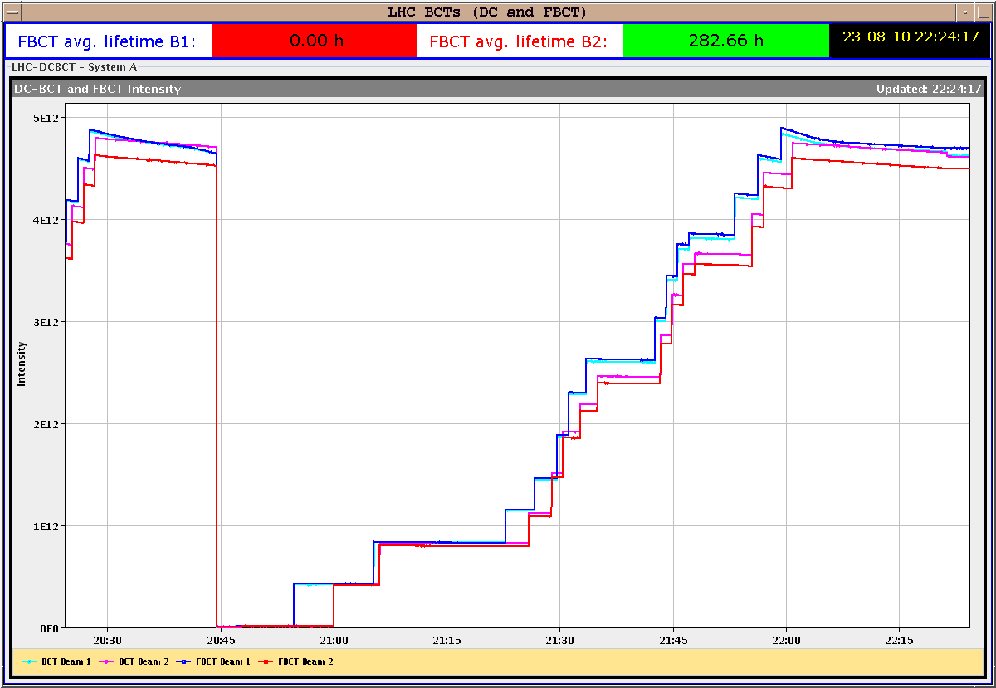
Injection

Slide 8
List of Ongoing/Pending Work
Commissioning work for higher intensities:
Multi-bunch injection: N bunches per injection, completed for beam1, to be completed for beam2.
Transverse damper: vector feedback with multiple bunches at 450 GeV, maybe together with multi-bunch injection. 1 shift.
Multi-bunch studies for RF and BPM's, instrumentation, dump, ...
Crossing-angle setup at 450 GeV. Address losses with 100 micro-rad in IP2, goal is 150 micro-rad (full, see w33 Tuesday summary).
Increase of intensity:
Increase bunch intensity to 1.1e11.
More bunches after 1 week with 48b?
Maintenance of LHC performance & protection:
Monitor collimation validity and efficiency (loss maps). 1.5 shifts.
Correct the momentum cleaning for beam 2 (collimator setup IR3). 1 shift.
Study and measurements of important LHC parameters:
New and improved filling scheme from Massi.
Independent measurement of beta*: k-modulation.
Measurement of transverse beam distribution at 3.5 TeV.
Define plan
Agree target crossing angles
Needs MP discussion
Put into operation
Discussion on k change

Slide 9
List of Ongoing/Pending Work
Additional commissioning work for higher intensities:
Check of orbit feedback improvement (minimize energy changing COD trims). Can be parastitic. 2 ramps.
PLL commissioning work (better tune feedback with high intensities and damper on): at 450 GeV and later during ramp. 6 times 0.5 shifts.

Slide 10
Possible Planning
Tu am – Wed am: access → 48b fill (old scheme, 1.1e11 per bunch, 2.7 micro-rad emittance) with end-of-fill measurement of transverse distribution.
Wed am: transverse damper tests at 450 GeV
Wed pm – Thu am: 48b fill (new scheme), end-of-fill measurement of transverse distribution
Thu am: ramp for collimator checks and loss maps, radial loop test
Thu pm – Fri am: 48b fill (new scheme), end-of-fill measurement of transverse distribution
Fri am: tbd

Slide 11
Week 34
Open Issues for next Technical Stop:
CMS cooling for central tracker.
Ion pumps in dump line MKB (B2 only 4 out of 8 pumps working; few days intervention).
BLM racks (in buildings SR1 and SR5 and both at position BY02): would like to correct the way the power cable for the multi-plug arrives inside the rack.
QPS boards: several boards had to switch from channel A to B.
Access team to replace oxydized connectors for PAD-PX24 (3 hours).
CV needs to replace a motorization of the water valve of the sector 56 (3h).
RCBH18.R7B2 – Miguel Cerqueira Bastos.
RCSSX3.L1 super blocked for cryo.

