Slide 1
Week 33
Main goals for week 33:
  Luminosity production;
  First 150 ns bunch train attempts;
  Roman Pots: check movement at 3.5 TeV, with 1b;
  Off momentum loss maps for Beam2 in collision configuration;
  Moving to 48bx48b

Slide 2
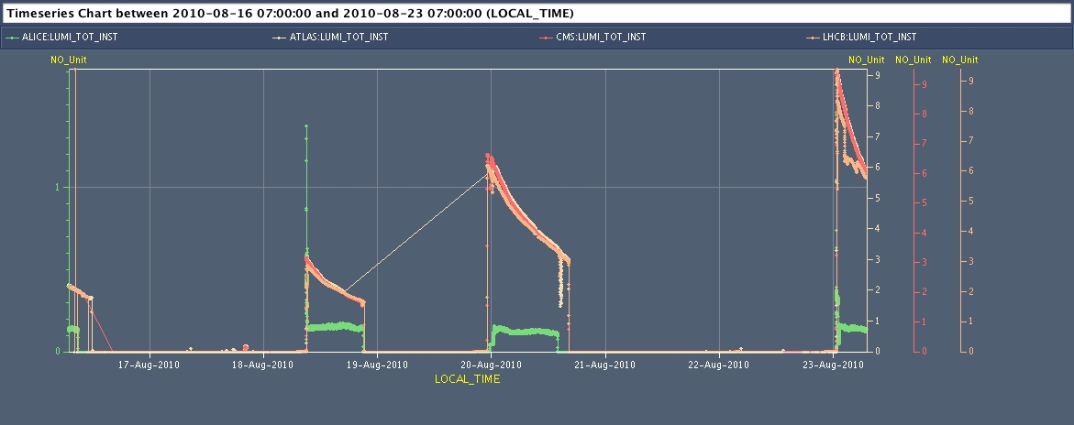
Week 33
Operation with 25 on 25 and 48 on 48 bunch configurations:
  3 fills with up-to 240 nb⁻¹ per fill ➔36.5 h of luminosity production
  ➔ ca. one fill every other day; peak luminosity: L = 9.5 10³⁰ cm⁻² sec⁻¹
  average fill time above 12 hours (10.5, 12, 14, [>7])
  integrated luminosity: 640 nb⁻¹ (105, 105, 240, [190])
  ➔ ca. 22% efficiency (wrt to scheduled time = 1 week); 48% machine availability

Slide 3
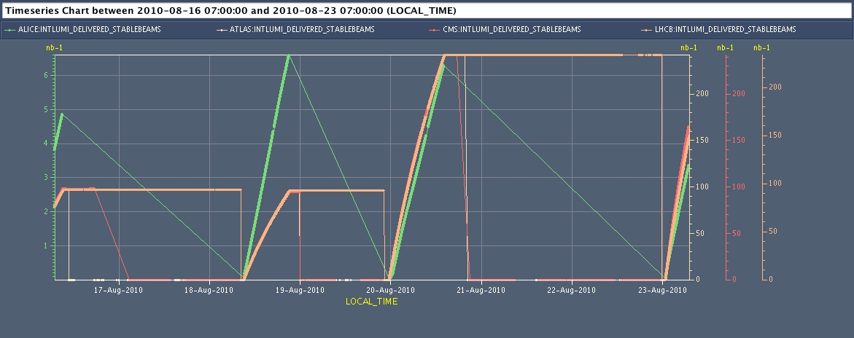
Week 31

Slide 4
Week 33
  ca. 45% efficiency relative to available beam time
  ca. 22% efficiency per scheduled time

Slide 5
Monday:
Started the day with physics fill from previous night.
Morning: End of fill studies
  Damper studies.
Afternoon: Access for various interventions:
  Among others: BLM updates;
  Finished access at 00:30 at night.
Night:
  Some delays due to problems with PC trips and QPS;
  Then BLM validation test with beam after firm ware update.

Slide 6
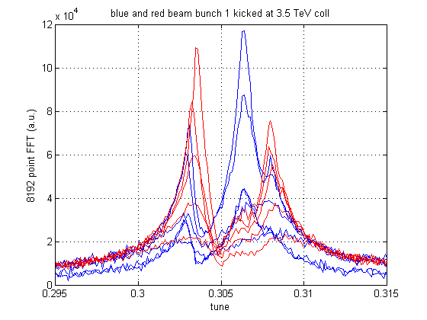
Damper used at 3.5 TeV with different gains (horizontal plane)
red: beam 2 kicked
gain beam 2 damper
increased x16
in steps of x2
blue: beam 1 kicked
gain beam 1 damper
increased x16
in steps of x2
Data from bunch 1 oscillations (8192 turns), Qkicker used at full strength
gain setting: -25 dB to -1 dB in steps of 6 dB (-19 dB used operational)

Slide 7
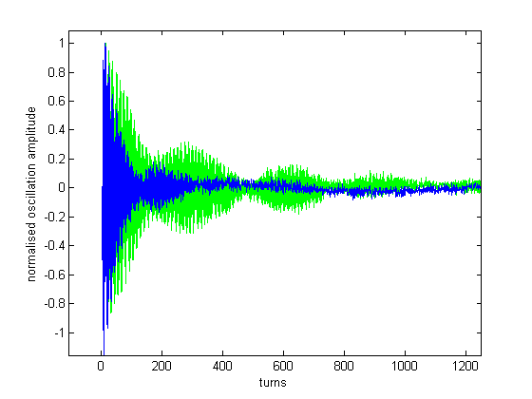
Damper used at 3.5 TeV with different gains (horizontal plane)
Time domain data (-25 dB and -7 dB gain) horizontal plane, beam 1
-25 dB
-7 dB
beating of two modes,
both well damped
data from bunch 1 oscillations (8192 turns), Qkicker used at full strength
gain setting: -25 dB and -7 dB, beam 1 kicked, horizontal plane
factor 8 gain increase on one beam does not lead to a factor 8 increase of damping
→ beams coupled, gain for damper on other beam was kept constant

Slide 8
Tuesday:
Morning: Bunch Train Studies:
  Ready for other systems (ADT, RF…) to make test on 1 train of 4 bunches ( B1);
  Non closure of LHCb spectrometer bump after polarity inversion;
Afternoon:
  Dispersion measurements and Loss map measurement for Beam2 at 3.5 TeV: ➔ Hierarchy not satisfied for off momentum particles (-1kHz RF shift)
  Issue with Q-feedback and damper cohabitation during ramp: feedback system locks onto Hump signal.
Night:
  Struggling to prepare new fill for physics with 25 bunches (QPS; trips & SPS).

Slide 9
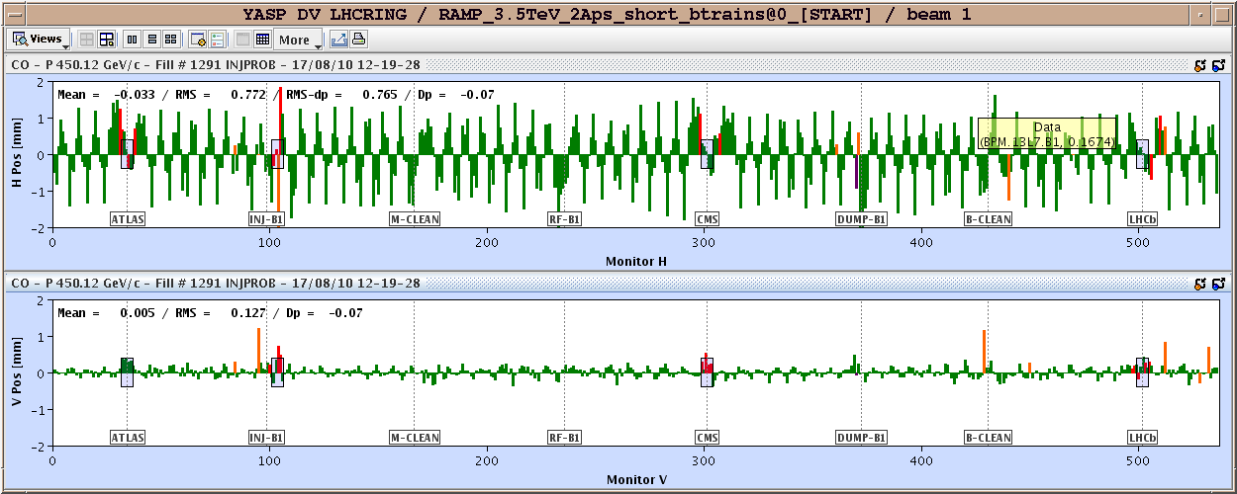
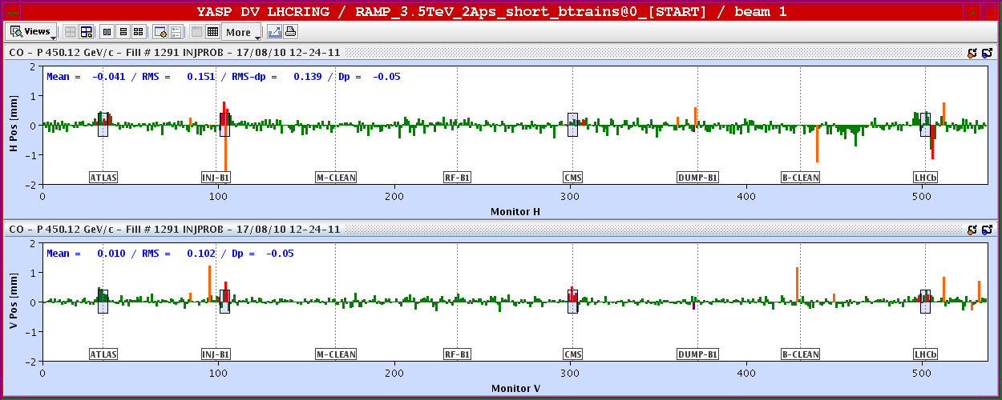
Orbit in the LHC for injection with bunch trains:
Orbit after LHCb
spectrometer
polarization
change:
Top: initial orbit
for new polarity
Bottom:
After correction.

Slide 10
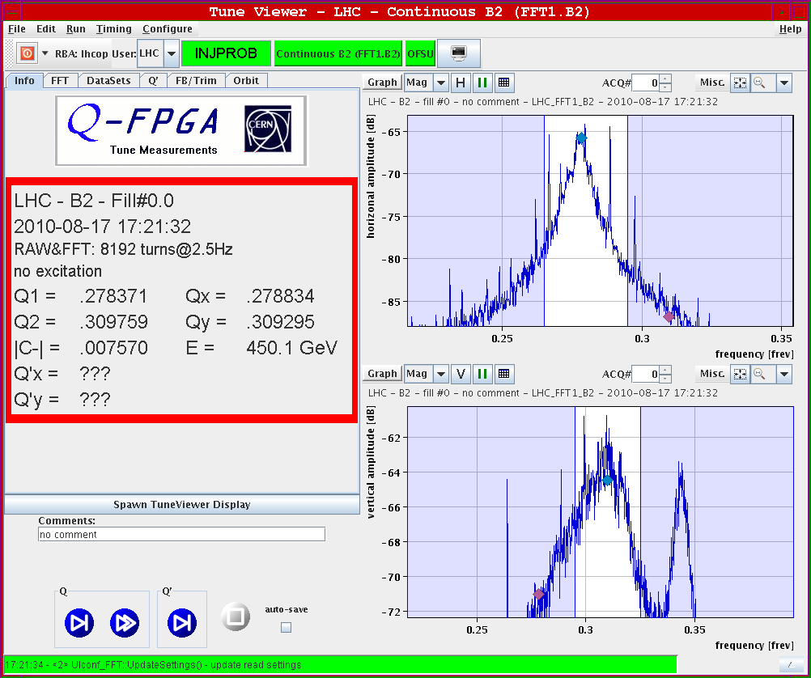
Tune and Hump with damper on:
Beam 2: Vertical tune and Hump signal
are approximately equally
strong with damper on.

Slide 11
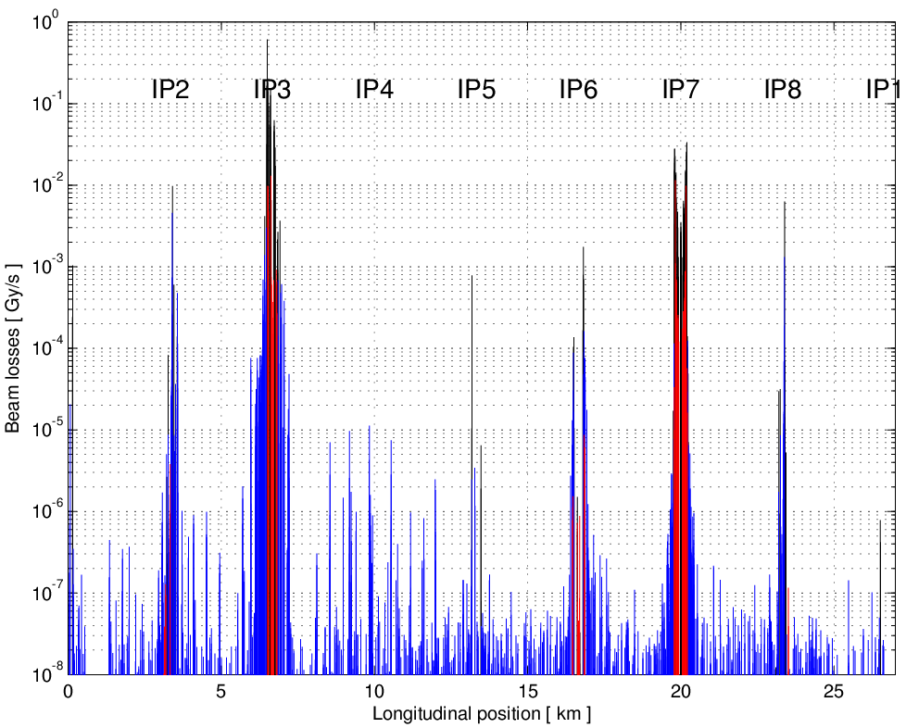
Collimators – Loss maps on momentum
Stefano Redaelli, Walter Venturini, Joerg Wenninger
BLACK = collimators
RED = warm elements
BLUE = cold elements
1bx1b, Physics conditions -1000 Hz RF trim
TCTs see about ~0.01 of the primary loss spike and the cleaning efficiency to the cold elements is 99.25% (4 stage hierarchy is respected).
Operation with 25 bunches can continue in these conditions
To be repeated for B2

Slide 12
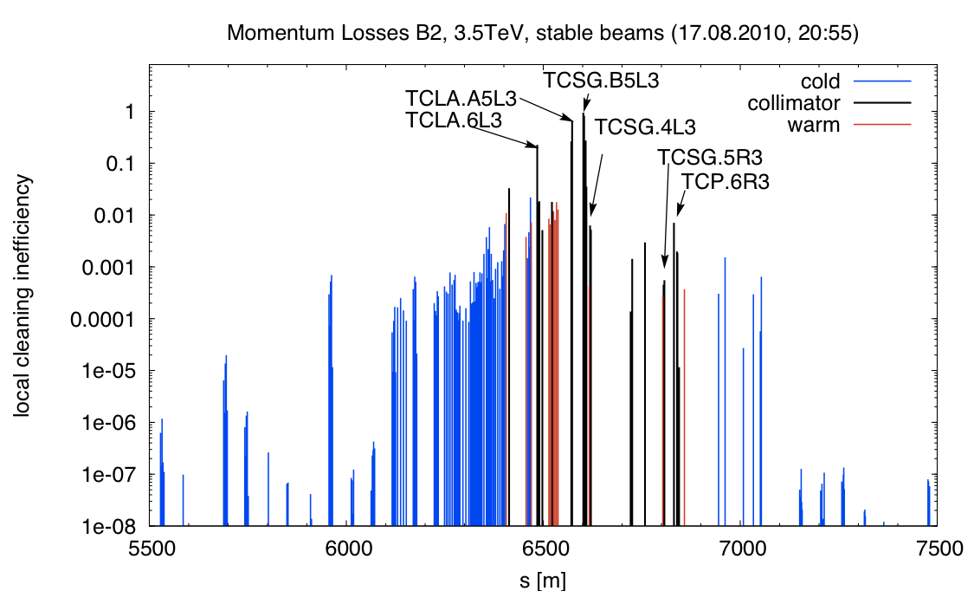
Beam Losses in the LHC during injection with bunch trains
Daniel Wollmann:
The hierarchy is violated in this case: The TCSG.B5L3.B2 acted as primary collimator.
One can also see, that the losses
on the TCLA.A5L3.B2
are quite high
(~64% of the losses at
the TCSG).

Slide 13
Wednesday 18.8.
Morning: Physics fill with 25 bunches:
  07:00: Injection;
  07:25: Start ramp;
  09:00: End of squeeze and stable beams;
  Emittances: ε_{x1} = 3.0 μm; ε_{y1} = 3.0 μm; ε_{x2} = 3.4 μm; ε_{y2} = 4.0μm;
  Initial peak luminosity: L = 3 10³⁰ cm⁻² sec⁻¹;
  ➔ total delivered luminosity after 12 hours: 90nb⁻¹; (105nb⁻¹ with eof studies )
  19:00: Start moving Roman pots in steps:
  ➔ 30σ to 25σ; 20σ;
  21:00: Luminosity scan in IP1 to verify optimized collisions point;
  21:30: Beam dump & ramp down
22:00: Access for quench heater power supply problem on RB.24L2:

Slide 14
Thursday 19.8.
Morning: Machine in access:
  BLM crate in Pt7 (broken power supply);
  RQT12.R1B1 repair of FGC: access in PM15;
  09:00: RCBCH6.R8B1 tripped ➔ access required in Pt8;
  ATLAS asked if they could have short access in shadow of Pt8 intervention;
13:00: LHC ready for beam but now we have problems in the SPS:
  MST extraction septum in fault;
  Problem with the access chain.
15:00: Beam back in the SPS:
  Injection setup in the LHC;
  Loss map studies in IR3 ➔ looks good at 450 GeV;
  Tested Radial-Loop using external RF frequency trims;

Slide 15
Thursday 19.8.
16:45: MPS fault in the SPS:
  No beam for 1 hour;
  Second loss map measurement;
  Dispersion measurement at 450 GeV for Beam2;
18:15: Inject nominal bunches for Q-feedback & Damper studies:
  Initial problems with BQM (SPS used old bunch structure);
  Observe some ‘odd’ excitations in horizontal BBQ for B2;
  Measure PLL and BBQ spectra with different damper gains ➔ good result for PLL measurements;
19:10: Dump beams to prepare new fill:
  XPOC error due to losses at TCDS Beam1 ➔ BLM thresholds for new – shorter bunch spacing?;

Slide 16
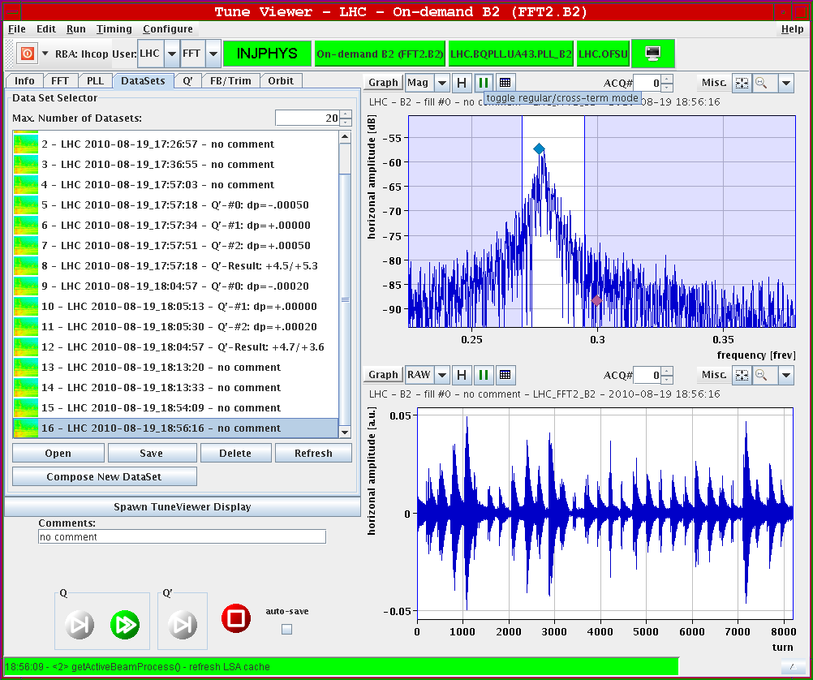
Thursday 19.8.
Horizontal
BBQ for
Beam2:

Slide 17
Thursday – Friday 19-20.8.
Thursday: First physics fill with 48 bunches per beam:
  20:30: Injection finished ➔ 4.5 10¹² protons per beam in 48 bunches;
  ε_{x1} = 2.9 μm; ε_{y1} = 2.9 μm; ε_{x2} = 3.3 μm; ε_{y2} = 3.5 μm;
  21:00: Start ramp;
  21:40: End ramp;
  22:20: Start Squeeze
  Initial luminosity: L = 6.65 10³⁰ cm⁻² sec⁻¹;
  23:30: Stable physics; L = 6.15 10³⁰ cm⁻² sec⁻¹;
➔ fitted average emittances for bunch current of N_{b} = 9 10¹⁰:
σ = 4.05μm; with β* = 3.6m (average of three 1/β* measurement in IR5)
  ➔ integrated luminosity = 240 nb⁻¹ after 16 hours;

Slide 18
Fill 1295
1 LR in 2 (33m)
1 LR in 2 (33m)
1 LR in 8 (33m)
1 LR in 8 (33m)
1 LR in 2 (22m)
1 LR in 2 (22m)
no Long Range interactions
with Long Range
  IPs: 1 5 2 8 - 1 5 8 - 1 5 2 - 1 5 - 2 8 - 8
giulia papotti (BE/OP/LHC)

Slide 19
Friday 20.8.
End of Fill studies:
  Luminosity scans in all IPs (large scan in IP1);
  Damper studies;
  Orbit feedback test for radial loop correction;
  16:15: Beam dump; very clean & without any unusual losses
Afternoon:
  Cryo problem in Pt6 right after the beam dump.

Slide 20
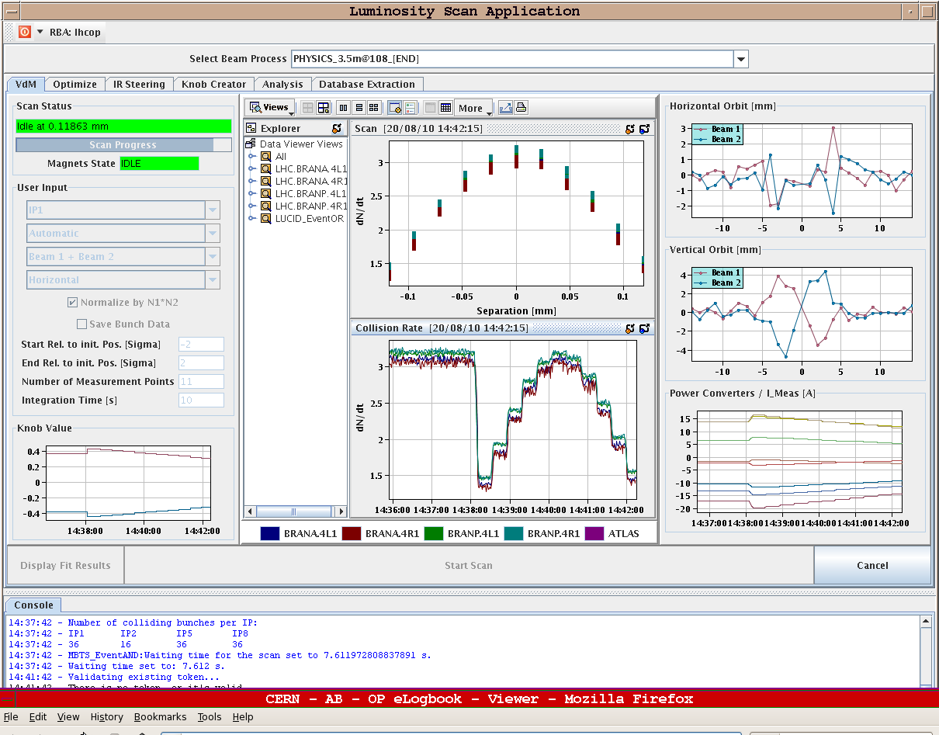
Friday 20.8.
Lumi scans
in IR1:
average
beam
emittances:
ε_{x} = 4.4μm
ε_{y} = 4.9μm
growth of
10% to 20%
over the fill!

Slide 21
Saturday 21.8.
Morning & Day: Recovery from Cryo problems:
  20:00: Cry recovered for pre-cycle in S56 and S67;
  22:15: Starting injection;
  22:30: Injection kicker fault - sparking (called experts); spark occurred after clean injection;
  22:30: Beams dumped due to Cryo problem for right IR5 triplet (back by 01:00);
Preparing second fill with 48 bunches:
  03:30: Injection finished ➔ 4.5 10¹² protons per beam in 48 bunches;
  ε_{x1} = 2.6 μm; ε_{y1} = 2.6 μm; ε_{x2} = 2.8 μm; ε_{y2} = 3.2 μm;
  03:40: Start ramp; losses in IR3 at beginning of ramp;
  ➔ Beams dumped by SIS TCDQ_B2 interlock triggered by the
  TCS_BEAM_OFFSET_B2;
  04:50: Trip of RCBYVS4.L1B1 during the ramp down combo;
  ➔ power module to be exchanged on RCBYVS4.L1B1, access needed in Pt 1;

Slide 22
Sunday 22.8.
Morning: Access following perturbation of electrical network:
  06:50: PC permit sector 45 lost due to perturbation on electrical network; ALICE and LHCb dipoles also tripped;
  RD1.LR5 also down (water cable fault);
  QPS: RQS.A12B2 and RQTF.A81B1 we changed QPS board;
  09:00: Access finished and experiments back up running;
Morning and afternoon: Trying to get machine ready for beam:
  09:00: Start pre-cycle (RQTL11.L5B2 needed change of board channel and several ciruits tripped);
  RQ6.L1B1/B2 tripped several times due to a bad contact (caused too low threshold) that was probably generated during intervention in the morning.
  ➔ need access again. Access finished by 12:15.
  13:50: Machine ready for injection;
  Asking for mastership resulted in a PM - with no beam in the machine - first triggered inputs in PM seem to be BLMs in 6 ➔ search for BPM expert; interventions finished by 18:00.

Slide 23
Sunday 22.8.
Morning and afternoon: Trying to get machine ready for beam:
  09:00: Start pre-cycle (RQTL11.L5B2 needed change of board channel and several ciruits tripped);
  RQ6.L1B1/B2 tripped several times due to a bad contact (caused too low threshold) that was probably generated during intervention in the morning.
  ➔ need access again. Access finished by 12:15.
  13:50: Machine ready for injection;
  Asking for mastership resulted in a PM - with no beam in the machine - first triggered inputs in PM seem to be BLMs in 6 ➔ search for BPM expert; interventions finished by 18:00.
  18:00: Starting injection;
  19:00: Staring over injection with nominal bunches ➔ Beam dumped by BPM interlock in point 6 (BPM L & R for Beam 1);
  19:30: Problems in IP6 (BPM error: CALIBRATION MODE); fixed by 21:15;

Slide 24
Sunday – Monday 22-23.8.
Third fill with 48 bunches per beam:
  22:20: Injection finished ➔ 4.7 10¹² protons per beam in 48 bunches;
  Emittances between 2.5 μm and 3.0 μm (measured in the SPS);
  22:30: Start ramp;
  00:40: Start Squeeze
  Initial luminosity: L > 9.4 10³⁰ cm⁻² sec⁻¹;
  00:50: Stable beams after optimization:
  L = 9.1 10³⁰ cm⁻² sec⁻¹;
➔ fitted average emittances for bunch current of N_{b} = 9.8 10¹⁰:
σ = 3.35μm; with β* = 3.6m (average of three 1/β* measurement in IR5)
  ➔ integrated luminosity = 190 nb⁻¹ after 7.5 hours;

Slide 25
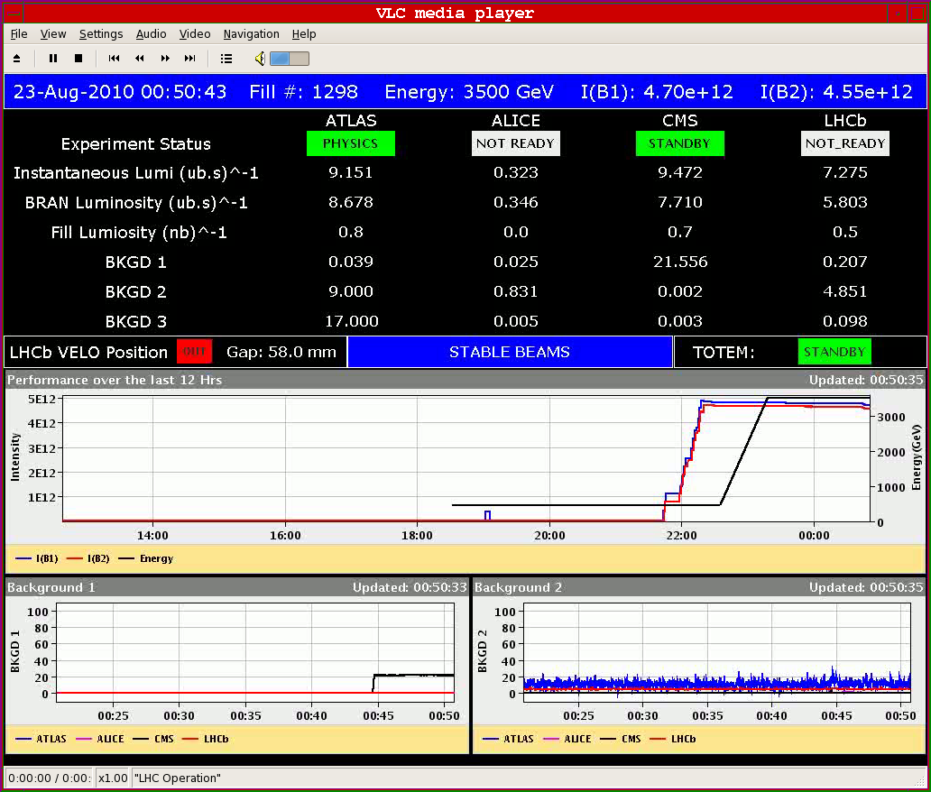
Sunday-Monday 22-23.8.
Initial luminosity
above
9.4 10³⁰ cm⁻² sec⁻¹!

Slide 26
Monday 23.8.
Plan for the week:
  Continue physics fills with 48 bunches;
  Continue preparatory studies for bunch train injection;
  Loss maps and β* measurement via Q1 modulation;
Coordinators for week 34:
  Ralph Assmann & Roger Bailey

Slide 27
Week 33
Open Issues for next Technical Stop:
  CMS cooling for central tracker.
  Ion pumps in dump line MKB (B2 only 4 out of 8 pumps working; few days intervention).
  BLM racks (in buildings SR1 and SR5 and both at position BY02): would like to correct the way the power cable for the multi-plug arrives inside the rack.
  QPS boards: several boards had to switch from channel A to B.
  Access team to replace oxydized connectors for PAD-PX24 (3 hours).
  CV needs to replace a motorization of the water valve of the sector 56 (3h).
  RCBH18.R7B2 – Miguel Cerqueira Bastos.
  RCSSX3.L1 super blocked for cryo.

