Slide 1
Friday 20.8.
Morning: First physics fill with 48 bunches per beam:
20:30: Injection finished ➔ 4.5 10¹² protons per beam in 48 bunches;
ε_{x1} = 2.9 μm; ε_{y1} = 2.9 μm; ε_{x2} = 3.3 μm; ε_{y2} = 3.5 μm;
21:00: Start ramp;
21:40: End ramp;
22:20: Start Squeeze
Initial luminosity: L = 6.65 10³⁰ cm⁻² sec⁻¹;
23:30: Stable physics; L = 6.15 10³⁰ cm⁻² sec⁻¹;
➔ fitted average emittances for bunch current of N_{b} = 9 10¹⁰:
σ = 4.05μm; with β* = 3.6m (average of three 1/β* measurement in IR5)
➔ integrated luminosity = 240 nb⁻¹ after 16 hours;

Slide 2
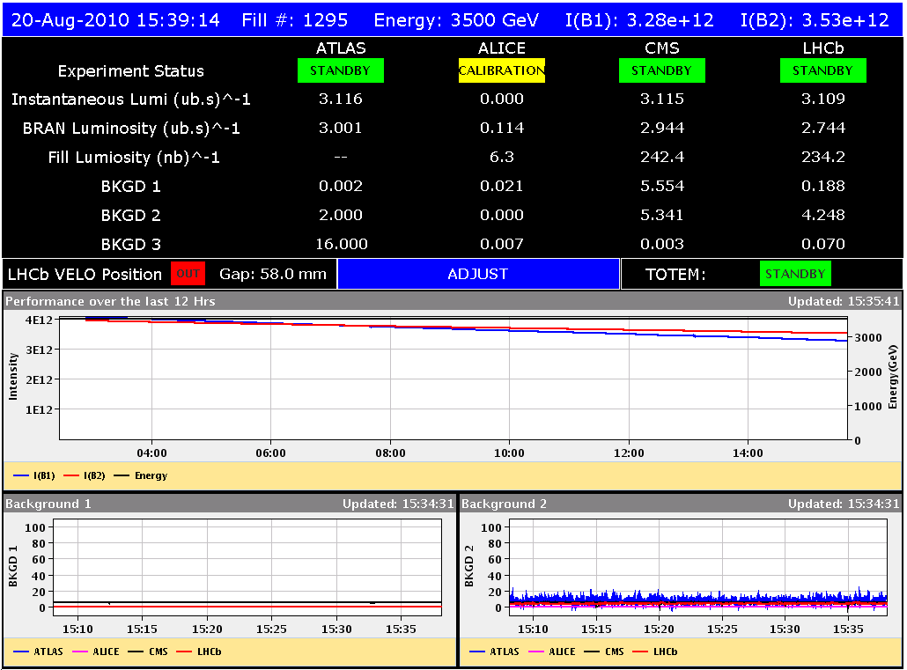
Firday 19.8.
48
bunches
in both
beams:
integrated
Luminosity
of more
than
240 nb⁻¹

Slide 3
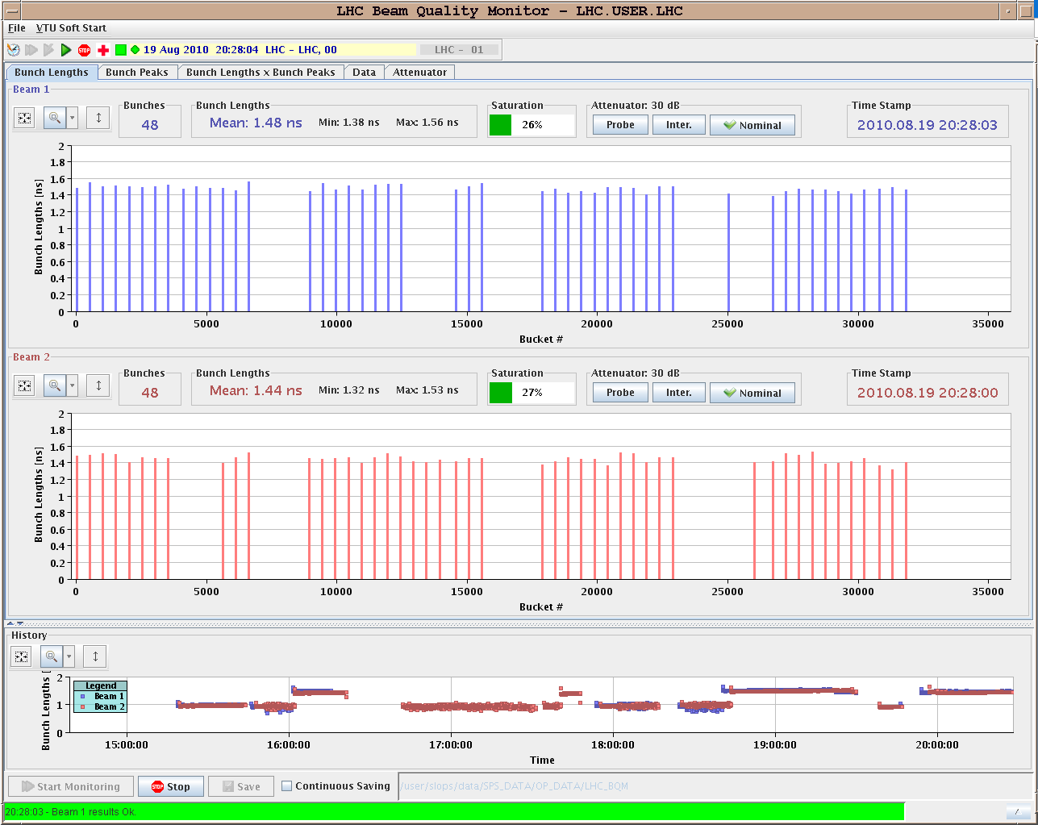
Thursday 19.8.
48 bunches
in both
beam:
beginning
of the
fill.

Slide 4
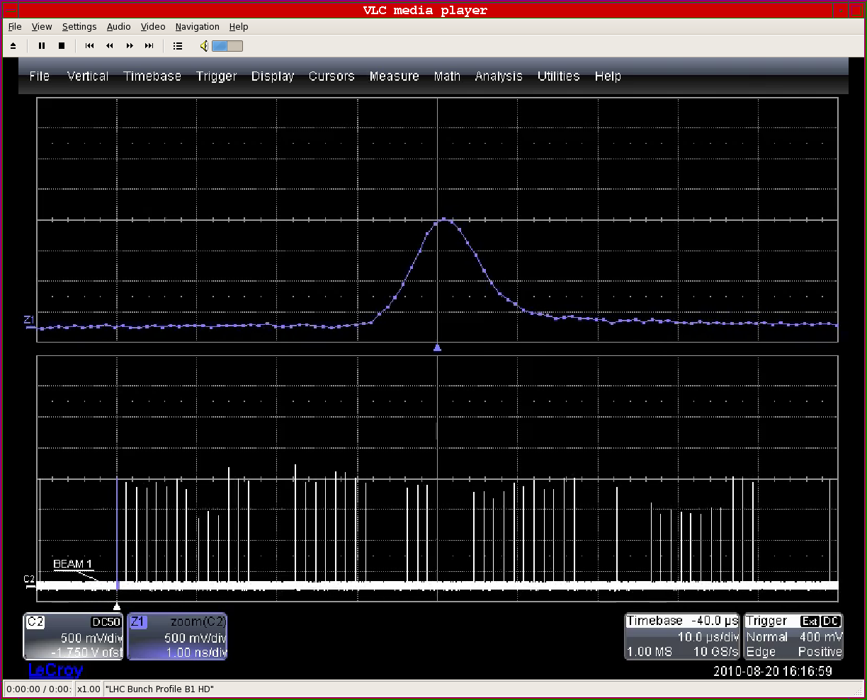
Firday 19.8.
Beam 1 bunch distribution at end of fill:

Slide 5
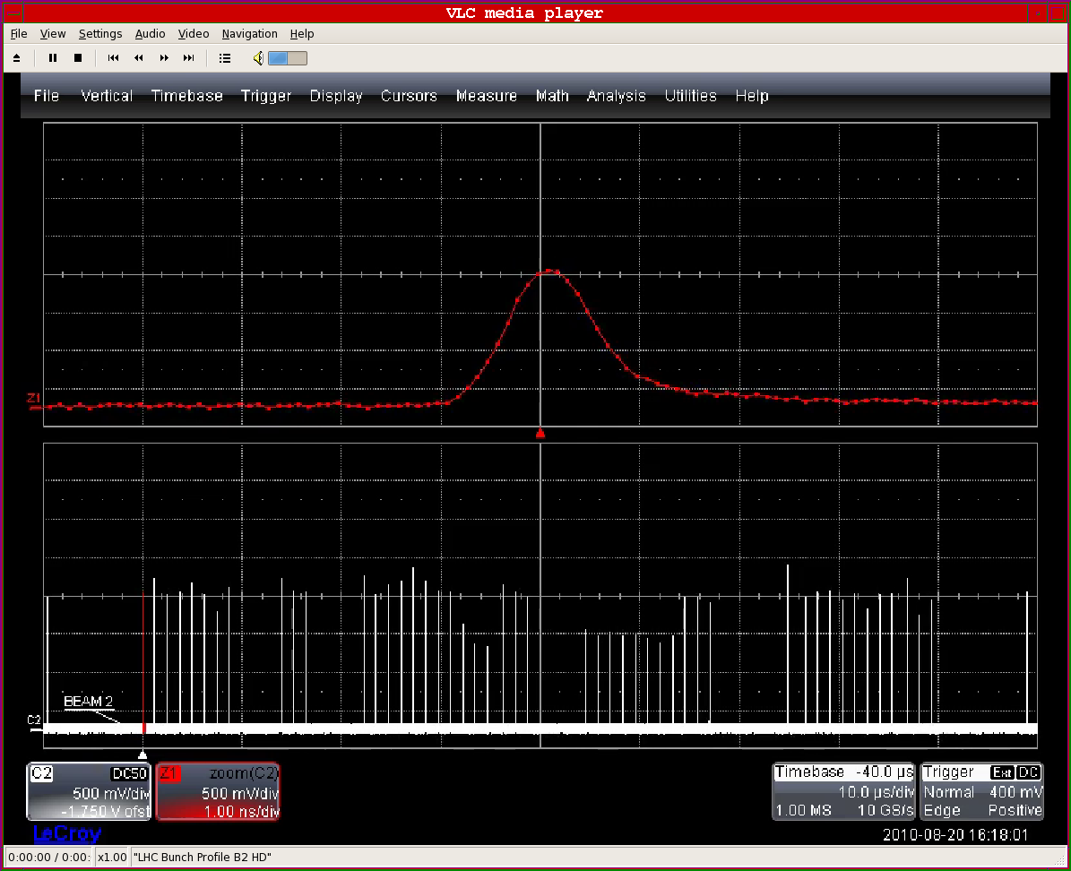
Firday 19.8.
Beam 1 bunch distribution at end of fill:

Slide 6
Fill 1295
16 hours of stable beams
first 48 + 48
IPs: 1 5 2 8 - 1 5 8 - 1 5 2
- 1 5 - 2 8 - 8
giulia papotti (BE/OP/LHC)

Slide 7
Fill 1295
1 LR in 2 (33m)
1 LR in 2 (33m)
1 LR in 8 (33m)
1 LR in 8 (33m)
1 LR in 2 (22m)
1 LR in 2 (22m)
no Long Range interactions
with Long Range
IPs: 1 5 2 8 - 1 5 8 - 1 5 2 - 1 5 - 2 8 - 8
giulia papotti (BE/OP/LHC)

Slide 8
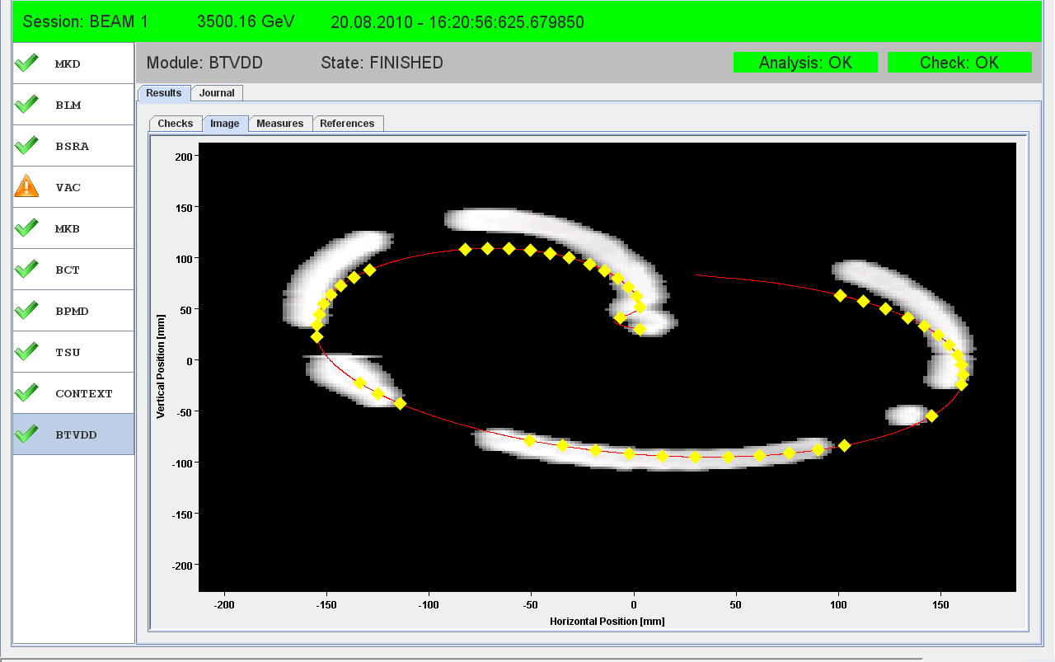
Firday 19.8.
Very clean dump by operator switch:

Slide 9
Friday 20.8.
End of Fill studies:
Luminosity scans in all IPs (large scan in IP1);
Damper studies;
Orbit feedback test for radial loop correctio;
16:15: Beam dump; very clean & without any unusual losses

Slide 10
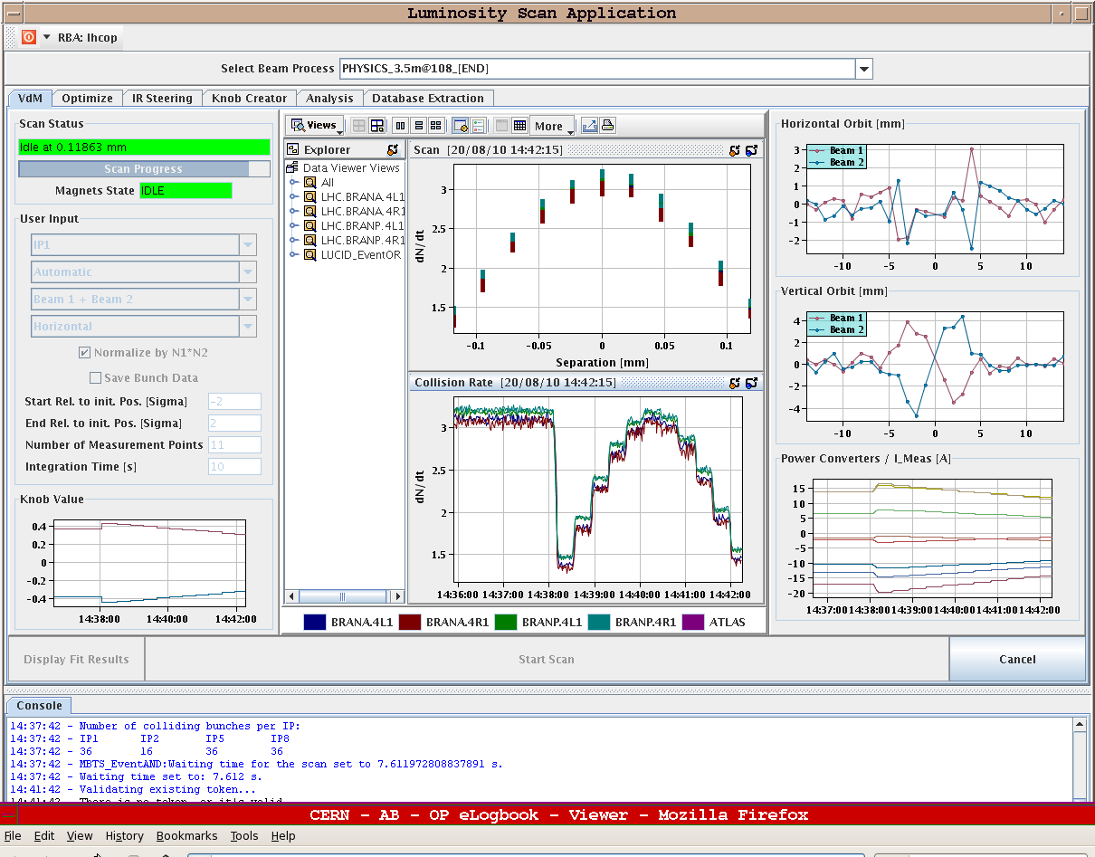
Firday 19.8.
Lumi scans
in IR1:
average
beam
emittances:
ε_{x} = 4.4μm
ε_{y} = 4.9μm
growth of
10% to 20%
over the fill!

Slide 11
Saturday 21.8.
Morning until noon:
Recovery from cryo problem in Pt6.
Afternoon and over night:
New physics fill with 48 on 48 bunches.
Sunday to Monday:
Physics Fills with 48 bunches per beam.

Slide 12
Week 33
Open Issues for next Technical Stop:
CMS cooling for central tracker.
Ion pumps in dump line MKB (B2 only 4 out of 8 pumps working; few days intervention).
BLM racks (in buildings SR1 and SR5 and both at position BY02): would like to correct the way the power cable for the multi-plug arrives inside the rack.
QPS boards: several boards had to switch from channel A to B.
Access team to replace oxydized connectors for PAD-PX24 (3 hours).
CV needs to replace a motorization of the water valve of the sector 56 (3h).
RCBH18.R7B2 – Miguel Cerqueira Bastos.

