Slide 1
Wednesday 18.8.
Morning: Physics fill with 25 bunches:
07:00: Injection;
07:25: Start ramp;
09:00: End of squeeze and stable beams;
Emittances: ε_{x1} = 3.0 μm; ε_{y1} = 3.0 μm; ε_{x2} = 3.4 μm; ε_{y2} = 4.0μm;
Initial peak luminosity: L = 3 10³⁰ cm⁻² sec⁻¹;
➔ total delivered luminosity after 12 hours: 90 nb-1;
19:00: Start moving Roman pots in steps:
➔ 30σ to 25σ; 20σ; ours: 90 nb-1;
21:00: Luminosity scan in IP1 to verify optimized collisions point:
➔ 30σ to 25σ; 20σ;
21:30: Beam dump & ramp down
22:00: Access for quench heater power supply problem on RB.24L2:

Slide 2
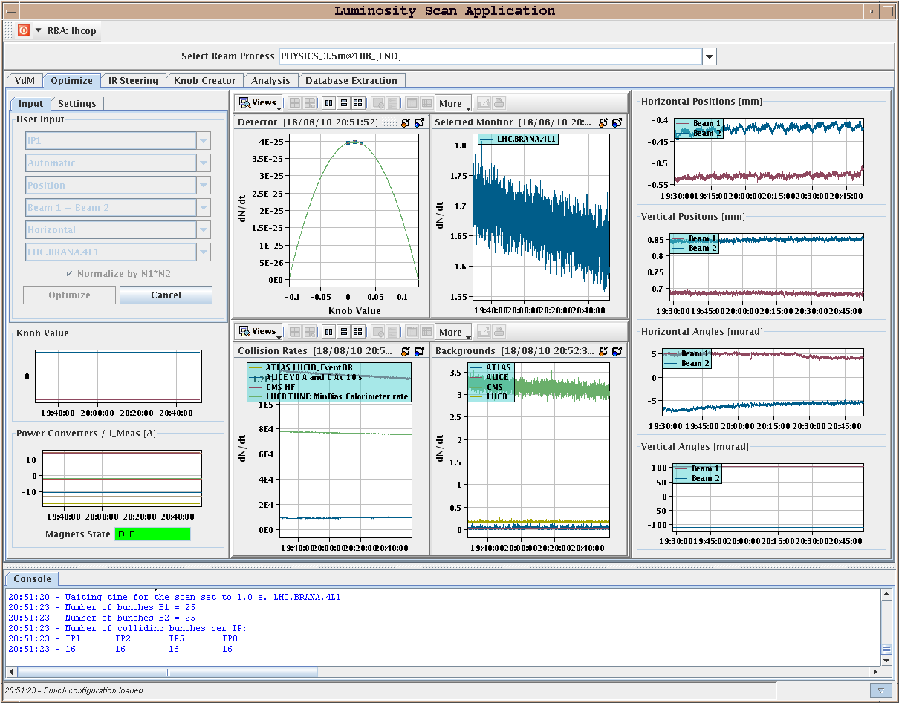
Wednesday 18.8.
Luminosity scan in IR1:
Horizontal
0.01mm
(1σ = 40-60μm)

Slide 3
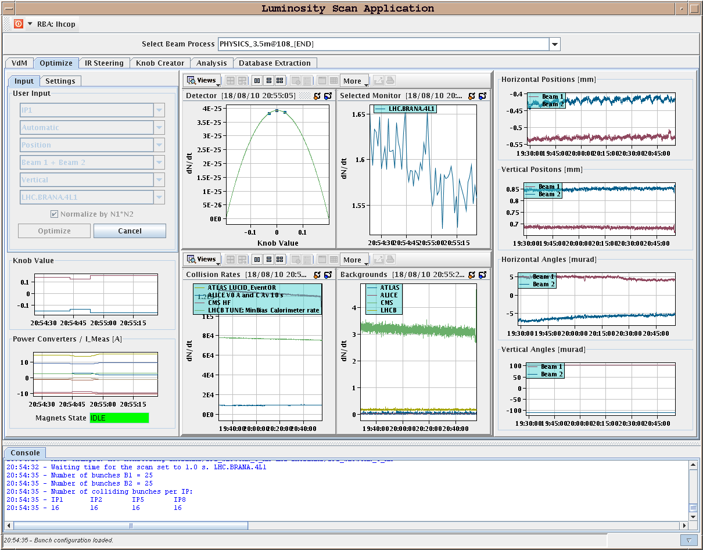
Wednesday 18.8.
Luminosity scan in IR1:
Vertical
0.002mm
(1σ = 40-60μm)

Slide 4
Wednesday 178.8.
23:15: Access finished and quench heater power supply charging.
00:40: Preparation of new physics fill:
01:30: Injection;
02:30: Some problems with tune feedback system:
Too many peaks present in the spectrum.
Feedback locked onto the wrong peak.
Put in large trims (more than 0.01).
➔ tightened the windows and took the trims out slowly.
RQT12.R1B1 tripped during this process and both beams were dumped
03:40: Start new injection
03:50: At the moment of over injection a BLM crate in point 7 trips (power supply broken) ➔ fixed by 7:30 (4h without beam).
04:40: RQT12.R1B1 tripped again; (FGC reboots itself from time to time)
➔ needs replacement (access in PM15);

Slide 5
Thursday 19.8.
Morning:
New physics fill with end-of-fill studies for damper at 3.5 TeV (49 bunch fill not before late evening-night).
or
Dedicated tune feedback and fitter studies and collimation in verification in IR3 at 450 GeV (could then start early on testing the tune feedback and damper at 450 GeV with 49 bunches).
(Late) Afternoon:
New Physics Fill with 49 bunches per beam.

Slide 6
Week 33
Open Issues for next Technical Stop:
CMS cooling for central tracker.
Ion pumps in dump line MKB (B2 only 4 out of 8 pumps working; few days intervention).
BLM racks (in buildings SR1 and SR5 and both at position BY02): would like to correct the way the power cable for the multi-plug arrives inside the rack.
QPS boards: several boards had to switch from channel A to B.
Access team to replace oxydized connectors for PAD-PX24 (3 hours).
CV needs to replace a motorization of the water valve of the sector 56 (3h).
RCBH18.R7B2 – Miguel Cerqueira Bastos.

