Slide 1
Goals of week 32
Deliver luminosity for physics
Prepare for the next intensity increase
Operation consolidation
Protection device periodic validation
Preparation for 10A/s ramp rate
Observations / Analysis of physics fill
M. Meddahi & J. Wenninger

Slide 2
Week 32 in numbers
System faults : 25 hrs
Beams in stable beams: 43 hrs
Peak Luminosity : ~4x10³⁰ cm⁻²s⁻¹
Total integrated luminosity: ~1.4 pb⁻¹

Slide 3
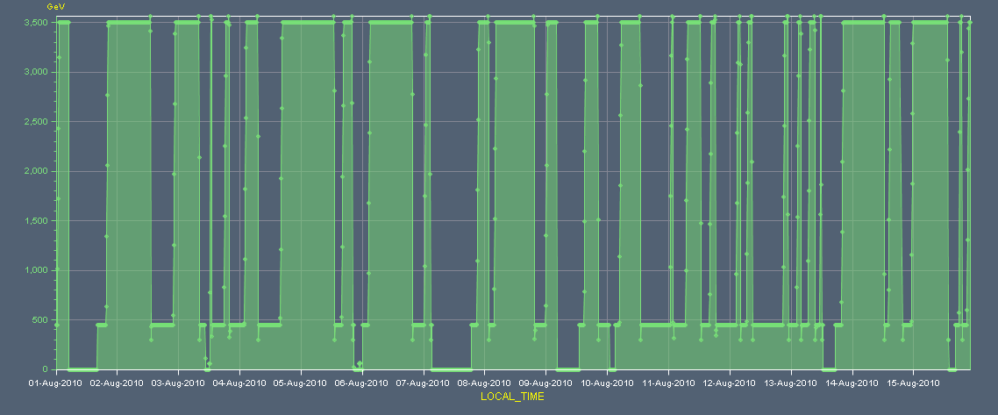
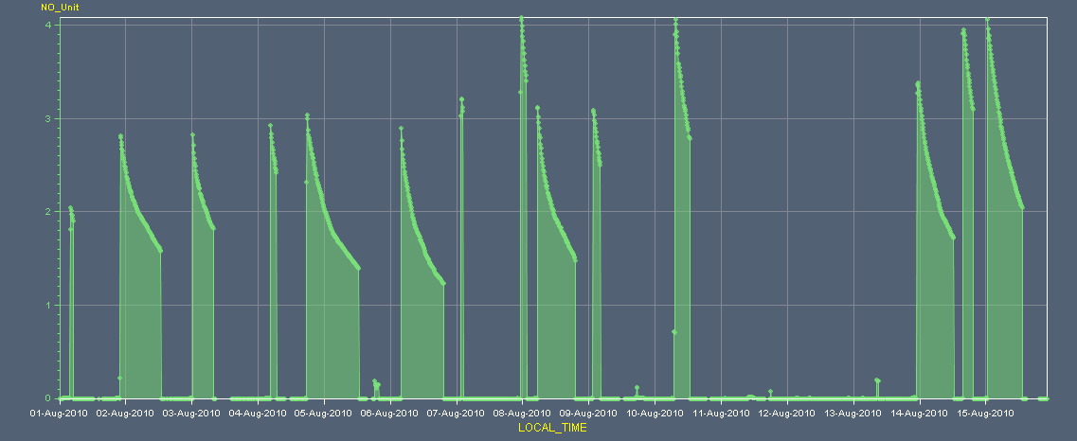
Energy & Luminosity 1-15 August

Slide 4
Operation consolidation
OFB, QFB, BPM data consolidation – Ralph Steinhagen – Lars Jensen
deployed new OFC version (reject undesirables) and new BPM FESA server with additional checks to intercept non-physical measurements
Consolidation of Orbit from injection to physics – Joerg Wenninger
Feed forward Q’ correction at end of squeeze – Stefano Redaelli
New beam process driving the EOS to Collisions – Mike Lamont
Sequencer update
Procedure update – all EICs

Slide 5
BLM consolidation – Christos Zamantzas – Annika Nordt
Test PM and XPOC recording functions update:
Temporary deployment of the next firmware version to the processing electronics
Dry check of PM events
Checks with beams: 3 PM events generated – 1 debunched beam + 1 by injecting to a closed collimator.
Detailed analysis and validation done
Ready to release and test the new version today.
Required to move to 48 bunches end of this week.

Slide 6
Operation consolidation
5 physics attempts dumped at flat top
1 beam dump at flat top by RQTD/Fs trip when QFB was being switched off. OFC crashed. Understood and fixed.
2 beam dumps during last step of squeeze - RSF2.A67B2 and RSF2.A23B2 trips
→ step in current, which were generating a too high voltage on the circuit. Affecting all SF and SD of B2
→ Regenerated chromaticity / sextupole functions for squeeze and re-trimmed knob functions using matched data points only. Current functions now smooth throughout - Aarush & Mike

Slide 7
Operation consolidation
2 beam dumps right before collisions – RCBXH1.R2 trip
→ Circuit RCBH1.R2 trips due to excessive acceleration at the start of the collisions function.
At the limit: problem manifested itself after ~ 1 week…
→ Issue with trim incorporation in LSA.
Fix my Mike Lamont – to be deployed
→ Possible watch dog … ?

Slide 8
Collimators – TCT alignment vs. orbit Stefano Redaelli
Comparison between collimator alignment and orbit change: TCTH.R2.B2 - TCTV.R5.B2 - TCP.R7.V.B2
(dis)agreement at the level of 100-200 μm between orbit and collimator beam based alignment check of PM events

Slide 9
Collimators – Roman Pots alignment – Stefano Redaelli, Mario Deile
In physics conditions: 3.5 TeV, b* = 3.5 m, crossing ON, separation OFF
Beam based alignment of 4 Roman pots (2 vertical and 2 horizontal) of beam 2.
With the last pot alignment, the beam was dumped from the XRP BLM (unmaskable) with a small step of 50 microns.
For the other pots the alignment was done with 100 microns setps without problems
The new settings found need further analysis (and must be completer with beam 1 alignment) before they can be used.

Slide 10
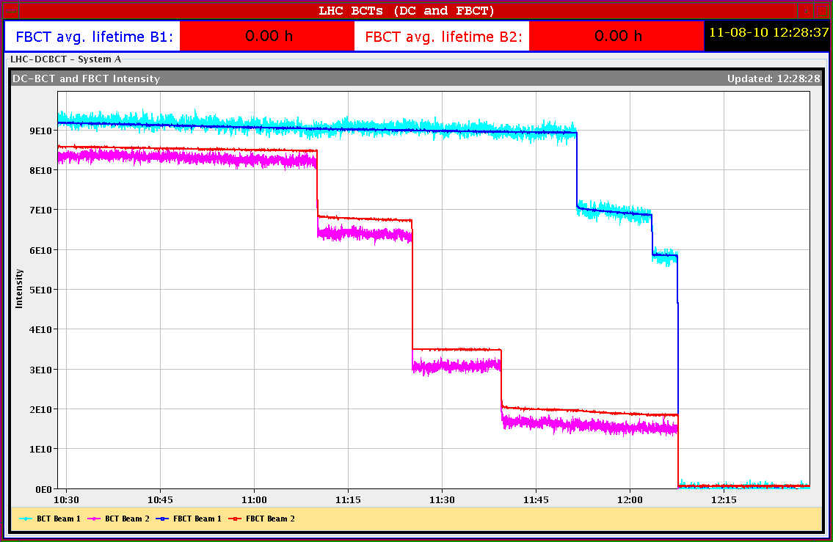
Collimators – Loss maps on resonance Stefano Redaelli – Alick Macpherson - Joerg Wenninger
1b x 1b, ramp - squeeze – collide - collimators at physics settings and TOTEM Roman pots at 20 / 25 σ for V/H pots
preparation for moving to 20 / 25 σ settings(V/H) for data taking.
For B1 and B2: cross 3rd order resonance in H and V
B1V
B1V
B2V
B1H
B2V
B2H

Slide 11
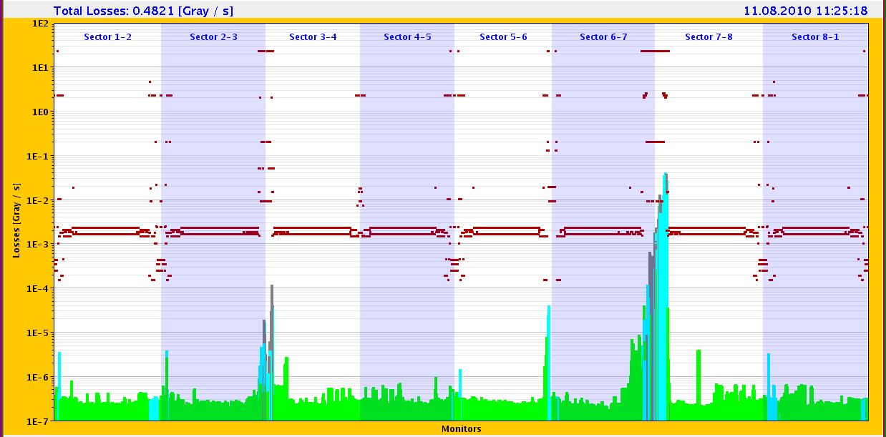
Wednesday 11 August
BLMs to check
Loss maps looked good: no apparent peaks at unexpected locations -Collimator hierarchy respected for reasonably slow losses. Leakage to cold magnet typically below the 10e-4 level.
(1) No actions needed from collimation side for collimator physics settings; (2) For the next physics fills, Roman pots to 20/25 (V/H) sigma settings.

Slide 12
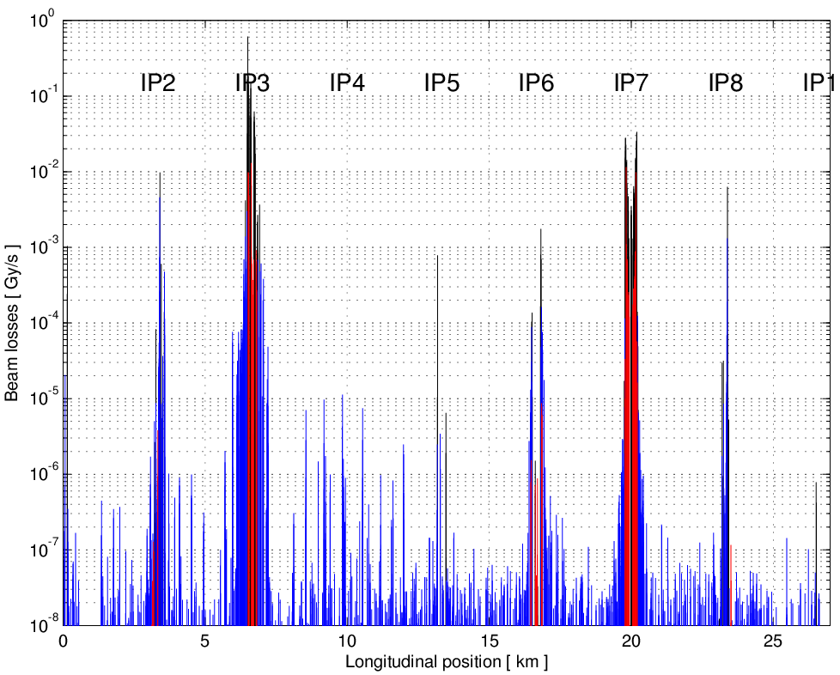
Collimators – Loss maps on momentum Stefano Redaelli, Walter Venturini, Joerg Wenninger
BLACK = collimators
RED = warm elements BLUE = cold elements
1bx1b, Physics conditions -1000 Hz RF trim
TCTs see about ~0.01 of the primary loss spike and the cleaning efficiency to the cold elements is 99.25% (4 stage hierarchy is respected).
Operation with 25 bunches can continue in these conditions
To be repeated for B2

Slide 13
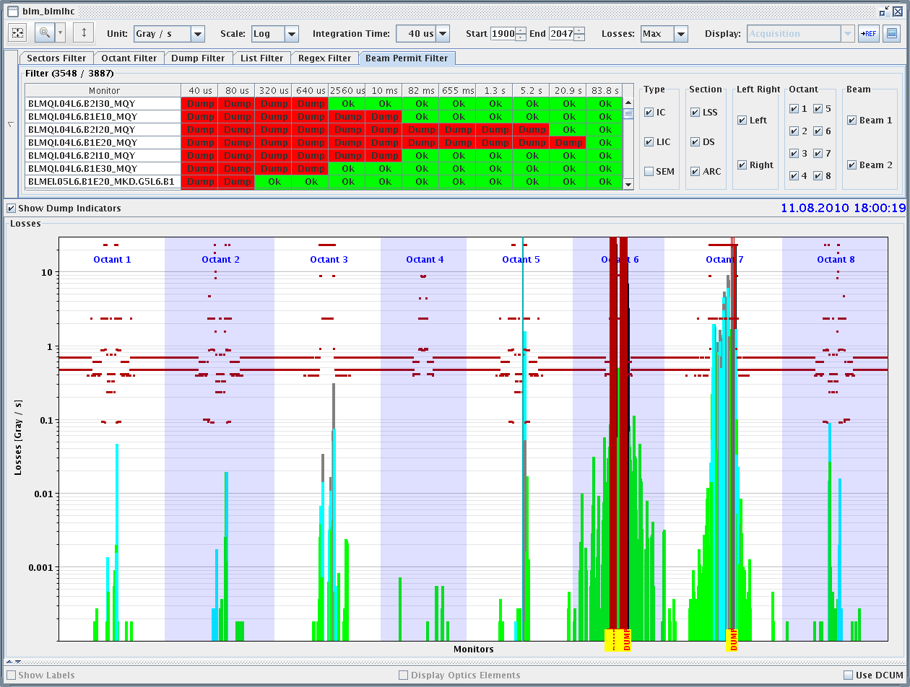
LBDS : asynchronous beam dump Wolfgang Bartmann, Chiara Bracco, Jan Uythoven
1 x 1, ramp , squeeze, collide.
Beam de-bunched – 6x10¹⁰ p / beam.
High loss signals in IR6, some monitors in saturation.
Clear peaks at TCTs.
Losses analyzed -->
O.K. to continue 25b operation

Slide 14
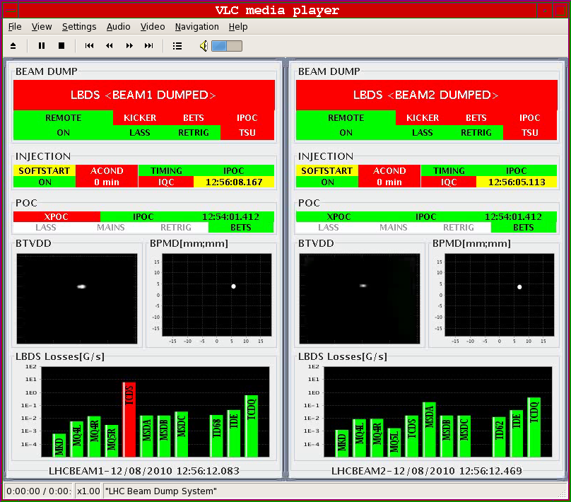
LBDS: 450 GeV beam dump validation
XPOC error on B1; the TCDS beam loss bar appears in red on the LBDS display
checked on another dump : all BLM behaviors as expected

Slide 15
Test ramp at 10 A/s Mike Lamont, Ralph Steinhagen, Rhodri Jones, Walter Venturini , Rogelio Tomas and team
Friday morning:
Ramp went fine up to the dump at ~1.7 TeV.
Beams dumped by SIS: energy consistency check dumped: the currents/energy of the 8 sectors were seen not consistent. This was a consequence of the fast ramp (and therefore energy change) rate. Fixed for the next attempt.
Sunday afternoon:
Ramp perfect all the way to 3.5 TeV.
Both ramps:
Orbit, tune and chromaticity rather stable – FBs O.K.
Optics measurements in the ramp and on the FT.

Slide 16
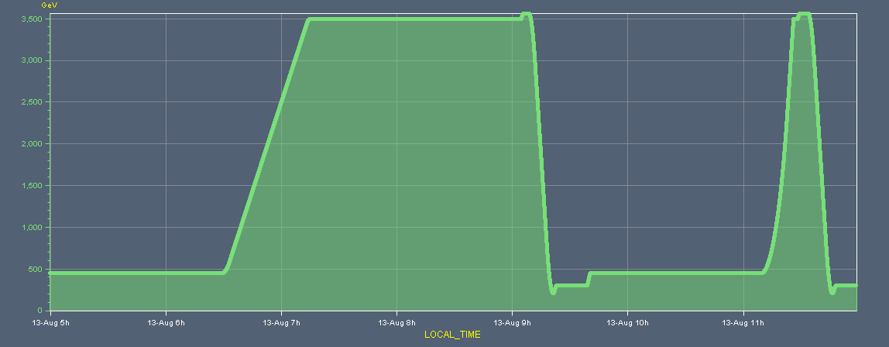
Test ramp 10 A/s
Ramp duration reduced from 46 to 16 minutes

Slide 17
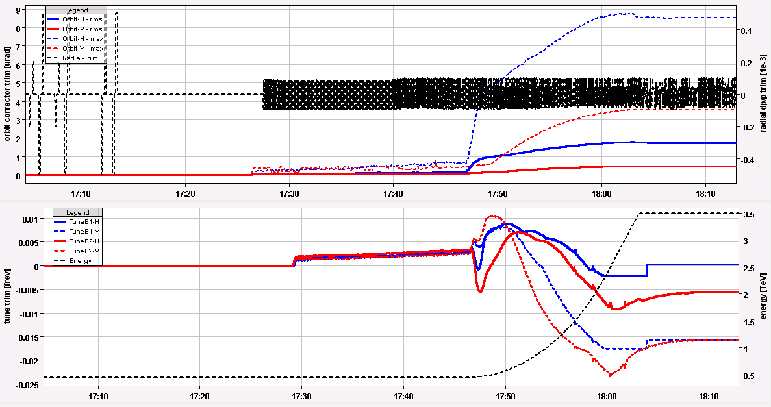
Feedbacks
FB trims

Slide 18
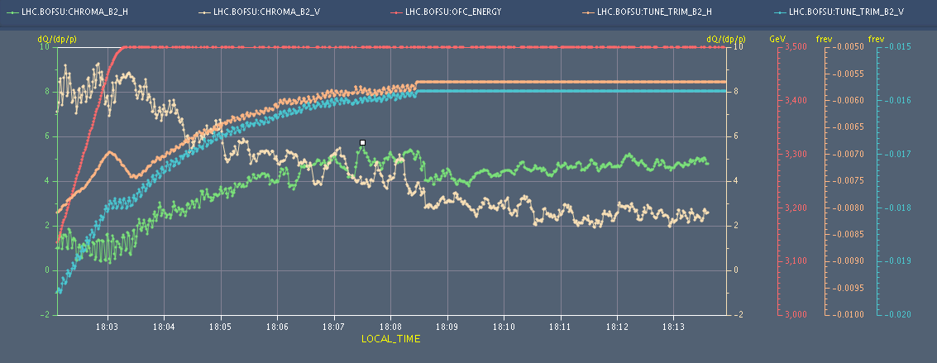
Decay at 3.5 TeV
Q and Q’ decay on the flat top

Slide 19
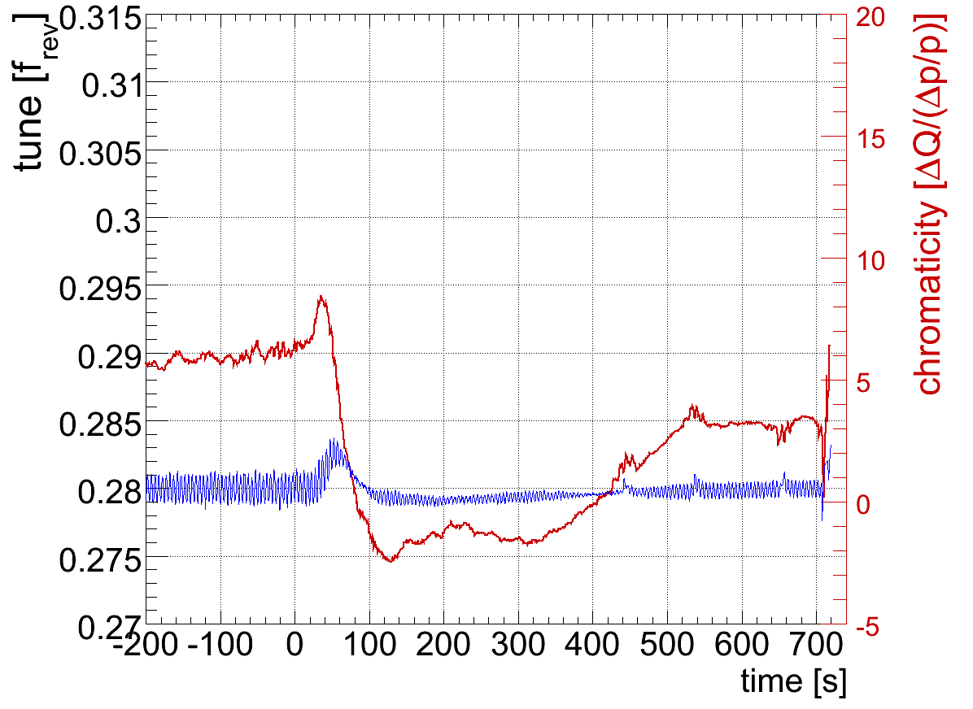
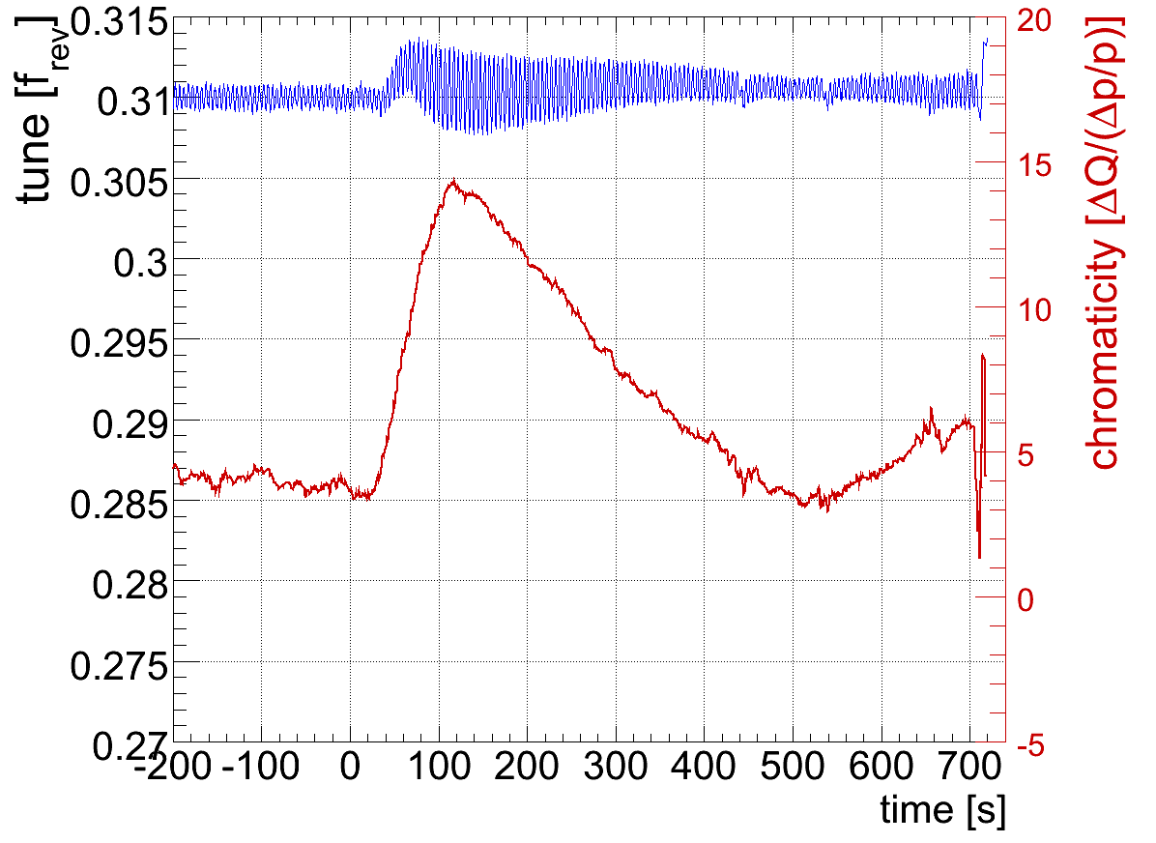
Test ramp at 10 A/s
Chromaticities during the ramp- Ralph Steinhagen Moderate drifts (|dQ'| < 10) and typical b3 error than pushes one plane up (V) and the other down (H).
AC-dipole excitations
B1 horizontal
B1 vertical

Slide 20
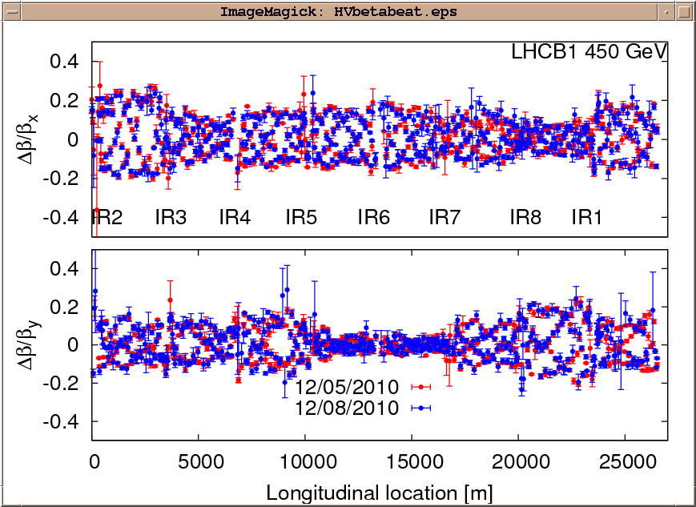
450 GeV optics measurements – B1
Rogelio Tomas and team

Slide 21
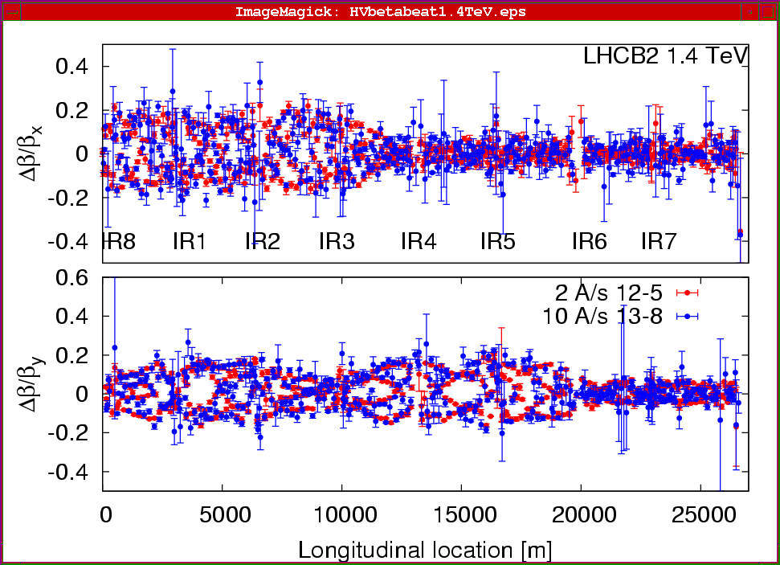
1.4 TeV optics measurements – B2
Rogelio Tomas and team

Slide 22
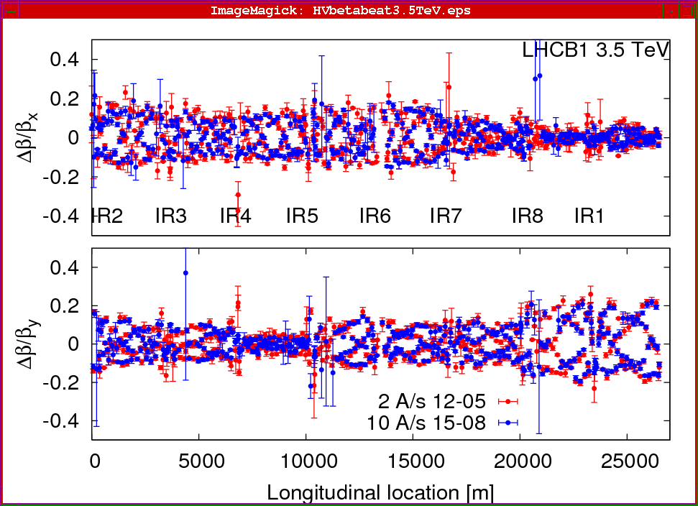
3.5 Tev optics measurements – B1

Slide 23
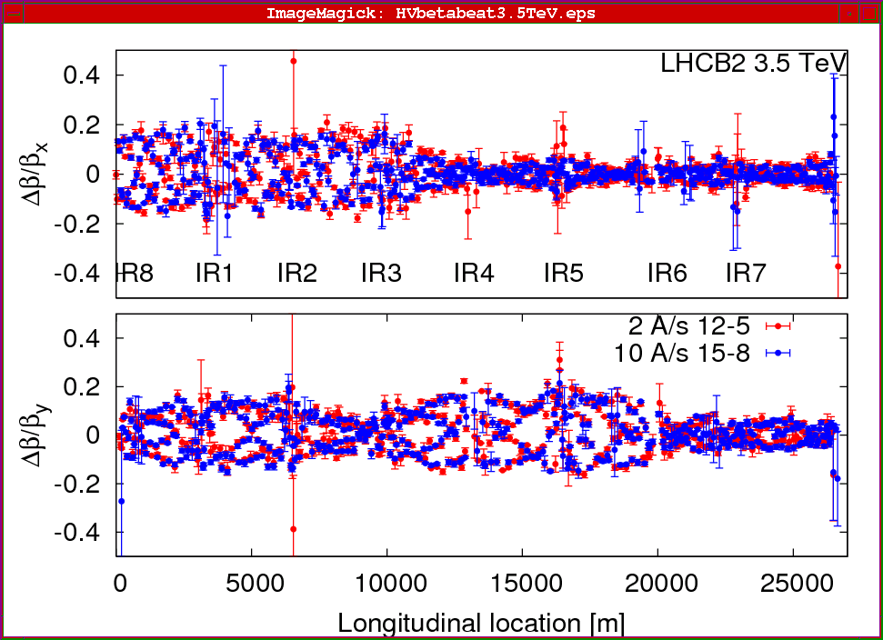
3.5 TeV optics measurements – B2

Slide 24
Physics fill – 10 August
25bx25b - B1, B2 H,V ~ 2 μm
Luminosity peak of 4x10³⁰ in both CMS and ATLAS
No sudden losses observed. About 50 nb⁻¹ delivered in ~5 hrs
Beam dump : (fake) temperature interlock TCLIB.6R2.B1

Slide 25
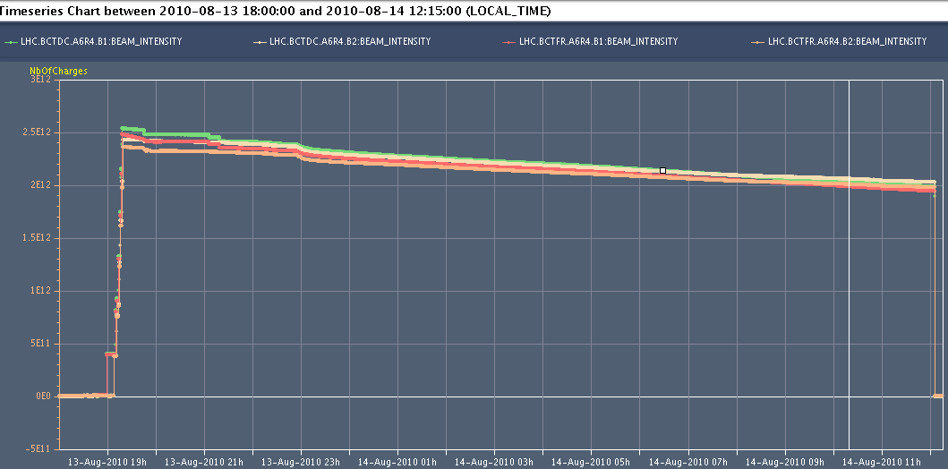
Physics fill: Friday 13 to Saturday 14 August
Fri. 13 @ ~23:00 – Sat. 14 @ ~12:00: ~13 h in stable beams
Peak Luminosity ~ 3.3 μbs⁻¹
Fill luminosity ~107 nb⁻¹
Ramp
start
Tune
settings
Start
Ramp
to
collisions
Tune
settings
~13 h

Slide 26
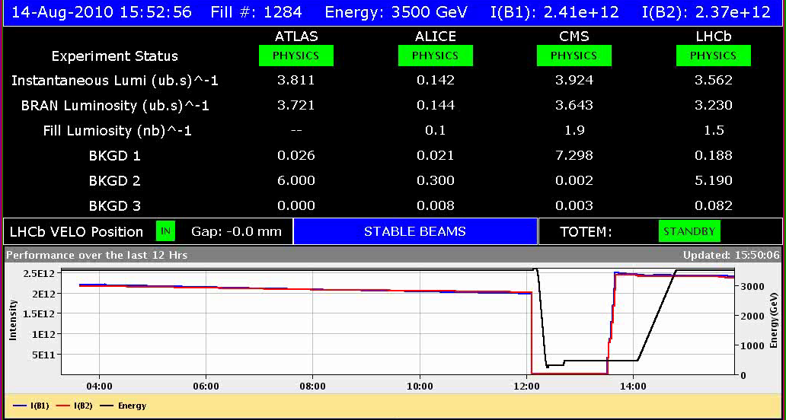
Physics fill: Saturday 14 August
25b x 25 b - B1: H=2.8 V=2.5 - B2: H=3.1 V=3.4
9.6e10/bunch
14:00 – Start ramp → 15:52 : Stable beams
Walter + Ron + Alick + Markus
→ 3h40 roll over from Physics beam dump to stable beams!

Slide 27
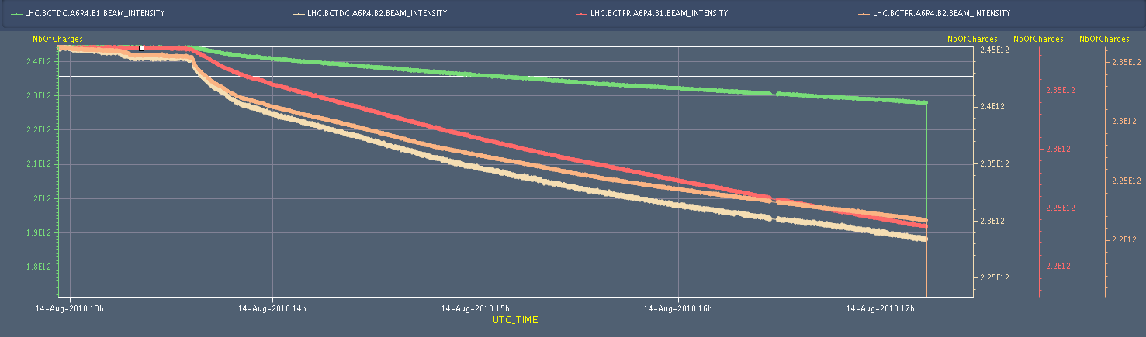
Physics fill: Saturday 14 August
3.5 hrs of stable beams
Fill luminosity ~43 nb⁻¹ for IP 1 and 5
Dump by Roman Pot XRPV.B6R5.B1 moving to new approved settings (20/25 σ vs 25/30 σ)
~3.5 h

Slide 28
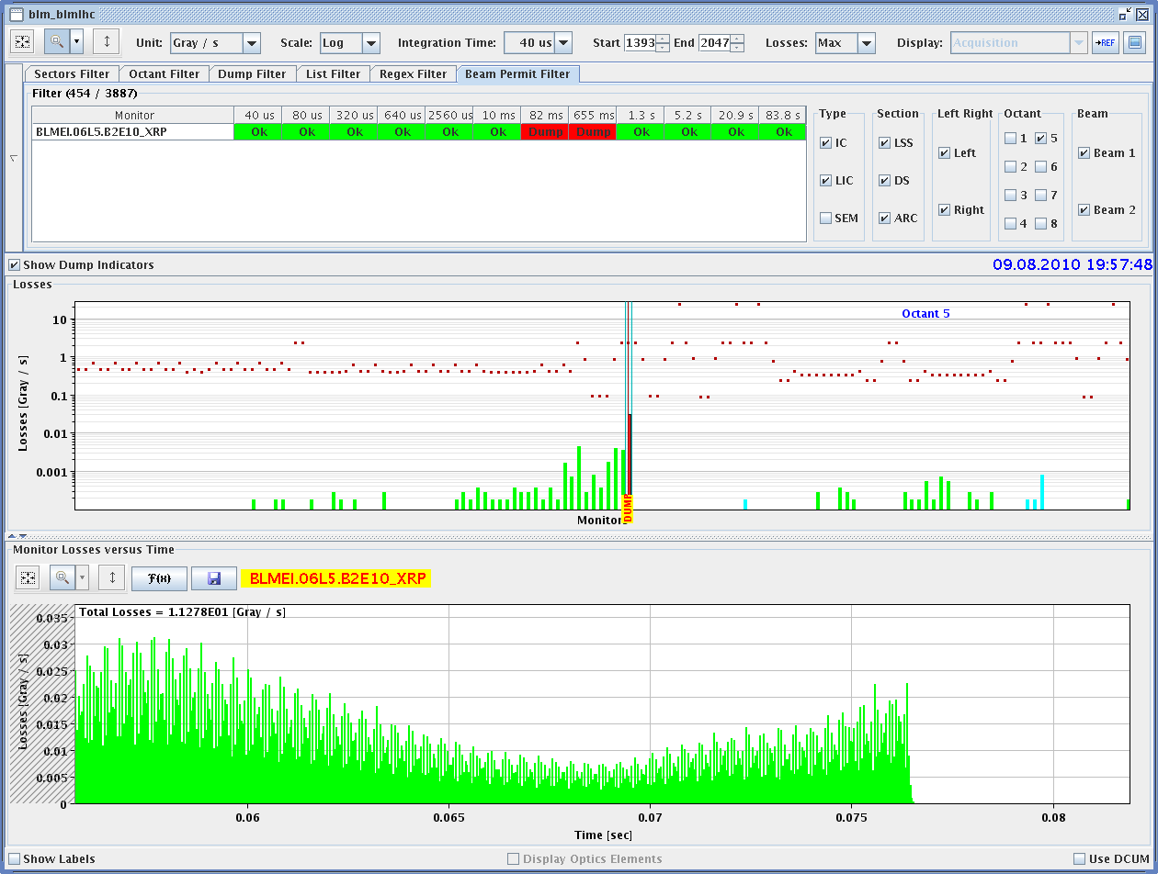
Beam dump during RP alignment
Horizontal RP on B2. Loss map has a large local peak.
RP BLM

Slide 29
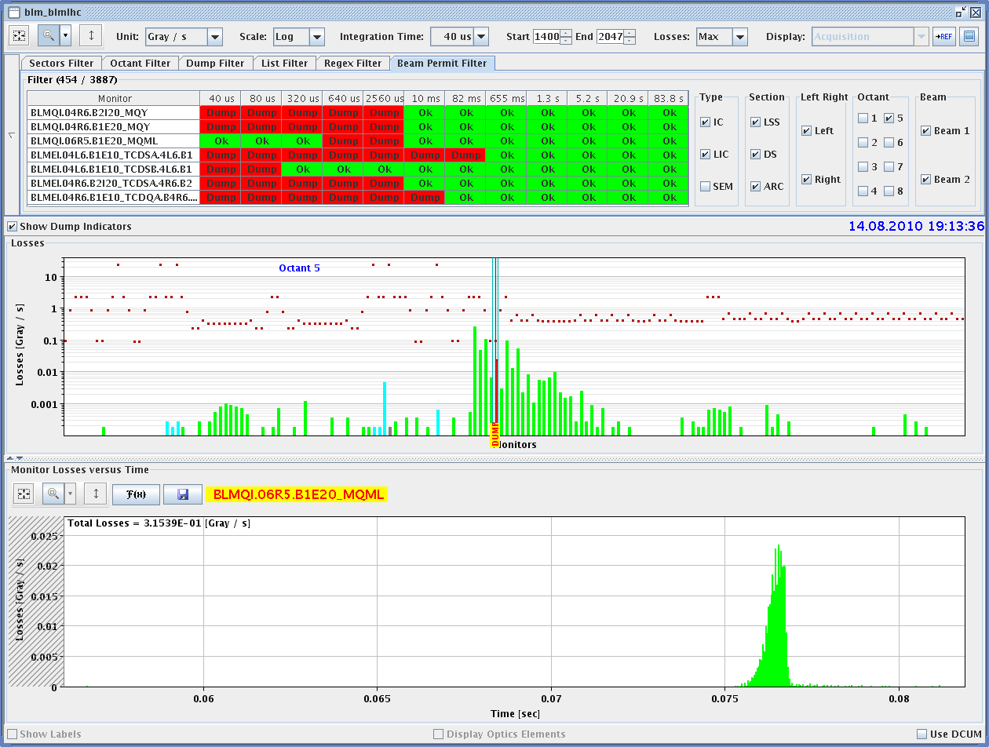
TOTEM event in stable beams (V B1)
Very similar time structure than the 4 events with losses on SC magnets – loss map less localized than during alignment event.
RP BLM

Slide 30
Physics fill – Sunday 15 August (00:40->13:00)
25b x 25b - B1: H 2.5; V 2.4 - B2: H 3.0; V 3.3 μm
~ 0.96e10 / bunch
Initial peak luminosity of about 3.9 μbs⁻¹
12 hour fill – Fill luminosity ~123 nb⁻¹

Slide 31
Physics fill – 15 to 16 August
25b x 25b - B1: H 2.5; V 2.4 - B2: H 3.0; V 3.3 μm
~ 0.96e10 / bunch
Initial peak luminosity of about μbs⁻¹
XX hour fill – Fill luminosity ~XX nb⁻¹

Slide 32
Plans
Monday:
8:30 – 9:30: EOF (ADT - TBC)
9:30 - Dump physics fill
9:30 – 13:00: Ramp down + new BLM firmware release (dry tests)
CMS solenoid ramping down
LHCb dipole ramping down and will switch polarity when ramping up
13:00 – 16:00: LHC in access
16:00 – 20:00: LHC recover 450 GeV injection conditions + some 450 GeV tests (BLMs…) + CMS and LHCb ramping back up.
Overnight
BLM requalification tests (tbc) and test ramp with Loss maps on momentum - B2?
Week 33: coordination: Oliver Bruening
Moving to 48bx48b
First 150 ns bunch train attempts
Roman Pots: check movement at 3.5 TeV, with 1b

Slide 33
Pending Access for Monday 16 August
CMS – LHCb
Fast BCT – Pt 4 – change attenuators -David Belohrad
IP6 UA63 :CPU in CFV-UA63-BCTFD crate to change -David Belohrad
Magnetic probes in the machine for the studies related to the hump - access in point 5 (Louis Walckiers) – 3 hours
UJ76 – Diamon monitors – 1h - Barbara Holzer - Ruediger Schmidt

Slide 34
Access for TS in 35
RCBH18.R7B2 – Miguel CerqueiraBastos
CV need to replace a motorization of the water valve of the sector 56 - not urgent ~3 hours
Access team to replace oxydized connectors for PAD-PX24 in case of stop (3 hours)
QPS boards: several boards had to switch from channel A to B.
BLM racks (in buildings SR1 and SR5 and both at position BY02): would like to correct the way the power cable for the multi-plug arrives inside the rack.
Ion pumps in dump line MKB (B2 only 4 out of 8 pumps working; few days intervention, next TS)

