Slide 1
Report Week 29 (R. Assmann, O. Bruening)
Monday 08h00 – Thursday 18h00: Technical stop.
Thursday 18h00 – Saturday 12h30: Recovery without beam.
Thu 18h00: LHC closed. Requalification of various magnets (following interventions during technical stop).
SPS MD’s: no beam from SPS until Fri 8h00.
Fri 06h30: Start of LHC dry-runs with 10 A/s.
Fri 11h00: Short in SPS main dipole diagnosed. Need to replace main dipole in SPS. No beam for LHC. Continuing LHC dry runs.
Sat 04h00: SPS intervention completed. CMS access in shadow.
Sat 08h00: PS RF problem. No beam from PS.
Since Saturday 12h30: Recovery with beam.
Changes during LHC technical stop (SMP, …)
3 SPS magnets changed (different orbit → transfer line setup)
Transfer line work in TI2 for HiRadMat work
Change in LHC precycle and rampdown: 2 A/s → 10 A/s

Slide 2
Saturday 24.7.
12h30: Beam back in LHC.
Injection setup.
Transfer lines were corrected to the old reference after the orbit change in the SPS.
Large non-closure after polarity siwtch of LHCb dipole + compensator bump. Corrected it on one of the compensators.
Relatively large synchro loop error at injection ~ 60 deg peak to peak. Needs adjusting before filling later on. (Check dp/p on first turn).
cfv-sr7-blmr tripped several times in shift.

Slide 3
Saturday 24.7.
14h23: Beam dump checks – IR6 BPM interlock (B. Goddard, M. Meddahi).
P6 Interlock BPM checked with single pilot and bumps only at L or R of P6. B2 tested only (only system changed in technical stop). All 8 combinations L/R, H/V, +/- triggered both crates A&B correctly at the right amplitudes.
Repeated above tests with single INDIV bunch; again all OK
Repeated with 2 INDIV bunches for H plane, with turncount set to 170/100, to try to reproduce problems seen 10 days ago. All behaved OK, with crates A&B triggering - only difference wrt 1 bunch was that trigger happened at maybe 0.5 mm larger amplitude for 2 bunches.
No attempt made to check intensity dependence.
All Interlock BPM tests passed OK.
Beam dump requalified at 450 GeV

Slide 4
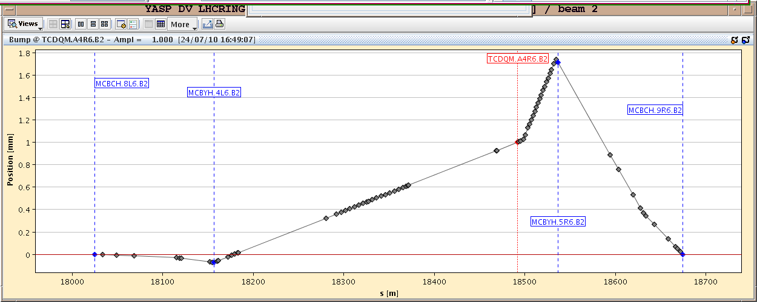
IR6 Checks

Slide 5
Saturday 24.7.
Pilot and nominal bunch injection recovered
17h05: Injection tests with higher bunch intensity (BG, MM).
Trajectories in TLs different after TS. SPS extraction resteered with extraction bumpers, to optimise traj. in TT40 and TT60
Corrections also needed in TI2 using TT60 and TI2 elements.
TI2 worse with RMS of 0.6 mm in H: SPS magnets (orbit) + TI2 MQI204 / attached BPMI removed/reinstalled for HiRadMat.
TI8 RMS wrt old reference now about 0.4 mm.
Losses checked on TCDIs. Losses consistent with offsets of up to several sigma - SPS pilot beam had H emittance of 1.6 um.
Still work on TI2 and TI8 trajectories tomorrow. New TCDI setup tomorrow not excluded, at least for most critical losses.
Losses in LHC checked: overinjection, injection of 2nd nominal bunch. Possible to inject the INDIV bunches (OK for the night) but losses up to 50-60 % of threshold on Q8/Q7 BLMs: unscraped INDIV bunch W/O transverse blowup (~2um HV).
Need pilot, INDIV and LHC2 multibunch beams all OK for tomorrow with correct transverse parameters and scraping.

Slide 6
Saturday 24.7.
Recurring BLM problem: repair attempt #1
18h23 – 22h20: BLM crate problem in point 7 repair attempt:
Experts have changed a piece of HW and deployed some more software diagnostics to follow-up the problem.
In parallel, the faulty crate (cfv-sr7-blmr) has been taken out from the SIS interlock.
As soon as possible, a power cycle should be done by Christos to get rid of the offset in BLM point 7. In case communication is again lost, we should restart in diamon the process BLMLHC_M on the crate cfv-sr7-blmr)
During the down-time, SPS has corrected the instabilities which were preventing using the scrapers and INDIV is now back to nominal settings.

Slide 7
Saturday/Sunday 24/25.7.
23h12: Prepare ramp.
Accumulated more than 25 units of chromaticity trim.
Limits changed in LSA.
23h41: Start ramp.
Loss of intensity.
00h30: 3.5 TeV orbit corrected.
00h34: Beam dump test → OK.
00h37: Triplets in 78 and 81 tripped.
Beam dump requalified at 3.5 TeV

Slide 8
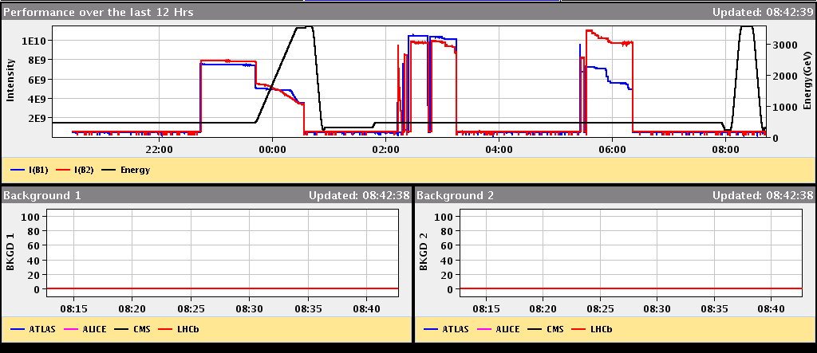
History
1st test ramp with modified LHC cycle
Ramp

Slide 9
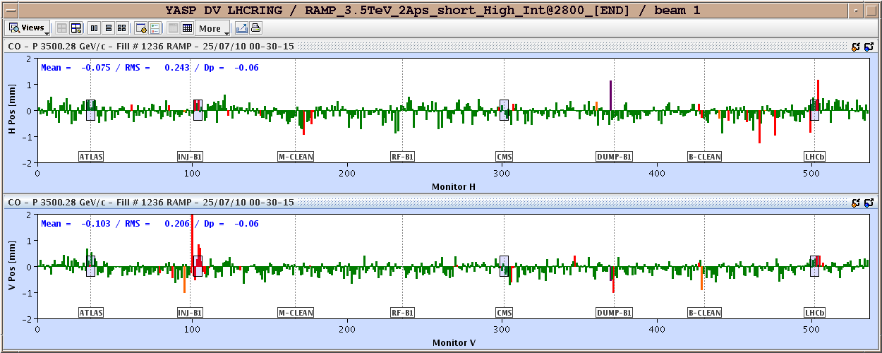
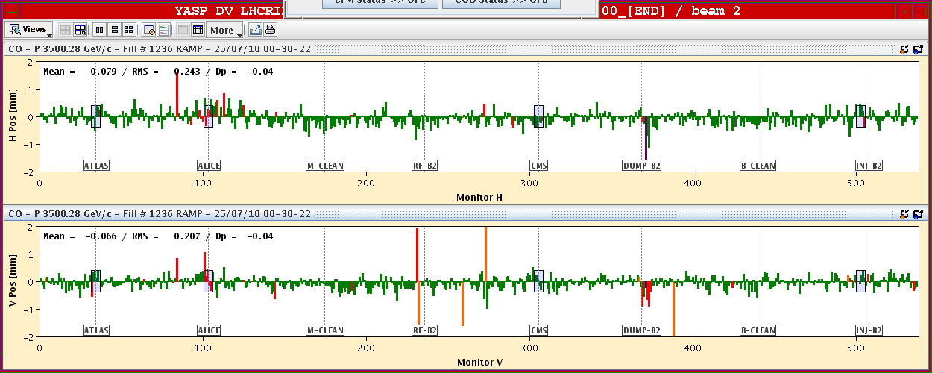
Orbit at 3.5 TeV

Slide 10
Sunday 25.7.
02h15: Beams at injection:
Chromaticity correction.
Beta beat measurement at injection.
03h15: Loss the cryo maintain in S23. Reset remotely.
04h37: EPC piquet informed us that the TCR and filters in P2 are off.
07h00: Reset of P2 compensator. Recover and pre-cycle. During night: 7 trips more on BLM crate,
09h30: Prepare for test ramp with pilot bunch (fix chromaticity and orbit problems).
10h26: Start of ramp.
11h23: Requested beam dump at 3.5 TeV. Rampdown and precycle. CMS cosmic run. Ramp up of ALICE solenoid. Work on BLM crate in IR7.

Slide 11
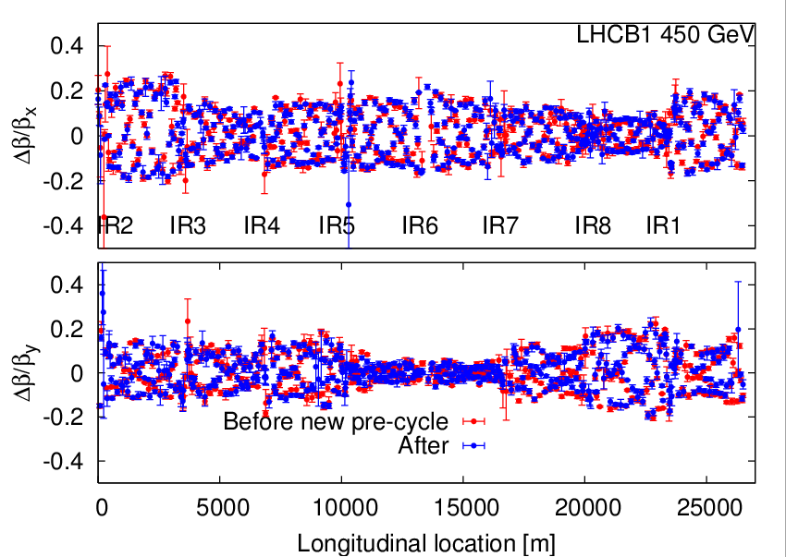
Beta Beat B1
Optics requalified B1 at 450 GeV

Slide 12
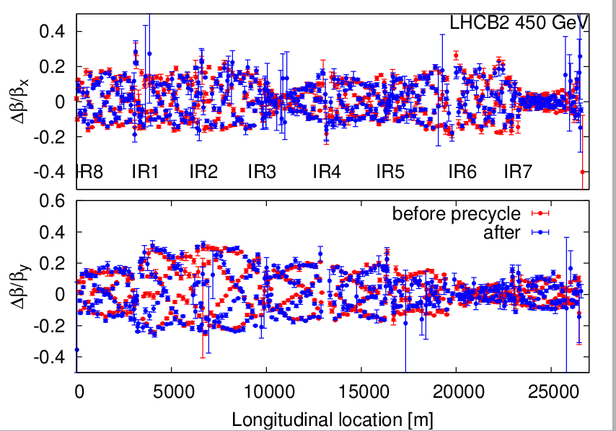
Beta Beat B2
Optics requalified B2 at 450 GeV

Slide 13
Successful Pilot Bunch Ramp (High Chrom.)
Pilot bunch ramp OK
2nd test ramp with modified LHC cycle

Slide 14
Sunday 25.7.
13h00: Injection.
14h49: Orbit feedback and the radial modulation:
Suddenly radial trims went crazy. Sent in huge RT RF trims.
More than 2 mm off from our references in orbit immediately.
Switched off, reset real time trims and switched on again.
14h52: Beam dump analysis for last night (B. Goddard):
Both the dumps with pilots at 3.5 TeV looked OK (00:33 and 11:23).
The beams are in the right place on the BTVDD for both dumps, and XPOCs were passed OK including the new kicker generators.
For the first one at 00:33 there was rather a lot of uncaptured or satellite beam which was on the TCDQ, certainly for B2.
One problem still is that we are missing PM and XPOC data from a lot of BLMs in P6 - this has to be fixed (BI were working on it but no news as to the recent status).

Slide 15
Sunday 25.7.
15h12: Start ramp with 1 bunch of 9e10 per beam.
Loose full beam 1: chromaticity, bad BPM readings with lower intensity, bad orbit through feedback, dump
Loose ~15% of beam 2: orbit.
Measure chromaticity during ramp and note down by hand.
16h05: Beam dump 3.5 TeV. SMP summary (J. Wenninger):
The SMP SBF modifications were checked:
Forcing the SBF to FALSE.
SBF to relaxed mode [x4] - only for beam2.
SBF to normal - only for beam2
Symmetry of SMP: no issue is expected for beam1. Will be quickly tested with the next ramp. Everything behaved as expected.
Forcing SBF1/2 and reset. As specified the relaxing has no effect.
Above 2 TeV, when SBF2 switched to FALSE in normal mode, the relaxing was checked. For an intensity of 8E10, SBF2 was TRUE up to 3.5 TeV in relaxed mode (threshold 1.2E11, normal threshold 3E10).
New SMP software qualified

Slide 16
Successful Pilot Bunch Ramp (High Chrom.)
3rd test ramp with modified LHC cycle
Chromaticity
Orbit

Slide 17
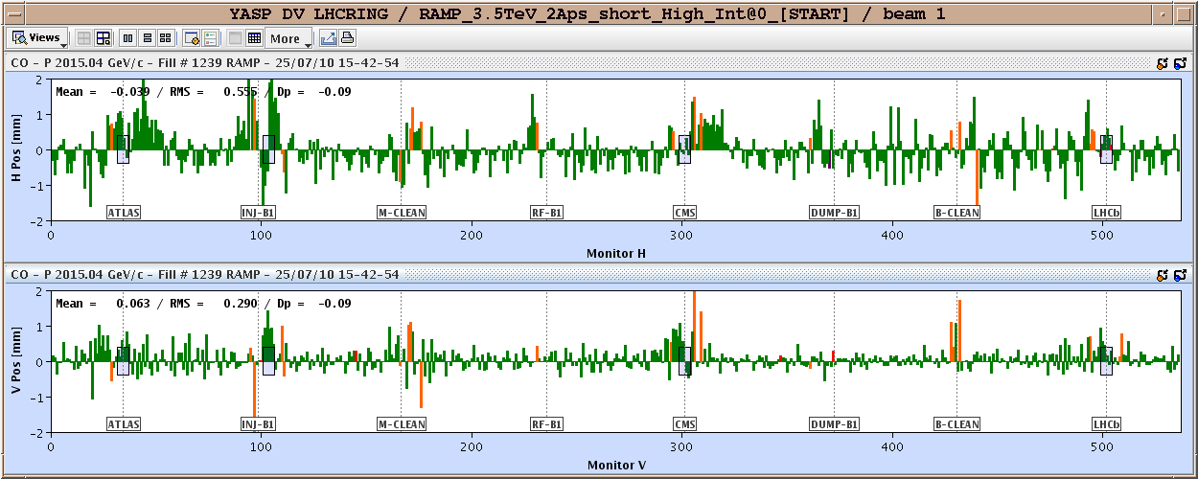
Orbit B1

Slide 18
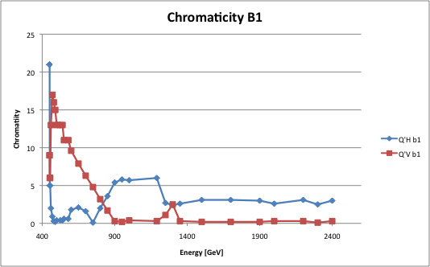
Chromaticity B1
Used for chromaticity feedforward

Slide 19
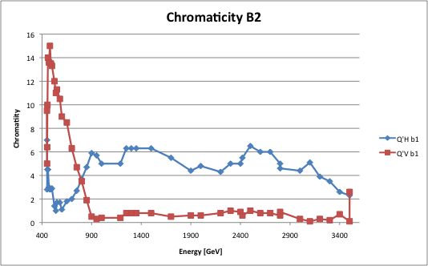
Chromaticity B2
Used for chromaticity feedforward

Slide 20
Sunday 25.7.
16h12: requested beam dump.
17h38: Summary of BLM intervention.
exchanged components from SR7.R: CISV, BOBR, ethernet cables, re-seated CPU
eliminated as cause of operating system crash: FESA processes, BLETC, BLECS, BOBR, timing cards
Interim solution: Survey script running on bdidev1 monitoring the CPU. On detection of no transmission will initiate a soft reboot of the LynxOS.
If SR7.R crate is seen down in DIAMON operators should wait more than 5 minutes to allow the survey process to restart it.
17h39: Trip RCS.A45B1. Access for repair. Trip of RQTL9.R7b2 temperature sensor (reading forced by expert).
22h11: Start precycle on RCS.A45B1.

Slide 21
Sunday/Monday 25/26.7.
23h15: Injection setup.
00h50: Start ramp.
00h58: Beam 1 intensity loss and subsequent beam dump.
01h38: Beam 2 at 3.5 TeV.
Orbit correction → rocky (losses). Common correctors used!? Also day before.
Loss map test (without squeeze).
02h08: Requested beam dump. Rampdown & precycle.
03h00: Injection.
04h36: Start ramp.
60% of both beams lost at start of ramp.
05h00: Beam 1 dump (orbit feedback, SIS interlock, …?). Mask?
05h19, 06h07: RCS A45B1 tripped → access required at around 08h00. Also repair T sensor on RQD.A23.

Slide 22
Intensity History
4th and 5th test ramp with modified LHC cycle
Not OK yet → further ramp commissioning required!

Slide 23
B1 Chromaticity in Ramp
Energy

Slide 24
Longitudinal Blow-up
Close start of ramp?

Slide 25
Ahead
Recover LHC operation with nominal bunch:
Ramp with feedbacks on, longitudinal blow-up on, damper on → ramp nominal bunch without losses
Squeeze with beta beat measurements
Collision, crossing, RP, …
Loss maps at the end
Recover 13b operation → stable beams for ATLAS in present configuration.
ATLAS and CMS magnets back to normal configuration.
Multi-bunch injection → increase intensity factor 2 → 25b operation.
Afterward: stable running period with 25 b (~1.5 MJ)…
Next coordinators: R. Bailey & J. Wenninger

