Slide 1
Saturday 24.7.
10h09: Ramp down with 10 A/s → works well.
12h30: Beam back in LHC.
Injection setup.
Transfer lines were corrected to the old reference after the orbit change in the SPS.
Large non-closure after polarity siwtch of LHCb dipole + compensator bump. Corrected it on one of the compensators.
Relatively large synchro loop error at injection ~ 60 deg peak to peak. Needs adjusting before filling later on. (Check dp/p on first turn).
cfv-sr7-blmr tripped several times in shift.

Slide 2
Saturday 24.7.
14h23: Beam dump checks – IR6 BPM interlock.
- P6 Interlock BPM checked with single pilot and bumps only at L or R of P6. B2 tested only (only system changed in technical stop). All 8 combinations L/R, H/V, +/- triggered both crates A&B correctly at the right amplitudes.
Repeated above tests with single INDIV bunch; again all OK
Repeated with 2 INDIV bunches for H plane, with turncount set to 170/100, to try to reproduce problems seen 10 days ago. All behaved OK, with crates A&B triggering - only difference wrt 1 bunch was that trigger happened at maybe 0.5 mm larger amplitude for 2 bunches.
No attempt made to check intensity dependence.
All Interlock BPM tests passed OK.

Slide 3
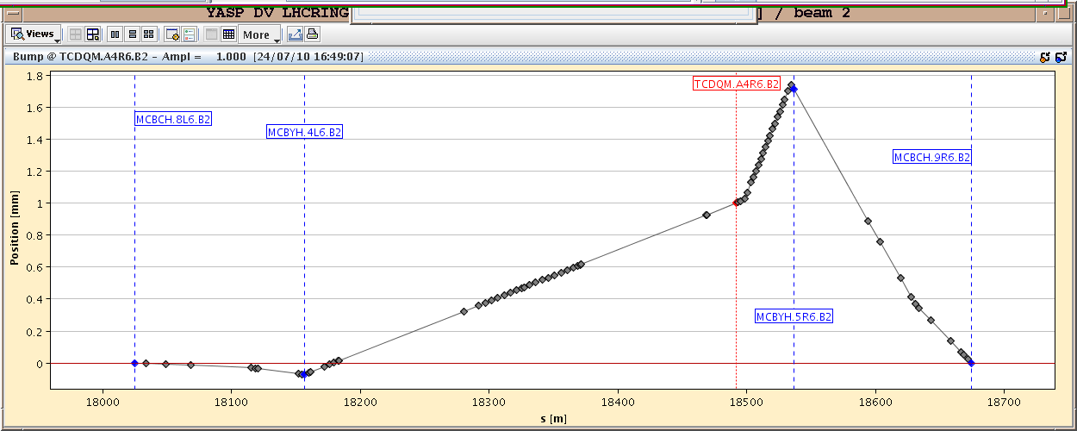
IR6 Checks

Slide 4
Saturday 24.7.
17h05: Injection tests with higher bunch intensity.
Trajectories in TLs different after TS. SPS extraction resteered with extraction bumpers, to optimise traj. in TT40 and TT60
Corrections also needed in TI2 using TT60 and TI2 elements.
TI2 worse with RMS of 0.6 mm in H: SPS magnets (orbit) + TI2 MQI204 / attached BPMI removed/reinstalled for HiRadMat.
TI8 RMS wrt old reference now about 0.4 mm.
Losses checked on TCDIs. Losses consistent with offsets of up to several sigma - SPS pilot beam had H emittance of 1.6 um.
Still work on TI2 and TI8 trajectories tomorrow. New TCDI setup tomorrow not excluded, at least for most critical losses.
Losses in LHC checked: overinjection, injection of 2nd nominal bunch. Possible to inject the INDIV bunches (OK for the night) but losses up to 50-60 % of threshold on Q8/Q7 BLMs: unscraped INDIV bunch W/O transverse blowup (~2um HV).
Need pilot, INDIV and LHC2 multibunch beams all OK for tomorrow with correct transverse parameters and scraping.

Slide 5
Saturday 24.7.
18h23 – 22h20: BLM crate problem in point 7 repair attempt:
Experts have changed a piece of HW and deployed some more software diagnostics to follow-up the problem.
In parallel, the faulty crate (cfv-sr7-blmr) has been taken out from the SIS interlock.
As soon as possible, a power cycle should be done by Christos to get rid of the offset in BLM point 7. In case communication is again lost, we should restart in diamon the process BLMLHC_M on the crate cfv-sr7-blmr)
During the down-time, SPS has corrected the instabilities which was preventing using the scrapers and INDIV is now back to nominal settings.

Slide 6
Saturday/Sunday 24/25.7.
23h12: Prepare ramp.
Accumulated more than 25 units of chromaticity trim.
Limits changed in LSA.
23h41: Start ramp.
Loss of intensity.
00h30: 3.5 TeV orbit corrected.
00h34: Beam dump test → OK.
00h37: Triplets in 78 and 81 tripped.

Slide 7
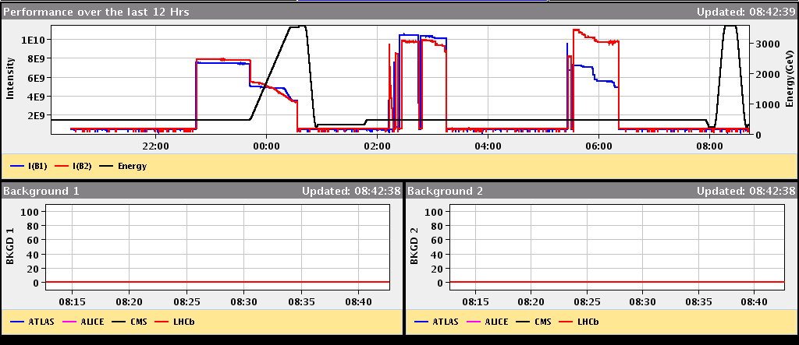
History
Ramp

Slide 8
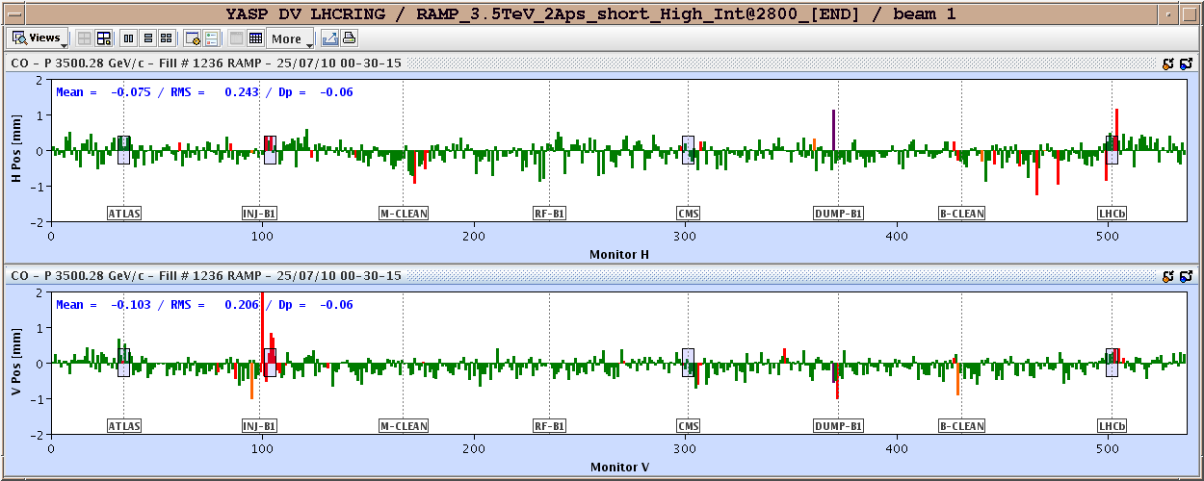
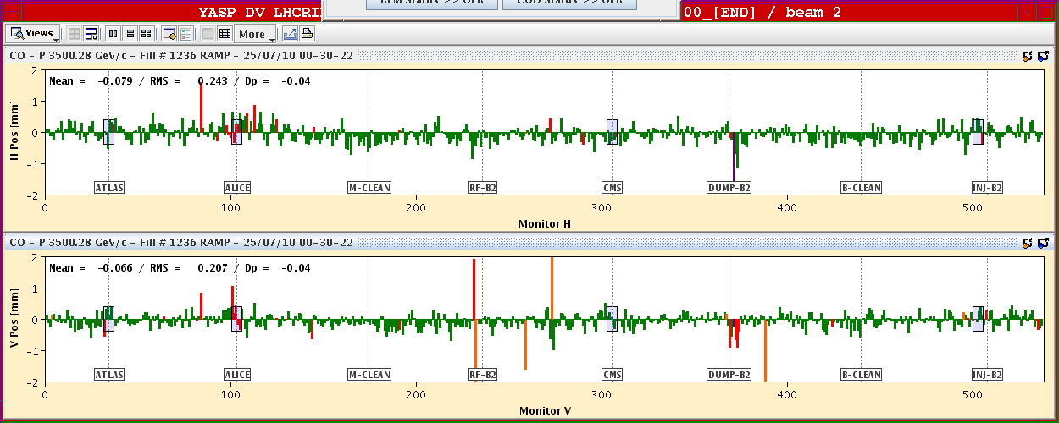
Orbit at 3.5 TeV

Slide 9
Sunday 25.7.
02h15: Beams at injection.
Chromaticity correction.
Beta beat measurement at injection.
03h15: Loss the cryo maintain in S23. Reset remotely.
04h37: EPC piquet informed us that the TCR and filters in P2 are off.
07h00: Reset of P2 compensator. Recover and pre-cycle.
During night: 7 trips more on BLM crate → needs to be fixed

Slide 10
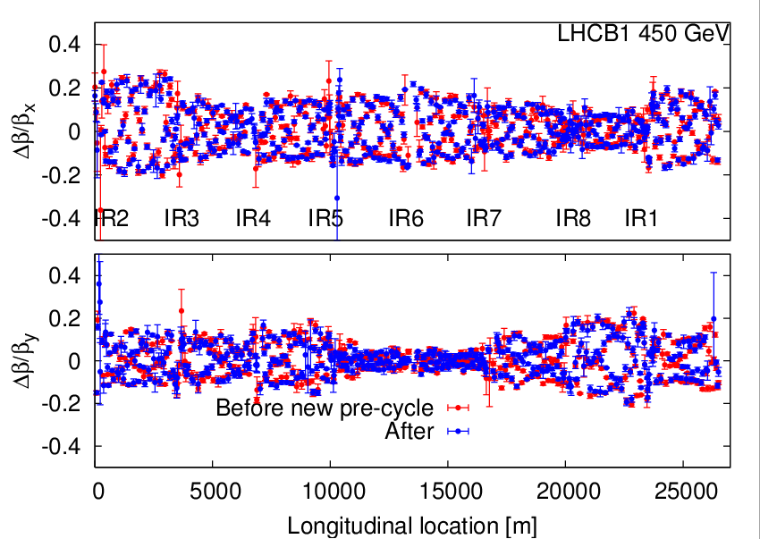
Beta Beat B1

Slide 11
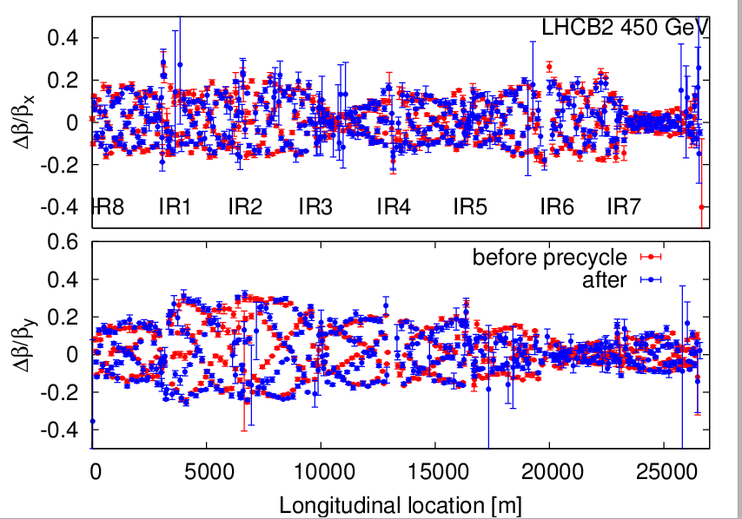
Beta Beat B2

Slide 12
Ahead
To be discussed
Present idea:
Sort out ramp with pilot bunch (x h)
Then test ramp with nominal bunch: squeeze, collisions, SMP, loss maps, … (~10 h)
Then multi-bunch injection setup or 13b fill.
Sort out BLM rack
CMS access, if access for the machine…

