Slide 1
Weekly summary
Summary Week 28 -12.07/19.07
M. Lamont & J. Wenninger
for the OP team and
for all colleagues from the various groups

Slide 2
General performance
Start of the week : operation with 8/9 bunches per beam, 9E10/b.
6 colliding pairs for ATLAS, CMS and LHCb.
Tuesday : switch to 12 bunch operation, 9E10/b.
8 colliding pairs for ATLAS, CMS and LHCb.
Peak luminosity 1.4E30 cm-2s-1
Thursday : switch to 13 bunch operation, 9E10/b.
8 colliding pairs for ATLAS, CMS and LHCb.
Stored energy : 660 kJ.
Peak luminosity : 1.6E30 cm-2s-1 for fill 1233 on Sunday.
Expected luminosity 1.7E30 cm-2s-1 for nominal emittances.
Longest fill : 19 hours.
Attempt to add an extra ½ intensity bunch for LHCf on Thursday.
Aborted, running late in the night, longer than expected beam position interlock check.

Slide 3
Record fill 1233
In stable beams for 19 hours
L at end: 0.7E30 cm-2s-1

Slide 4
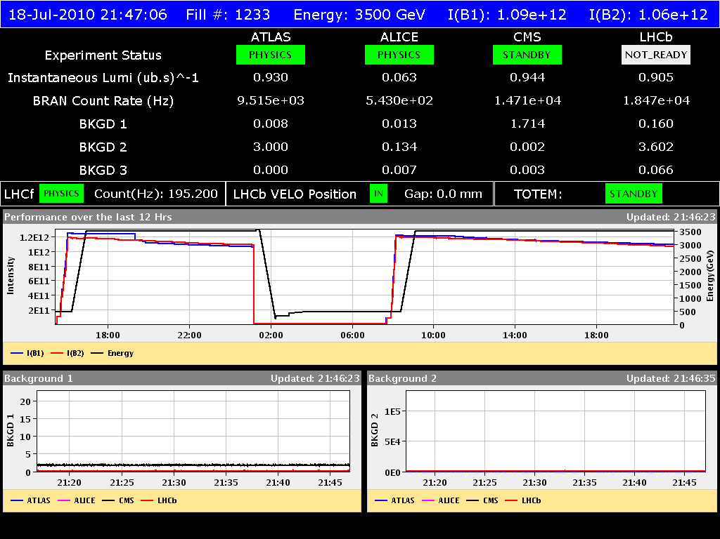
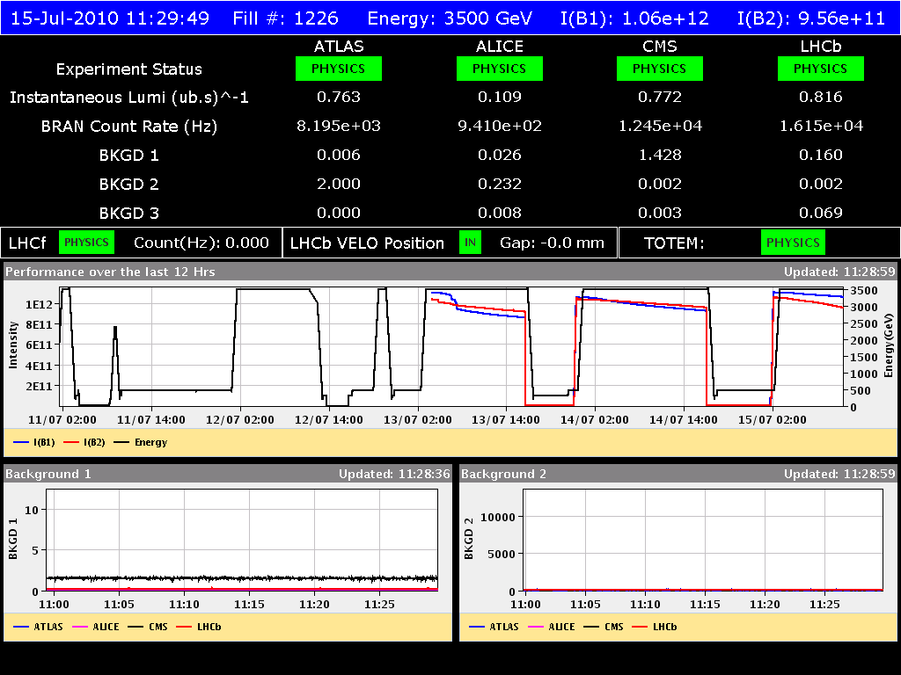
Good periods !

Slide 5
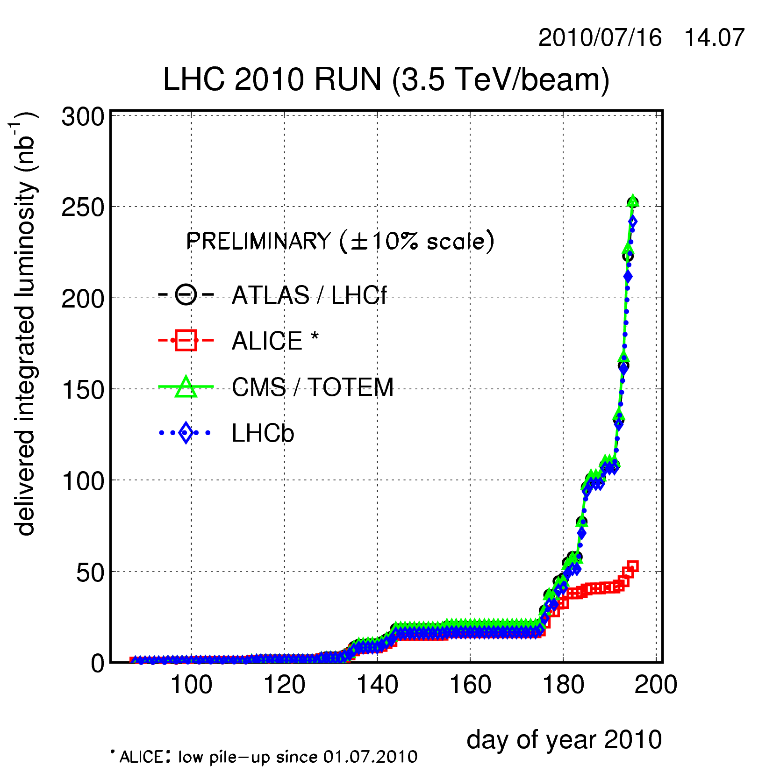
Integrated L (M. Ferro-Luzzi)
Does not include
the weekend !

Slide 6
Beams in collisions
Beam intensity lifetimes in collision between 25 and 125 hours.
Initially lifetime degradation when switching on transverse damper on B2, fixed by RF team during the week (better noise performance).
In the last fills dampers had positive or no effect on lifetime.
Fill with very equal TOTAL intensity tend to perform better.
Losses in collisions.
Bunch intensity losses have still been observed in collisions, but they became less frequent in the second half of the week.
Changes:
Damper ON (but not always).
Larger Q split B1-B2 : from 0.003 to 0.005.
Manual luminosity optimization.

Slide 7
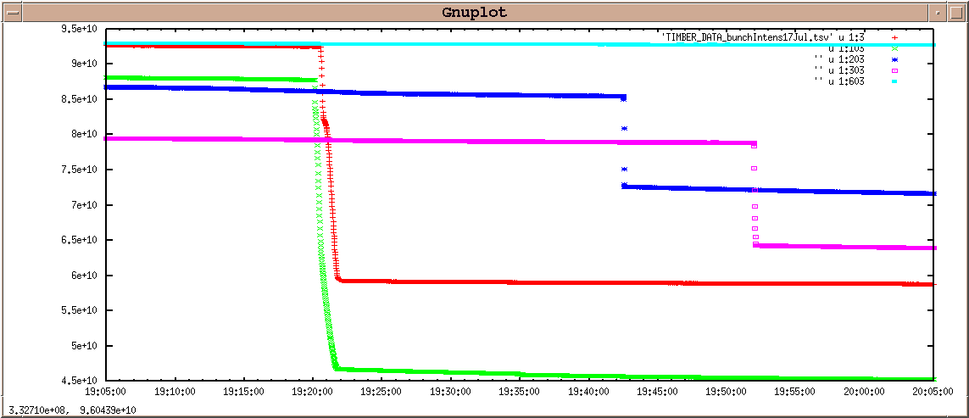
Bunch 1 loss at start of fill 1232: almost 50%

Slide 8
TOTEM - roman pots
Roman pots were moved into the beam during stable beams.
First to 30 sigma H and V.
Night Wednesday to Thursday: 25 sigma in V.
At 25 sigma candidate elastic events were observed.
No problems for operation, but some issues with stability of front-end software (diagnostics only – interlocking not affected).

Slide 9
Hump vs. GSM signal in the tunnel
Circulating beam (single nominal bunch) available at ~16:25 Started to switch OFF GSM network in the tunnel in the following order:
Sector 12 + TI2 Sector 23 Sector 34 sector 45 Sector 56 Sector 67 Sector 78 Sector 81 + TI8 + UX15
By 17:24 all GSM transmitters in the tunnel were OFF No significant modification on the hump amplitude By 18:00 the GSM network was re-established (for a total interruption of 1.5 h) This test was possible thanks to the contribution of IT/CS (A. Pascal, F. Chapron).
Test organized by G. Arduini on Thursday

Slide 10
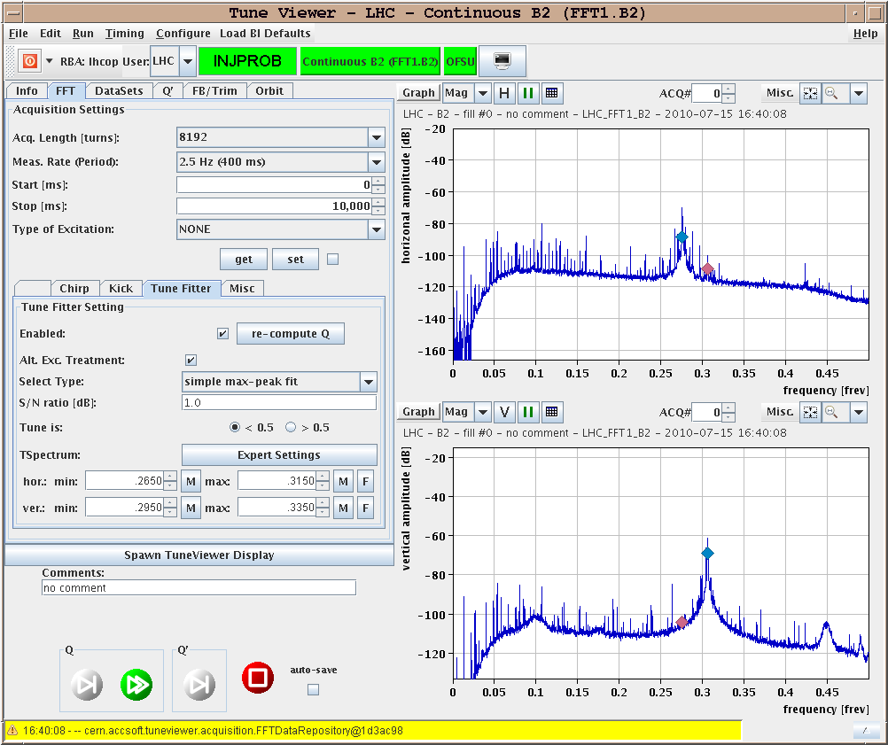
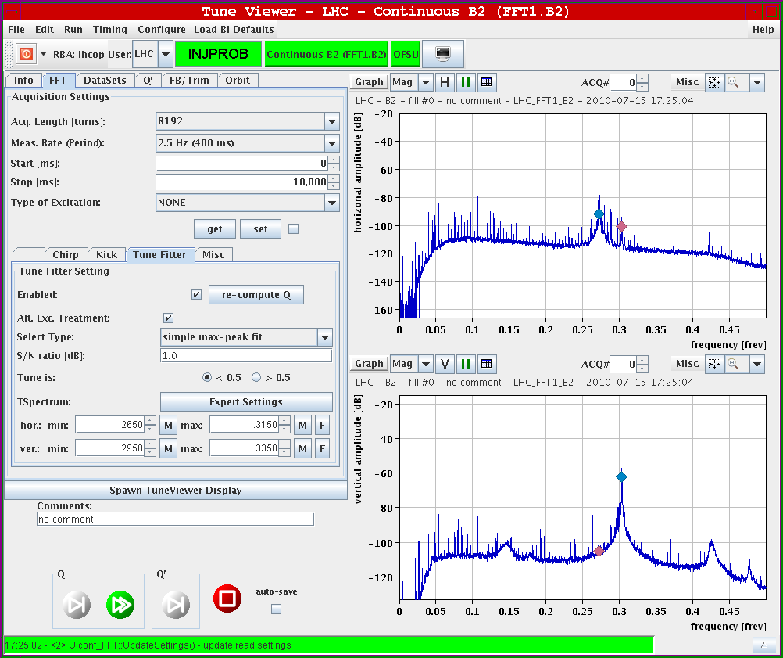
Hump vs. GSM signal in the tunnel
GSM ON – B2H
GSM OFF – B2H
GSM ON – B2V
GSM OFF – B2V
Typical slow drift in frequency as observed in other occasions, but no significant change in amplitude

Slide 11
Multi-bunch injection
SPS multi-bunch cycle
SPS cycle with 4 injections is ready.
Adjusted extraction kicker delays to extract ALL 4 bunches.
Extraction to upstream TEDs for both B1 and B2.
Extraction to TI2 downstream ok.
Everything looking ok – next step is injection into the LHC.
Multi-bunch injection into LHC
Delayed to after the technical stop. Suffered from booster MPS, SPS vacuum and expert availability issues.

Slide 12
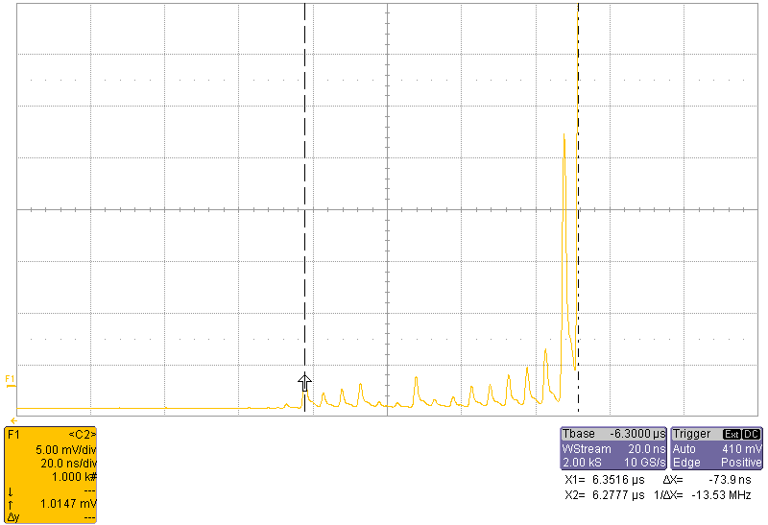
Ghost bunches
Small ghost bunches around main bunches reported by the experiments.
Intensity at the level of 0.1% of the main bunch.
Ghost bunches confirmed measurements of the RF group.
Bunches extend up to ≈ -80 ns. Spacing is 5 ns.
Abort gap population is
below 5E6 p/bucket (except
for messy 80 ns).

Slide 13
Capture losses
After a problem to due an energy mismatch build up by the orbit FB at injection, it was suggested by RF to adapt the RF frequency at injection to balance the energy errors of ring1 and ring2.
Injection fRF changed by +5 Hz.
Lower capture losses.
A better match could be obtained with orbit correctors after the technical stop.
Capture losses will become more critical as we inject more beam !

Slide 14
‘Big’ problems
PS booster MPS problem.
Filling of LHC did not suffer too much, some refills were delayed.
Solved Wednesday evening.
SPS vacuum problem : dipole in cell 406
Vacuum problem appeared Thursday in the SPS.
Survived the weekend, running just below the threshold of the ion pumps. Multi-bunch injection tests foreseen Friday had to be postponed.

Slide 15
Smaller problems
The usual zoo.
PC trips dumping the beams.
Spurious sector trips.
2 Quench heater PS to be repaired (access).
Ventilation in CMS cavern.
Servers dying.
MKI.
TDI motors.
Orbit FB: off, NaN, instability.
Electrical networks triggering FMCMs.

Slide 16
Feedbacks
LHC operation depends critically on the feedbacks.
Tune and orbit.
Performance is generally excellent, still some hick-ups.
Orbit correction kicks suddenly report back as ‘NaN’ – beam lost in squeeze.
Sudden instability observed in one fill – beam saved (see next slide).
Orbit feedback tends to shift systematically the orbit correctors, and therefore shift the energy. Caused a problem at injection Friday morning, the 2 beams being mismatched in energy: large amounts of un-captured beam.

Slide 17
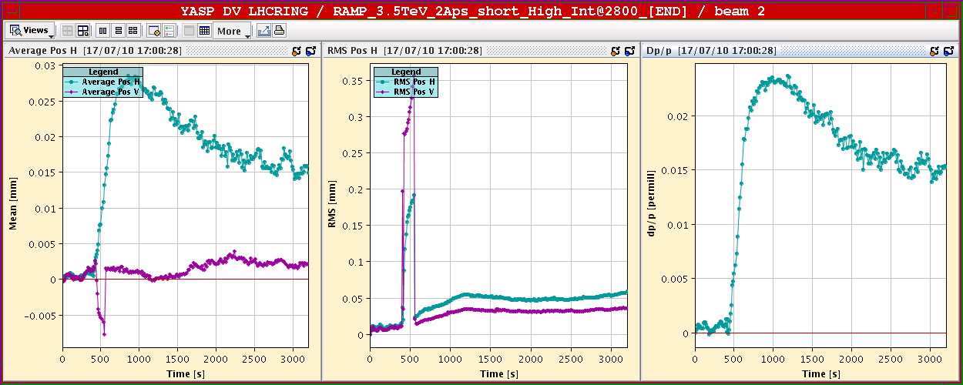
Orbit in the ramp fill 1232
Orbit correction becomes unstable – seems to be coming from IR4.
Orbit FB switches off.
Switch on worked, instability disappeared!
Very good stability
50 μm rms !!

Slide 18
Orbit effects
Orbit clean-up at injection
Injection orbit and corrector settings re-seeded wrt reference. RMS deviations back to 0.1 mm, corrector settings cleaner (Saturday).
Orbit and separation effects at 3.5 TeV
Following the orbit cleanup, the separation corrections no longer worked – luminosities were 0 at start of fill 1232 !
Orbit changes have been propagated to 3.5 TeV by OFB (most likely).
New settings had to be found, because the older settings did not match. Tedious in ALICE (3 hours !).
Inspection and comparison of the orbits in stable beams of a few fills of the week revealed significant fill to fill differences in the IRs (up to 0.5-1 mm) – must establish stricter correction policy, refresh references more frequently and improve the separation bump collapse procedure/settings.

Slide 19
This week
Technical stop
Beam setting up and operation
One dump with pilot bunch at 450 GeV and at 3.5 TeV for dump validation.
One ramp with 1 bunch of 9E10 / beam to validate modifications of SMP system (‘relaxed expert Setup Beam Flag limit [x4]).
Multi-bunch injection.
Energy matching ring1 and ring2.
Orbit and procedure clean-up at end of squeeze → collisions.
Loss maps for collimation.
Orbit feedback tests.
10 A/s for pre-cycle and ramp-down (tbc).
Could dream of 24 bunches per beam.

