Slide 1
Progress with Beam
Ralph Assmann
LMC, 30.6.2010
For the coordination team:
Week 26: Mike Lamont, Ralph Assmann
Week 25: Oliver Bruening, Joerg Wenninger
Acknowledgements to EIC’s, Operators, System Experts, …

Slide 2
Main Progress
Collimation setup and MP qualification for nominal bunch intensity completed. Settings into sequence.
Machine setup for July/August configuration:
Squeeze with separated beams to β* = 3.5 m
Beta beat measurements
100 μrad crossing angle in IR1 and IR5
Transverse damper for beam stabilization up to 3.5 TeV
Reduction of chromaticity during ramp (measurements)
Four physics fills with nominal bunch intensity:
New step up in instantaneous luminosity: 7-8 × 10²⁹ cm⁻² s⁻¹.
Approaching the 100 nb⁻¹ earlier than promised.
Working on characterizing interesting loss features.

Slide 3
Collimation and Machine Protection

Slide 4
High Intensity Collimation Setup for 3.5 TeV
Orbit and optics are different for 3.5 TeV and physics conditions, compared to injection. This requires a new beam-based collimation setup.
Setup at 3.5 TeV involves 76 collimators, covering the two beams and x, y, skew and off-mentum phase space.
Tertiary collimators have to be set up for three conditions due to change of setup in experimental areas (squeeze, separation, crossing angle, …).
Had to perform 108 collimator setups at 3.5 TeV.
Each setup takes 15 min ➔ 27 hours of beam time at 3.5 TeV required.
Reduced by factor 2 by doing both beams in parallel.
Losses of time due to beam efficiency. Several beam dumps due to loss of 0.1% of intensity, when touching halo.
In the end took ~30 h of beam time with single bunch of 1e11 p at 3.5 TeV. Time distributed over 10 days with ~1 collimation shift per day.
Finally, setup of smooth ramp functions including interlock thresholds.

Slide 5
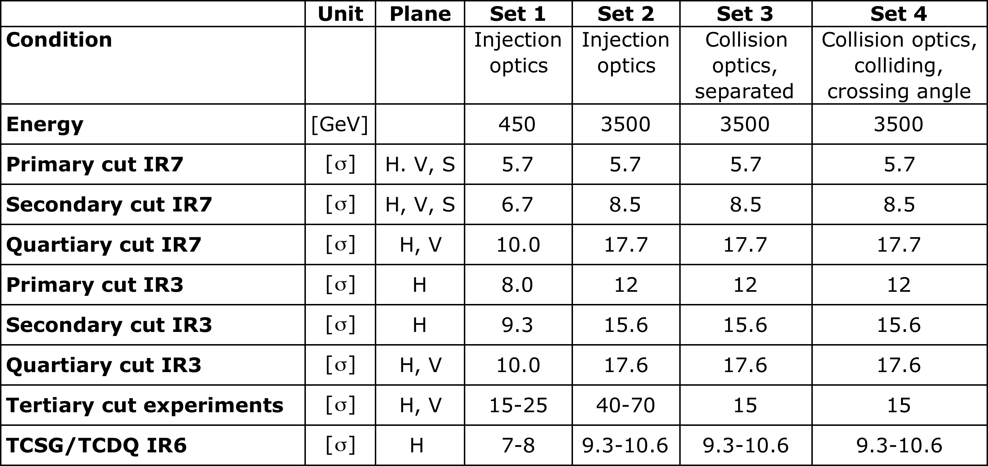
Collimation Setting Overview (in terms of β beam size, status 25.6.2010)
Last campaign established the collimation settings for set 2, 3 and 4!
Ramp functions move smoothly from set 1 to set 2 during energy ramp!

Slide 6
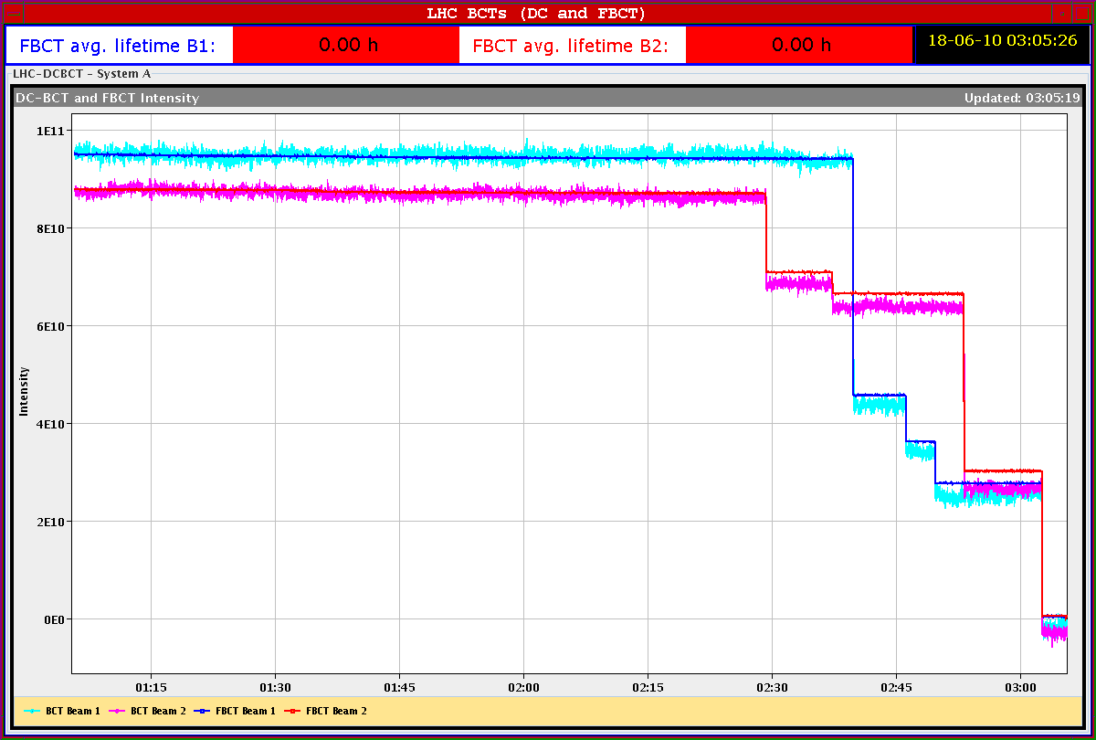
Qualification of Collimation Setup (3.5 TeV, squeezed, separated, 18.6.2010)
Beam 1
vertical
Beam 2
vertical
Beam 2
horizontal
Beam Intensity [p]
Qualification by provoking rapid beam losses on 1/3 resonances and by changing RF frequency (beam momentum)
Beam 1
horizontal
Beam 1 & 2
off-momentum
30 min

Slide 7
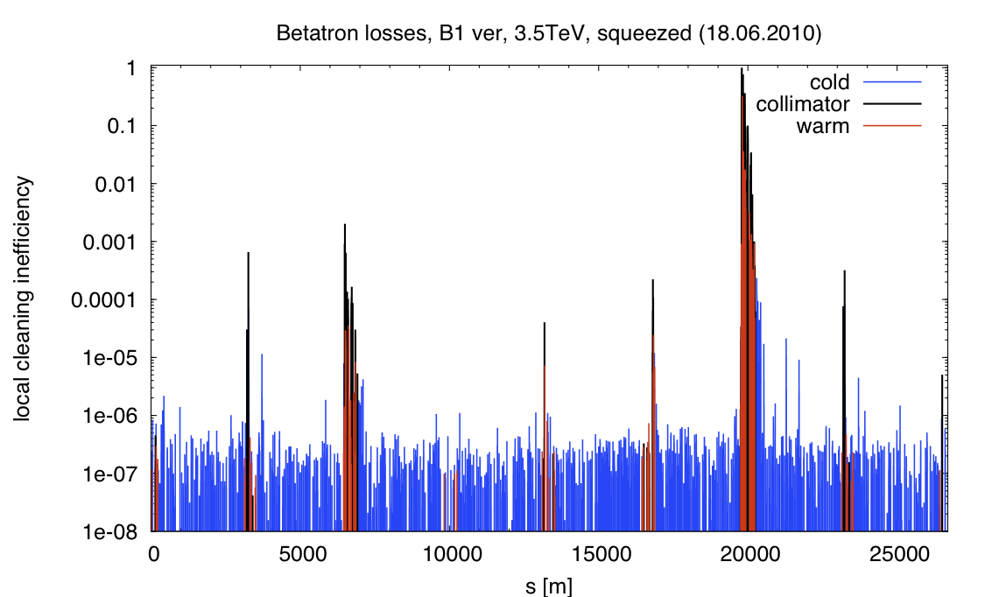
Example of Achieved Collimation Performance (Beam 1, Vertical Plane, 1.3s)
factor 10,000 cleaning to SC arc magnets
Off-momentum
Betatron
TCT
Dump
TCT
TCT
TCT

Slide 8
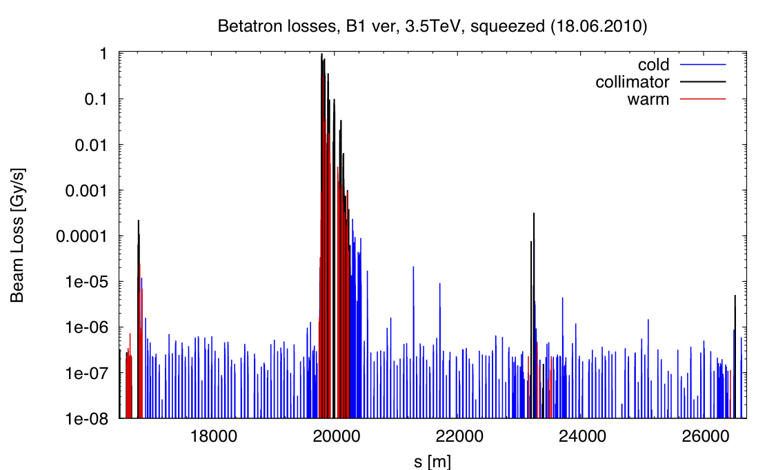
Zoom into Betatron Cleaning Region (Beam 1, Vertical Plane, 1.3s)
Expected loss locations in IR7 dispersion suppressor
Dump
TCT

Slide 9
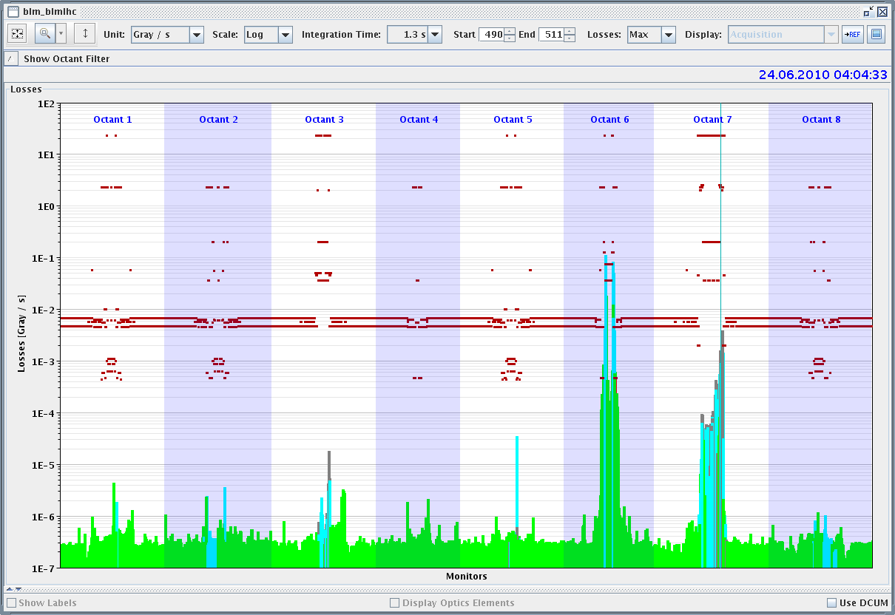
Beam Dump Qualification 3.5 TeV
Brennan et al
Dump
Betatron
Off-momentum
TCT

Slide 10
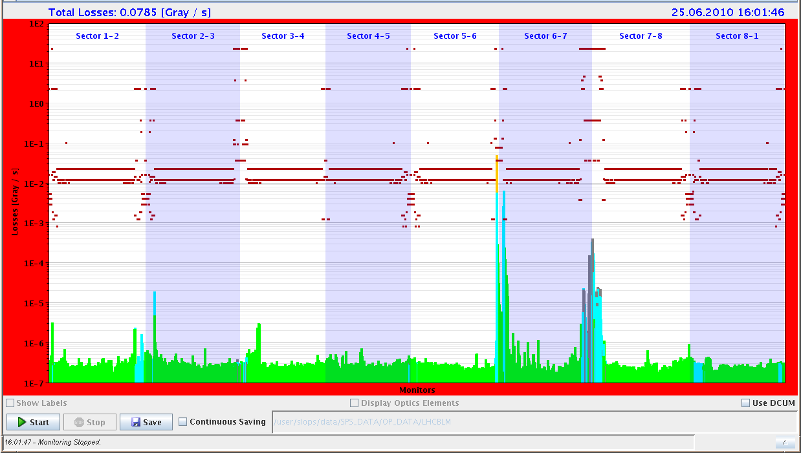
Beam Dump Qualification 450 GeV
Dump
Betatron
Off-momentum

Slide 11
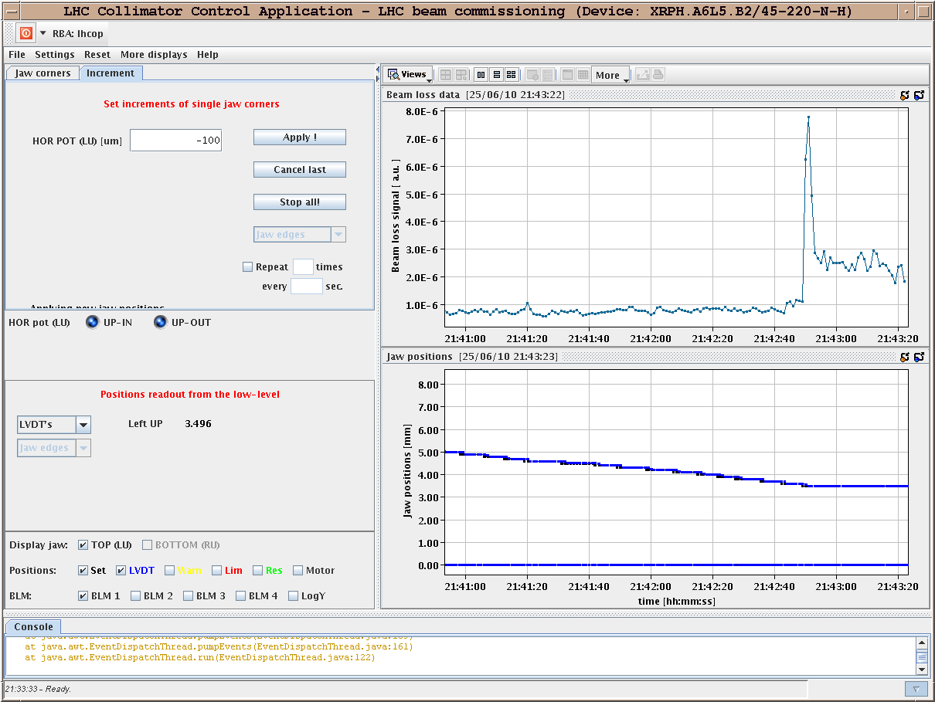
Roman Pot Calibration with 450 GeV Beam

Slide 12
Machine Setup for Summer

Slide 13
Chromaticity Measurement: New Fitter
R. Steinhagen et al

Slide 14
Chromaticity Measurement During Ramp
R. Steinhagen et al
➔ BPM modulation versus time as RF frequency is modulated

Slide 15
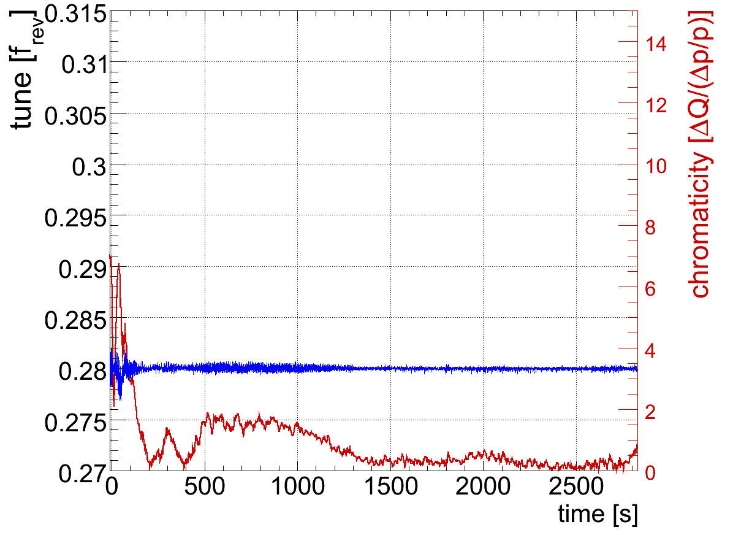
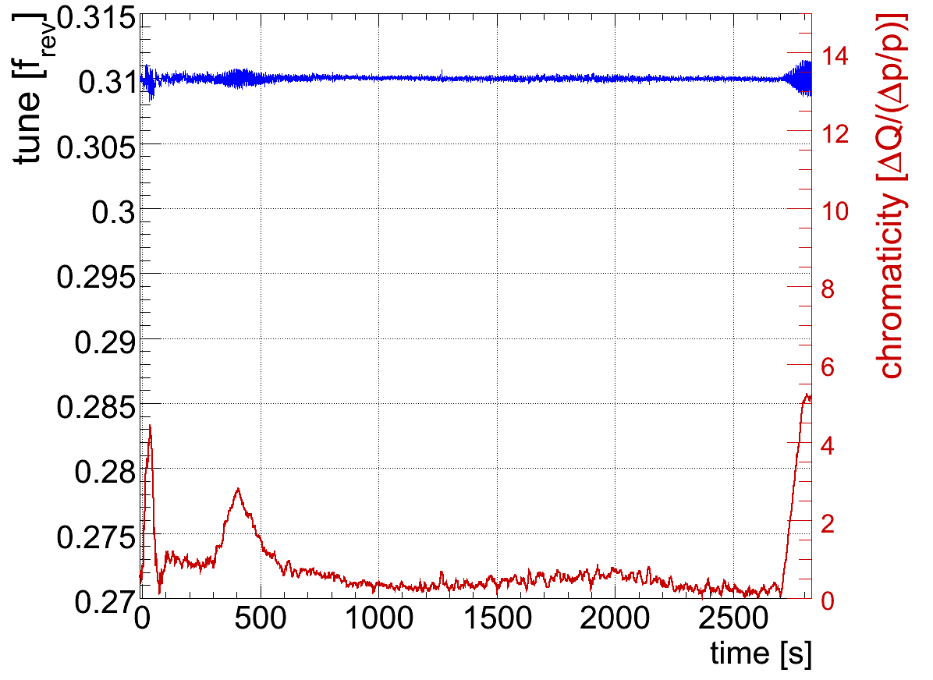
Chromaticity in Ramp: B1
R. Steinhagen et al
H: 0 → 6.5
V: 0 → 5
Stabilized with transverse damper
June 24th

Slide 16
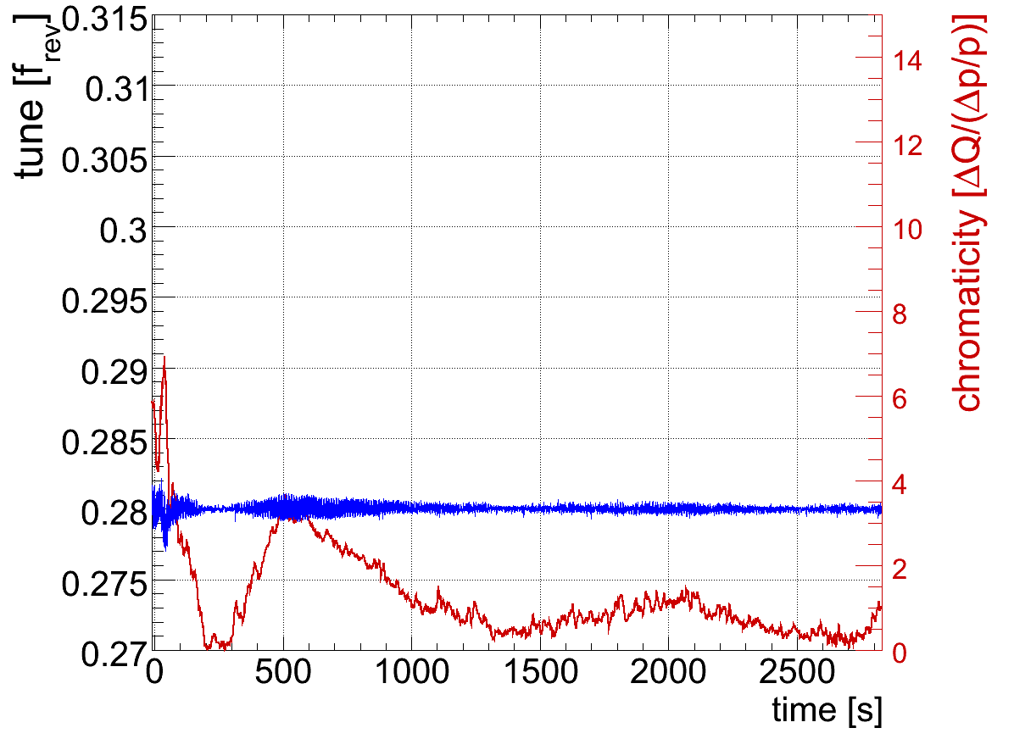
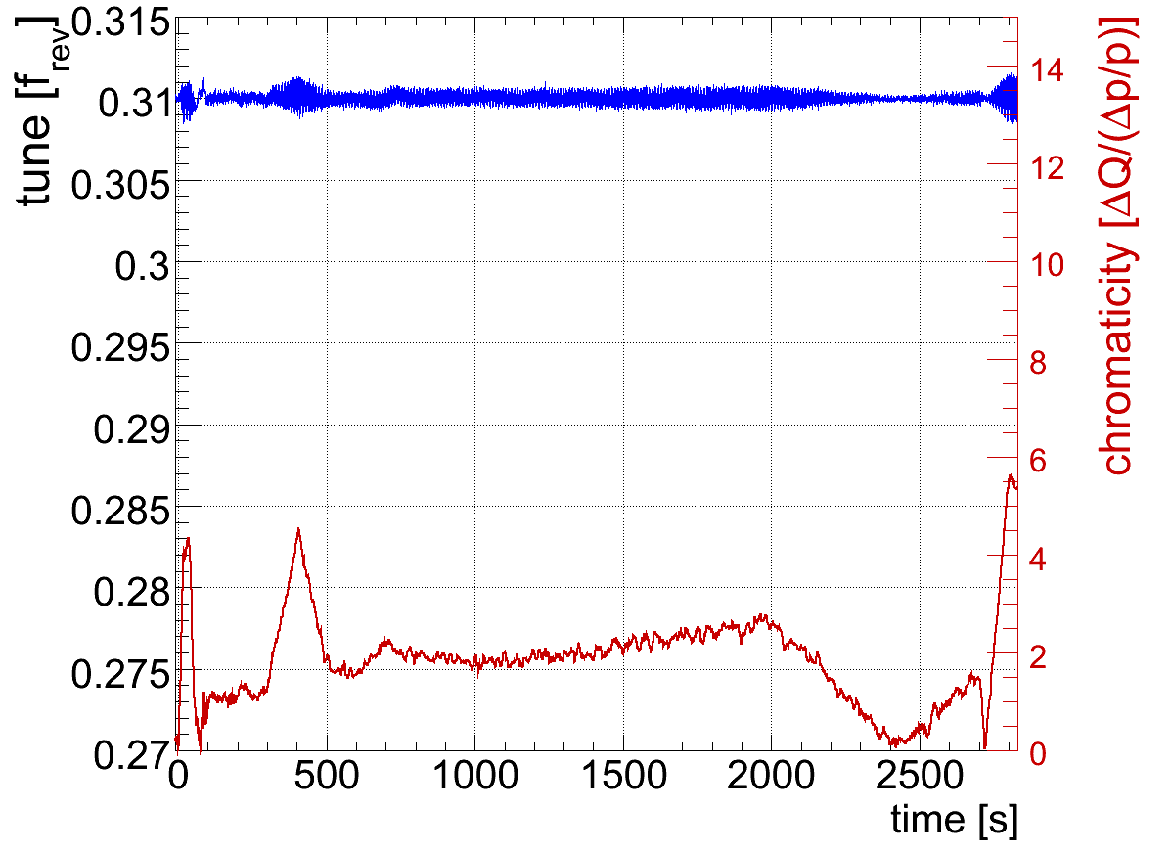
Chromaticity in Ramp: B2
R. Steinhagen et al
H: 0 → 7
V: 0 → 5.5
Stabilized with transverse damper
June 24th

Slide 17
Beta Beat (Rogelio Tomas Garcia et al)

Slide 18
Beta Beat (Rogelio Tomas Garcia et al)

Slide 19
Beta Beat (Rogelio Tomas Garcia et al)

Slide 20
Beta Beat (Rogelio Tomas Garcia et al)

Slide 21
Physics with Nominal Bunches

Slide 22
1st Physics Fill Nominal Bunches: Lifetime
~ 3 × 10¹¹ p per beam
Start of collisions
Sudden loss
~ 45 min
June 25

Slide 23
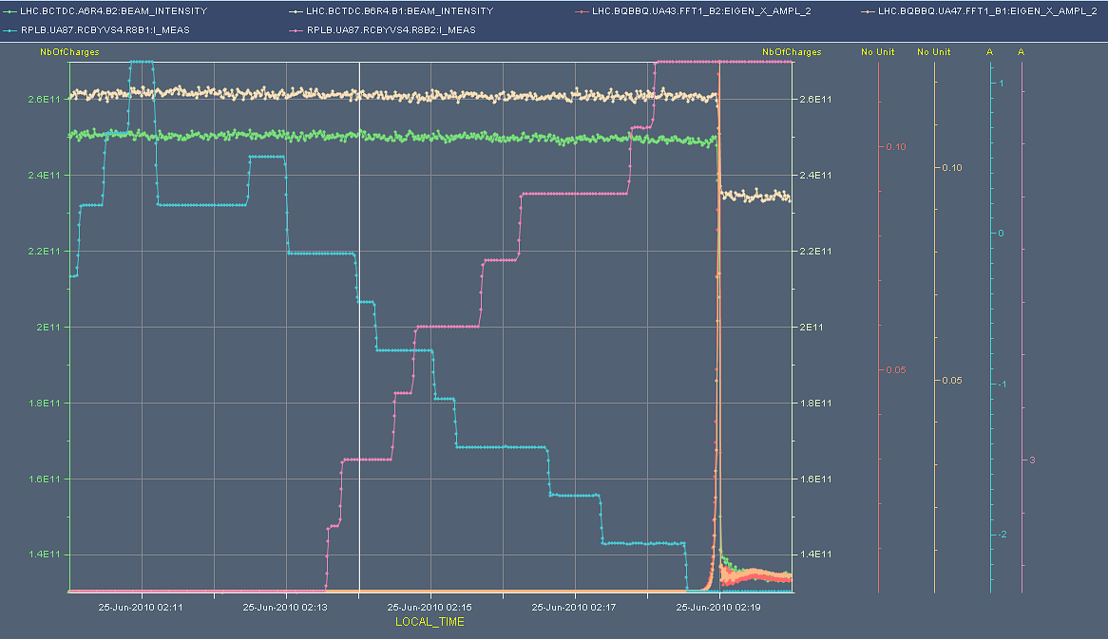
Scanning point 8 – vertical plane
M. Lamont
~ 3 × 10¹¹ p per beam
tune amplitude

Slide 24
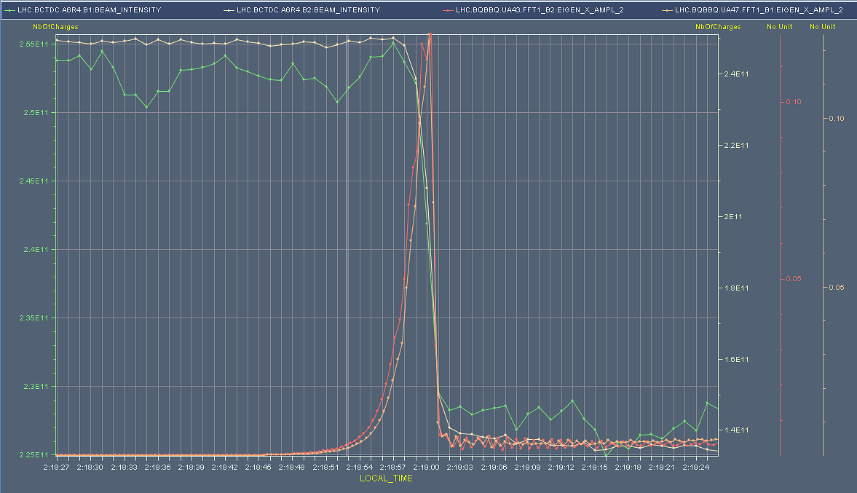
Tune amplitude - zoom
M. Lamont
beam intensities
~ 3 × 10¹¹ p per beam

Slide 25
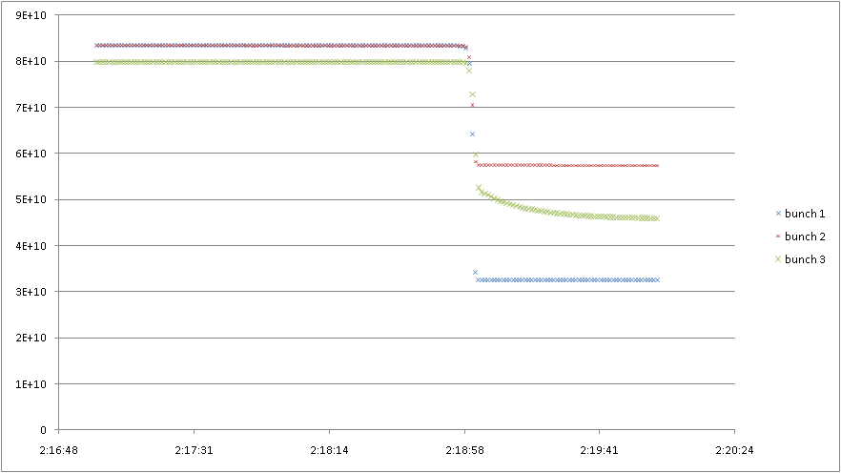
Bunch currents – beam 2
M. Lamont
~ 3 × 10¹¹ p per beam

Slide 26
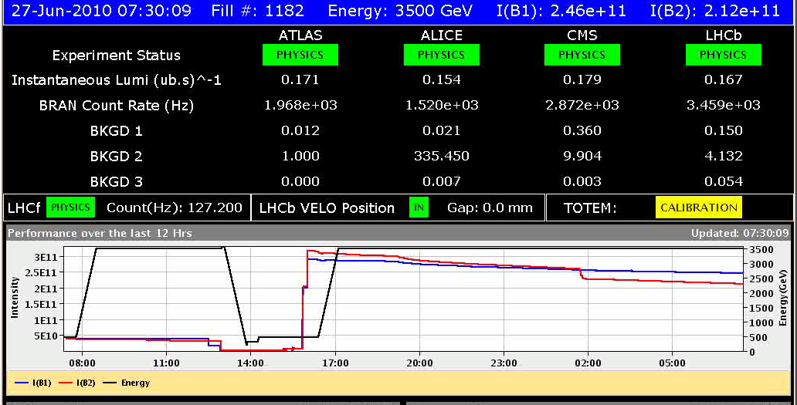
2nd Physics Fill Nominal Bunches: Intensity
June 26
~ 3 × 10¹¹ p per beam

Slide 27
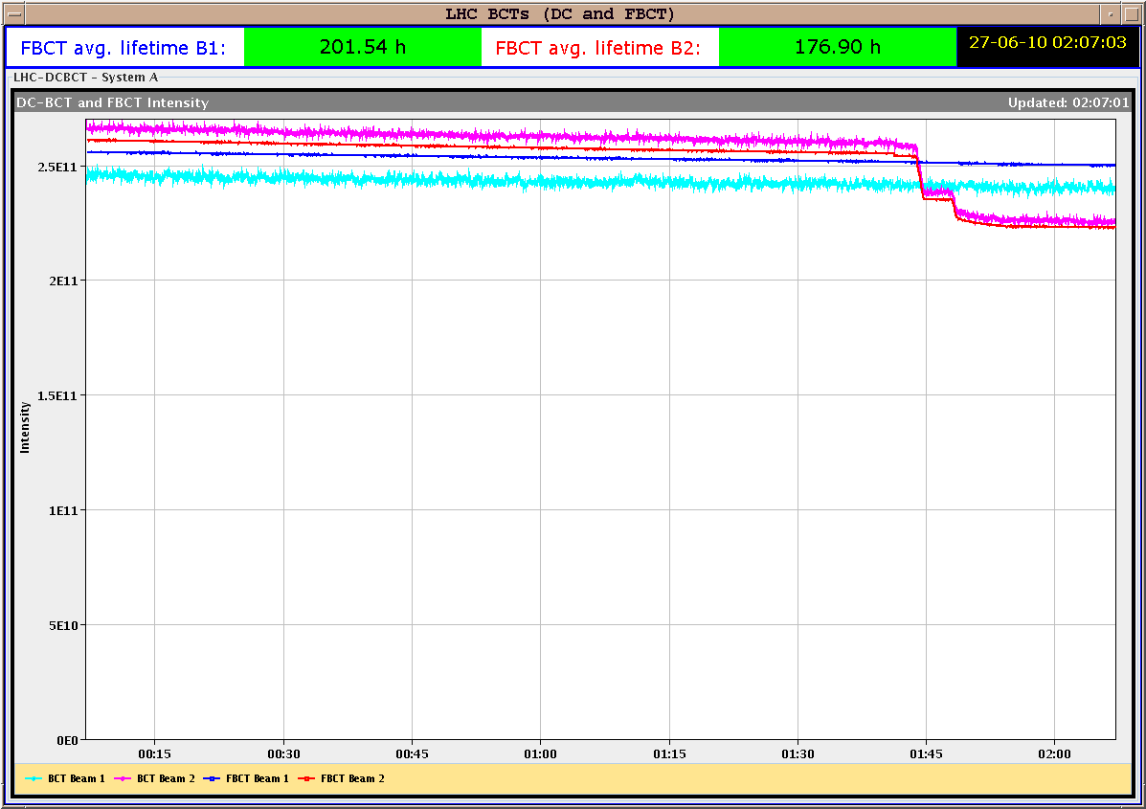
2nd Physics Fill Nom. Bunches: Lifetime, Int.
June 26
after ~6 hours
~ 3 × 10¹¹ p per beam

Slide 28
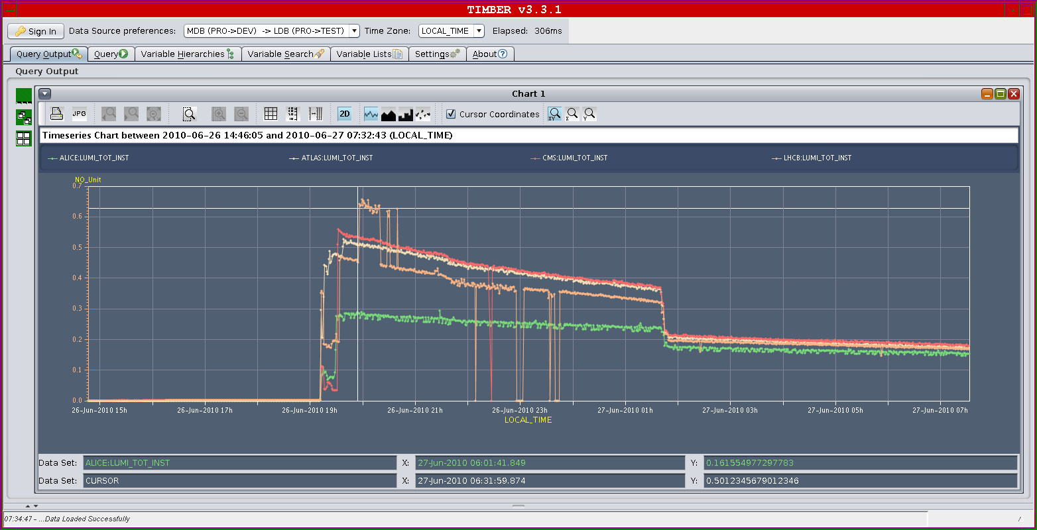
2nd Physics Fill Nominal Bunches: Lumi
~ 3 × 10¹¹ p per beam
June 26

Slide 29
3rd Physics Fill Nominal Bunches
June 29
~ 3 × 10¹¹ p per beam
→ New highest luminosity…

Slide 30
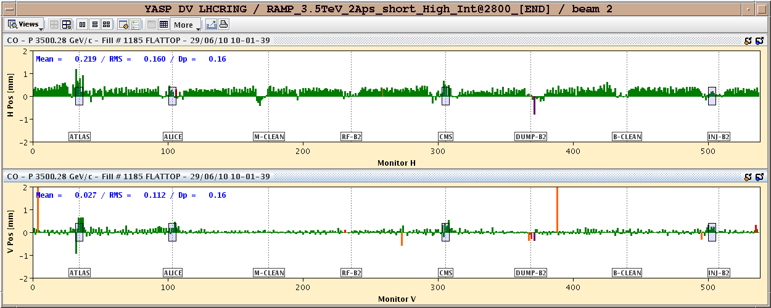
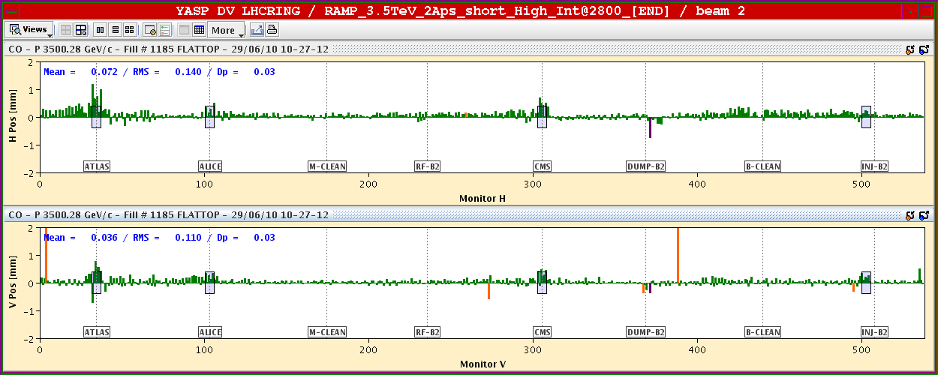
Orbit Tune Up

Slide 31
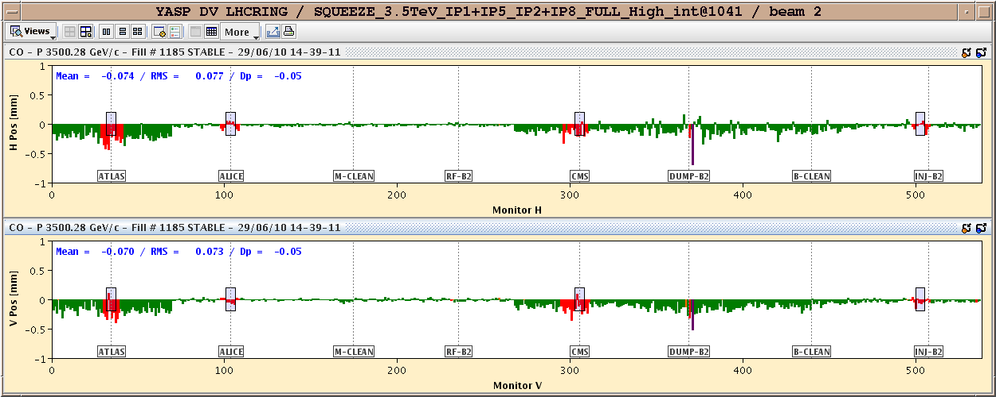
Orbit Change After 4 Hours (ΔE corrected)
Instrumental effects → 1 mm at interlocked BPM in IR6

Slide 32
3rd Physics Fill Nominal Bunches: Lifetime
~ 3 × 10¹¹ p per beam
June 29
Collision
From luminosity (collision rate) expect lifetime of ~330 h!
Why is lifetime reduced to ~10 hours?
Indication of slow diffusion process as seen before (loss of tails).
Crossing angle

Slide 33
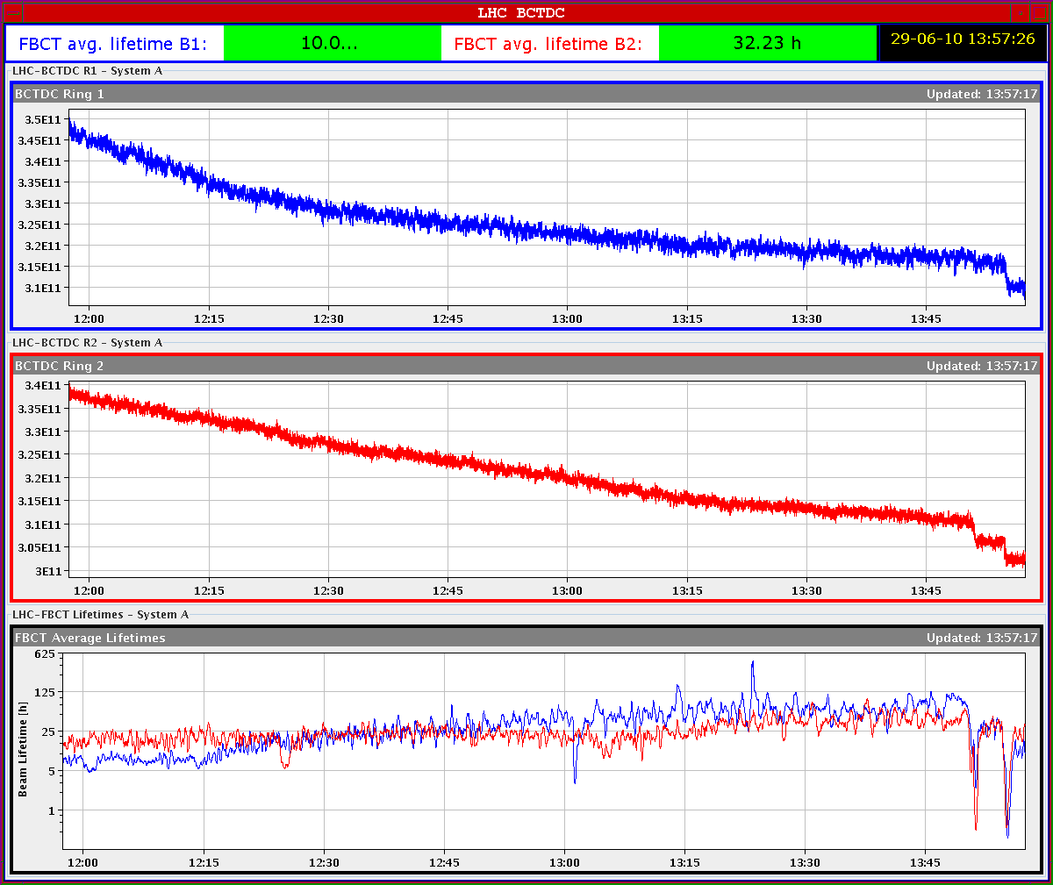
3rd Physics Fill Nominal Bunches: Losses
June 29
Intensity B1
Intensity B2
Lifetime recovering after collision
Sudden loss

Slide 34
What is this sudden loss?
It is a vertical beam size blowup (factor ~1.5). Stabilizes itself.
Mechanism not understood.
Could it be loss of Landau damping due to cut of beam tails with reduced dynamic aperture (R. Assmann)?
Collision introduces lower lifetime than expected from collision rate.
Proves that a diffusion process is generated: reduced dynamic aperture with beam-beam.
The beam tails outside of dynamic aperture are lost with time. As tails are lost, lifetime improves with time.
Big part of Landau damping is generated from the beam tails. As the beam distribution is cut, stability is lost at some point.
Blow up of beam size. Beam stabilizes again with new tails.

Slide 35
See Literature…

Slide 36
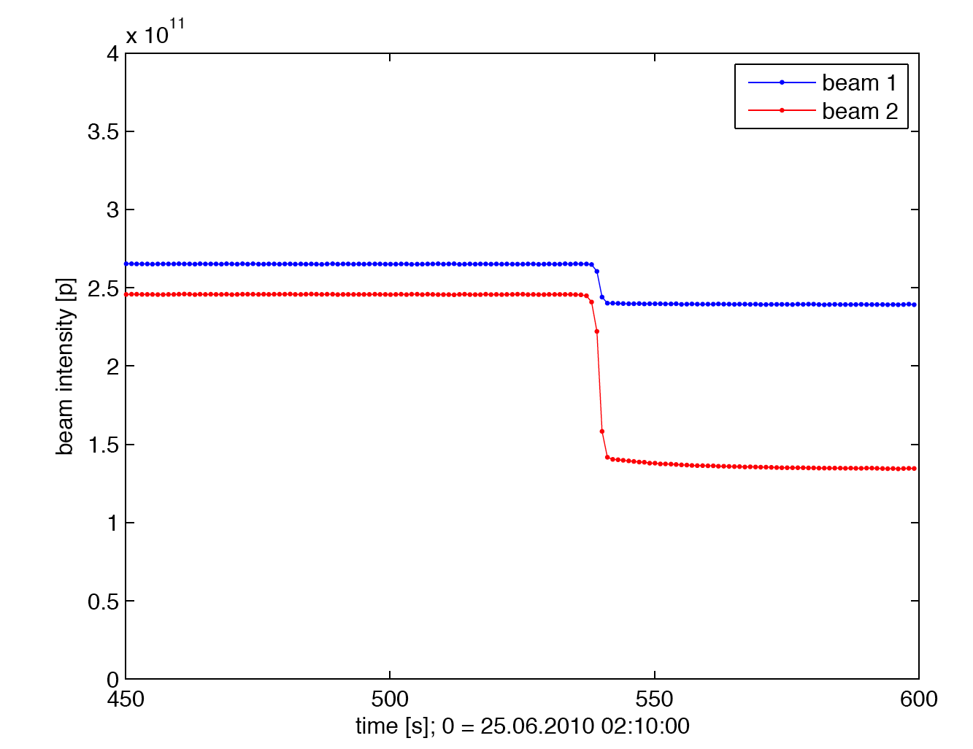
Loss in Stable Beams – Problem for Collimation? 25.06.2010, 02:19
Sudden beam loss during stable beams.
Peak beam loss rate: 6.3e10 p/s for beam 2. Relative loss rate: 26 %/s
Reminder: Specified peak beam loss rate at 7 TeV is 4e11 p/s!
During this fill we reached with 0.1% of nominal intensity already 16% of nominal loss rate!
Relative loss rate was 260 times beyond specification!
Good case to analyze collimation performance.
6.25e10 p in 1 s

Slide 37
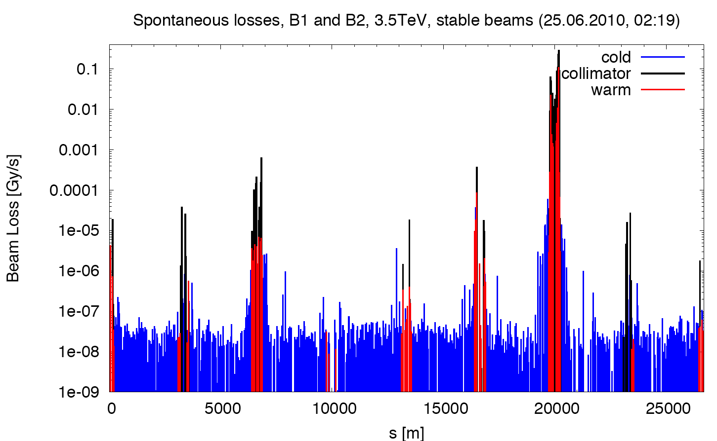
BLM Readings during Losses with Stable Beams (3.5 TeV, 1.3 s)
factor 25 below threshold for 3.5 TeV and loss rate of 6.3e10 p/s.
BLM abort threshold SC magnets @ 3.5 TeV
Leakage peak:
6 × 10⁻⁵ Gy/s

Slide 38
From Collimation: Can we Increase Intensity?
With the present beam stability we can push intensity by a factor ~25 before hitting the BLM threshold in SC magnets: 3e11 ➔ 7.5e12 (~70 nominal bunches)
All losses at collimators: no problem for damage!
Must work on beam stability to enter the regime above 1e13 protons:
Factor 10 better beam stability ➔ reach 2010/11 goal of 6e13 p per beam.
Factor 50 better beam stability ➔ reach nominal beam intensity 3e14 p per beam.
Note:
Assumes that BLM thresholds are accurate for 3.5 TeV. VERIFY!
More severe loss rates in shorter time bins (fast loss spikes).

Slide 39
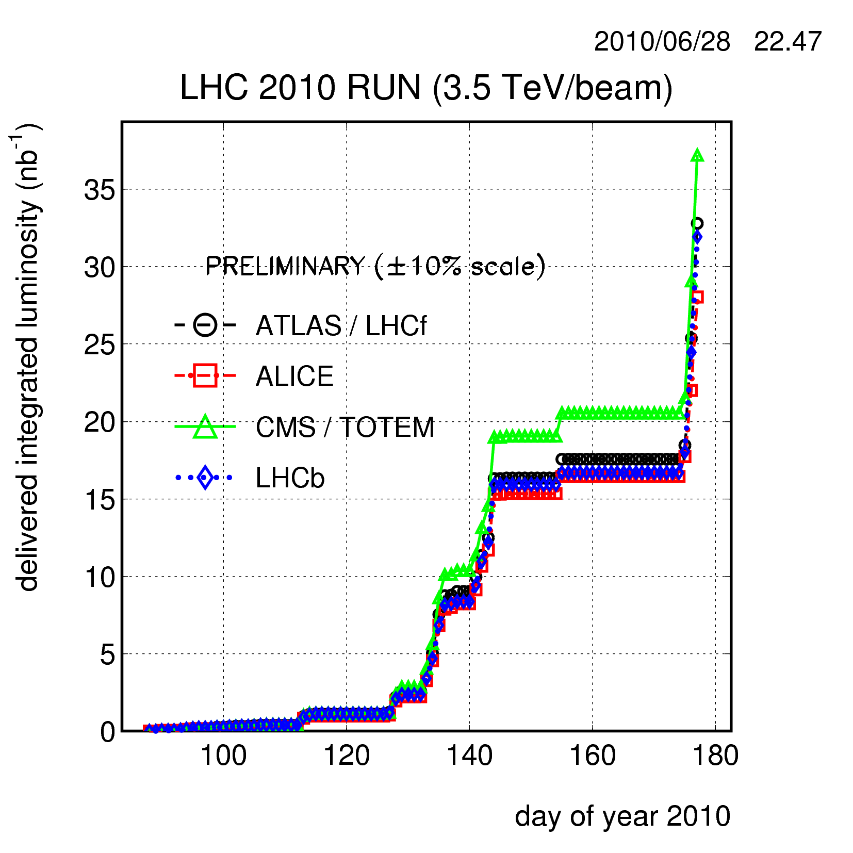
Luminosity Performance
+ 7 nb⁻¹ not included

Slide 40
Ahead
Physics, physics, physics, … with increasing intensities: reach and surpass luminosity of 10³⁰ cm⁻² s⁻¹
Four physics fills so far with 3 x 10¹¹ p per beam. A fifth is under preparation.
Tighten operational procedures (squeeze into sequence, beam process of collapse of separation bump, crossing angle, …).
Tune up and improve machine and its stability.
Next week start preparing in parallel multi-bunch injection.

