Slide 1
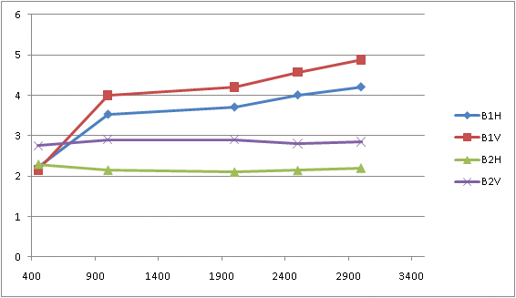
Saturday morning
10:05 Ramp lost to wire scan towards top energy
Old ws settings

Slide 2
11:52 Just lost QPS OK on RCO in S56 and QQT13.L6B2/B1. This is a communication problem with the QPS crate.
12:29
RQT13.L6 and R6 tripped for both beams. Also RCD and RCO in S56 and 67 tripped while trying to sort out the QPS issue.
13:30
re-injecting
14:00 lost S81.
nQPS on an RB magnet (B11.R8).
access required to change card
16:10 – end access
pre-cycle

Slide 3
Saturday
18:00 Beam back
19:00 Attempt to blow-up emittance with transverse feedback – really needs additional software
Switch off TFB – not effective
FMCM – 18 kV glitch
20:40 Blow up emittances in SPS via screens in TT10
3.6/4.4 on offer
TFB back on in LHC
Too high losses on transfer line collimators
different screens - OK
B1H | B1V | B2H | B2V
2.8 | 2.5 | 3.1 | 4.2

Slide 4
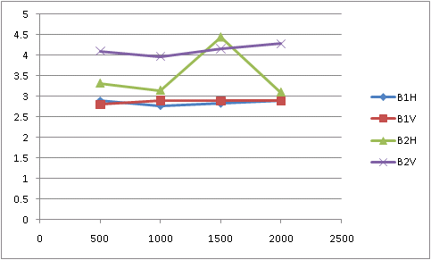
Saturday evening
22:30 start ramp
00:46 STABLE BEAMS

Slide 5
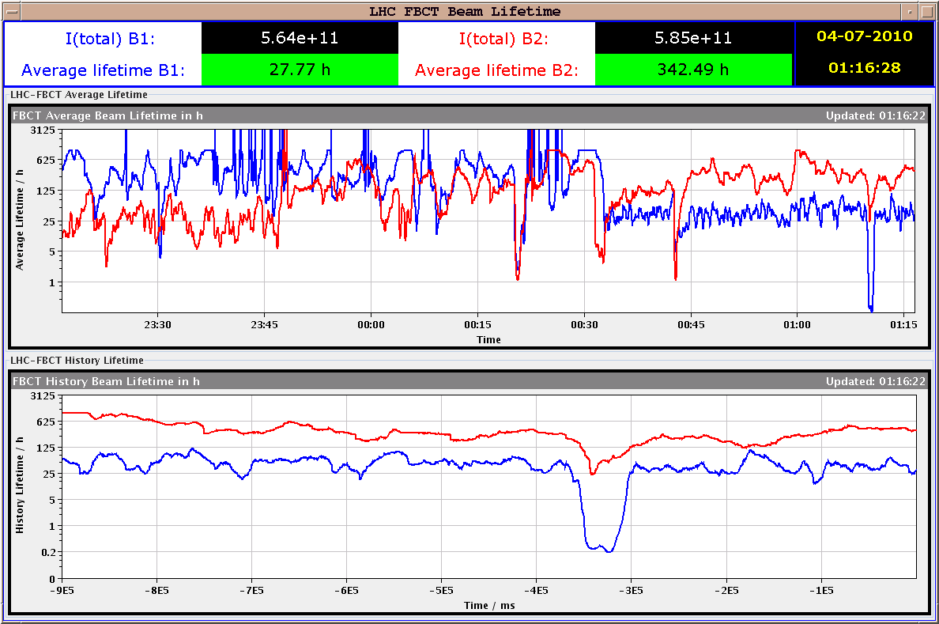

Slide 6
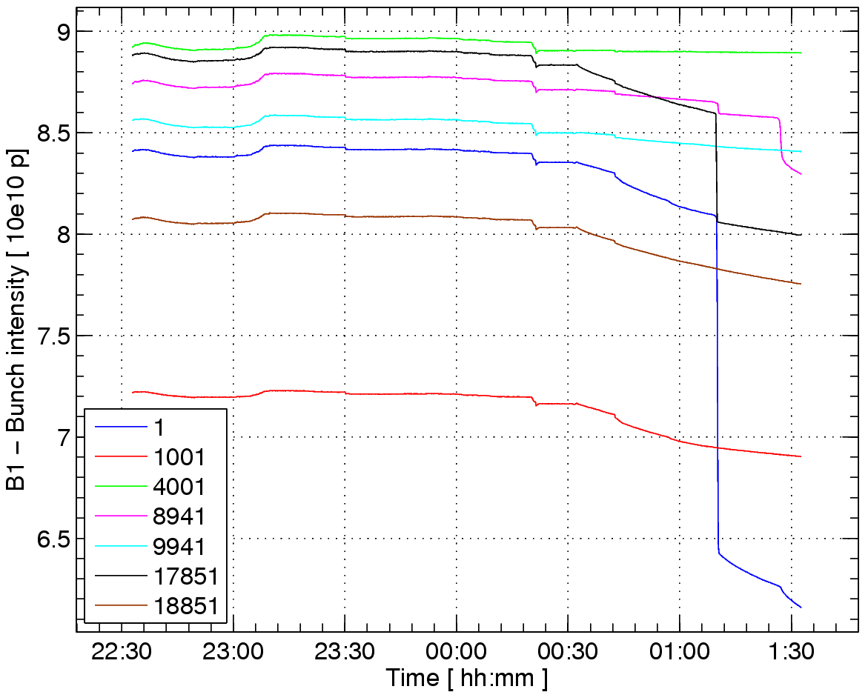

Slide 7
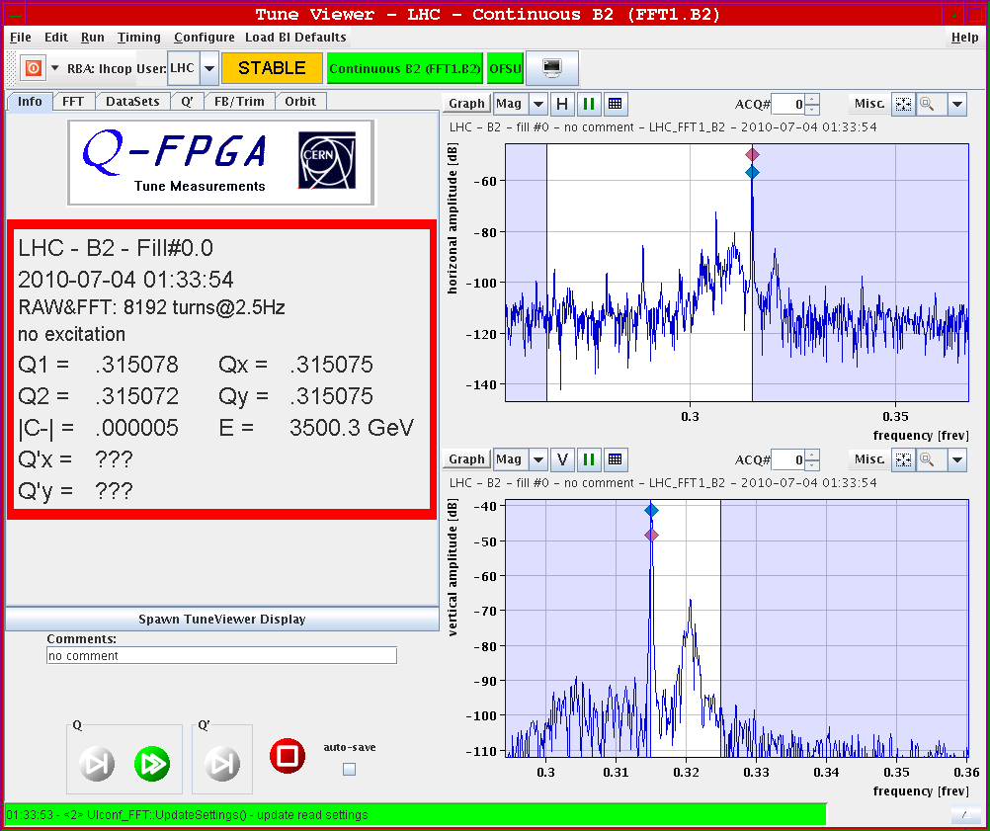

Slide 8
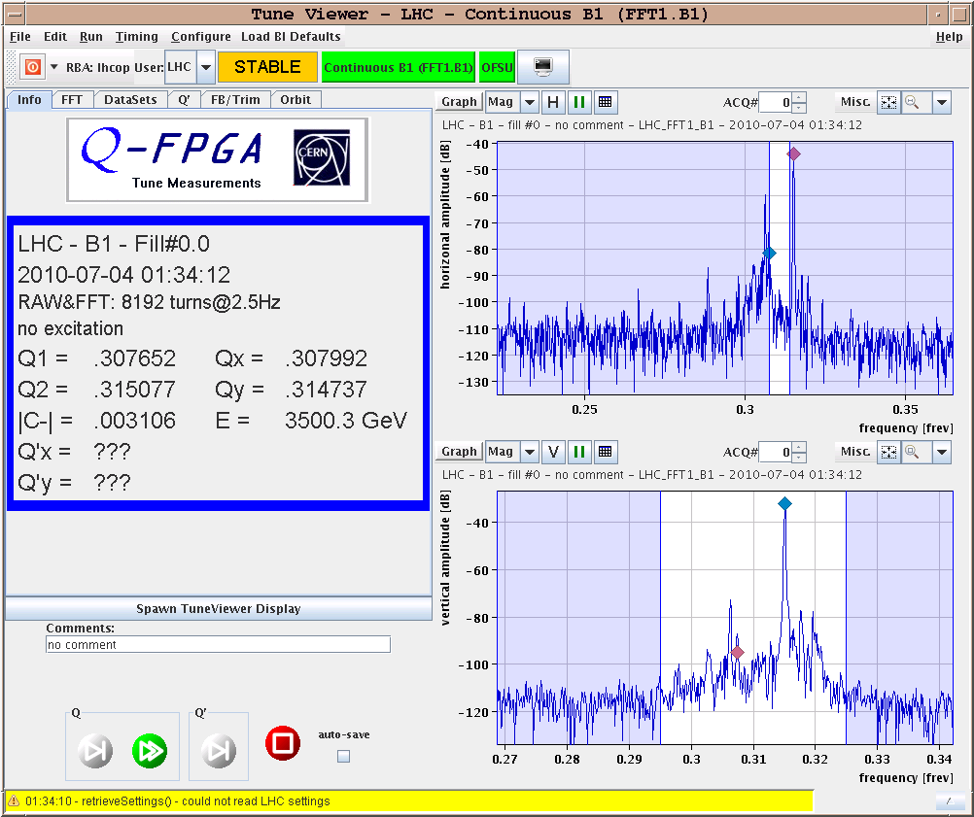

Slide 9
Sunday morning
01:35 Lost both beams, RD1.LR1 down because of a glitch on the electrical network.
The second fill went very well. The machine after precycle was in very good conditions and we could ramp and squeeze with small beam losses.
We had a moment of true panic when we thought that the OFB was ON while the separations were being collapsed. This proved not to be the case and we could proceed with the stable beams. After incorporation of lumi scan knobs. we went back to similar values of lumi for IP1, IP2 IP8 of ~6e29cm-2s-1. We left this conditions without lumi scans to see if we can keep the stable beams for a few hours.
06:27 Stable beams

