Slide 1
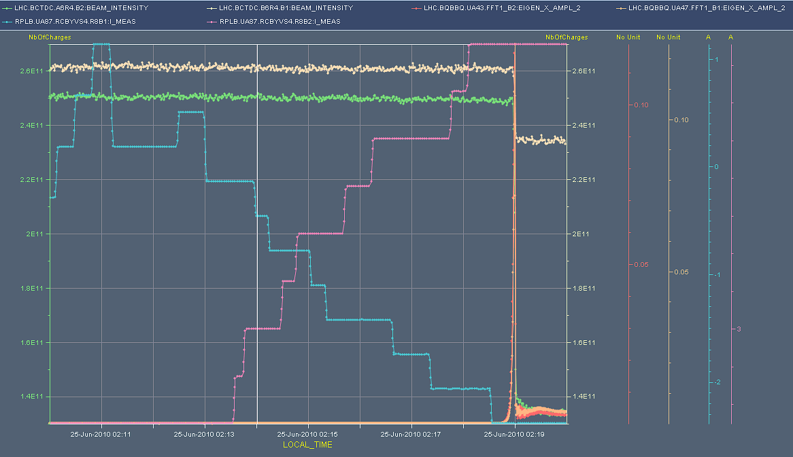
Scanning point 8 – vertical plane
tune amplitude

Slide 2
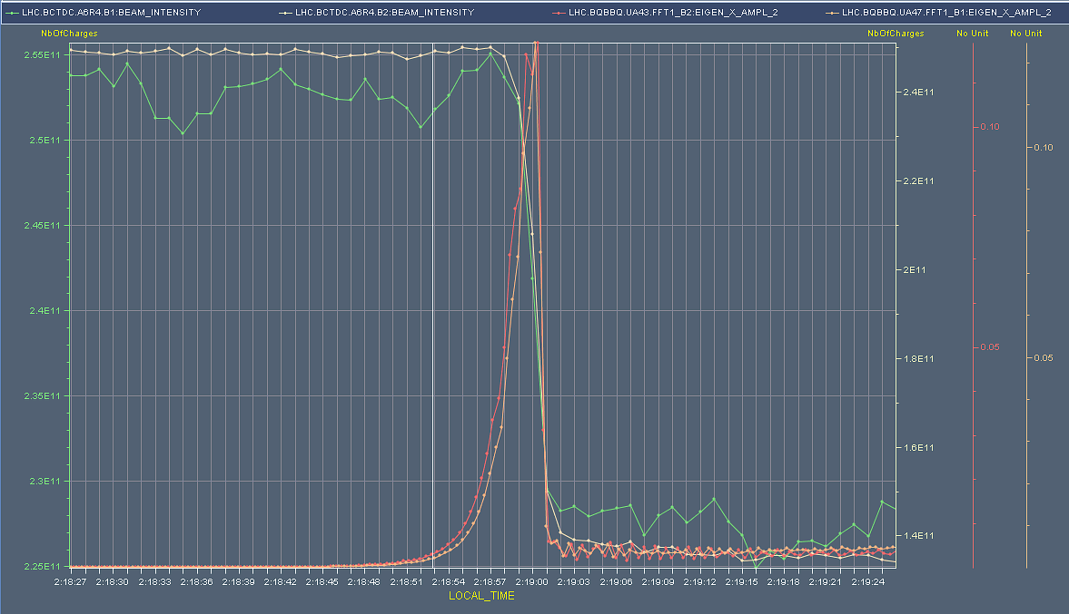
Tune amplitude - zoom
beam intensities

Slide 3
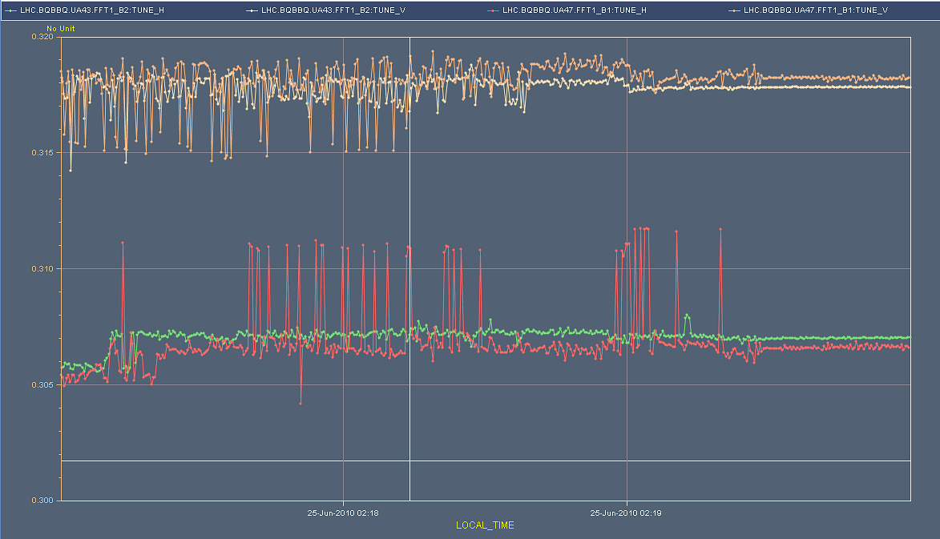
Tune split
or not… consignes missing instruction to split vertical

Slide 4
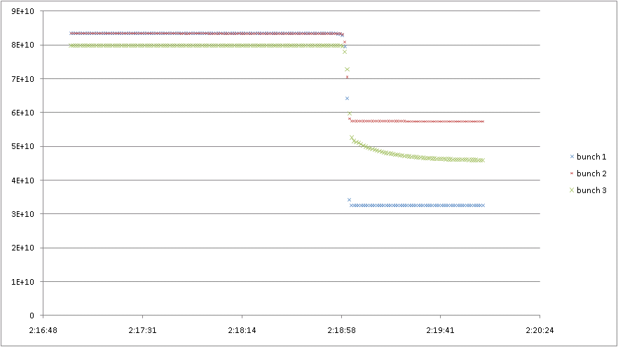
Bunch currents – beam 2

Slide 5
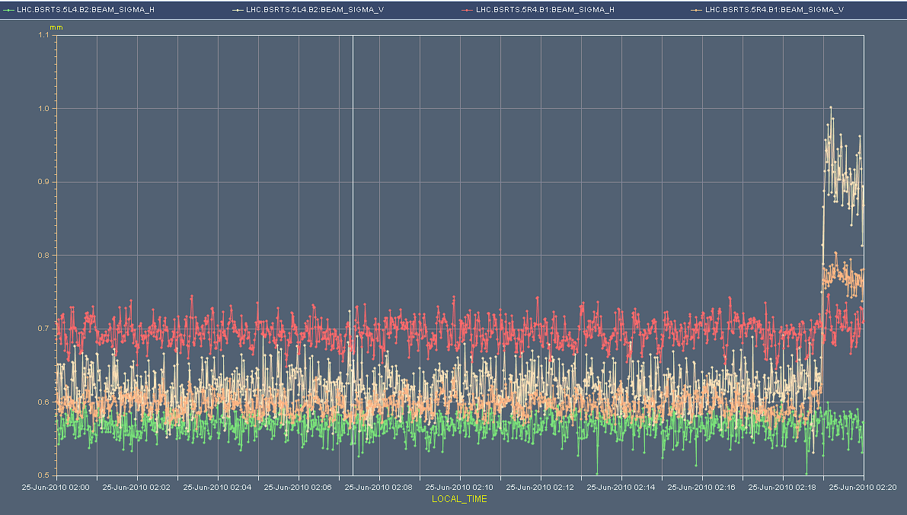
Beam sizes
Clear blow-up – vertical plane both beams

