Slide 1
Friday 25.6
12:00: Beams are back in the LHC following the access for RB78:
It was initially thought that the recent RB78 fault was a problem with the main circuit breaker. Then a nQPS noise problem when doing the zero calibration update. ➔ It seems now that the faults of RB78 still have not been understood!
12:00: Starting LBDS and longitudinal blow up studies at 450 GeV
All outstanding LBDS studies could be finished:
Asynch dumps from extreme orbit positions, 450 GeV, 1e11.
Dumps with orbit and energy offset and emittance blow up
Performed test of longitudinal blowup with nominal bunch intensities.

Slide 2
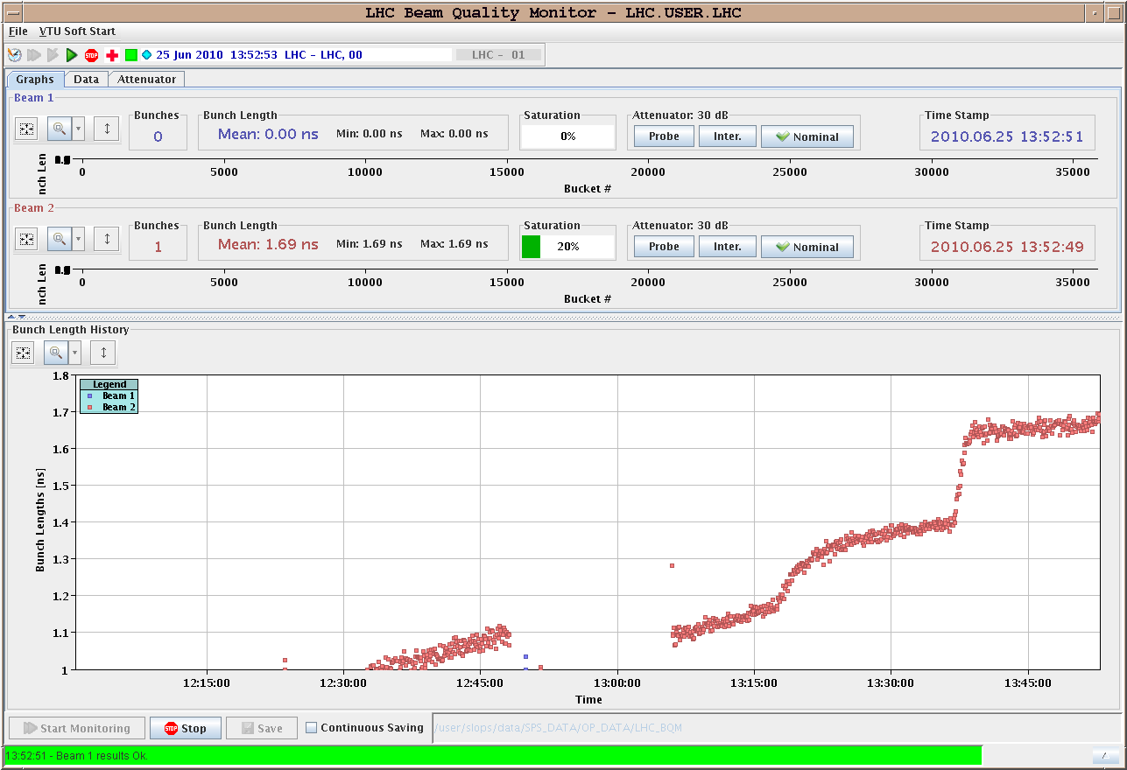
Friday 25.6
Longitudinal blowup with nominal bunch intensities:

Slide 3
Friday 25.6
18:00: Starting TOTEM Roman Pot setup at 450 GeV
Setup at 450 GeV with collision tunes.
6 roman pots per beam were set up (12 in total): B1 first set up with low intensity (~3e10) B2 set up with higher intensity (~9e10) B1 horizontal pot setup redone with high beam intensity

Slide 4
Saturday 26.6
23:00: Planned to start with test ramp with new sequence for squeeze and collapsing pumps but lost most of night shift due to technical problems:
23:15: Problems with PS RF system and LINAC2 delay startup.
02:40: Injectors are back (RF hardware had to be repaired) but cannot inject because the INDIV beam is still in wrong buckets from the injectors.
04:10: The beams keep shifting buckets in the injectors.
04:30: Manage to get 2x2 10^11 injected.
05:00: Error loading collimator settings for TCP.C6L7.B1.
06:00: Piquet can not resolve problems ➔ called Collimation experts
07:45: Collimator issues resolved by Stefano ➔ starting ramp.

Slide 5
Saturday 26.6
Plan for the weekend:
Test ramp with new sequence for squeeze and collapsing of the beam separation at the Ips ➔ Now ongoing.
Physics fills with 3 on 3 10¹¹ppb.
Hump measurements at 450 GeV (if time permits).

