Slide 1
Monday 7.6
07:00: Preparing new fill for Monday morning
08:00: Start over injection of 13 bunches per beam with 2 10¹⁰ ppb.
08:30: Injection finished and performing final measurements and adjustments.
10:00: End of ramp. Performing beam adjustments. Discovered that since Sunday morning the separation at the IRs was ramped to 0 in the ramp (mistake in setting incorporation).
10:18: Beams dumped by collimator motor interlock on TCLA.6L3B2 (noisy signal at sensor – collimator position was OK).
Noisy sensor disabled (enough redundancy).
Put separation back on into the ramp !
10:25: Start ramp down.
Issue on RCBXH1.R2 with U_RES. Almost at limit but cannot reset. Will probably give a problem during next ramp/pre-cycle. ➔ requires change of QPS card.

Slide 2
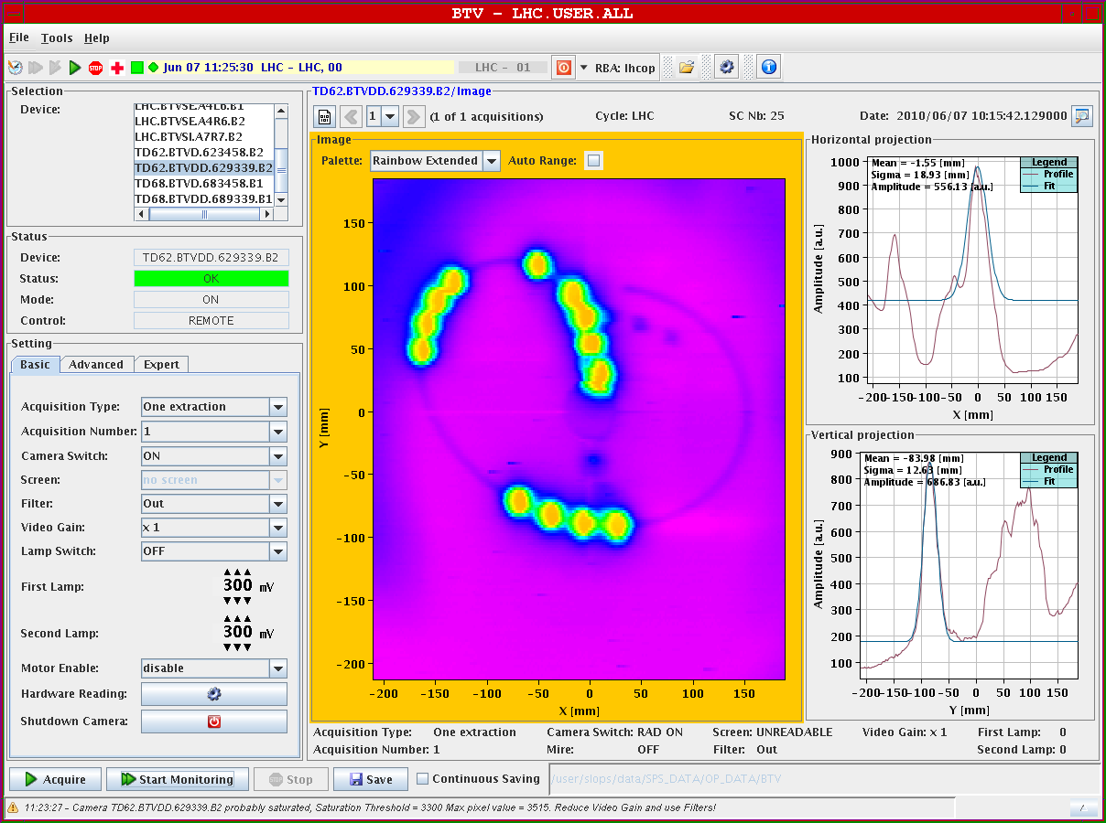
Debunched beam trace on B2

Slide 3
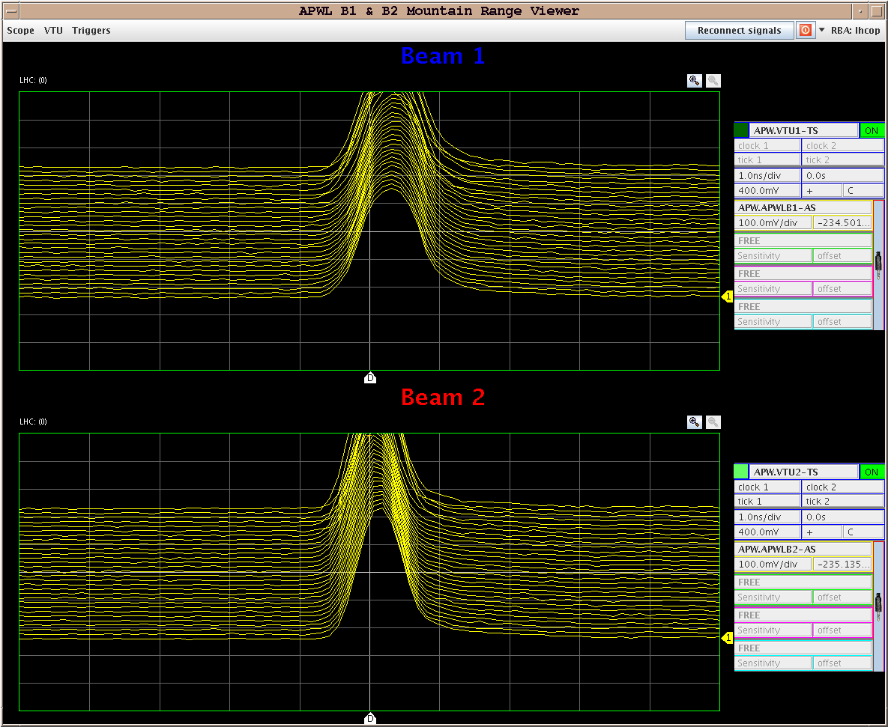
Monday 7.6
15:00: RF longitudinal emittance blow-up studies
Tested the newly-installed feature of the beam control which enables injection of band-limited noise into the phase loop.
The noise generation hardware and software work as advertised, and it was possible to produce longitudinal blowup to a given value by controlling the frequency spectrum of the applied noise (range ≈ 36 to 42 Hz).
Worked for 2E10 and nominal bunches.
Blow up on B1

Slide 4
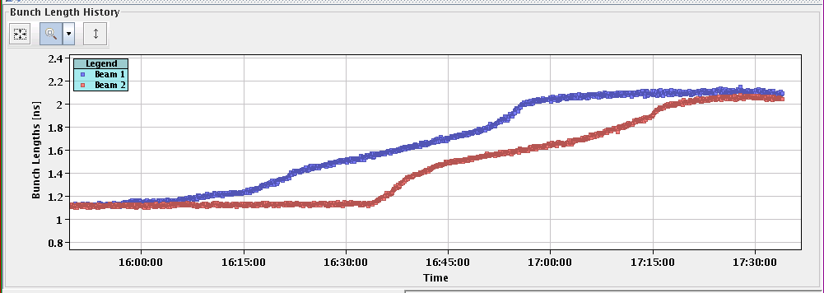
Monday 7.6

Slide 5
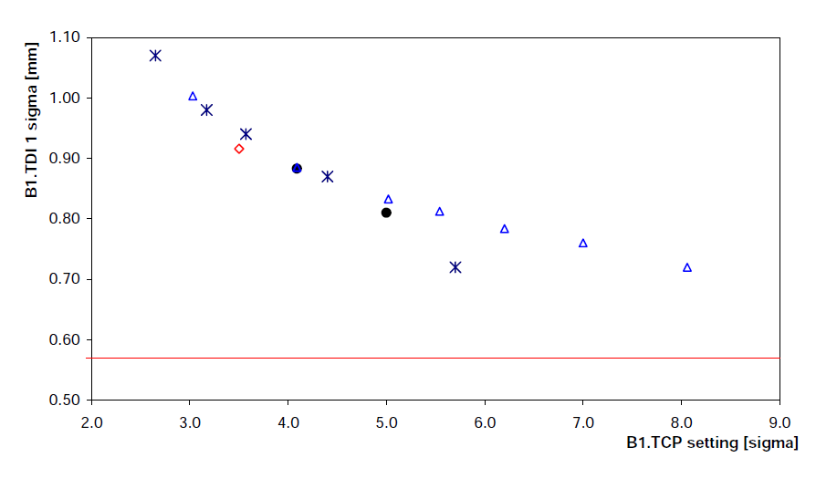
Monday 07.06
20:00 Injection protection studies.
21:00 : Sector 67 tripped.
nQPS for Q7L7, not understood.
23:00 : Injection protection – TDI settings
2 setup methods compared – they agree.
Settings Ok, shift of 0.4 mm of TDI B1.
Observed an unexplained systematic dependence of the beam sigma at collimator to be aligned on the ref. collimator setting (here TCP).
To be checked for other devices.

Slide 6
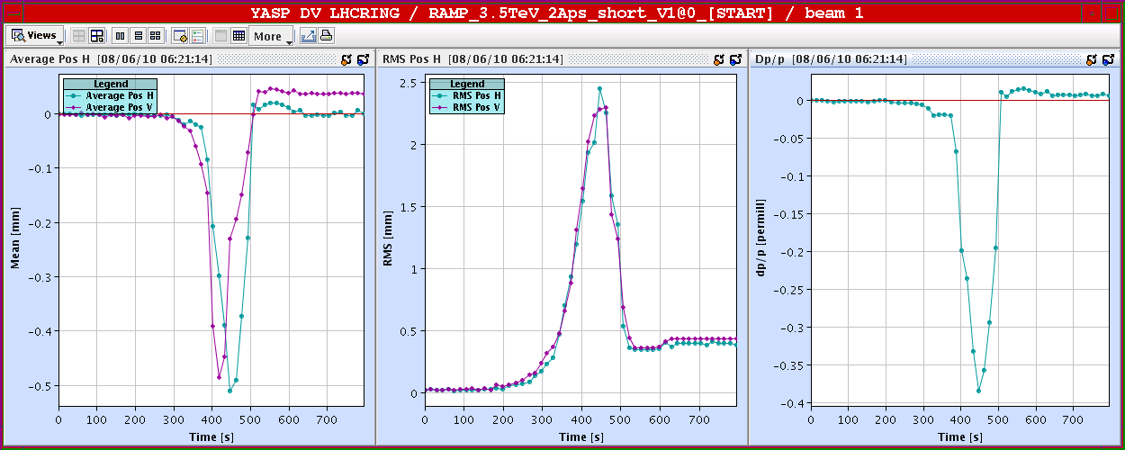
B1 systematic shifts versus intensity
03:00 : BI tests for high intensities.
Operation with 1 to few bunches with pilot to nominal intensities
Intensity prop. to time

Slide 7
Tuesday 08.06
Program for today (and night to Wednesday):
Continue BI tests for high intensities with 1 to few bunches with pilot to nominal intensities.
Hump investigations (variation of He flow).
Access around mid-day.
Transverse damper studies, longitudinal blowup continued.

Slide 8
Tuesday 08.06
Open Issues.
Sector 78 still requires final tests for validation of 10 A/sec ramp rate ➔ requires 1-2 h pre-warning and ca. 1 hour without beam).
Noisy nQPS board in A21L1 requires replacement ➔ requires access.
Noisy reading of temperature at current lead of DFBX.R8 – RD1 requires replacement of card ➔ requires access with 2 hours pre-warning for Cryo team.
QPS card for RCBXH1.R2 requires replacement ➔ requires access
New multiplier tube for abort gap monitor of Beam2 requires re-alignment ➔ requires access.
Multiplier tube for abort gap monitor of Beam 1 requires replacement ➔ requires access (but not before the end of the week).

