Slide 1
Thursday 27th
00h34: Sector 67 tripped again (see 21h51 entry Wednesday). Access. BLM problem.
08h52: Power glitch affecting various systems: RF, collimators, LHCb and ALICE dipoles, SPS. Recovery. New RF configuration.
13h24: Injection setup. Injection 7 x 1e11 per beam.
14h59: Stable beams (450 GeV collisions).
New record intensity at 450 GeV: 7e11 p (B1), 5e11 p (B2)
B1 without issues. B2 relatively unstable already before collision, significant losses. Too high chromaticity (fine for B1)?
Stable beam with injection betas. Lumi scans.
Instantaneous lumi of 0.015 (ub.s)^-1 [1.5e28] at ALICE
ALICE got ~1 million events
16h03: End of fill.

Slide 2
New RF Configuration (P. Baudrenghien et al)
Following matching to capture high intensity beams we have now reduced
Flat bottom voltage at 3.5 MV
3.5 TeV at 5.5 MVAs
This reqires less klystron power: we now have ONLY 4 KLYSTRONS PER RING
These settings should be OK for low intensity has well.
RF functions have been trimmed accordingly in
RAMP_3.5TeV_2Aps_short_V1
Ramp_3.5TeV_2Aps_short_V1START

Slide 3
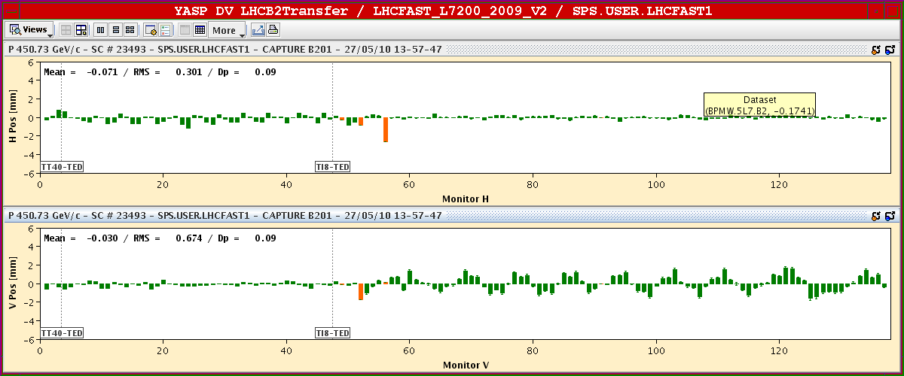
B2 Oscillation Starting in LHC (Injection)

Slide 4
Thursday 27th
16h03: End of fill:
Beam excursion interlock (too low intensity for some bunches).
Sector 12 trip (noise on the U_RES signal for RQ10.L2 , followed by the global protection mechanism tripping all the sector).
17h40: Sector 67 trip:
Noise with a period of 25 sec on B15L7 (as May 26 and 21)
19h00: Beam back.
No pre-cycle.
Q’ off by a significant amount on B1.

Slide 5
Thursday/Friday 27th/28th
20h38: Transverse damper studies.
H.B1: A VME crate in SR4 needs a local intervention before further commissioning
V.B1: Gain of two power amplifier chains is not correct; needs an intervention in UX45 (#5 and #6); problem most likely inUX45. V.B1 used with two power amplifiers (#7, #8) and two pick-ups works correctly in both modes (with and without FIR phase shifter)
H.B2: All power amplifiers used with two pick-ups, works correctly :-)
V.B2: All power amplifiers used, but only with pick-up Q9; pick-up Q7 has a noisy electronics; intervention in SR4 required
Multi-bunch mode needs to be tested.
04h00: Study of BPM shifts with intensity

Slide 6
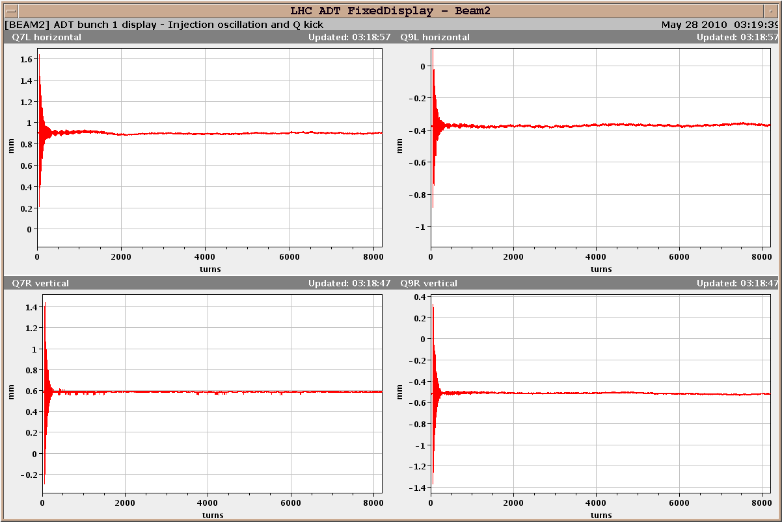
Dampers on for Beam 2: Damping

Slide 7
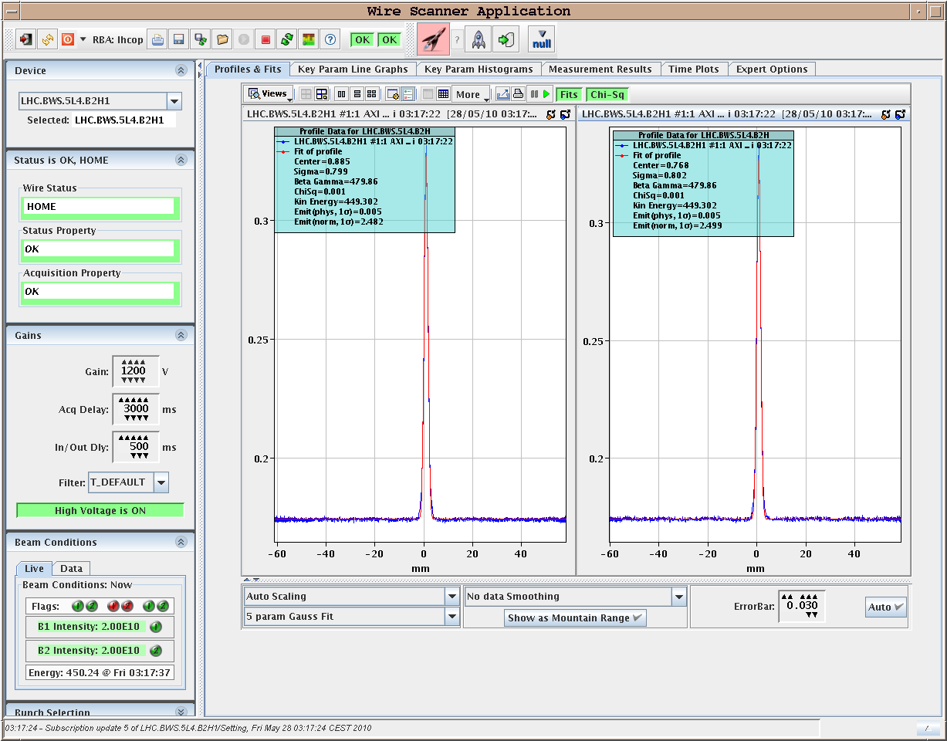
Emittance H at Injection: B2, Damper on
2.5 μm

Slide 8
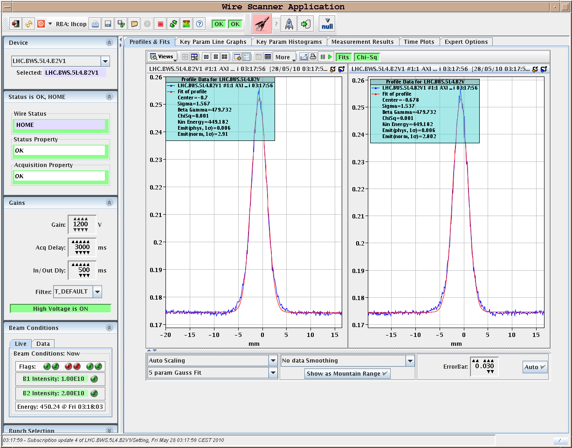
Emittance V at Injection: B2, Damper on
2.9 μm

Slide 9
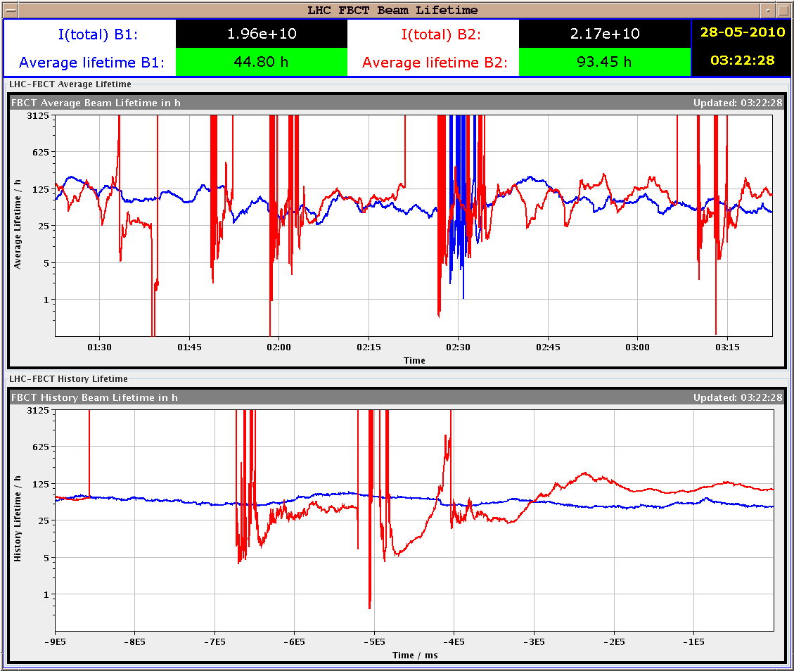
Lifetime B2 Damper ON

Slide 10
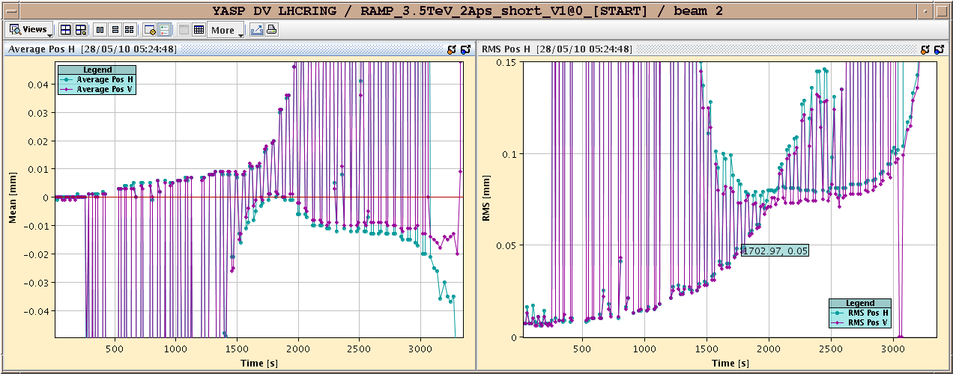
BPM Study – B2 (Ongoing)
Average Orbit
RMS Orbit
High I
High I
Low I
Low I

Slide 11
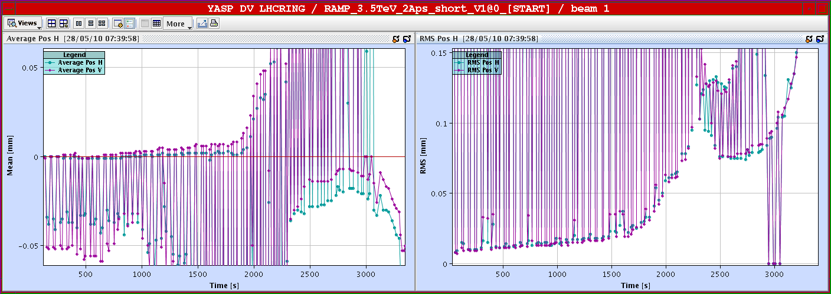
BPM Study – B1 (Ongoing)
Average Orbit
RMS Orbit
High I
High I
Low I
Low I

Slide 12
Ahead
Weekend:
Stable beams with 13 or more bunches per beam.
Interleaved with short checks at 450 GeV.

