Slide 1
Thursday
07h20: RF checks at 3.5 TeV (end-of-fill).
09h00: Beam dump and recovery.
12h00: Injection protection setup.
Found back consistent settings wrt last time.
Loss maps OK for both beams, TDI losses below primaries.
Over injection looks good.
Settings are in the trim, thresholds (0.5 sigma) need to be set by expert.
14h30: Collisions @450 GeV (collapsing separation bump not in stable beams) to ATLAS to perform some calibration of their liquid argon calorimeter.

Slide 2
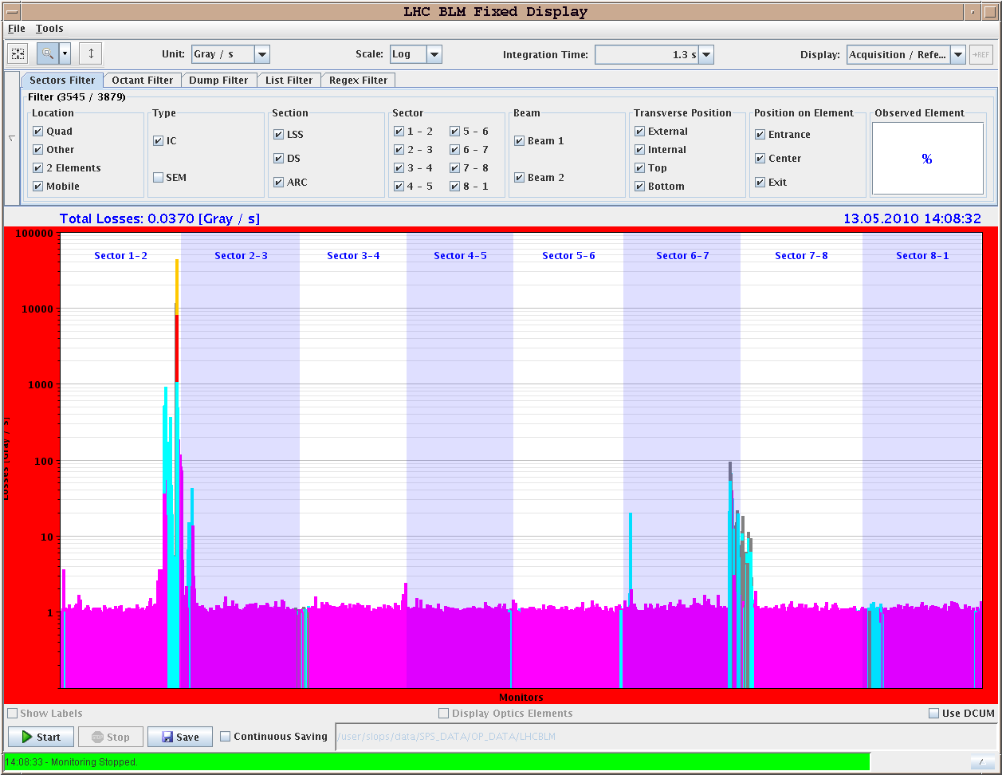
Losses from Over-Injection (B1)

Slide 3
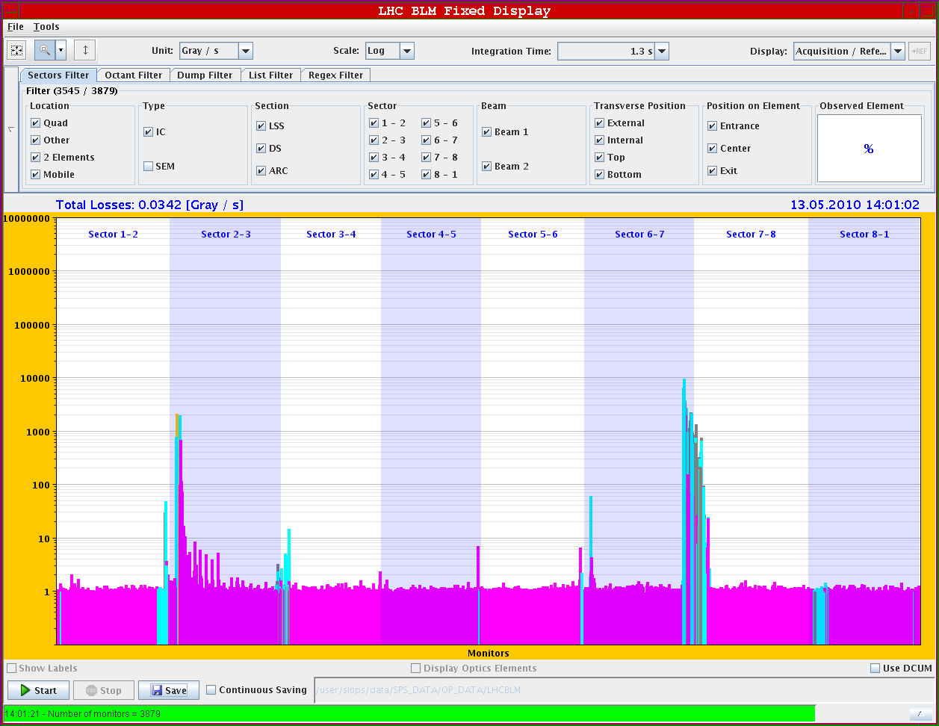
Losses from Stored Beam (B1)

Slide 4
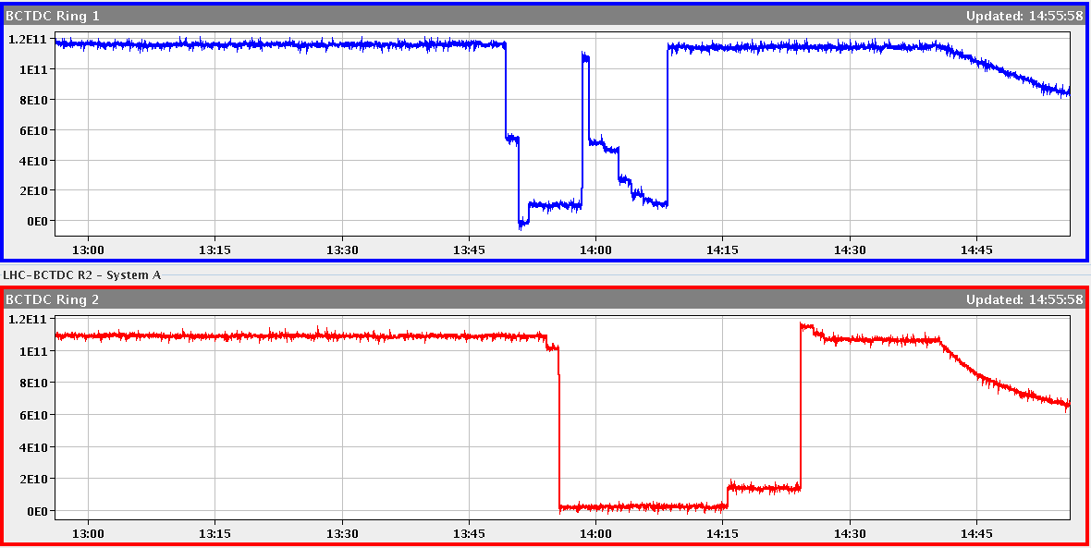
Collision in ATLAS

Slide 5
Thursday
15h00: Orbit feedback checks
Tests results are OK, OFB stable and reduced the orbit at the selected pick-ups.
No leakage or issues between H/V nor between B1 and B2 have been observed.
While the OFB corrected the bump perturbation, the FB correction is far from "perfect" (see leakage to the neighbouring pick-ups) due to the chosen locality of the orbit correction.
The OFB is configured to automatically switch 'off' if the orbit deviation exceeds 500 um (safety precaution). If you notice that the OFB turns 'off' during the ramp while the maximum orbit deviation is less -> just switch it back on for the given plane.
15h00: Collimator energy-dependent gap thresholds:
All set up for primary collimators and IR6 collimators / TCDQ.
Opened at end of ramp to allow stable beams with old settings.
Will be fully completed with new collimator set up at 3.5 TeV.

Slide 6
Thursday
18h00: Ramp with collimators and feedback (low intensity).
All fine. Arrive at 3.5 TeV without interlock and without beam losses.
At 3.5 TeV lost 75% of beam 1 while trimming chromaticity.
Separation bumps collapsed.
Squeeze to 2 m.
Beams dumped.
ALL future ramps with collimators closing and orbit feedback.
22:07: Lost cryo mantain and start in MSR6:
Back after 13 minutes.
Lost the following circuits at injection level... RPHH.UA67.RQ4.R6B1 RPHH.UA67.RQ4.R6B2RPHH.UA67.RQ5.R6B1 RPHH.UA67.RQ5.R6B2 RPLB.UA67.RCBYH4.R6B1RPLB.UA67.RCBYH5.R6B2 RPLB.UA67.RCBYV4.R6B2 RPLB.UA67.RCBYV5.R6B1
Continued without new pre-cycle.

Slide 7
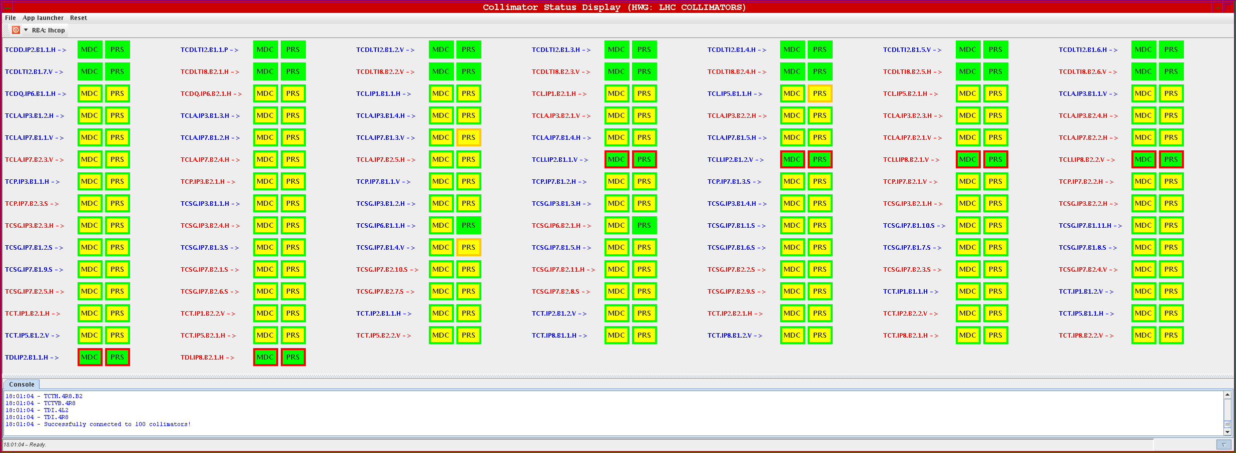
Collimators in Ramp

Slide 8
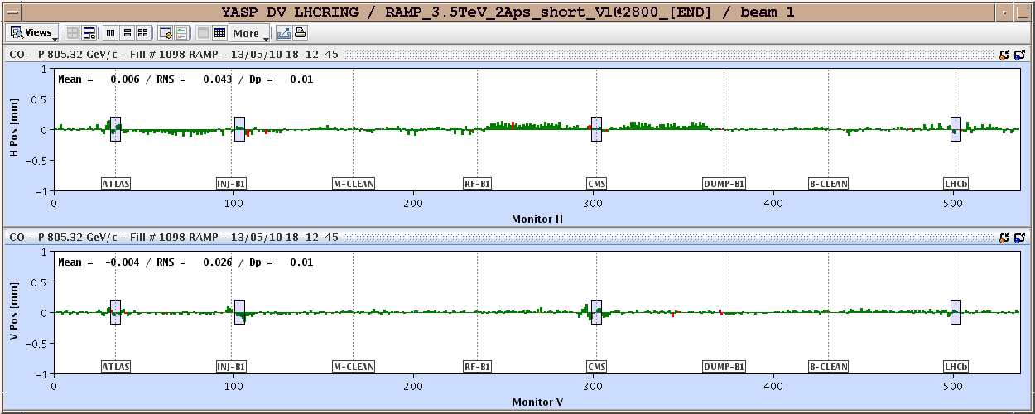
Orbit in Ramp

Slide 9
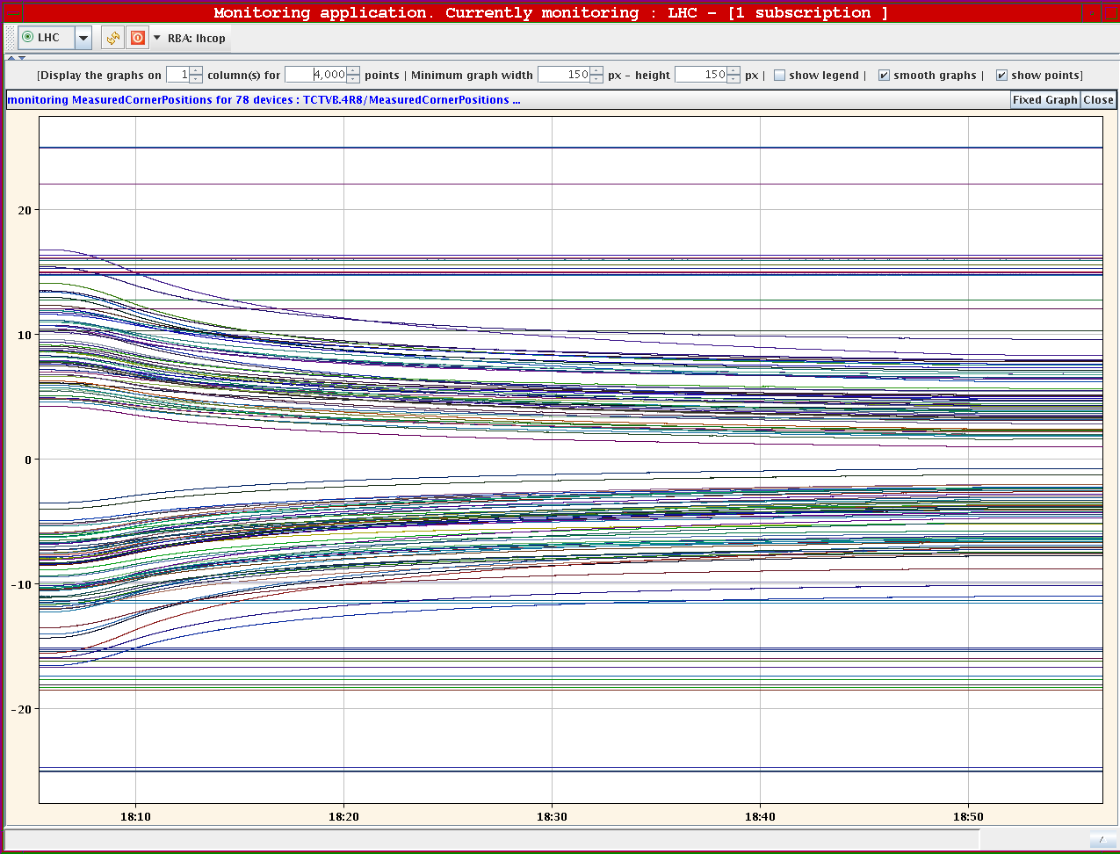
Closing Collimators During Ramp

Slide 10
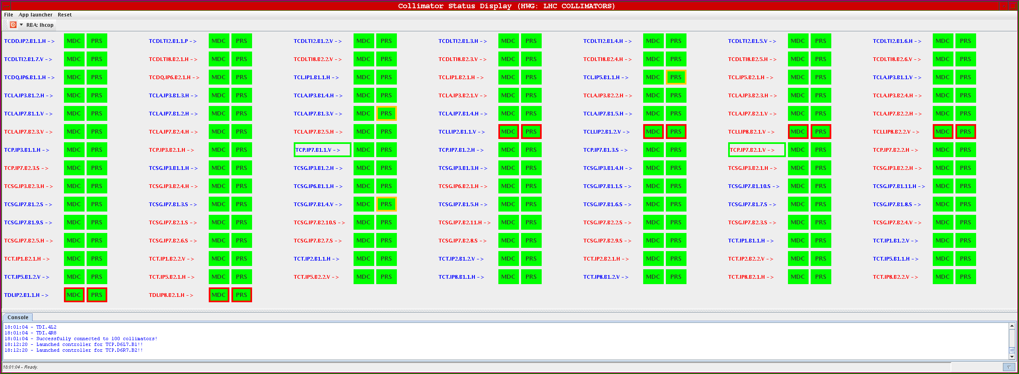
Collimators at 3.5 TeV

Slide 11
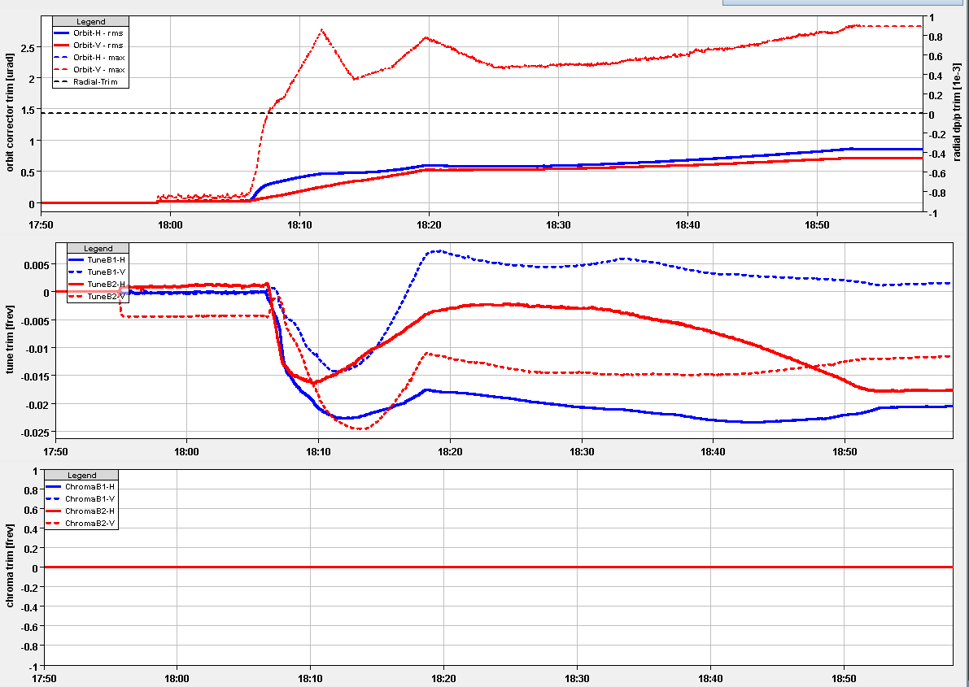
Orbit and Tune Feedback

Slide 12
Thursday/Friday
23h45: BPM sensitivity checks to intensity at 450 GeV
Mean orbit seen to be very stable from ~5.5e10 onwards.
Quickly diverges below this intensity for LOW sensitivity.
The switch to HIGH sensitivity clearly seen as jump at 2E10 (probably what ATLAS saw as last week as "noise on their measurements”)
2h00: Prepare fill for stable beams
Problems to load ramp settings for RQTDs: function had points with spacing less than 0.1s.
Lost beam 2 just after start of ramp (5h14): dump triggered by the beam excursion at Pt 6.
Reason for the dump may be that tune_trim regeneration was not correct (continuous tune viewer application stopped just after the start of the ramp) or to the orbit FB.
Beam dumped at 3.5 TeV (6h20).

Slide 13
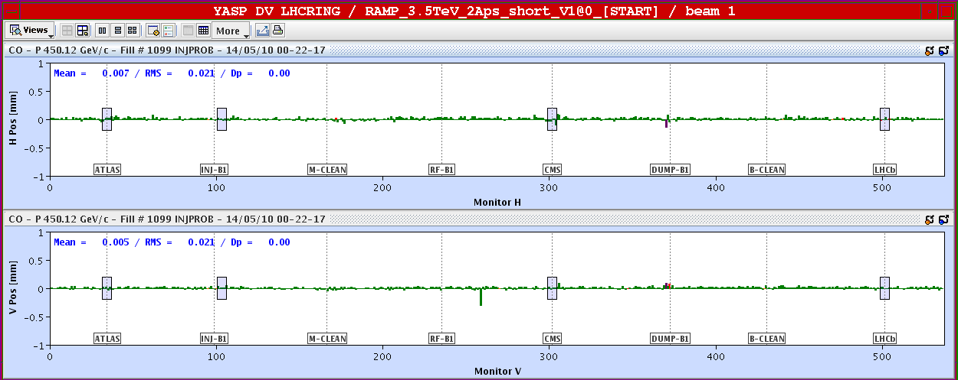
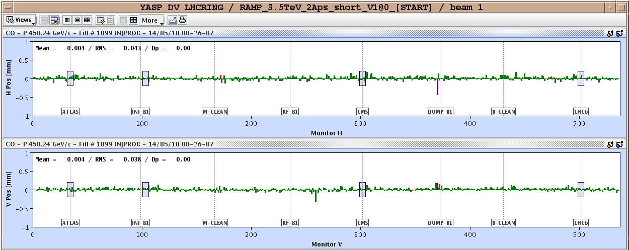
Orbit Diff with Intensity at 450 GeV: 1e11 ➔ 9e10, 6e10

Slide 14
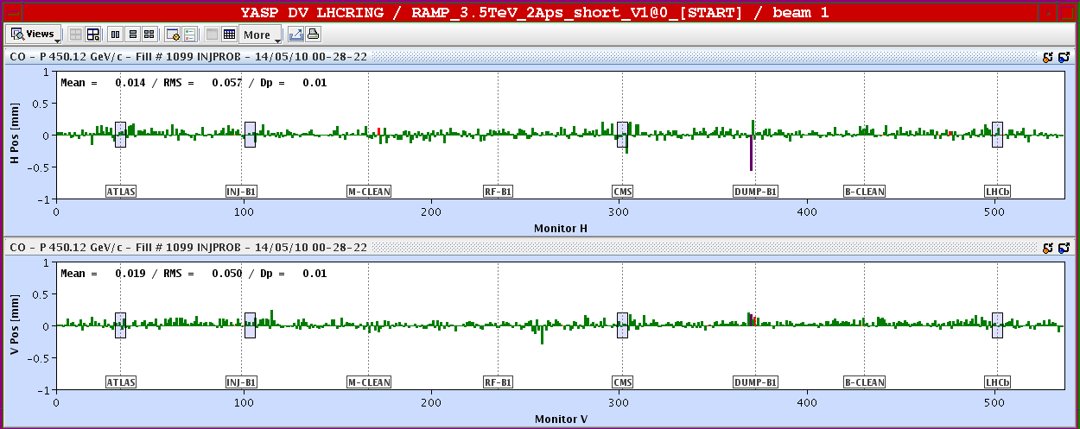
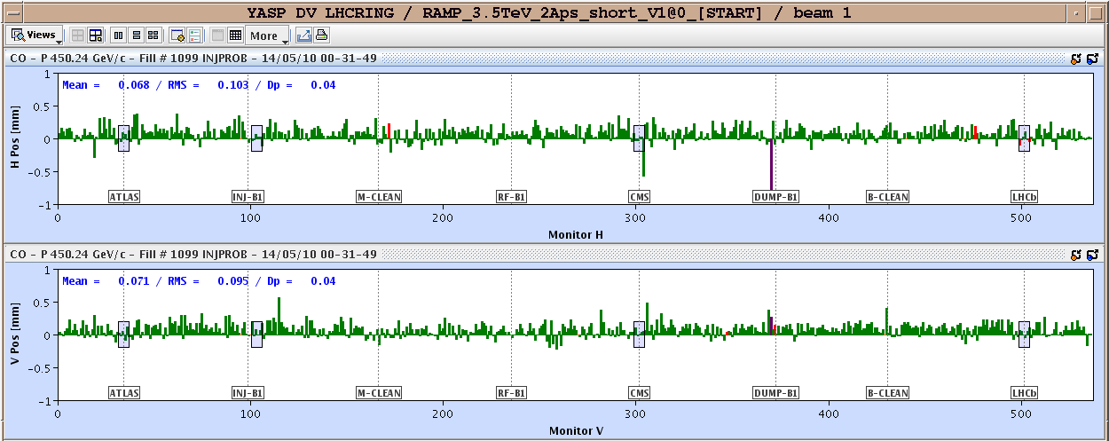
Orbit Diff with Intensity at 450 GeV: 1e11 ➔ 5e10, 4.3e10

Slide 15
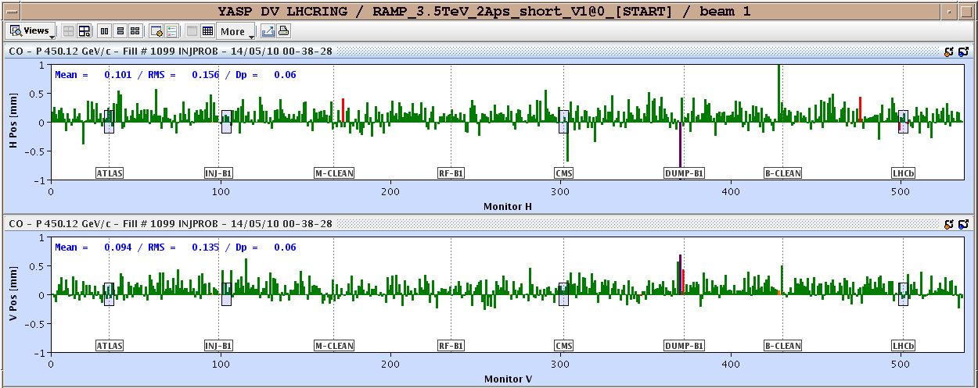
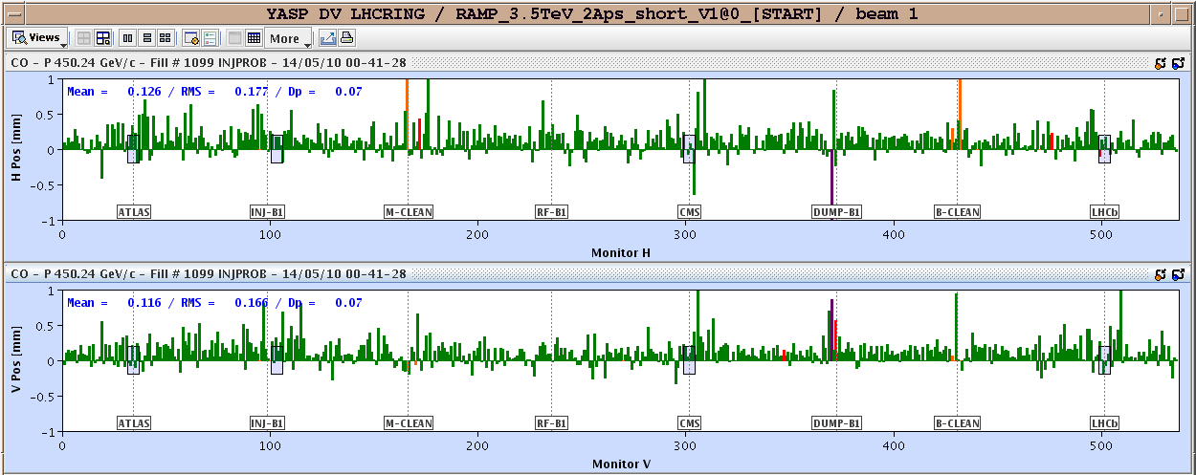
Orbit Diff with Intensity at 450 GeV: 1e11 ➔ 3.5e10, 2.5e10

Slide 16
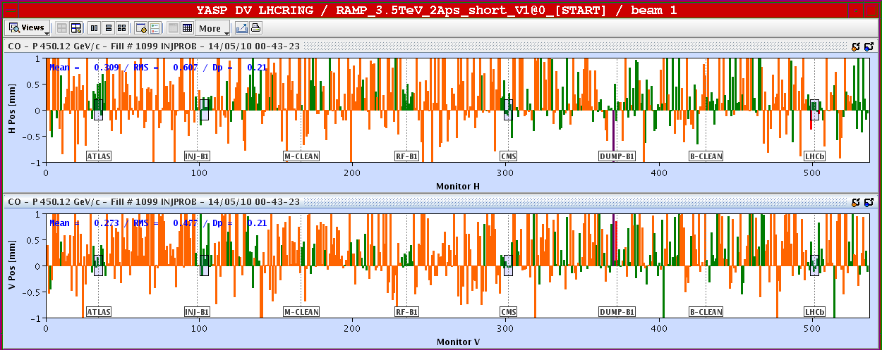
Orbit Diff with Intensity at 450 GeV: 1e11 ➔ 2e10

Slide 17
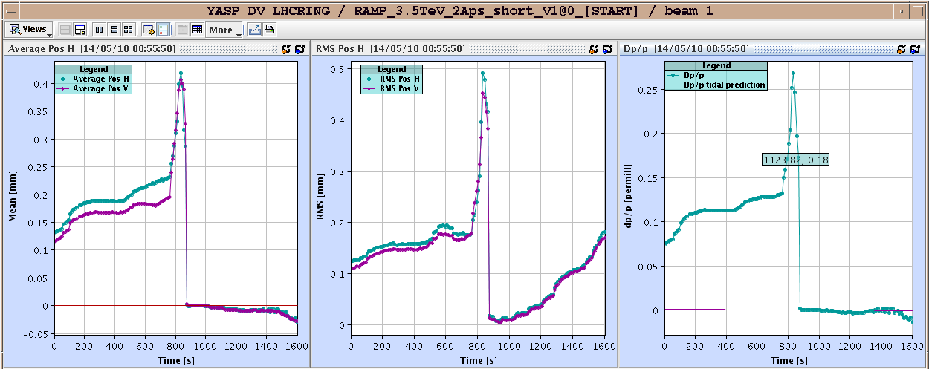
Orbit Sensitivity Summary

Slide 18
Friday
8h00: Loading new SIS software (J. Wenninger):
modified the interlock logic for the TCDQ orbit and monitored it with the last ramp & squeeze.
Previously I had a constant tolerance set to N=1 sigma, which corresponds to 1.6 mm at injection and 0.6 mm at 3.5 TeV.
B2 BPMs shift by 0.7 and 1.4 mm (!!) between probe-2E10 and 1E11 ! For B1 this is OK. To be checked with BI.
I modified the logic such as to be able to define the tolerance as a function of energy, i.e. N = N(energy).
I set the tolerance now such that for B1, the tolerance is more or less constant at +-2 mm (~ 3 sigma at 3.5 TeV) for B1, and +-2.4 mm (3.5 sigma at 3.5 TeV) for B2.
At the same time I will also activate the orbit interlock : +4 mm in the arcs + DISS, +- 6 mm around the IRs (Q6 to Q6, margin for sep. bumps). To be fine tuned. Dump if 12 or more BPMs above the limit (per plane and per beam).

Slide 19
Ahead
All work for step up in intensity is completed!
Now go to 4 x 2e10 per beam. As soon as ramped up, go to stable beams!
If we are lucky, we can have stable beams BEFORE 15h00! Be ready…

