Slide 3
Online monitoring

Slide 4
K-short mass offline

Slide 5
Before tune ~10 Hz, after tune ~60 Hz (at begin of fill)

Slide 6
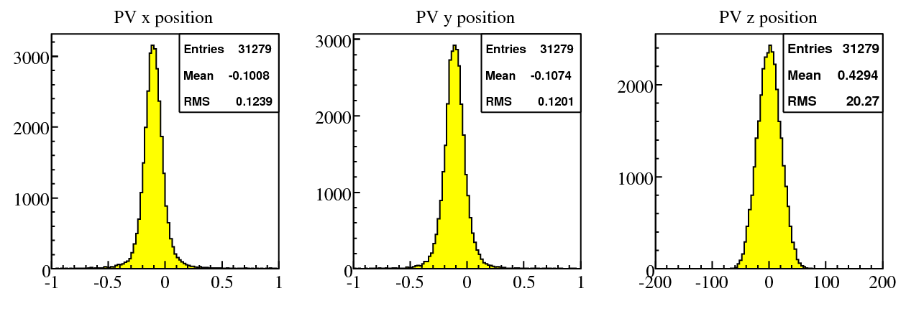
run 69240 (first run at 7 TeV) velo @ 14mm
RMS dominated by PV resolution
RMS dominated by size of IR

Slide 7
run 69246 velo @ 5mm
RMS smaller because vertex resolution
improves if Velo closer to beam
RMS dominated by size of IR

Slide 8
PV position for different runs
statistical uncertainties about 1 unit in last digit
systematic uncertainties due to movement of velo still unknown

