Slide 1
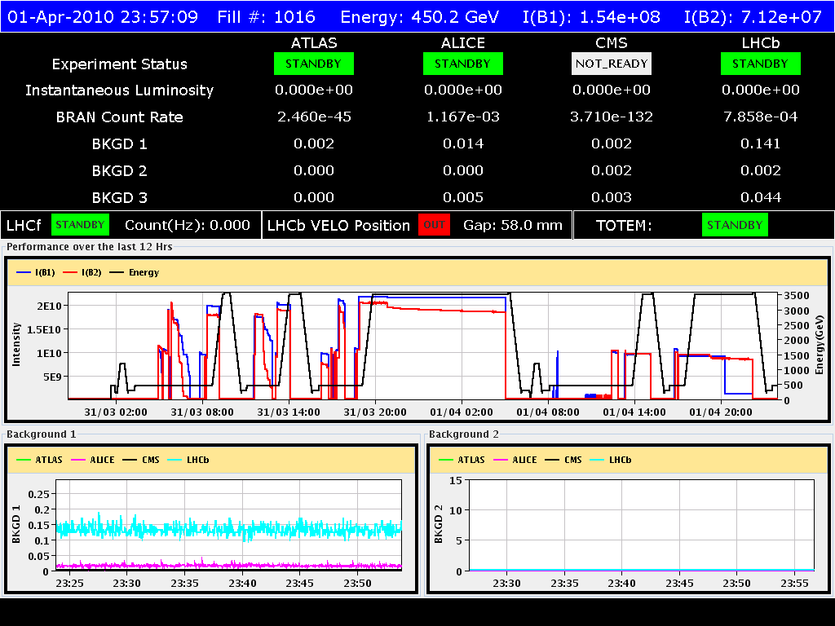
01/04/2010

Slide 2
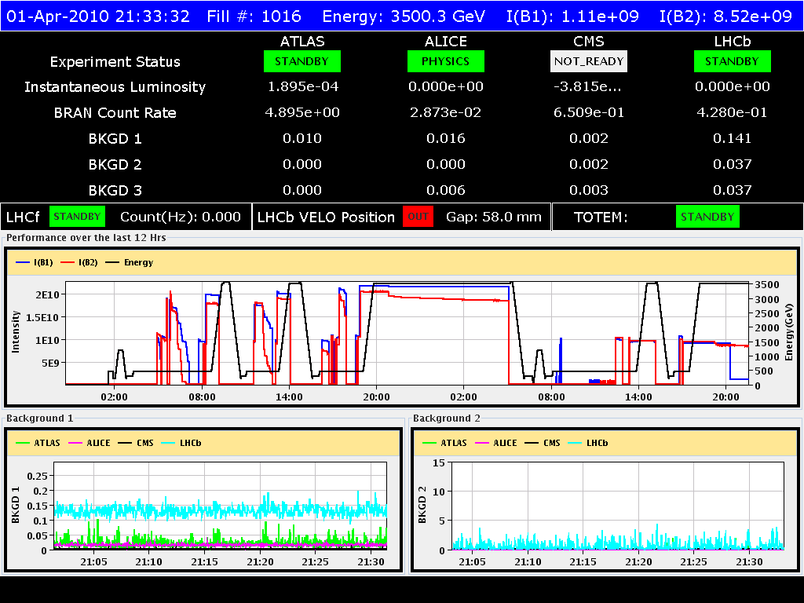
01/04/2010
Start of the studies delayed due to trip of RQD.A12 at 08:43 at the end of pre-cycling ➔ nQPS triggered but no signal observed above threshold.
Injection started at ~12:00 for RF capture optimization. Due to the low longitudinal emittance delivered by the SPS the capture voltage could be decreased from 8 to 5 MV at injection
Trim to new values implemented in the sequencer

Slide 3
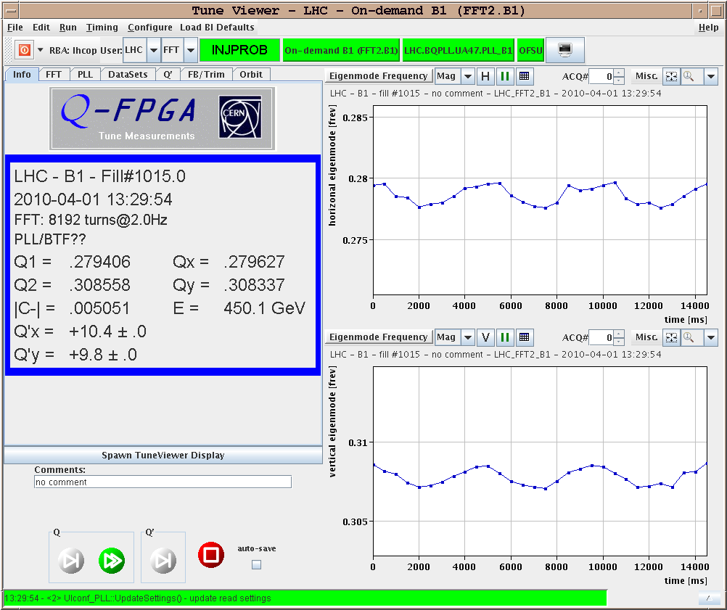
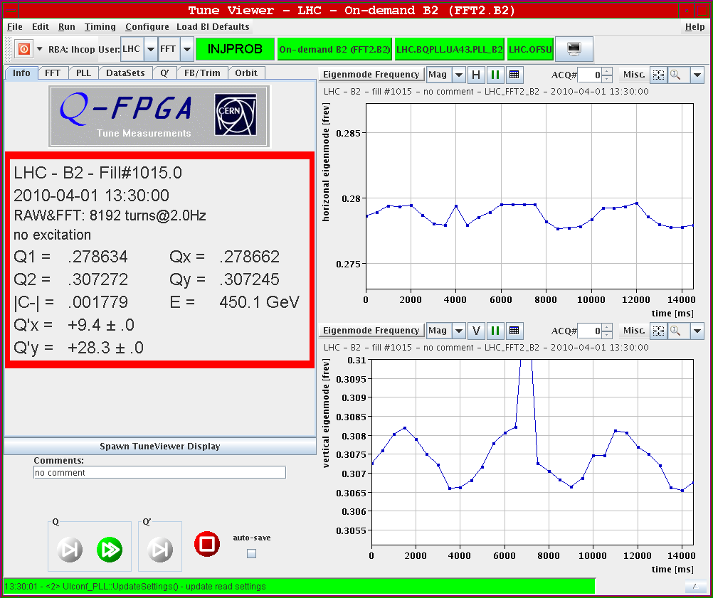
01/04/2010
Preliminary tests of the chromaticity measurement by RF frequency modulation

Slide 4
01/04/2010
Smooth ramp in preparation of squeeze test
15:00 Beam lost at flat-top due to bad manipulation with the sequencer
Finally ready to start the squeeze at 18:30
No losses during the squeeze (except to over enthusiastic use of AC dipole)

Slide 5
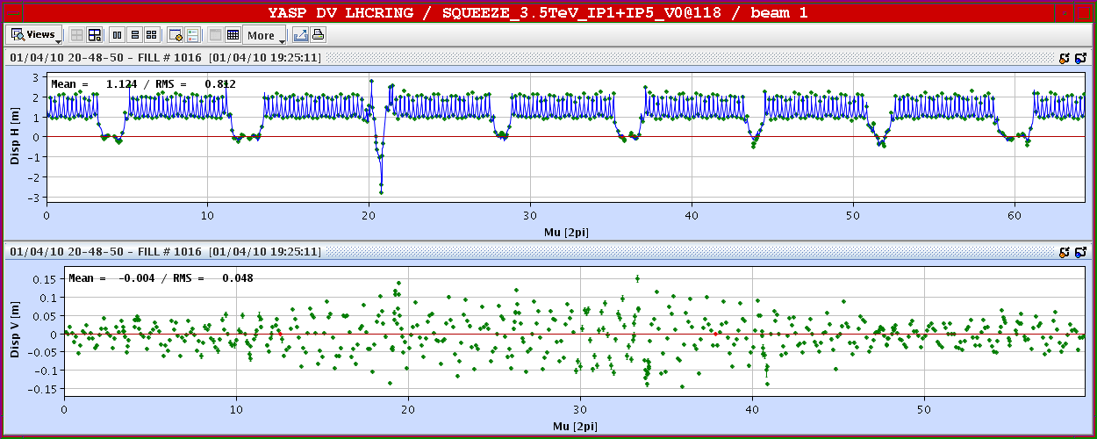
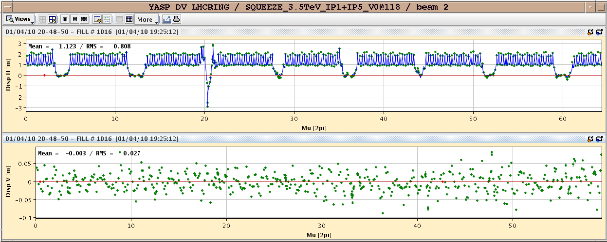
01/04/2010
β* = 9 m
Tune and chromaticity OK

Slide 6
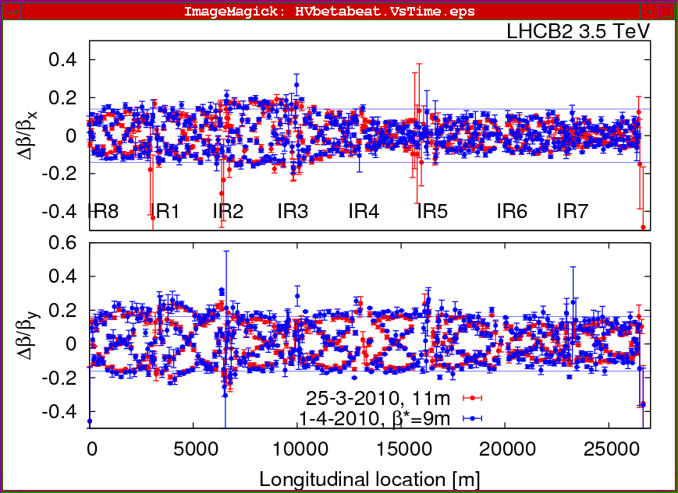
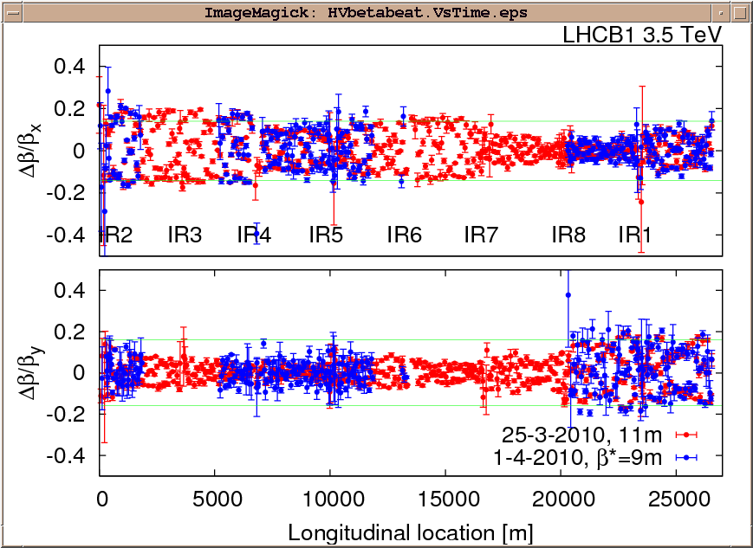
01/04/2010
β* = 9 m
Beta beating measurement
Beam 2
Beam 1 (lost 80 % of the beam during AC dipole excitation)

Slide 7
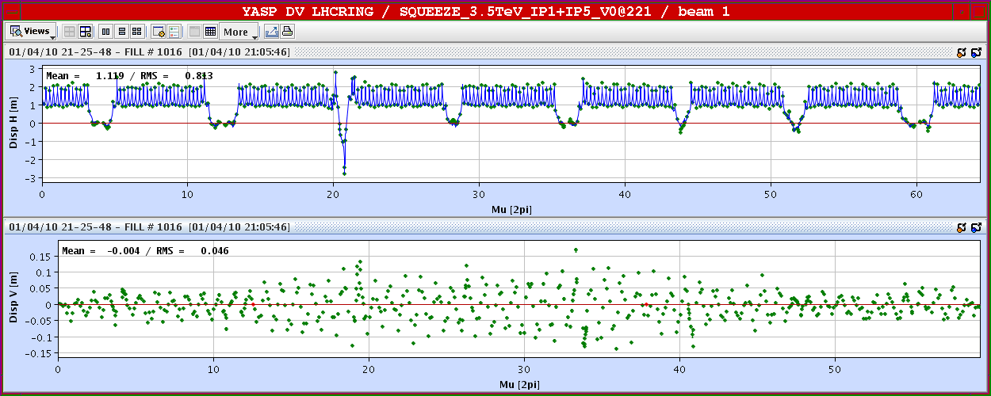
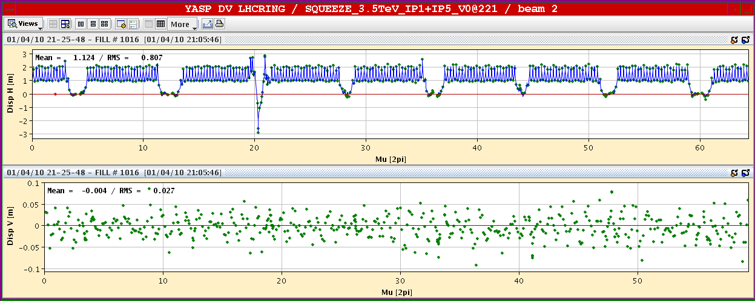
01/04/2010
β* = 7 m
Tune and chromaticity OK

Slide 8
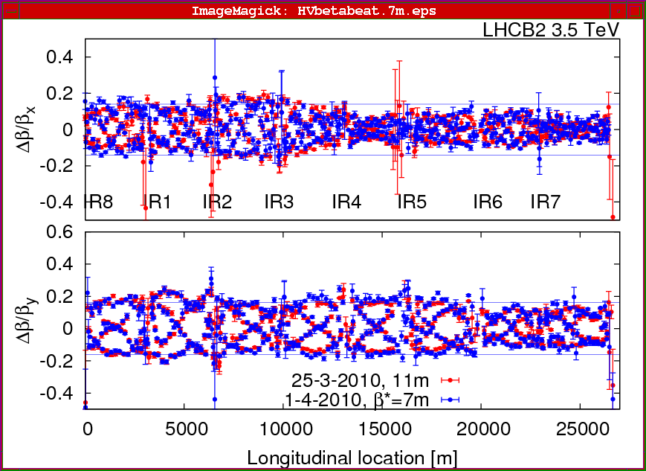
01/04/2010
β* = 7 m
Beam 2

Slide 9
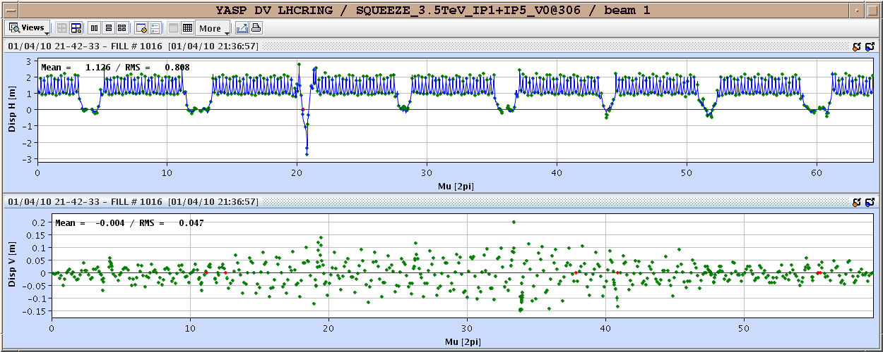
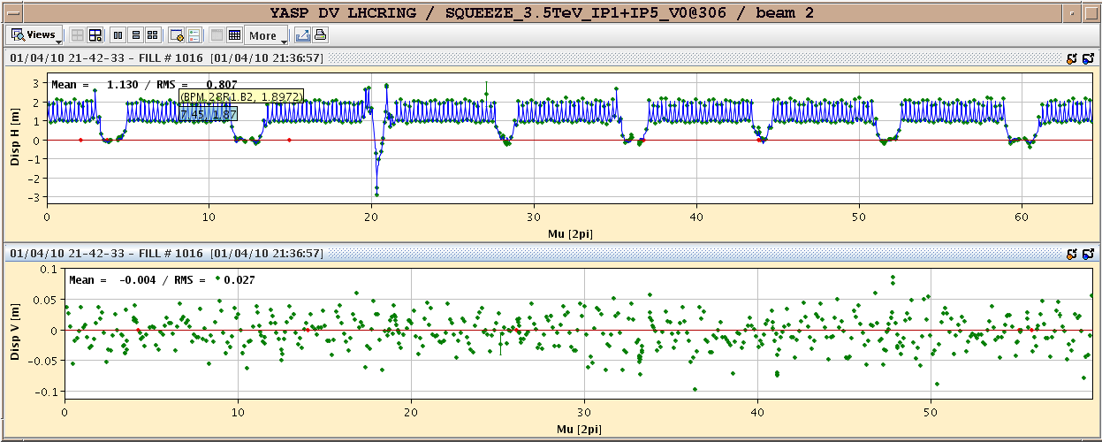
01/04/2010
β* = 5 m - Tune and chromaticity OK. Coupling increases to ~0.01

Slide 10
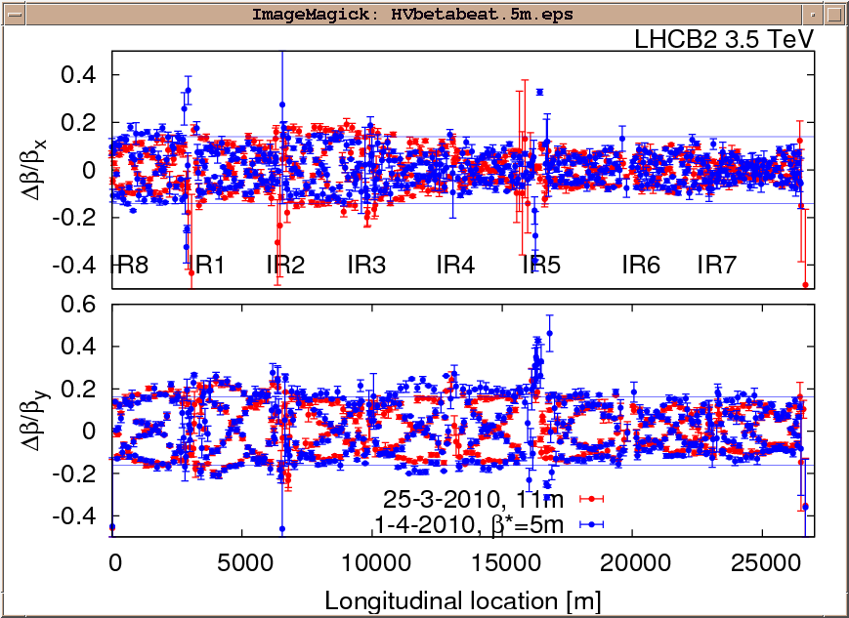
01/04/2010
β* = 5 m
Beam 2

Slide 11
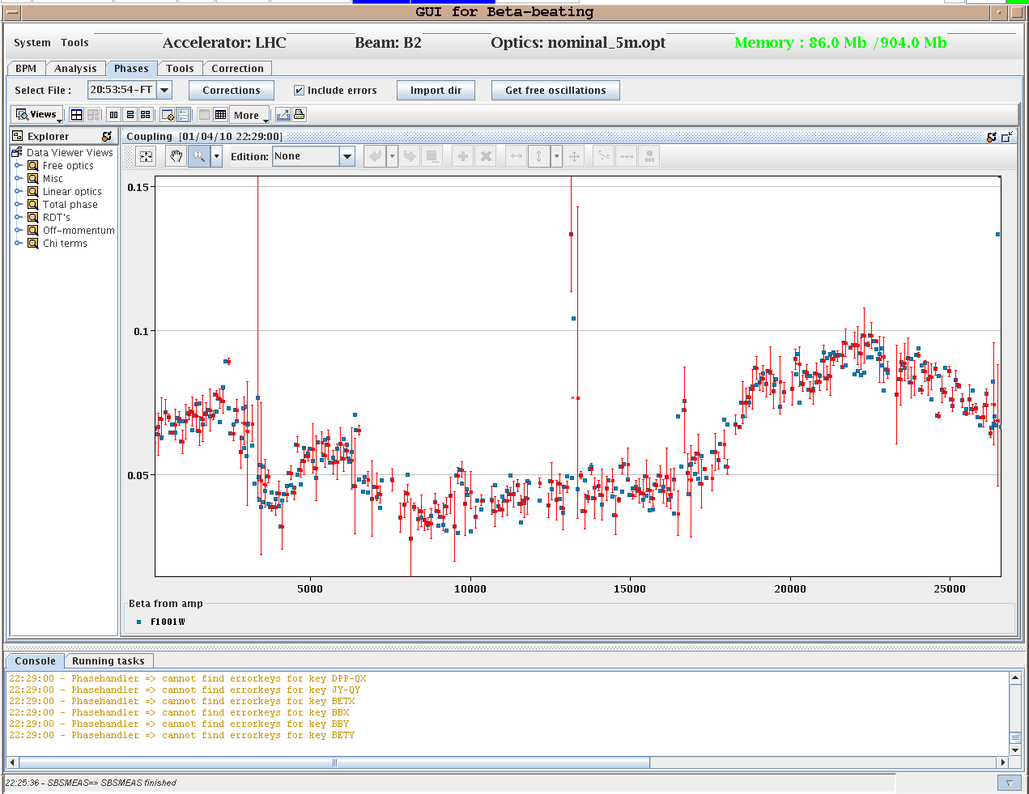
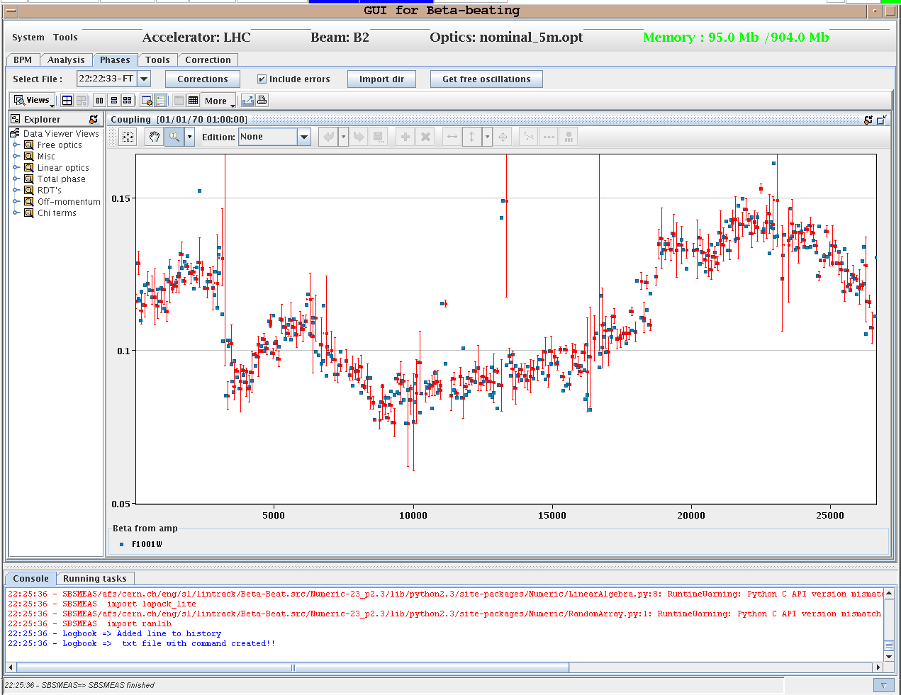
01/04/2010
Coupling Beam 2
β*=9 m β*=5 m

Slide 12
01/04/2010
Important loss during the ramp ➔ beam unstable. Likely chromaticity too low

Slide 13
01/04/2010
Today:
05:00 Ramp (without feedback) - OK
06:37 – lost cryo (oil pump?) – beams dumped
access in PZ45 for CRYO intervention
around 14:00 – recover from cryo
09:00 Tune feedback / chromaticity measurement during the ramp
14:00 Non linear chromaticity measurement and off-momentum beta beating
17:00-18:00 LHCb polarity change
Prepare fill for the night

Slide 14
01/04/2010
Saturday to Monday:
2 fills/day with an end of fill or beginning of fill study (2-3 hours)
Beginning/End of fill study list in work
Working point in collision
Machine protection tests
Non-linear chromaticity measurement at flat-top
b3 correction checks

