Slide 1
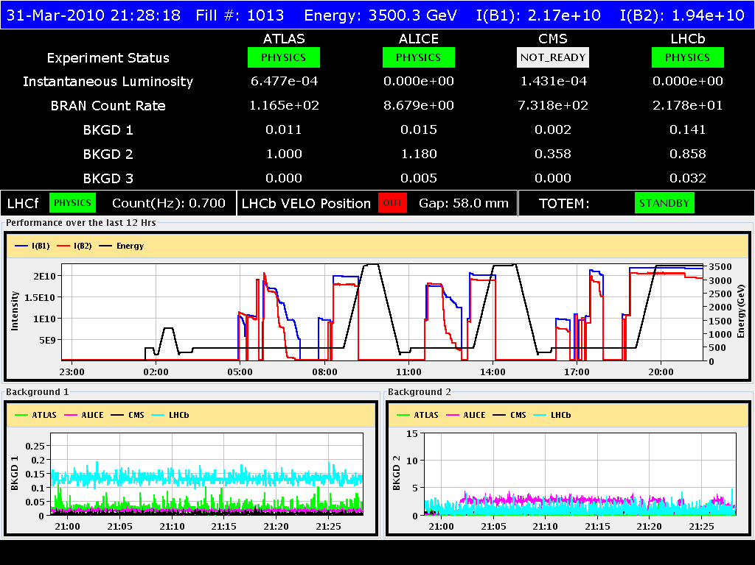
31/3/2010
Difficult day… but at the end stable beams

Slide 2
31/3/2010
The problems encountered overnight and the first ramp seem to be related to incorrect settings for the tune feedback (peak finder window)
Noticed possible correlation between reduction of the lifetime and increase of RF voltage from 8 to 12 MV before starting the ramp ➔ to be confirmed
For the time being we skip the increase in voltage before starting the ramp and we keep the voltage flat to 8 MV

Slide 3
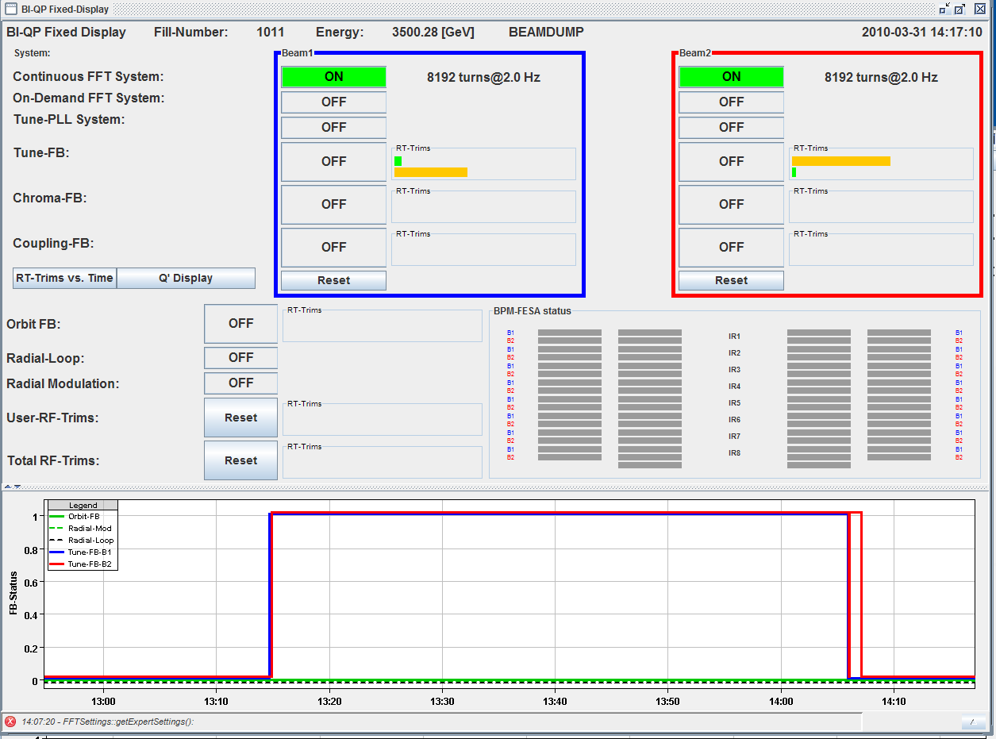
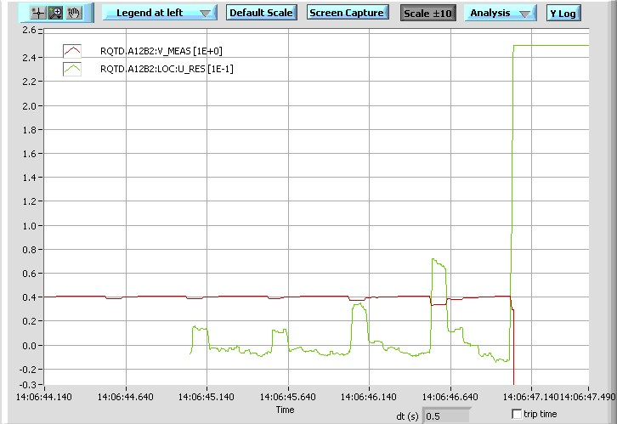
31/3/2010
One successful ramp at the beginning of the afternoon lost at flat-top during chromaticity measurement:
the tune feedback switched ON after being switched OFF and corrected the fast tune change induced by the energy trim during the chromaticity scan ➔ QPS tripped some RQT circuits

Slide 4
31/3/2010
Actions ongoing to fix the problems with the tune feedback:
Send corrections at a higher rate to the FGC. Ready for testing in a new version of the feedback controller, which will interpolate these changes and send them at 100ms intervals to the FGC.
A limitation on the allowed dV/dt (d2I/dt2) to be implemented at the FGC level ➔ new FGC version ready to be tested
Raise the QPS detection thresholds to be investigated

Slide 5
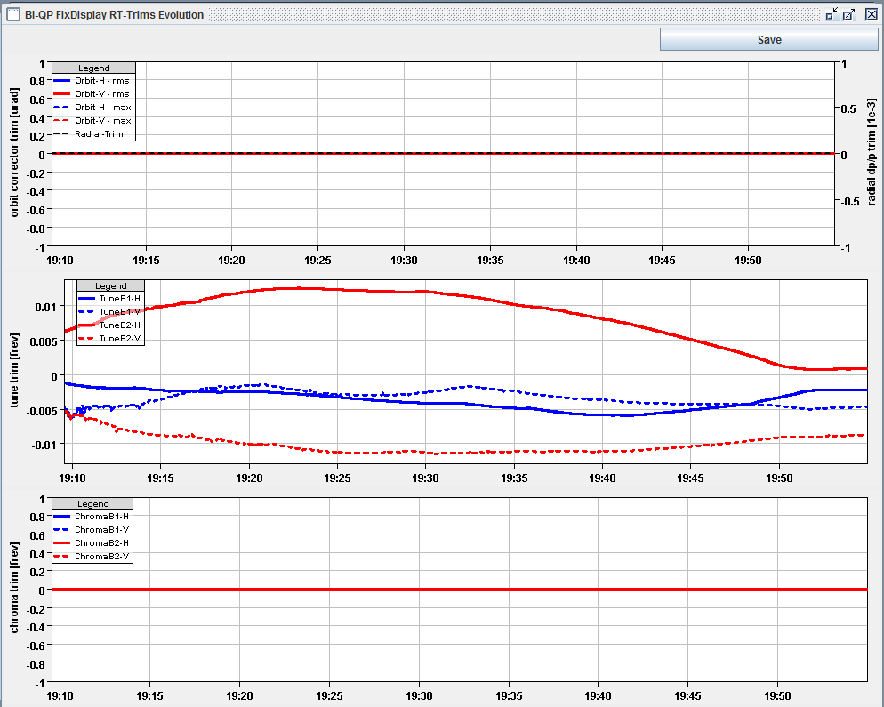
31/3/2010
After that preparation for an additional ramp: some problems with the positioning of the collimator ➔ operational procedure not correctly followed
Trims from the feedback during the previous ramp incorporated (coarse) in the ramp to reduce the correction introduced by the feedback now limited to ~0.015 ➔ to be continued

Slide 6
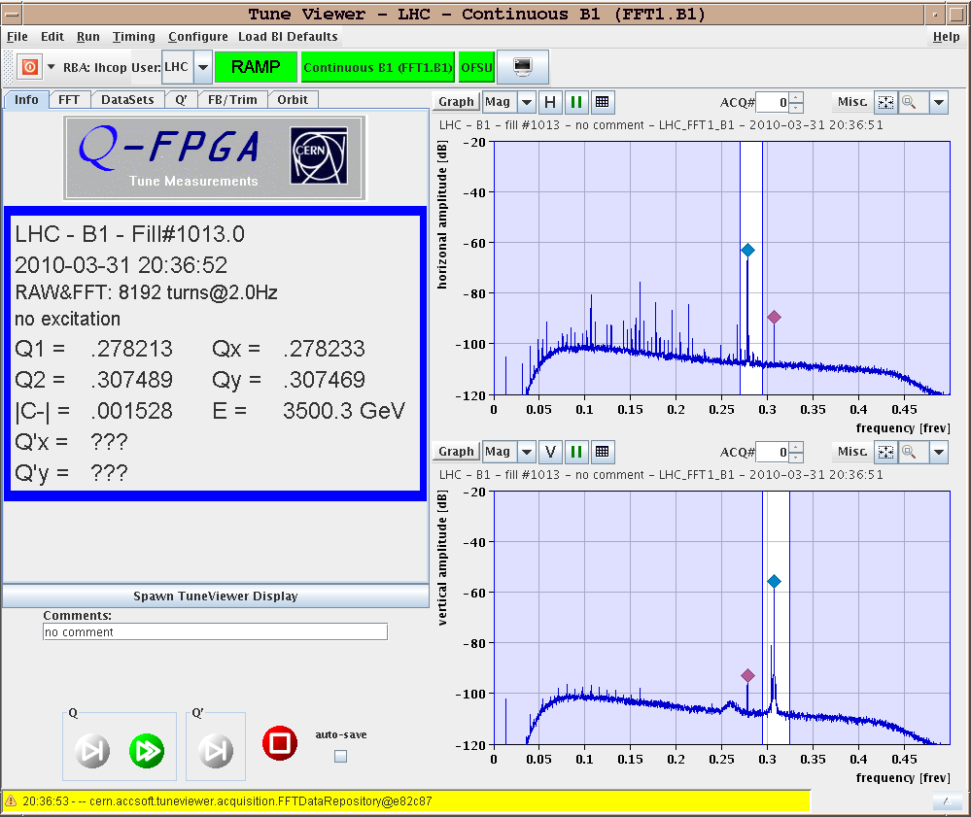
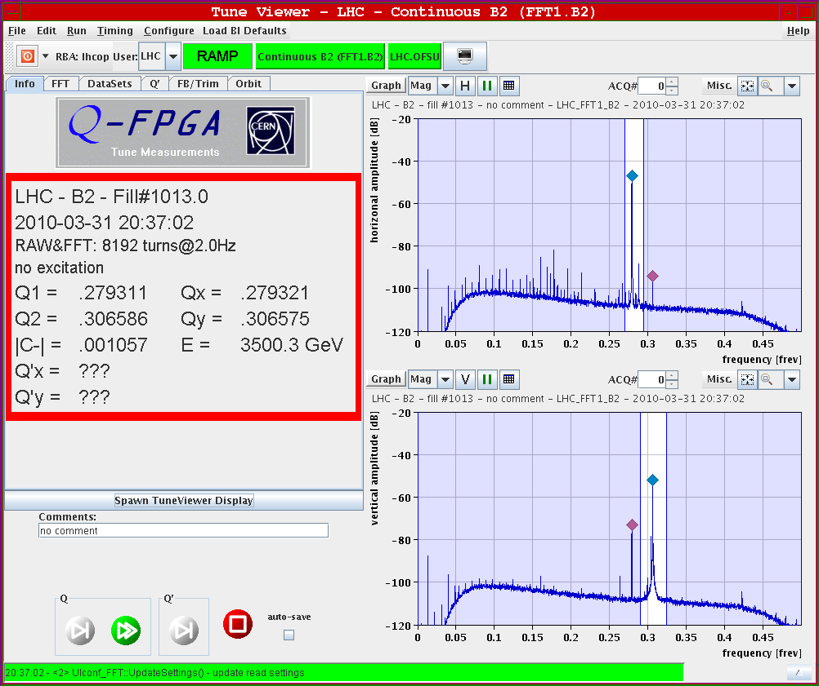
31/3/2010
Coupling correction at flat-top
Chromaticity before correction: B1: H:9.0, V:9.2 B2: H:8.9, V:10.3 Chroma after corrections: B1: H:5.4, V:3.6 B2: H:4.1, V:4.9

Slide 7
31/3/2010
We still see losses when we close the collimators. Blow-up still observed after injection and during the ramp mainly in the vertical plane beam 2. To be studied further.

Slide 8
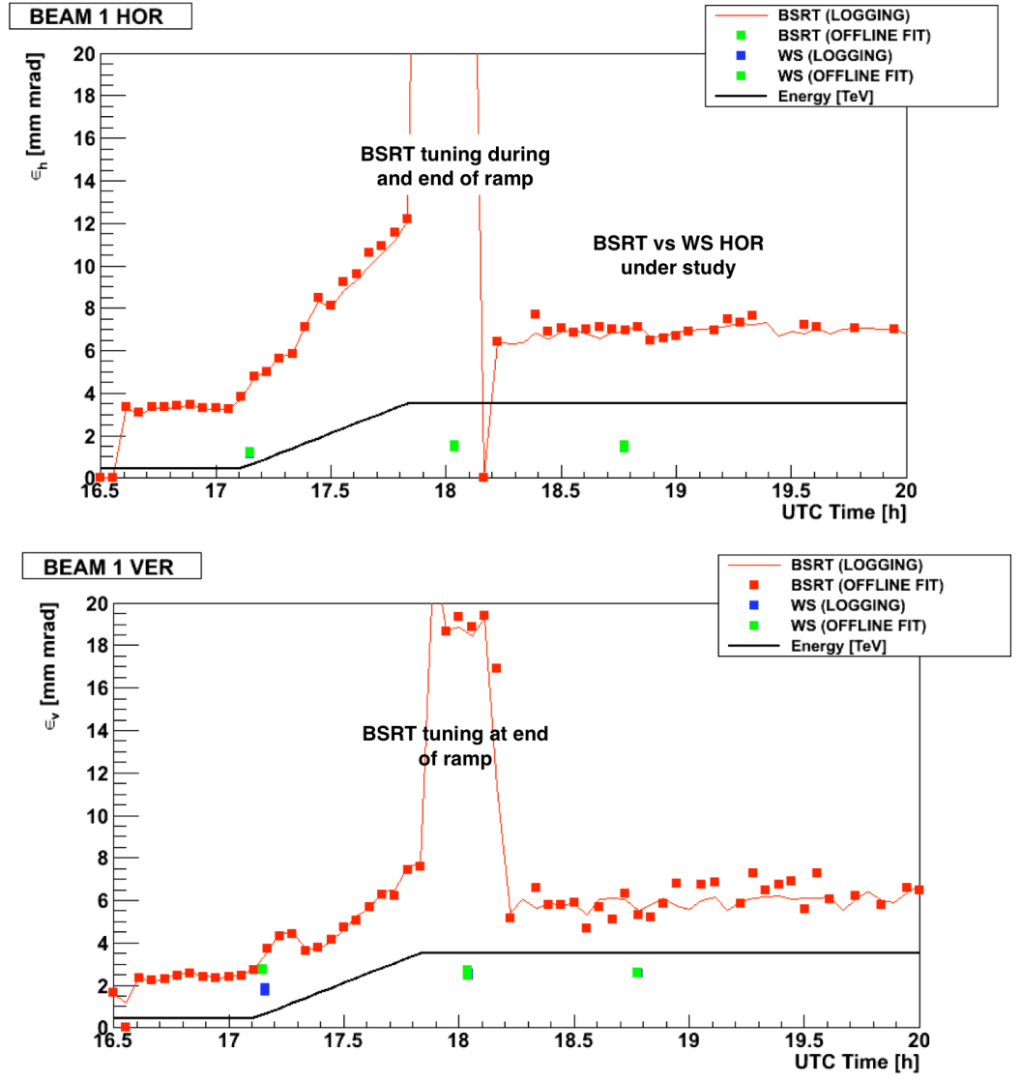
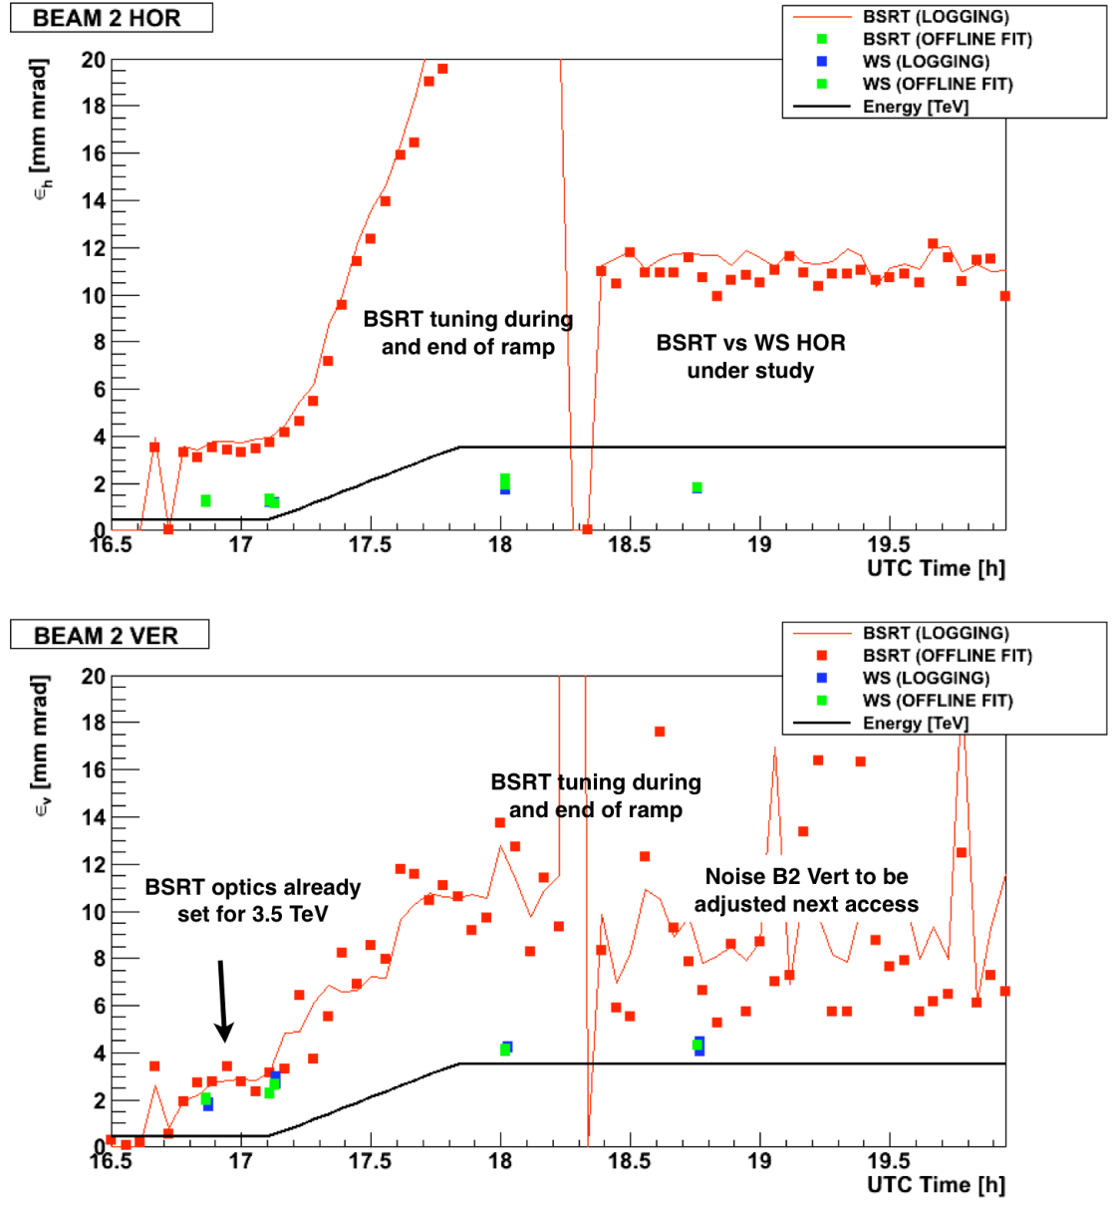
31/3/2010
BSRT for the moment can only give qualitative indications – see wire scanners

Slide 9
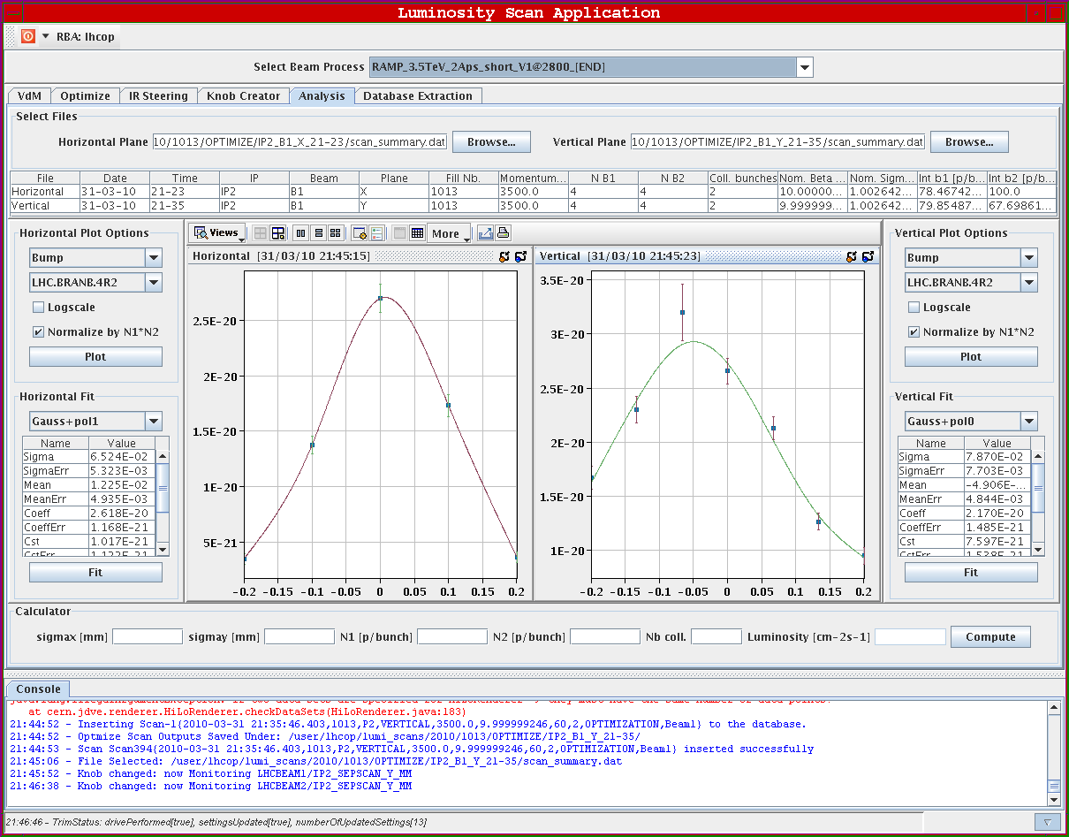
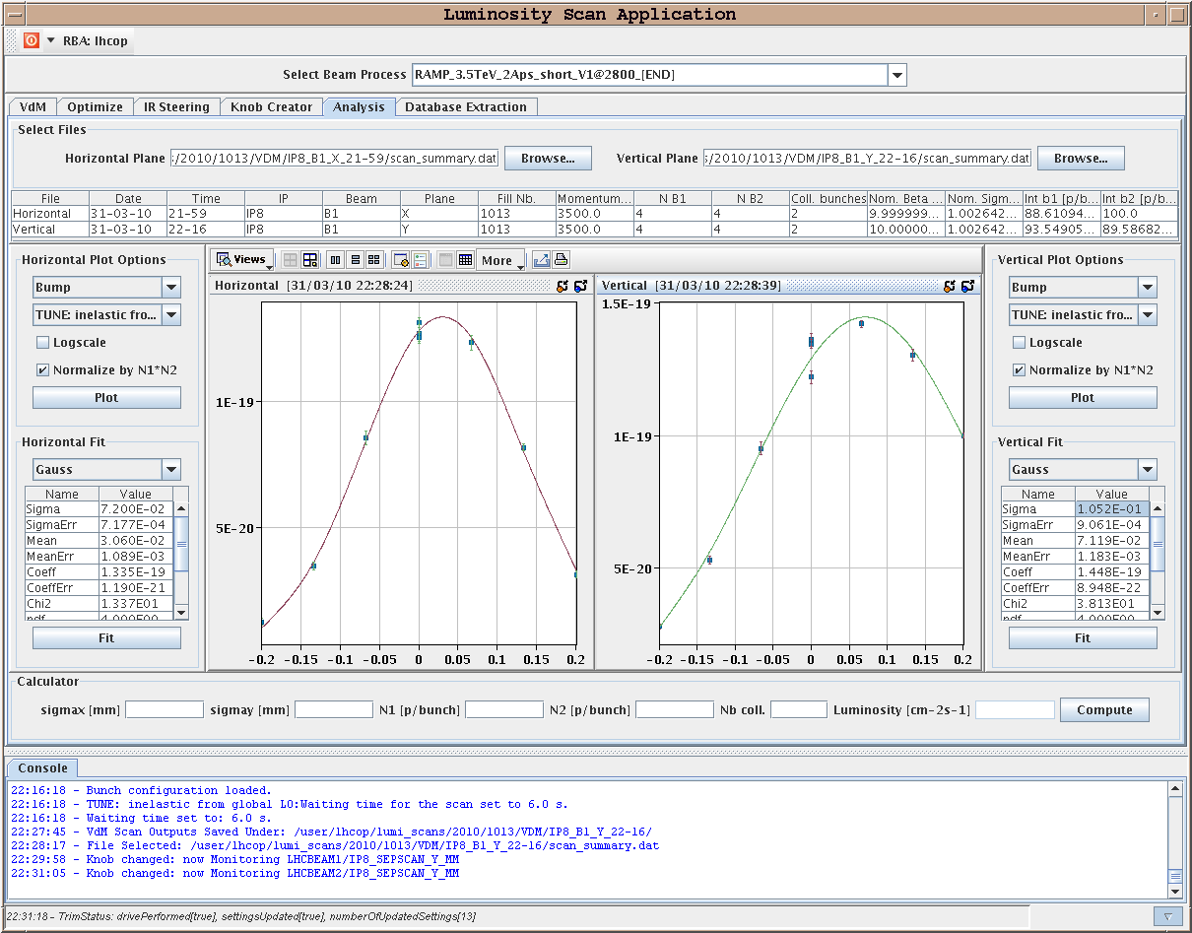
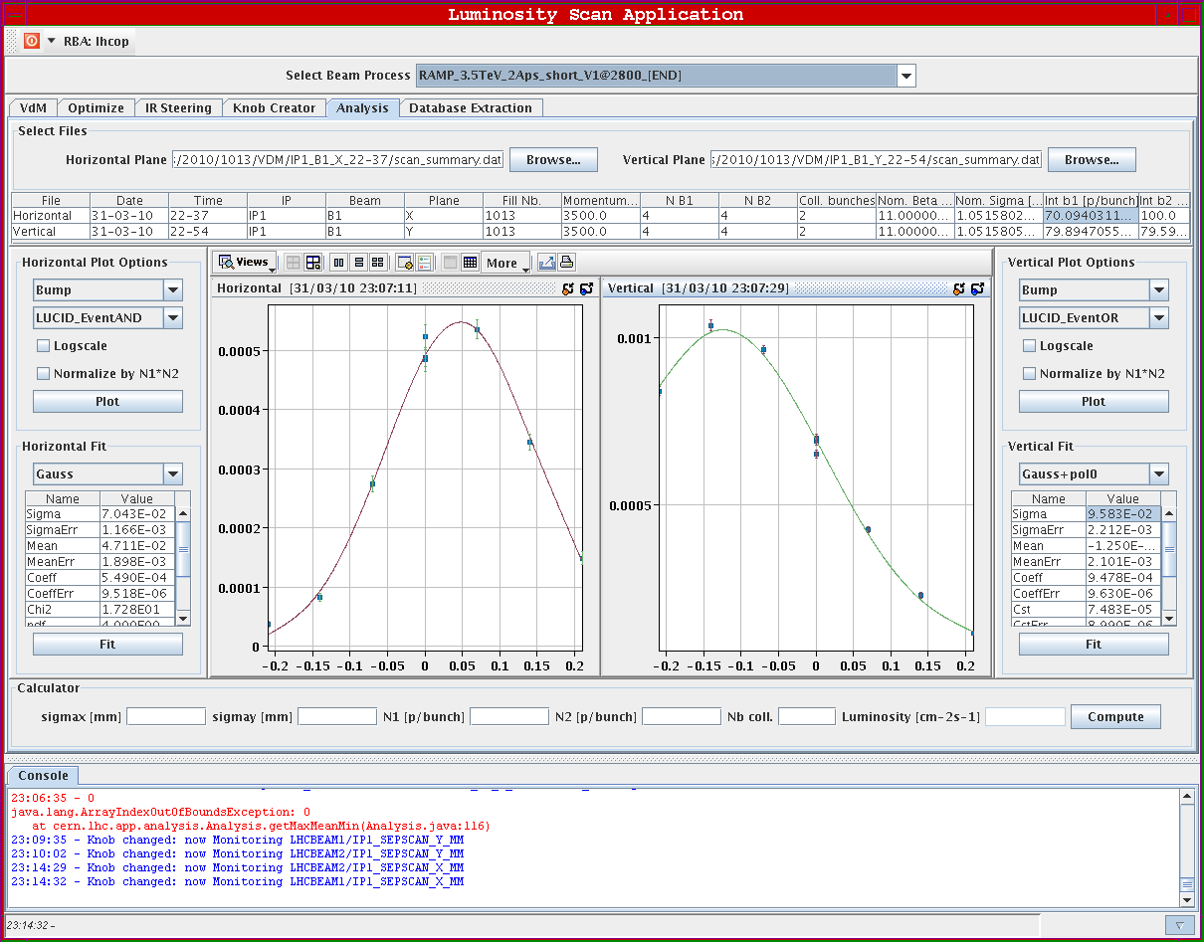
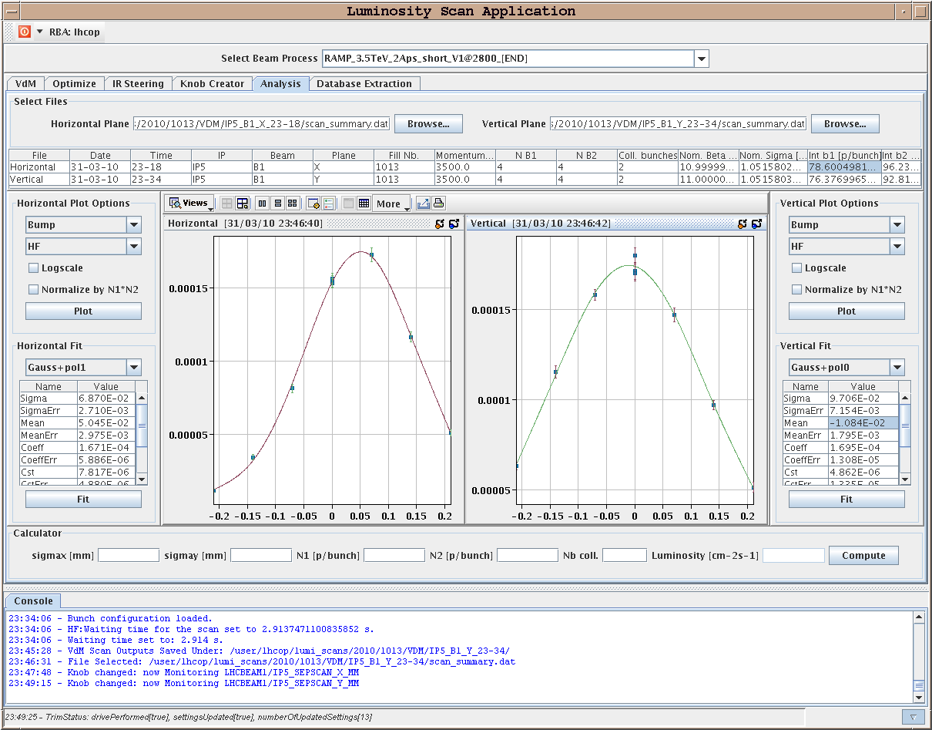
31/3/2010
Trim to separation bump IP1: HB1:0.045 mm, VB1:-0.062 mm / VB2=0.062 mm
Trim to separation bump IP2: HB1:0.012 mm, VB1:-0.215 mm / HB2= -0.05 mm, VB2=0.235 mm
Trim to separation bump IP5: HB1:0.025 mm, VB1:-0.01 mm / HB2:-0.025 mm
Trim to separation bump IP8: HB1:0.03 mm, VB1:+0.175 mm / VB2: -0.175 mm

Slide 10
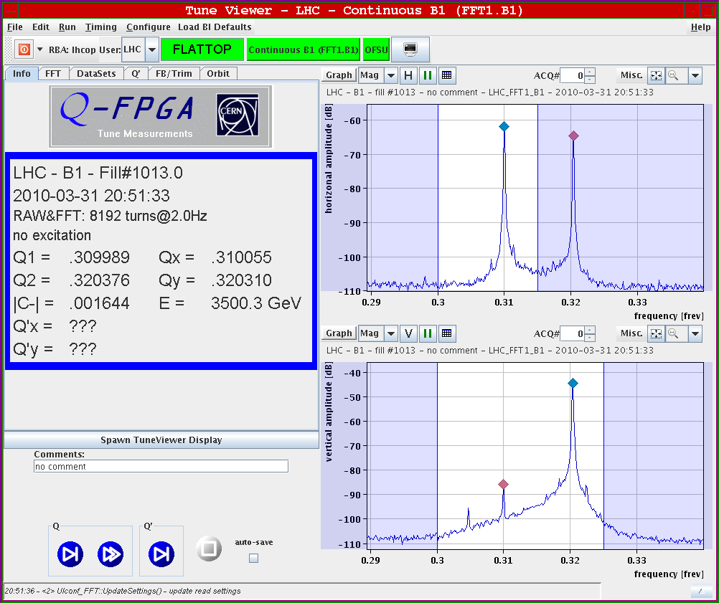
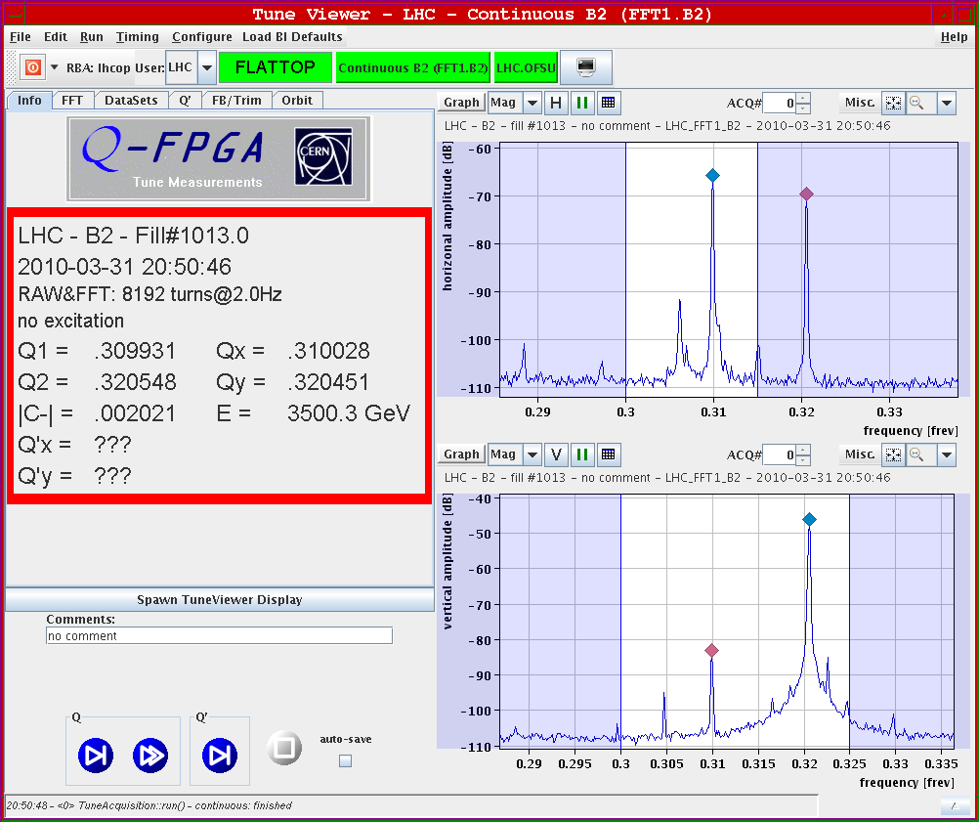
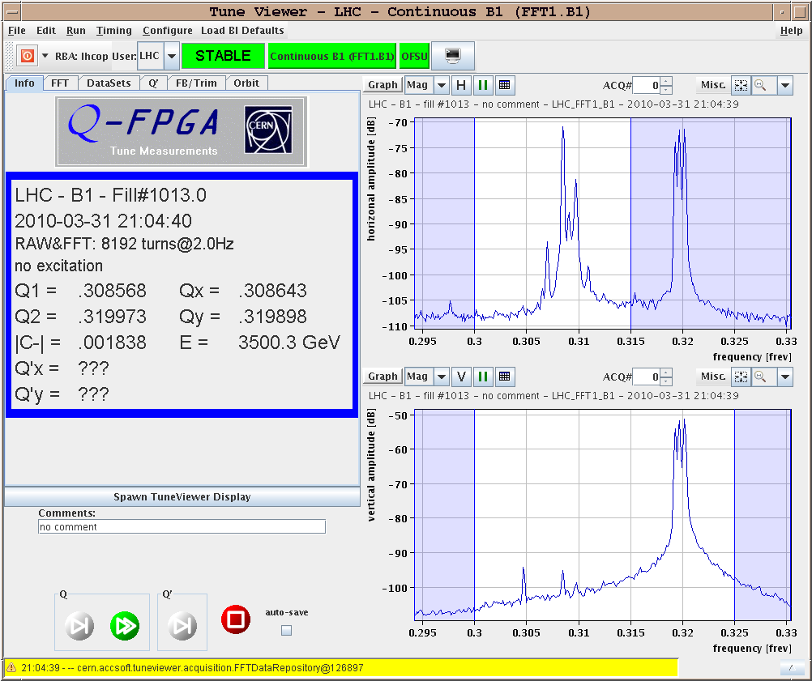
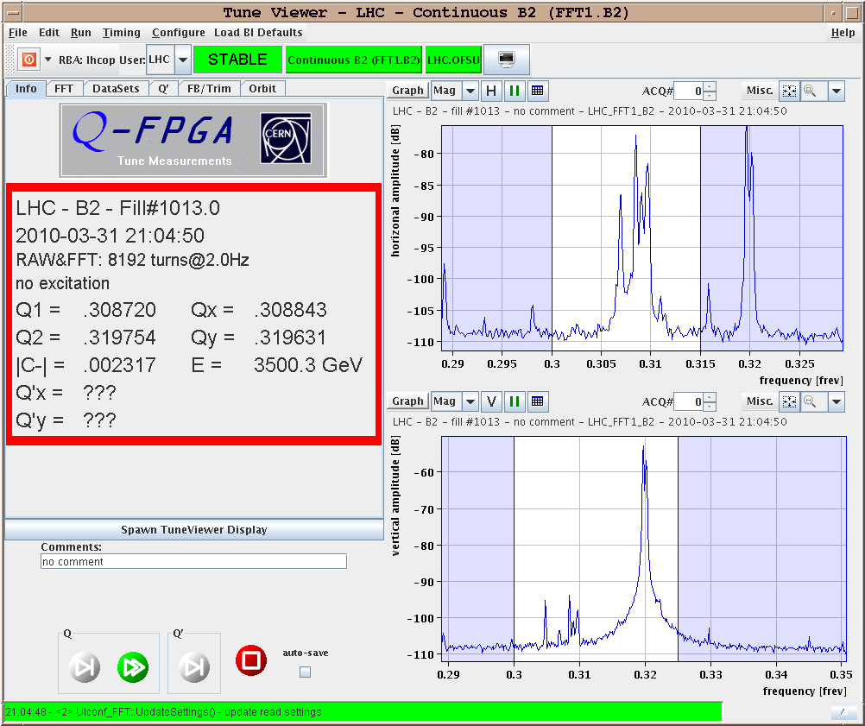
31/3/2010
Separation ON
Collision

Slide 11
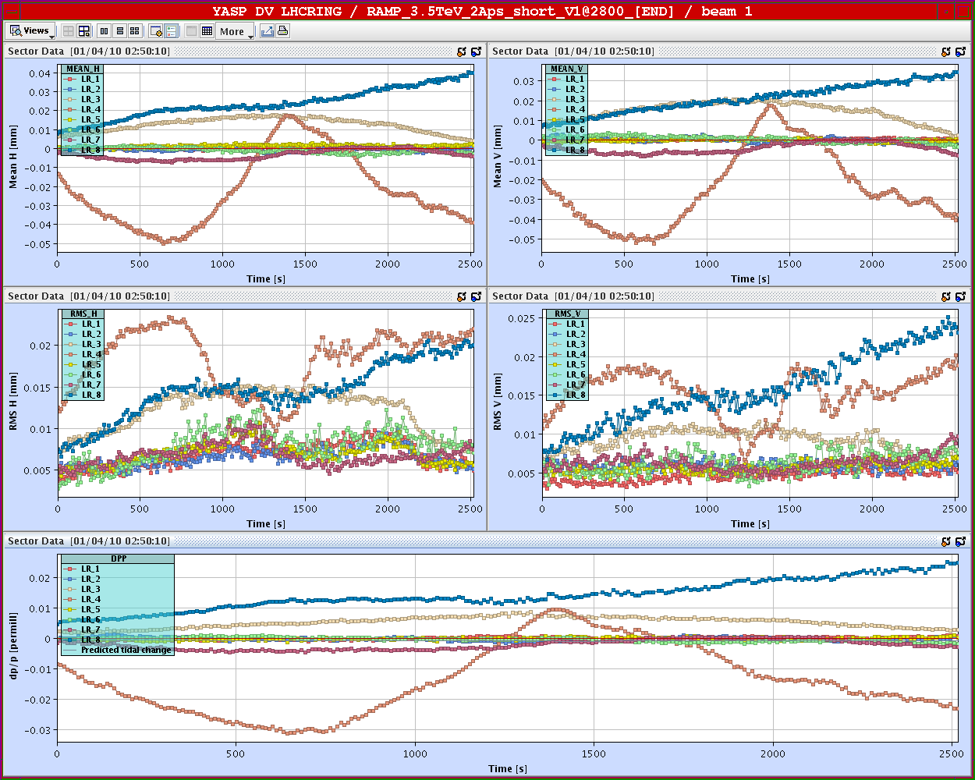
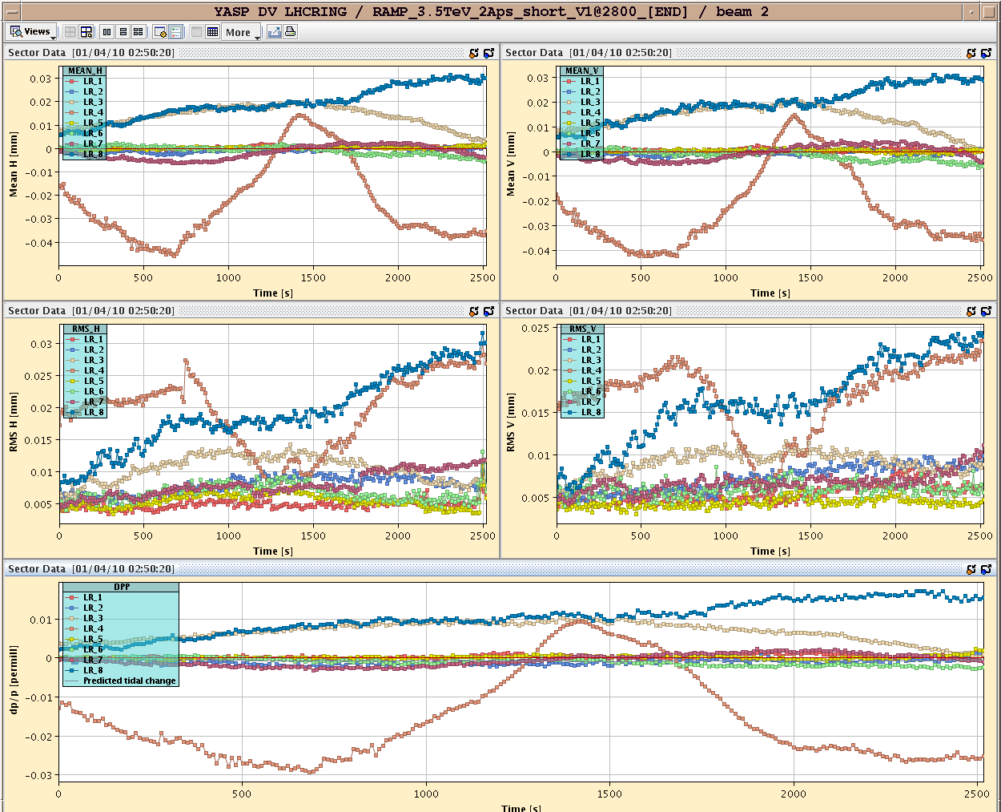
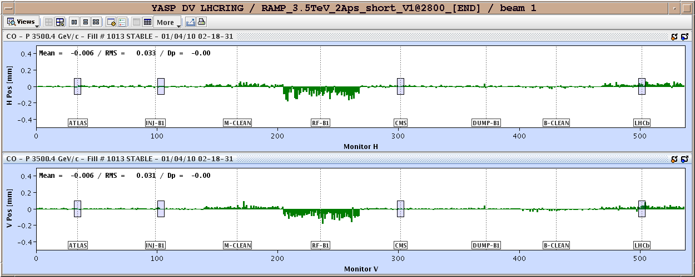
01/04/2010
Monitoring for most of the night. Some interesting features observed:

Slide 12
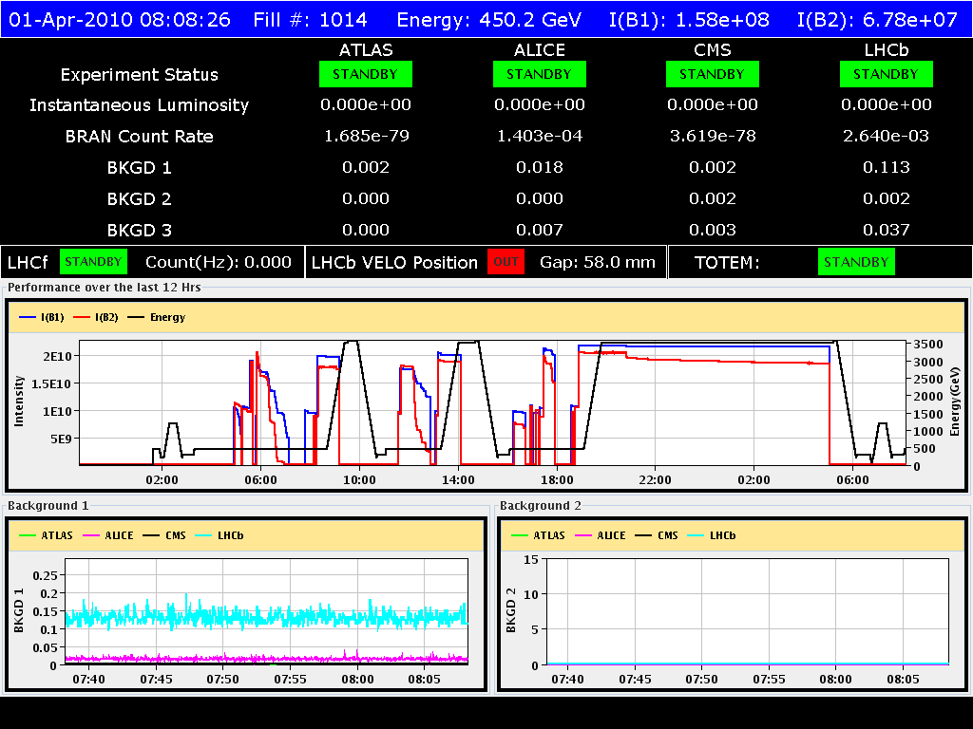
01/04/2010
Very good lifetime but still beam 2 is suffering more
Nice coast: terminated by RQF.A12 trip: reason for the moment unkonwn

Slide 13
01/04/2010
Program of the day:
09:00 Injection and capture voltage optimization to minimize blow-up
11:00 Ramp and squeeze test (down to 7 m and possibly to 5 m) with optics measurements
Evening: pre-cycle and fill for physics
Friday:
07:00 Programmed dump (hopefully)
09:30: Tune feedback and chromaticity measurement during the ramp
14:00: Investigation on lifetime at low energy (Non-linear chromaticity measurement, hump investigations: tune scan and dependence on RF parameters)
Evening: pre-cycle and fill for physics

Slide 14
31/3/2010
Saturday to Monday:
2 fills/day with an end of fill or beginning of fill study (2-3 hours)
Beginning/End of fill study list in work
Working point in collision
Machine protection tests
Non-linear chromaticity measurement at flat-top
b3 correction checks

