Slide 1
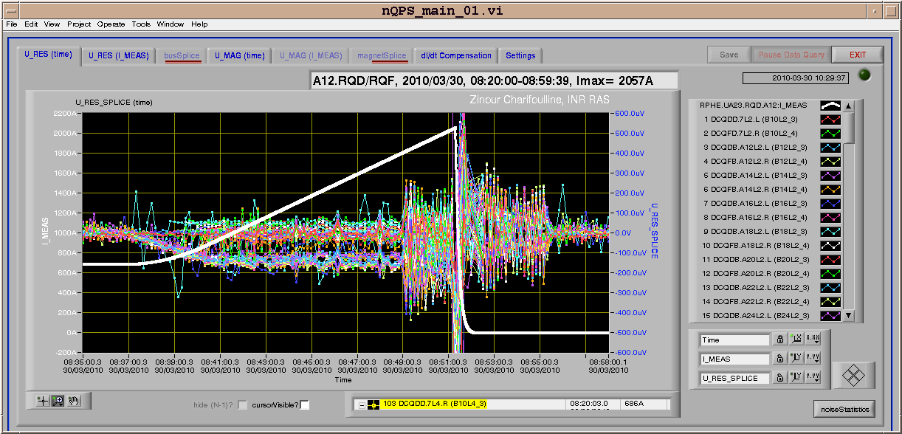
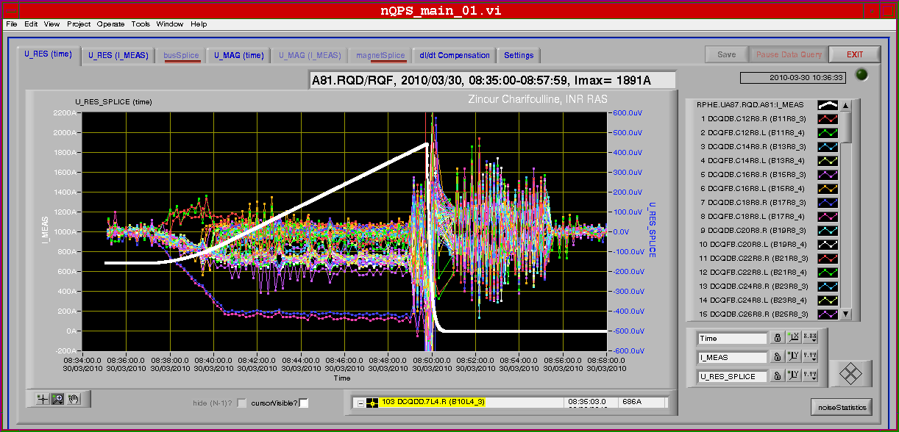
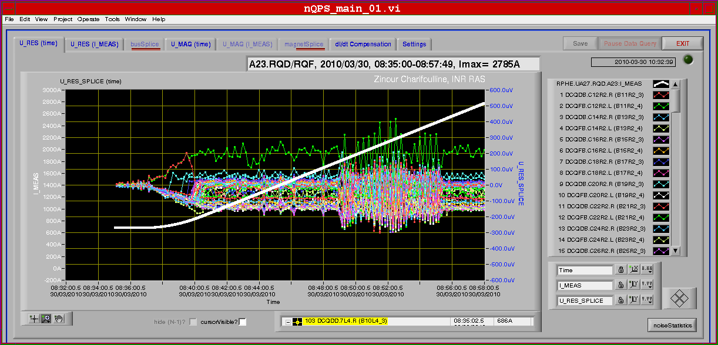
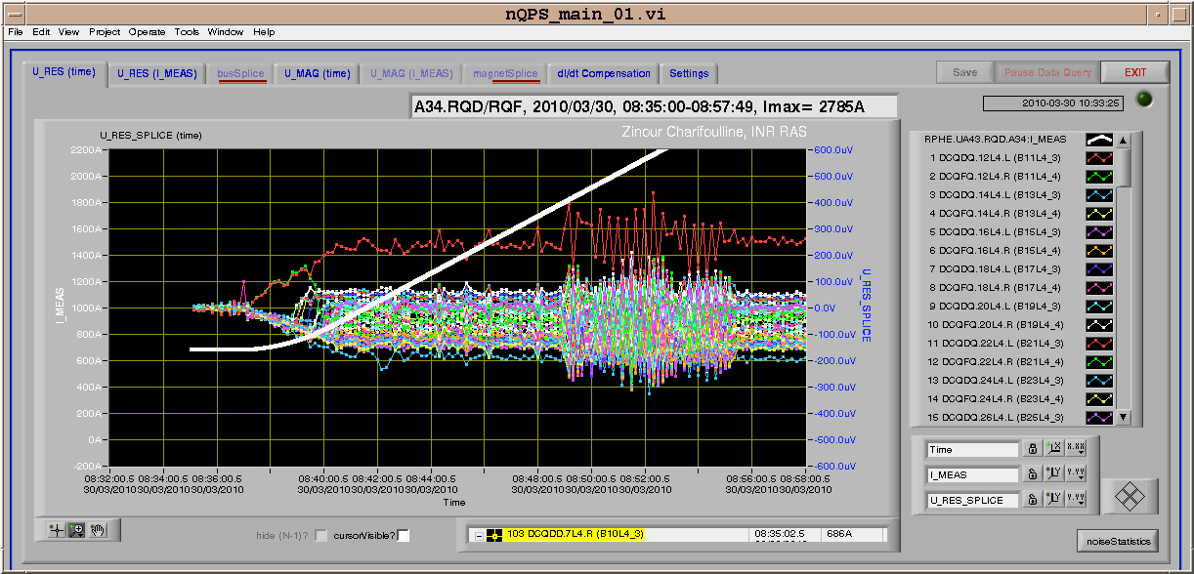
30/3/2010
Ramp started at 08:37 ➔ Oscillation observed on the new QPS system starting at 08:49 in all sectors but reducing in amplitude the further we get from point 1 ➔ trip of RQ.A81 followed by RQ.A12 within few minutes

Slide 2
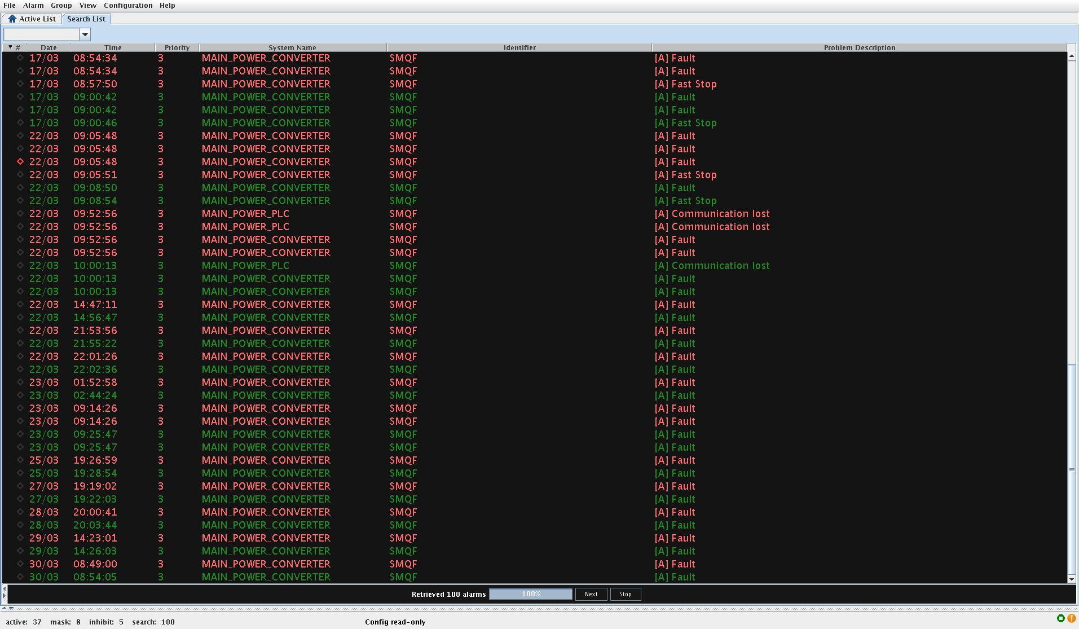
30/3/2010
at the same time trip of the QF circuit in the SPS while the QD circuit continued to pulse ➔ transformer effect in this case SPS is the primary and LHC is the secondary at the origin of the oscillation ➔ in the past this was not possible and both QF & QD circuits were stopped when one of them had an interlock ➔ will be restored today

Slide 3
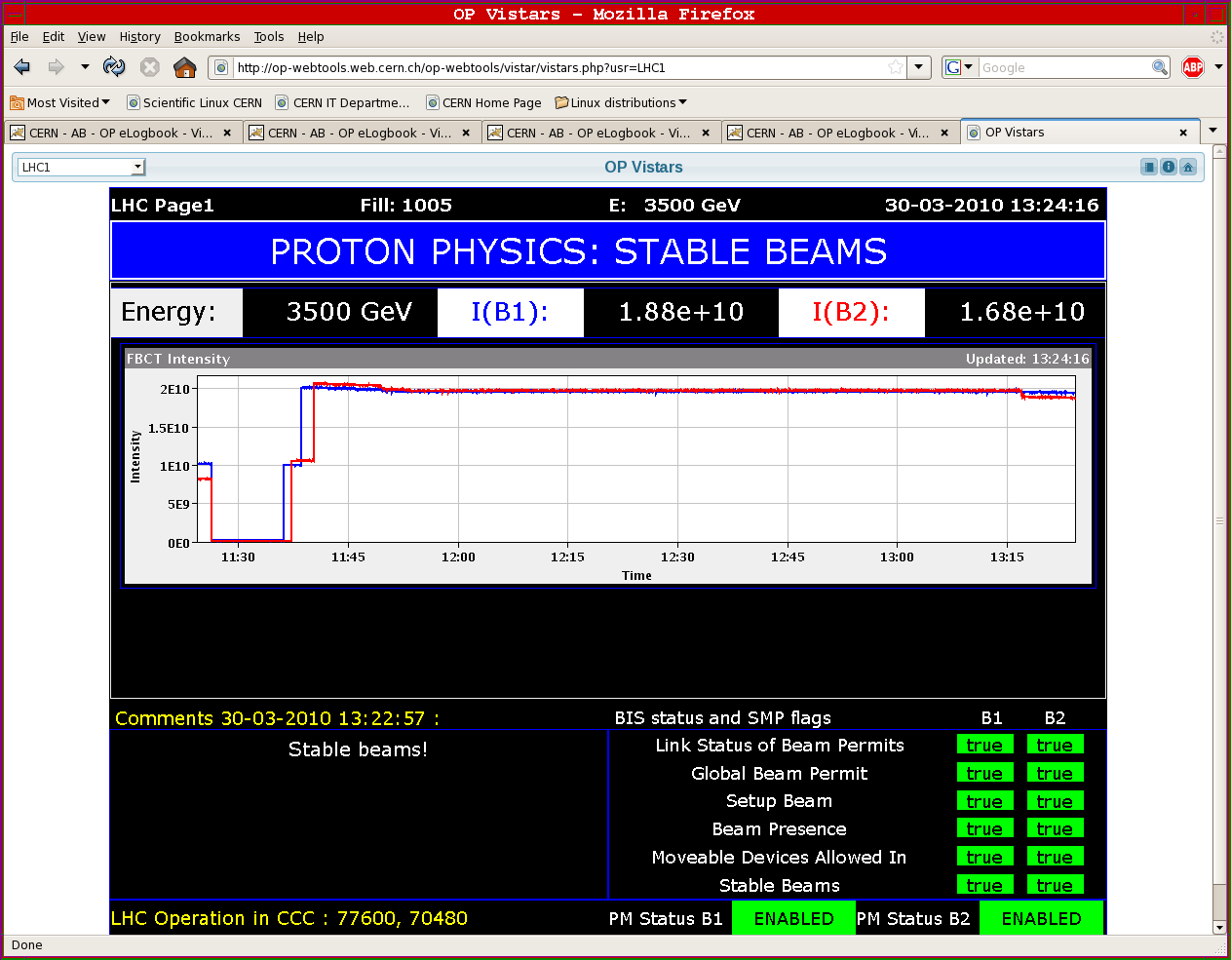
30/3/2010
11:15 injected again
12:38 : At 3.5 TeV

Slide 4
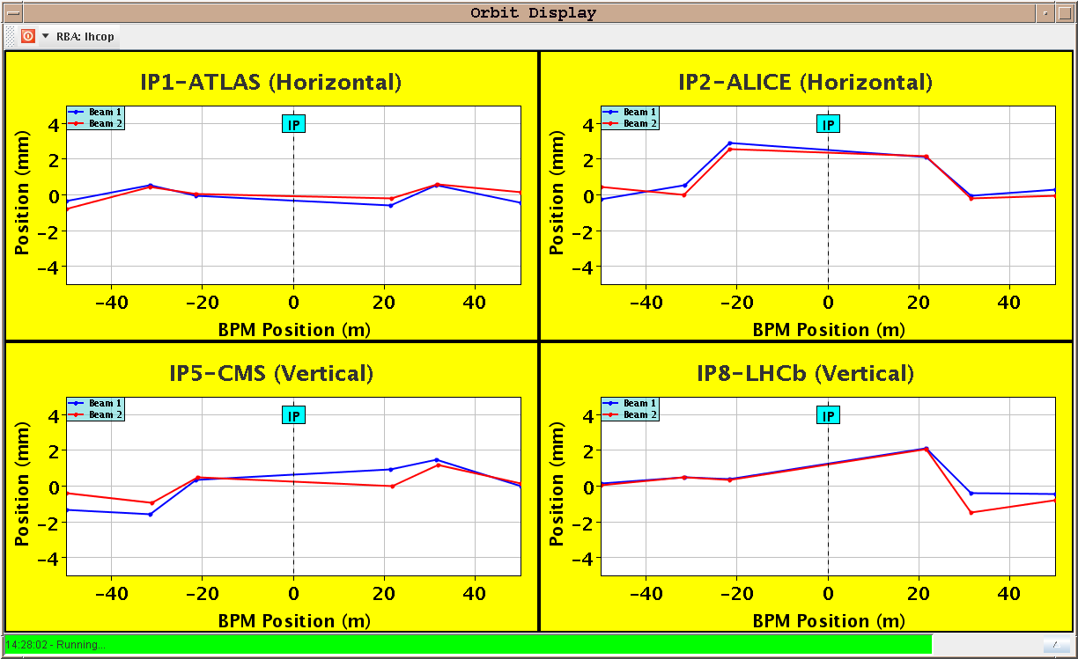
30/3/2010

Slide 5
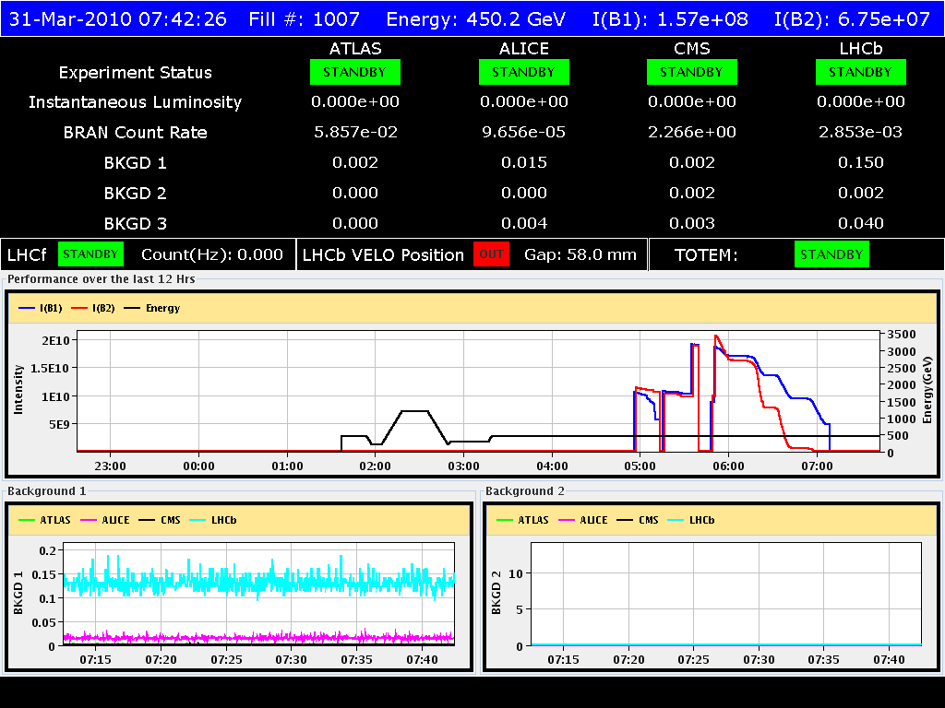
30-31/3/2010
End of fill at ~16:35 because of internal error of beam dump: tracking error of principal circuit of generator MKD K - beam 2. Recorded a positive tracking error of 0.5 %
Since then no physics...
Access to fix Beam dump problem
Another access required later to replace power converter RQT12.R4B1
Difficulties in re-arming the Beam-Dump ➔ piquet had to come in
Since then difficulties in getting good lifetime at injection ➔ being investigated

Slide 6
31/3/2010
Plan for the day:
Go for a physics fill
Separation scans at the IPs (tentatively beginning of the afternoon)
Possibly re-fill in the evening
For the following days:
Alternate commissioning steps during day and physics fill over evening/night
In particular clean-up the present injection and ramp

