Slide 1
Day 25.3.
09:00-11:30: Optics at 3.5 TeV
Optics re-measured with AC-dipole. Excellent reproducibility. Small emittance increase from AC-dipole.
Collapsed separation bumps & reproduced situation of 23.3 – OK !
Adjusted overlap IR5 (removed small Xing angle).
Understood problem of orbit non-reproducibility in ramp – new settings.
12:00: Collimation setup 3.5 TeV
Collimation just started…
12:36: Beam dump after RQTF/RQTD trip
14 PCs trip within 1 ms over all sectors.
‘Undesired’ reset of all RT trims by the reserve/test FB server (was brought up at that time) → locked off by S. Page/EPC. Cause for the other ‘unexplained’ trim Quad trips?

Slide 2
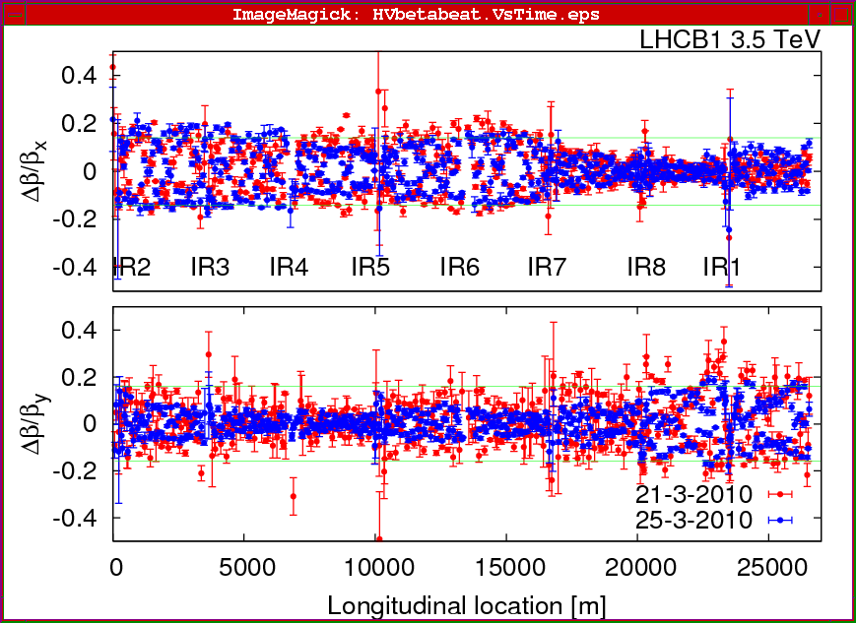
25.3.
Beta-beat beam1 evolution

Slide 3
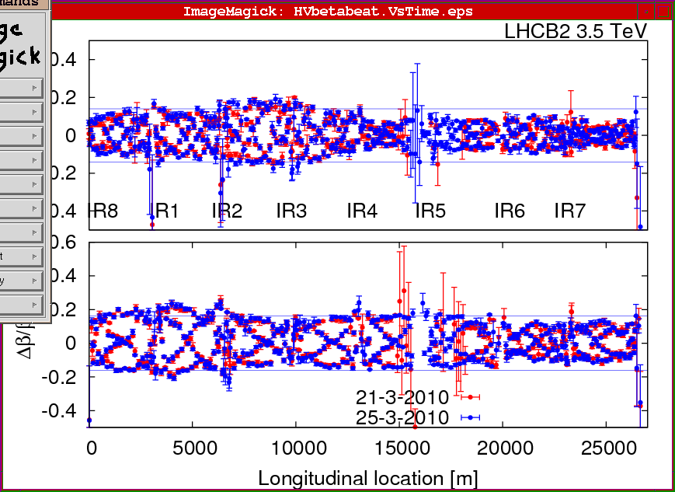
25.3.
Beta-beat beam2 evolution

Slide 4
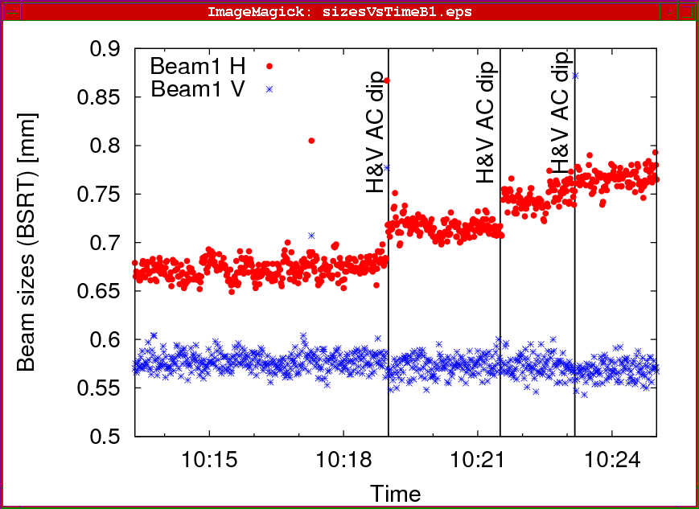
25.3
Emittance increase from AC-dipole
Approx. 15% on B1 H from 3 kicks/sweeps

Slide 5
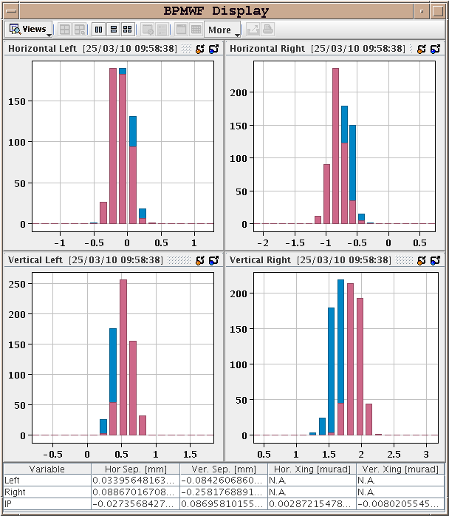
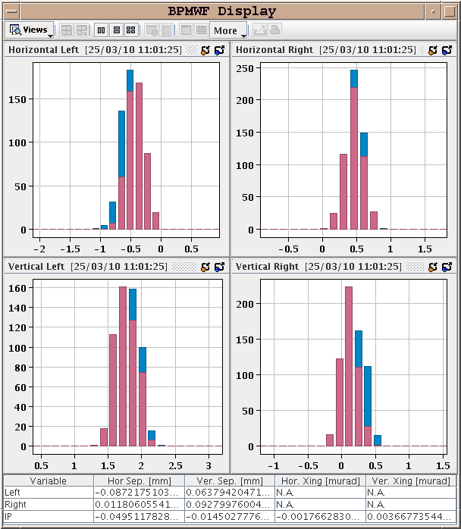
25.3.
Overlap in IR1 – IR5 from special BPMWF
IR1 IR5

Slide 6
25.3.
13:00 ALICE compensator transformer breakdown
18 kV perturbation in Pt2.
Affected: Cryo S23, CV, ALICE…
Transformer must be exchanged.
Local accesses until around 19:00
Klystron 5B1, ADT
CV Pt2
ALICE, TOTEM
Some TL studies in TI8 from 18:00
Probe bunch, emittance 2.5 nm (phys.), 1.1 um (norm.)

Slide 7
25.3.
22:00 Excellent Cryo news : recovery around midnight !
Plan for the night : 450 GeV collimation setup check, 3.5 TeV for collimation setup
04:00 beam in the rings
Some ‘funny’ orbit changes from IR2. To be understood.
450 GeV collimation setup check
Looking good for beam2, possible hierarchy issue on beam1 – tbc.
Problems to inject 4 bunches for setup check, last bunch to TDI– to be checked..
6:30 Ramp to 3.5 TeV
This time orbit is good.
Beam at 3.5 TeV – Collimation team starting ….

Slide 8
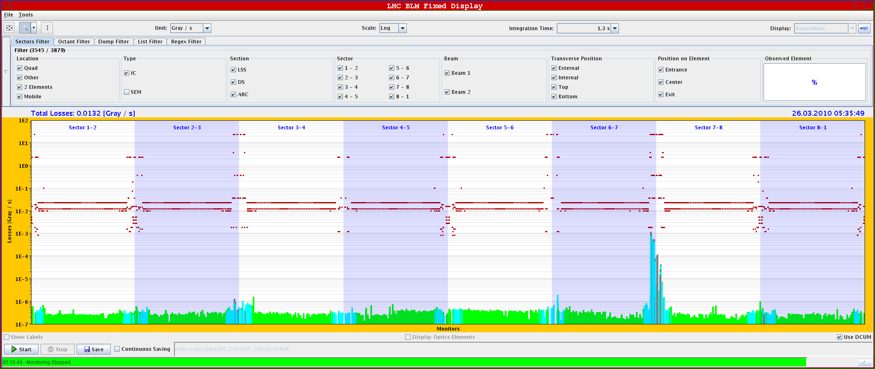
25.3
Collimation setup test – Qv resonance beam2

Slide 9
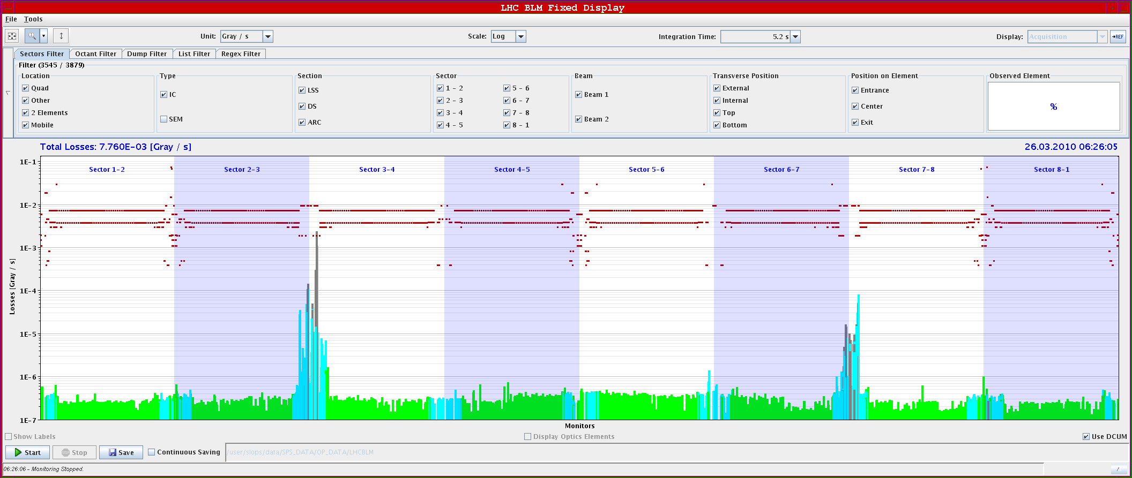
25.3
Collimation setup test – dp/p shift beam2

Slide 10
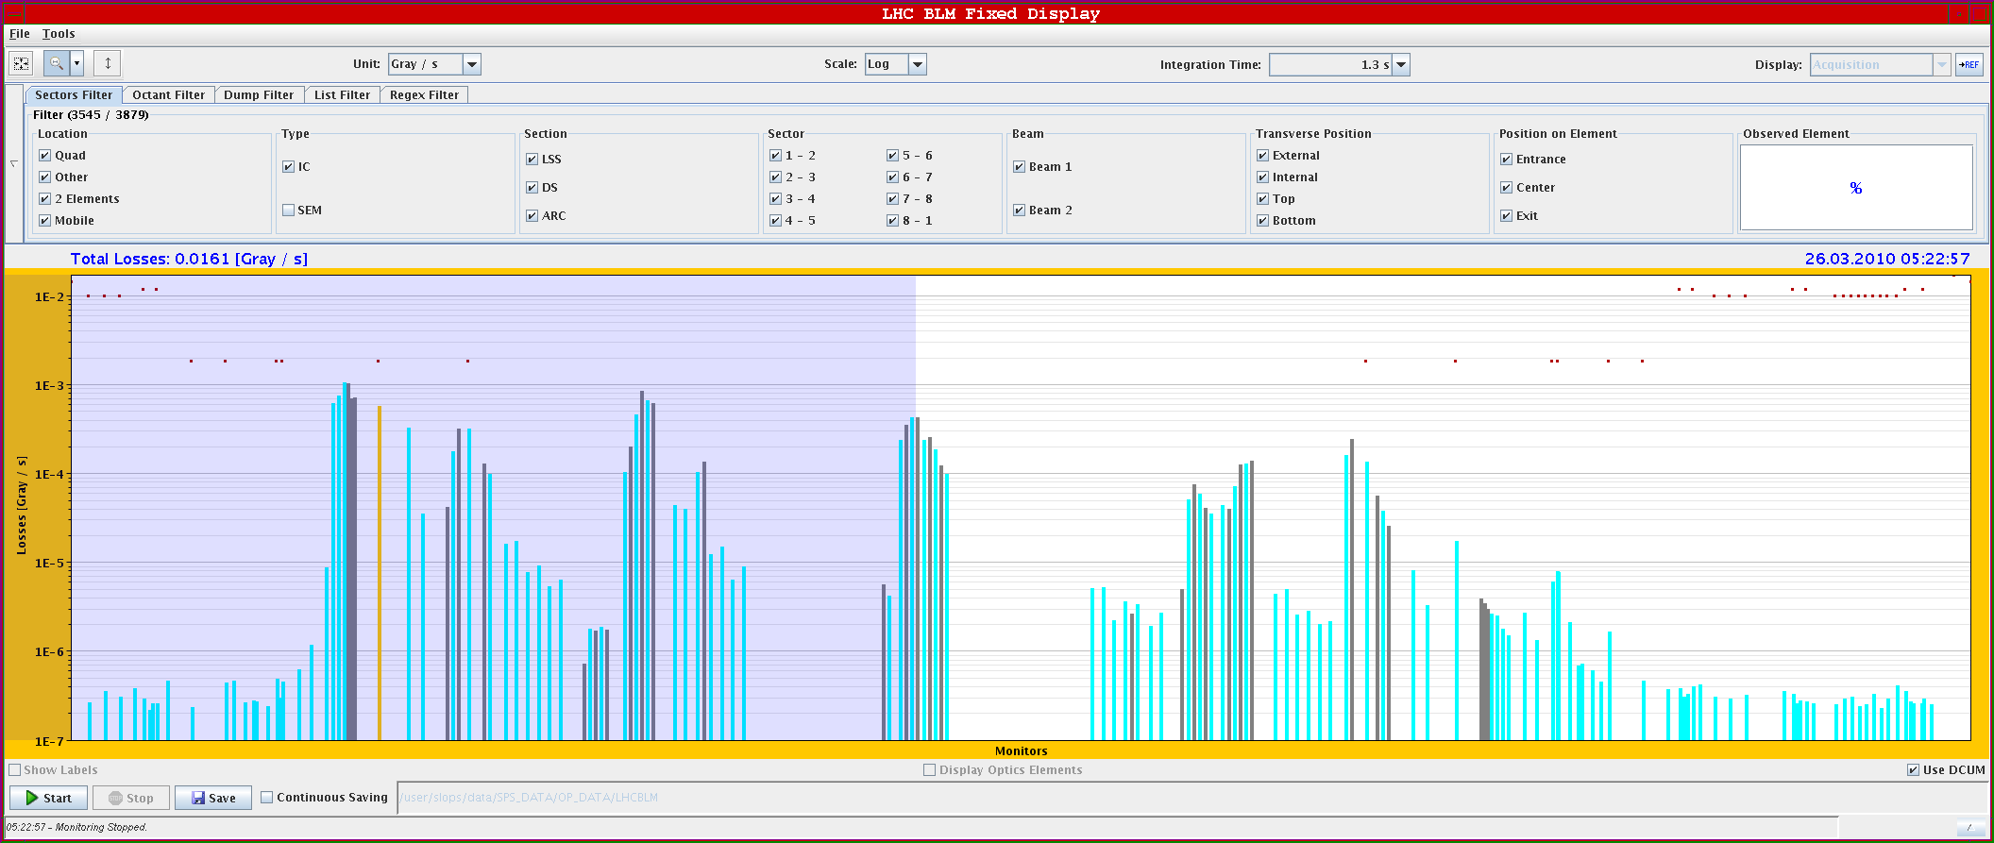
25.3
Collimator setup test beam1 – not quite as expected
Primary
Secondary ~ same level than primary

Slide 11
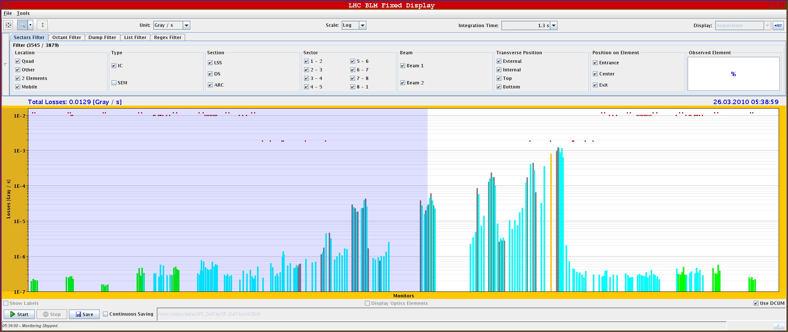
Collimator setup test – beam2
Primary

Slide 12
25.3
Protection/MP setup for 3.5 TeV - todos
Collimator setup
Dump protection (TCDQ) setup
Collimator setup test
H, V, dp/p → 3 destructive tests
Dump protection setup test
Debunch beams, dump (simulation of asynch. Dump)
→ 1 destructive test
Collimator + TCDQ ramp
TCDQ – beam Software Interlock (activate)
Orbit Software Interlock (activate)

Slide 13
25.3
Protection/MP setup for 450 GeV - todos
Collimator Setup
Dump Protection (TCDQ) Setup
Revisit….
Revisit….
Collimator setup test
H, V, dp/p → 3 destructive tests
Dump protection setup test
Debunch beams, dump (simulation of asynch. Dump)
→ 1 destructive test
TCDI (TL) collimator setup check
High(er) intensity injection tests – possible request to allow for injection of 5E10 in empty ring in inject & dump mode
Orbit Software Interlock (activate)

Slide 14
25.3.
Program for next 24+ hours
Once more: shift by 24 hours. Start compressing…
25 | THU | N | 4 | Recovery from 18 kV perturbations
25 | THU | N | 4 | Collimation check 450 GeV
26 | FRI | M | 4 | Protection device and collimator setting-up - 3.5 TeV
26 | FRI | M | 4 | Protection device and collimator setting-up - 3.5 TeV
26 | FRI | A | 4 | Protection device and collimator setting-up - 3.5 TeV
26 | FRI | A | 4 | LBDS 450 + 3.5 TeV
26 | FRI | N | 4 | LBDS 450 + 3.5 TeV
26 | FRI | N | 4 | Protection and collimator check - 3.5TeV
27 | SAT | M | 8 | Protection and collimator check - 3.5TeV
27 | SAT | A | 8 | 'Higher' intensity 450 GeV - preparation for stable beams
27 | SAT | N | 8 | Two beam operation 3.5 TeV - non-colliding STABLE 2-3h
28 | SUN | M | 8 | Collimation 450 GeV - if needed
28 | SUN | A | 8 | Contingency
28 | SUN | N | 8 | 450 GeV Collision STABLE BEAMS
29 | MON | M | 8 | Contingency
29 | MON | A | 8 | Contingency
29 | MON | N | 8 | Preparation MD

