Slide 1
Day 24.3.
08:00-11:20: Injection
Q, Q’, orbit
One bad injection (large emittance from SPS [best guess]) on beam2 → PM.
11:20: ramp to 3.5 TeV
Orbit excursion peaks at ~ 1 mm rms in horizontal due to issues with incorporation of corrections.
Not too nice orbit at 3.5 TeV.
Restored by reloading settings from 23.3.
Settings incorporation redone…

Slide 2
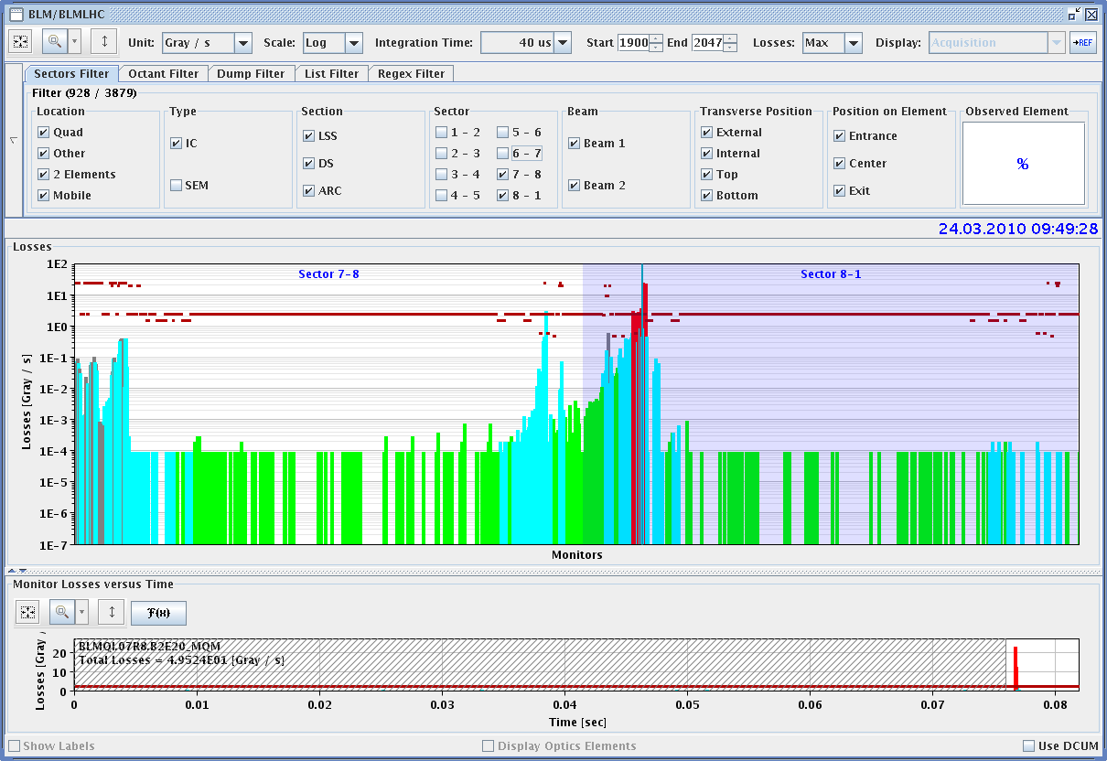
24.3.
Losses visible on ring BLMs due to scrapping on TCDI collimators
Showers from C jaws shine directly on BLM attached to cryostats.

Slide 3
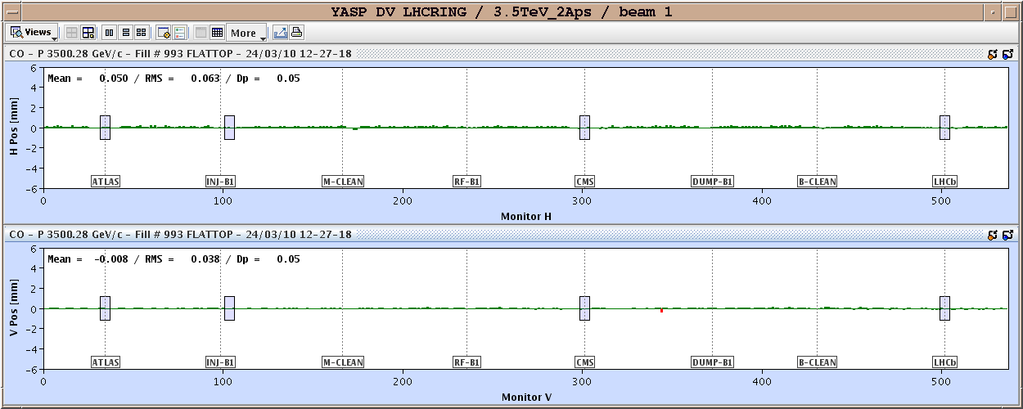
24.3.
Orbit at 3.5 TeV after reloading settings
Reproducible to 40 um over 24 hours

Slide 4
24.3.
12:50 cold compressor 23 lost
No useful (new) work done for collimator
Access until around 18:00
RPLA.22L2.RCBH22.L2B2 repaired
Klystron 6B1 recovered, but lost 5B1
TL studies from 20:00-24:00
Intensity of to 1.1E11 LHC INDIV beam, emittances ~ 1.8 um in TI2.
Clean profiles, good stability.
Tails scans with 1.1E11 – looking good.
S23 recovered 02:00
Pre-cycle S23.
Injection 04:00
Non-linear chromaticity

Slide 5
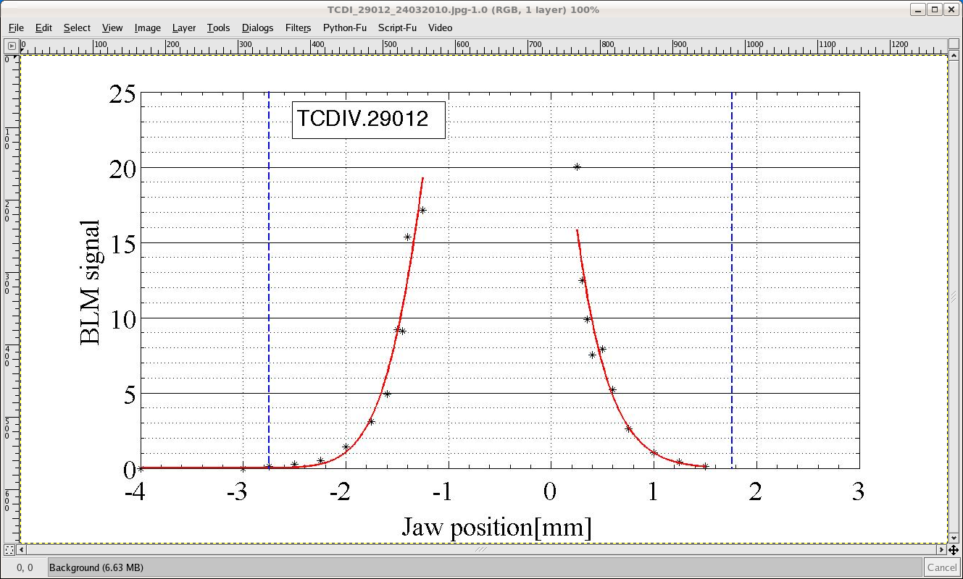
24.3.
Clean tails in TL

Slide 6
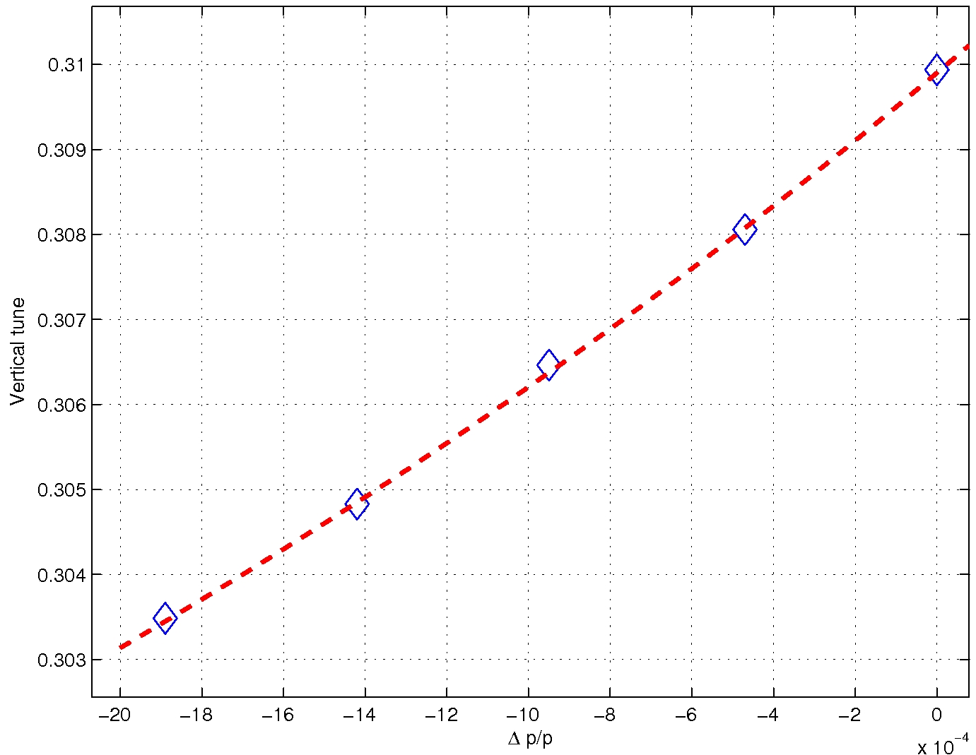
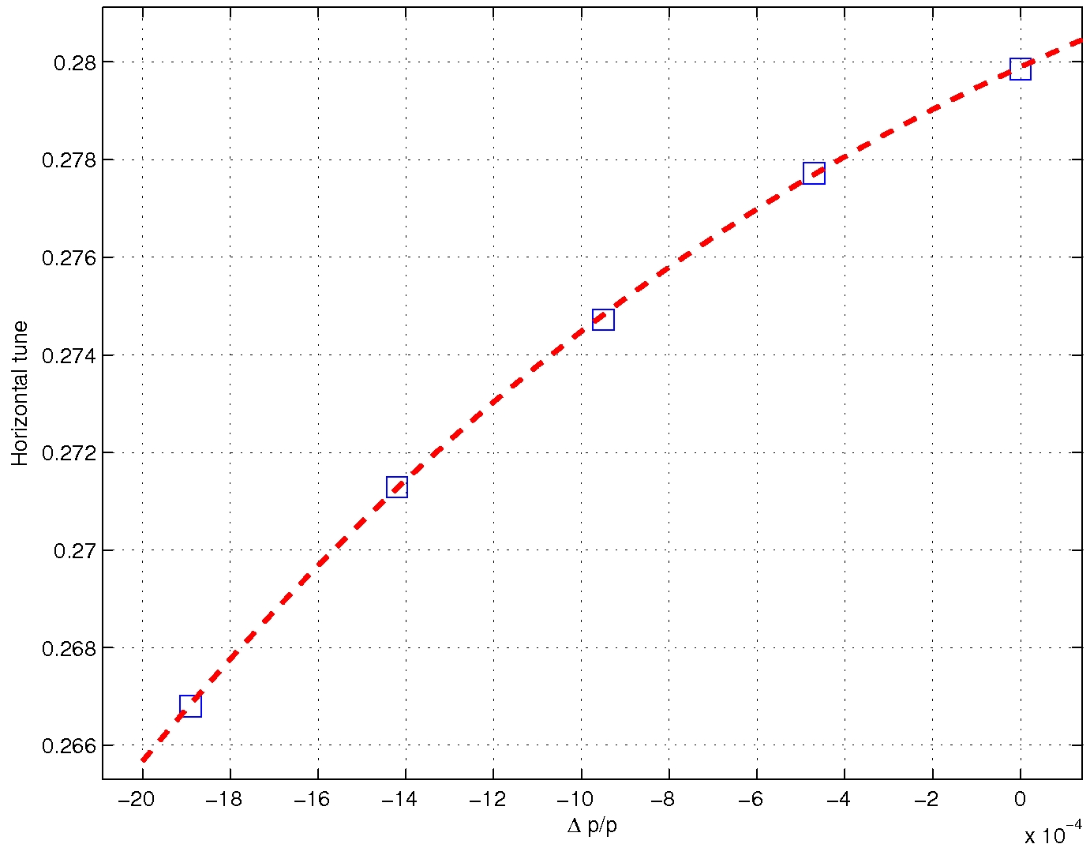
24.3.
Non-linear chromaticity

Slide 7
24.3.
05:00 Cryo S81 lost – current lead RSS.A81B1 – locked.
07:00 Beam back
08:15 Beam at 3.5 TeV
Again orbit in the ramp not great. Need to revisit once more…
Program for next 24+ hours
Repeat what we missed…
25 | THU | M | 4 | Measurements at 3.5 TeV
25 | THU | M | 4 | Protection device and collimator setting-up - 3.5 TeV
25 | THU | A | 4 | Protection device and collimator setting-up - 3.5 TeV
25 | THU | A | 4 | LBDS 450 + 3.5 TeV
25 | THU | N | 4 | LBDS 450 + 3.5 TeV
25 | THU | N | 4 | Beam dump at 800 GeV
26 | FR | M | 8 | Measurements at 3.5 TeV
26 | FR | A | 8 | Protection device and collimator setting-up - 3.5TeV
26 | FR | N | 8 | Two Beam Operation setting-up - 3.5 TeV (2 bunch ramp)

