Slide 1
Wednesday morning
08:00 – Tune feedback
08:00 – RF commissioning
Cavities phased
Still to do: fine cogging, higher intensity
12:00 – MPS tests
16:00 – Injection studies
Midnight – Transverse damper
04:00 – Cryo
07:00 – Access – point 2
Thanks to CSA and RP

Slide 2
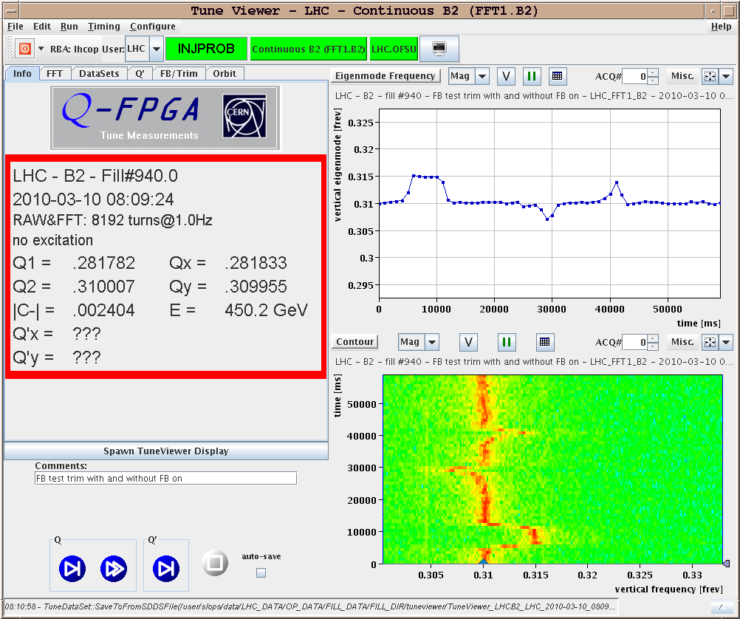
Tune feedback

Slide 3
MPS
First MPS test : RD1.LR1 OFF. Dump time 12:26:07. Test successful - clean dump by FMCM - no orbit movement, no loss.
Next MPS test : RD34.LR7 off. PM stamp 12:52:44. Test successful - clean dump by FMCM - no orbit movement, no loss.
Next MPS : RQ4.LR3 off. PM stamp 13:40:24. Test successful - very clean dump. No beam loss.

Slide 4
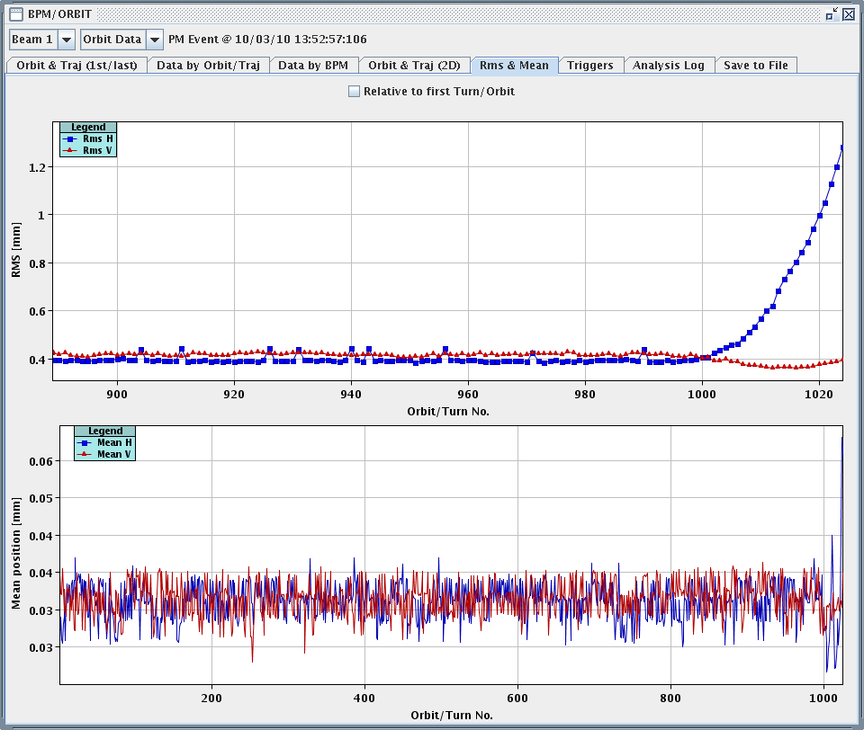
MPS
Next MPS test : RQ4.LR3 off, but with FMCM masked. PM stamp 13:52:57. It seems that with so little beam, the BLMs never got over threshold, and we lost the beam over 2 seconds until the beam offset got large enough to trigger the BPM interlocks.

Slide 5
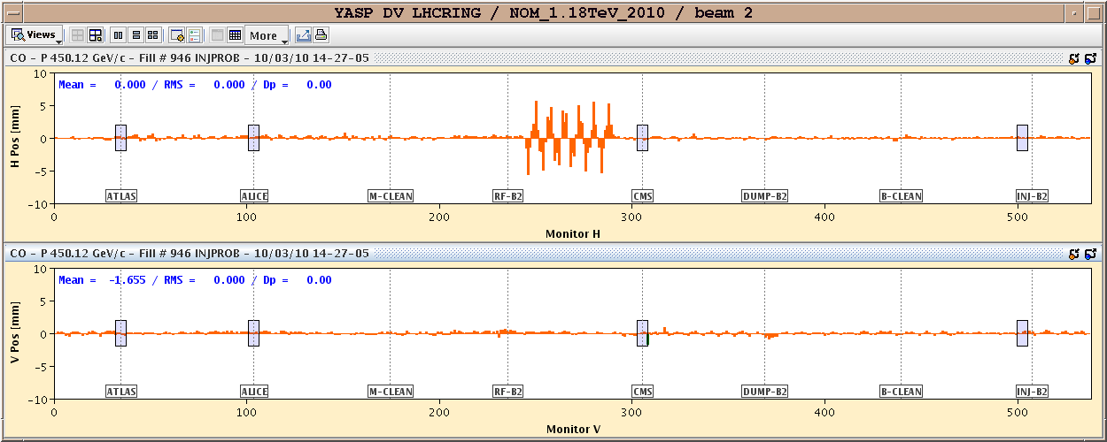
MPS
Next MPS test : large orbit excursion in one ARC. Test successful SIS dump on orbit excursion B2 H plane and on COD settings in B2 H plane. To be checked which one came first.

Slide 6
Summary of injection studies 1/2
B1 B2 measured and corrected tunes and orbits – OK
B1 B2 measured beta beat, and optical mismatch at end of TLs - betabeat has changed significantly and is larger - betatron mismatch factor to nominal optics at injection point is around 0.02/0.005 H/V for B2, 0.04/0.008 for B1.
B1 B2 checked injection oscillations – OK
B1 B2 measured circulaing beam emittance with WS and BSRT
B2 measured injected and dumped emittances for dump after 2 LHC turns
B2 measured injected and dumped emittances for dump after ~20 s. Small emittance blowup (if any) - to be quantified

Slide 7
Summary of injection studies 1/2
B1 B2 beam-based setup of TDI and TCLIs around beam - B1 jaws always closer than collimation reference values - B2 some differences also to understand.
B1 checked TDI jaw movement sign with bumps - OK
B1 B2 measured injection losses with cleaning and protection collimators at nominal settings. B2 injection extremely clean, with almost no losses visible. B1 scruffier - H injection needs steering. For B2 at first glace no noticeable difference for TDI/TCLI in or out.
B1 measured loss maps for grazing beam on TDI/TCLI at protect settings, and calibrated and tested ALICE BCM. Losses seen at all protection devices and also some peaks through 23, to analyze in detail.

Slide 8
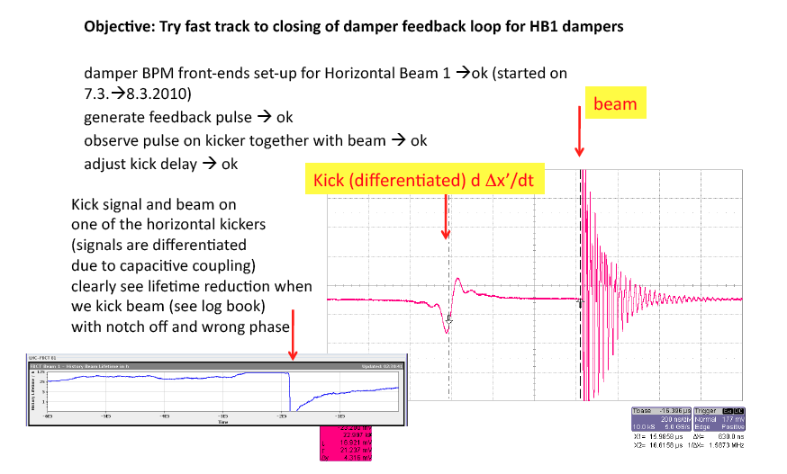
Transverse damper

Slide 9
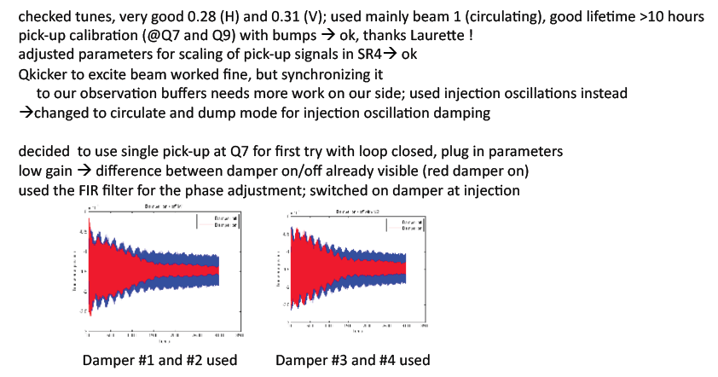
Transverse damper

Slide 10
Transverse damper

Slide 11
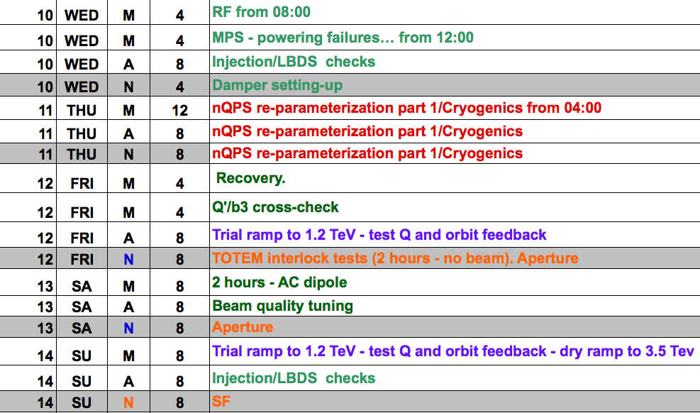
This week

Slide 12
Next week

