Slide 1
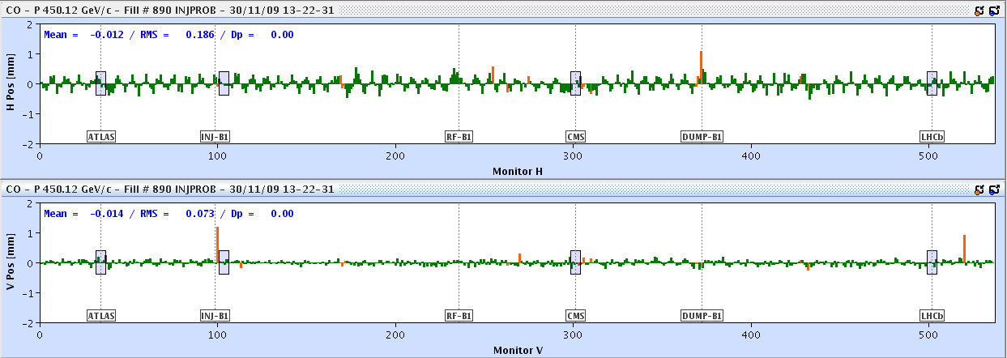
30/11/09
Solenoids on and corrected during the day in:
Alice
Atlas
CMS
All pretty smooth with inevitable questions about polarities. No instrumentation issues observed.
Alice solenoid – orbit distortion

Slide 2
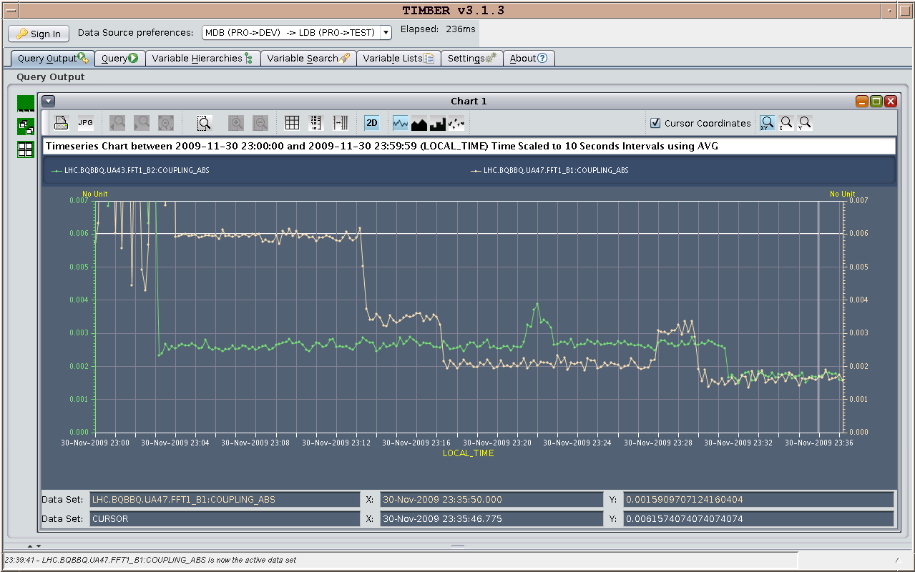
Coupling - finally
Coupling after correction of the solenoids with split knobs: - Beam 1: |C-| less than 1.8e-3 - Beam 2: |C-| less than 1.8e-3

Slide 3
Summary of aperture measurements / kick response:
Global aperture measurements (B1) were done in parallel with the kick response measurements (B2).
This was not ideal because we did see some cross talk between the measurements, but at least we could advance with both programs.
Both measurements were done with collimators open to parking positions.
They have been put back to the reference settings after.
clear drop in lifetime seen – 50 hours to around 3 hours
Kick response:
Finished beam1
Done 4.5 sectors, missing 2 sectors for beam 2
Missing all triplet correctors.

Slide 4
Aperture measurements:
Scanned H plane for beam 1. All BLM thresholds kept active during the measurements, so we dumped several times (mainly for losses in the warm regions).
We performed aperture measurements in the V plane for beam 2.
For H-beam 1, we mainly lost in the warm IP6 (details of beam loss locations still to be looked at) and we could not find apparent loss locations in the rest of the machine. The bump amplitude was limited to 7-8 sigmas.
Possible aperture bottlenecks outside IP6: 6R2, 6R8.
Vertical aperture for beam 2: found several loss locations in the arcs, in particular in sector 7-8. See details in the logbook.

Slide 5
Wire scanners
In preparation for the aperture measurements, we performed the calibration of the wire scanners, which looks very good. There is a very good linearity (a few % error!) between amplitude of orbit bumps and offset of the beam seen by the wire.
We have measured systematically the emittance for every beam during the aperture measurements, even several times for the same beam.

Slide 6
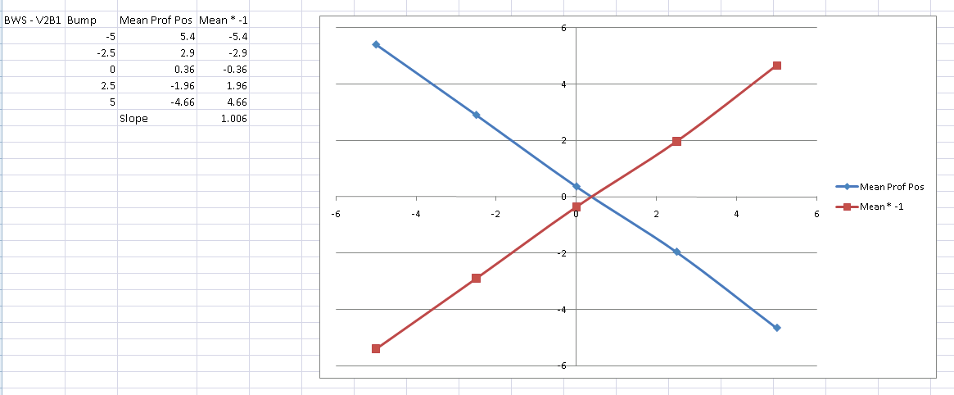
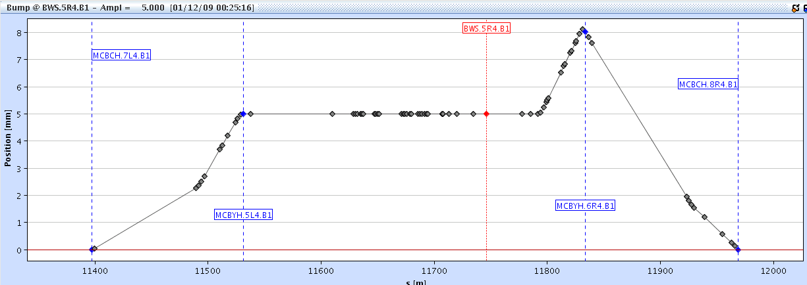
Wire scanner calibration

Slide 7
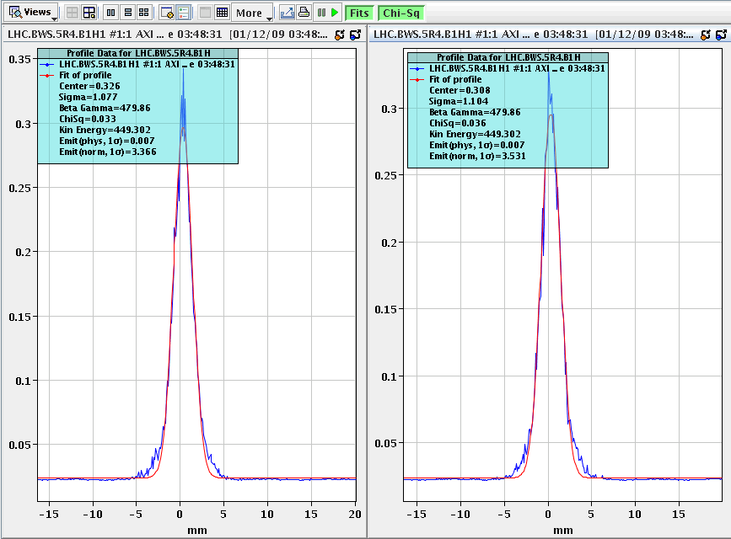
Wirescanner

