Slide 1
E-cloud build-up & instabilities: expectations, observations and outlook
Humberto Maury Cuna*, Elena Benedetto, Giovanni Rumolo, Frank Zimmermann, et al
BCWG, 9 November 2010
* CINVESTAV, Mexico

Slide 2
outline
electron-cloud effects
modeling tools
LHC e-cloud strategy, LHC predictions
secondary emission yield & conditioning
(old) simulations for nominal LHC & 50 ns spacing
new simulations for 24-bunch 50-ns trains
old studies for LSS
conclusions

Slide 3
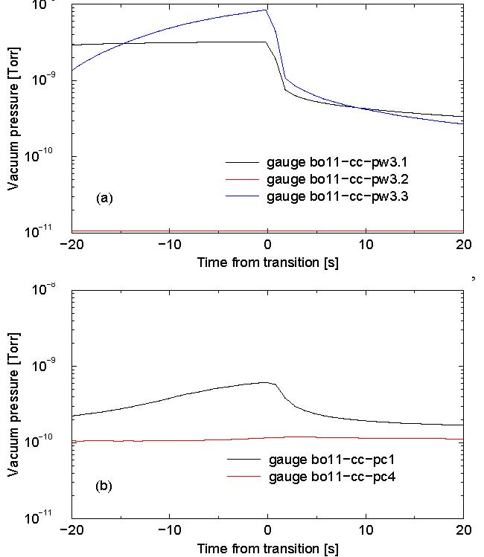
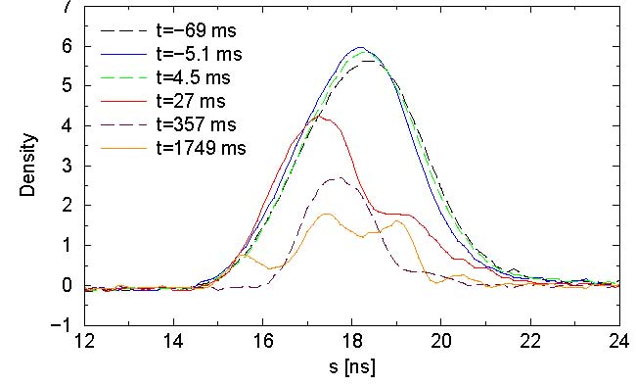
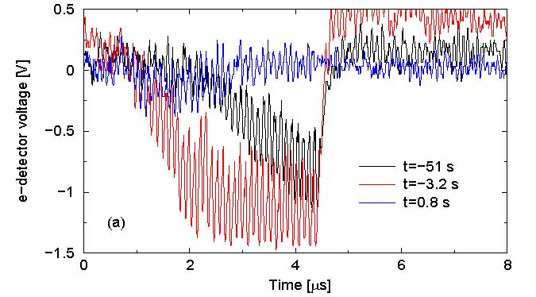
can e- cloud be a problem for s.c. hadron ring?
RHIC
Presentation to LHC MAC 10 June 2005
At 108 ns bunch spacing, electron cloud and electron-ion interactions
cause transverse instabilities, emittance growth, and beam loss, along
with vacuum pressure rise and background increase.
Electron cloud effects occur both in the warm (30% of length) and cold
(about 70%) regions.
vacuum pressure rise
measured e-flux
warm
cold
evolution of longitudinal
profile during beam loss
near γ _{t}
J. Wei

Slide 4
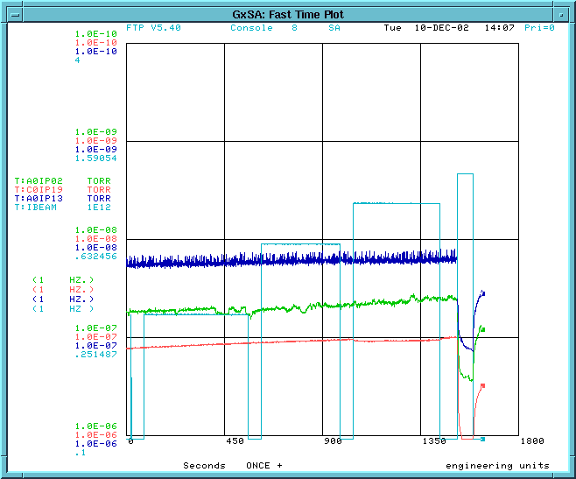
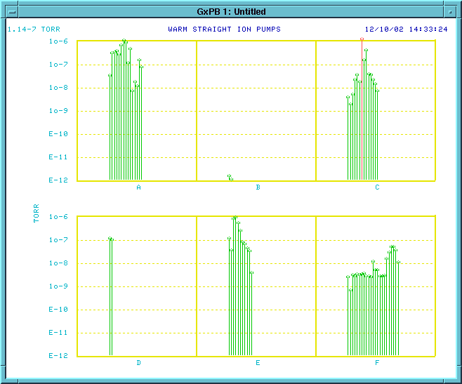
e-cloud induced pressure rise in other hadron rings
SPS
TEVATRON
no field
threshold ~4x10¹⁰ ppb
vacuum increase
in most straights
J. Annala,
B. Hanna
dipole field
M. Jimenez

Slide 5
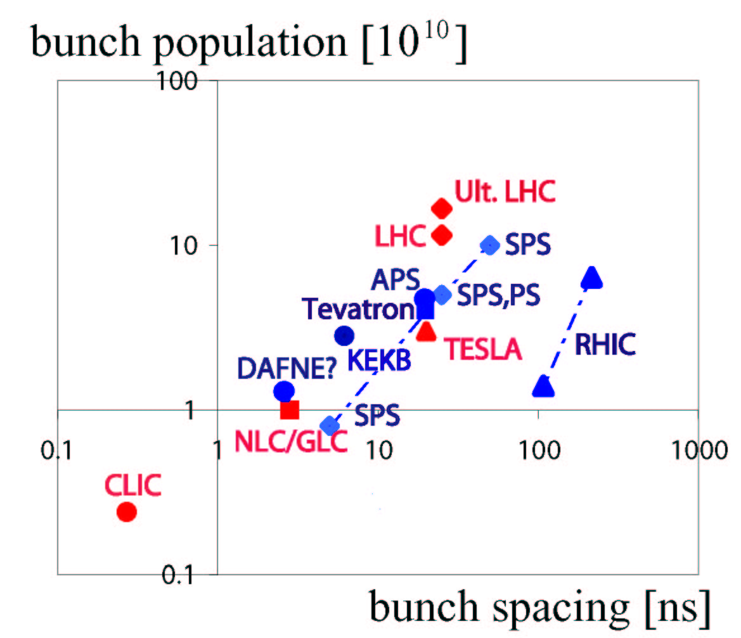
blue: e-cloud effect observed
red: planned accelerators
e-cloud is problem for short bunch spacing
& high bunch charge;
LHC is in dangerous
territory

Slide 6
electron-cloud effects
vacuum pressure rise
single-bunch instability
- interplay w. impedance & beam-beam
multibunch instability
incoherent emittance growth
heat load in cold arcs (quench)
perturbation of beam diagnostics

Slide 7
modeling tools at CERN
ECLOUD (F. Zimmermann, O. Bruning, X.-L. Zhang,
G. Rumolo, G. Bellodi, Jim Crittenden, et al +)
- e-cloud build up, electron flux on wall,
heat load, multi-bunch wake field
HEADTAIL (G. Rumolo, F.Z., E. Benedetto,…)
- e-cloud driven single-bunch instability,
incoherent emittance growth, interplay
w. impedance & space charge
Micromaps (G. Franchetti, E.B., F.Z.)
- precise incoherent effects

Slide 8
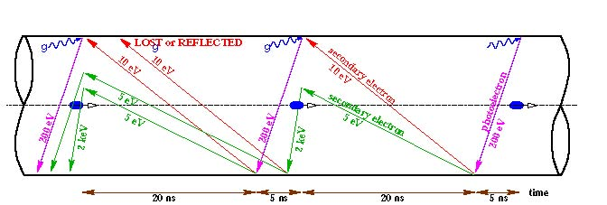
schematic of e- cloud build up in LHC arc beam pipe,
due to photoemission and secondary emission
[F. Ruggiero]

Slide 9
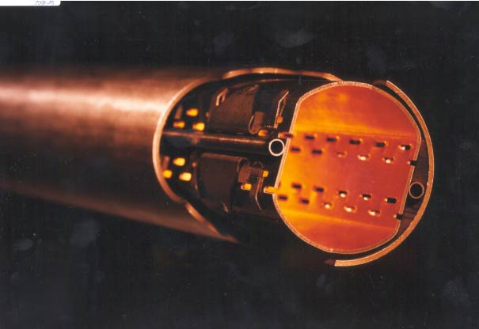
LHC strategy against electron cloud
1) warm sections (20% of circumference) coated by TiZrV
getter developed at CERN; low secondary emission; if
cloud occurs, ionization by electrons (high cross section
~400 Mbarn) aids in pumping & pressure will even improve
2) outer wall of beam screen (at 4-20 K, inside 1.9-K cold bore)
will have a sawtooth surface (30 μm over 500 μm)
to reduce photon reflectivity to ~2% so that photoelectrons
are only emitted from outer wall & confined by dipole field
3) pumping slots in beam screen are shielded to prevent
electron impact on cold magnet bore
unique
vacuum system!
4) rely on surface conditioning (‘scrubbing’);
commissioning strategy; as a last resort doubling or tripling
bunch spacing suppresses e-cloud heat load

Slide 10
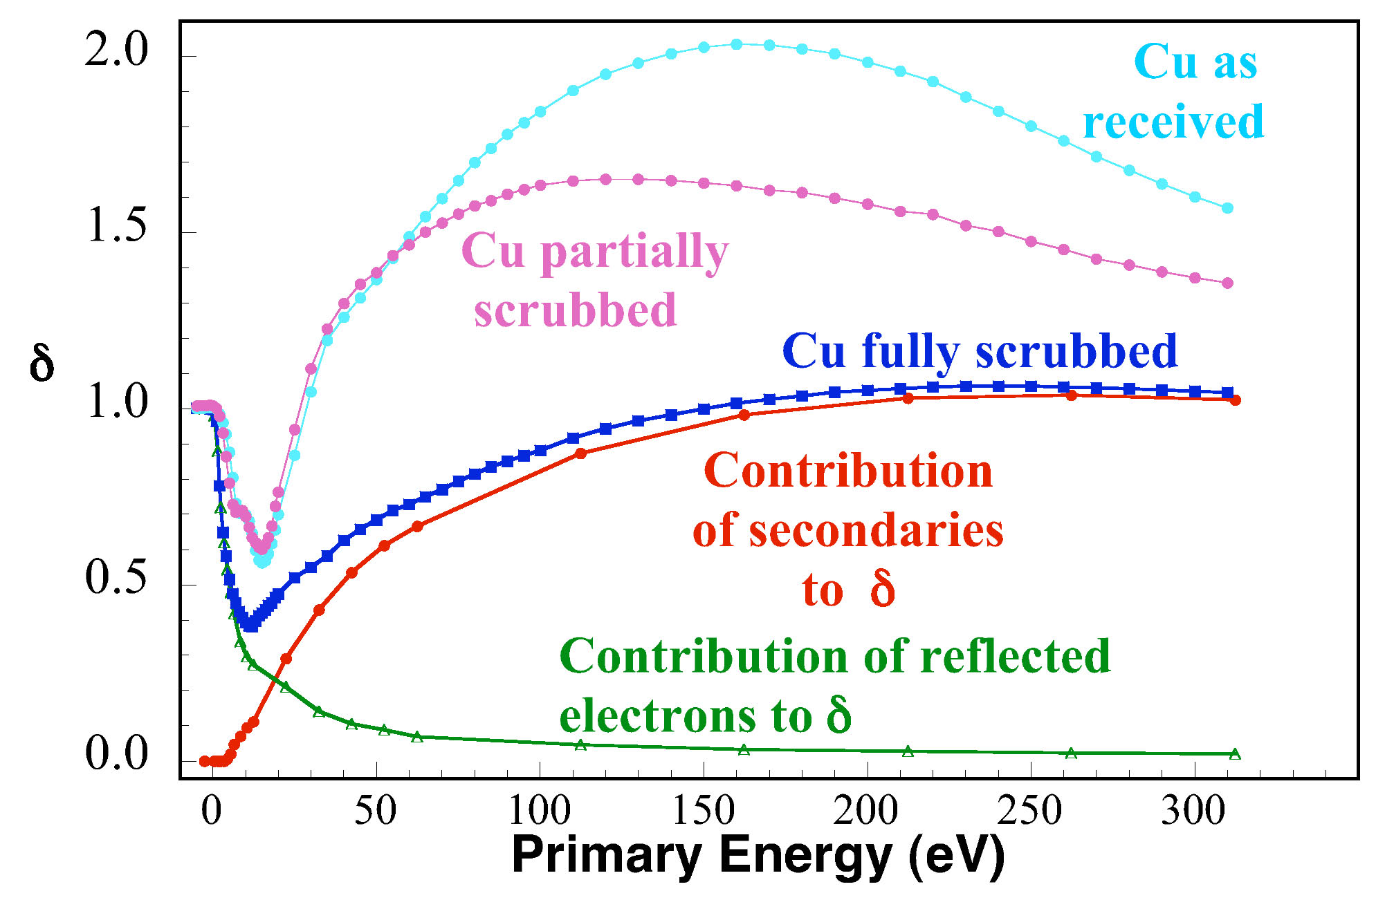
R. Cimino, I. Collins, 2003; CERN-AB-2004-012
yield
δ_{max}
R
ε_{max}
probability of elastic electron reflection seems to approach 1 for
zero incident energy and is independent of δ*_{max}

Slide 11
Present Model of Secondary Emission Yield
secondary electrons consist of true secondaries and elastically reflected;
since 2003 we assume that elastic reflection is independent of Θ (no data)
true secondaries:
[M. Furman, 1997]
this δ∗_{max}
is rescaled
considering
R
[Kirby, 2001;
Henrist, 2002;
Furman, 1997]
elastic reflection:
[Cimino, Collins, et al., 2003]
this quantum-mechanical formula fits the data well for E₀~150 eV
M. Furman includes rediffused electrons and finds that they increase the
heat load by 100%

Slide 12
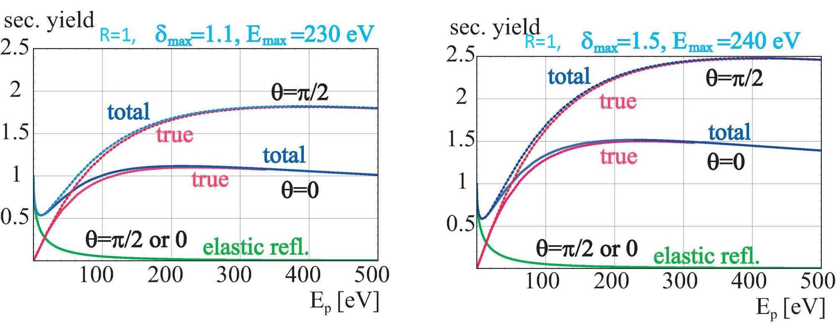
SEY model examples

Slide 13
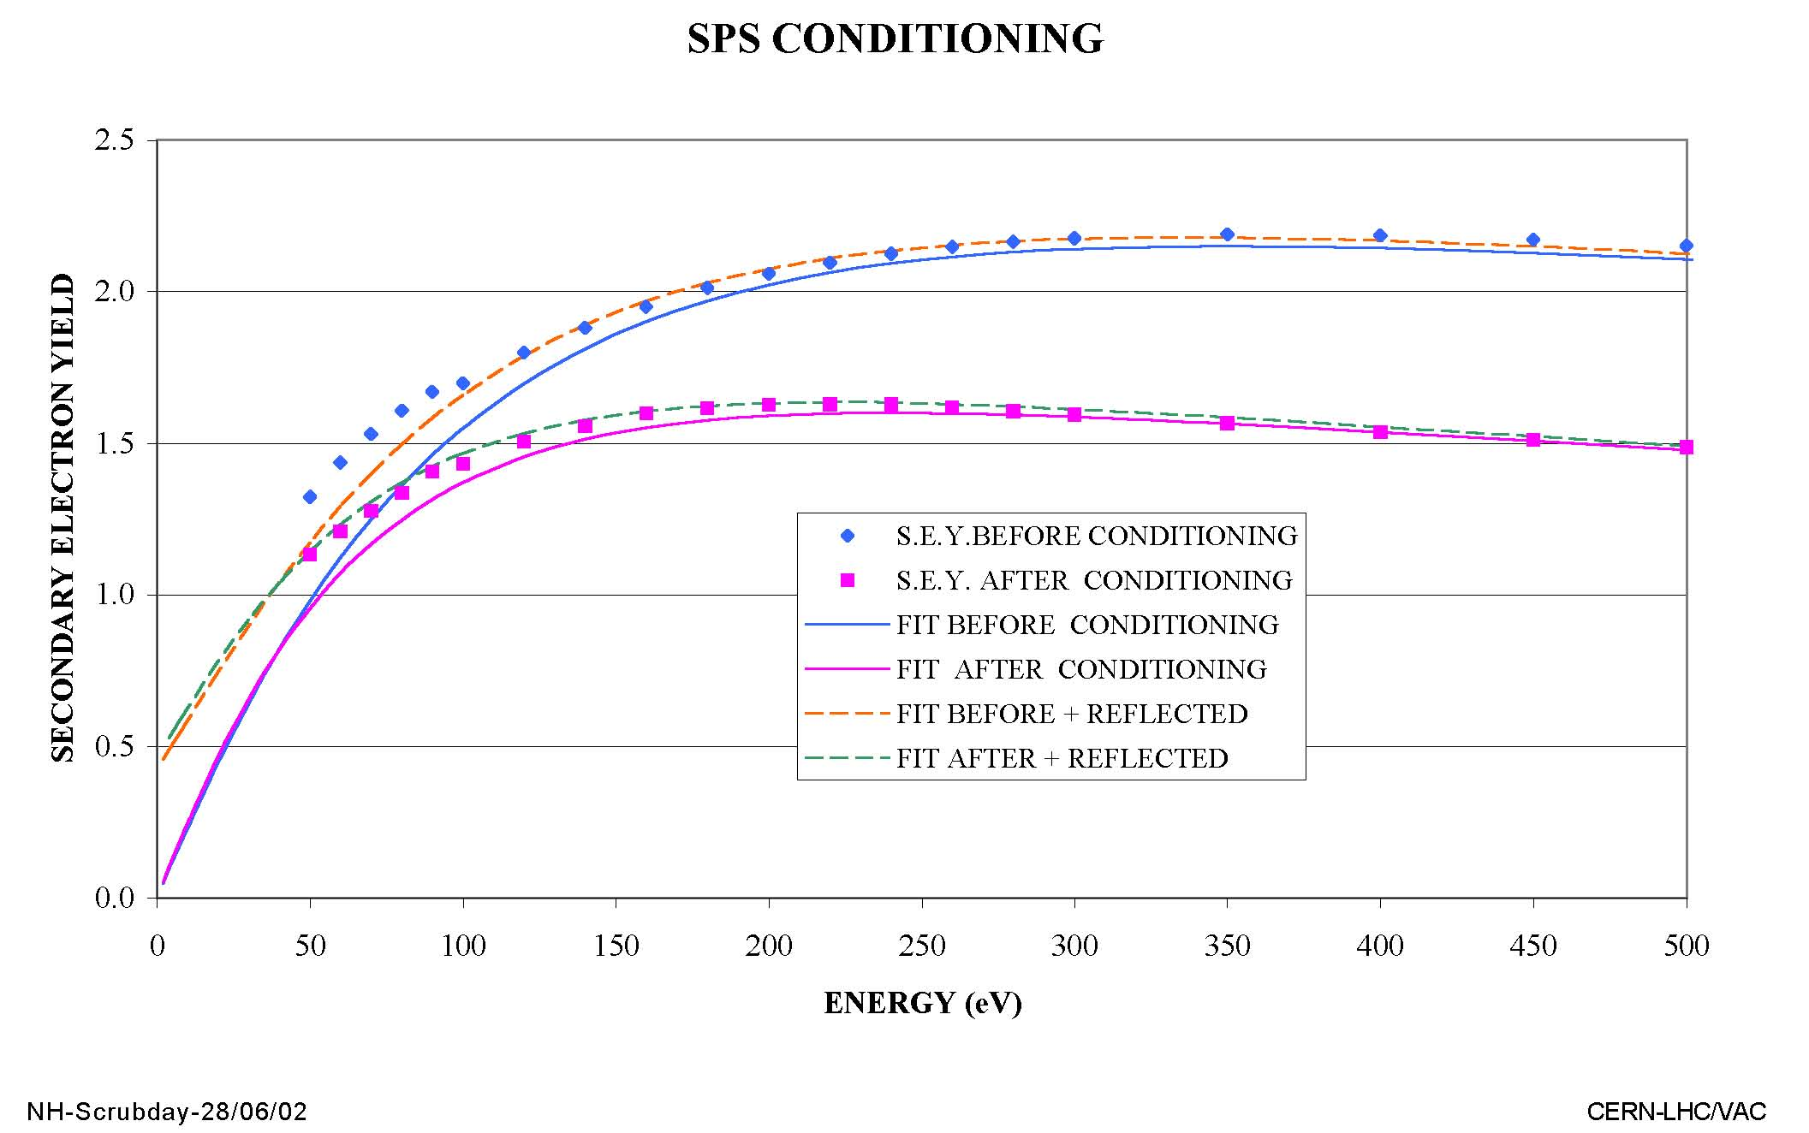
in-situ conditioning in the SPS (2002)
N. Hilleret, SPS Scrubbing Day, CERN, 2002

Slide 14
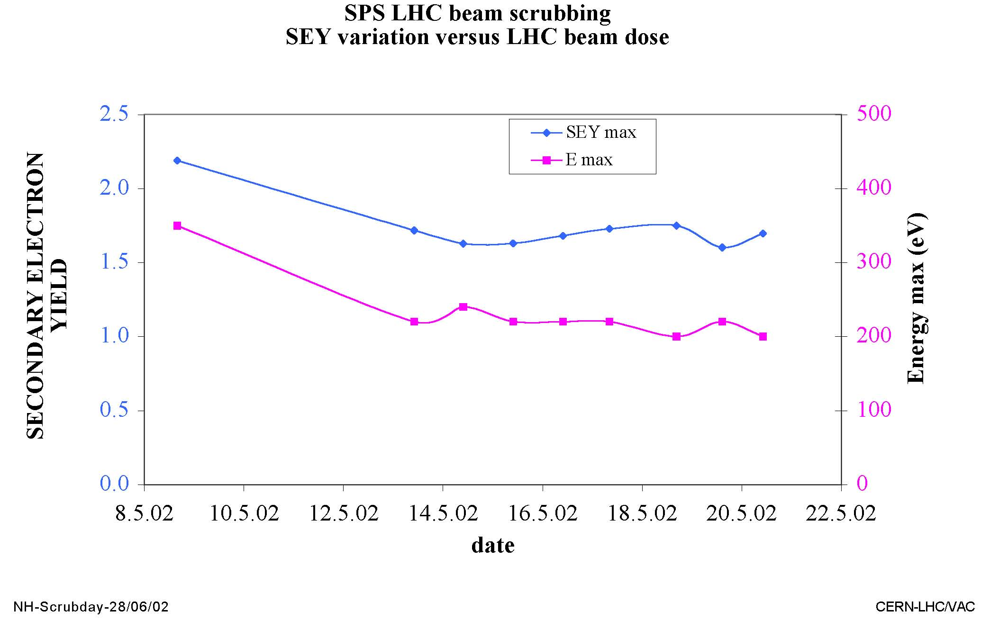
in-situ conditioning in the SPS (2002)
SEY decreased from 2.2 to 1.6 within 5 days
N. Hilleret, SPS Scrubbing Day, CERN, 2002

Slide 15
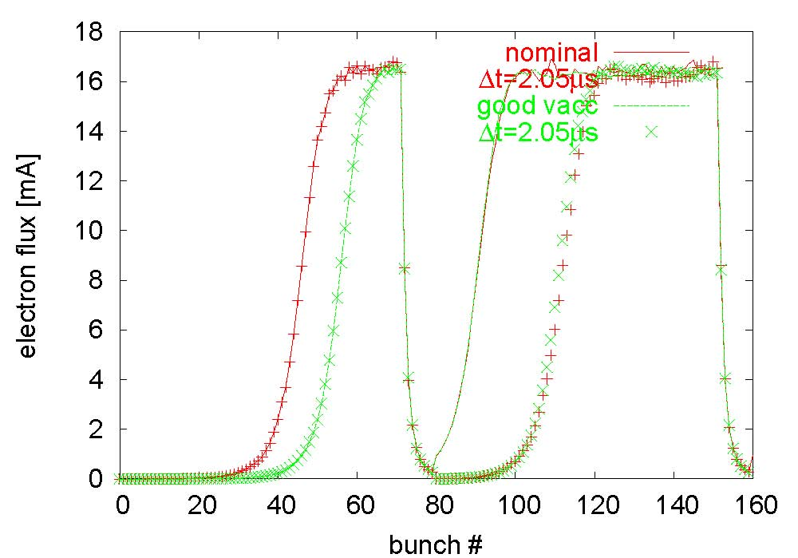
SPS benchmarking 2004, strip detector simulation
Daniel Schulte
two different
bunch train
spacings
two different
pressures
(40 ntorr
and 4 ntorr)
surface conditions (δ_{max}, R) and detector properties are uncertain
constrain parameters by benchmarking multiple measurements
change distance between trains & use relative measurements

Slide 16
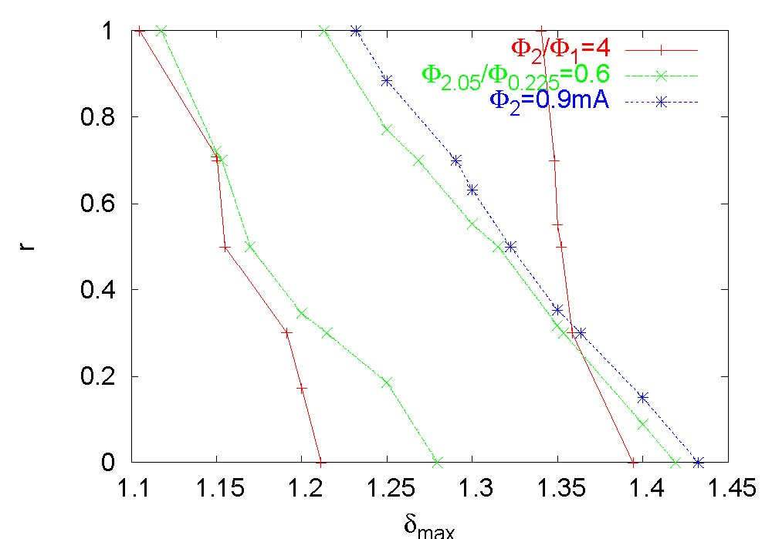
flux: (1) ratio 1&2 trains, (2) two spacings, (3) absolute
Daniel
Schulte
note:
results
sensitive
to pressure,
chamber
geometry,
etc.,
variation:
δ_{max}~1.4-1.3
R~0.1-0.7
three curves intersect at δ_{max}=1.35, R=0.3;
flux at later times (Φ=0.3 mA) δ_{max}=1.2 reached in SPS!

Slide 17
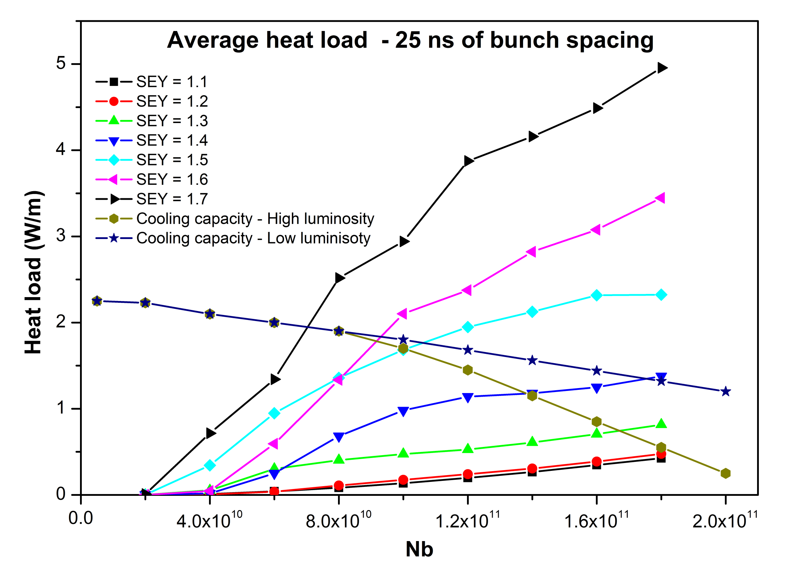
Simulated heat-load for nominal LHC
need SEY<1.5
H. Maury Cuna

Slide 18
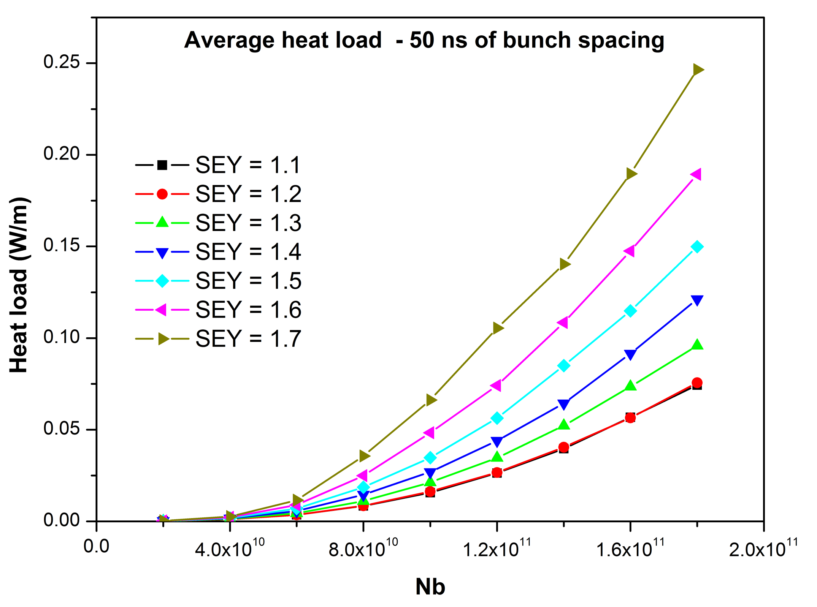
Simulated heat-load for LHC w 50-ns spacing
1404 bunches at 7 TeV
50 ns should have no problem !?!
H. Maury Cuna

Slide 19
e- cloud can lead to bunch instability

Slide 20
LHC emittance growth for different ρ_{e}
LHC injection, Q’=2,
N_{b}=1.15x10¹¹
single-bunch
instability
threshold
~3x10¹¹ m⁻³
K. Ohmi, F.Z.,
PRL85, 2000
E. Benedetto, Ph.D. Thesis, Politecnico di Torino, 2006

Slide 21
LHC emittance growth for different N_{b}
LHC injection,
Q’=2,
ρ_{e}=6x10¹¹ m⁻³
at ρ_{e}=6x10¹¹m⁻³
single-bunch
instability
threshold
N_{b}~6x10¹⁰
E. Benedetto, Ph.D. Thesis, Politecnico di Torino, 2006

Slide 22
LHC emittance growth for different Q’
E. Benedetto, Ph.D. Thesis, Politecnico di Torino, 2006
at ρ_{e}=6x10¹¹m⁻³
instability
suppressed
for Q’>15
similar to LHC
slow
emittance
growth
below
threshold
LHC injection,
N_{b}=1.15x10¹¹,
ρ_{e}=6x10¹¹ m⁻³
slow emittance growth never vanishes; precise value depends on optics & e-cloud distribution around the ring (E. Benedetto, G. Franchetti, F.Z., PRL97:034801,2006)

Slide 23
surface conditioning

Slide 24
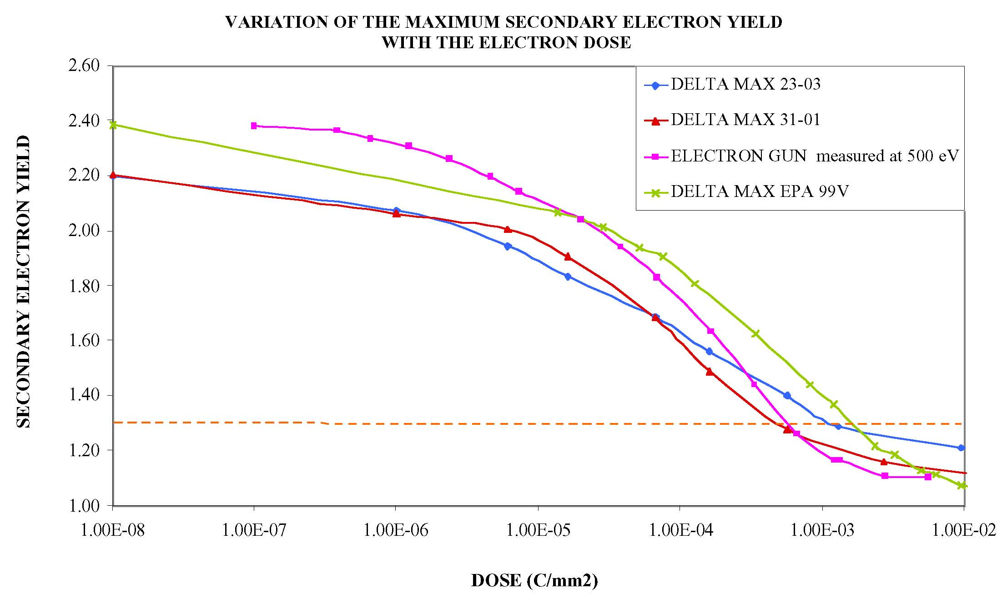
surface conditioning by e- bombardment
1 mC/mm²
N. Hilleret, Twostream Instabilities workshop, KEK, 2001

Slide 25
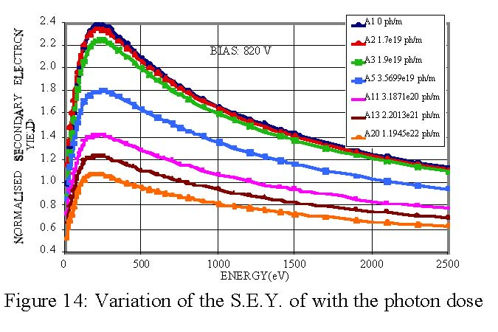
surface conditioning by synchrotron light
N. Hilleret et al, EPAC2000
need 10²⁰ photons/m! with 0.01 ph/m/proton/turn
7 hours with 400 nominal bunches at 3.5 TeV might do??!
(but much lower critical energy & sawtooth chamber)

Slide 26
Presentation to LHC MAC 10 June 2005
“scrubbing” in LHC?
still lacking experimental data, e.g., on ε_{max}(θ), R(θ)
uncertainty in heat load prediction of factor ~2
also incomplete understanding of scrubbing
(COLDEX data vs. prediction, RHIC, DAFNE)
if δ_{max}~1.3 reached in commissioning, no scrubbing
is needed for heat load and fast instabilities
pressure should be ok too according to N. Hilleret
one concern: long-term emittance growth and poor
lifetime (observed in SPS after scrubbing)
we still believe we need to prepare a scrubbing
strategy in case it turns out to be necessary
to go to δ_{max}~1.3 (e.g., tailor train spacings &
train lengths at nominal bunch intensity)

Slide 27
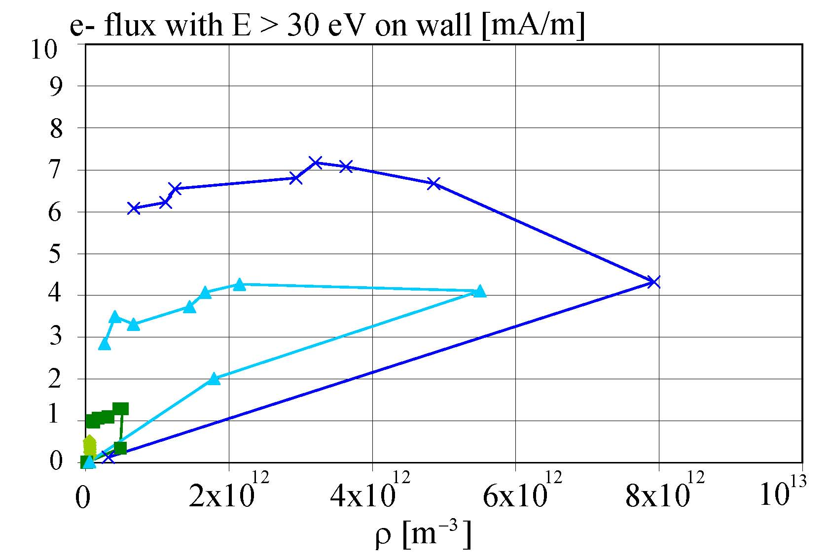
Presentation to LHC MAC 10 June 2005
stability limit
at injection
nominal filling pattern
top energy
δ_{max}=1.7
nominal N_{b}
δ_{max}=1.5
δ_{max}=1.3
δ_{max}=1.1
the challenge is to decrease δ_{max} to 1.3 with a stable beam

Slide 28
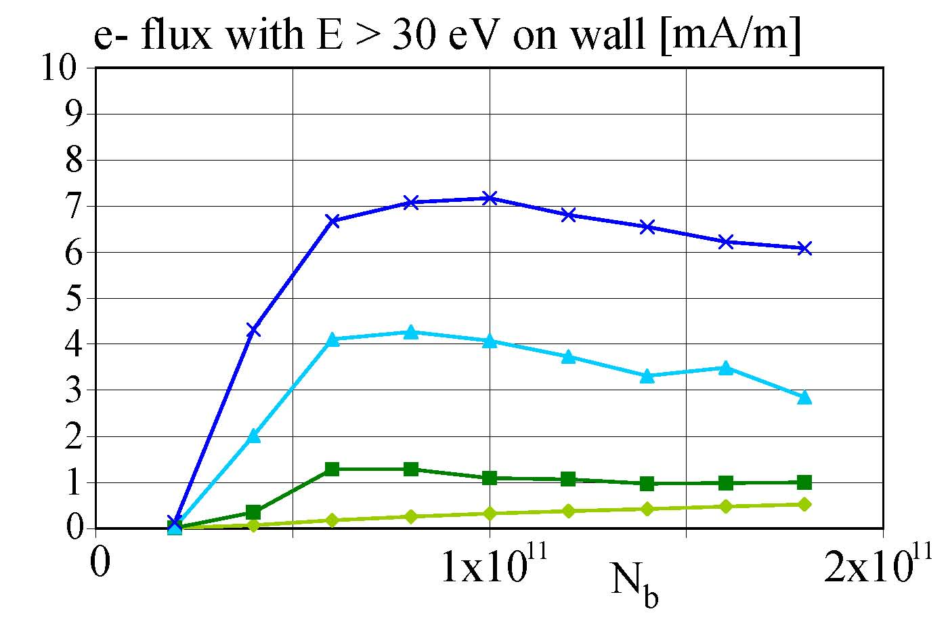
Presentation to LHC MAC 10 June 2005
LHC vacuum pressure with electron cloud
e- flux@wall vs. intensity, 25 ns spacing, ‘best’ model
δ_{max}=1.7
δ_{max}=1.5
δ_{max}=1.3
δ_{max}=1.1
R=0.5
calculation for 1 batch
17 hr running at 3 mA/m gives CO pressure corresponding to
100-hr beam lifetime (N. Hilleret, LHC MAC December 2004)

Slide 29
4x24 50-ns bunch trains
(with 3x37 gaps);
observations:
instability of 3rd and 4th train
heat load

Slide 30
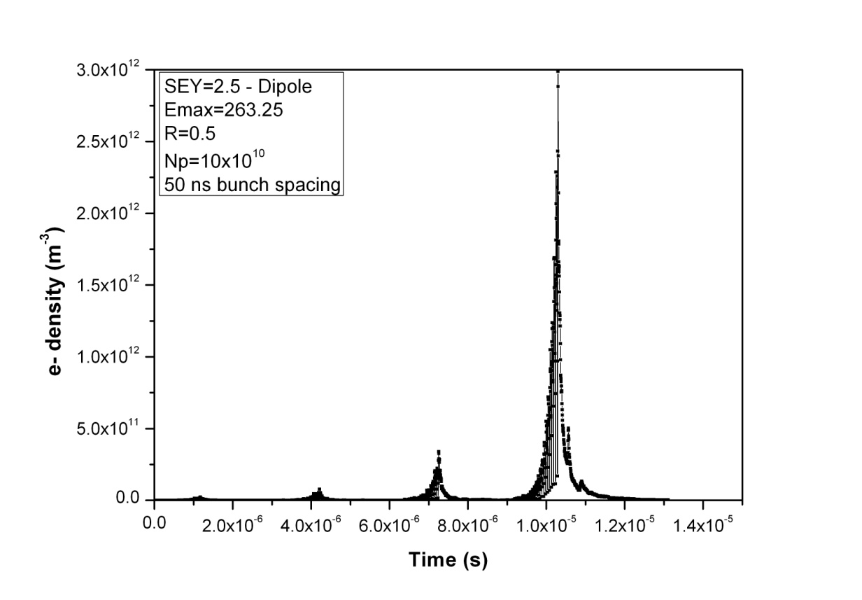
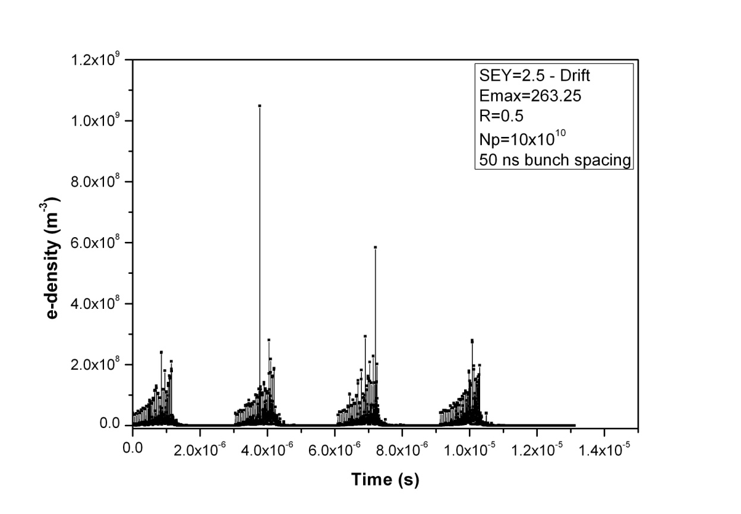
LHC at injection: 4x24 bunch pattern (+3x37 missing bunches)
we need δ_{max}≥2.5 (R=0.5)
for multipacting in
the arc dipoles
there is no multipacting
in the arc drifts at this value
of δ_{max}
2x10¹²
m⁻³
arc dipole
δ_{max}=2.5
R=0.5
1 ntorr (=equivalent p at RT)
N_{b}=10¹¹
instability threshold
central cloud density
10⁹ m⁻³
arc drift
δ_{max}=2.5
R=0.5
1 ntorr
N_{b}=10¹¹
H. Maury Cuna

Slide 31
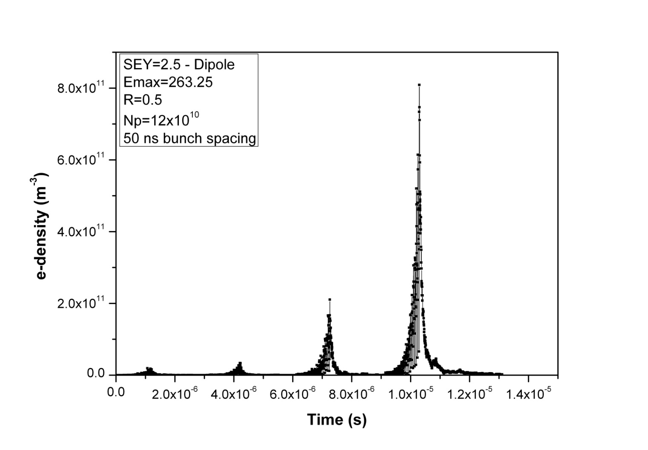
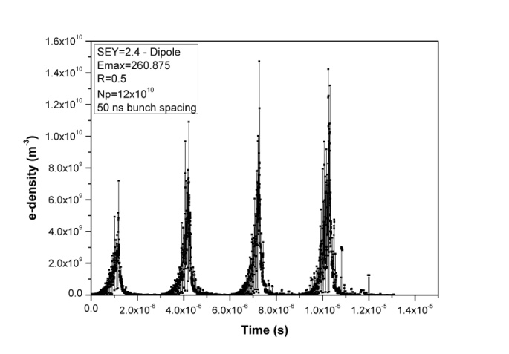
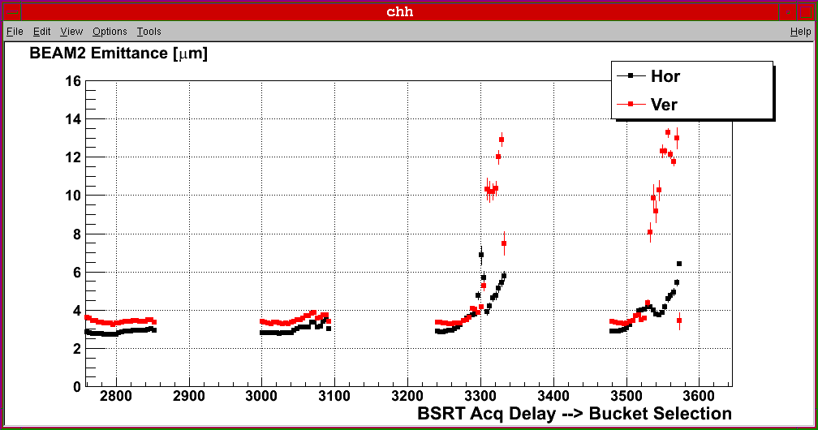
LHC at injection: 4x24 bunch pattern (+3x37 missing bunches)
8x10¹¹
m⁻³
for δ_{max}=2.4, R=0.5:
no multipacting
arc dipole
δ_{max}=2.5
R=0.5
1 ntorr
N_{b}=1.2x10¹¹
10¹⁰ m⁻³
~instability
threshold
arc dipole
δ_{max}=2.4
R=0.5
1 ntorr
N_{b}=1.2x10¹¹
central
cloud
density
emittance growth observation
F. Roncarolo
2/11/2010

Slide 32
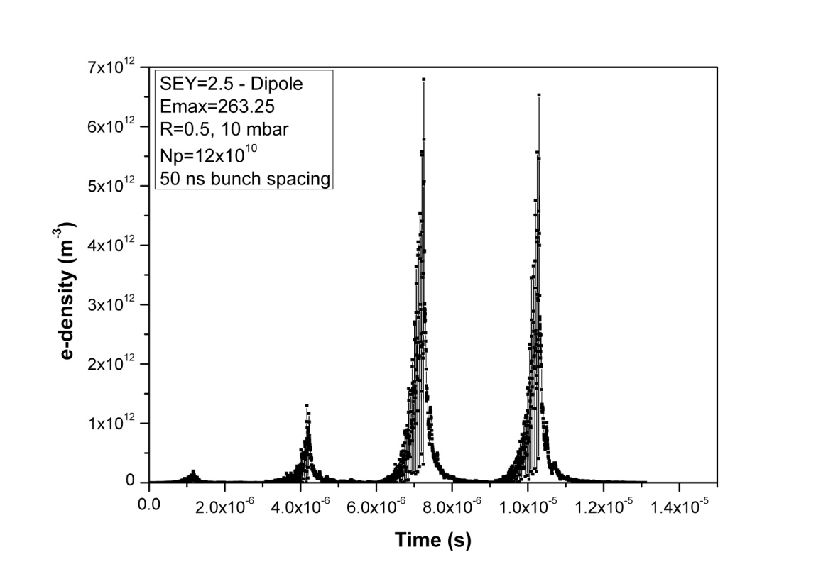
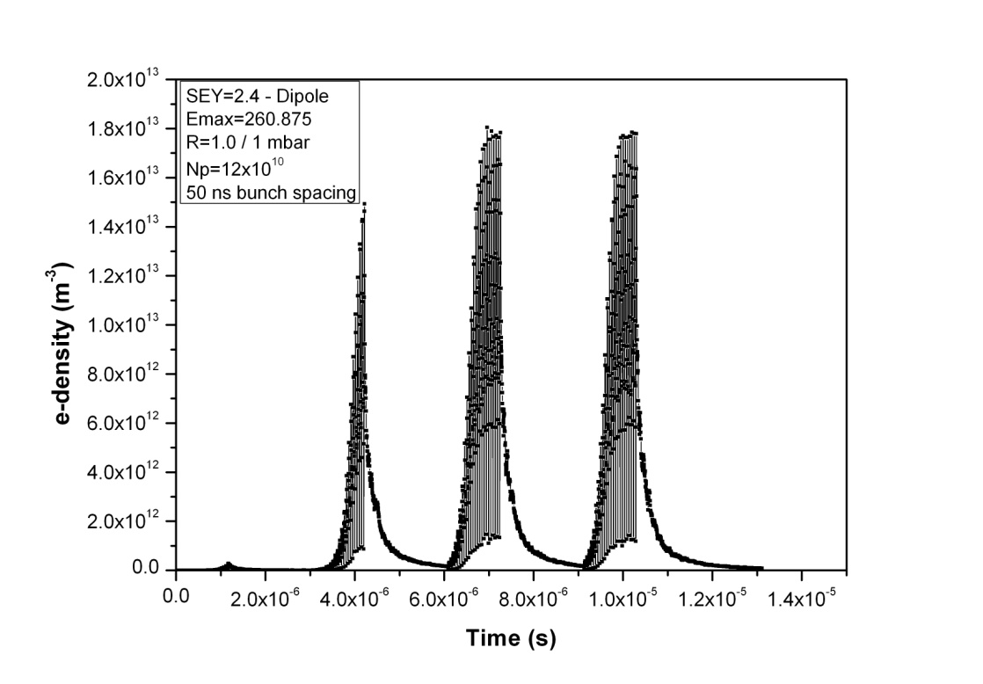
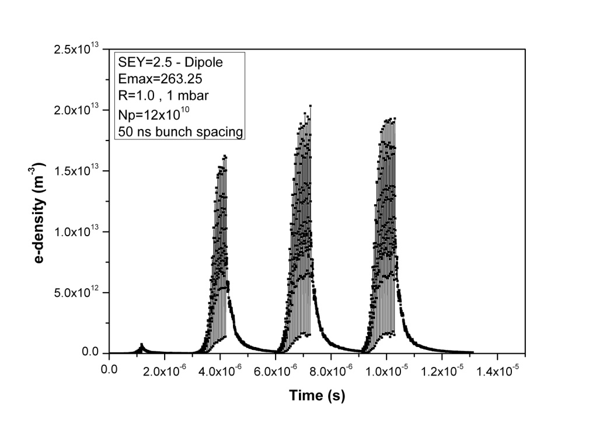
LHC at injection: 4x24 bunch pattern (+3x37 missing bunches)
central cloud density
8x10¹¹
m⁻³
7x10¹²
m⁻³
arc dipole
δ_{max}=2.5
R=0.5
1 ntorr
N_{b}=1.2x10¹¹
arc dipole
δ_{max}=2.5
R=0.5
10 ntorr
N_{b}=1.2x10¹¹
~instability
threshold
~instability
threshold
2x10¹³
m⁻³
2.5x10¹³
m⁻³
arc dipole
δ_{max}=2.5
R=1.0
1 ntorr
N_{b}=1.2x10¹¹
arc dipole
δ_{max}=2.4
R=1.0
1 ntorr
N_{b}=1.2x10¹¹
~instability
threshold
~instability
threshold

Slide 33
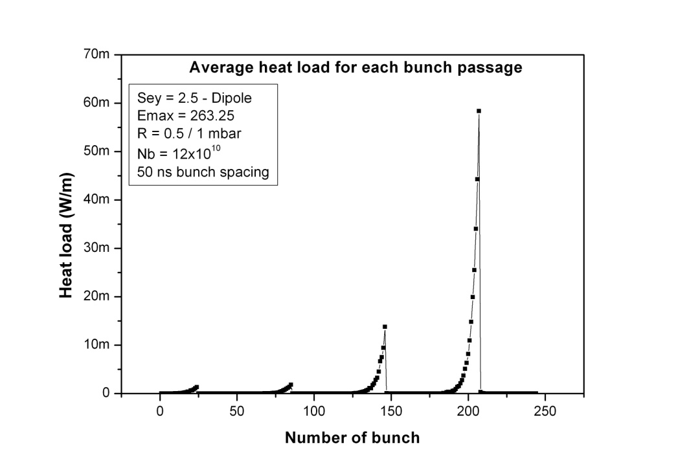
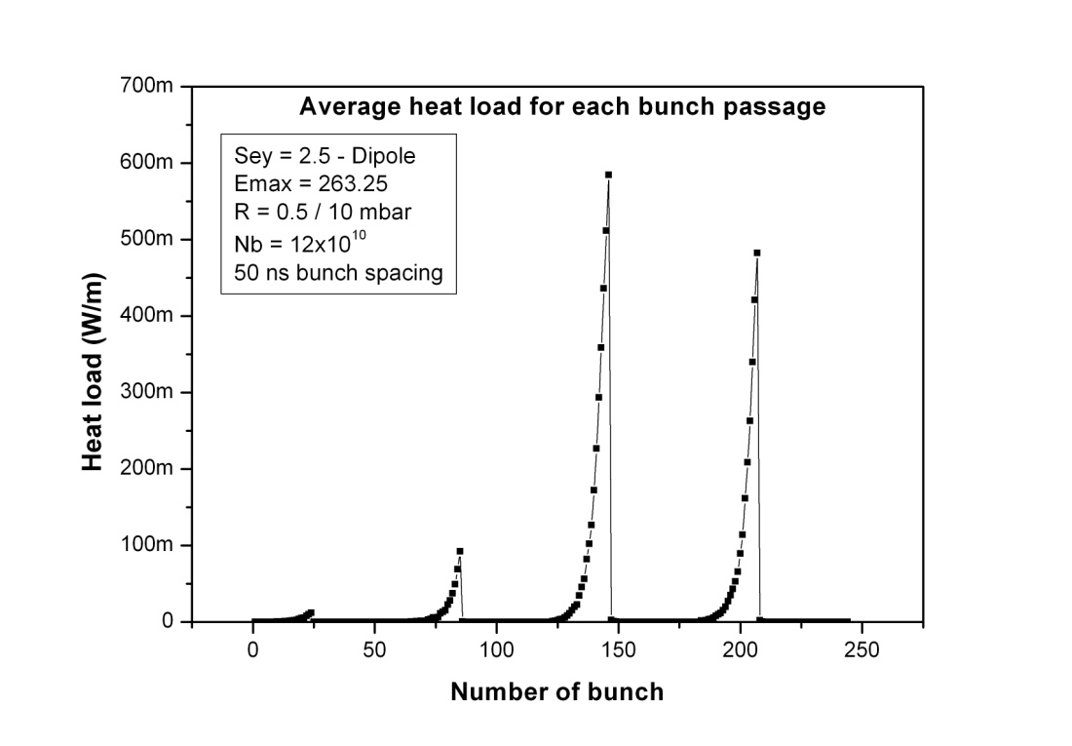
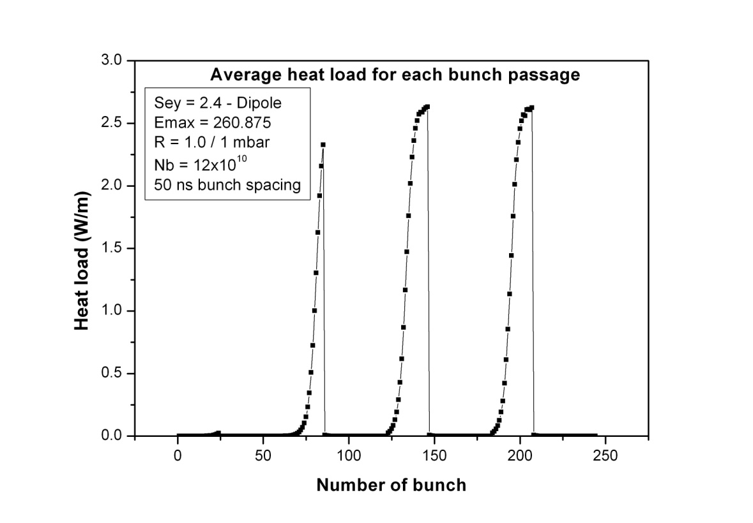
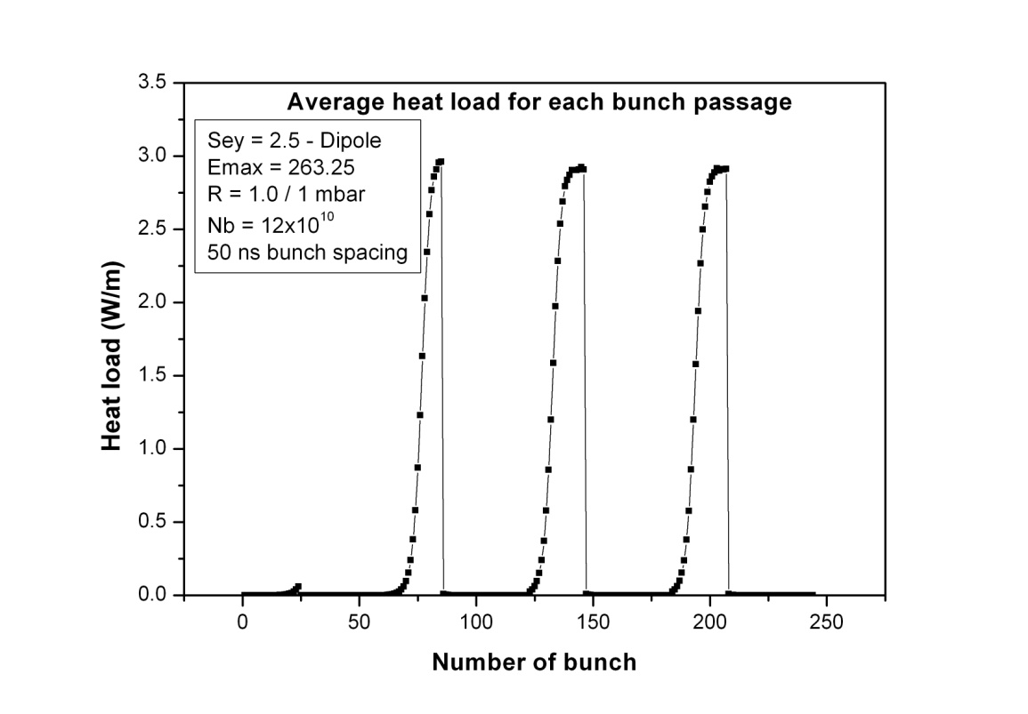
LHC at injection: 4x24 bunch pattern (+3x37 missing bunches)
70
mW/m
/bunch
700
mW/m
/bunch
arc dipole
δ_{max}=2.5
R=0.5
1 ntorr
N_{b}=1.2x10¹¹
arc dipole
δ_{max}=2.5
R=0.5
10 ntorr
N_{b}=1.2x10¹¹
3 W/m
/bunch
3.5 W/m
/bunch
arc dipole
δ_{max}=2.4
R=1.0
1 ntorr
N_{b}=1.2x10¹¹
arc dipole
δ_{max}=2.5
R=1.0
1 ntorr
N_{b}=1.2x10¹¹

Slide 34
simulation results for 4x24 bunches [at injection]
(1.85 μs spacing between batches)
H. Maury Cuna
δ_{max} | N_{b} | P [ntorr] equivalent press.@RT | R | dP/ds [mW/m] | total e- flux [μA/m] | e- flux > 30 eV [μA/m]
2.4 | 1.2x10¹¹ | 1 | 0.5 | 0.001 | 0.034 | 0.011
2.5 | 1.2x10¹¹ | 1 | 0.5 | 0.18 | 0.697 | 0.239
2.5 | 1.2x10¹¹ | 10 | 0.5 | 3.3 | 12.3 | 4.34
2.5 | 1.2x10¹¹ | 1 | 1.0 | 61 | 268 | 69.8
2.4 | 1.2x10¹¹ | 1 | 1.0 | 46 | 200 | 52.7
2.5 | 1.0x10¹¹ | 1 | 0.5 | 0.44 | 2.1 | 0.71
2.5 (top!) | 1.2x10¹¹ | 1 | 0.5 | 59 | 356 | 93.8
30 days continuous running at 70 μA/m gives CO pressure
corresponding to 100-hr beam lifetime (N. Hilleret, LHC MAC Dec.2004);
2 days continuous running at 70 μA/m gives 1 mC/mm² !

Slide 35
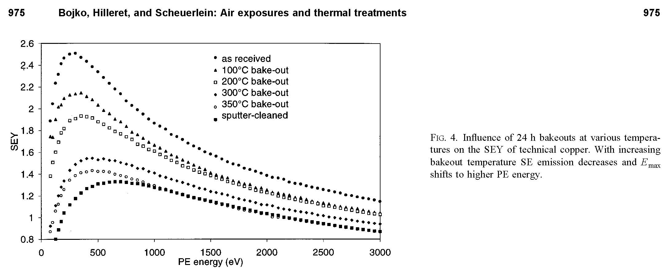
secondary emission yield of copper
J. Vac. Sci. Technol. A 18.3., May/Jun 2000
δ_{max}=2.5 is expected for “as-received” unbaked copper surface

Slide 36
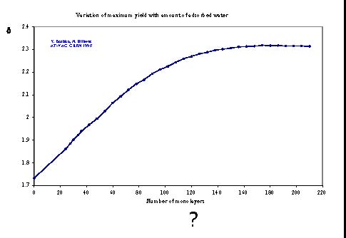
variation of secondary electron yield with water surface coverage
N. Hilleret, LHC MAC, December 2004

Slide 37
electron cloud in the LSS
electron-cloud simulations at 25-ns bunch spacing for the two-beam IR sections were performed by Giovanni Rumolo, Adriana Rossi and Frank Zimmermann in the period 1999-2002 to specify the acceptable maximum secondary emission yield in this region
nominal LHC beam & SEY values between 1.1 and 1.4 had been considered; see
F. Zimmermann: Electron-Cloud Simulations for the LHC Straight Sections, LHC Project Note 201, 1999;
Rossi, G. Rumolo, F. Zimmermann: A Simulation Study of the Electron Cloud in the Experimental Regions of LHC, Proceedings ECLOUD’02 workshop, Geneva, Yellow Report CERN-2002-001, pp. 123).
new simulations for much higher SEY are being launched

Slide 38
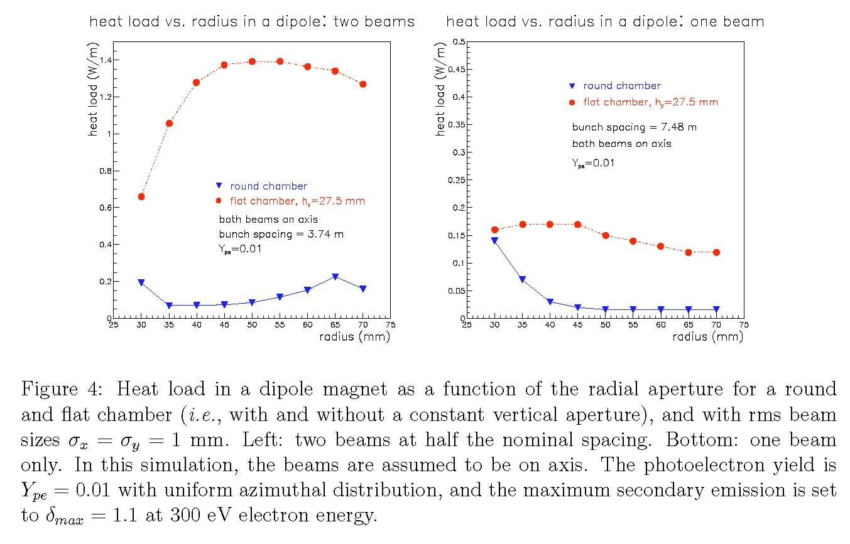
flat chamber: more multipacting;
larger radius harmful with two beams
LHC Project Note 201, 1999

Slide 39
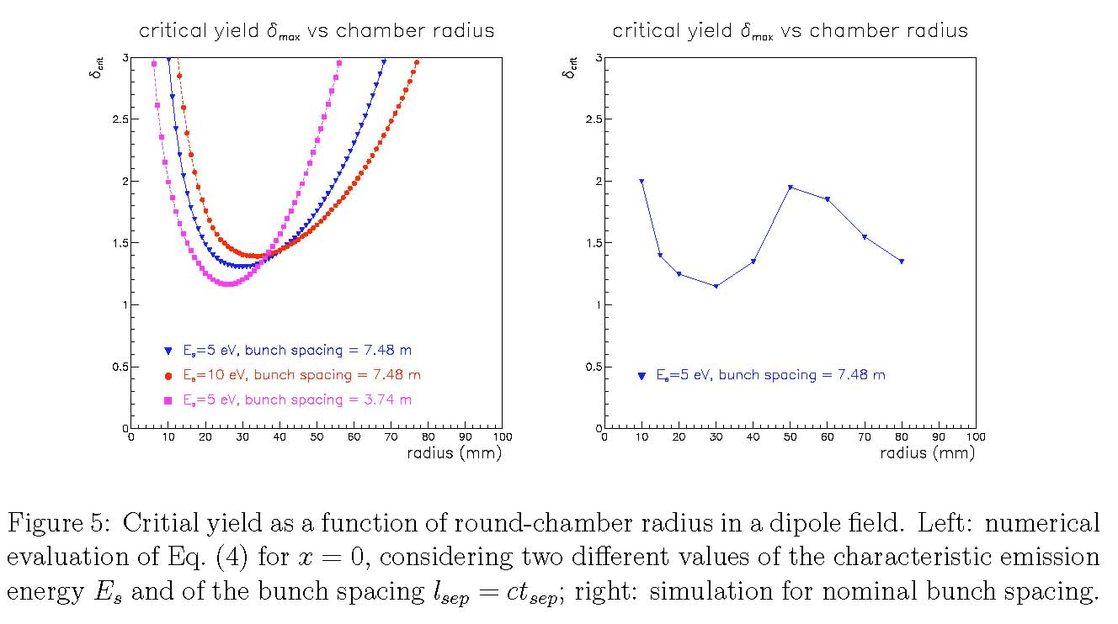
most critical chamber radius depends on bunch arrival time;
analytical calculation agrees with simulations
LHC Project Note 201, 1999

Slide 40
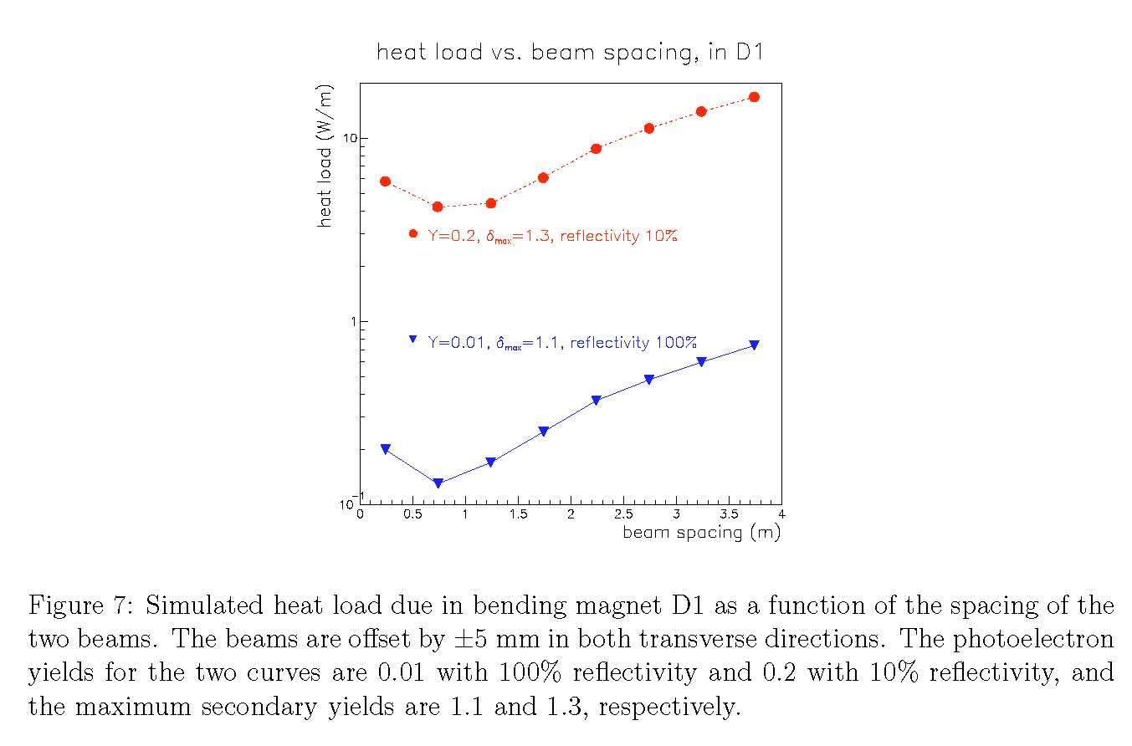
interleaved bunch arrival most dangerous (D1 example)
LHC Project Note 201, 1999

Slide 41
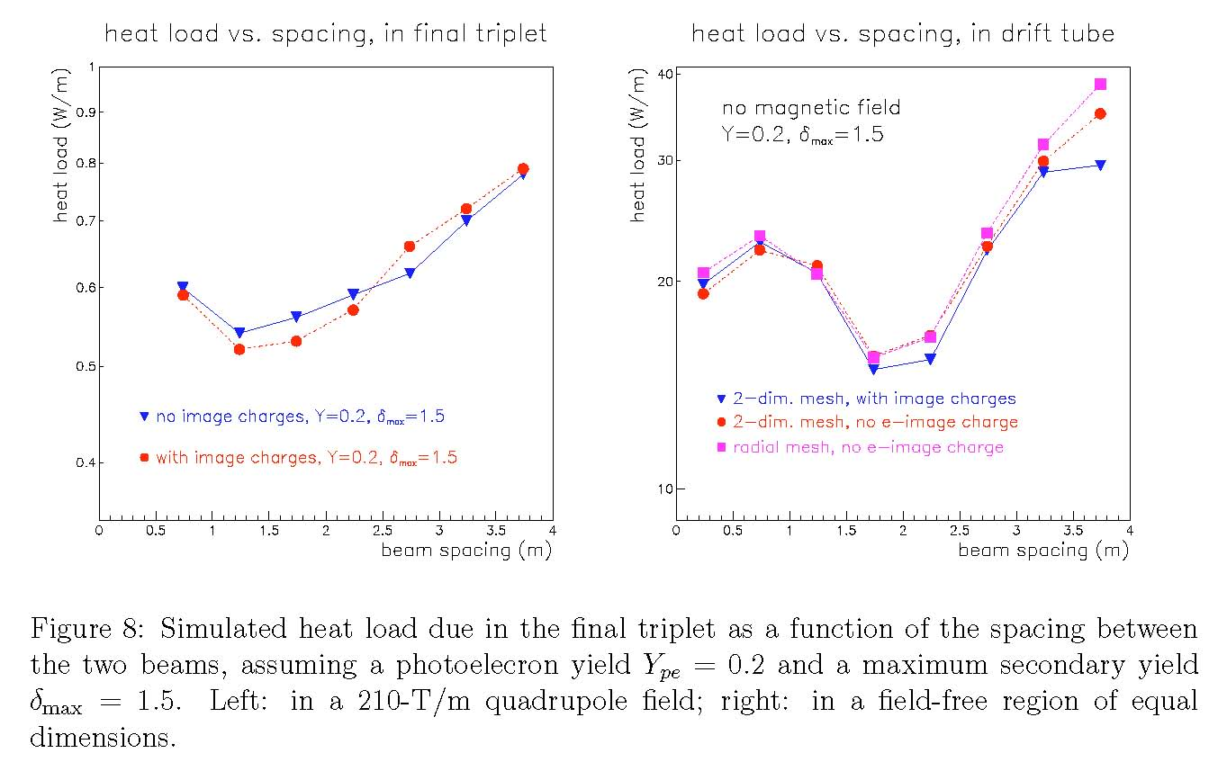
interleaved bunch arrival most dangerous (triplet example)
LHC Project Note 201, 1999

Slide 42
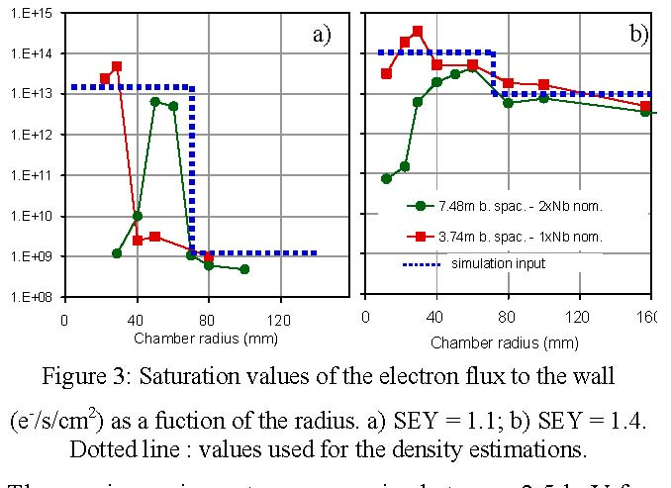
e- flux vs chamber radius with two beams & 2 arrival times
A. Rossi et al, Proceedings ECLOUD’02

Slide 43
very preliminary conclusions
at 50-ns spacing strong evidence for large electron
cloud build up in warm and cold sections
cold sections are of bigger concern
both heat load & instability in 3rd and 4th train
indicate SEY δ_{max}~2.5 in the arcs
(larger than expected) at R=0.5
av. e-cloud density ~6x10¹¹ m⁻³ (from Q’ effect)
expected tune shift: ΔQ~r_{p}ρ_{e}Cβ/(2γ)~ 0.0025
new simulations for LSS and more simulations for
arcs are in progress
determine R from memory effect between trains

