Slide 2
Friday
19:00-20:00: Injection set-up. Unable to turn RF power on for module M1B1 for beam 1.
20:00-21:00: Beam 2:
Inject and correct beam 2.
For the first time two bunches in a single LHC beam (total intensity 8e9 p in beam 2).
instrumentation and beam dump. All OK.
21:00-22:00: Beam 2:
Undulator successfully at 200A, no light seen yet.
Switching on LHCb spectrometer to nominal
RF triggered beam dump. RF problem related to 18 kV distribution problem.
22:00-01:00: Work on RF. Injection set-up.

Slide 3
Overnight Friday - Saturday
22:00-01:00: Work on RF. Injection set-up.
01:00-02:00: Work with Beam2.
LHCb spectrometer non-closure (0.8mm) corrected.
Then RF problems and no beam.
01:00-06:00: Work with Beam1.
Beta beat studies and correction: Dipole b2, IR8 and IR2. Improvement for most arcs in horizontal beta-beating for beam1. Clear big error in IP7 remains.
100 beam dumps to verify change in dump kicker firmware.
07:00-09:30: Prepare and perform pre-cycle.

Slide 4
Saturday 2/3
09:30-10:00: Prepare injection.
10:00-12:00: Beam2 only.
Correct tunes and chromaticity.
Bring on ALICE spectrometer. Establish reference. Interrupted by several interlocks from RF. ALICE spectrometer non-closure (0.35mm) corrected.
12:00-14:00: Golden orbit and IR steering.
Beam-beam separation minimized in all IR's.
ALICE solenoid switched on.
Golden orbit loaded.
Orbit in cleaning insertions corrected to Sunday reference (collimation beam-based alignment).
Software interlock on dipole correctors activated (for STABLE beam mode).

Slide 5
Saturday 3/3
14:00-16:00: Reestablishing collimation.
Collimator settings reloaded. No reoptimization required (very good machine and collimator reproducibility). Loss patterns OK. Injection OK (~70% injection efficiency).
Identified lifetime reduction from transverse damper. Lifetime with collimators in nominal position and transverse damper off reached >25h.
BLM beam loss spectra recorded with collimator scans.
Most collimator position interlocks activated (except injection and dump protection).
ALL COLLIMATORS LOCKED IN POSITION

Slide 6
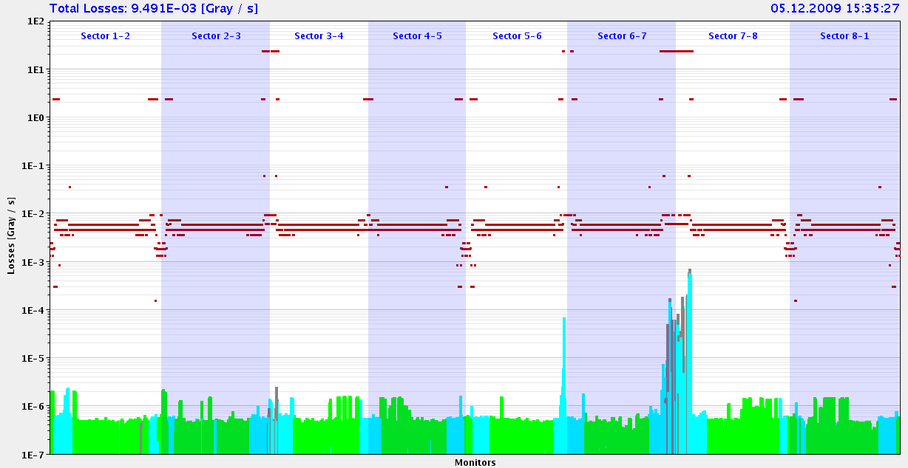
Collimators
Move Qx across 0.33 resonance. Loss pattern for beam 2 attached. Looks OK (losses at collimators).

Slide 7
Saturday 3/3
16:00-17:00: RF work.
16:00-20:00: Dump and injection protection.
TDI's set up.
TCDQ and IR6 TCSG set up.
Tests for asynchronous dumps. OK.
Position interlocks on 2 TDI, 2 TCDQ, 2 IR6 TCSG, 2 TCLIA, 2 TCLIB.
ALICE solenoid inverted.
Injection kickers adjust for multi-bunch injection
20:00-23:00: Trip of B24.R1. Recovery, pre-cycle and injection set-up.
23:00-00:00: Re-establish reference. Final dump protection checks.

Slide 8
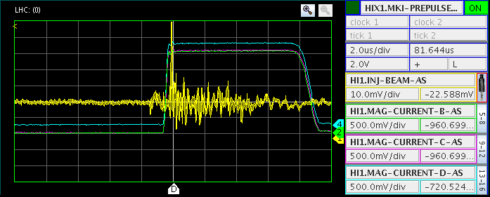
Injection

Slide 9
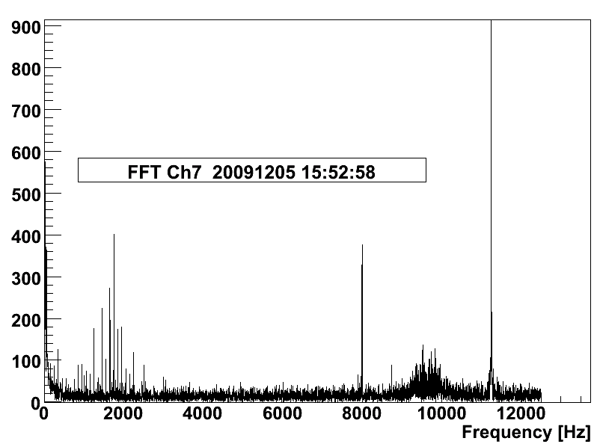
BLM

Slide 10
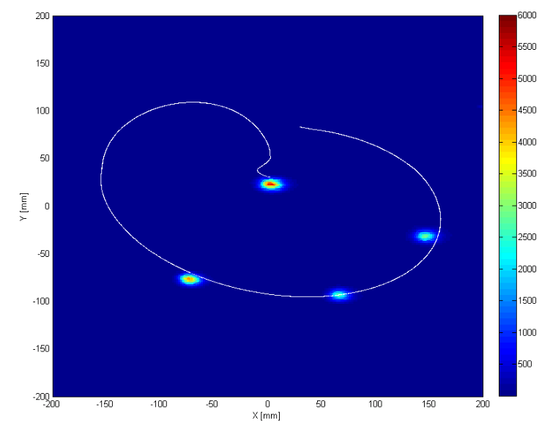
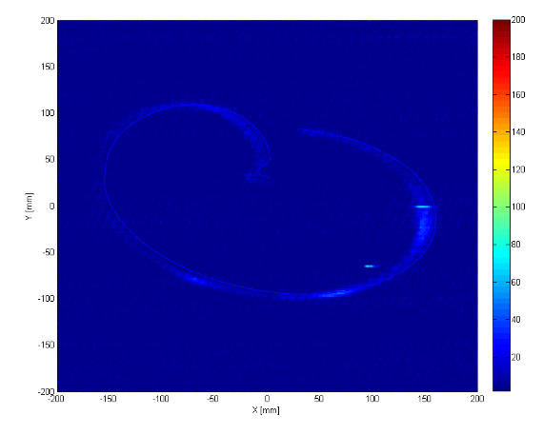
Beam dump

Slide 11
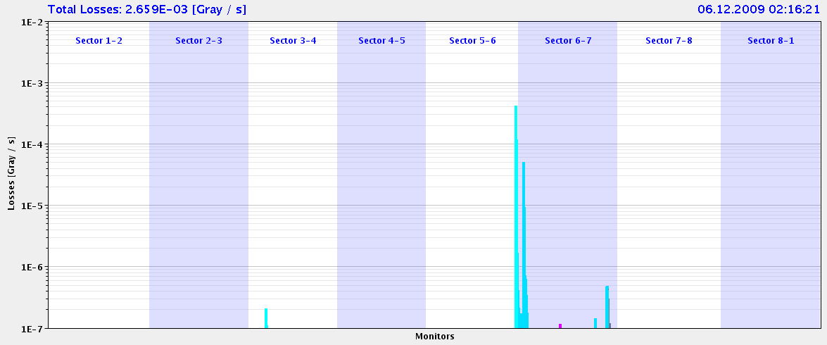
Beam loss Monitors – upcaptured beam dump

Slide 12
Sunday morning
00:00-02:30: Four bunch setup.
1.5e10 p in beam1 in 4 bunches. Fully protected machine. 25h beam lifetime. Correctly dumped.
At 01:32: Two beams with each 4 bunches stored. B1: 1.4e10. B2: 1.5e10.
Dump tests show normal loss patterns both for bunched and unbunched beams.
02:30- 06:30:
RF, controls, B2 lifetime - thrash
Finally successful around 6:30 after resolving a lifetime problem with beam 2. 4 on 4 circulating and colliding with reasonable lifetime for both beams.

Slide 13
Sunday a.m.
Beam dump
re-boot of DC BCT
Beam back
Switch off on all LHC sectors
Access for QPS heater power supply
Recover & recycle
22:30 Stable beam
4 on 4 – increased intensity ~6e9 bunch – looks good
00:23Beam dumped – cryogenics
access
06:30 warm compressors (1/2 of the high pressure stage) is still not working.
04:30 Electrical perturbation
tripped other sectors

Slide 14
Planning
Recovery
Stable beams
Increased intensity
Ramp

