Slide 1
Beam commissioning strategy
Mike at last LMC
Energy | Safe | Very Safe
450 | 1 e12 | 1 e11
1 TeV | 2.5 e11 | 2.5 e10
3.5 TeV | 3.0 e10 | probe
Global machine checkout
Essential 450 GeV commissioning
Trial ramps
Machine protection commissioning 1
Experiments’ magnets at 450 GeV
Xmas
450 GeV collisions
You are here!
Ramp commissioning to 1 TeV
System/beam commissioning
Machine protection commissioning 2
3.5 TeV beam & first collisions
Full machine protection qualification
System/beam commissioning
Pilot physics

Slide 2
Operational overview
Mike at last LMC
Pre-cycle gives a reproducible machine
tunes, orbit
Beam lifetime
Up around 50 hours with collimators out
3 – 5 hours with collimators in
Beam size
Nominal emittance measured
B1 vertical not pretty – injection oscillations
Intensity limited to < 5 e9 so far
Optics
Dispersion – stunningly good
Beta beating ~40% max
➔ now fixed to ca. 20h!
planned to be increased to
2 10¹⁰ by end of the week!

Slide 3
Thursday 3.12. and Friday 4.12.
Beta-Beating measurement
Beam 1 has a positive effect from the corrections applied.
Need to understand IR7 results more carefully for Beam 2.
Aperture checks (including IRs)
separation bumps and crossing angle studies
luminosity scan knobs successfully tested
TDI and LBDS studies
Beam Instrumentation studies (e.g. tune meter and synchrotron light monitor: undulator at 200A)
first time two bunches in one beam (8 10⁹ in Beam2)
lifetime reduction observed with collimators in close position ➔ crash program to investigate curses
➔ finally understood (e.g. BI cable to the damper system)

Slide 4
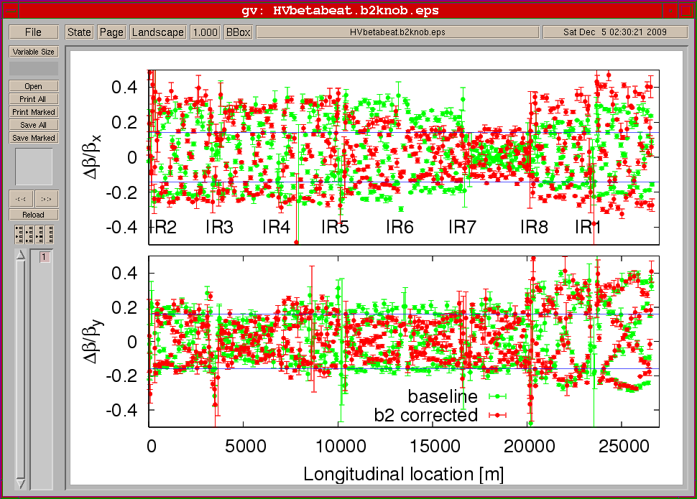

Slide 5
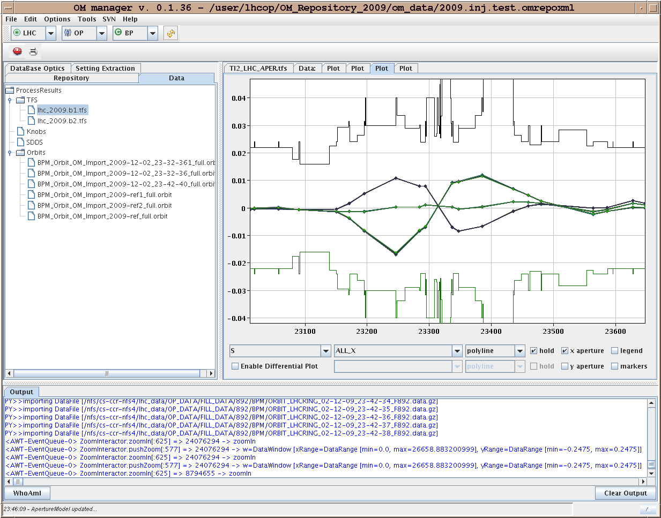
Example

Slide 6
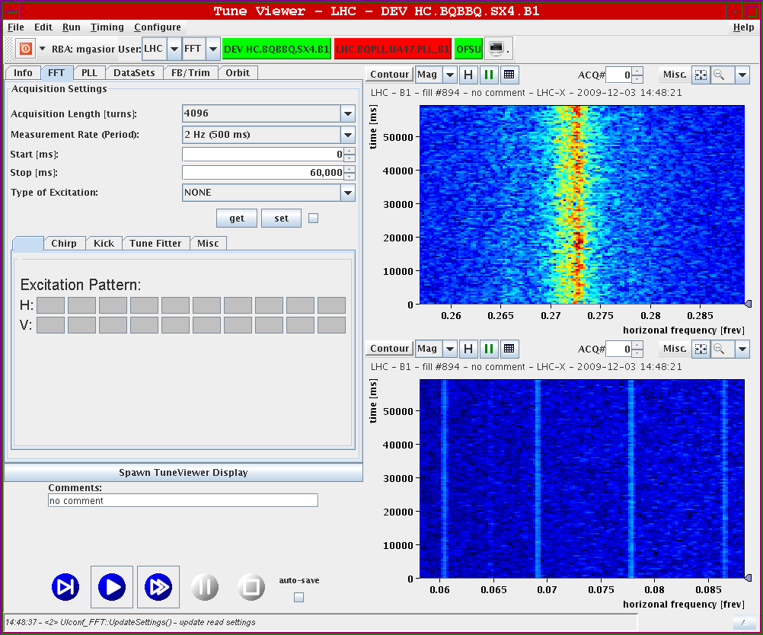

Slide 7
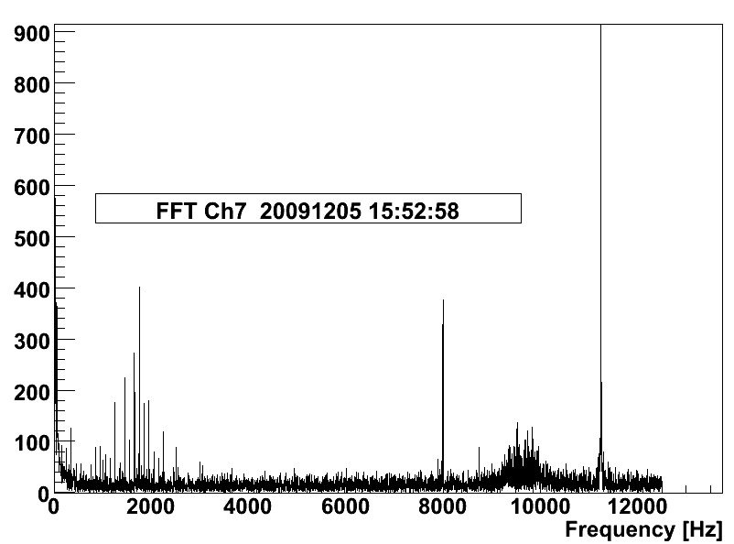
BLM

Slide 8
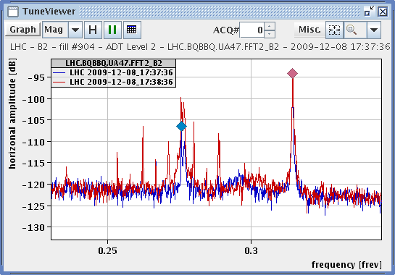
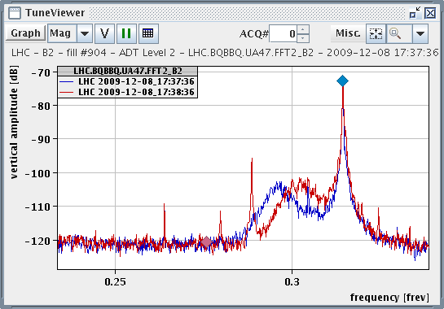
Damper spectrum Level 2 vs Level 3 (without and with input [BI and damper])

Slide 9
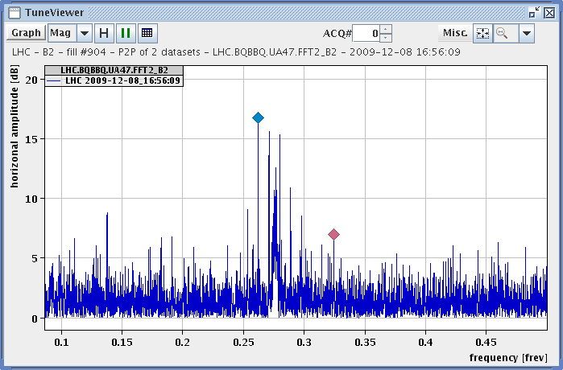
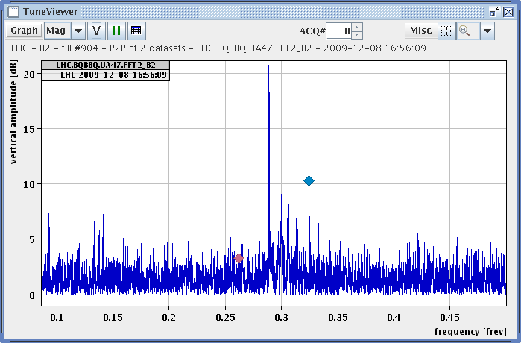
Relative Tune spectrum Level 2 vs Level 3

Slide 10
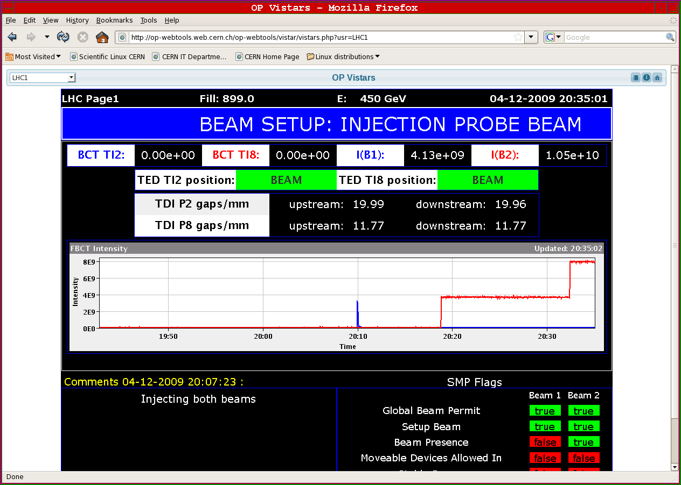

Slide 11
Saturday 5.12. and Sunday 6.12. Preparing for Stable Beam
Aperture studies continued
Establishing Golden Orbit and IR steering
tunes, orbit, spectrometer magnets on
Working on Undulator setup (but still not operational)
RF tuning for better configuration
Klystron configuration for reducing power on load
Dump and Injection protection setup
Reestablishing Collimator setup ➔ all collimators locked
Setup for 4 x 4 (4 10⁹/per bunch) operation:
B1: 1.4 10¹⁰; B2: 1.5 10¹⁰.
Stable beam configuration on Sunday morning

Slide 12
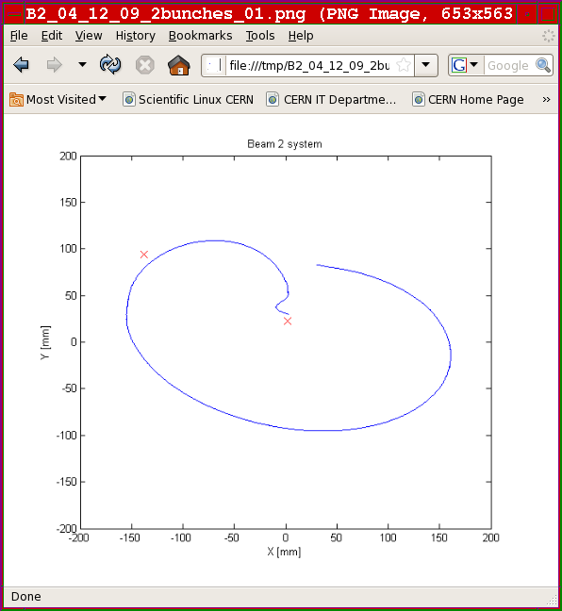

Slide 13
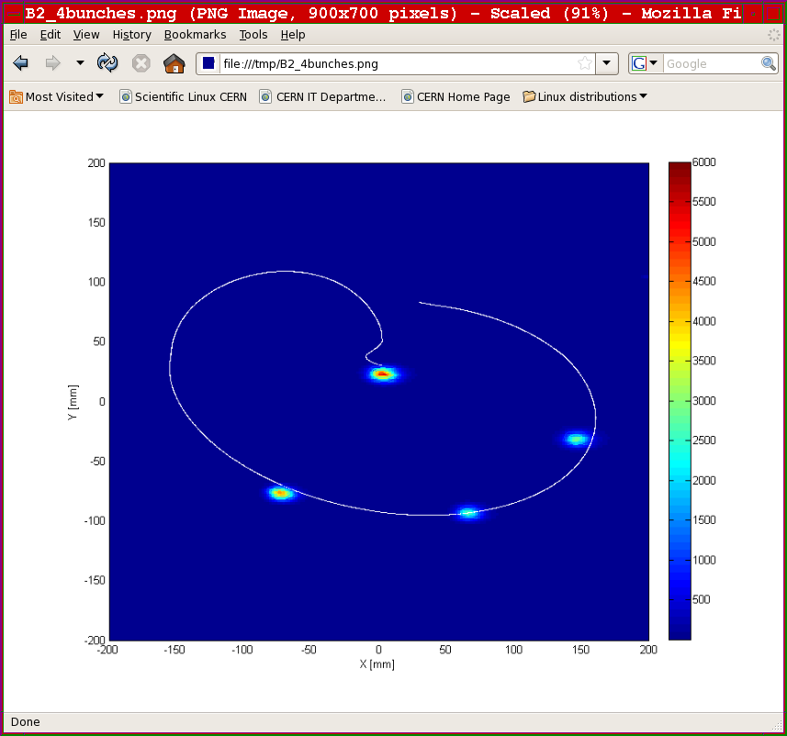

Slide 14
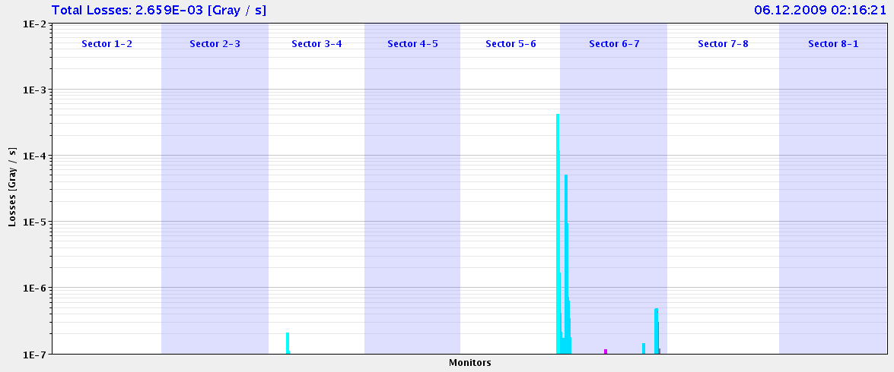
Beam loss Monitors – upcaptured beam dump

Slide 15
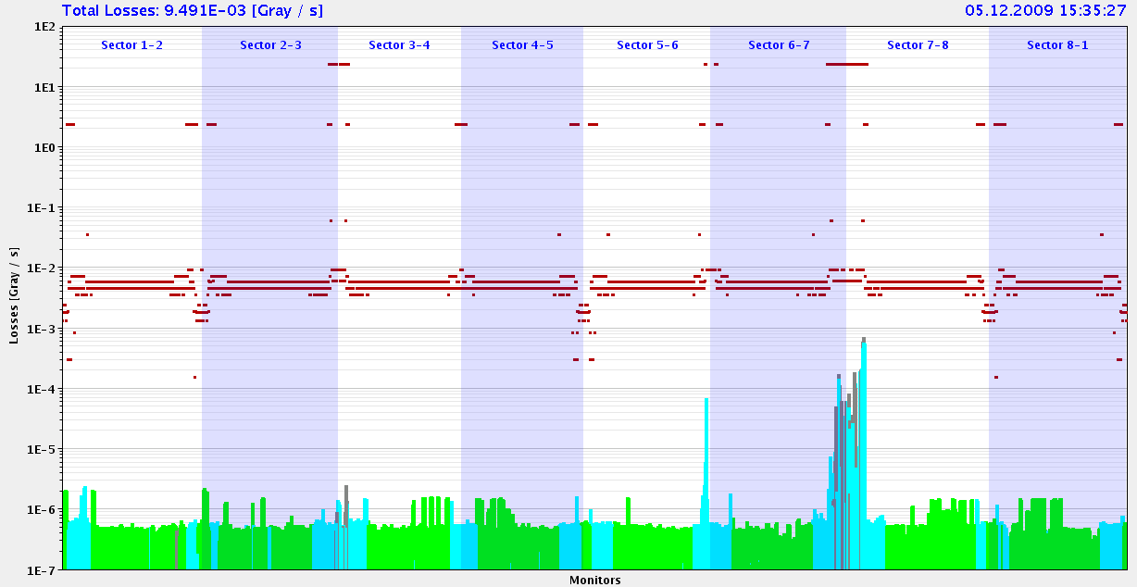
Collimators
Move Qx across 0.33 resonance. Loss pattern for beam 2 attached. Looks OK (losses at collimators).

Slide 17
Monday 7.12.
Cryo down in sector 45: access most of the day; recovery foreseen for 22:00
(problems with access in LHCb – key distribution)
19:15: start ramp down of Alice magnet and ramp of LHCb spectrometer
magnet to positive polarity.
20:37: switch off ALICE Solenoid and switch to negative polarity
21:00: Cryo conditions back
22:00: recovering collimator settings
22:30:RF ready with 5 RF cavities running
23:30: pre-cycle
02:00 Stable beams in the machine after some problems with controls
but bunches in wrong buckets ➔ protection of abort gap

Slide 18
Tuesday 8.12.
Morning used for Investigation of noise on damper system and RF vertex adjustments
Stable beam run for LHCb with spectrometer off
run terminated after 10 min due to trip of RQs in S12 (nQPS thresholds too low)
Afternoon work on injection kickers, interlock BPMs, tune FB (➔ Beam2 FB ready)
Evening first ramp with 2x2 and tune FB active in Beam2 both beams made it with good lifetime, but beam1 was lost rapidly (reason not understood).
SPS : bunches of 2-4 10¹⁰ ready in the ring.

Slide 19
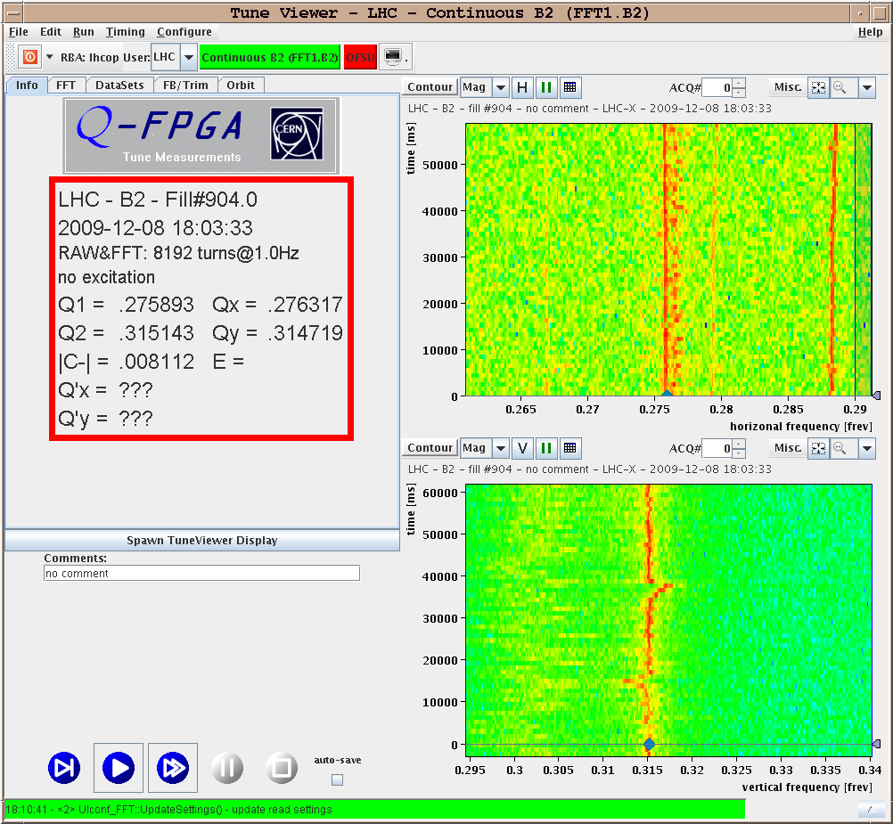
Q Feedbacks & damper
Q FB tested and the used for the ramp.
Noise on damper, leading to lifetime reduction is at least partly due to cable link to Q measurement system (excitation). Solution should be ready soon. But some noise also internal…
>> some time most be devoted to damper studies (noise etc).

Slide 20
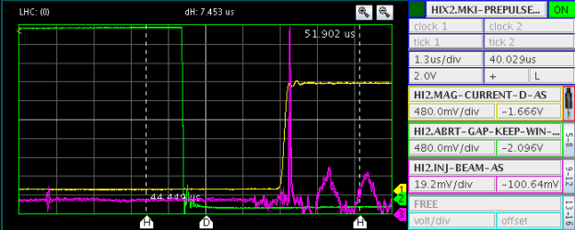
Injection kicker MKI
MKI delays fine tuned on bunch 1 – for multi-bunch injection.
Measured delays for ‘Abort Gap Keeper’ signal that protects from injection into the abort gap – direct links from LBDS to MKIs to ensure consistency of abort gap position for dump & injection.
>> requires access to activate

Slide 21
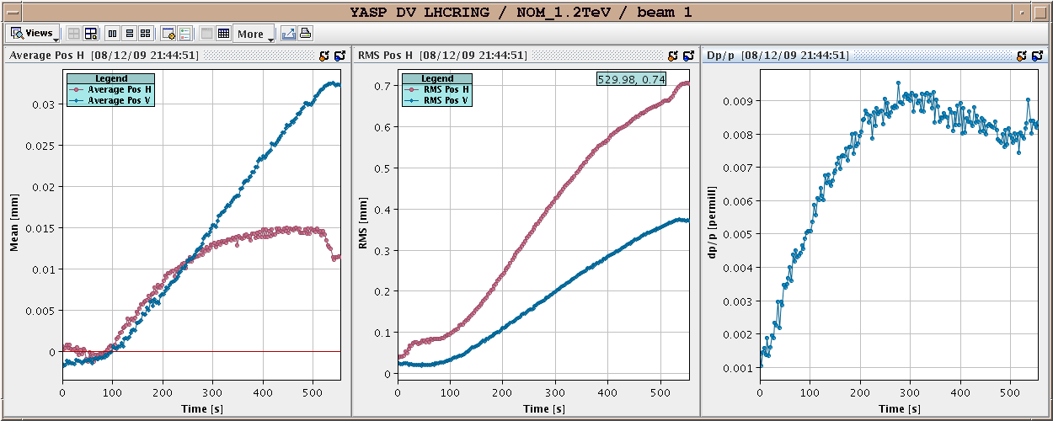
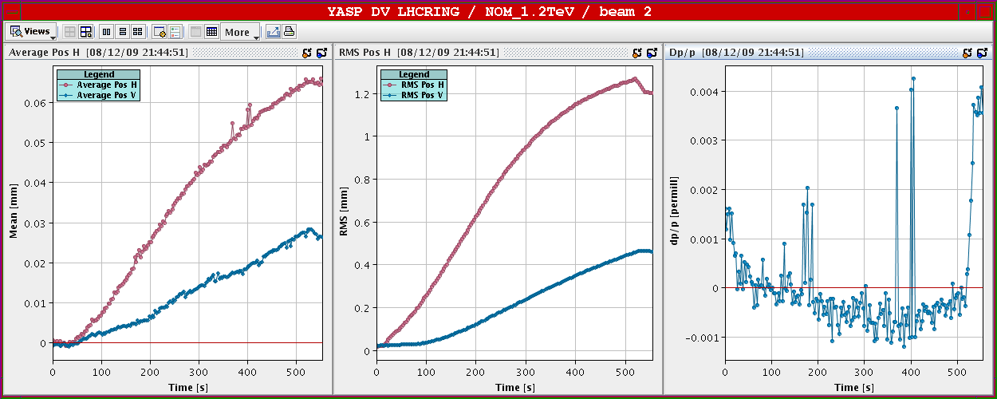
Orbit during ramp…
Different for B1-B2.
So far every ramp on B1 was different >> need orbit FB with more intensity !!!
time wrt start (s)

Slide 22
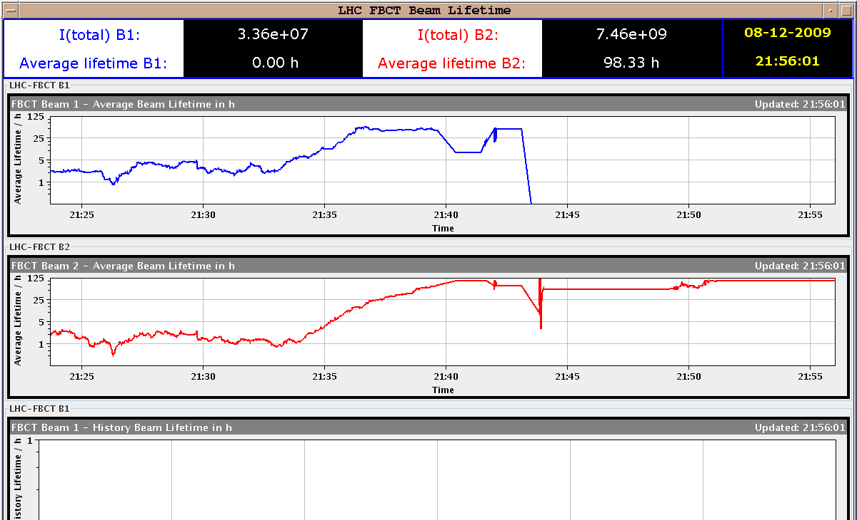
Beam lifetimes during ramp

Slide 23
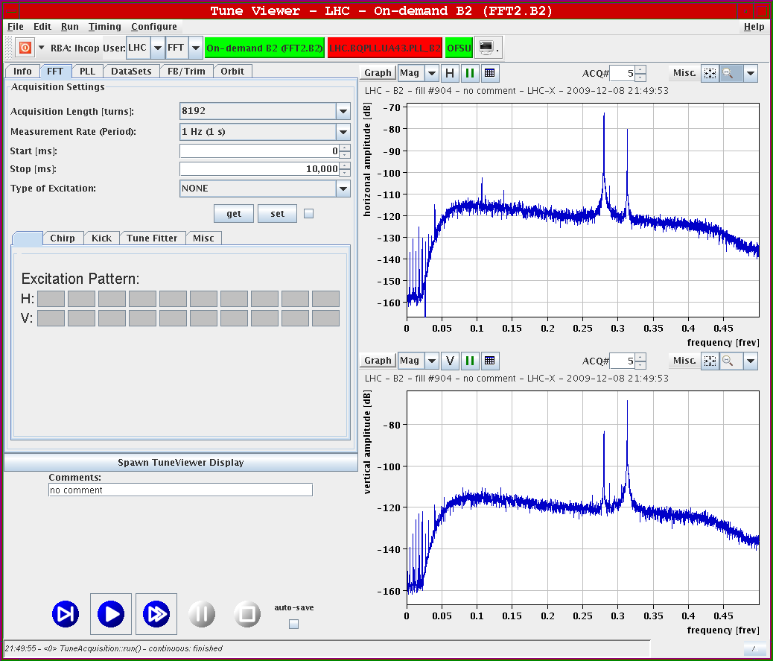
Tune Spectra at 1.17 TeV (Level 3)

Slide 24
Plan for the day and week
Deliver LHCb run without spectrometer ✔done
Test transverse IP steering in IR5 ✔done
but lost beam at end of LHCb run due to sudden bad lifetime in BEAM2
Since noon: planned to be over by 15:00
access for LBDS (BPM polarity and abort gap interlock): 2, 6, 8
access collimators: IR3 (PRS module in electronics rack)
access in IR4 (RF damper & BI for synchrotron light undulator)
access for some miscellaneous activities (TOTEM)
Continue safe beam preparation for higher intensities
transfer line collimators; test of asynchronous beam dump; abort gap monitoring
Plan for stable beam operation this night with 4 10⁹ / bunch

Slide 25
Conclusions
Excellent performance:
-stable beam configuration
&
-first collisions at 1.17 TeV
-on good track for stable beam collisions with higher intensities

