Slide 1
LHC Progress Week 6
Coordination: G. Arduini, E.B. Holzer
Pb-p run till Sunday 6 am
Followed by p-p set-up

Slide 2
Ending the pPb Run with Records
Sun 10/2 6:04 OP dump of the last Pb-p fill – lumi requests from experiments surpassed
ATLAS records
ALICE: 31.14 nb⁻¹
ATLAS: 30.25 nb⁻¹
CMS: 30.79 nb⁻¹
LHCb: 2.08 nb⁻¹

Slide 3
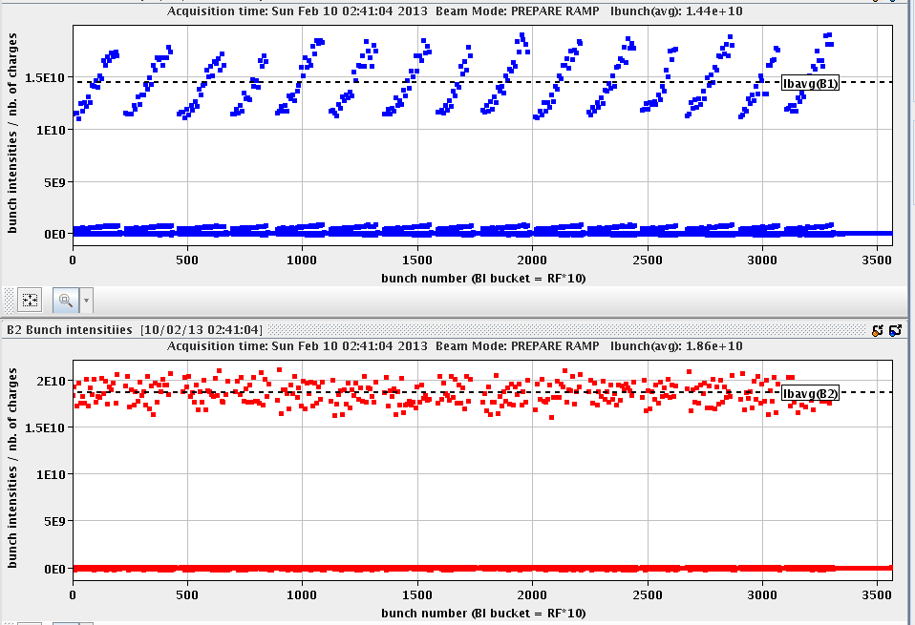
Saturday - Day of Records
Very good beam from injectors – B1H emittance ~20% smaller
Very short turnaround
B1H
B1V

Slide 4
Luminosity production p-Pb and Pb-p
Collisions for ALICE only
From p-Pb to Pb-p
ALICE polarity change

Slide 5
Stable Beams Statistics – week 6
Fill | Day | Peak L [10²⁸ cm-2s-1] | Stable beam [h] | Int L [nb-1] | Dump | # bunches [Pb/p]
3523 | Mon 4/2 | 7.2 | 4:22 | 0.74 | BPMS IP6 | 192 / 216
3524 | Mon 4/2 | 7.4 | 3:14 | 0.43 | BPMS IP6 | 192 / 216
3525 | Mon 4/2 | 10 | 2:09 | 0.64 | Trip of RQTL9.R3B2 | 338 / 338
3527 | Tue 5/2 | 10 | 4:22 | 1.04 | BPMS IP6 | 338 / 338
3529 | Tue 5/2 | 10 | 2:08 | 0.64 | S12 trip, likely SEU | 338 / 338
3533 | Wed 6/2 | 10.7 | 3:57 | 1.09 | BPMS IP6 | 338 / 338
3534 | Wed 6/2 | 11.5 | 5:03 | 1.28 | BPMS IP6 | 338 / 338
3535 | Thu 7/2 | 10.2 | 5:07 | 1.33 | SIS orbit correctors (EoF test) | 338/338
3537 | Thu 7/2 | 10 | 5:16 | 0.8 (VdM) | BPMS IP6 | 314/272
3538 | Fri 8/2 | 9.6 | 10:00 | 1.98 (ALICE only) | BPMS IP6 | 338/338
3540 | Fri 8/2 | 8.5 | 1:57 | 0.5 (VdM) | QPS RQX.L8 | 314/272
3541 | Sat 9/2 | 11.6 | 5:03 | 1.28 | BPMS IP6 | 338/338
3542 | Sat 9/2 | 11.7 | 3:57 | 1.17 | OP dump | 338/338
3543 | Sat 9/2 | 12.4 | 6:34 | 1.67 | OP dump | 338/338
3544 | Sun 10/2 | 11.5 | 2:35 | 0.86 | OP dump | 338/338
Total in 6 days |  |  | 64 h | 15.5 nb-1 | 42% in stable beams

Slide 6
Fills that did not make it into stable beams
Fill | Day | Dump
3526 | Tue 5/2 | Switching on OFB after cogging | Losses IP7: Noisy BPM IP8 leads to orbit drift
3528 | Tue 5/2 | Switching on OFB after cogging | Problem diagnosed and BPM disabled
3531 | Tue 5/2 | Losses at start of ramp, IP3 collimation | Reduce longitudinal blow-up at injection
3532 | Tue 5/2 |  | Same problem with BPM as above – BPM found re-enabled
3536 | Thu 7/2 | during cogging: SIS position interlock | too large momentum offset excursion for B2 (p) ➔ > 10 BPMs out of tolerance

Slide 7
Downtimes
Wed 6/2 ~6 hours downtime: lost the cryo compressor of sector 23
Wrong impurity reading which was not caught in time → an alarm is scheduled for implementation in LS1
Very speedy recovery – no loss of CM
Access: FBCT, LHCb, UPS, collimators, TIM, LBDS B2 (checking on retriggering signals)
Fri 8/2 ~7 hours downtime: RQX.L8 trip
RQX.L8 QPS trigger (heaters fired) due to faulty instrumentation related to voltage tap V1 B of current lead 2. Error not related to protection crate working and reacting correctly. DFBX instrumentation to be checked ➔ Access
A pin on the current lead cable was found faulty (weak connection)
In the shadow replacement of CPU (second time) on RF crate used for synchronization

Slide 8
Varia
Tue 5/2 LHCb polarity switched to positive
Thu 6/2: End of fill test: bump scan at the BSRT position for BSRT calibration. Scan from +1.5 to -1.5 mm. The last trim was just at the edge for the SIS interlock on the COD settings. Beam dump (it was nevertheless very close to its natural length.)
Thu 6/2: Scraping test at injection to determine the systematic errors on energy calibration due to orbit reading dependence on intensity/bunch length.
Thu 6/2: VdM scan in ALICE and CMS
Fri 7/2: 10 hour fill for ALICE only head-on
To bring ALICE integrated luminosity up to the same as ATLAS and CMS
The other experiments at 1% of their peak luminosity
Fri 7/2: VdM scan ATLAS (beams dumped during LHCb scan)
Sat 9/2: VdM scan LHCb
Sat 9/2: Test for 50Hz noise / instability studies by separating the beams and reducing / switching off the ADT gain

Slide 9
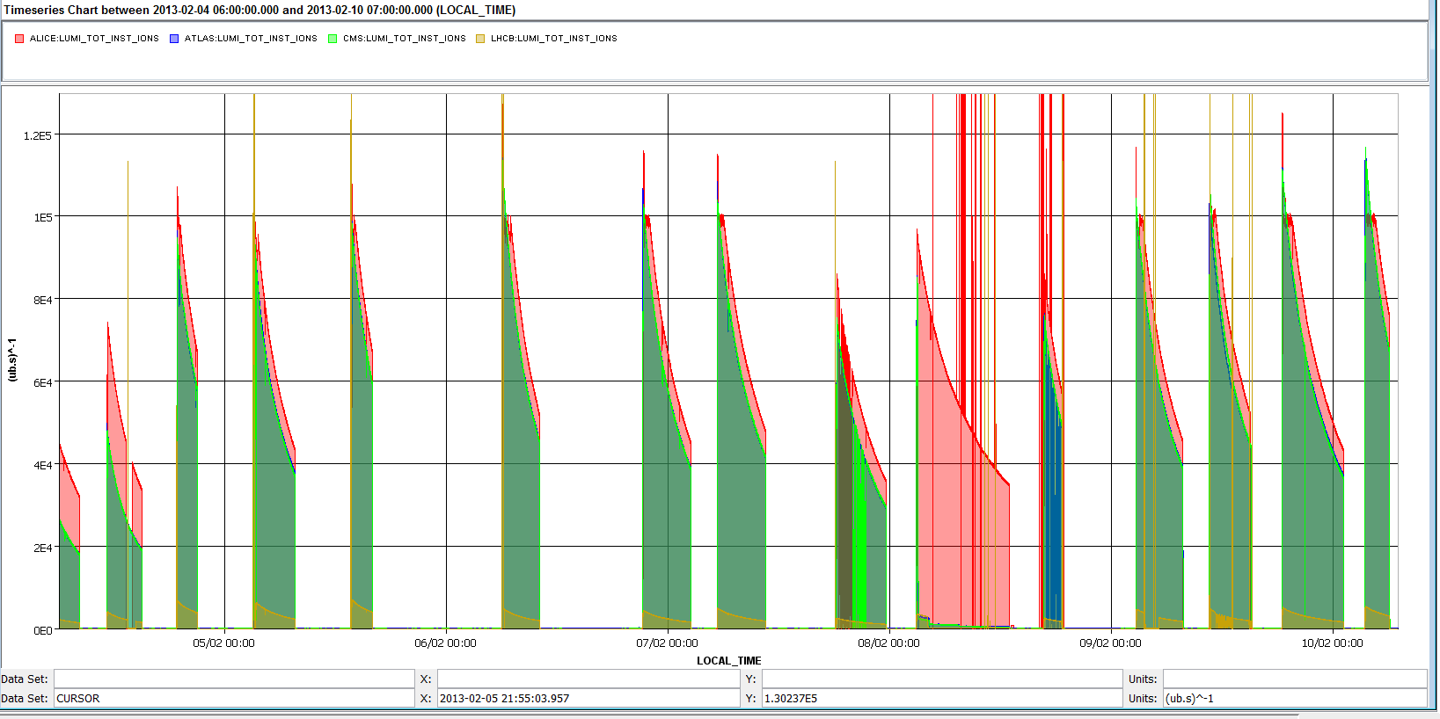
Luminosities over the week

Slide 10
Issues and Measures taken
Losses during squeeze:
Mon 4/2: Increase bandwidth of orbit feedback – corresponding to a factor 2 reduction in orbit perturbation
Tue 5/2: Increase BLM monitor factor
Investigated Tue, looked very promising, but not implemented: B1 horizontal orbit bump in IP7, around RQ11.R7B1
Losses at the start of the ramp B1, IP3 ion collimation leakage:
Tue 5/2: Reduction of longitudinal blow-up at injection
Wed 6/2: BLM monitor factor increase
Re-matched the LHC energy at injection to the SPS
Frequent latches of the injection quality check due to position at BPMI.87204 – line steering not sucessful
Tue 5/2: IQC BPM tolerances updated. Injection oscillations and losses OK ➔ no more systematic latches

Slide 11
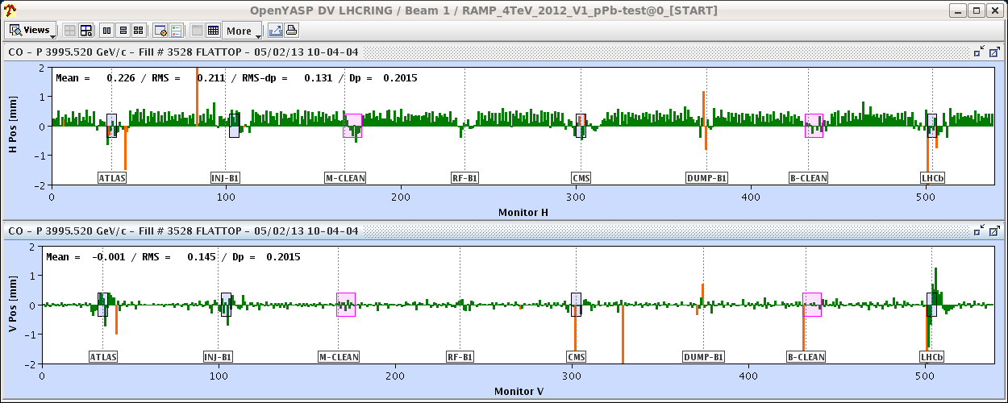
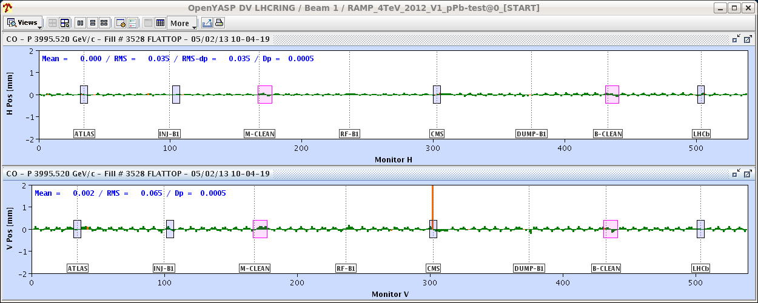
Issues and Measures taken
Losses after cogging when switching of the orbit feed-back:
Structure in point 8 resulting from fluctuating BPM reading: BPMS.2L8.B1 V reading between 0 and 2 mm
Some non closure in the attempt of the OFB to correct it resulting in higher losses at the collimators and beam dump due BLMQI.11R7B1E10_MQ (0.65 ms running sum)
→ disable BPMS.2L8.B1 (V), OFB bandwidth not changed

Slide 12
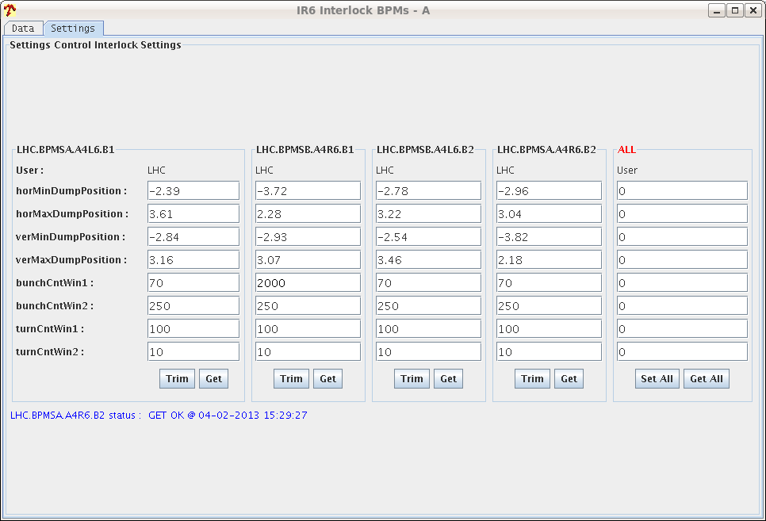
Issues and Measures taken
Dump by interlock BPMSB.A4R6.B1:
Mon 4/2: Interlock limit relaxed: out-of-limit counts in 100 turn window increased from 70 to 2000
After this change this BPMS did not trigger anymore, but the next one: dump at around 3 – 3.5 E9 charges/bunch

Slide 13
Issues and Measures taken
Thu 6/2 14:59 Beam dump during cogging: too large momentum offset excursion for B2 (p) during the process ➔ > 10 BPMs out of tolerance
From the week-end the common frequency after cogging was trimmed by -10 Hz to keep the Pb beam closer to the central orbit (minimize losses during squeeze). This lead to larger energy offset for protons and a proton orbit which is further displaced outwards.
On Wednesday we already reduced the common frequency offset from -10 Hz to -6 Hz
→ Increased the limit for the orbit position SW_interlock by 0.2mm
→ added another 4+2 Hz to the cogging frequency trims to move the p beam closer to the center
→ Thu: tuning of the cogging procedure to avoid large offsets
Wed
Fill 3534

Slide 14
BLM Threshold changes of previous week
Saturday 2/2: BLM MF from 0.1 to 0.2 for the monitors:
BLMEI.09R7.B1E23_MBA
BLMEI.09R7.B1E30_MBA
BLMEI.09R7.B1E21_MBB
Sunday 3/2: increasing BLM MF from 0.1 -> 0.3 for:
BLMEI.09R7.B1E23_MBA
BLMEI.09R7.B1E30_MBA
BLMEI.09R7.B1E21_MBB
BLM2I.11R7.B1E23_MBB
BLM2I.11R7.B1E24_MBB

Slide 15
BLM threshold changes
In addition to the BLM monitor factor changes of last week:
For ion losses downstream of the collimation regions in IP7 and IP3
Tuesday 5/2
For betatron cleaning losses during squeeze: BLM Monitor factor (MF) change as agreed by rMPP meeting this morning: - BLMQI.11R7.B1E10_MQ from 0.3 -> 0.45 - BLMQI.09R7.B1E10_MQ from 0.3 -> 0.45 - BLMEI.09R7.B1E21_MBA from 0.1 -> 0.3 - BLMEI.09R7.B1E22_MBA from 0.1 -> 0.3 - BLMEI.09R7.B1E22_MBB from 0.1 -> 0.3 - BLMEI.09R7.B1E23_MBB from 0.1 -> 0.3 - BLMEI.09R7.B1E24_MBB from 0.1 -> 0.3
Wednesday 6/2
Monitor factor of BLMQI.08R3.B1I10_MQ from 0.1 to 0.3 for IP3 losses at the start of the ramp

Slide 16
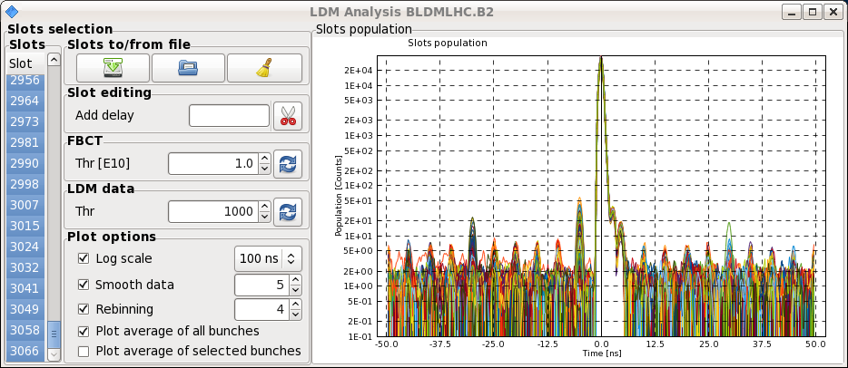
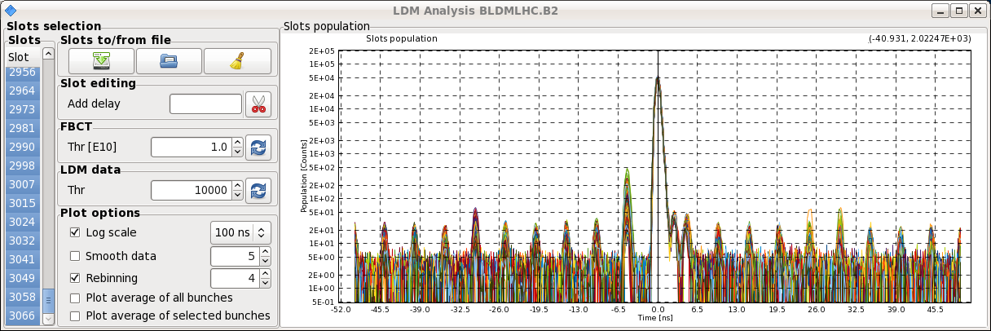
Satellites during VdM scans
Satellite population reduced as compared to previous VdM scan (thanks T. Bohl!)
Fill 3540
Fill 3537

Slide 17
Intermediate Energy p-p Run

Slide 18
2013 1.38 TeV run configuration
J. Wenninger
50 ns beam, full machine, not pushed.
Un-squeezed optics (β* = 10/11 m).
Crossing angles ±170 μrad (also IR8).
Separation ±1.5 mm.
LHCb in good polarity, ALICE in negative polarity (PC).
Beam size ~120 μm.
Provides ≥ 10 times larger L than in 2011.
Pre-cycle maintained at 4 TeV (also ramp down from 4 TeV).
With 10x larger luminosity than 2011 we need ~24 hours of stable beams for 2 pb⁻¹
No change wrt injection
Run | Nb | Ib | Nc | β* | ε (μm) | L (cm-2s-1) | Stored E (kJ) | Pile-up
2011 | 80 | 1.20E+11 | 68 | 11 | 2.7 | 4.34E+30 | 2122 | 0.45
2012 | 1374 | 1.20E+11 | 1000 | 11 | 2.2 | 7.75E+31 | 36451 | 0.54

Slide 19
Sunday: Preparation for p-p run
7:00 - 9:30 access: BPMS IP6, BI in IP4, ADT, ATLAS, CMS
Interlock settings of BLM (thresholds), BPMS and RF reverted to high intensity pp settings
ADT and feedback settings reverted to pp (bandwidth, gain, gating)
BBQ, Head-tail monitor settings reverted
Reverted ALICE polarity to negative
BPMS interlock windows put back to 70 wrong readings within 100 turns.
10:00 – 16:00 2 cycles with probes to check the cycle, measure and correct tune, chromaticity and orbit, verify instruments and damper settings.
Spool functions implemented to compensate the decay at flat-top
Updated SIS limits for beta* and energy
Updated the SIS COD and BPM interlock for STABLE beams
BLM monitor factors increased on 13 monitors for roman pot set-up

Slide 20
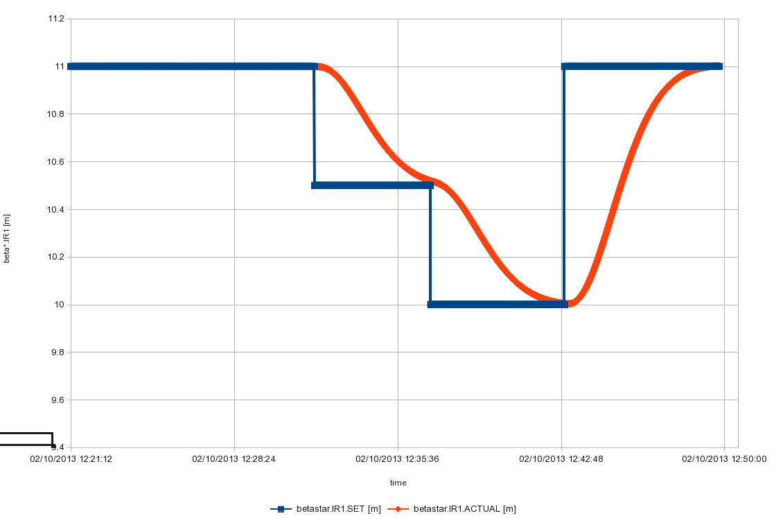
Quick test of real-time squeeze starting from 11.0 to 10.5 to 10.0 and back to 11.0 m (ML and RS)
Aim was to probe the feasibility of real time beta* leveling post-LS1. It was a naked squeeze in IR1 only with no prior orbit, tune, or chromaticity corrections included. 2nd order feedback effects on tune and orbit clearly observed. Beam lifetime OK throughout test.

Slide 21
p-p run preparation cont.
17:00 – 19:00 testing interlocks by BPMS with orbit bumps
Abort gap monitor: calibrated p-p at 1.38 TeV and 450 GeV
BRAN IP2 back in
19:30 – 20:40: loss maps at injection
20:40 – 4:30: cycle with 5 bunches:
Collision set-up
Collimator set-up (TCTs and TCLs)
Vertical roman pot alignment and data taking (3 hours)
Betatron loss maps in collisions and asynchronous dump test (RP moved to 22 sigma)
Loss maps and asynchronous dump test at injection

Slide 22
Validation
 | Injection (Inj. Prot. IN) | Injection (Inj. Prot. OUT) | Flat-top separated | Un-Squeezed Collision (with RP IN?)
Betatronic-H | Validated OK | Validated OK | tbd | To be validated
Betatronic-V | Validated OK | Validated OK | tbd | To be validated
Neg. off-mom | Validated OK | -- | -- | tbd (+500 Hz)
Pos. off-mom | Validated OK | -- | -- | --
Asynch dump | redo | -- | -- | To be validated
tbd=to be done
LBDS B1 train: tbd
BPMS position interlocks IP6: validated by J. Uythoven

Slide 23
1.38 TeV p-p run
BSRT (B2) and beam dump checks with high intensity and LBDS check (B1) in parallel (5 hours)
1 cycle to complete off-momentum/betatron loss maps (4 hours) at 1.38 TeV
Intensity ramp-up
1 fill with ~80 bunches (including some individual bunches for VdM scans)
Multi_100b_46_16_22_36bpi9inj
1 fill with ~500 bunches
50ns_480b_471_0_461_72bpi12inj
1374 bunches
50ns_1374b_1278_36_1218_144bpi12inj

Slide 24
Quench test
Thursday 6 am till Saturday 6 am
Accesses for quench test:
Scope installation in IP6 (12L6). 2 hours. It has priority over Q6L8 scope installation because we will need it on Monday morning (the first quench test). To be confirmed whether it can be done before high intensity tests/pp physics at intermediate energy
Fast measurement system on RQ6.L8 (30 min in the UA83 by Jaromir Ludwig). Ramp to 300 A afterwards.
LBDS check (E. Carlier – working hours) if in the shadow of another access

Slide 26
Current Setting Limits
ADT:
settings for 1.5E11 (will saturate at 1.7E11 and injection interlocked at 1.8E11)
Gain modulation function for prepare ramp set to 2012 values
RF:
Phase loop for nominal proton intensity. Acquisition will saturate above 1.7E11. Pilots below 1E10 are unlikely to be measured.

