Slide 1
Wednesday 6.2.2013
10:06 Dump fill 3533: interlock BPMS in IP6
Changed BLM threshold: monitor factor of BLMQI.08R3.B1I10_MQ from 0.1 to 0.3 for ion collimation losses at the start of the ramp
Re-matched the LHC energy at injection to the SPS
12:56 lost the cryo compressor of sector 23
Wrong impurity reading which was not caught in time → an alarm is scheduled for implementation in LS1
Very speedy recovery – no loss of CM
Access: FBCT, LHCb, UPS, collimators, TIM, LBDS B2 (checking on retriggering signals)
circuit RCD.A12B2 has been fixed
17:52 cryo back → start pre-cycle
Problem to close vacuum valves around LHCb, calling piquet:
Switch on the two ion pumps, which are part of the LHCb velo vacuum system and this allowed to open the vacuum valves around IP8. Leave the ion pumps running in order to avoid being blocked again at the next access.

Slide 2
Evening
19:10 injecting again
Losses at the start if the ramp at BLMQI.08R3.B1I10_MQ: 13% of thresholds
Considering threshold increase by factor 3 → no significant change in loss with respect to previous fill
Problem with the re-phasing data communication → solved by restarting "ALLSynchro_R" on cfv-sr4-alldiag1 (A.Pashnin RF)
→ proceed with cogging
Orbit after cogging OK
Max losses during squeeze: 31% of BLM dump level
21:22 stable beams fill 3534
2:25 dump fill by BPMS IP6
5 hours in stable beams – longest time in SB in Pb-p

Slide 3
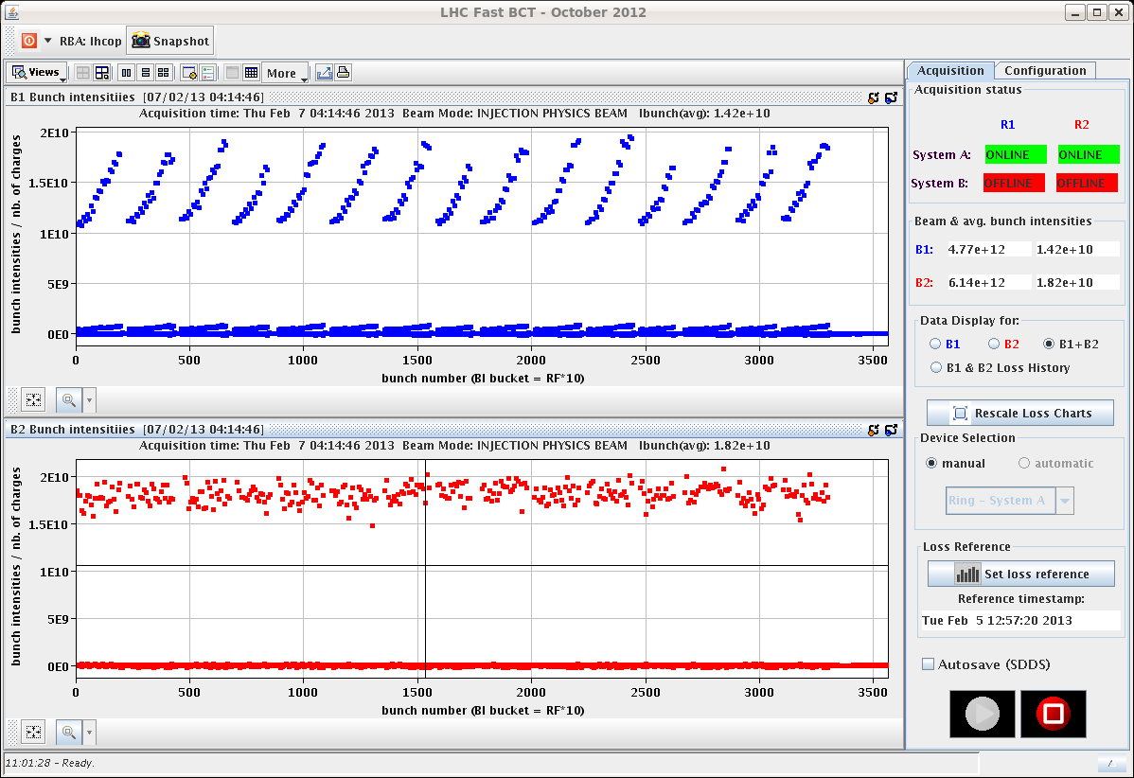
Night
3:19 re-injecting
Beam from the injectors nicely stable this night
Losses at start of ramp: 23%
Losses during squeeze: 21%
5:24 stable beams fill 3535

Slide 4
Stable Beams Statistics
Fill | Day | Peak L [10²⁸ cm-2s-1] | Stable beam [h] | Int L [nb-1] | Dump | # bunches [Pb/p]
3523 | Mon 4/2 | 7.2 | 4:22 | 0.74 | BPMS IP6 | 192 / 216
3524 | Mon 4/2 | 7.4 | 3:14 (+0:33) | 0.43 | BPMS IP6 | 192 / 216
3525 | Mon 4/2 | 10 | 2:09 | 0.64 | Trip of RQTL9.R3B2 | 338 / 338
3527 | Tue 5/2 | 10 | 4:22 | 1.04 | BPMS IP6 | 338 / 338
3529 | Tue 5/2 | 10 | 2:08 | 0.64 | S12 trip | 338 / 338
3533 | Wed 6/2 | 10.7 | 3:57 | 1.09 | BPMS IP6 | 338 / 338
3534 | Wed 6/2 | 11.5 | 5:03 | 1.28 | BPMS IP6 | 338 / 338
3535 | Thu 7/2 | 10

Slide 5
Planning
Thursday VdM scan
Test for energy calibration systematic error – 30 min
1 fill: ALICE, if followed by CMS
filling scheme: 200ns_314Pb_272p_14inj_24bpi
Followed a fill with ALICE only collisions
Friday: VdM scan ATLAS and LHCb
Pb-p till ~ 6am Sunday 10/2
NO ALICE polarity switch
p-p intermediate energy Sunday to ~6am Thursday 14/2
BSRT test with high intensity 50 ns proton beam (up to 1380 bunches with >1.4x10¹¹ p/b) – 4 hours
Quench test Thursday to ~6am Saturday 16/2

Slide 6
1.38 TeV p-p run
Setup ~4 shifts
Access to set-up for the higher intensity → ~ 2 hours
Reverting to high-intensity proton OP → 1 shift ?
1 cycle with probes for checkout, optics measurements.
1 cycle with 3 nominal bunches for collimator setup (TCTs), RP set-up (?), collision setup, first loss maps & asynch. dump test in collision.
→ 1½ - 2 shifts.
2 cycles to complete off-p /betatron loss maps → 1 shift.
Intensity ramp-up
1 fill with ~80 bunches
1 fill with ~500 bunches (including some individual bunches for VdM scans)
1374 bunches

Slide 7
To be scheduled
BSRT test with high intensity 50 ns proton beam (up to 1380 bunches with >1.4x10¹¹ p/b) – 4 hours
For LBDS one dump of B1, train with 50 ns spacing, at 450 GeV
Accesses for quench test:
Scope installation in IP6 (12L6). 2 hours. It has priority over Q6L8 scope installation because we will need it on Monday morning (the first quench test). To be confirmed whether it can be done before high intensity tests/pp physics at intermediate energy
Fast measurement system on RQ6.L8 (30 min in the UA83 by Jaromir Ludwig). Ramp to 300 A afterwards.

