Slide 1
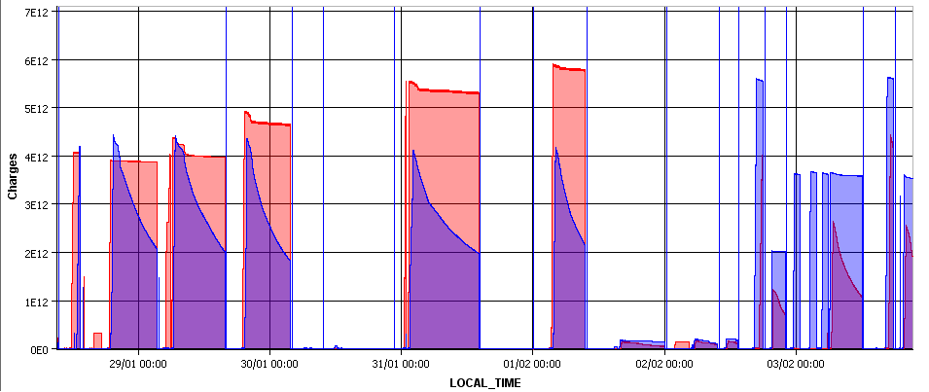
Monday Morning 4-Feb 2013
Bernhard Holzer, Joerg Wenninger
Beam Currents
338
338
192
96
source re-fill / access
cryo problem
change mode to Pb-p

Slide 2
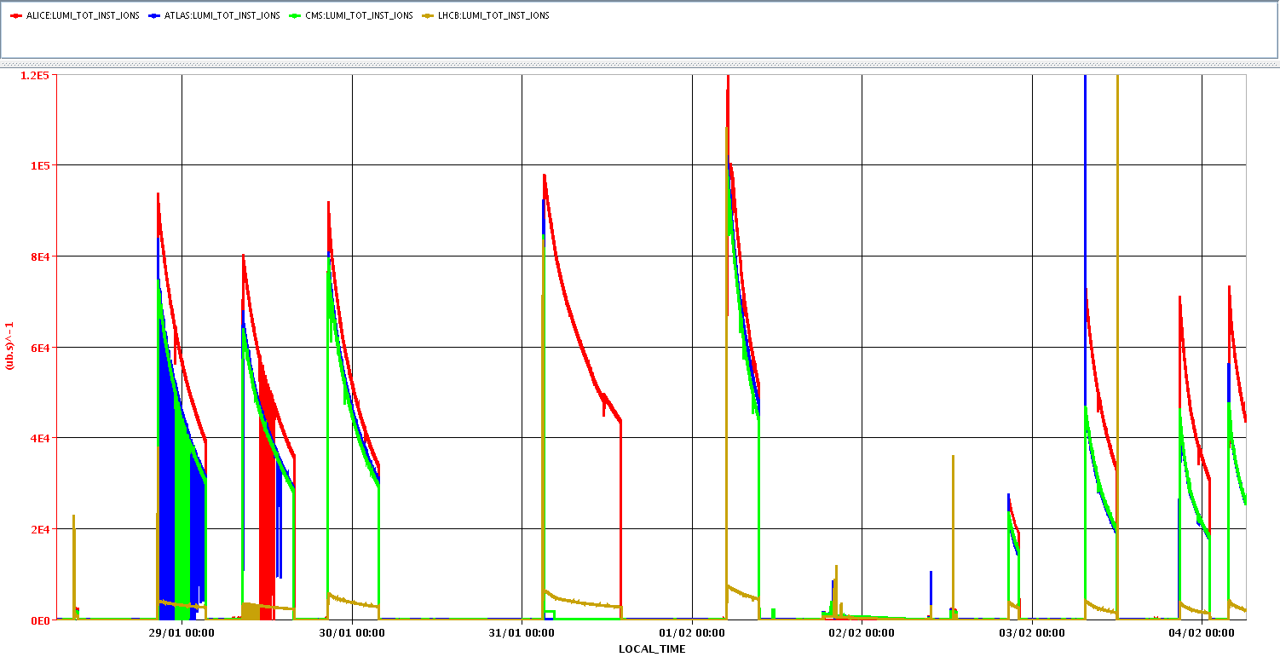
LHC STATUS
The week:
Luminosity
10²⁹
(court. Alick)

Slide 3
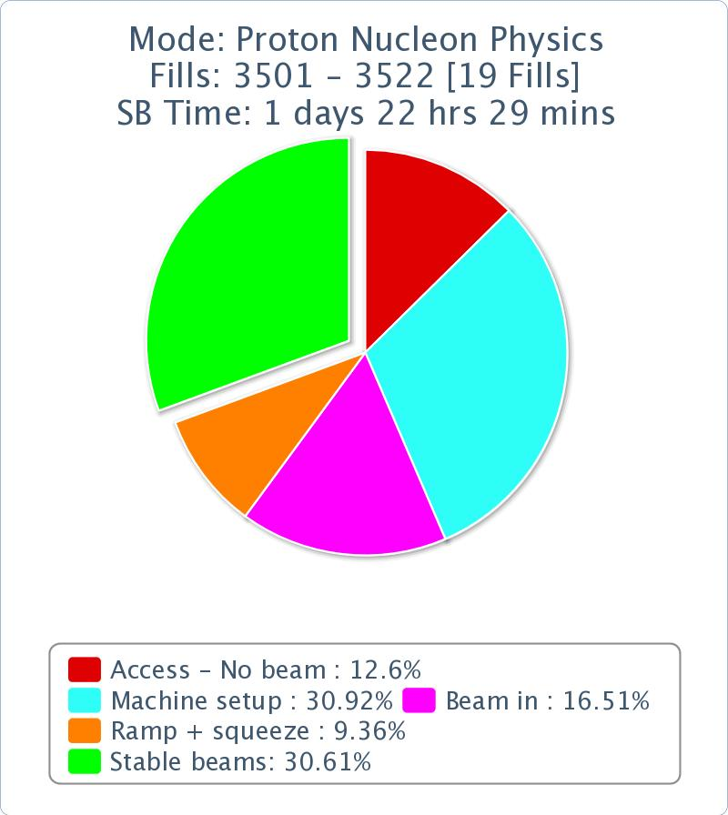
LHC STATUS
The week: stable beams = 30 %
main issue: changing particle species
ALICE | ATLAS | CMS | LHCb
16.4 | 19.6 | 19.8 | 1.5
Fill | Day | Peak L [cm-2s-1] | Stable beam [h] | Int L [nb-1] | Dump
3503 | 28/01/2013 | 9.3E+28 | 06:44 | 1.4 | RF cogging
3505 | 29/01/2013 | 7.9E+28 | 07:07 | 1.1 | BPMS
3506 | 29/01/2013 | 9.1E+28 | 07:08 | 1.35 | BPMS
3509 | 30/01/2013 | 9.8E+28 | 10:59 | 2.4 | programmed dump
3510 | 31/01/2013 | 1.00E+29 | 04:26 | 1.2 | programmed dump
3516 | 02/02/2013 | 2.7E+28 | 01:22 | 1.1 | programmed dump
3520 | 03/02/2013 | 7.2E+28 | 04:25 | 0.76 | BPMS
3522 | 03/02/2013 | 7.0E+28 | 04:14 | 0.67 | on going
Alice spec
96 bunch
192 bunch
192 bunch

Slide 4
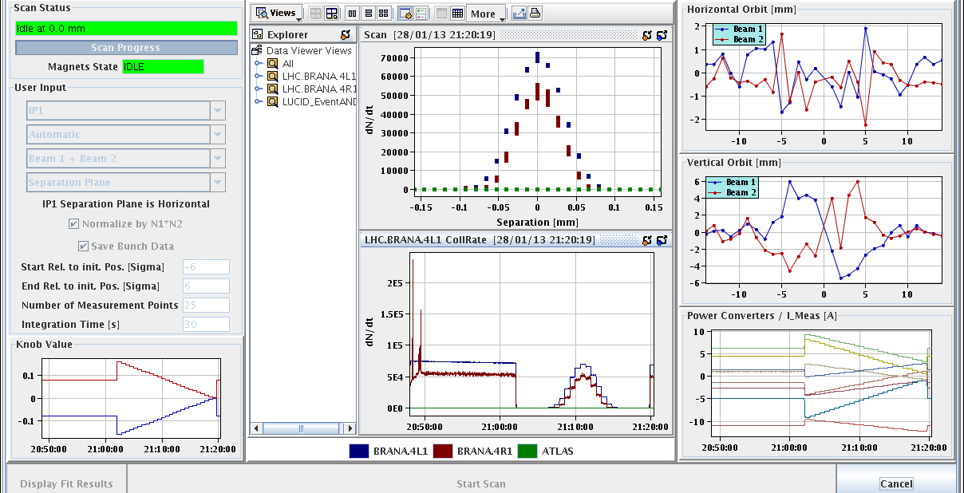
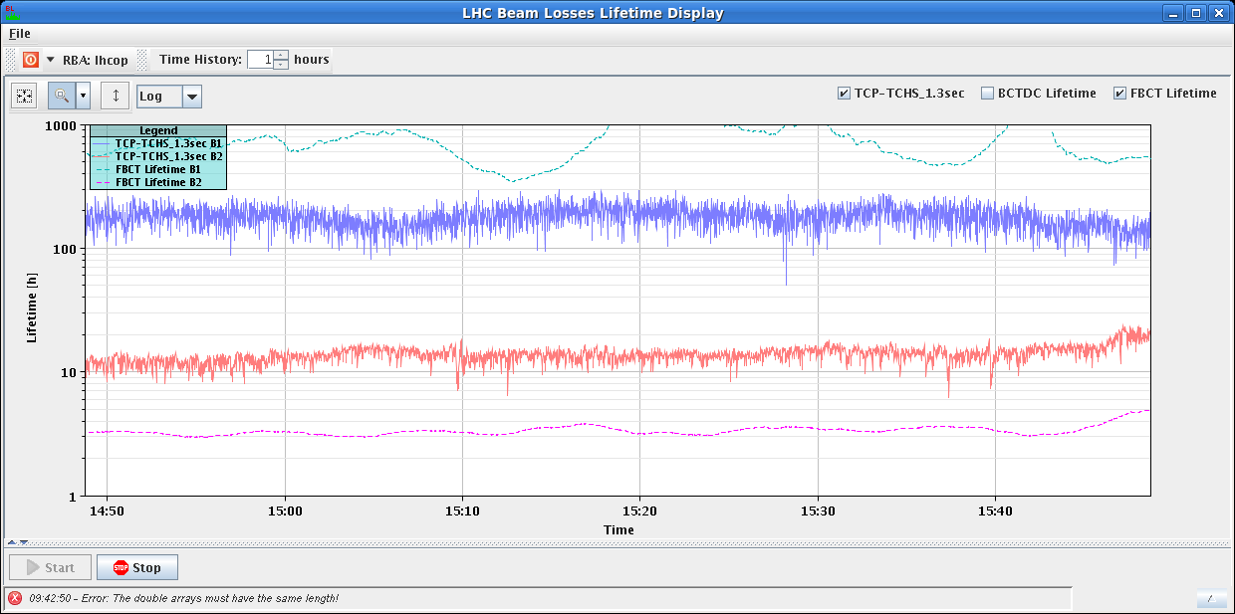
LHC STATUS
The week: Main Issues
Monday Morning
... after ALICE polarity flip: set up & VdM scans
Tuesday
end-of fill check: separate beams in IP1,5
LHcb polarity flip
bunch blow up: set to 1.5 ns
Wednesday
source re-fill
Temperature alarm in UX45 Faraday cage -> access
In the meantime:
Stable beams, and /or
ADT test on B2 in preparation for quench test, and /or,
Access
Water Leak in S34
Problem with beam imminent warning

Slide 5
LHC STATUS
The week: Main Issues
Thursday
special ALICE run, IP1,5 separated
fill 3509, = 2.4 nb⁻¹
Just as we planned to dump cryo problem in S23.
Magnetic bearings of cold compressor.
τ ≈ 8.5h

Slide 6
LHC STATUS
Friday Morning
... LHC in stable beams ... last fill before
going to Pb-p mode
09:30h beam dump (OP)
10:20h Problem at MKI8, access needed to change “switch”
... replace a pump
in parallel” prepare Pb-p settings
Injection schema for Pb/p with 15 bunches created
Flipped the signs for the dp/p offset in the orbit references.
Beta-beat corrections flipped to Pb/p for the squeeze and the collision BP
Setting up of the ADTs for Pb (B1) and p (B2)
Settings for the lifetime display for B1 Pb and B2 p
Setting the correct RF re-phasing for Pb/p
...
15:00h Injection Probe Beam

Slide 7
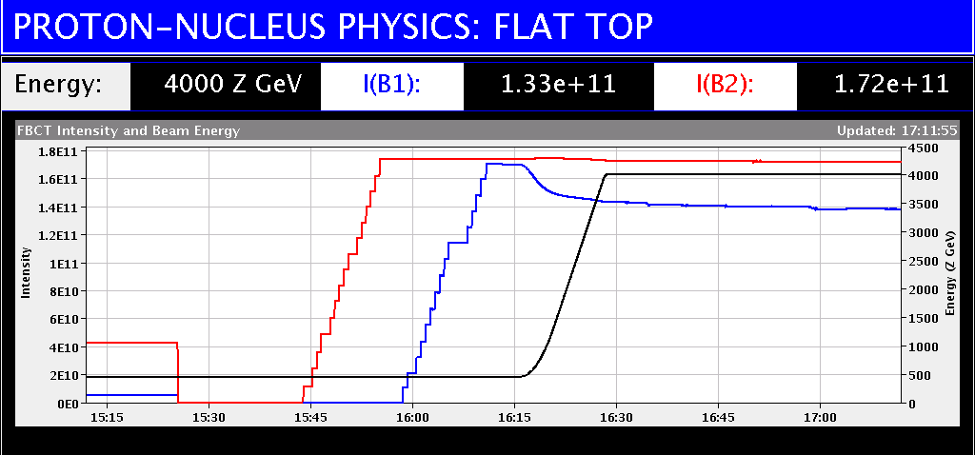
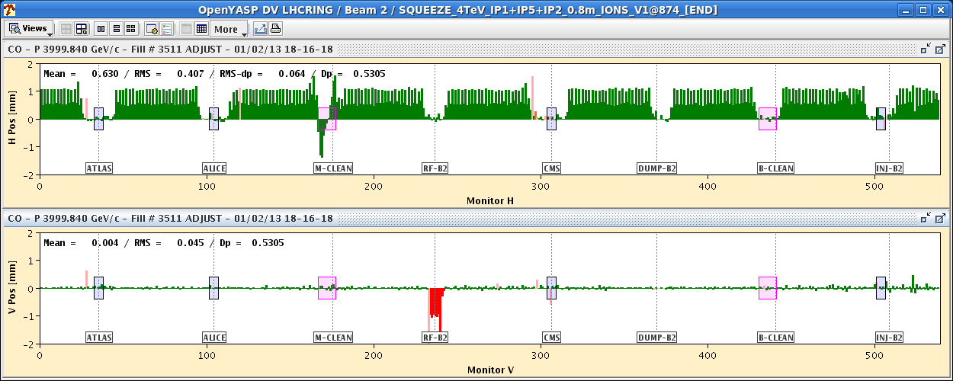
LHC STATUS
Friday Late
18:00h inject 15 bunches / beam,
ramp for collimator alignment & loss maps
16:30h flat top & re-phasing
... some problems with ± Δrf
18:00h squeeze / adjust
18:20h check orbit:
Orbit difference with fill 3509 at same
moment in the cycle (end of squeeze).
The orbit reproducibility is excellent.
vert. rms difference 45 um
largest change in TCTH.4R8.B2 0.2 σ

Slide 8
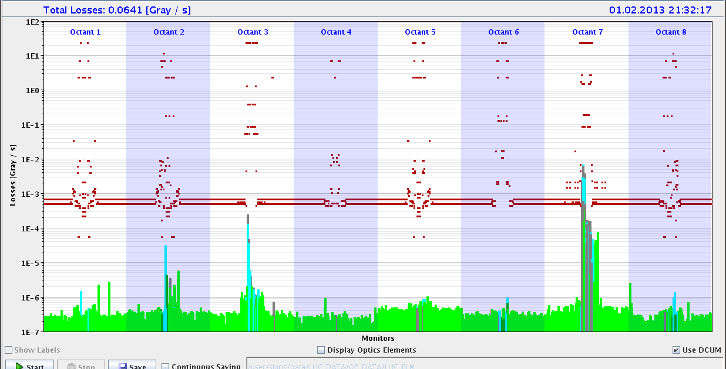
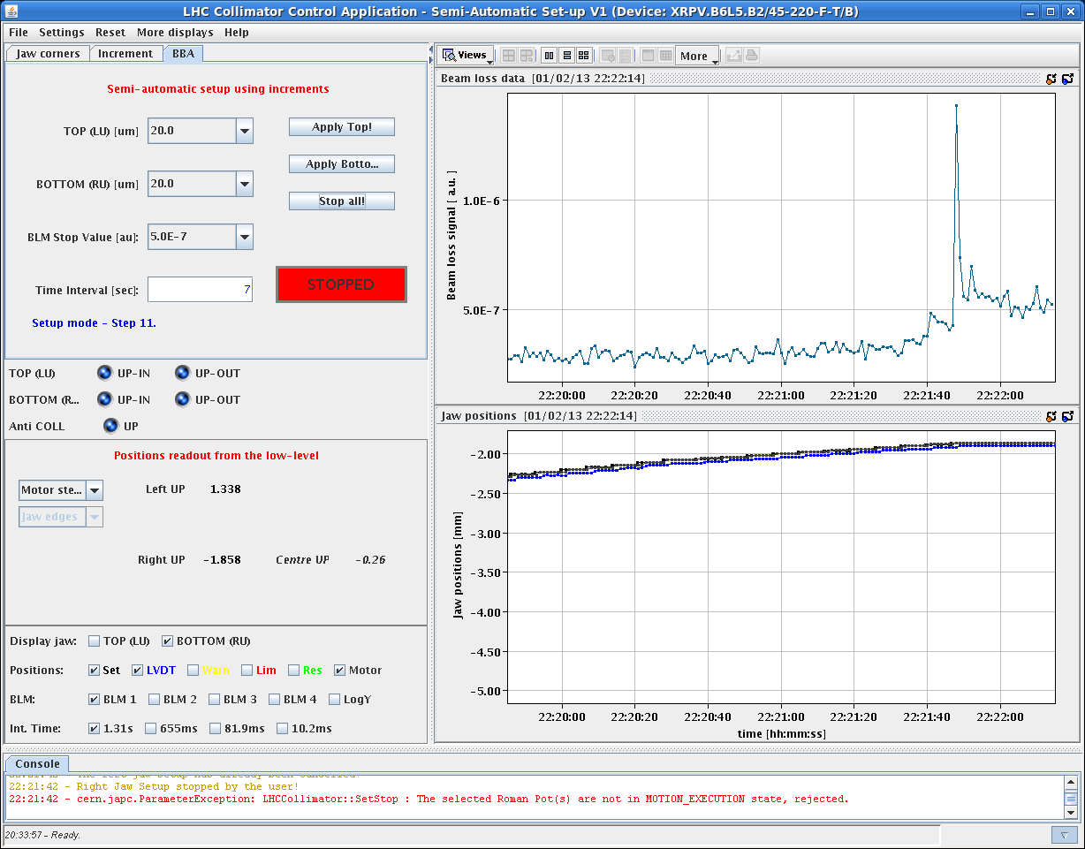
LHC STATUS
Friday Late
18:30h lumi in all IPs
18:50h ... 20:30h start TCT alignment
21:00h loss maps
22:00h alignment roman pots
23:40h off momentum loss maps
24:00h beam dump, cycling

Slide 9
Saturday
Morning used to complete the loss maps and asynch dumps (with RPs).
All loss maps OK (B. Salvachua), but the off-p cleaning for B1 (Lead) was observed to be worse than in the opposite configuration.
Asynch dump OK, but abort gap monitor (BSRA) info missing.
14:30 BSRA switched back on – it had shut down automatically after seeing too much beam (some time ago) – not a nice feature since no alarm…
Cryo worries with temperature in arc S56.

Slide 10
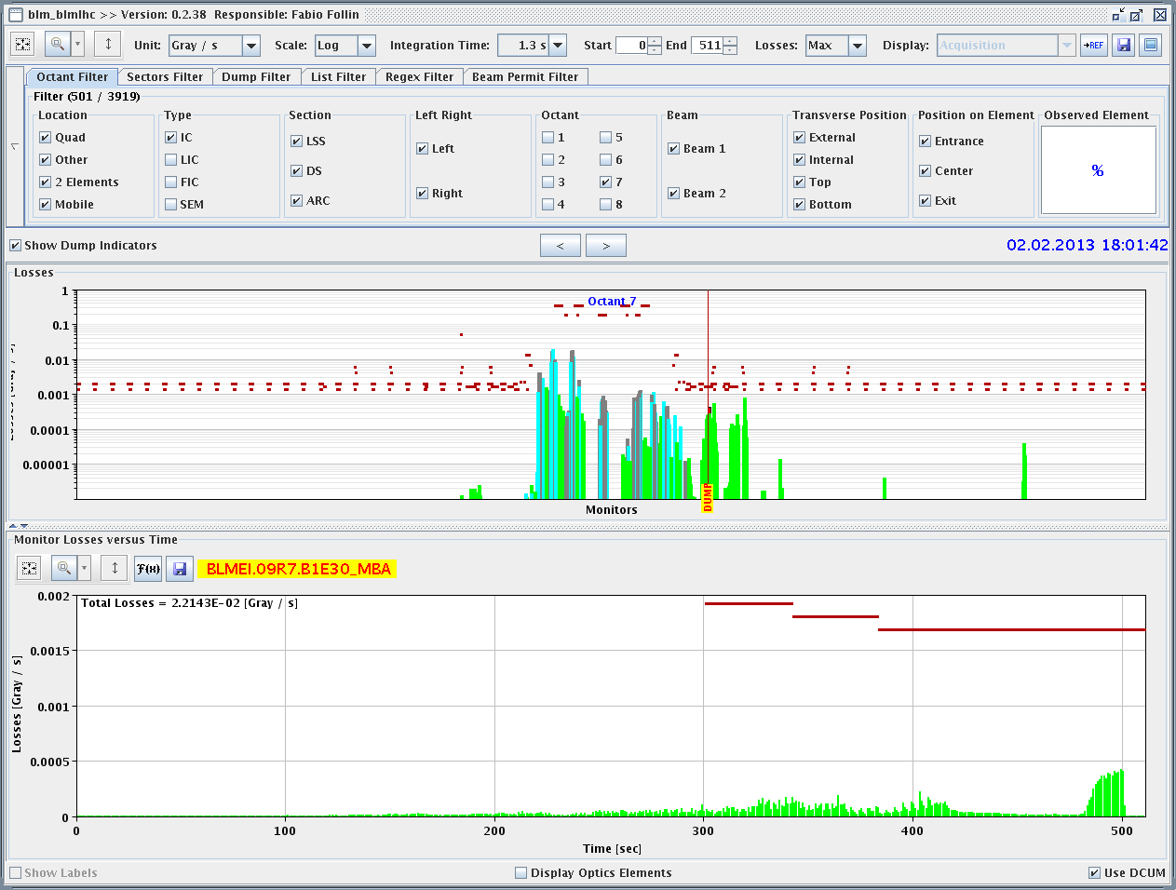
Saturday
16:00 Filling for 338 bunches / beam.
18:00 Beam dumped during the cogging, in the phase where the beams are brought to the common frequency.
Monitor in cell 9, on the 20 s RS. 1.3 s RS has margin.
1.3s RS

Slide 11
Saturday
A check of the losses on the previous low intensity fills shows that this effect was already present in the morning, but not detected due to the low beam intensity.
We therefore decided:
Perform a fill with 96b to be able to get through and then scale losses to 338 b,
Re-center the common frequency down by 6 Hz (pushes ions less inwards).
19:15 Filling.
20:15 Cogging OK, but BLMs up to ~40% → need a some margin for 338p (but not too much).
20:30 Towards end of squeeze (~ 1m) again losses, but also on Q11R7 – BLM threshold already increased by 3 !
Losses on Q11R7 too high for 338 b/

Slide 12
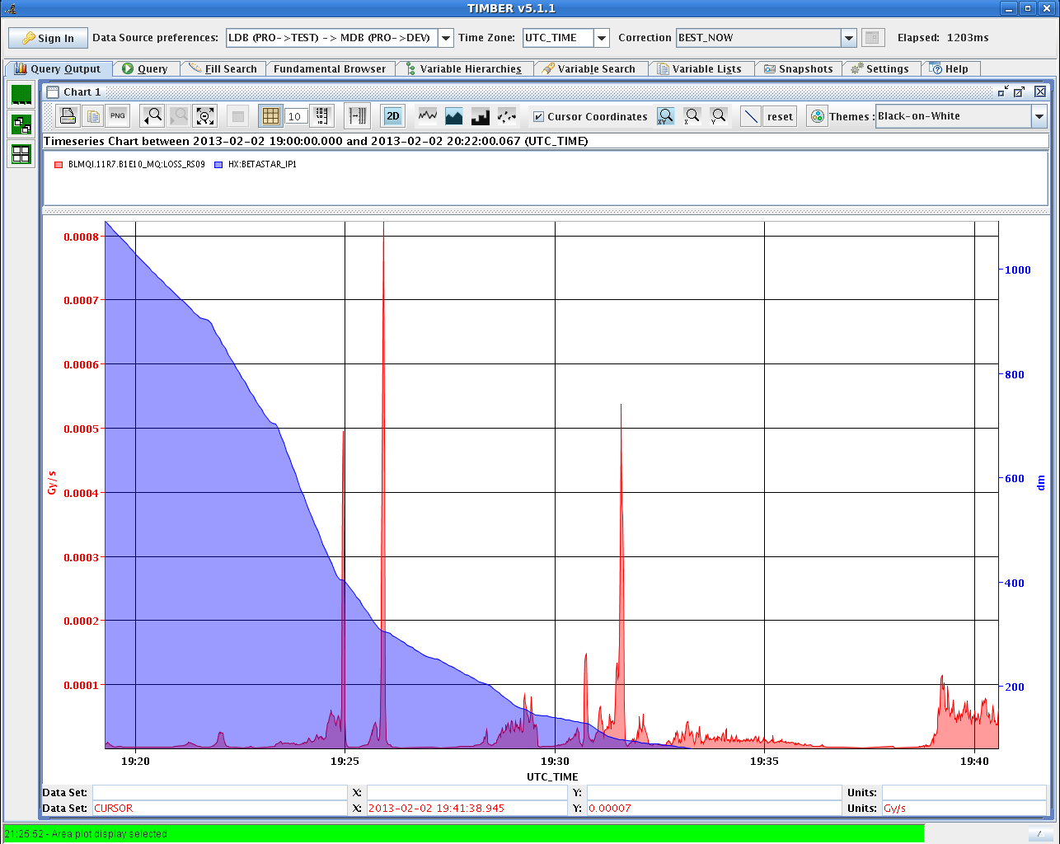
Losses on Q11R7
3m
4m
Beta*
1m

Slide 13
Saturday
20:40 Stable beams fill 3416.
22:00 Dump.
In agreement with Rudiger, increase of BLM MF from 0.1 to 0.2 for the monitors:
BLMEI.09R7.B1E23_MBA
BLMEI.09R7.B1E30_MBA
BLMEI.09R7.B1E21_MBB
New filling scheme with 192 Pb bunches.
200ns_192Pb_216p_9inj24bpi
We shift the common frequency at 4 TeV another 4 Hz to help a bit the Pb beam during cogging.

Slide 14
Sunday Morning
07:00h .. after solving the LEIR problem (electronic card)
fill for physics: 192Pb x 216p bunches & ramp
applying 6Hz freq shift at flat top ... to gain some safety margin
ramp: ok
cogging: warning level of ≈50% dump threshold
07:20h squeeze: β*=4m, 40% dump threshold
β*=0.9m, 60% dump threshold
adjust & lumi optimisation : ok
07:40h stable beams
12:00h beam dump: SIS

Slide 15
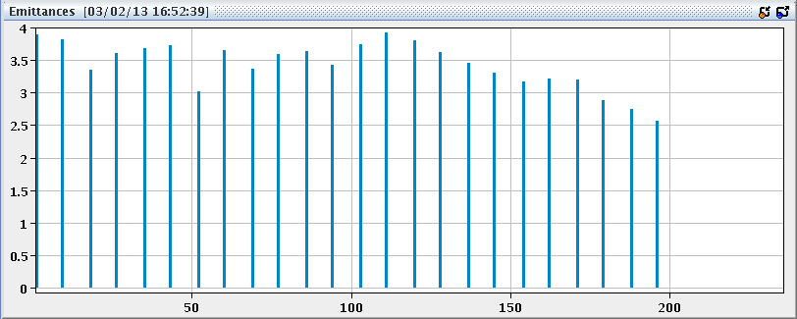
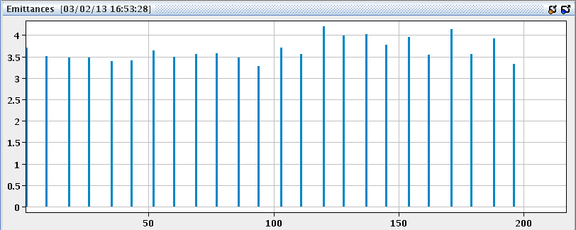
Sunday Afternoon
12:30h pre-cycle ...
again ... no beam from LEIR
preparing for new fill: increasing BLM thresholds (monitor factor)
from 0.1 -> 0.3 for
BLMEI.09R7.B1E23_MBA
BLMEI.09R7.B1E30_MBA
BLMEI.09R7.B1E21_MBB
BLM2I.11R7.B1E23_MBB
BLM2I.11R7.B1E24_MBB
16:30h injection for physics
“once more unto the breach, dear friends”
338 bunches
emittances in b1 (Pb) ε_{n}= 3.5 ... 4

Slide 16
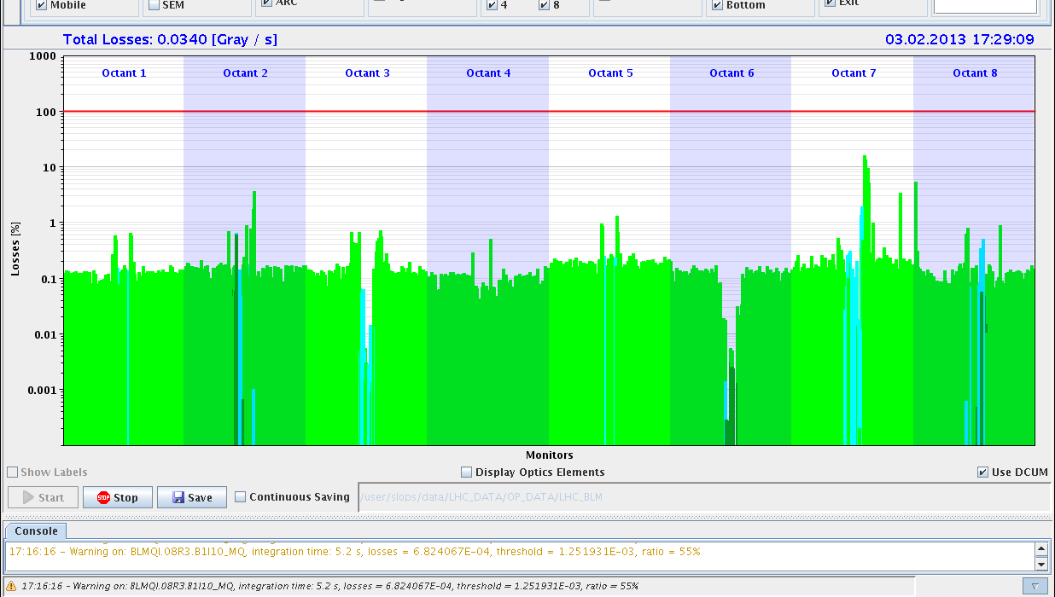
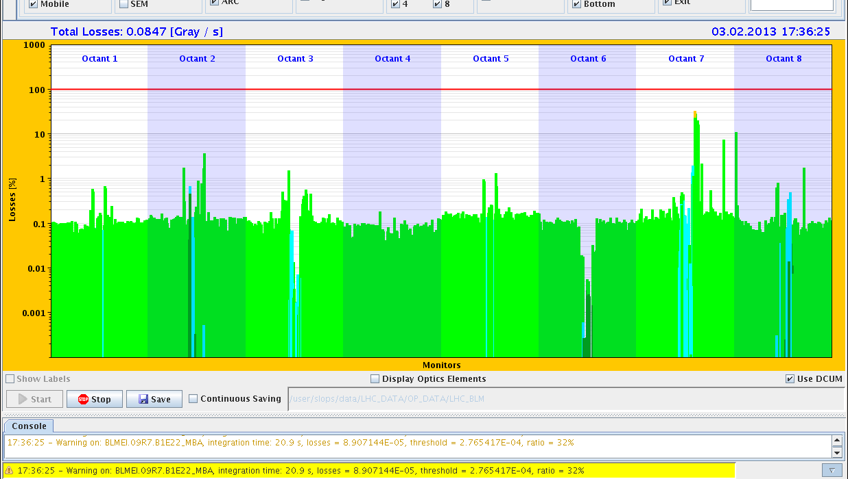
Sunday Afternoon
17:15h ramp, 338 bunches
start of ramp: BLM ≈59% for a short moment
17:30h flat top ... no problem
17:40h re-phasing: warning level

Slide 17
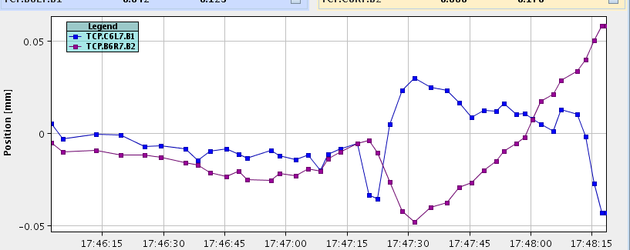
Sunday Afternoon
17:40h BLM losses reach more than 60% around β*=4m
and around β*=3m they reach the dump threshold.
beam dump, BLMs 11.R7
some additional information:
we did: increase the BLM monitor factor
go back to 1.4ns blow up
fill 338 bunches
slow down the cogging procedure (go in 4 steps)
orbits observed before the dump: (Joerg)
hor. orbit at TCP IR7, Δx=40μm

Slide 18
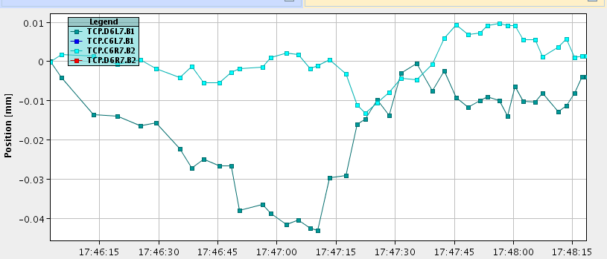
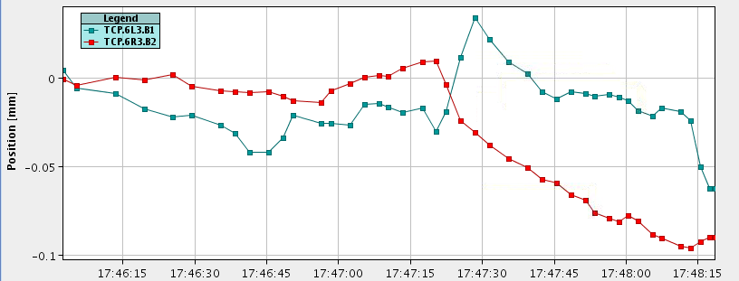
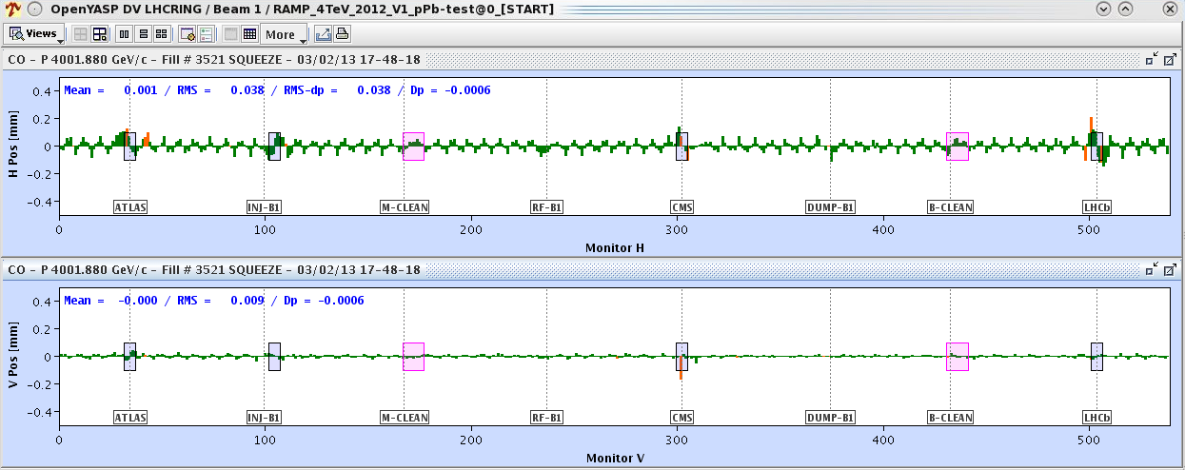
Sunday Afternoon
orbits observed before the dump
vert. orbit at TCP IR7, Δx=10μm
hor. orbit at TCP IR3, Δx=70μm
general orbit:
last orbit (@dump) -10 sec)
b1
b1

Slide 19
Sunday Night
decision: we go back to reduced bunch filling scheme
192Pb x 216p
19:20h injection
20:16h ramp & flat top
20:30h squeeze
loss rates up to 82% (11R7)
21:00h stable beams
01:00h beam dump, BPM6

Slide 20
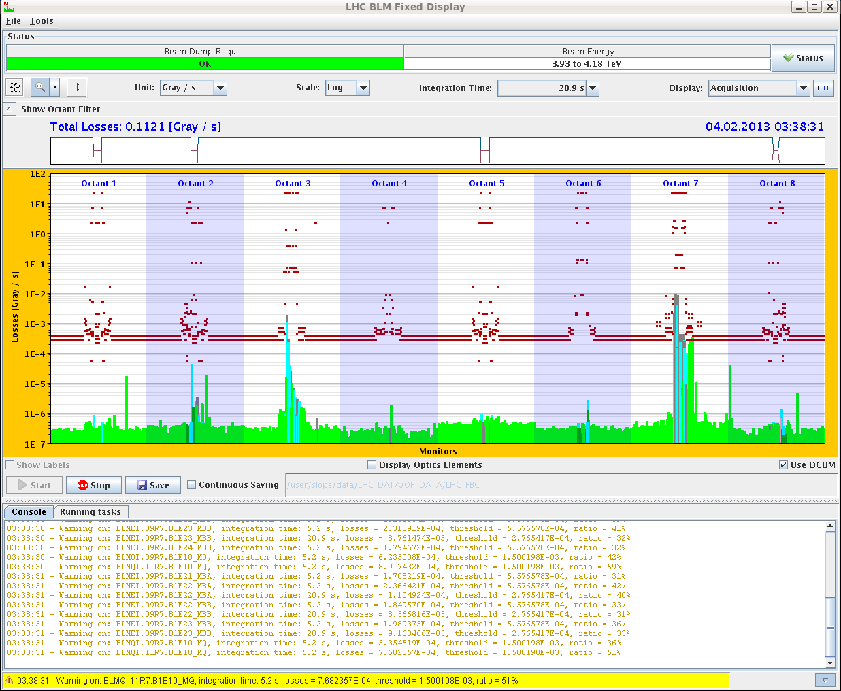
Sunday Night
02:00h new injection
ramp, re-phasing ok
squeeze: up to 52 % dump threshold
03:50h stable beams

