Slide 1
Saturday Morning 2-Feb 2013
Bernhard Holzer, Joerg Wenninger
Friday Morning
... LHC in stable beams ... last fill before
going to Pb-p mode
09:30h beam dump (OP)
10:20h Problem at MKI8, access needed to change “switch”
... replace a pump
in parallel” prepare Pb-p settings
Injection schema for Pb/p with 15 bunches created
Flipped the signs for the dp/p offset in the orbit references.
Beta-beat corrections flipped to Pb/p for the squeeze and the collision BP
Setting up of the ADTs for Pb (B1) and p (B2)
Settings for the lifetime display for B1 Pb and B2 p
Setting the correct RF re-phasing for Pb/p
...
15:00h Injection Probe Beam

Slide 2
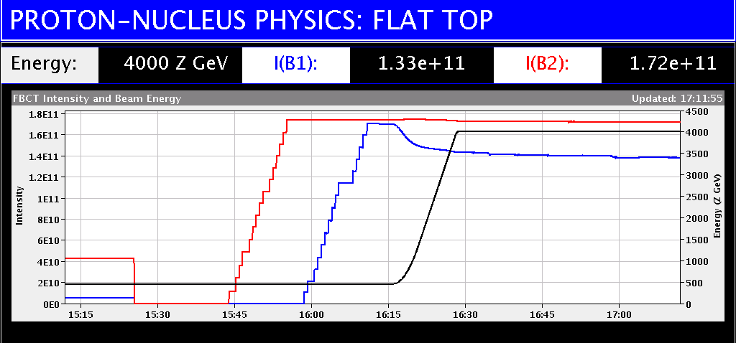
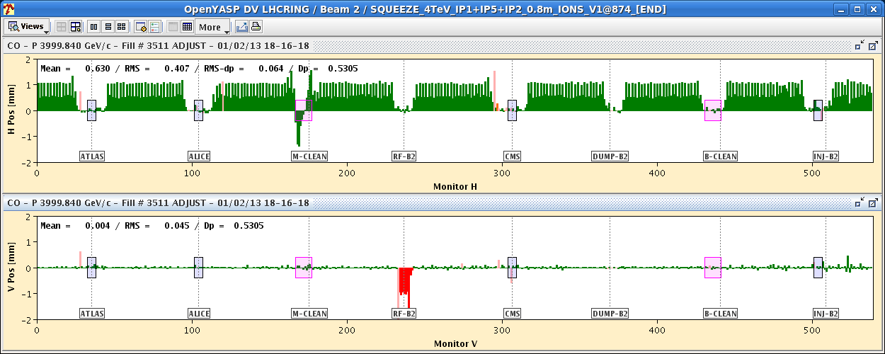
LHC STATUS
Friday Late
18:00h inject 15 bunches / beam,
ramp for collimator alignment & loss maps
... don’t panic, its software
16:30h flat top & re-phasing
... some problems with ± Δrf
18:00h squeeze / adjust
18:20h check orbit:
Orbit difference with fill 3509 at same
moment in the cycle (end of squeeze).
The orbit reproducibility is excellent.
vert. rms difference 45 um
largest change in TCTH.4R8.B2 0.2 σ

Slide 3
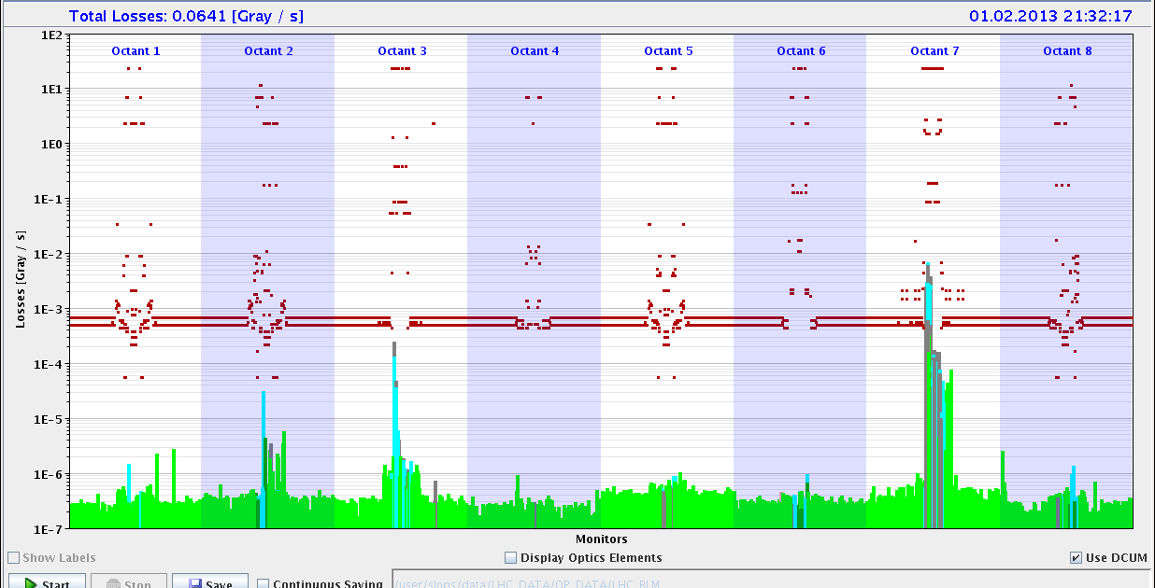
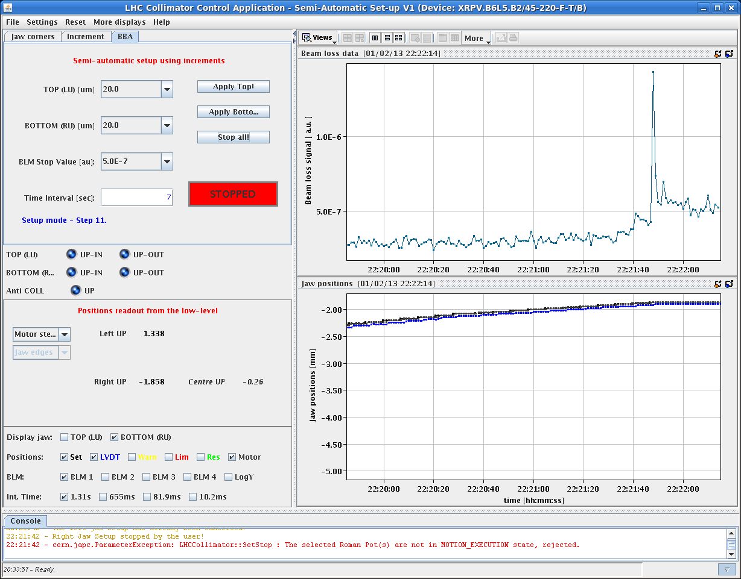
LHC STATUS
Friday Late
18:30h lumi in all IPs
18:50h ... 20:30h start TCT alignment
21:00h loss maps
22:00h alignment roman pots
23:40h off momentum loss maps
24:00h beam dump, cycling

Slide 4
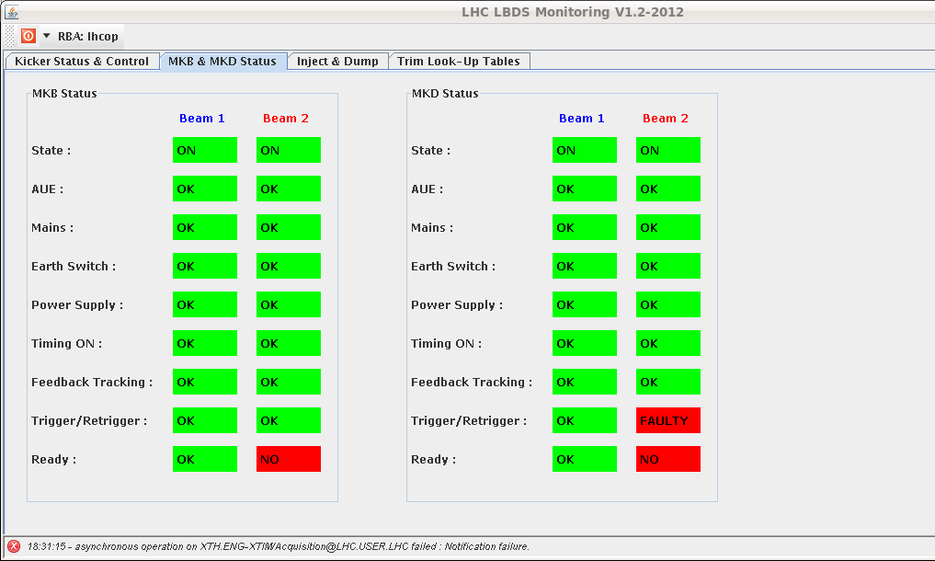
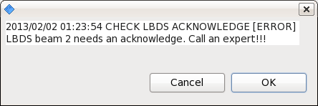
LHC STATUS
Friday Night
00:30h problem with lbds
... communication fault on the the trigger card ?
02:00h PSB quadrupole problem, no beam
05:00h beam back, new injection
06:00h flat top,
continue loss maps.

Slide 5
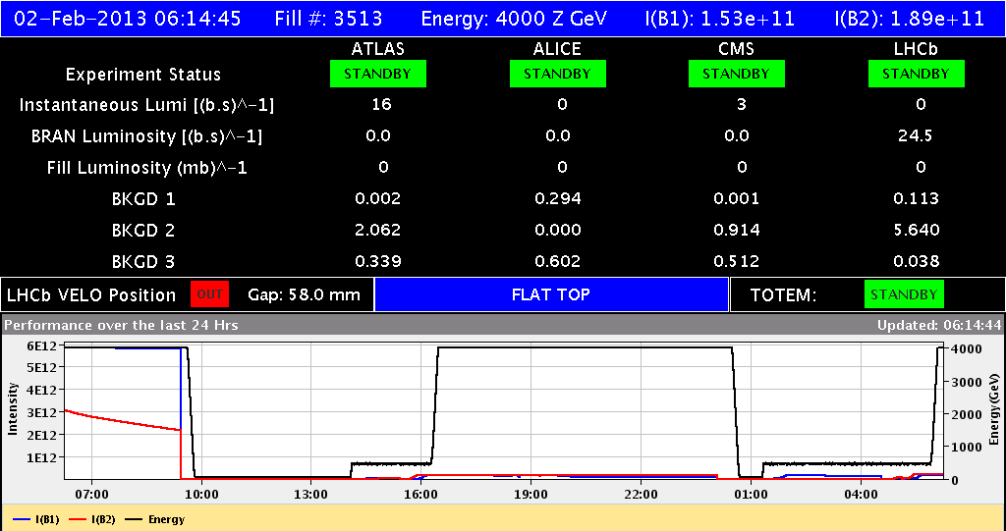
LHC STATUS

