Slide 1
Saturday
Morning used to complete the loss maps and asynch dumps (with RPs).
All loss maps OK (B. Salvachua), but the off-p cleaning for B1 (Lead) was observed to be worse than in the opposite configuration.
Asynch dump OK, but abort gap monitor (BSRA) info missing.
14:30 BSRA switched back on – it had shut down automatically after seeing too much beam (some time ago) – not a nice feature since no alarm…
Cryo worries with temperature in arc S56.

Slide 2
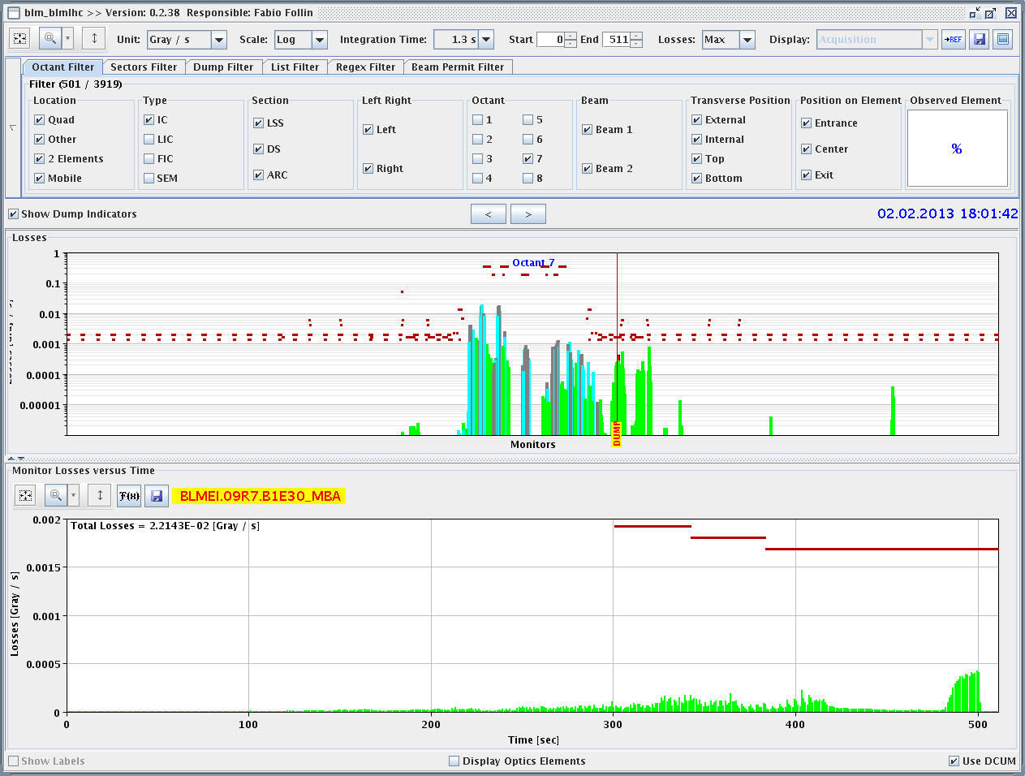
Saturday
16:00 Filling for 338 bunches / beam.
18:00 Beam dumped during the cogging, in the phase where the beams are brought to the common frequency.
Monitor in cell 9, on the 20 s RS. 1.3 s RS has margin.
1.3s RS

Slide 3
Saturday
A check of the losses on the previous low intensity fills shows that this effect was already present in the morning, but not detected due to the low beam intensity.
We therefore decided:
Perform a fill with 96b to be able to get through and then scale losses to 338 b,
Re-center the common frequency down by 6 Hz (pushes ions less inwards).
19:15 Filling.
20:15 Cogging OK, but BLMs up to ~40% → need a some margin for 338p (but not too much).
20:30 Towards end of squeeze (~ 1m) again losses, but also on Q11R7 – BLM threshold already increased by 3 !
Losses on Q11R7 too high for 338 b/

Slide 4
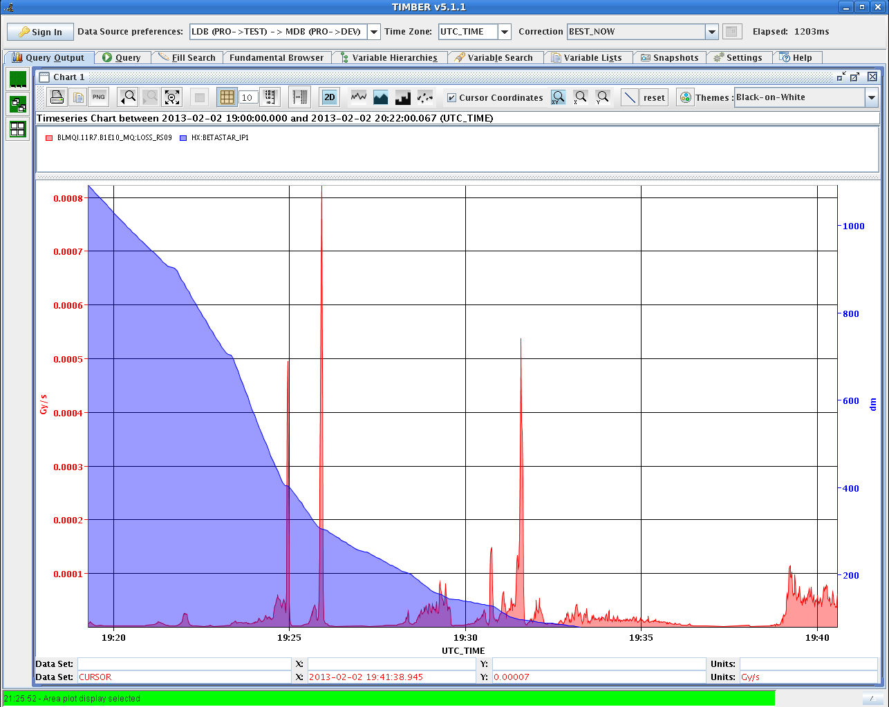
Losses on Q11R7
3m
4m
Beta*
1m

Slide 5
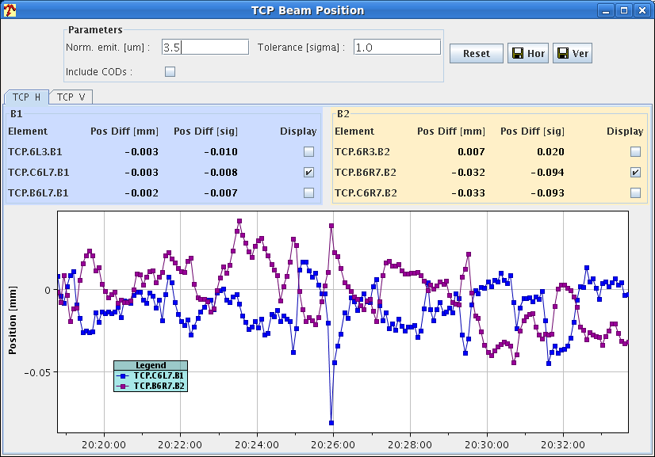
Orbit at TCPs – H plane
B1: within +20 / - 40 um (+ spike @ 4 m)

Slide 6
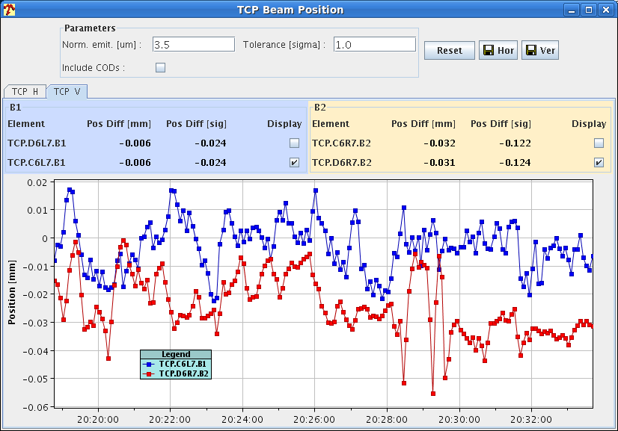
Orbit at TCPs – V plane
B1: within +- 20 um

Slide 7
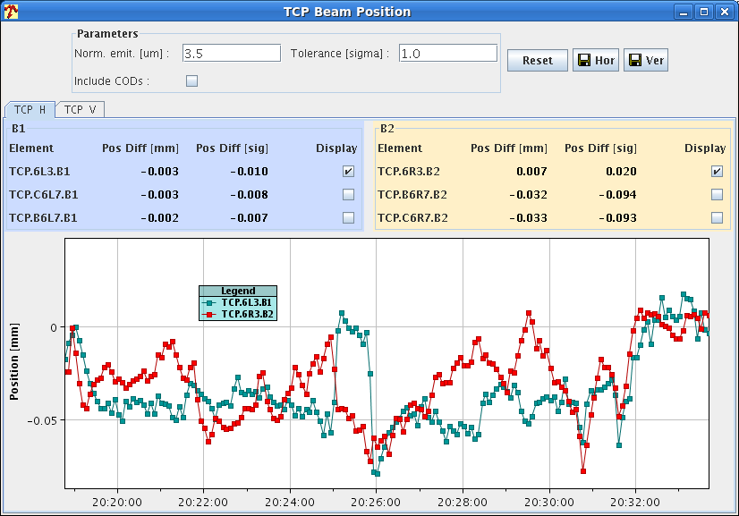
Orbit at TCPs in IR3
B1: within +10 / - 80 um

Slide 8
Saturday
20:40 Stable beams fill 3416.
22:00 Dump.
In agreement with Rudiger, increase of BLM MF from 0.1 to 0.2 for the monitors:
BLMEI.09R7.B1E23_MBA
BLMEI.09R7.B1E30_MBA
BLMEI.09R7.B1E21_MBB
New filling scheme with 192 Pb bunches.
200ns_192Pb_216p_9inj24bpi
We shift the common frequency at 4 TeV another 4 Hz to help a bit the Pb beam during cogging.

Slide 9
Night - Sunday
Pb intensity low and erratic, Django coming in to check LEIR. Issue solved by manual reset of LEIR damper.
06:00 Ions back… Filling 192b.
During cogging and squeeze, losses at ~60% of dump threshold on the 20s RS. 35% of threshold on Q11R7 BLM.
07:30 Stable beams fill 3520, 7E-24 cm-2s-1.
Another issue: we have now offset the beams radialy to help the ions, but this means:
The absolute energy offset is larger for p, lower for Lead.
The beta-beat corrections for the end of squeeze are not really good …
Ideally should always cogging a the centered fRF…

