Slide 1
LHC Progress Week 3
Coordination: G. Arduini, E.B. Holzer, J. Jowett

Slide 2
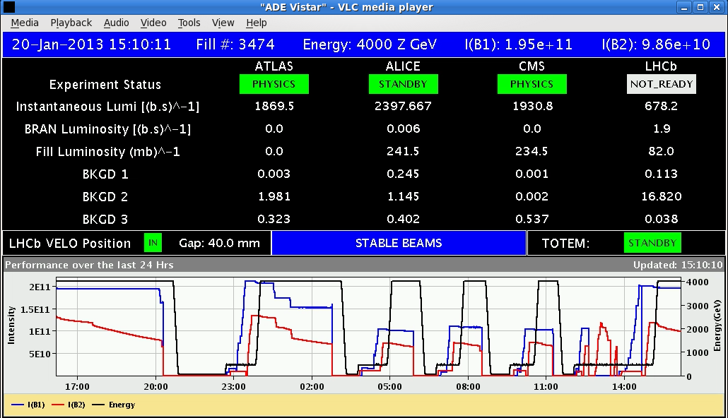
Sunday 21.1.2013
2:50 – 10:20 3 fills for off-momentum loss maps and asynch. dump
10:50 - 12:45 asynch. dump test and B2 loss maps at injection
12:45 start to fill for p,Pb
stable beams
15:08 stable beam
p,Pb fill 3474, 1.5 hours
13 bunches/beam
A. Boccardi fixed BSRA, and re-calibrated it
Verified that the abort gap cleaning is working
Dumped beam 2 in order to do loss maps with B1 only
  B1H, B1V and negative off-momentum loss maps in collision
  → all validated by collimation team → OK for increasing intensity

Slide 3
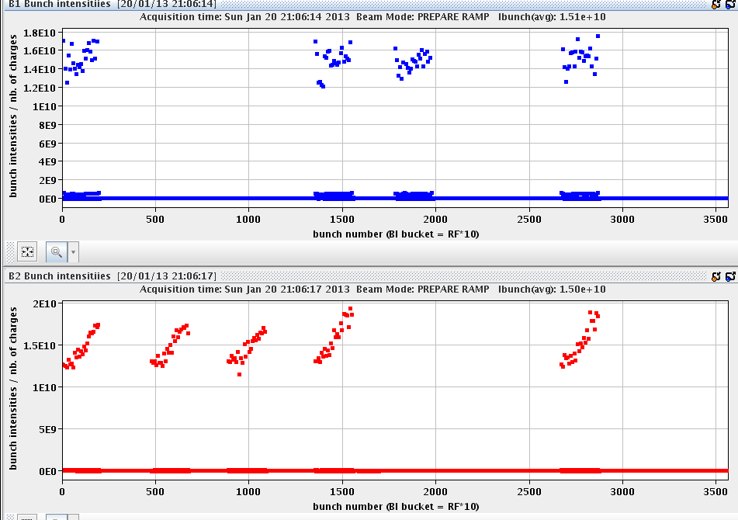
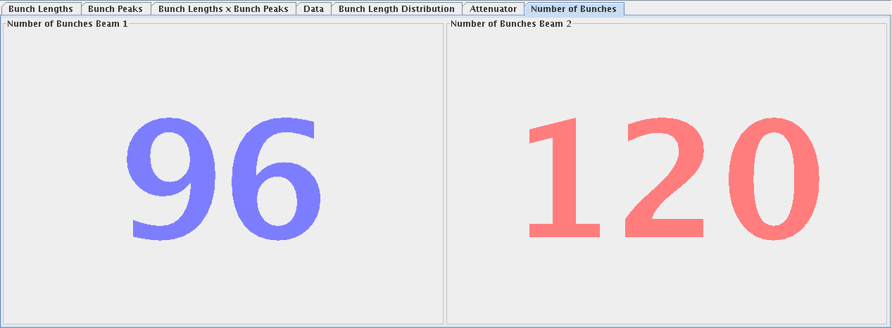
Sunday Evening and Night
19:10 – 20:12 Problem with RF synchronization
between SPS and LHC
→ workaround used
21:00 Trains of
p and Pb in the LHC
21:22 beam dump by SIS during the ramp: Missing BPM data (24% missing for 1 minute) for B2
1:47 – 4:07 stable beams Fill 3478, trains of 96 p and 120 Pb bunches (200ns_96p_120Pb_4inj24bpi) – 2:20 h stable beams
  Leveling for ALICE MB data

Slide 4
Monday Morning
5:20 injecting for fill 3479 338 bunches/beam 200ns_338p_338Pb_15inj24bp

Slide 5
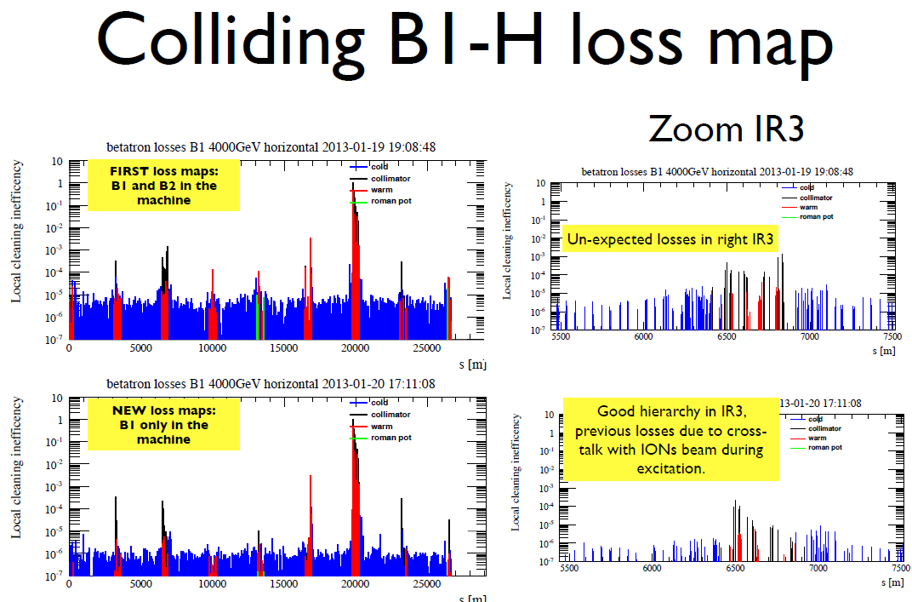
From Belen Salvachua Ferrando

Slide 6
Loss maps for Collimation validation
All protection validated OK (Jan, Belen, Stefano)
 | Injection (Inj. Prot. IN) | Injection (Inj. Prot. OUT) | Flat-top | Squeezed, separated | Squeezed Collision with RP IN
Betatronic-H | DONE | DONE | DONE | DONE | DONE
Betatronic-V | DONE | DONE | DONE | DONE | DONE
Neg. off-mom | DONE | -- | -- | DONE (+500Hz) | DONE (+500Hz)
Pos. off-mom | DONE | -- | -- | -- | DONE (-500Hz)
Asynch dump | DONE | -- | -- | DONE | DONE

Slide 7
Mayor Issues and Downtimes
 |  | hours
Mon 14/1 | Fixing issues at injection (BPM rephasing, OFC controller) | 3
Mon 14/1 | Access for ALICE | 2
Mon 14/1 | No beam from SPS | 2:20
Tue 15/1 | Power glitch, short on 18 kV cable in Meyrin. All sectors tripped. Cryo lost P18 | 12:30
Tue 15/1 | TDI movement (remote reset needs to be executed after a power cut) and undulator quench | 1:40
Tue - Wed | BIW (Beam Imminent Warning) sirens point5 +access in the shadow | 6:30
Wed - Thu | Problem IT switch leads to cryo loss | 25:45
Thu 17/1 | Problems with injectors, chroma and orbit measurement | 3
Fri 18/1 | Trip of RSF1.A56B2 during pre-cycle, access to repair | 4:30
Sat 19/1 | MKB LBDS problem, access for PLC exchange | 4
Sat 19/1 | Injection problems (RF timing signal disabled, wrong bucket) | 2
Sun 20/1 | RF synchronization between SPS and LHC | 1
 | Total: 68 hours or 41%

Slide 8
Beam Commissioning
 |  | hours
Mon - Tue | optics with experiment bumps on-momentum during squeeze and collision beam process | 6
Tue | off-momentum optics at beta*=0.8m | 4
Thu | Collimator alignment, loss maps and squeeze set-up | 7
Thu | IR2 aperture measurement | 6
Fri | p,Pb through all the cycle and collisions in all IPs | 9:30
Fri | TCT alignment and loss maps | 10:00
Sa | Loss maps | 3:30
Sa | RP alignment, loss maps, asynch. dumps | 12:00
Sun | Loss maps and asynch. dumps | 12:45
Sun | p,Pb to stable beams and loss maps | 4:30
Sun | Trains of p and Pb | 6:00

Slide 9
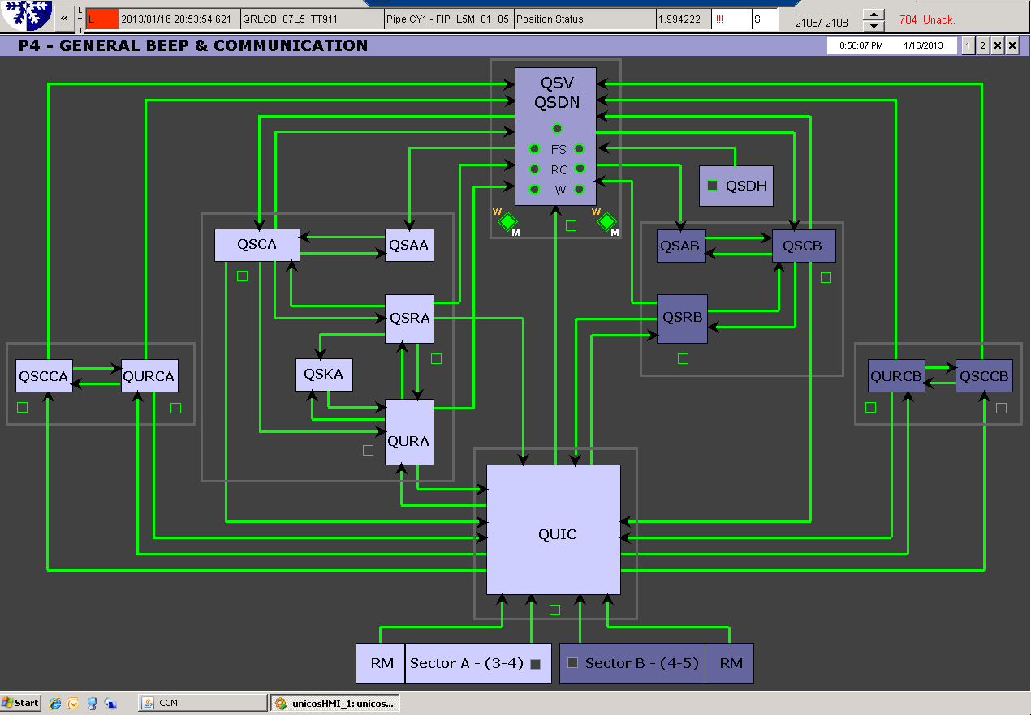
Problems encountered at P4: 1st episode
Tuesday 15th :Stable Cryogenics conditions
~ 17:00: start of having erratic losses of communication between QUI-QURCx, RM,QSRB, QURA
~ 21:00: call NetOp that sends a piquet Firstline to check the switch S2475-R-IP14
~ 23:30: Difficulties to localized the problematic switch
because not possible to make a diagnostic remotely
-> Decision to postpone it for next day
“Cryo Maintain was OK “
Wednesday 16th : communication became worse
~04:00: com. totally lost -> cryo op block interlocks..
~06:00: call NetOp for intervention
~10:30: ready on site
With help of expert switch is localized
Even with the switch changed, problem still present?
-> further investigations
~ 12:00: every that looks fine,
we decide to stop the intervention
First diagnostic from NetOP:
the problem could have been related to a number of
VME access processes that wrongly started with an automatic script(killed this morning ~11:00)
A. Suraci CCC - 8:30 Meeting January 17th 2013

Slide 10
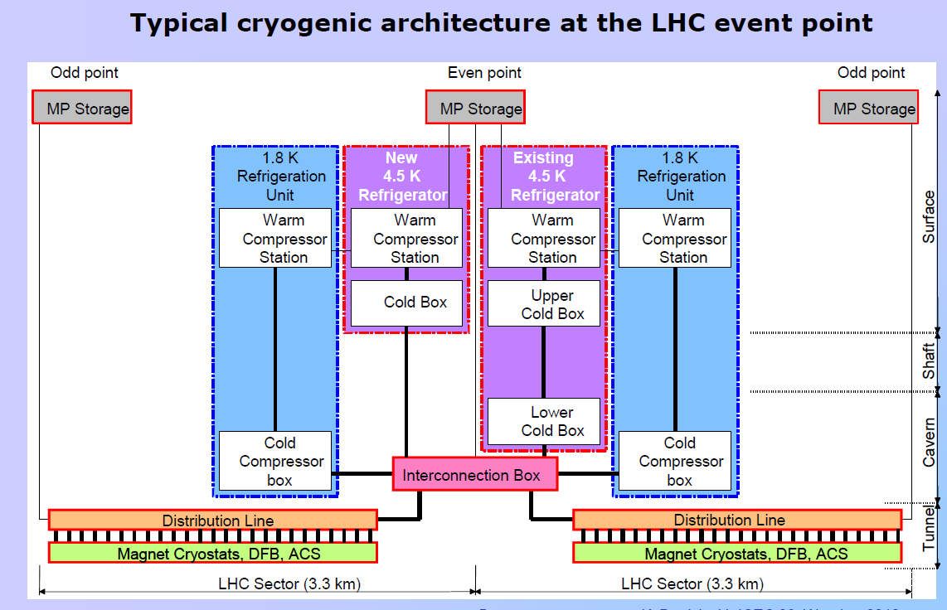


Problems encountered at P4: 2nd episode
Wednesday 16th:In order to avoid Full stop of our Cryo plant
-> Many devices have been taken in manual mode, interlocks blocked,…
“Cryo Maintain conditions recovered”
~ 13:00: start releasing devices in Auto mode
-> during , we lost our QURCA
(machine that allows to cooldown/maintain S34 @ 1.9K)
~ 13:15: fast recovery started
Not an easy one because of
Reconnection at low pressure
Hydraulic instabilities at the inlet of CC1
Thursday 17th:
~ 06:00: Finally back on track
A. Suraci CCC - 8:30 Meeting January 17th 2013

Slide 11
Issue of the problem with the cryo network switch is being followed up by TIOC

Slide 12
Varia
Verified that SPS and TL stable without the ‘Stable Filter’ which were lost during the power glitch on Tuesday → will run in this condition for the rest of the run
Pb ion source refilled Tuesday during power glitch recovery
  Hope to be able to make in to the end of the run with one refill
  At the limit as this refill was moved ahead in time
Reduced long blow-up for protons during the ramp

Slide 13
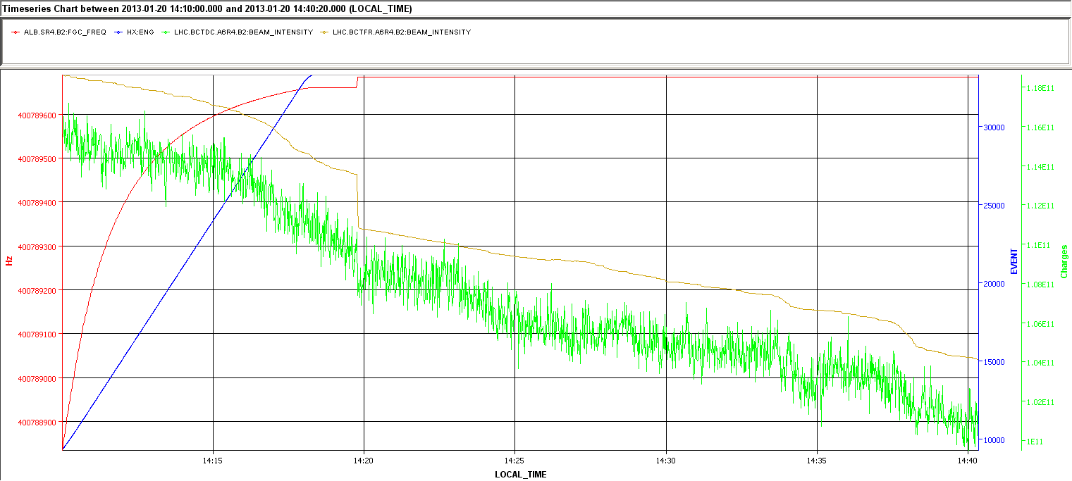
Cogging - Philippe
Worked straight away without any problem
No losses on p beam
~2% loss on Pb beam (13 bunches)
  No indication of debunching – but DCBCT rather noisy for a conclusion

Slide 14
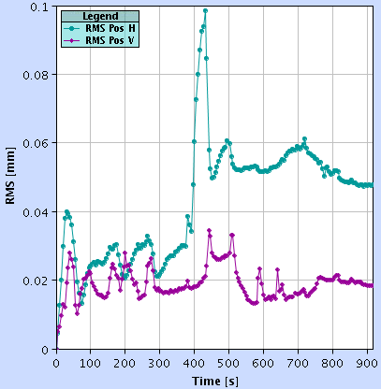
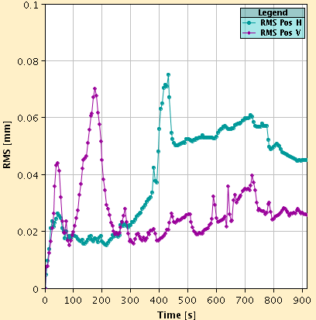
Orbit variations in the squeeze
J. Wenninger
RMS orbit change (inner part of LSS excluded) along the squeeze. One dominant spike left between 4m and 3m.
  Leave attempts to cure until test ramp for ALICE polarity inversion.
B1
B2
100 μm

Slide 15
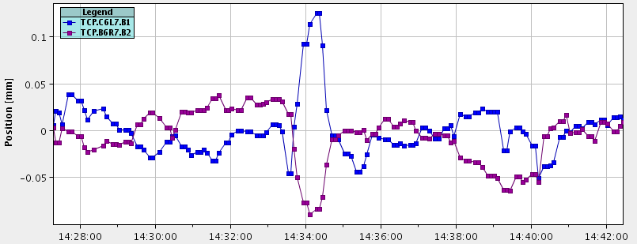
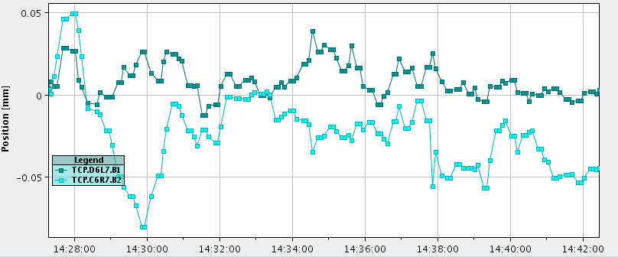
Orbit change in IR7 during squeeze
J. Wenninger
H
V

Slide 16
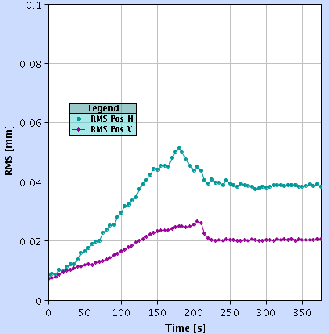
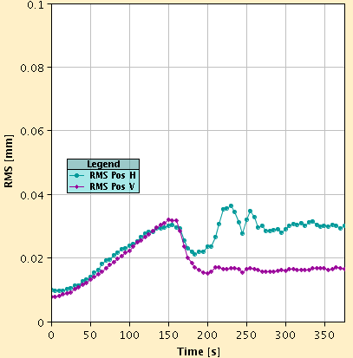
Orbit variation during collision BP
J. Wenninger
Ok – no worries.
B1
ALICE Xing change
B2
ALICE Xing change
100 μm

Slide 17
Open Issues
No good BPM reading with p intensities of ~3-4 E10 → will be a problem when we want to increase proton intensities
Still ‘flickering’ orbit readings – missing BPM data (after SW update)
IQC/InjSequencer often detect beam has been injected while in reality it has not, mostly at first injection
Correct sequence for programmed dump

Slide 18
Access request:
  LHCb for Muon Station – needed for data taking; ~3 hours; RP needed
  TI capteur det. Feu; RE 58; RP needed; 2h anytime
MPP OK for RP insertion required
For the time being the gain of the damper is not gated as well as the BBQ reading
Extraction conditions and transfer line trajectory for ions to be checked
Margin for 1 cavity trip for RF HW interlock (1 hour during ramp down) could be re-introduced
Damper setting optimization
Coordination Week 4: Mike and Jan

Slide 20
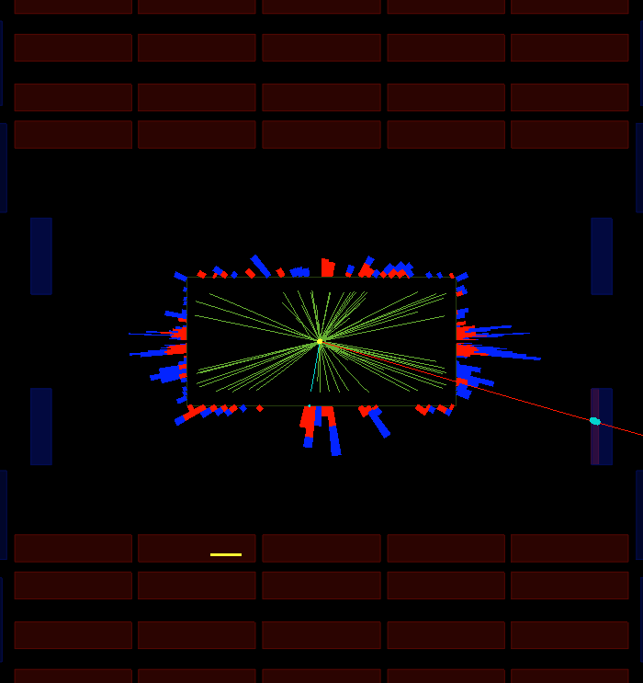
CMS p,Pb event
a muon hitting the end cap muon chambers

Slide 21
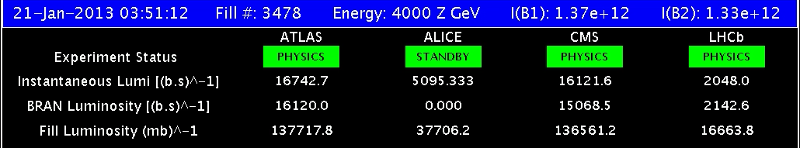
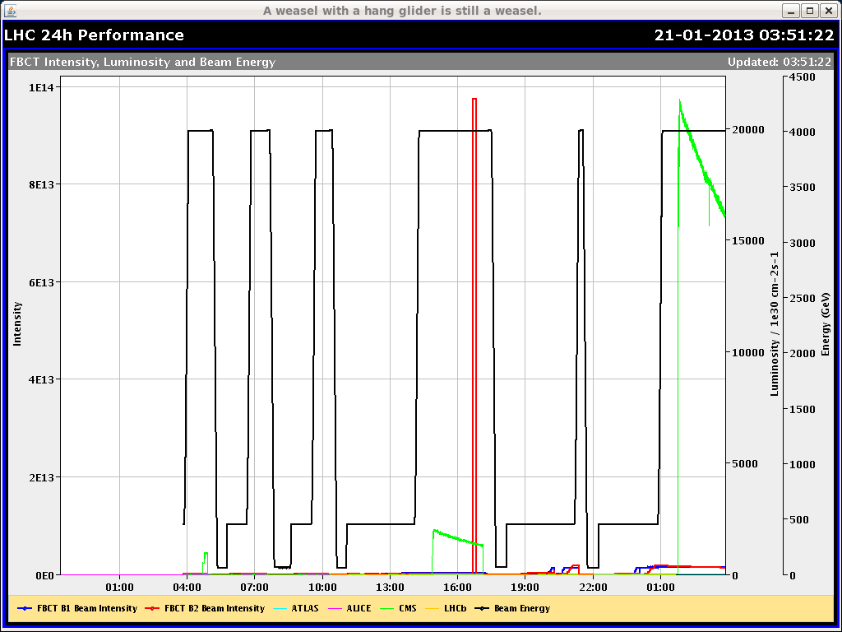
Luminosity

