Slide 1
Fri 18/1
09:20 Beams colliding in all IPs
Trims consistent with those found during pPb pilot run
09:30 – 10:24:
Orbit optimization
FBCT re-phasing
Collimator alignment check for TCSG.6L7.B2 (offset within tolerance)
10:28: Trip of RSF1.A56B2 during the pre-cycle
Implemented new SW for orbit acquisition front end to avoid problems observed with OFB in the last few days
Investigations on RSF1.A56B2 trip by QPS and EPC expert. Finally access required
13:30-14:50 Access for EPC experts. Found a cable with a bad contact on current measurement system.
15:30 Starting to inject
Taking some time to optimize procedures
17:30 Finally machine full

Slide 2
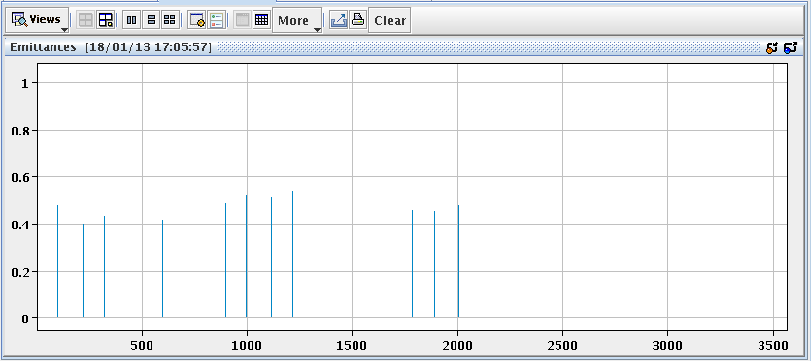
Fri 18/1
Emittance at injection
B1V
B1H
B2Vx208/82
B2Hx208/82

Slide 3
Fri 18/1
18:30-19:20. Betratronic loss maps at flat-top after cogging
19:40-23:00 TCT alignment and corresponding betatronic loss maps at the end of the squeeze (separated)
23:00-23:50 Go in collision everywhere:
Optimization. Data missing for Lumi scan application from ALICE. Had to do it manually.
Problem fixed later by ALICE
23:50-01:25 TCT alignment and Betatronic loss maps in collision

Slide 4
Collimator alignment (BS,DM,GV,LL,SR)
Loss maps at FLAT TOP, after cogging. For protons, the cleaning in DS of IR7 ok but need to analyse offline the losses in IR3. For IONs the cleaning in DS IR7 is worse than for protons (as expected).
We then went to SQUEEZE and aligned TCTs after squeeze and did loss maps after the alignment. 16 TCTs were aligned in 1 hour, the parallel alignment procedure with ions worked as well as the alignment with protons. When we did loss maps we saw higher losses at IP2 and IP8 than for the 2012 proton operation, this could be explained by the new beta* at those IPs and by the fact that TCTs at IP2 are at 10 sigmas instead of 12 sigmas. However, in order to discard the possibility of any off-center collimators we re-checked the alignment of TCTV and TCTH at IP2. The center was within 50 um for the TCTV and wihtin 10 um for the TCTH, so we are confident that the alignment is correct. Detailed analysis of the loss maps will be made offline.
We then went to COLLISION and aligned the TCTs and loss maps after alignment. The alignment took again 1 hour and then we proceeded with loss maps. First look indicated that the TCT's losses are ok.

Slide 5
Sat 19/1
01:30: Started roman pot alignment in collision
02:40: Beams dumped by wrong step in ALFA RP movement during alignment (BLMs)
03:51 Start injection – No ion beam from SPS. Continue with B1.
04:30-07:30 Loss maps at injection with B1:
Issues with the signal (too low with resonance crossing)
Vertical blow-up not working. Fixed rapidly by expert
06:00 Ion beam available but problem with Beam Dump B2 ➔ Called expert ➔ Access required to restart PLC
07:37 Completed loss maps at injection with B1. Prepare access.
08:40 Access

Slide 6
Validation
 | Injection (Inj. Prot. IN) | Injection (Inj. Prot. OUT) | Flat-top | Squeezed, separated | Squeezed Collision with RP IN
Betatronic-H | B1 DONE | B1 DONE | DONE | DONE | tbd
Betatronic-V | B1 DONE | B1 DONE | DONE | DONE | tbd
Neg. off-mom | B1 DONE | -- | -- | tbd (+500 Hz) | tbd (+500 Hz)
Pos. off-mom | B1 DONE | -- | -- | -- | tbd (-500 Hz)
Asynch dump | B1 DONE | -- | -- | tbd | tbd
tbd=to be done

Slide 7
Plans
Loss maps (~24 hours remaining):
Ramp for alignment of roman pots in collision + loss maps with RP in (betatronic and negative off-momentum) (~1 shift)
Negative off momentum squeezed separated (1 ramp). Roman pots out.
Asynchronous dump squeezed separated (1 ramp). Roman pots out.
Asynch dump in collision (1 ramp). Roman pots in with sequence.
Positive off-momentum in collision (1 ramp). Roman pots in with sequence.
Complete injection loss maps (betatronic, positive and negative off momentum, asynch dump) (~2-3 hours).
If OK from MPP:
STABLE BEAMS Single_13b_8_8_8_pPb in the morning tomorrow (1 hour of STABLE BEAMS)
Then 200ns_96p_120Pb_4inj24bpi
No Roman pot insertion in STABLE BEAMS before Monday.

Slide 8
Pending
For the time being the gain of the damper is not gated as well as the BBQ reading
Extraction conditions and transfer line trajectory for ions to be checked
Margin for 1 cavity trip for RF HW interlock (1 hour during ramp down) could be re-introduced
Damper setting optimization

Slide 9
Pending
Accesses (not urgent – during working hours):
Demineralized water leak search from point 2 to 5. Contact TI.
Insulation vacuum gauge check in point 4. Contact Cryo.
From Monday onwards during working hours and during ramp down contact B. Feral (164704) for TIM operation (remote RP survey in sector 45 and 56)

