Slide 1
Major Event on 15/01/2013
EL Report
8:30 meeting 16/01/2011
F Duval, on behalf of EN/EL

Slide 2
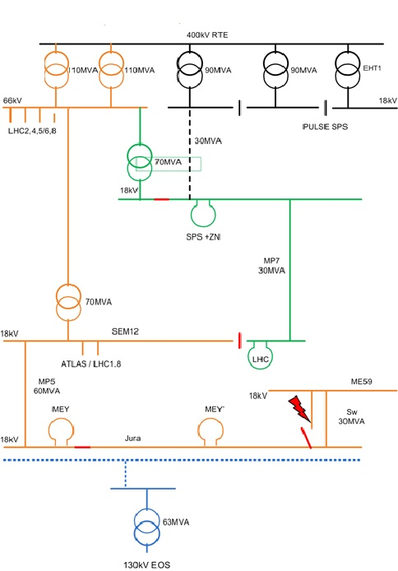
network configuration
event at 8:27

Slide 3
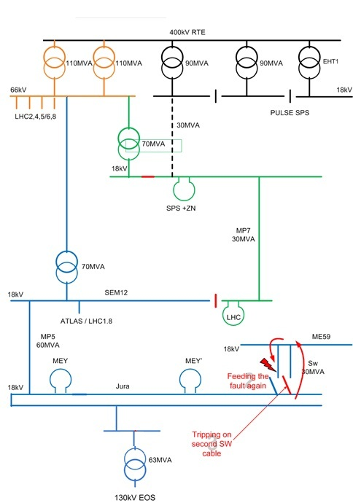
network configuration
event at 8:27
Voltage drop:
100% in the Meyrin west area for 30 minutes
80% in the rest of Meyrin + LHC18 + LHC1 for 300mS
25% in the rest of CERN for 300mS

Slide 4
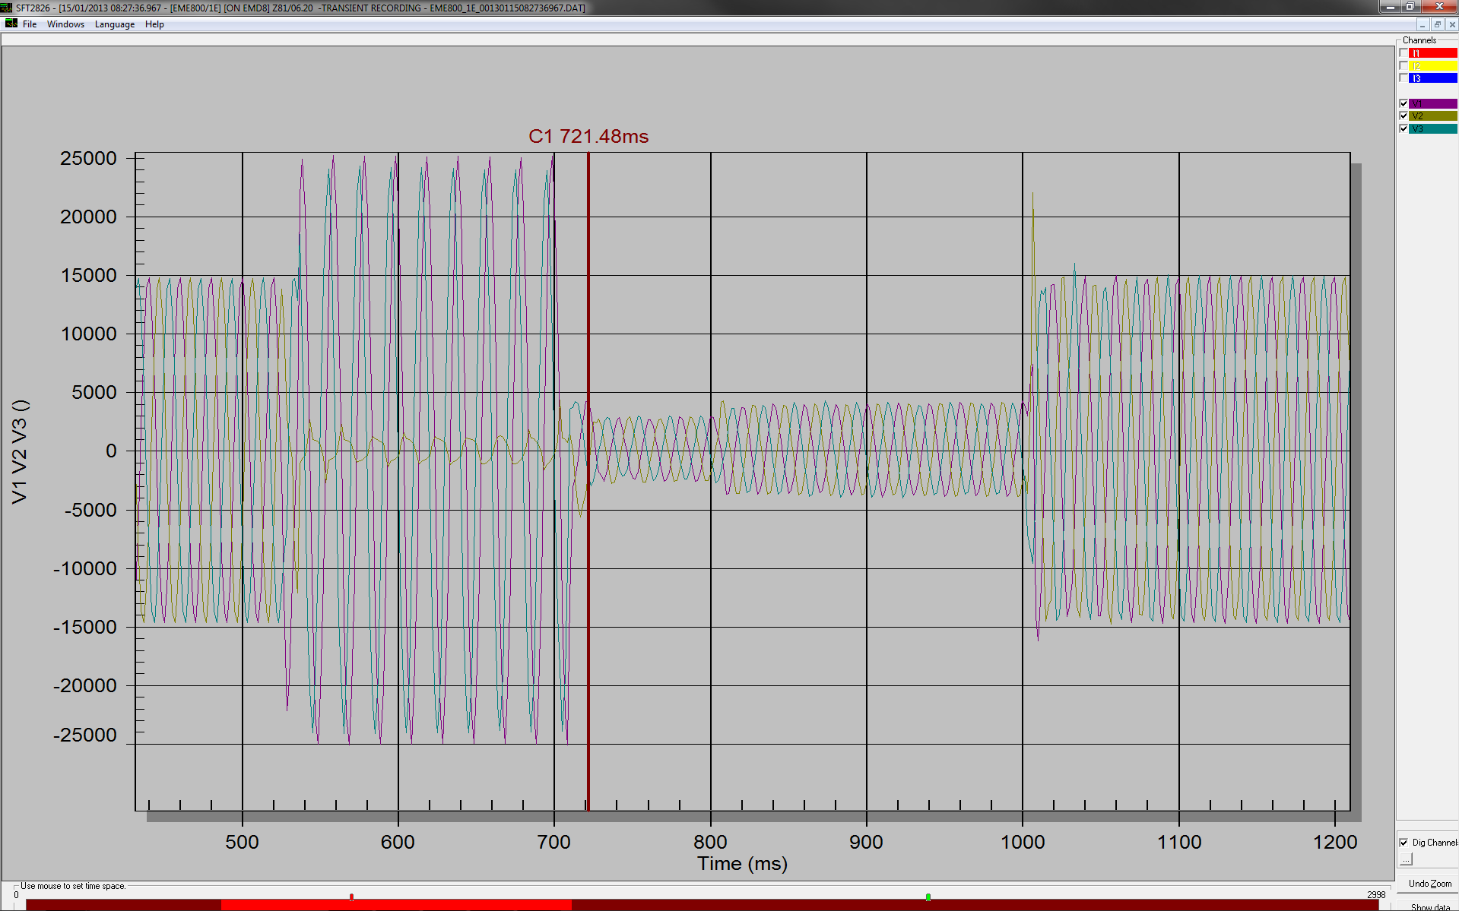

Slide 5
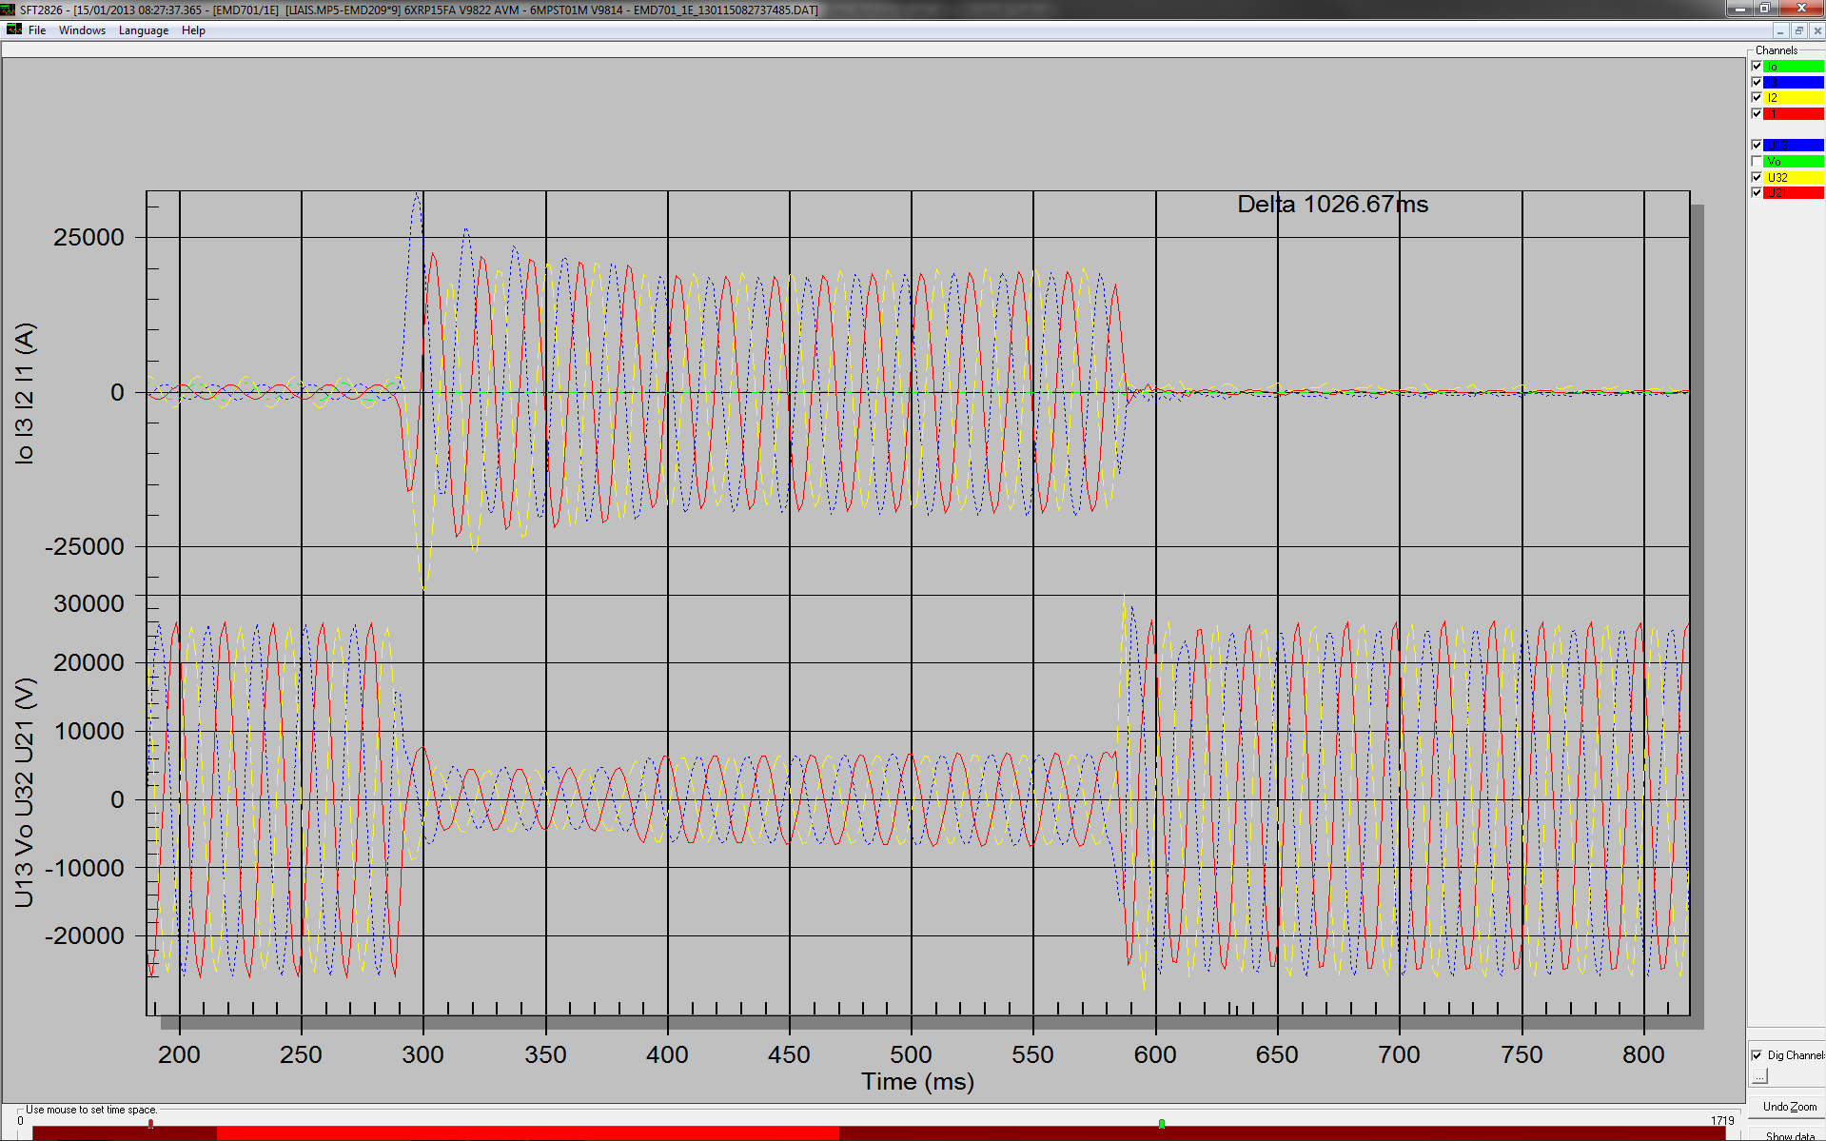

Slide 6
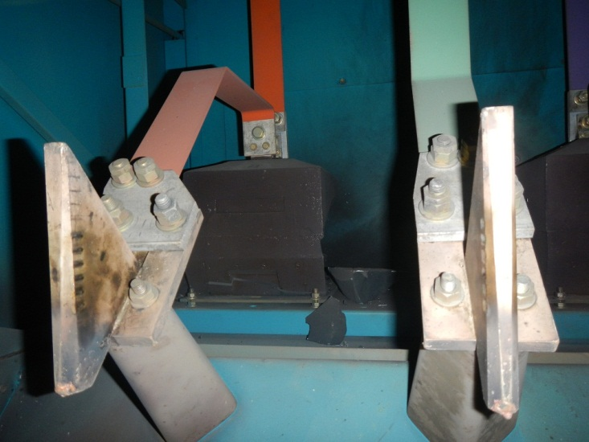
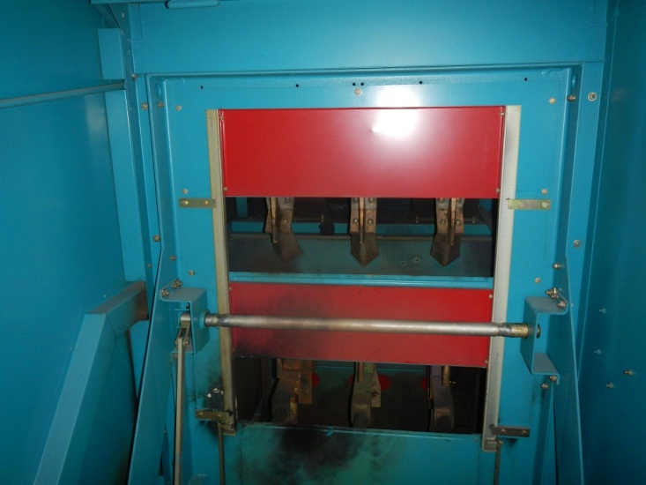
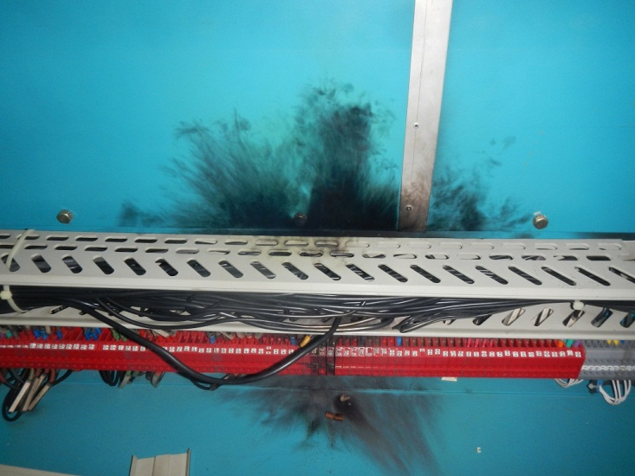
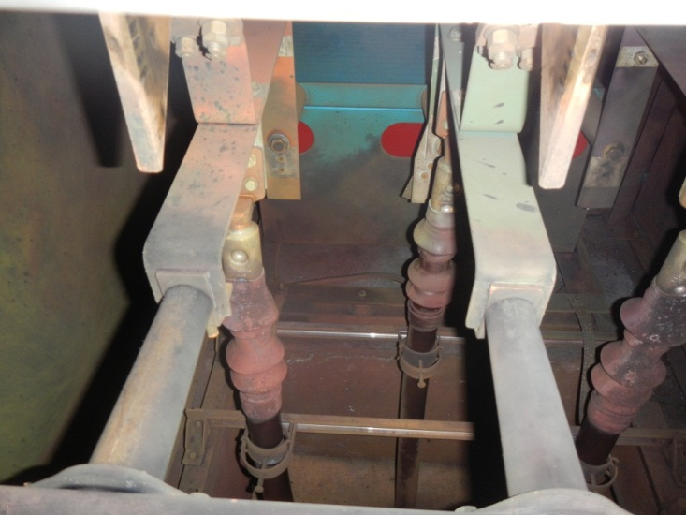
Substation ME59 cubicle EMD210 cables + CB compartments

Slide 7
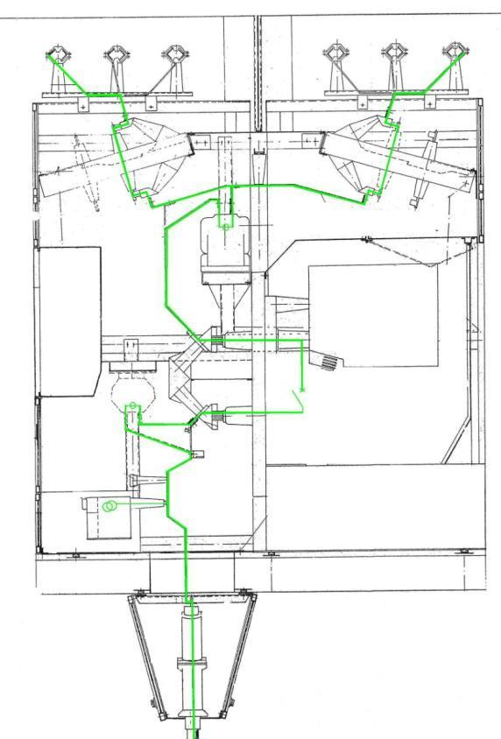
DETAILS INSIDE CUBICLE
Busbar
Upstream CT
Circuit Breaker
Downstream CT
VT
Cable Terminal

Slide 8
Network reconfigured at 08:58 (30 minutes) ME59 fed from one cable only; ME59 replacement is part of our consolidation plan for 2013, the cable link will be repaired and connected to the new substation (in 03 or 04/2013)
Recovery

