Slide 1
LHC Status Saturday Morning 12-Jan
Bernhard Holzer, Jan Uythoven
... status Friday 08:30h
machine cycled, hardware checks ok,
short access for replacement of RCBV12.L7B2
RCBV28.R1B1
10:41h Access finished, preparing for injection
some delay: post mortem not available
decision: due to availability of experts:
start with Pb / p injection first
15:20h first ion injection: SPS BQM problem ...
masked ... but then wrong timing

Slide 2
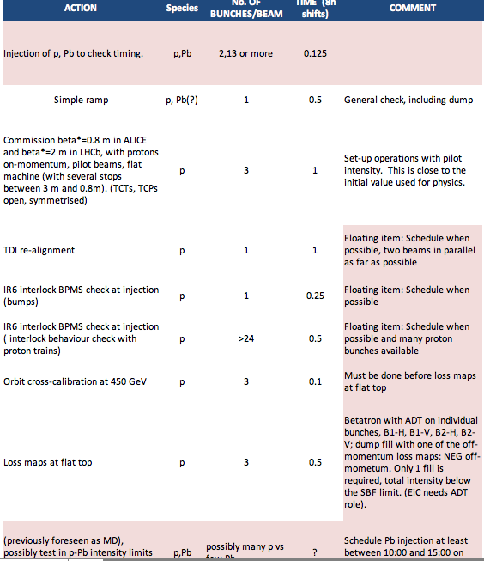
Friday Morning
start with Pb injection
first
then back to original plan

Slide 3
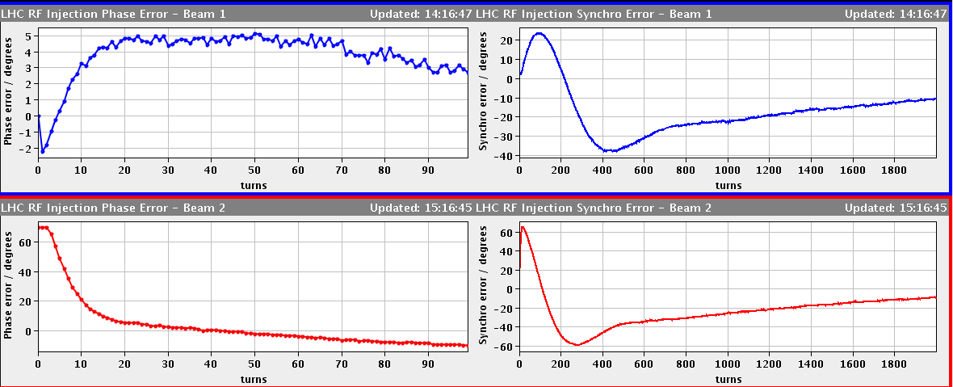
Friday Afternoon
15:30h first successful Pb injection ... leads die to BQM problem to
wrong timing / bucket in LHC
... not world record in long beam quality
5º
b1
60º
b2
Phase error at injection
16:20h prepare for a first test-ramp
Masked all BPM, BLM and RF interlocks (loss maps) and collimator movements
16:33h flat top reached with p-Pb bunches !!

Slide 4
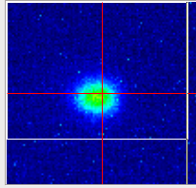
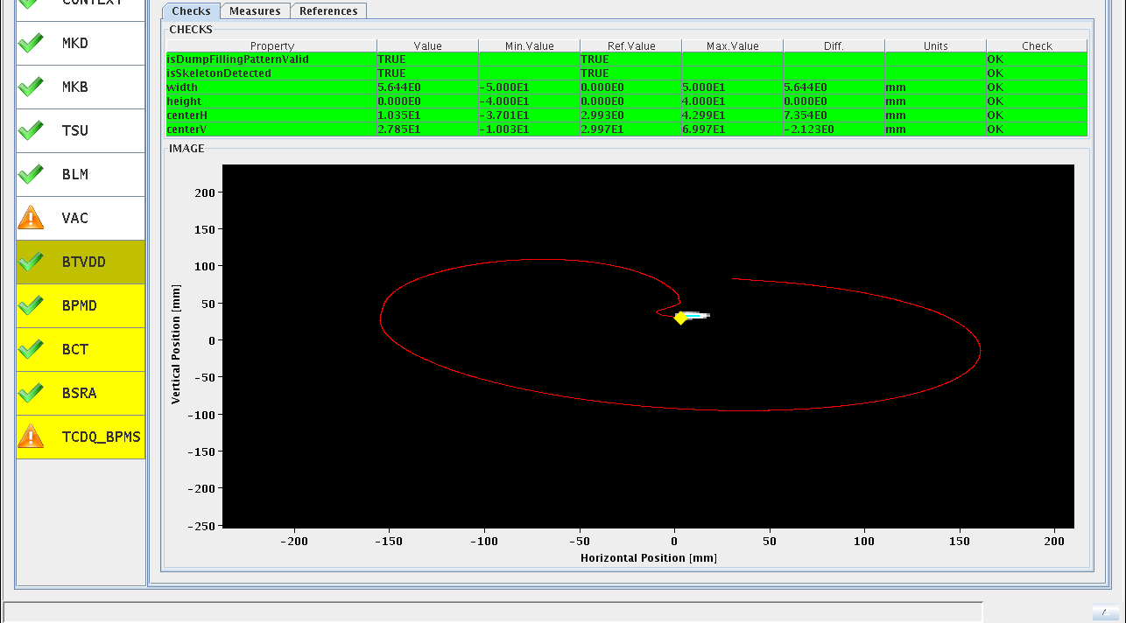
Friday Afternoon
15:30h first successful Pb injection ... leads due to BQM problem to
wrong timing / bucket in LHC
16:30h synchrotron light from a single pilot 4TeV
Pb bunch !!! (... in beam 2)
17:07h dump in “flat top” to check the system
(mainly position of bunch at dump)

Slide 5
Friday Afternoon
17:20h preparing for squeeze
little problem: matching quadrupole RQTL11.R2B1 beyond current limit.
(by ≈ 1A ... limit increased from 350-> 351A)
17:40h change particle type back to p-p operation
preparing the machine for proton injection / ramp / squeeze
& optic checks
19:50h When trying to move the TDI to +-8mm,TDI.4L2 right jaw got stuck at -8.2mm
21:00h injection three bunches
21:20h ramp, flat top

Slide 6
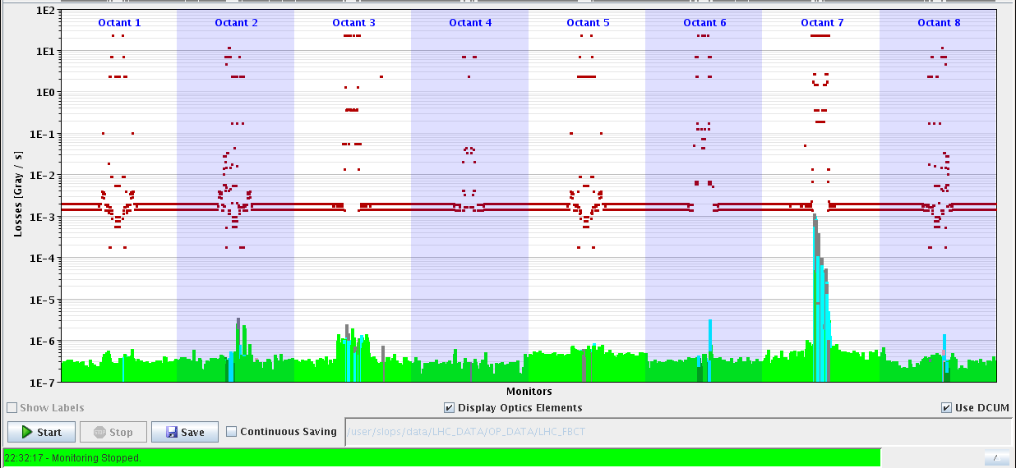
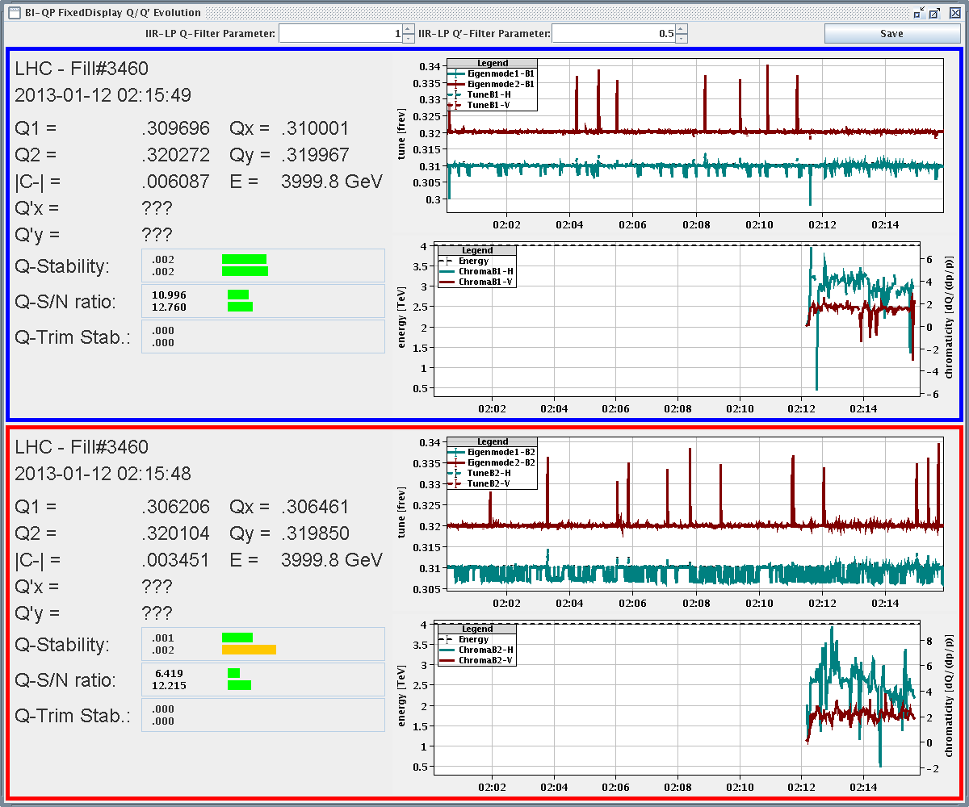
Friday Night
22:00h loss maps in flat top
to check for reproducibility
23:05h preparing for squeeze & optics checks
orbits flattened (x-ing angle & separation bumps off)
TCTs open
00:15h start Δβ/β measurement at flat top
00:50h squeezing in steps
tune / chroma / coupling / orbit correction
stops at β* = 7m, 3m, 1m
for optics measurement

Slide 7
Friday Night
04:40h reached β*=0.8m
04:50h beam loss in b1 during tune optimisation
optics measurement for beam 2
05:40h beam dump (OP)
ramp down, prepare for new injection
trip of RCD.A56B2 ... reset & recycle
Next step: TDI alignment studies

Slide 8
Friday Morning
✔
✔
✔
⬅
✔

