Slide 1
Friday 14th December - morning
Waiting for a repair of the RBIH400107 power converter in TT40.
RBIH400107 has been moved to the spare power converter with relevant interlocks but the PC does not follow the reference correctly.
Verification of injection timing of h=9 beam with TEDs in
11:00 Repair of TT40 power supply
Fill for loss maps – 12b
(ADT gain in ramp increased)
(Started WBTN and Diode-Orbit ACQ accuracy tests. RS)
12:30 loss maps end of squeeze
13:10 loss maps in collision

Slide 2
Increased ADT bandwidth in the "wideband mode" which is used for the 25ns (and during the squeeze for 50ns) operation should allow to reduce the blowup or cleaning window to a single bunch without interfering with the neighbour bunches.
A test to prove this was conducted at the end of the loss maps. A train of 12 bunches spaced by 25ns was circulating at 4TeV (used for loss maps). The cleaning window was reduced to one single bunch slot and the blow up excitation was activated for the bunch in the slot #50. The bunch blew up and lost intensity, while bunches in the neighbour slots did not suffer any measurable losses. The test was then repeated for bunches in the slots #47 and #48.
Daniel

Slide 3
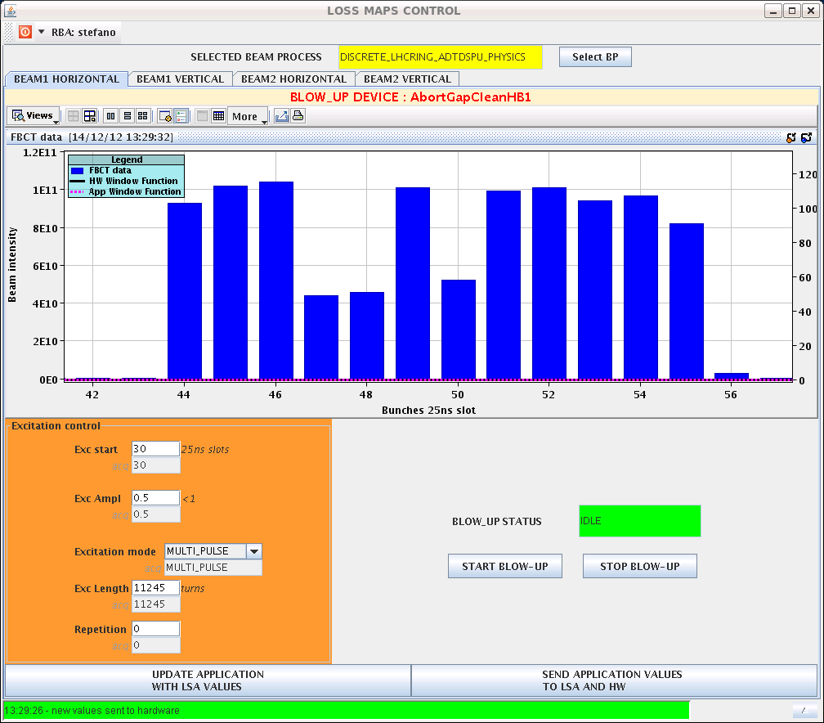
Bunch sculpture

Slide 4
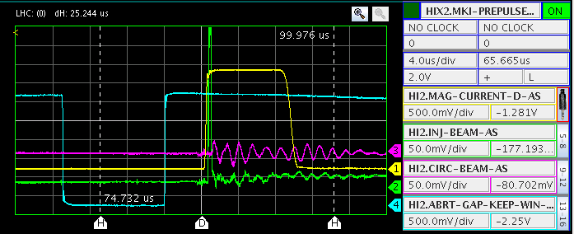
Friday afternoon
13:30 end loss maps
Finish validation of h=9 beam

Slide 5
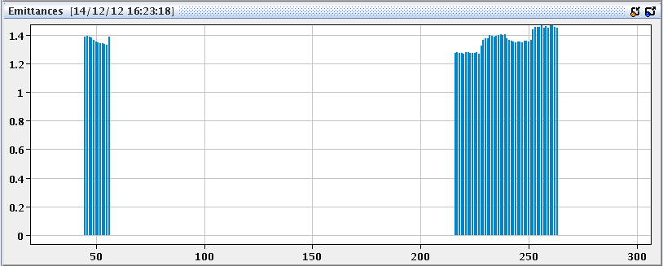
H=9 B2H
16:00 Injection of h=9 beam

Slide 6
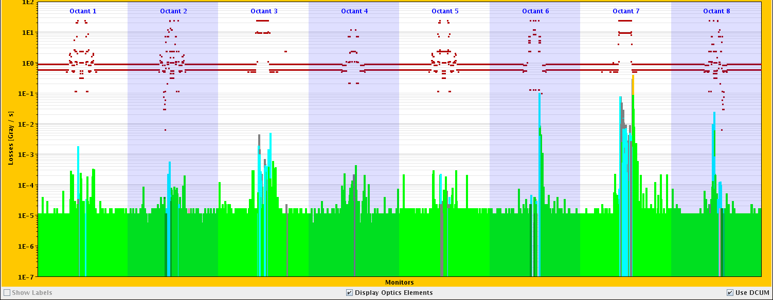
Friday evening
Restarted for 25 ns MD at 16:30 after Loss maps and h=9 injection test
Injection of 804 bunches with reduced bunch intensity (0.9x10¹¹ p/b) for heat load comparison at different bunch intensity for benchmarking purposes
First ramp lost due to SW interlock (several BPM not returning data)
Difficulties in filling again (octupoles not set correctly, unexplained BPM trigger at injection)
21:50 Finally at flat-top after an UFO (67% of dump threshold) during the ramp

Slide 7
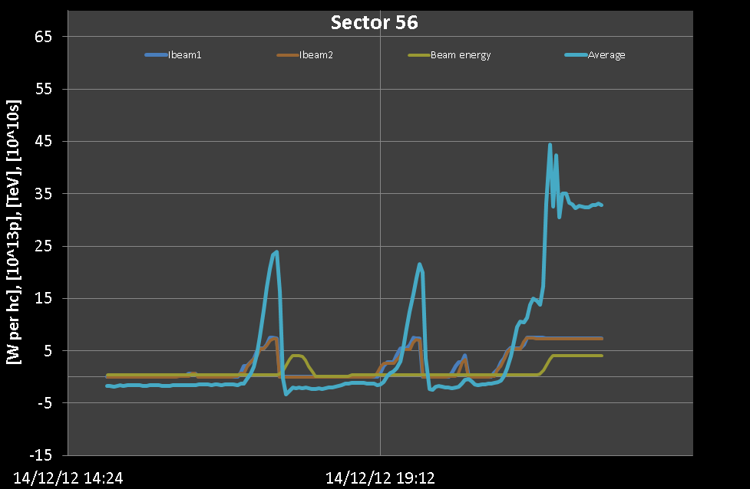
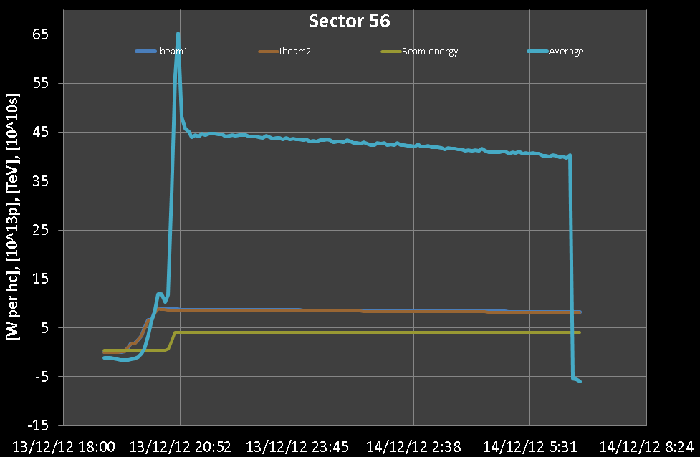
Heat load
0.9x10¹¹ p/b
1.15x10¹¹ p/b

Slide 8
Saturday 15th morning
23:04 beams dumped due to loss of communication with a few access elements in point 6
Patrol lost in a few sectors in point 6
Ready for injection at 03:00
Inject trains of 288 bunches. Dumped by injection losses in point 2 at 05:10 when we had 1884 bunch/beam. Heat load not yet stabilized.
Fill the machine with trains of 72 bunches (2100 bunches with a stop at ~1000 bunches) for benchmark purposes. Let the heat load to stabilize.
During filling (06:30) problem with TDI in point 2. OK after piquet intervention.

Slide 9
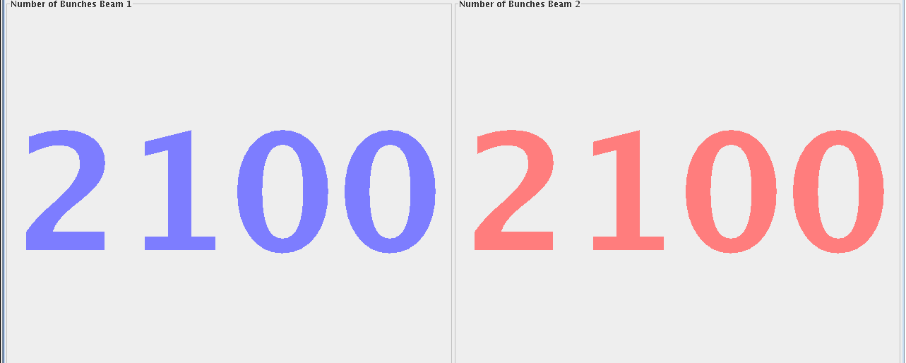
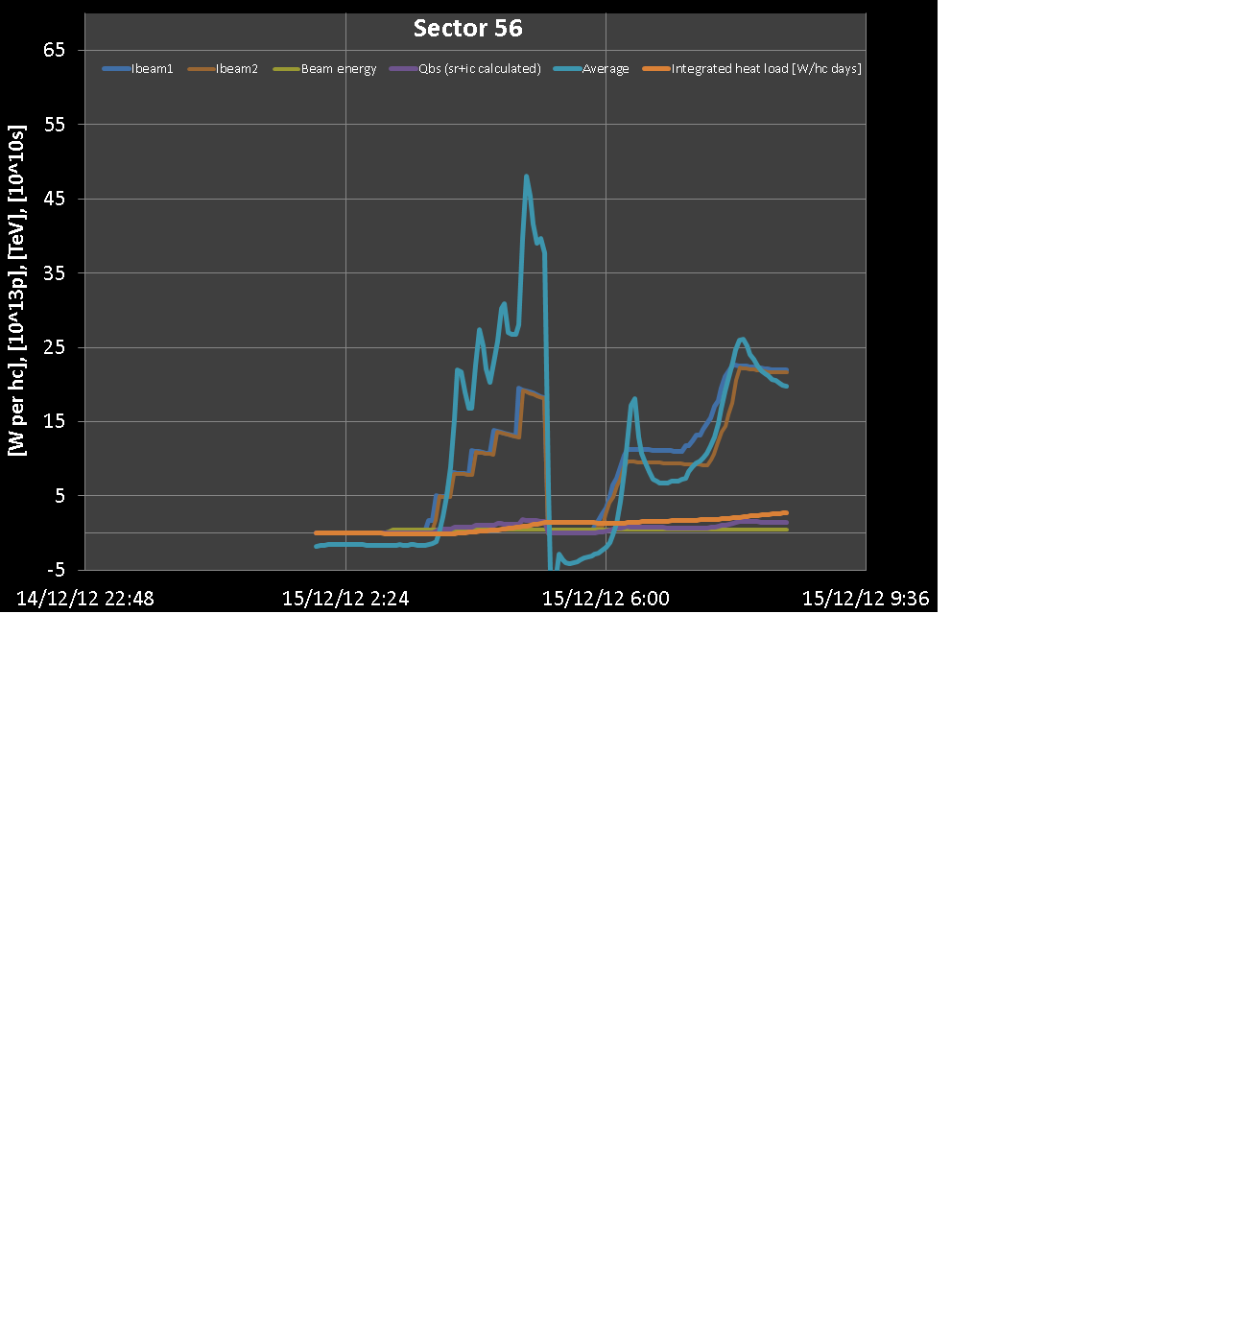

Slide 10
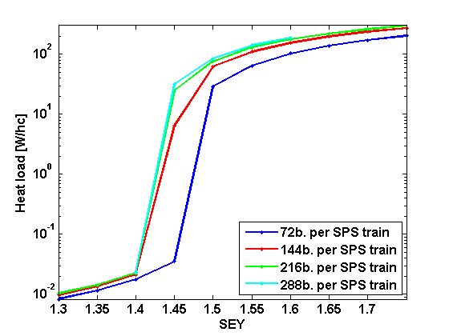
SEY of the beam screen
Preliminary estimation of present SEY situation in the arcs. Detailed analysis to reconstruct SEY history is ongoing.
An important benchmark for our model is to check the consistency of the heat load with different filling patterns (e.g. 72b vs. 288b). Last steps after 4 TeV tests.

Slide 11
Next step:
Fill with 4 trains of 288 bunches to get final reference for heat load in steady state (~1 hour)
Then go for physics (BCMS)
2*48b – short fill as test
25ns_396b_372_348_372_96bpi5inj

Slide 12
Sunday
Global aperture measurement at 450 GeV (MG – 4 hrs)
Ralph Steinhagen – 1hr
RF: longitudinal feedback and fast BQM ~ 2 hrs
19:00 start access for BI (attenuators BPMS point 6 (and schottky)
Pre-cycle
Verification of BPMS
pA MD until 06:00

