Slide 1
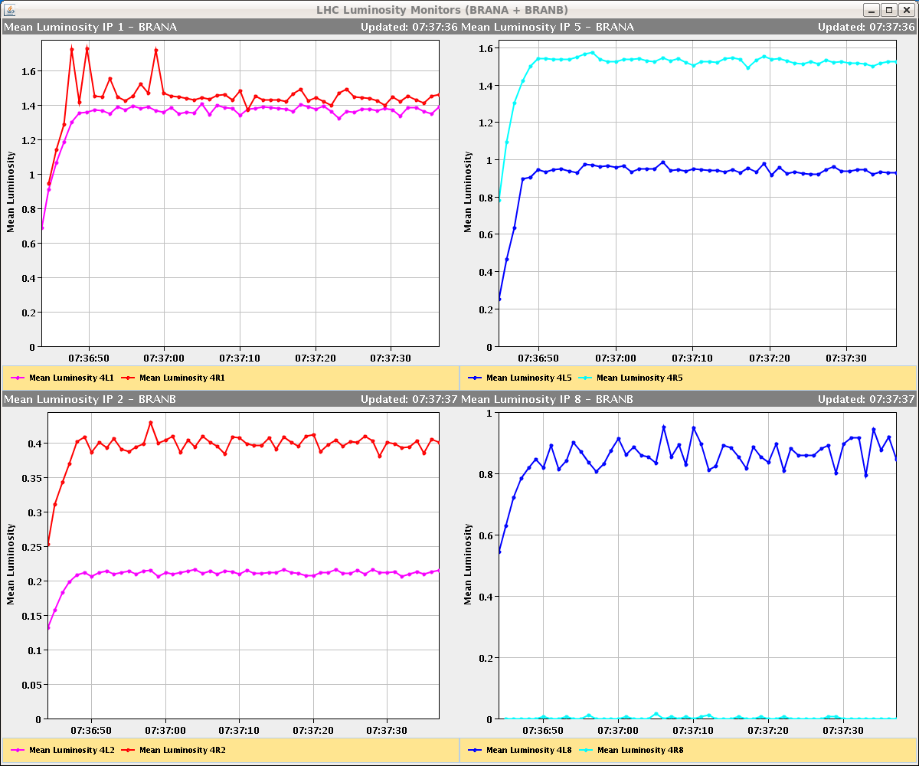
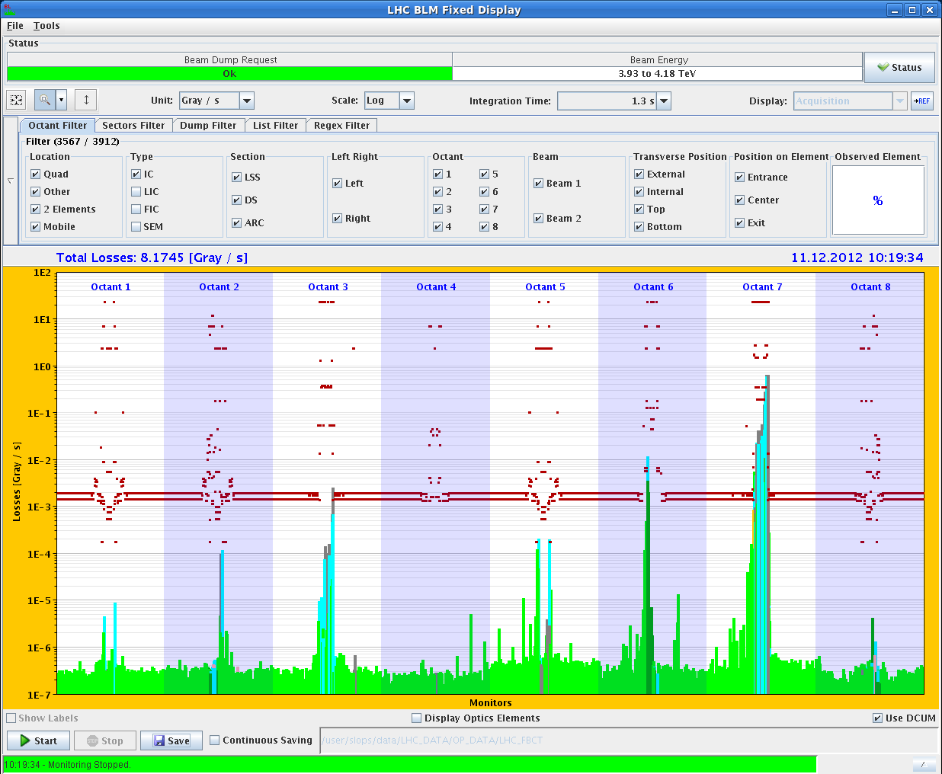
LHC Status Wednesday Morning 12-Dec
Bernhard Holzer, Mike Lamont
Tuesday Morning:
TCT / TCL alignment
07:00h ramp, squeeze, adjust,
optimisation of collisions in all IP’s
08:00h.. 09:30h TCT and TCL alignment in collisions
10:10h loss maps
11:36h new injection
... but ... cryo loss (reading error of T-gauge) ... and access
13:00h access to fix the problem on the TDI.4L2 / for Cryo / for QPS crate in B9L5 /
for change of RQ5.L1 FGC

Slide 2
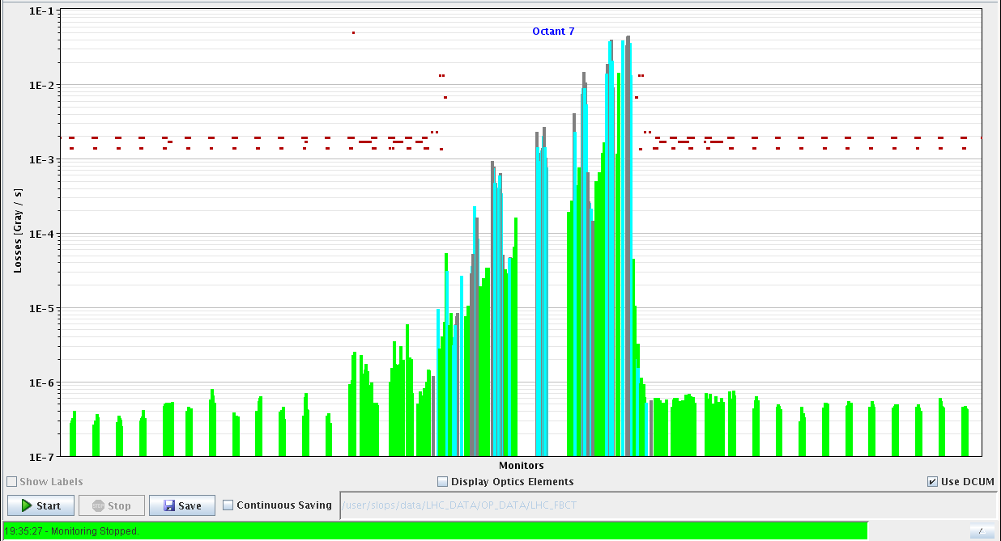
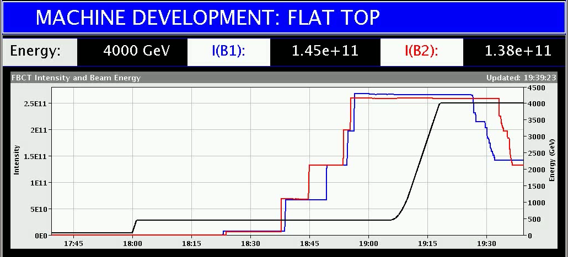
Wednesday Morning
Tuesday Late:
... for the fun of it ... access door YCPS04=US650 has been closed by the site manager.
It was found slightly open, probably due to a strong ventilation air flux.
16:50h access finished, machine ready, precycle
nota bene: problem at TDI.4L2 not solved yet, only “save beam” for beam 2.
Plan: * no h =9 bunch trains
* finish collimators and loss maps
18:00h injection 4 bunches, sbf
19:00h ramp
19:20h loss map at flat top
b1h, b1v, b2h, b2v
continue with remaining beam for colli set up
in ”adjust”

Slide 3
Wednesday Morning
Tuesday Late:
20:00h: TCT collimator alignment starting.
20:40h Alignment of 16 TCTs completed.
21:00h loss maps after collimator alignment at end of squeeze
21:50h asynch. dump
23:00h new injection
00:00h ramp, squeeze, adjust
01:00h starting loss maps in adjust
b1h, b1v, b2h, b2v, off momentum +500Hz
01:40h beam dump & new injection
ramp-squeeze-adjust
04:00h asynch dump

Slide 4
Wednesday Morning
Tuesday Night:
05:00h new injection, r-s-a
05:50h off momentum at end-of-squeeze: -500Hz
Next Steps:
Machine Studies 25ns beam beam (12h)
Ramp 25ns bunch Trains
back to 450 GeV 25ns checks / scrabblings
... and still to be done: TDI 2 repair & check on beam
h = 9 for 25ns trains

Slide 5
Remaining 25 ns studies (48 h scheduled)
 | Time | # bunches/beam
Damper set-up | 2 h | 12
Long range beam-beam MD (IR1/5) – luminosity measurement required | 5 h | 12+48 (BCMS)
Long range beam-beam MD (IR1/2/5/8) – luminosity measurement required | 5 h | 12+2x48 (BCMS)
Ramp down and Recovery | 2 h
E-cloud ramp (no squeeze) | 6 h | 12 + 5x72 (372)
E-cloud ramp (no squeeze) | 7 h | 12 + 11x72 (794)
E-cloud ramp (no squeeze) | 7 h | 12 + 8x144 (1164) or 12 + 16x72 (1164)
Ramp down and Recovery | 2 h
Fill at 450 GeV for verification effectiveness scrubbing at 4 TeV | 6 h | 12+144+9x288 (2748)
Fill at 450 GeV for verification effectiveness scrubbing at 4 TeV | 6 h | 12+17x72 (2460)

